Slide 1
Record Store Project
Cristian Ferreiro Montoiro – cristian.Ferreiro@e-uvt.ro
https://github.com/cristiancfm/record-store-project

Slide 2
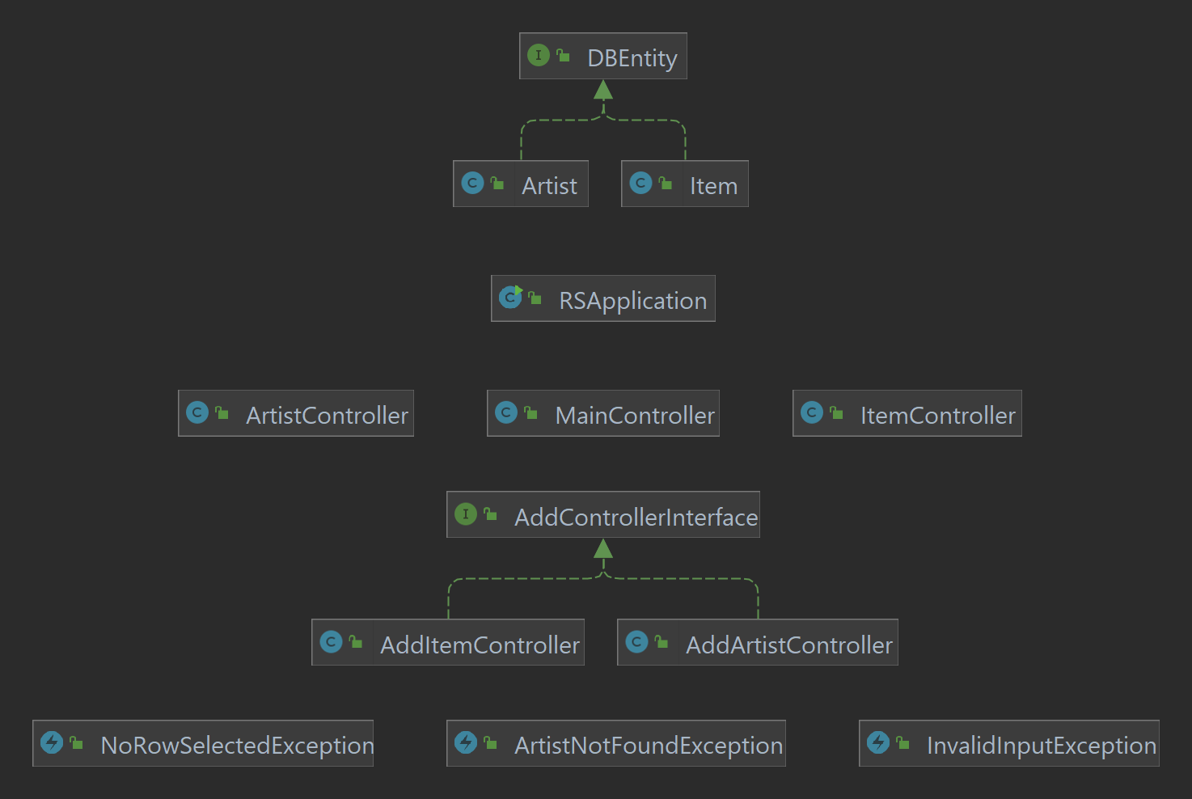
Diagram

Slide 3
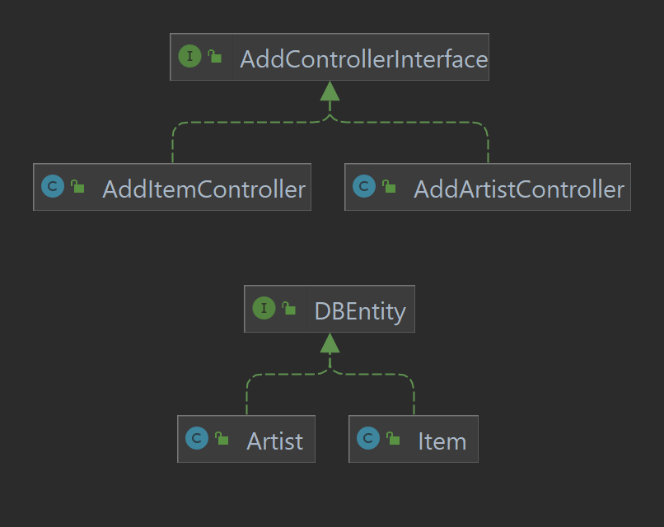
Interfaces

Slide 4
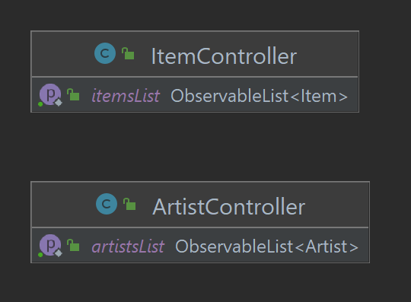
Collections

Slide 5
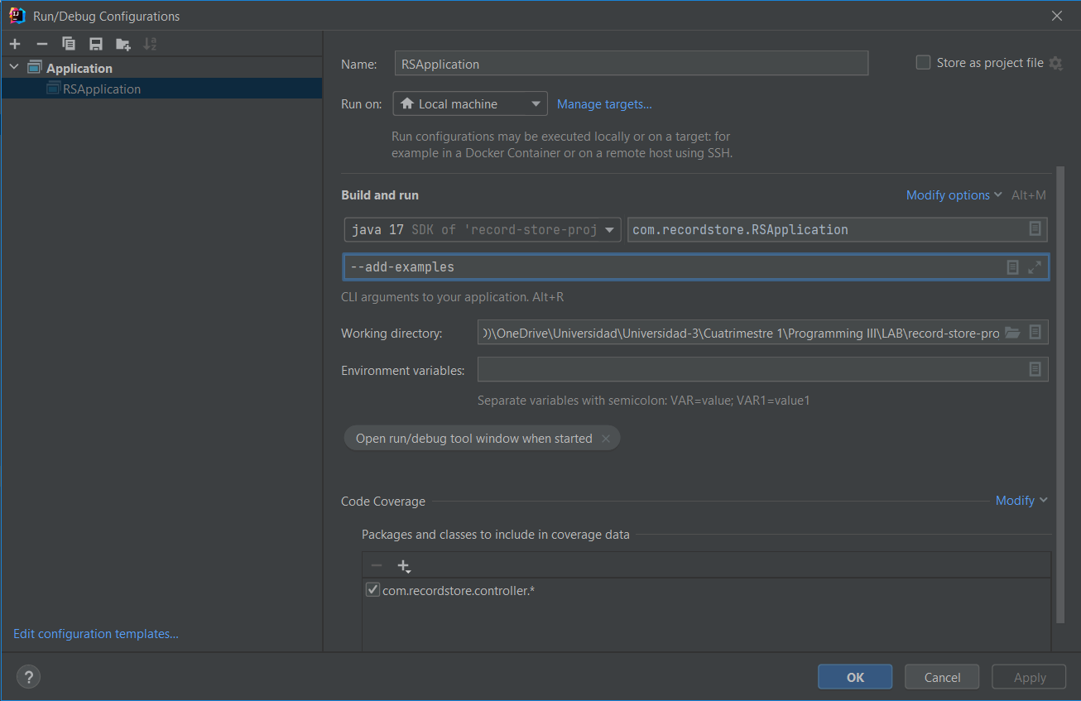
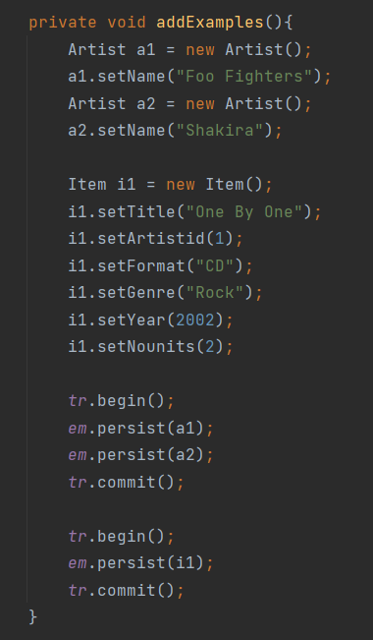
Program Arguments

Slide 6
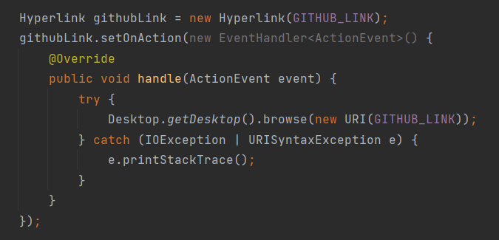
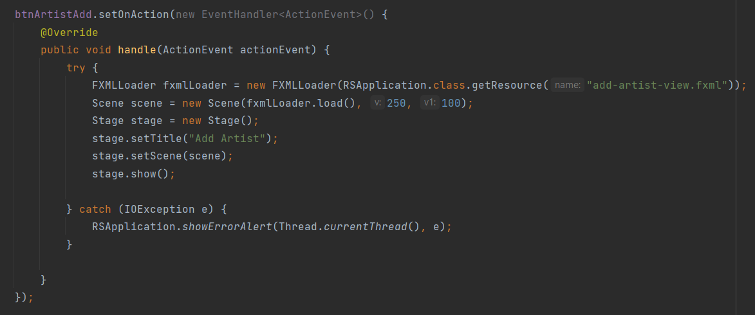
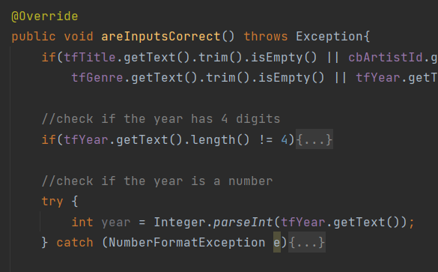
Exceptions
MainController
URISyntaxException
AddItemController
NumberFormatException
ArtistController, ItemController
IOException

Slide 7
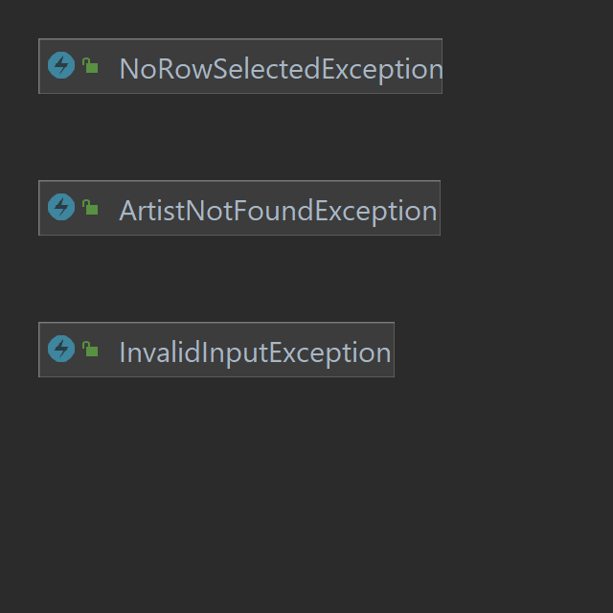
Custom Exceptions

Slide 8
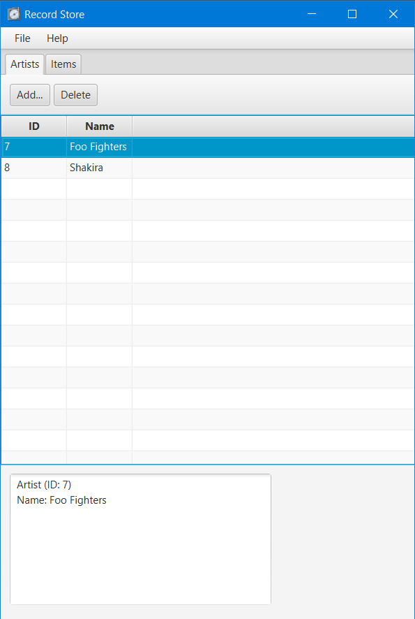
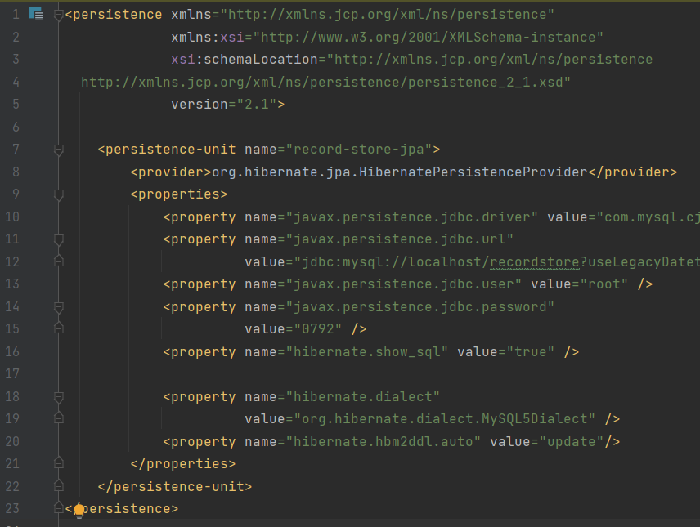
Database Connection

Slide 9
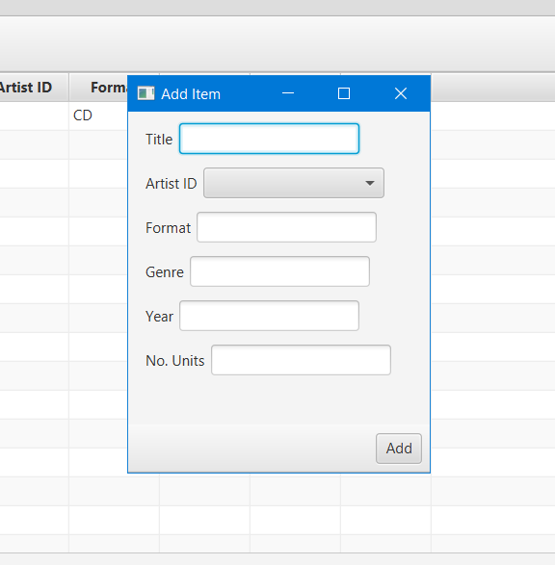
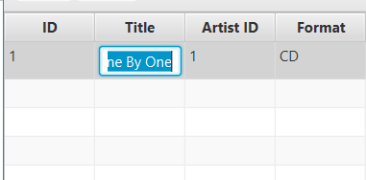
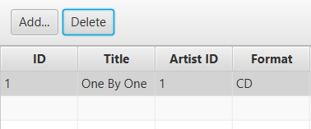
Create, Update, Delete

Slide 10
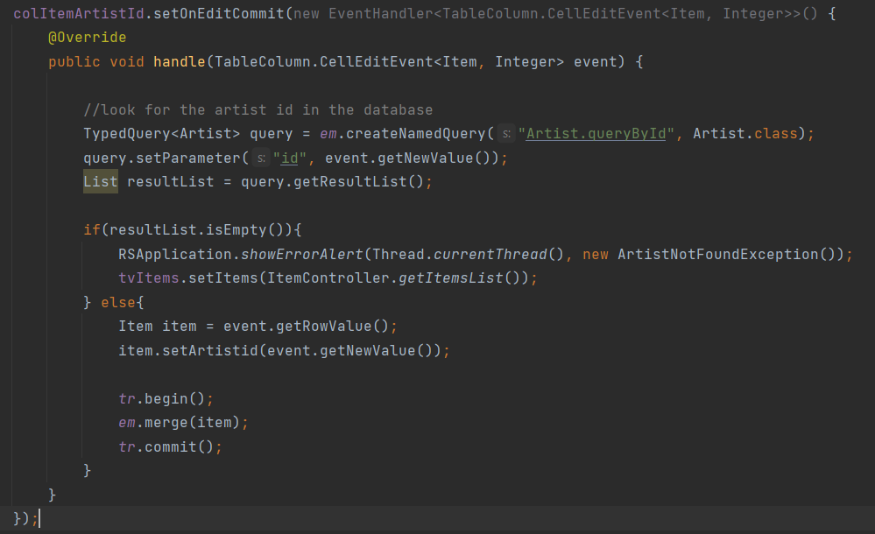
Data Input Validation
AddItemController, AddArtistController
ItemController

Slide 11
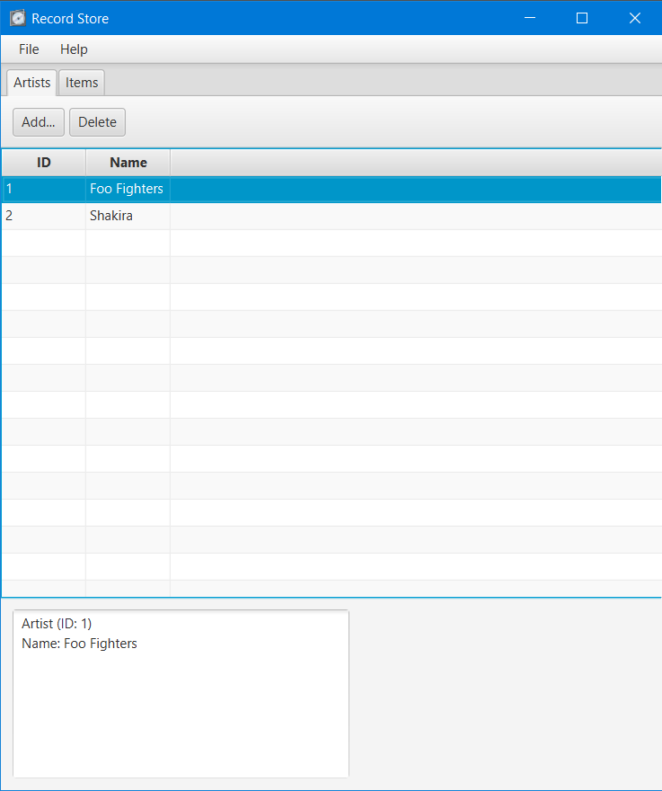
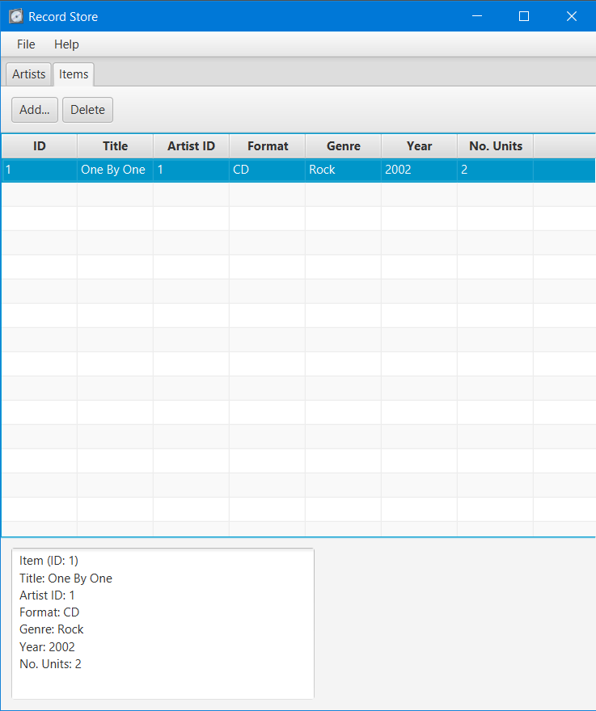
Scenes
ArtistController
ItemController

Slide 12
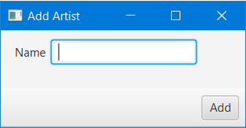
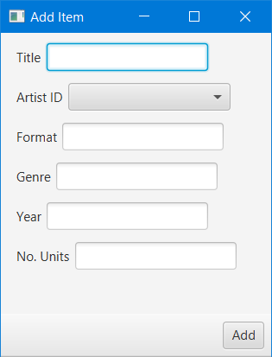
Scenes
AddArtistController
AddItemController

