Slide 1
Arhitecturi Paralele Science and Recap
Prof. Florin Pop
As. Drd. Ing. Cristian Chilipirea
cristian.chilipirea@cs.pub.ro
Elemente preluate din cursul Prof. Ciprian Dobre

Slide 3
Knowledge

Slide 4
Knowledge

Slide 5
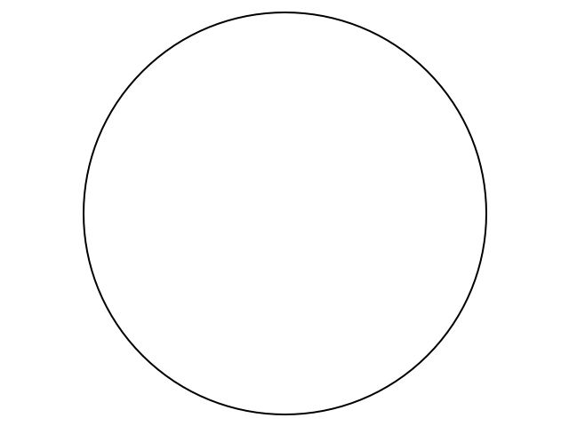
All Human Knowledge
Notes:
This disc represents all human knowledge.
Human knowledge is the combined knowledge of all humans on the planet.

Slide 6
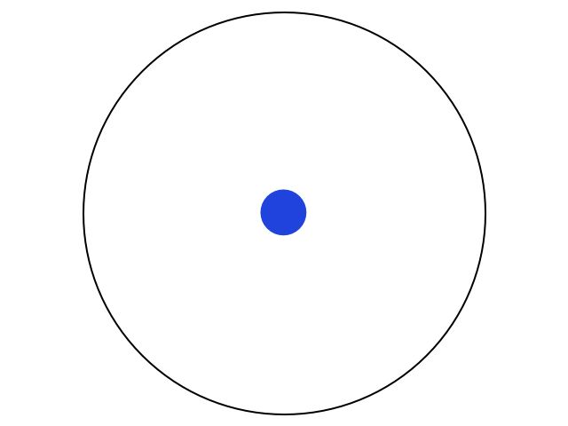
Knowledge
Notes:
The blue dot is what we learn in school.

Slide 7
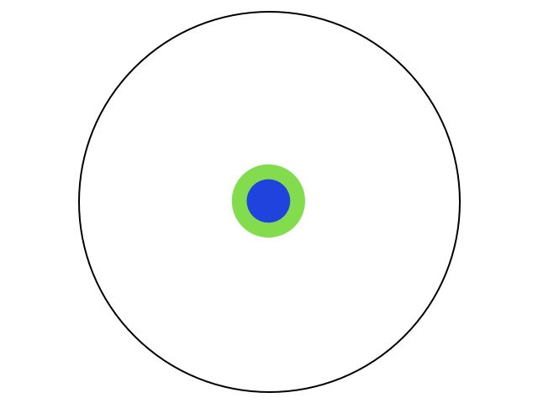
Knowledge
Notes:
The green is what we learn in high school

Slide 8
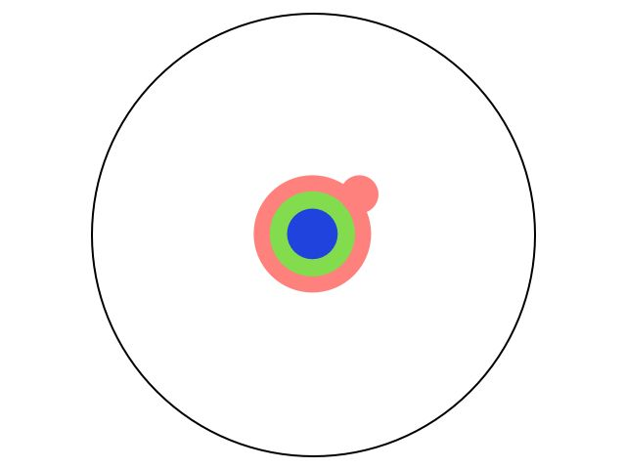
Knowledge
Notes:
The orange is what we learn during our bachelor.

Slide 9
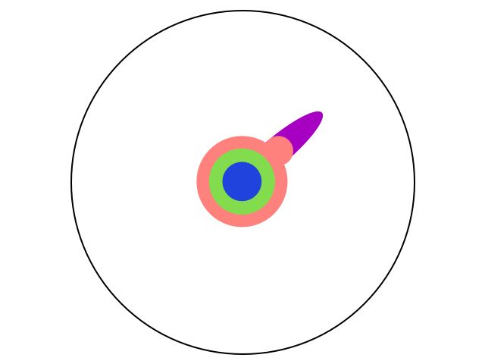
Knowledge
Notes:
The purple is what we learn during the masters.
It concentrates on a specific area.
It prepares us to have access to the most recent scientific works.
It also exposes us to a lot of state of the art scientific literature in our field.

Slide 10
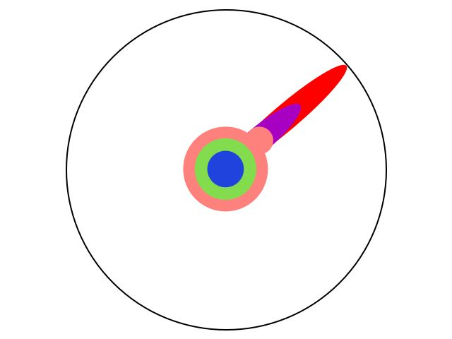
Knowledge
Notes:
Finally the red is the PhD.
For some, it can even be industry.
This is the trip we have to take with the least amount of guidance and fill in the gap between what we were thought and what the most recent and most relevant research in our field is.

Slide 11

Knowledge
Notes:
Getting to the edge of human knowledge is not enough if we don’t push it and make it grow.
Why?
Well look at medicine today, it either cuts something out, or kills something. Is it enough?

Slide 12
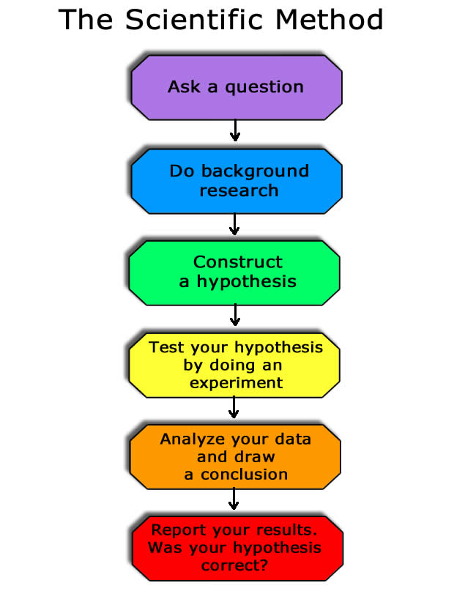
Notes:
Without the last part the scientific method is useless. Without reporting results knowledge is not spread and the work does not contribute to the total that is human knowledge.

