Slide 1
Arhitecturi Paralele Consens în Sisteme Distribuite 2
Lect. Dr. Ing. Cristian Chilipirea
cristian.chilipirea@mta.ro

Slide 3
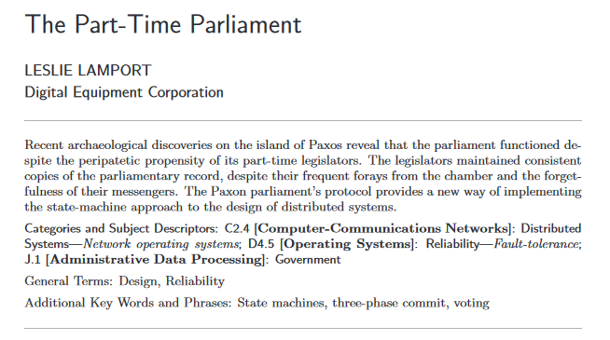

Consens rezistent la Faults - Paxos

Slide 4
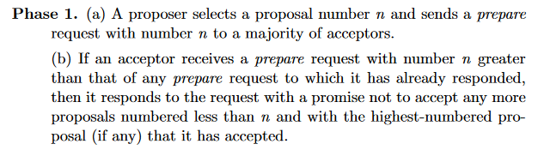
Paxos

Slide 5
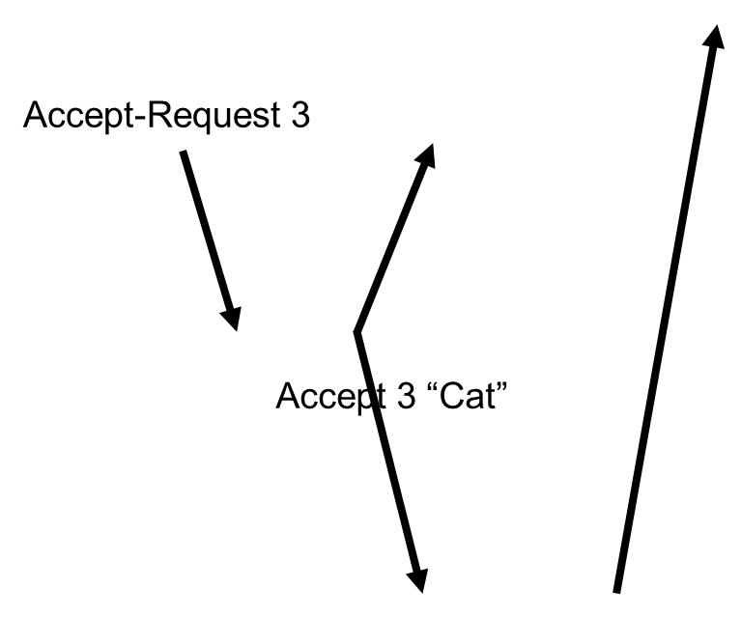
Paxos
Client
Prepare 3
Proposer
Acceptors
Promise 3
Learners
Notes:
https://en.wikipedia.org/wiki/Paxos_(computer_science)#cite_note-agree-1

Slide 6
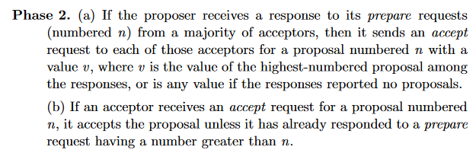
Paxos

Slide 7
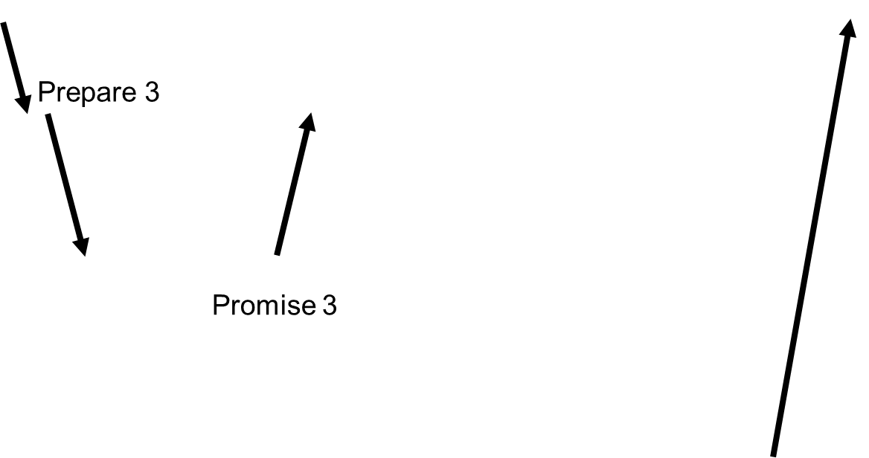
Paxos
Client
Accept-Request 3
Proposer
Acceptors
Accept 3 “Cat”
Learners
Notes:
https://en.wikipedia.org/wiki/Paxos_(computer_science)#cite_note-agree-1

Slide 8
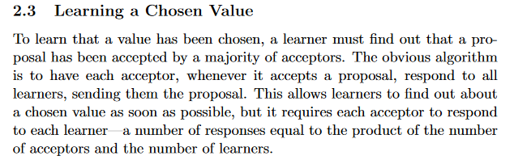
Paxos

Slide 9
Paxos
Client
Prepare 3
Accept-Request 3
Proposer
Acceptors
Promise 3
Accept 3 “Cat”
Learners
Notes:
https://en.wikipedia.org/wiki/Paxos_(computer_science)#cite_note-agree-1

Slide 10
Paxos
Client
Accept-Request 3
Prepare 3
Proposer
Prepare 4
Proposer
Acceptors
Promise 3
Accept 3 “Cat”
Promise 4 (3, “Cat”)
Learners
Notes:
https://en.wikipedia.org/wiki/Paxos_(computer_science)#cite_note-agree-1

Slide 12
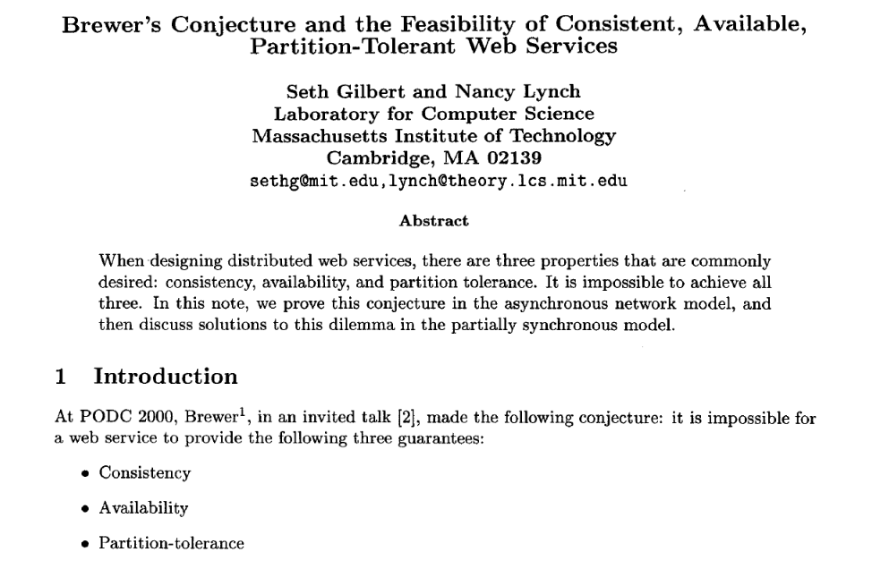
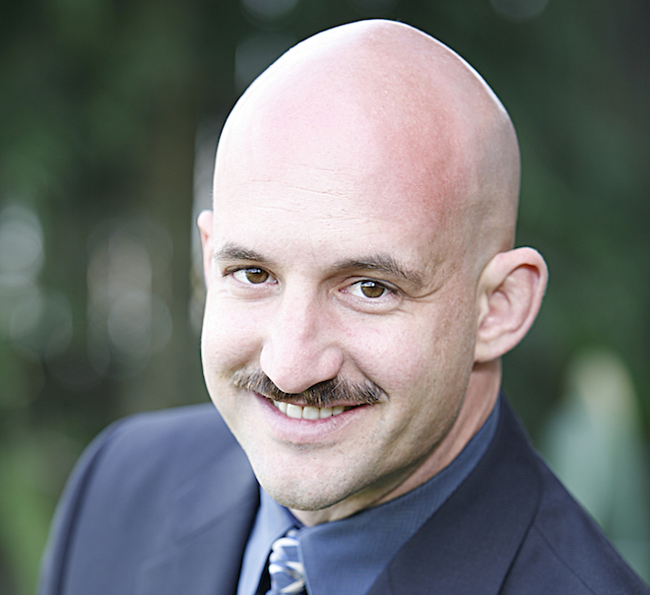
CAP Theorem

Slide 14
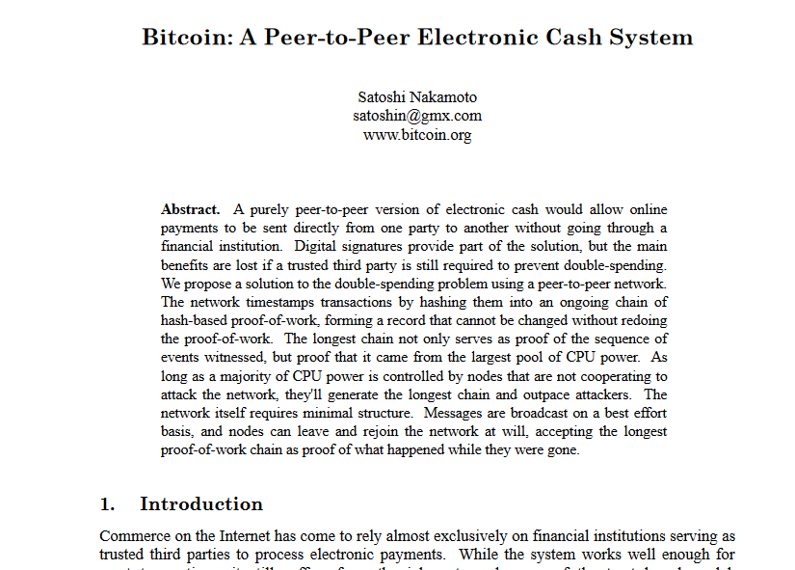

Bitcoin and Blockchain

Slide 15
Bitcoin and Blockchain
Cheats on the CAP theorem
Eventual consistency
Availability
Partition-tolerance (But short)

Slide 16
Proof of Work

Slide 17
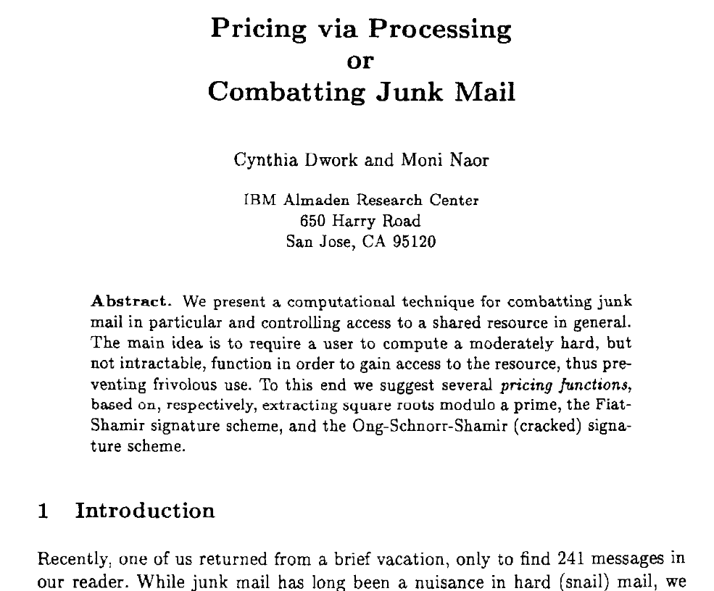
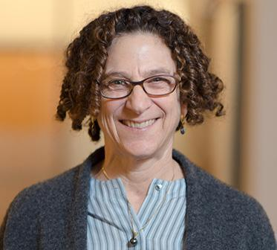
Proof of Work

Slide 18
Proof of Work
y = f(x)
f() este extrem de lentă computațional
x = g(y)
g() este extrem de rapidă computațional

Slide 19

Proof of Work
x; Cât este f(x)?

Slide 20
Proof of Work
Processing!!!

Slide 21
Proof of Work
Processing!!!

Slide 22
Proof of Work
y

Slide 23
Proof of Work
g(y) == x?
DA - știu că a muncit
NU – încearcă să trișeze

Slide 24
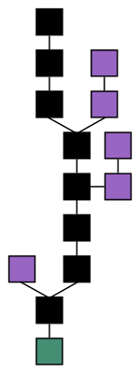
Blockchain

Slide 25
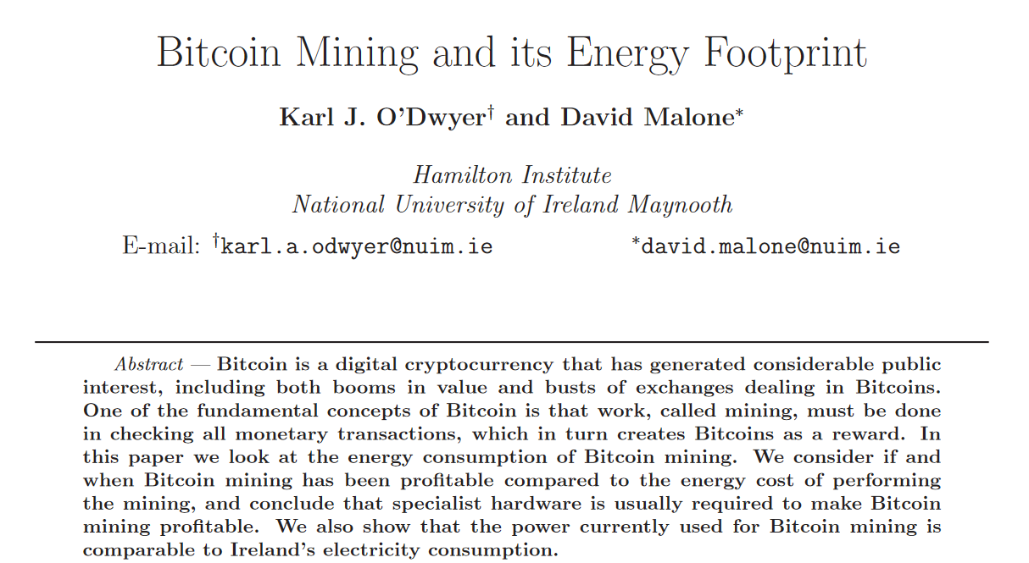
Bitcoin energy consmption

Slide 26
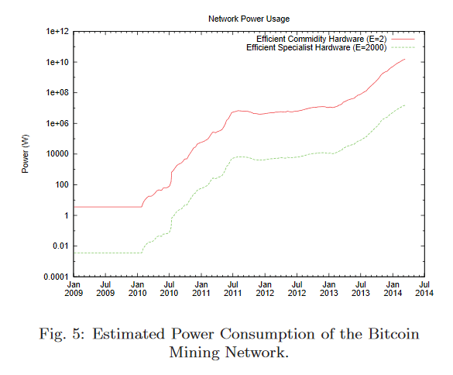
Bitcoin energy consmption

Slide 28
Transactions

Slide 29
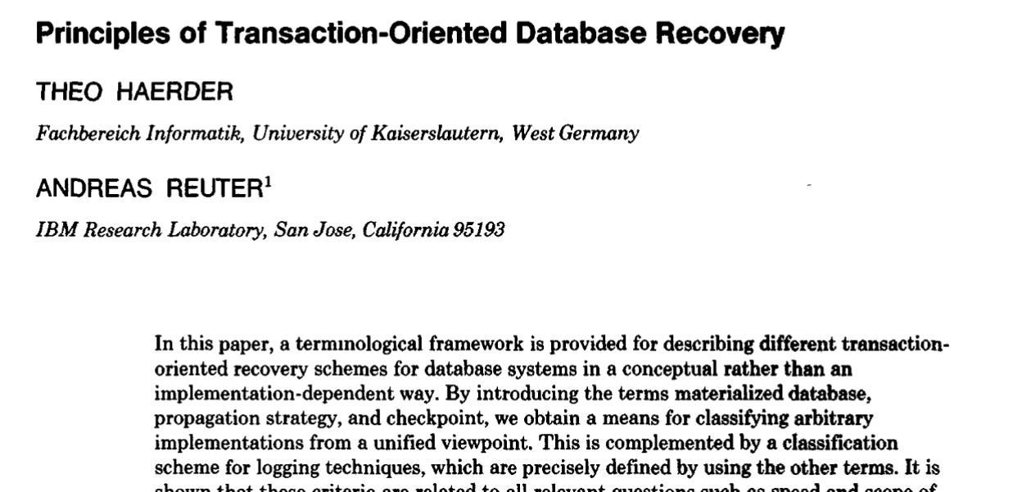


ACID
Notes:
Andreas Reuter
Theo Härder

Slide 30
ACID
Atomicity
Consistency
Isolation
Durability

Slide 32
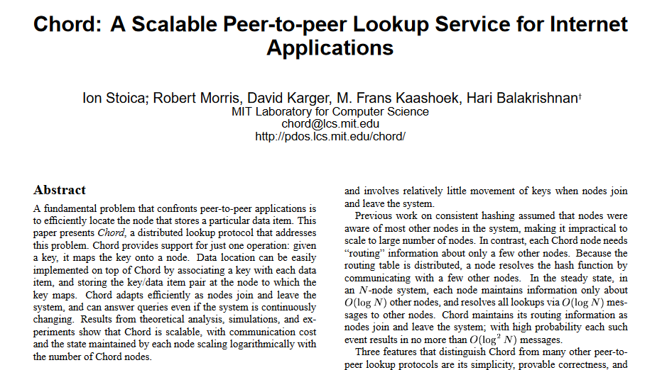
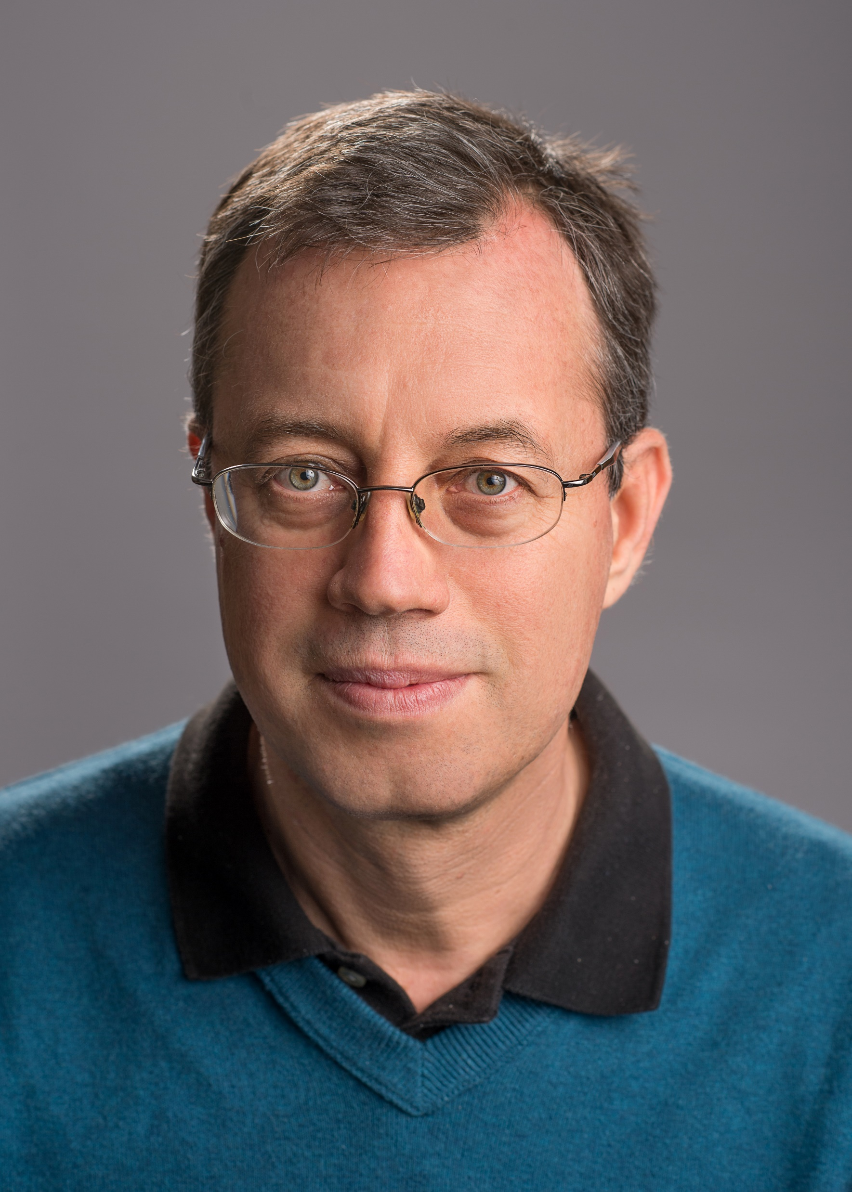
Distributed Hash Table Chord

Slide 33
Amazon DynamoDB

Slide 34
Caching

Slide 35
Peer to Peer

Slide 36
Geolocation

Slide 37
Content Delivery Networks

Slide 38
Load Balancing

