Slide 1
Auth0

Slide 2
npm install @auth0/auth0-spa-js –save
ng generate service services/auth
Protect access to individual resources:
ng generate guard services/auth --skipTests

Slide 3
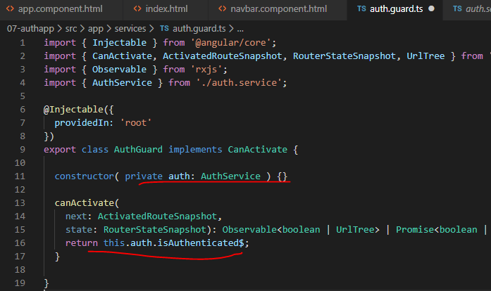
Guard

Slide 4
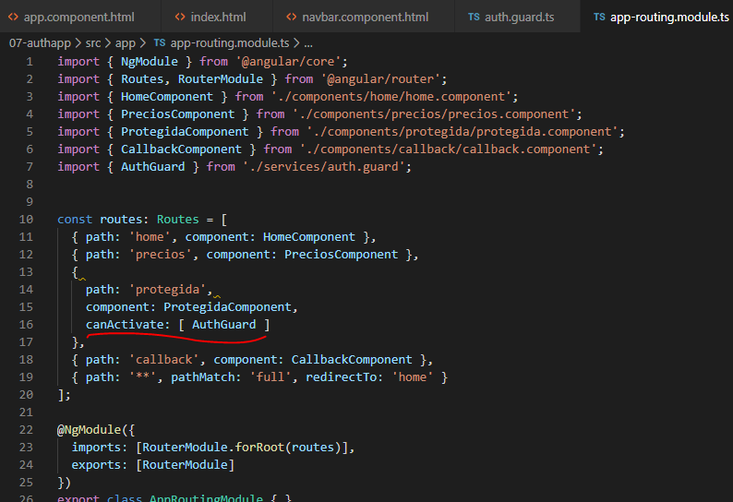

Slide 5
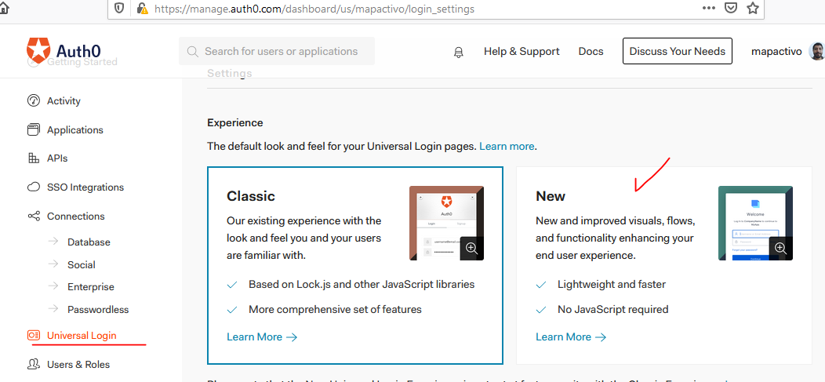

Slide 6
https://github.com/Klerith/angular-auth0

