Slide 1
Sección 6 - SpotiApp
Spotify API

Slide 2
Primeros componentes
npm add jquery --save
npm add popper.js --save
npm add bootstrap --save
ng g c components/home --spec=false -is
ng g c components/search --spec=false –is
ng g c components/artista --spec=false –is
ng g c components/shared/navbar --spec=false –is

Slide 3
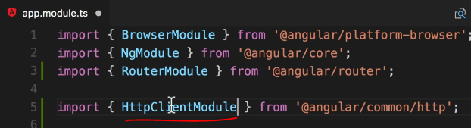
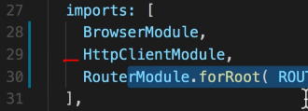
Consumir APIs

Slide 4
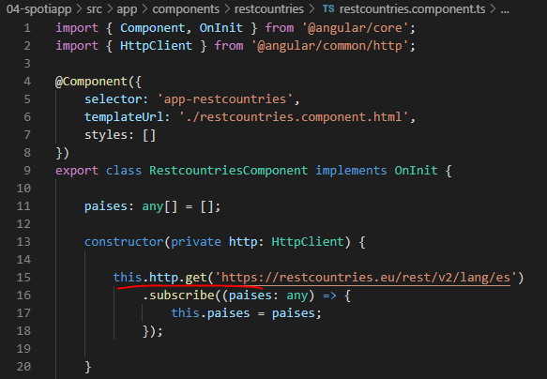

Slide 5
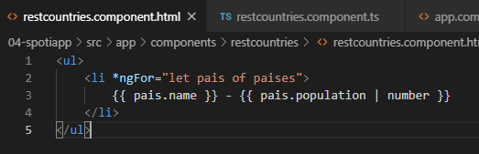

Slide 6
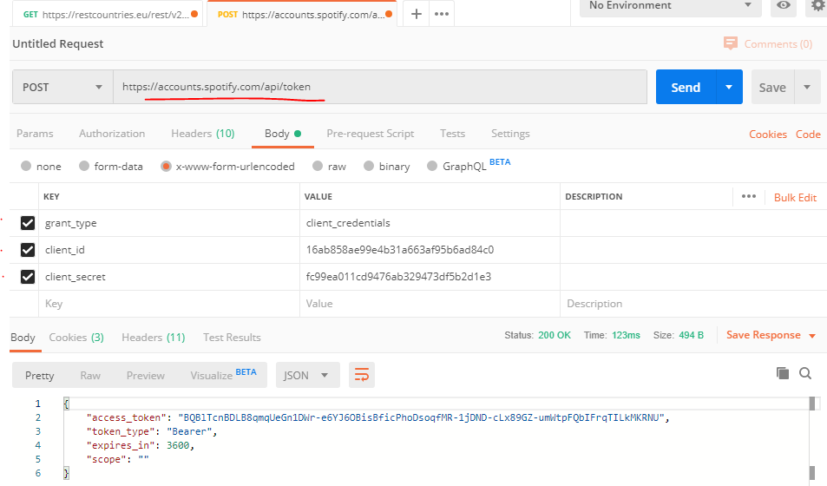
Get Spotify token
https://accounts.spotify.com/api/token
Client ID 16ab858ae99e4b31a663af95b6ad84c0
Client Secret fc99ea011cd9476ab329473df5b2d1e3

Slide 7
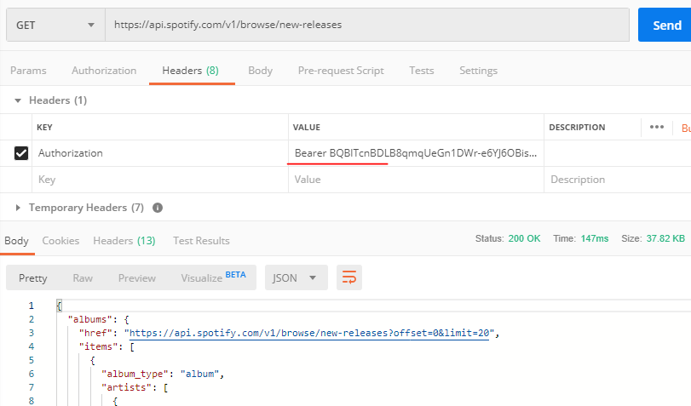
Usar el token anterior:

Slide 8
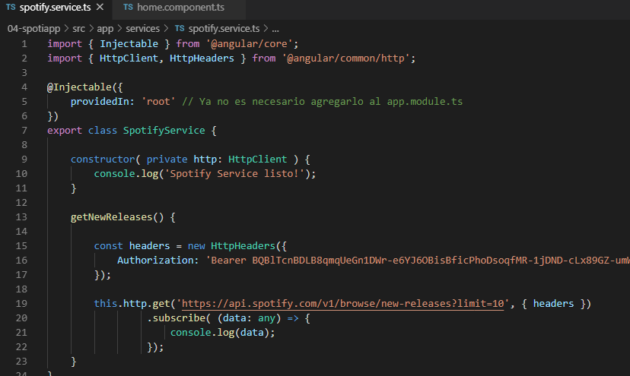
Desde angular

