Slide 1
Austria or Australia?
Can CLIP ViT-B/32 tell two countries apart from images alone — or does it only know the postcards?
The Visionaires · Phase I midpoint · 11 Nov 2026 · zero-shot · Country211
Left: an Austria photo. Right: an Australia photo (both from our cached Country211 set).

Slide 2
Problem & motivation (0:00–0:35)
Austria ↔ Australia: famously confused by name — but visually?
CLIP ViT-B/32 (OpenAI), pre-trained, used zero-shot — no training on our data
Country211: real geotagged photos from 211 countries, incl. both of ours
Question: does CLIP use place evidence — or stereotypical scene cues?

Slide 3
Two angles on one model (0:35–0:50)
Pair 1 · text side · AI-aided — Cristian Knebel & Alexander Strasser
Do the words in the prompt change the verdict? 3 label sets: EN / DE / mixed
Prediction Explorer UI + Language Shift scatter
Pair 2 · image side · no LLMs — Shamekh Al-Suwi & Eiman Mohamed
Does the image content decide — and where do errors live?
t-SNE map, k-means clusters, density, scene probes

Slide 4
Pair 1 — method (0:50–1:20)
500 photos — 250 Austria + 250 Australia (Country211 train + test), cached
3 label sets: EN: Austria / Australia · DE: Österreich / Australien · Mixed: Österreich / Australia
CLIP scores each photo under all three sets + top-5 of all 211 countries
Prediction Explorer: photo + one bar chart per label set, ✓/✗ verdict, close-call margin, “Only mistakes”
Language Shift: one dot per photo — Austria score EN (x) vs DE (y); reads the same cache

Slide 5
Pair 1 — findings (1:20–2:00)
Accuracy 86.6 % (EN) → 76.8 % (DE) · mixed 82.8 %
482 / 500 photos get a lower Austria score with German names
93 photos flip outright — EN says Austria, DE says Australia (71 are Austrian photos)
139 / 500 wrong under at least one label set
CLIP isn’t reading “Austria” — it’s reading the token.

Slide 6
Pair 2 — method (2:00–2:35)
600 photos (150/50/100 per country, all splits) — nothing trained, every split unseen
512-d embeddings; zero-shot error 17 % with “a photo taken in …” prompts
5 prompt pairs to test fragility; 10-NN vote as image-side check
14 CLIP scene probes (explicitly unreliable); k-means k = 9 (silhouette 0.05); t-SNE map
Sub-clustering of the worst cluster

Slide 7
Pair 2 — findings (2:35–3:15)
Clusters 0/2/3/6: 220 photos, place-specific, error ≤ 7 % (Vienna streets, AU coast, alpine snow, field hockey)
Clusters 1/4/5/8: 314 photos (52 %) hold ≈ 80 % of errors (night skies, conferences, windows/graffiti, concerts)
Sparser → worse: density 0.75 → 0–2 % err; 0.633/0.641 → 24–35 % err
Stereotypes, not places: snow/buildings → Austria; wildlife/night → Australia; 20 of 27 shown errors: AT photo → “Australia”
Errors split 69 AT : 33 AU — bias towards Australia
Worst cluster splits: portraits 19 % err vs concerts 50 % (neighbours 27 %) → text-side failure

Slide 8
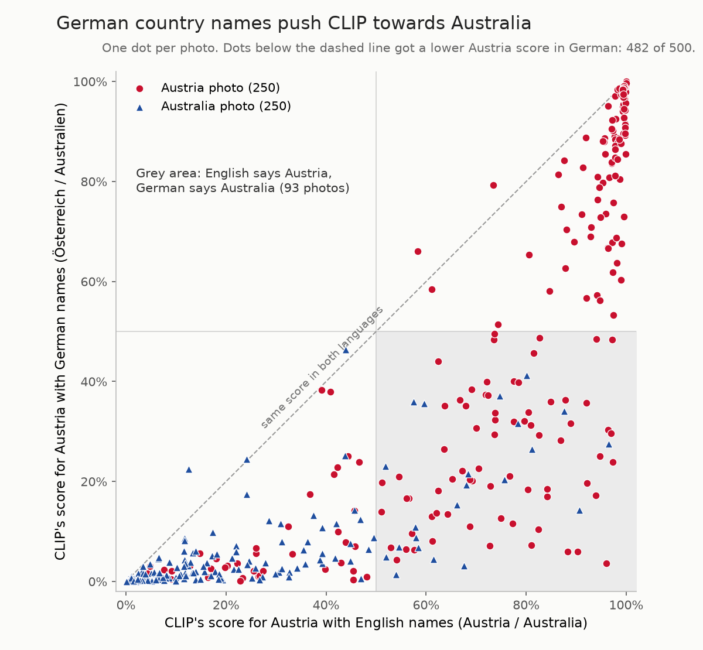
Visual 1 — Language Shift (3:15–3:35)
Below the diagonal = German pulled towards Australia: 482 of 500 dots
Grey box = 93 flips: the words alone decided the country

Slide 9
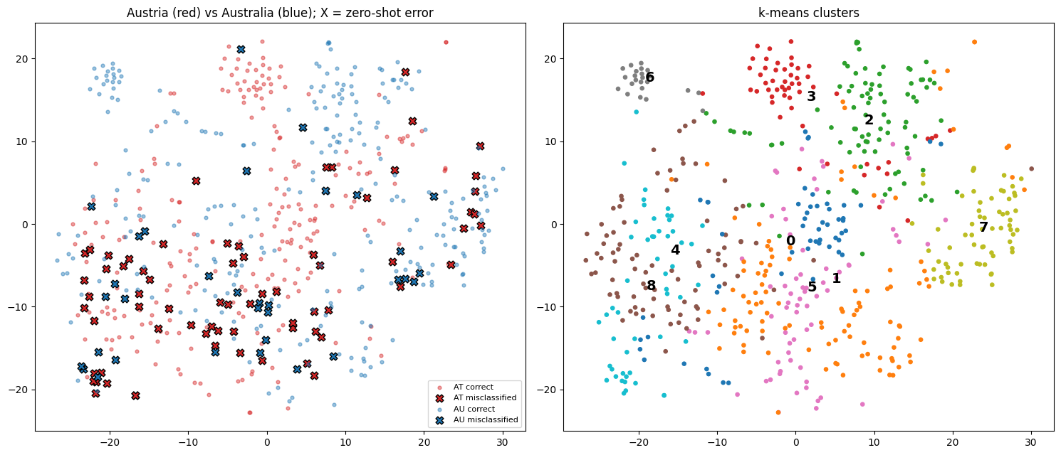
Visual 2 — the embedding map (3:35–3:55)
X = zero-shot error — errors pile up in the mixed centre, country islands stay clean
9 k-means clusters, each one kind of scene

Slide 10
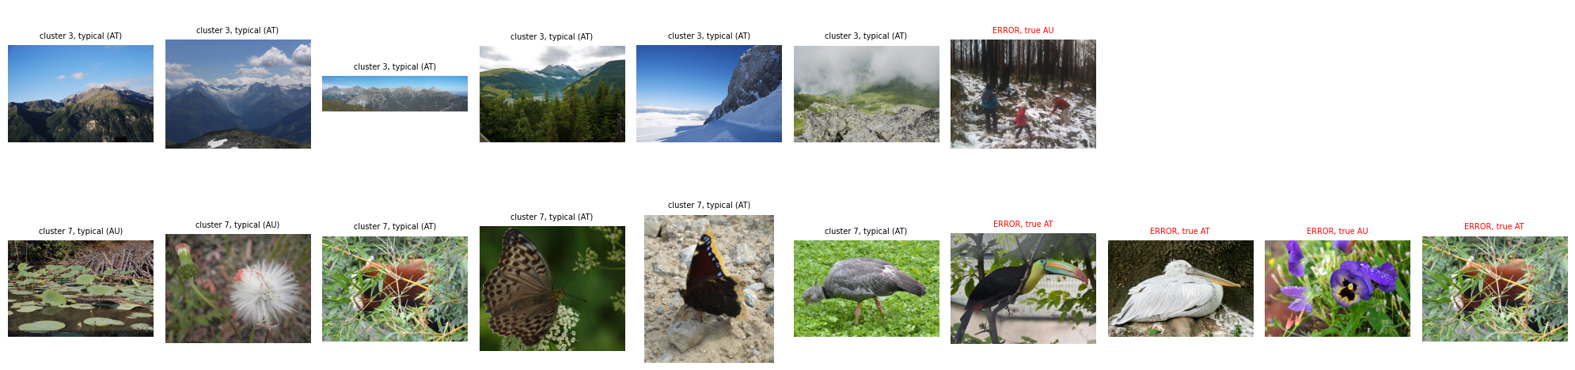
Visual 3 — montages (3:55–4:15)
Snow says Austria: cluster 3’s only error is an Australian snowy forest
Wildlife says Australia: cluster 7’s worst errors are Austrian zoo animals (toucan, pelican)
Cluster 8 = two problems: portraits 19 % vs concerts 50 % err — a text-side failure

Slide 11
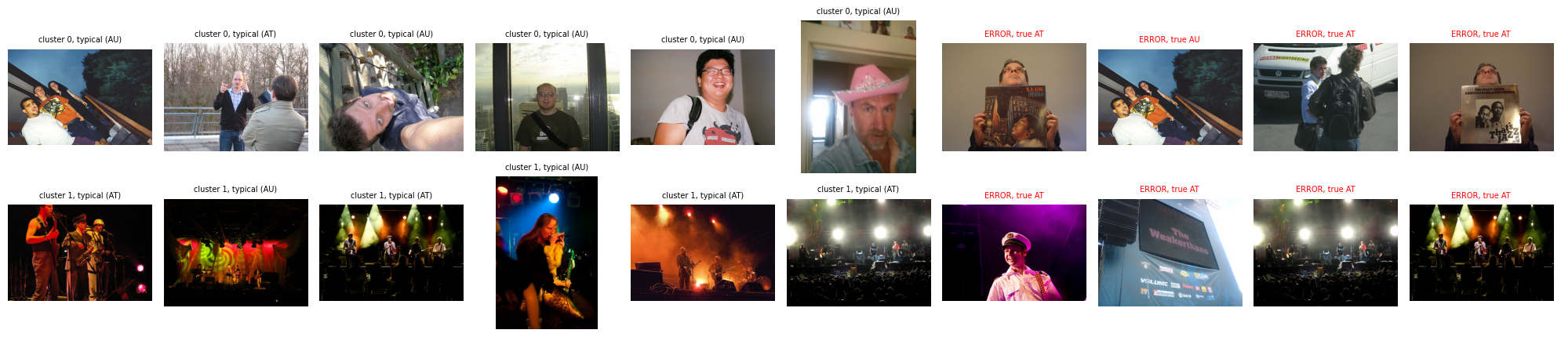

Slide 12
Two sides, one story (4:15–4:30)
Text side: wordings move the scores — 482/500 dots shift, 93 flips
Image side: place-specific scenes separate cleanly (≤ 7 %); otherwise stereotypes, biased to Australia
CLIP reads scenes, not places — and the answer is unstable under prompt changes.

Slide 13
What GenAI did — and didn’t — do (optional, 4:30–4:35)
ChatGPT: project idea, model + dataset, chose Language Shift & Prediction Explorer
Claude Code (3 agents): 8 robustness fixes proposed for the Explorer (cache path, offline class names, Tk crash, label overlaps, stale predictions…)
Rejected: uv setup (“use his setup”), dropping .eval(); open: JPEG re-encoding, train split
From our reflection: easy results, but “it felt like a black box” — verification stayed human

Slide 14
Where we stand (4:35–4:50)
CLIP separates Austria from Australia when the photo shows a place; otherwise it falls back on scene stereotypes and flips with the prompt
Next: train split as second dataset (≈ 300 MB), click-through scatter → explorer, requirements.txt, README IDs
Submission — 11 Nov 2026, 23:59: public repo ✅ · AI interaction record ✅ · GenAI reflection ✅ · video ≤ 5:00 ⬜
https://github.com/cristianknebel/AI-and-Visualization

