Slide 1

On the replicability of sports and exercise science research: assessing the prevalence of publication bias and studies with underpowered designs by a z-curve analysis Cristian Mesquida PhD researcher NLRN Pre-Symposium for Young Meta Scientists Groningen (2024)

Slide 2
Between 70% and 82% of studies reported a statistically significant that would fully or partially support the hypothesis tested
(Büttner et al., 2020; Twomey et al., 2021)
Are these estimates high?­
Well, the answer is that it depends

Slide 3
Proportion of supported hypothesis = α × (1 − % true hypotheses) + power × % true hypotheses
So if 70% studies support their hypotheses….
So to observe a 70% of studies supporting their hypotheses we need an average power of 70% (at least)

Slide 4
So what is the average power in sports and exercise research?
- We do not known
- Typical sample size in sports and exercise science is ∼ 25 participants
- Within-subject designs can achieve high power even with small sample sizes
- Most studies use within-subject desgins

Slide 5
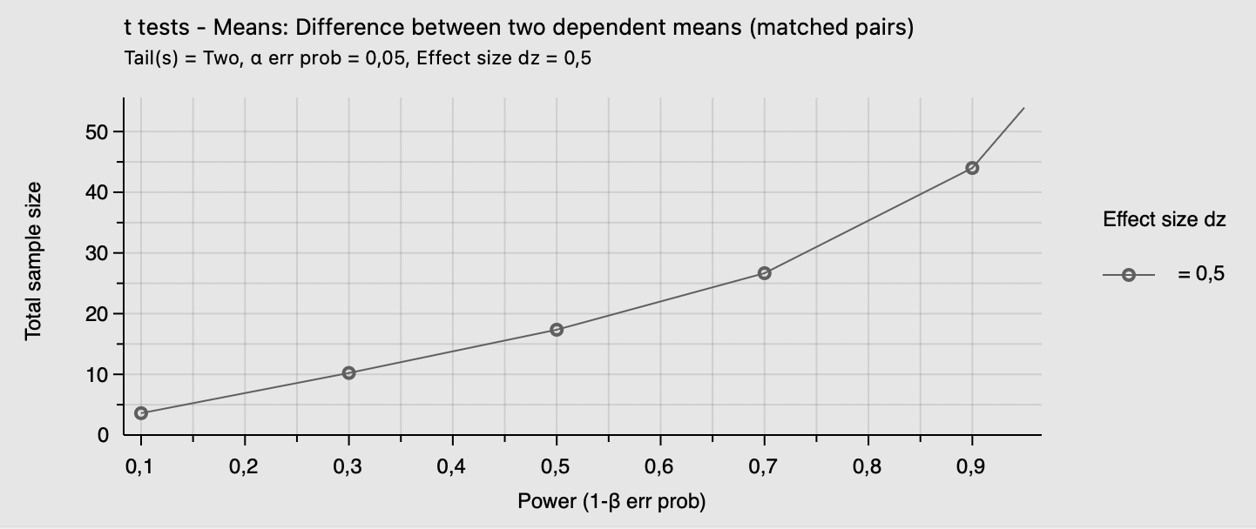
Two-tailed paired t-test

Slide 6
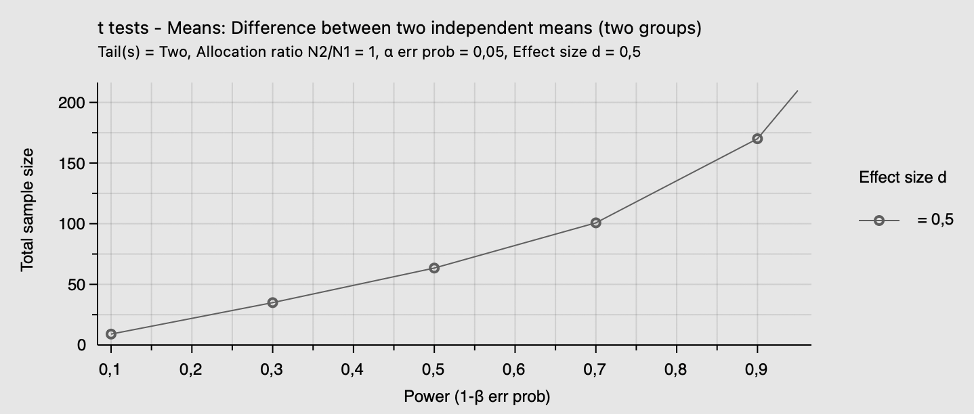
Two-tailed unpaired t-test

Slide 7
If power is (much) smaller than the proportion of studies that support the hypothesis, then there is an excess of significant results

Slide 8
The “troubling trio”
- Publication bias
- p-hacking
- Small sample sizes
Inflated type I error rate
Proportion of supported hypotheses

Slide 9
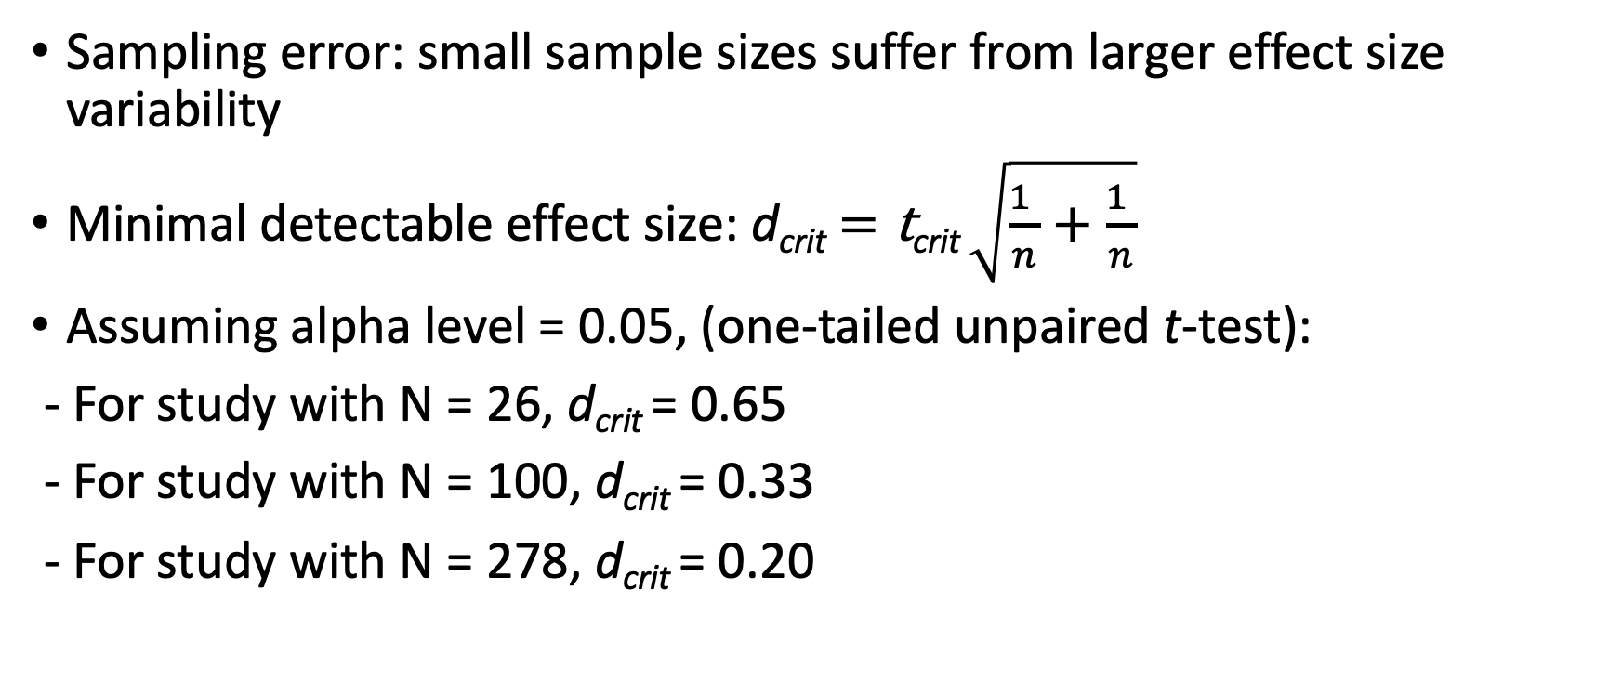
Why publication bias (and p-hacking) are problematic especially with small sample sizes?
Sampling error: small sample sizes suffer from larger effect size variability
Minimal detectable effect size: d_{crit} $=\text{t}\text{crit} \sqrt{\frac{1 }{n}+\frac{1 }{n}}$
Assuming alpha level = 0.05, (one-tailed unpaired t-test):
- For study with N = 26, d_{crit} = 0.65
- For study with N = 100, d_{crit} = 0.33
- For study with N = 278, d_{crit} = 0.20

Slide 10
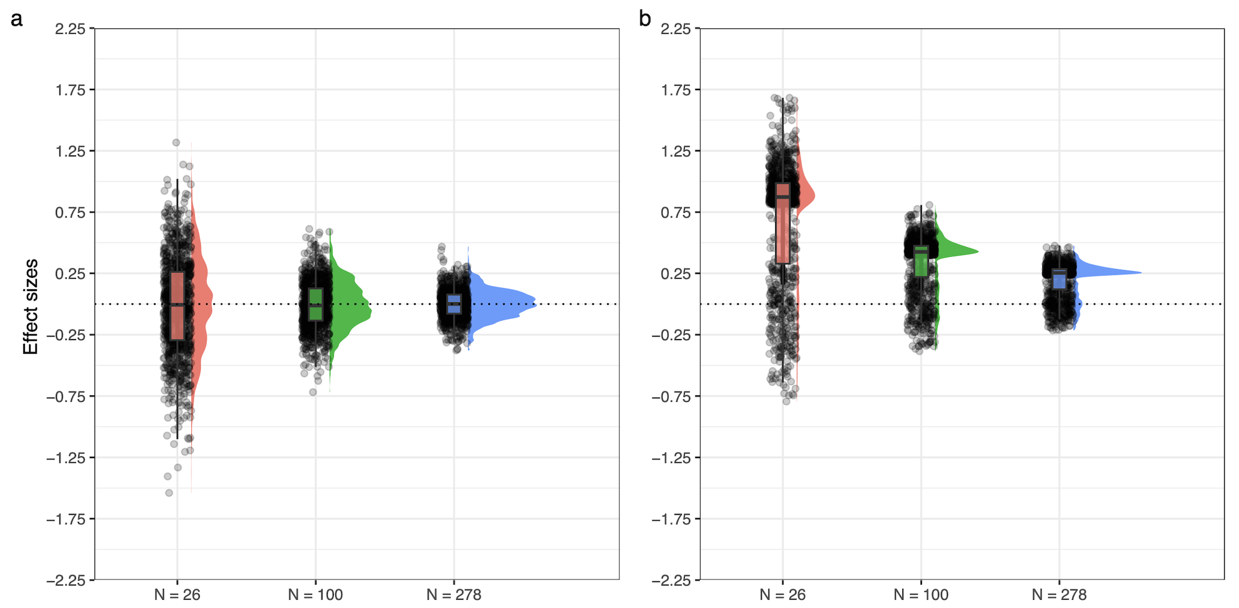

Slide 11
z-curve method (Bartoš & Schimmack, 2020)
It transforms (significant and non-significant) p-values into absolute z-scores
It compares the expected and observed distribution of z-scores
(Bartoš & Schimmack, 2020)

Slide 12
“a literature suffering from selection bias and studies with underpowered designs is more likely to contain a disproportionately larger proportion of p-values between 0.01 and 0.05 relative to non-significant values (p > 0.05) and “highly” significant values (p < 0.001)”

Slide 13
Observed Discovery Rate: proportion of studies supporting the hypothesis (i.e., p < 0.05)
Expected Discovery Rate: average power of studies reporting significant and nonsignificant results
Expected Replication Rate: average power of studies reporting a significant result
Maximum False Discovery Rate: worst-case scenario with the highest possible proportion of type I errors

Slide 15
Study protocol
350 articles published across 10 journals
Experimental or quasi-experimental studies
Use a t-test or ANOVA
Test a hypothesis
Select the p-value central to hypothesis

Slide 16
81 indepdenent p-values were excluded
Test a hypothesis of no difference with a classic hypothesis test
Claim hypothesis was supported when obtaining an effect in the other direction
Report an inexact p-value (e.g., p < 0.05) and could not be recomouted

Slide 17
Results
- Proportion of hypotheses supported = 0.67
- Strong evidence of publication bias: 0.67 > 0.31
- Average power = 11%
- Average power of studies support hypothesis (i.e., p < 0.05) = 50%
-Maximum false discovery risk = 0. 42 95% CI [0.12; 1]
- High heterogeneity in power

Slide 18
So what are the (statistical) consequences?
- Inflated type I error rate
- Inflated type II error rate
- Inflated effect sizes
Low replicability

Slide 19
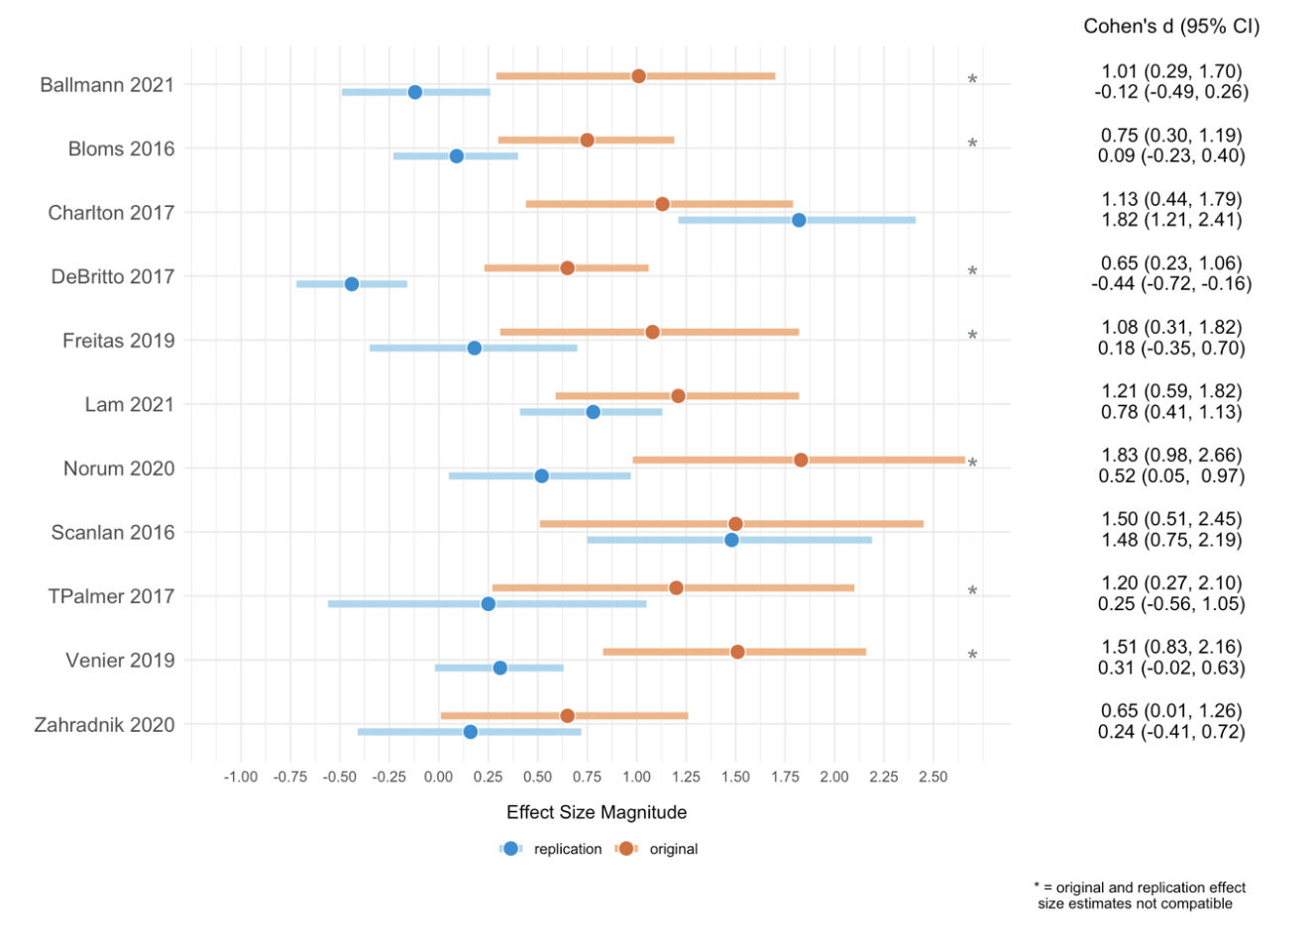
What are the (practical) consequences?
- 56% replication rate with significance criterion
- 36% effect sizes were not compatible
- 88% effect sizes were overestimated
Murphy et al., (2024)

