Slide 1
Gradient Echo (GRE) in MRI
Principles, Sequences & Clinical Applications
Based on original Spanish lecture · Enhanced English version

Slide 2

Frame 1 / 100

Slide 3
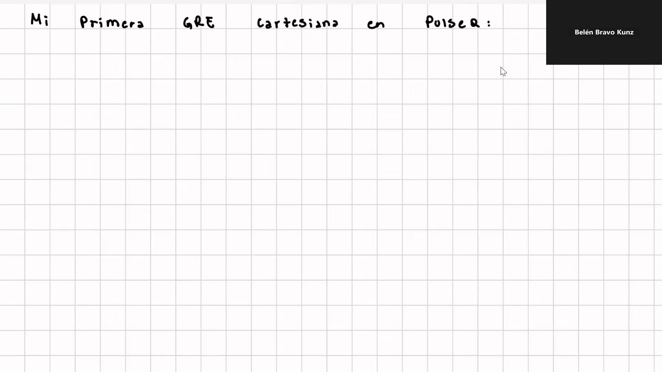
Frame 2 / 100

Slide 4
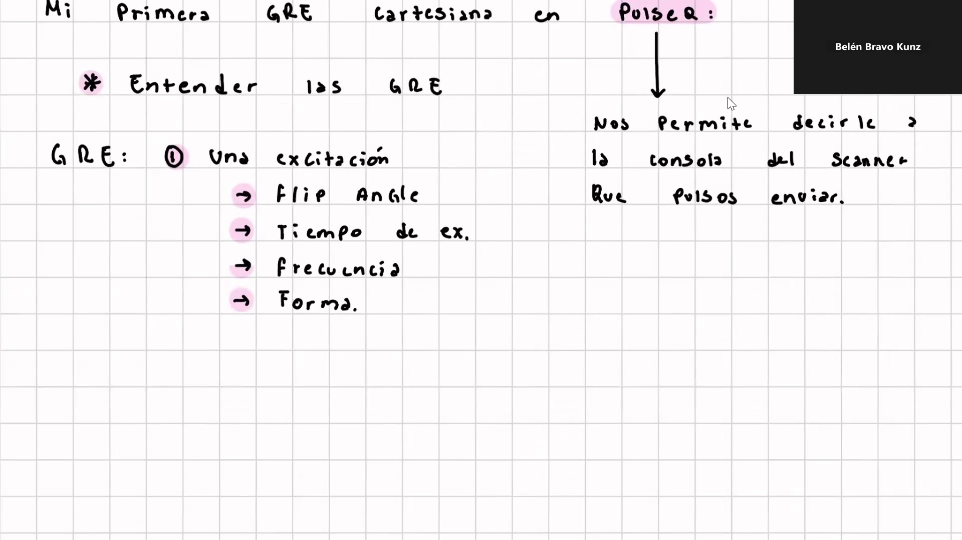
Frame 3 / 100

Slide 5
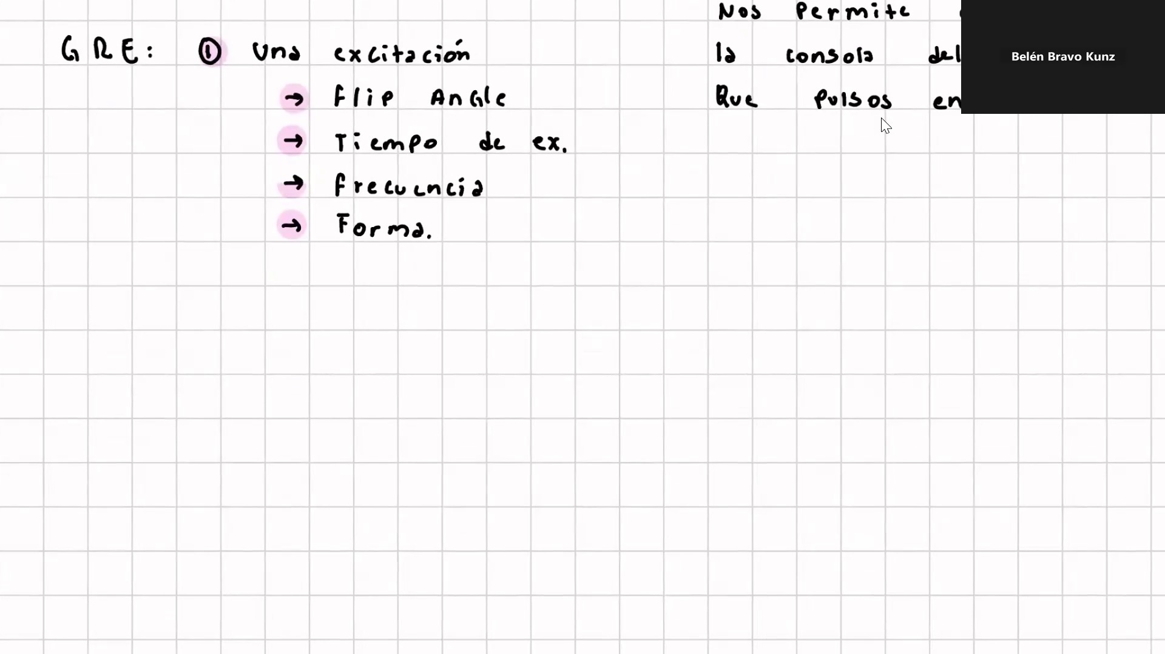
Frame 4 / 100

Slide 6
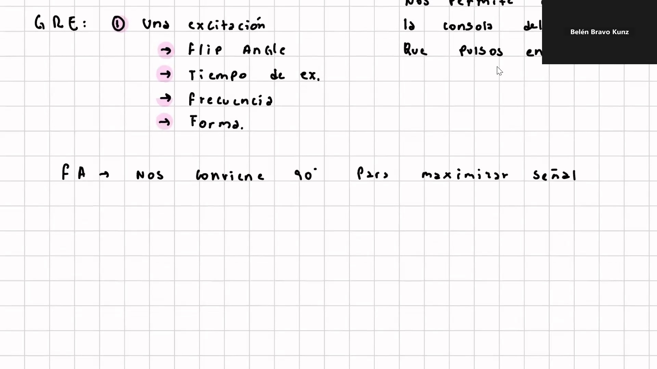
Frame 5 / 100

Slide 7
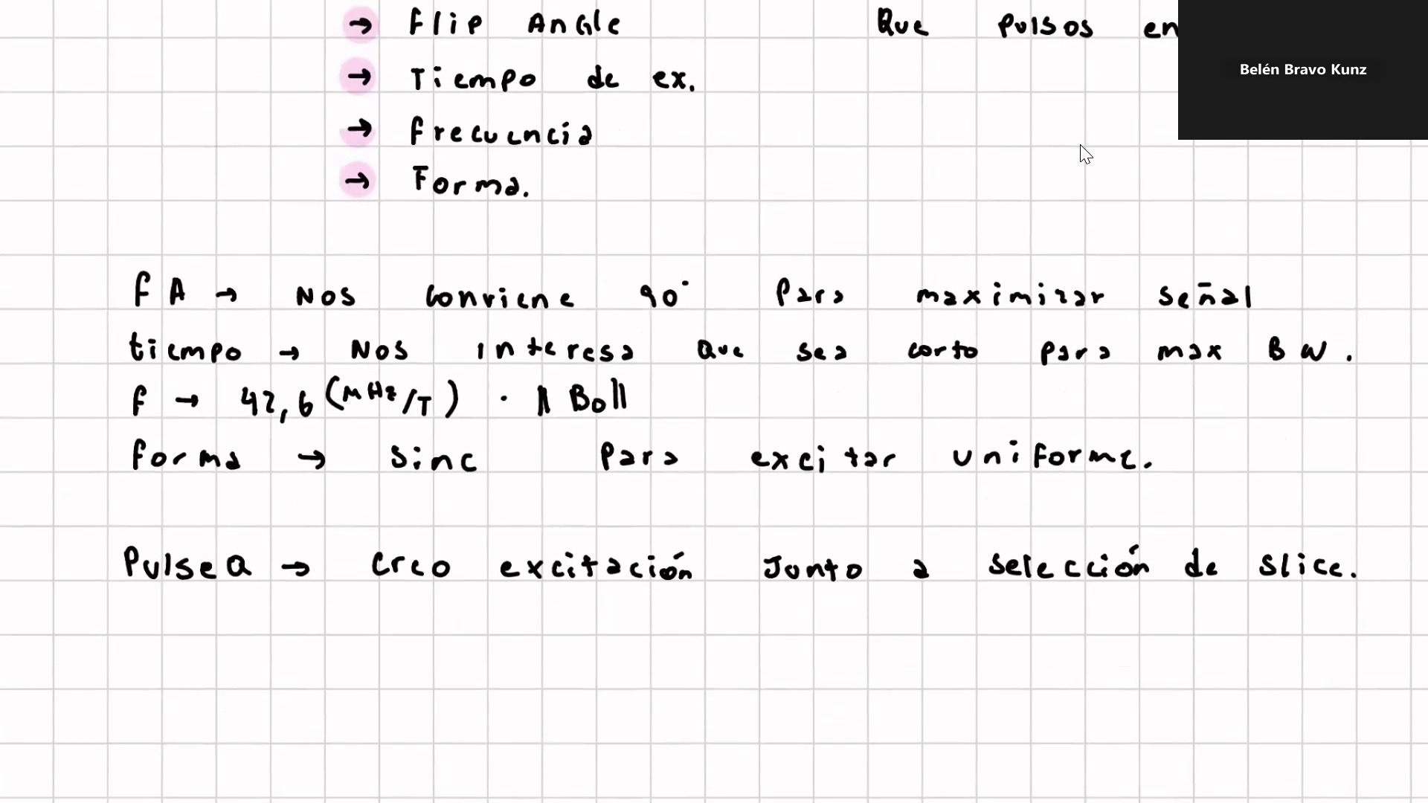
Frame 6 / 100

Slide 8
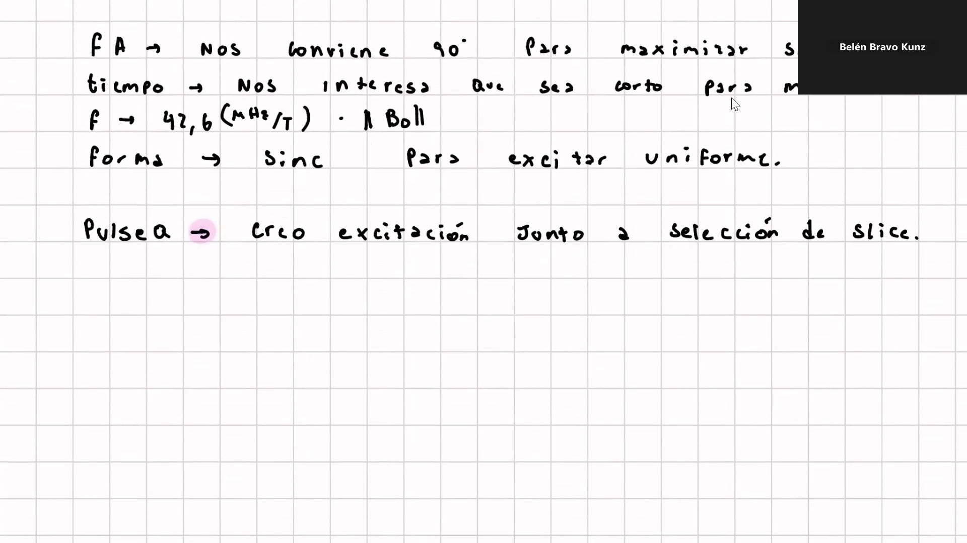
Frame 7 / 100

Slide 9
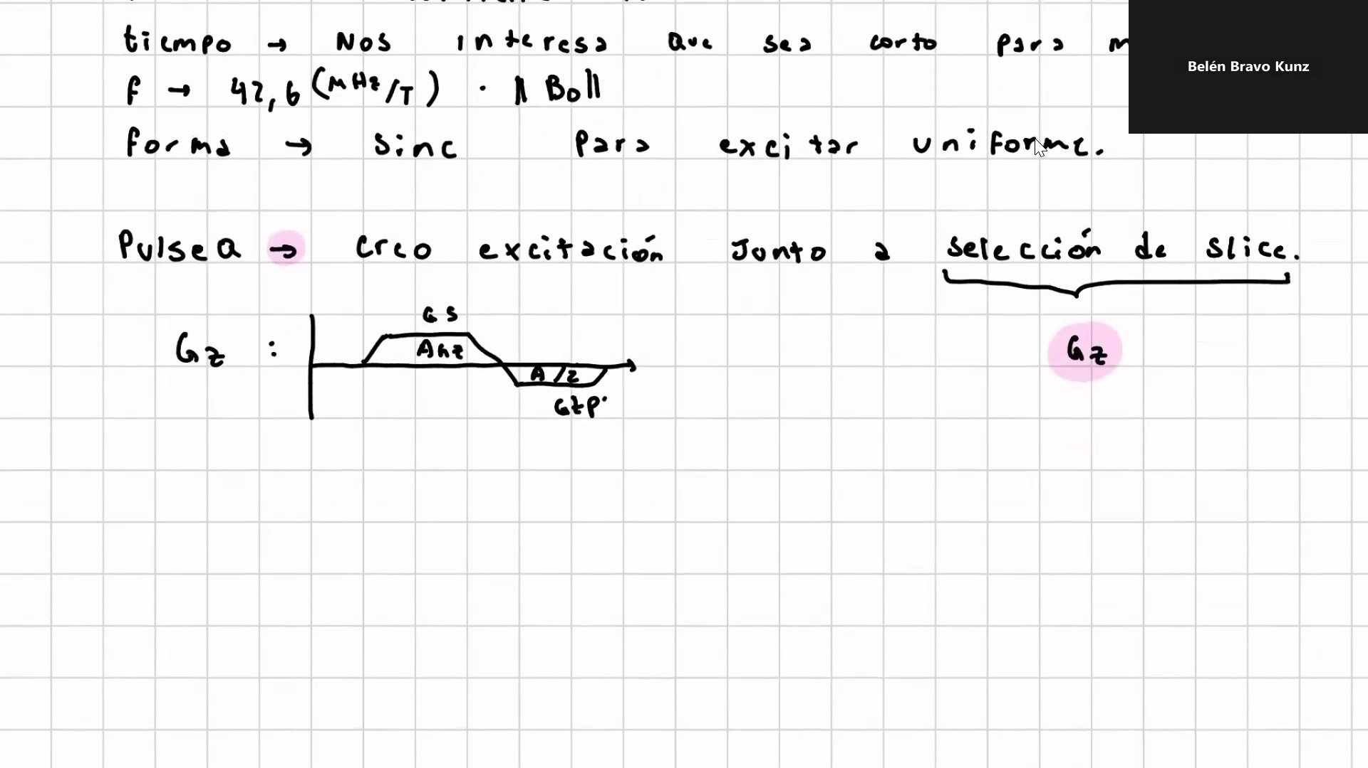
Frame 8 / 100

Slide 10
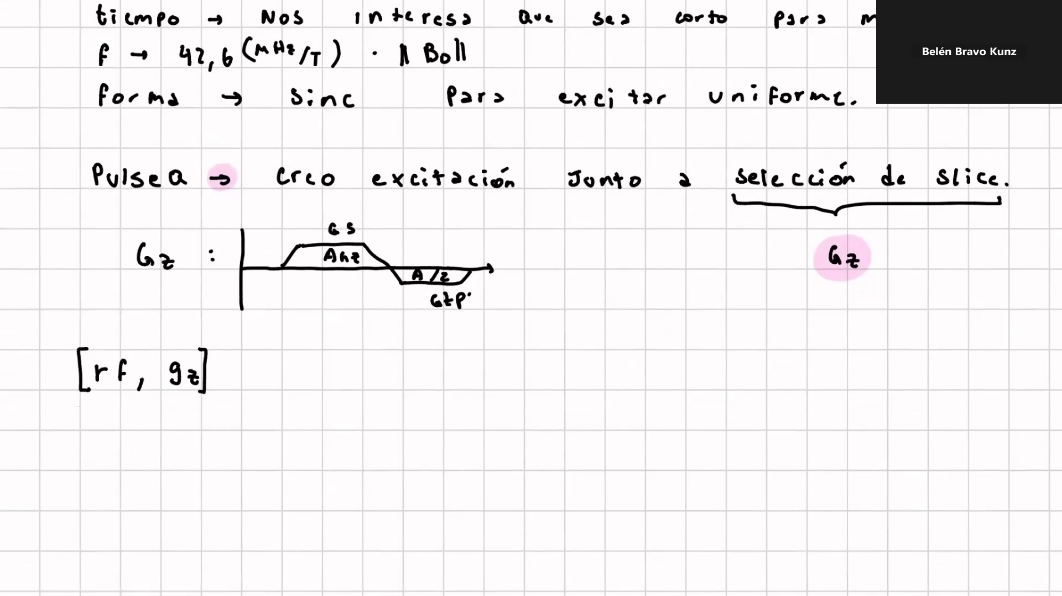
Frame 9 / 100

Slide 11
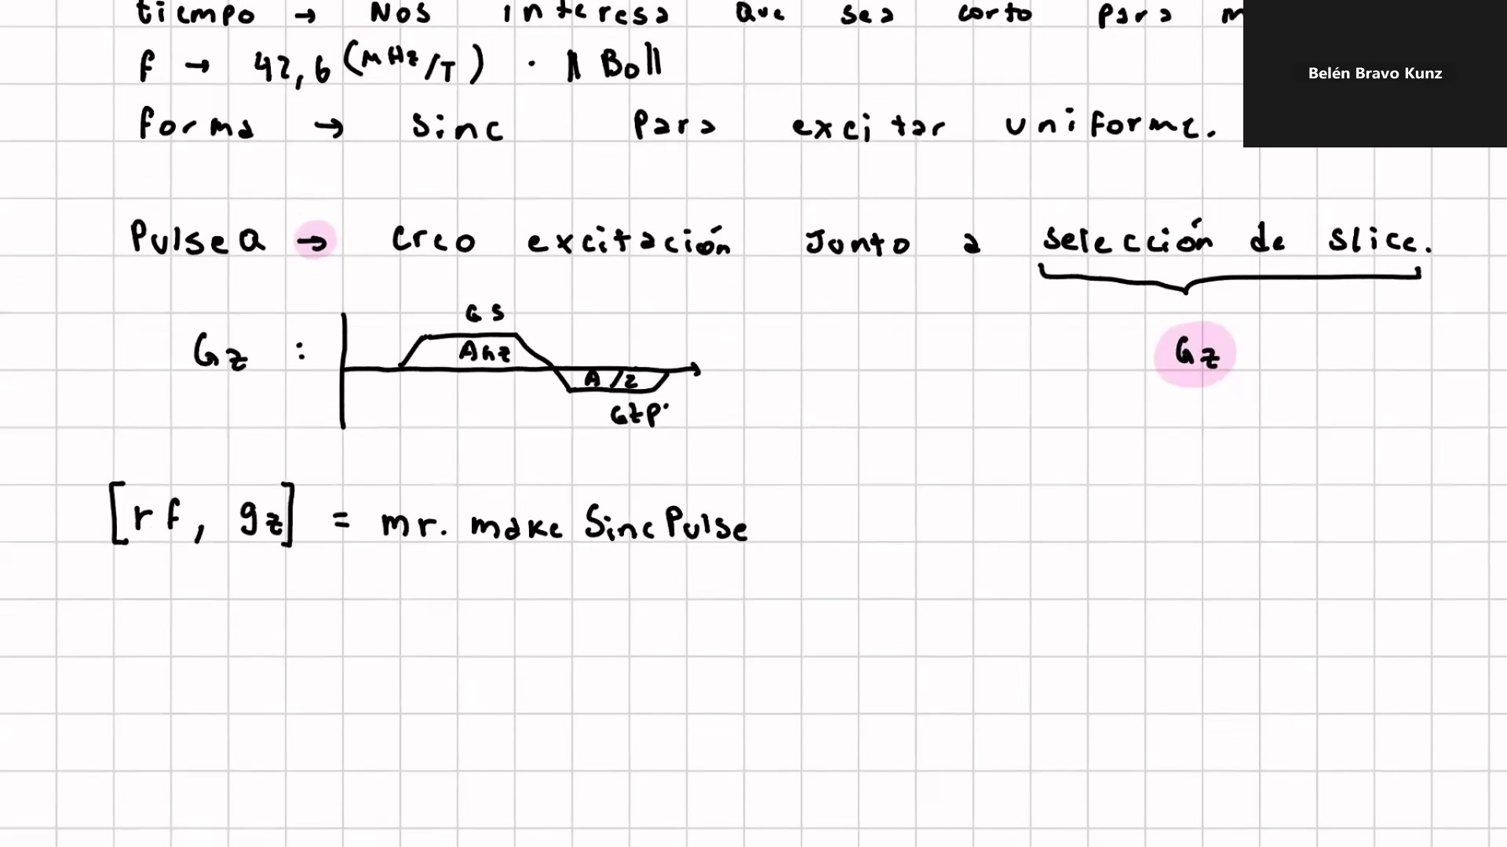
Frame 10 / 100

Slide 12
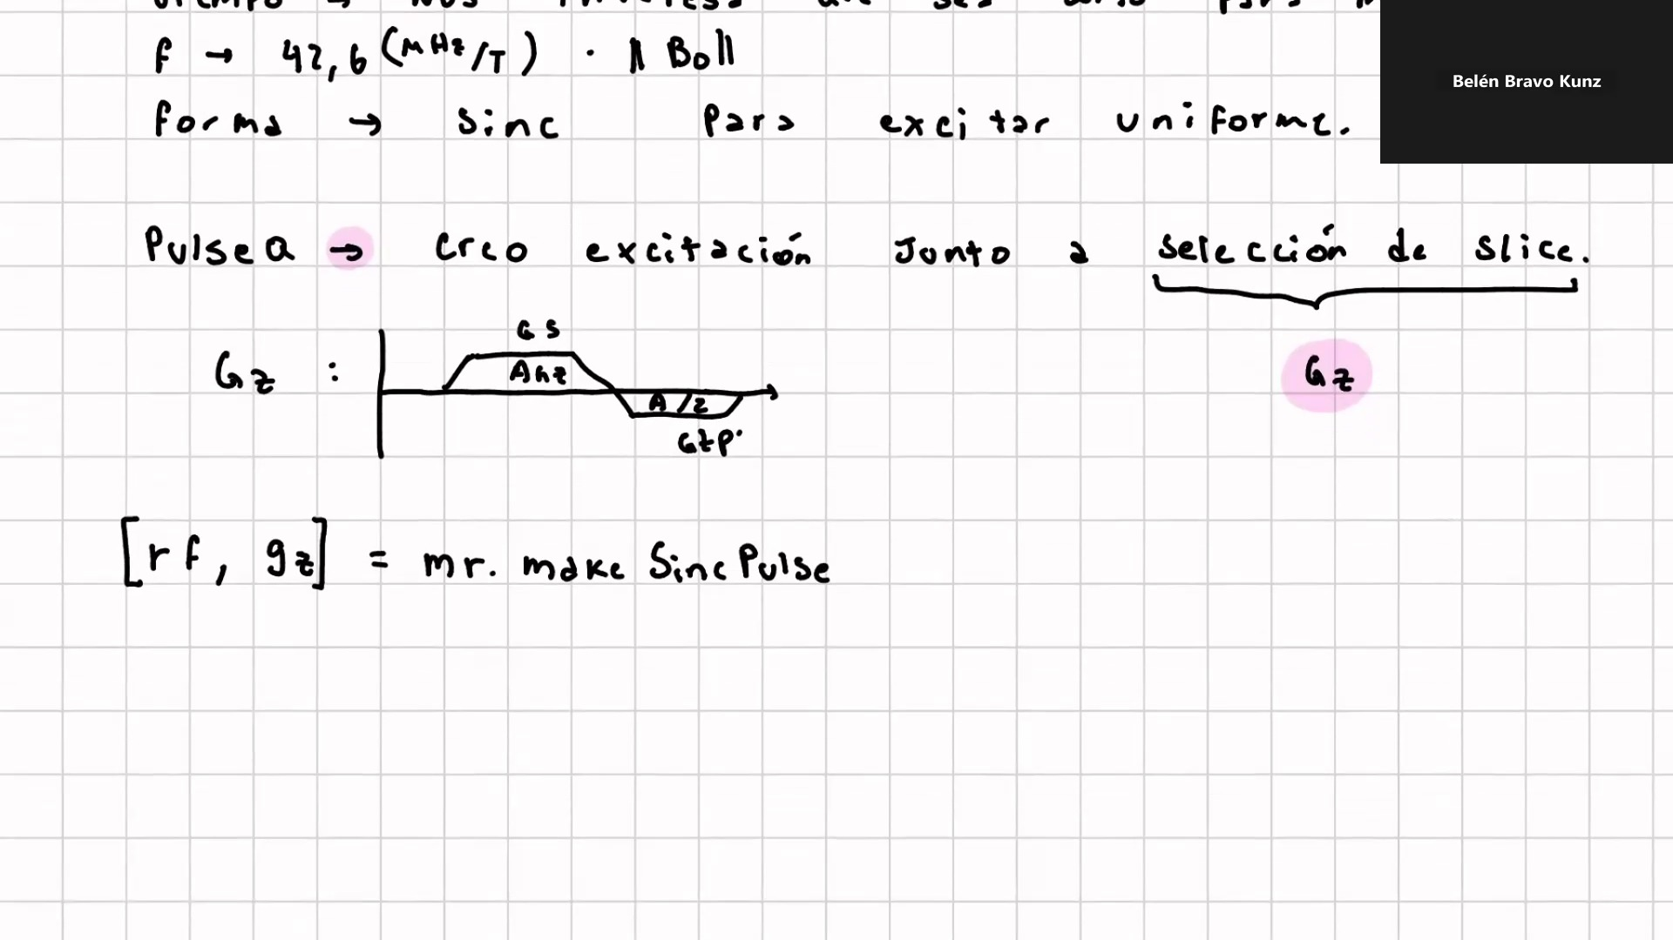
Frame 11 / 100

Slide 13
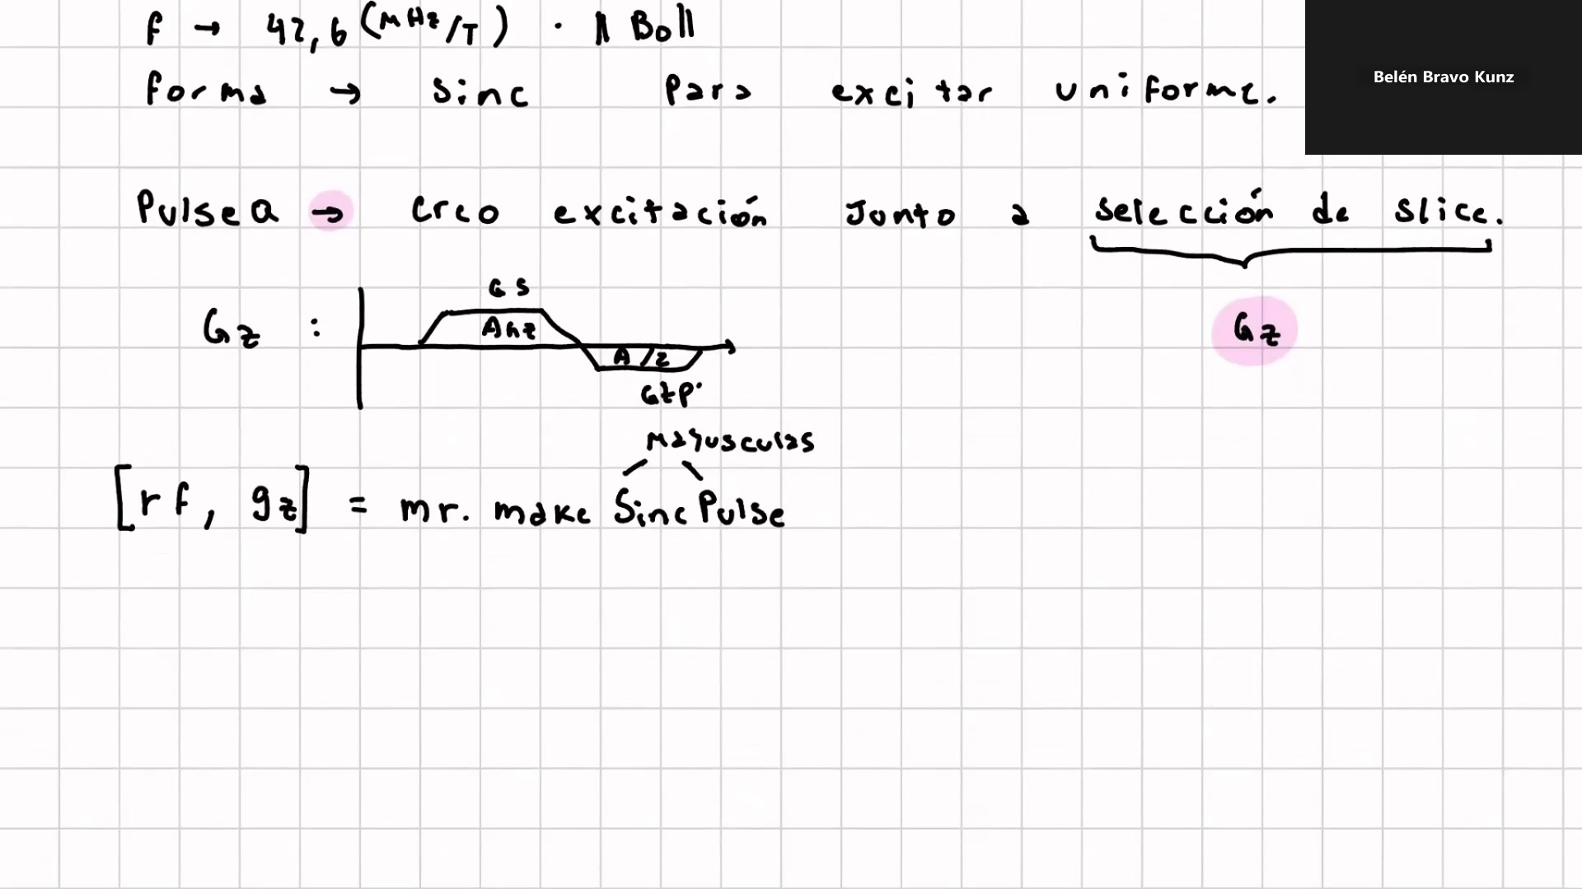
Frame 12 / 100

Slide 14
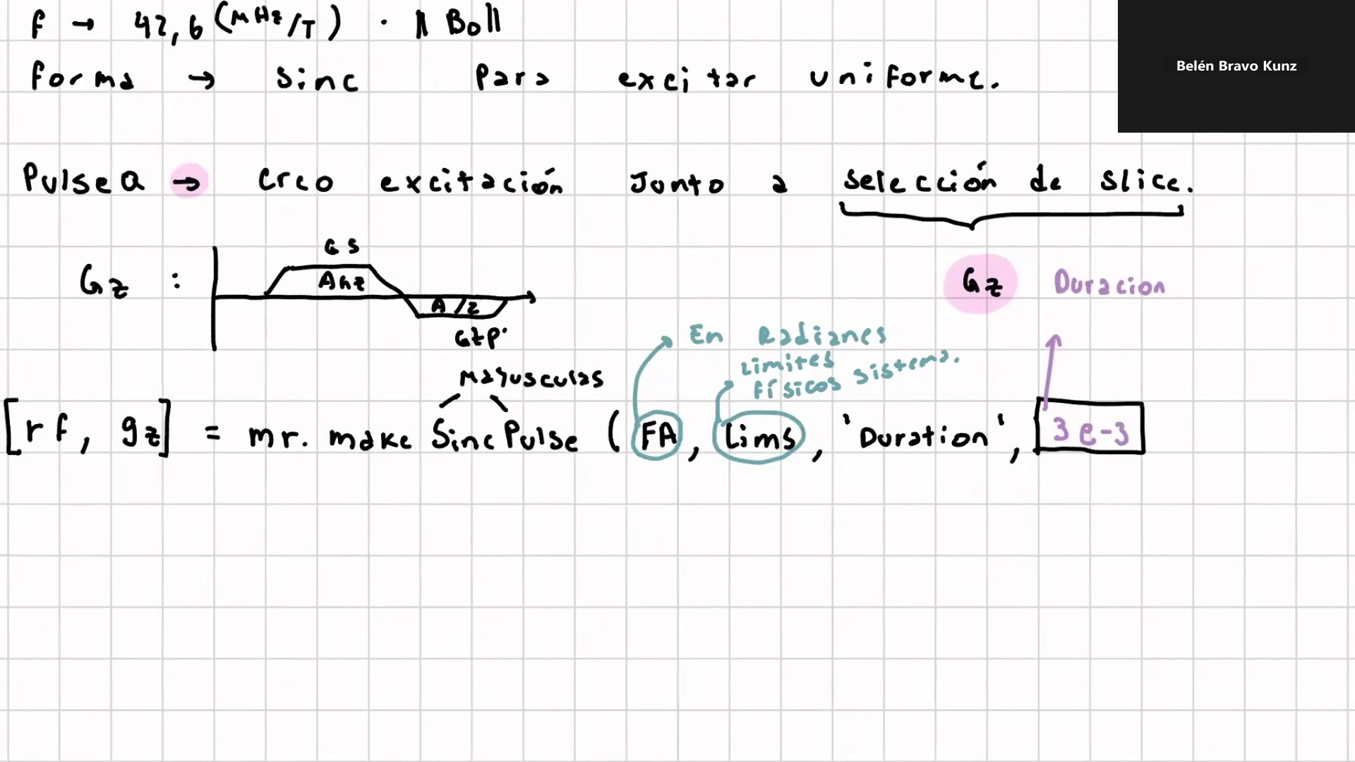
Frame 13 / 100

Slide 15
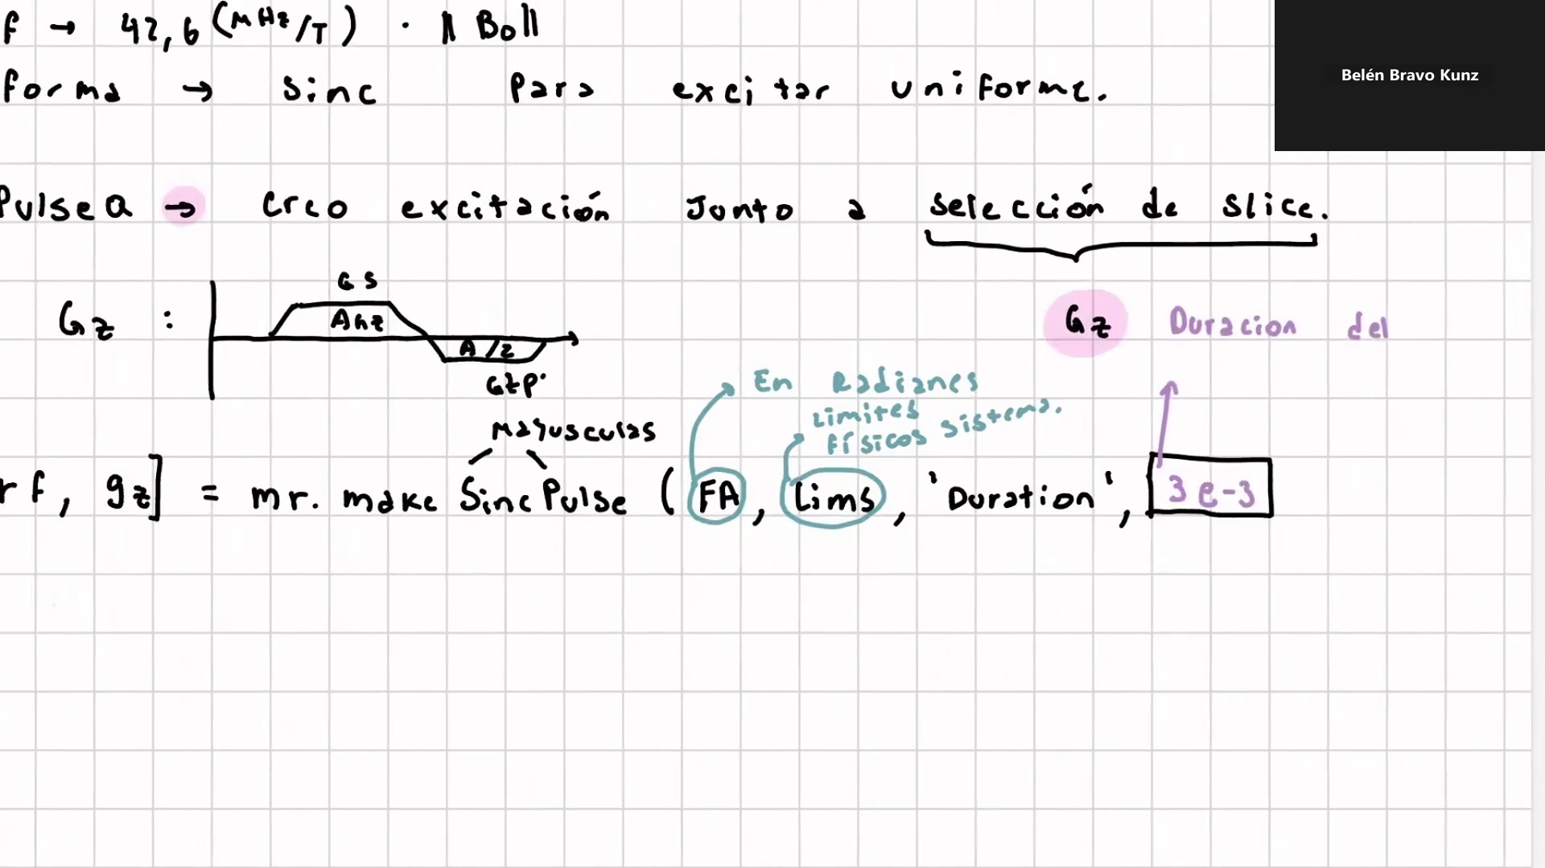
Frame 14 / 100

Slide 16
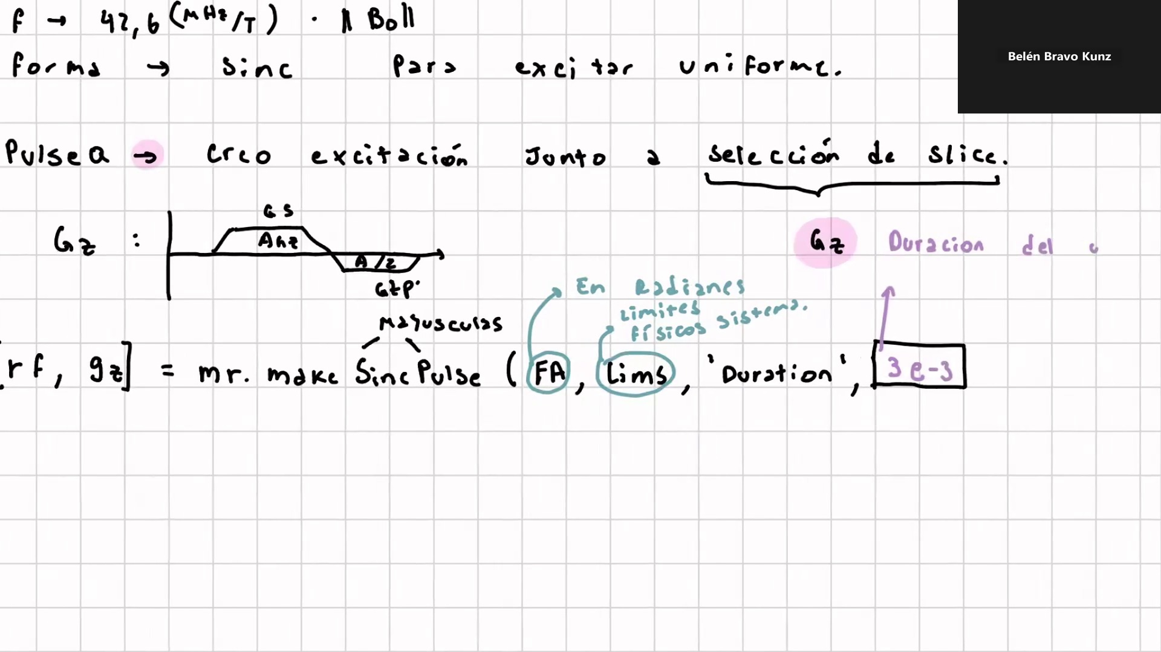
Frame 15 / 100

Slide 17
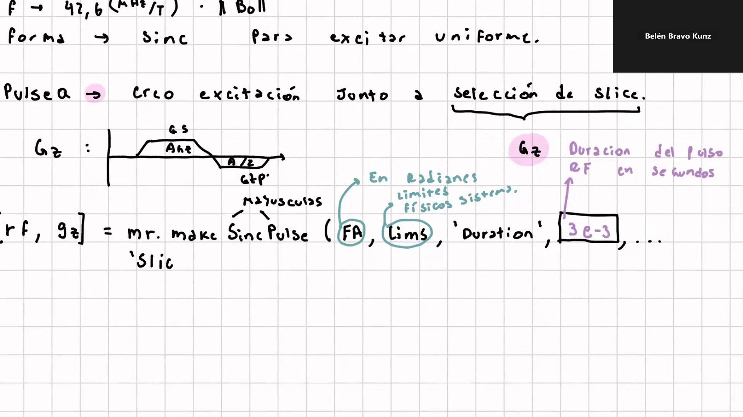
Frame 16 / 100

Slide 18
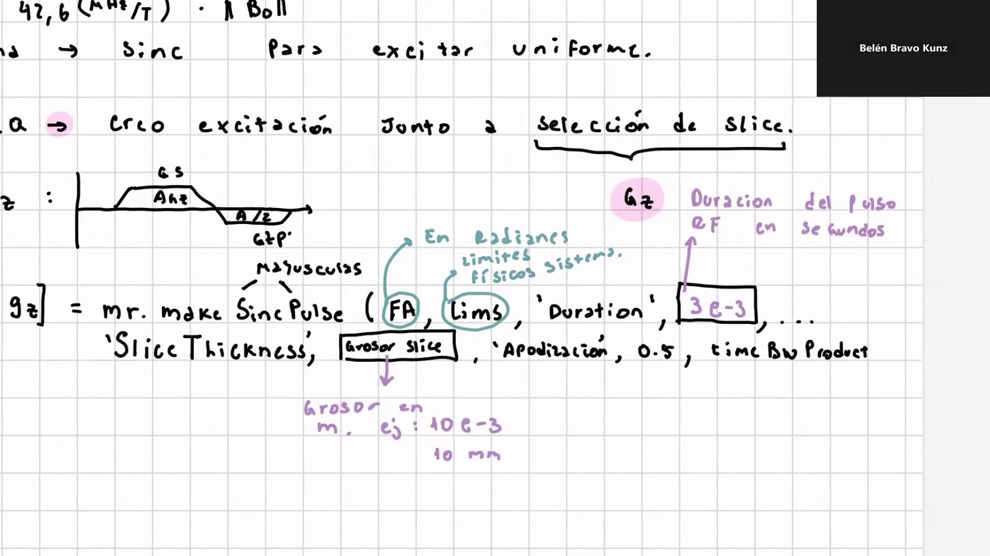
Frame 17 / 100

Slide 19
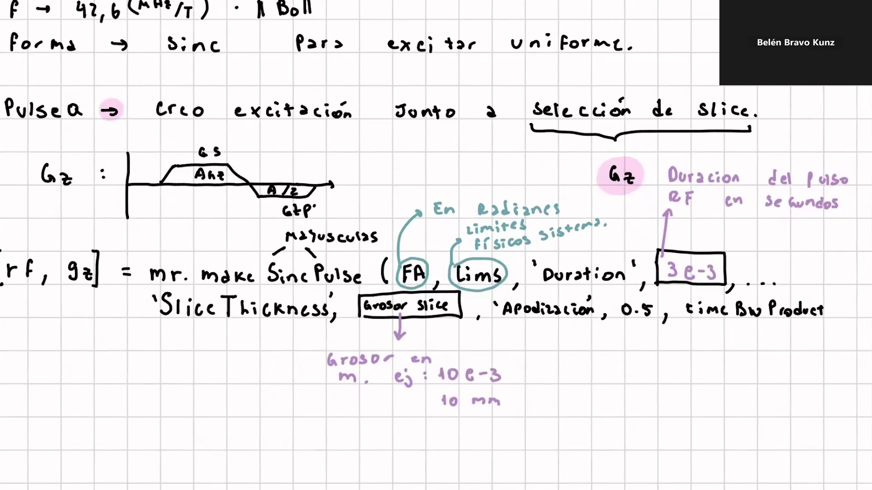
Frame 18 / 100

Slide 20
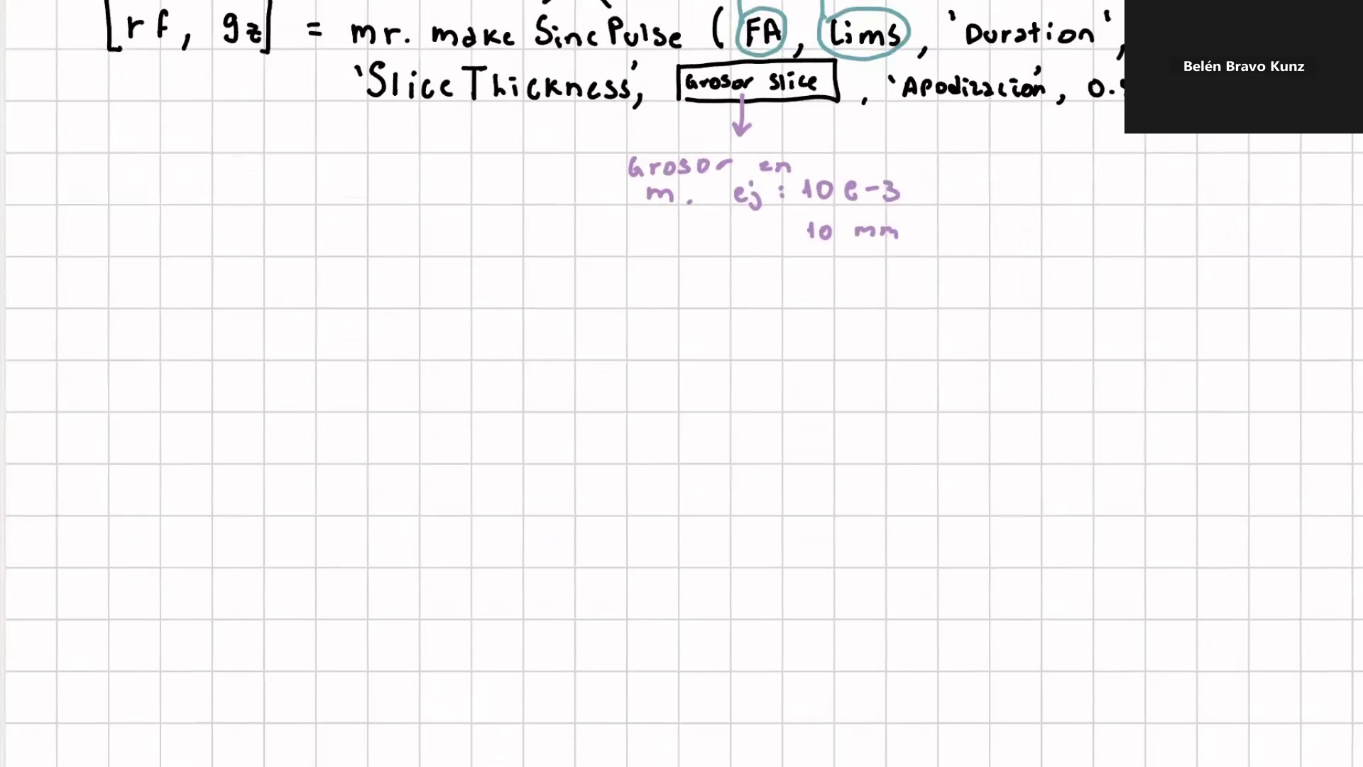
Frame 19 / 100

Slide 21

Frame 20 / 100

Slide 22
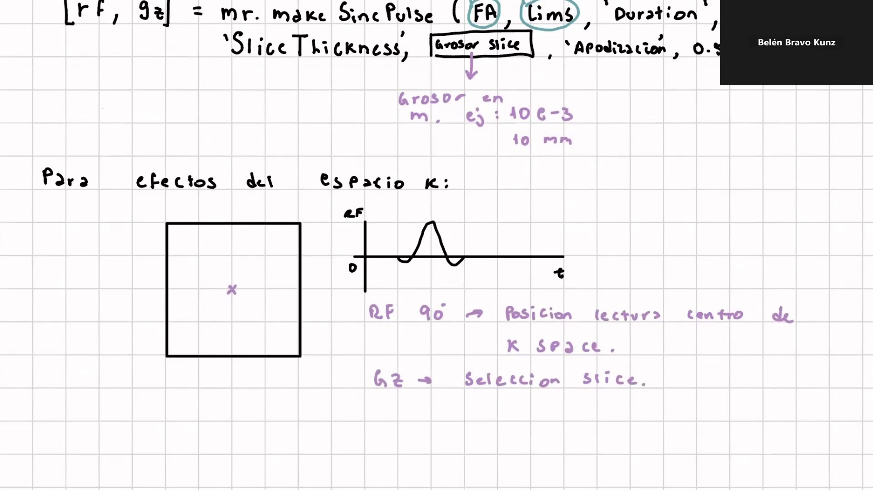
Frame 21 / 100

Slide 23
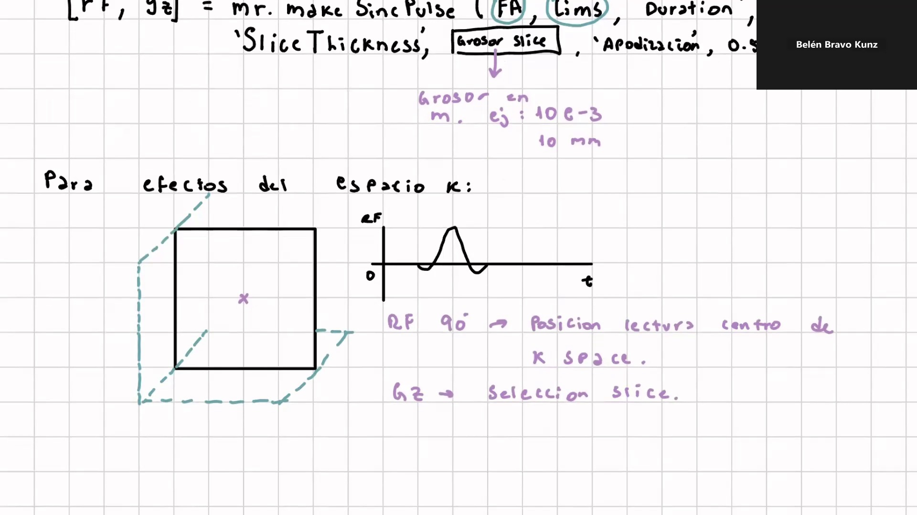
Frame 22 / 100

Slide 24
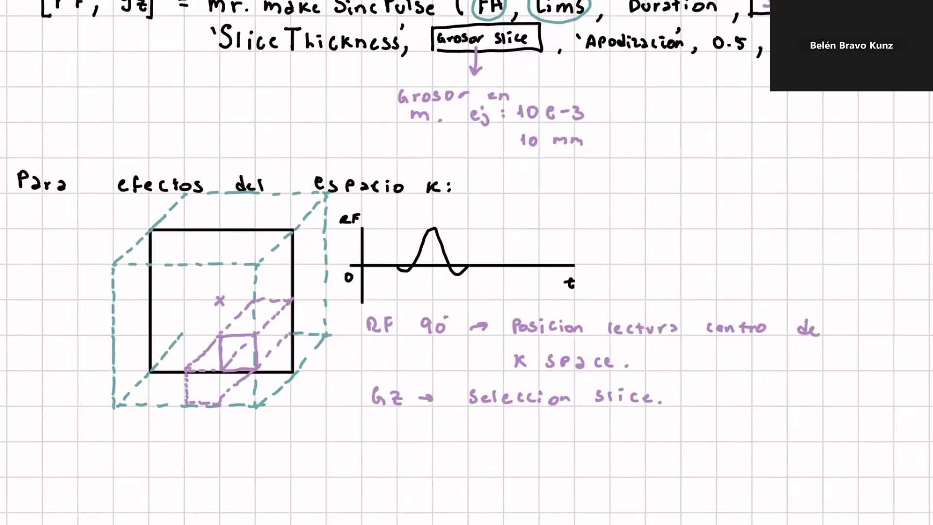
Frame 23 / 100

Slide 25
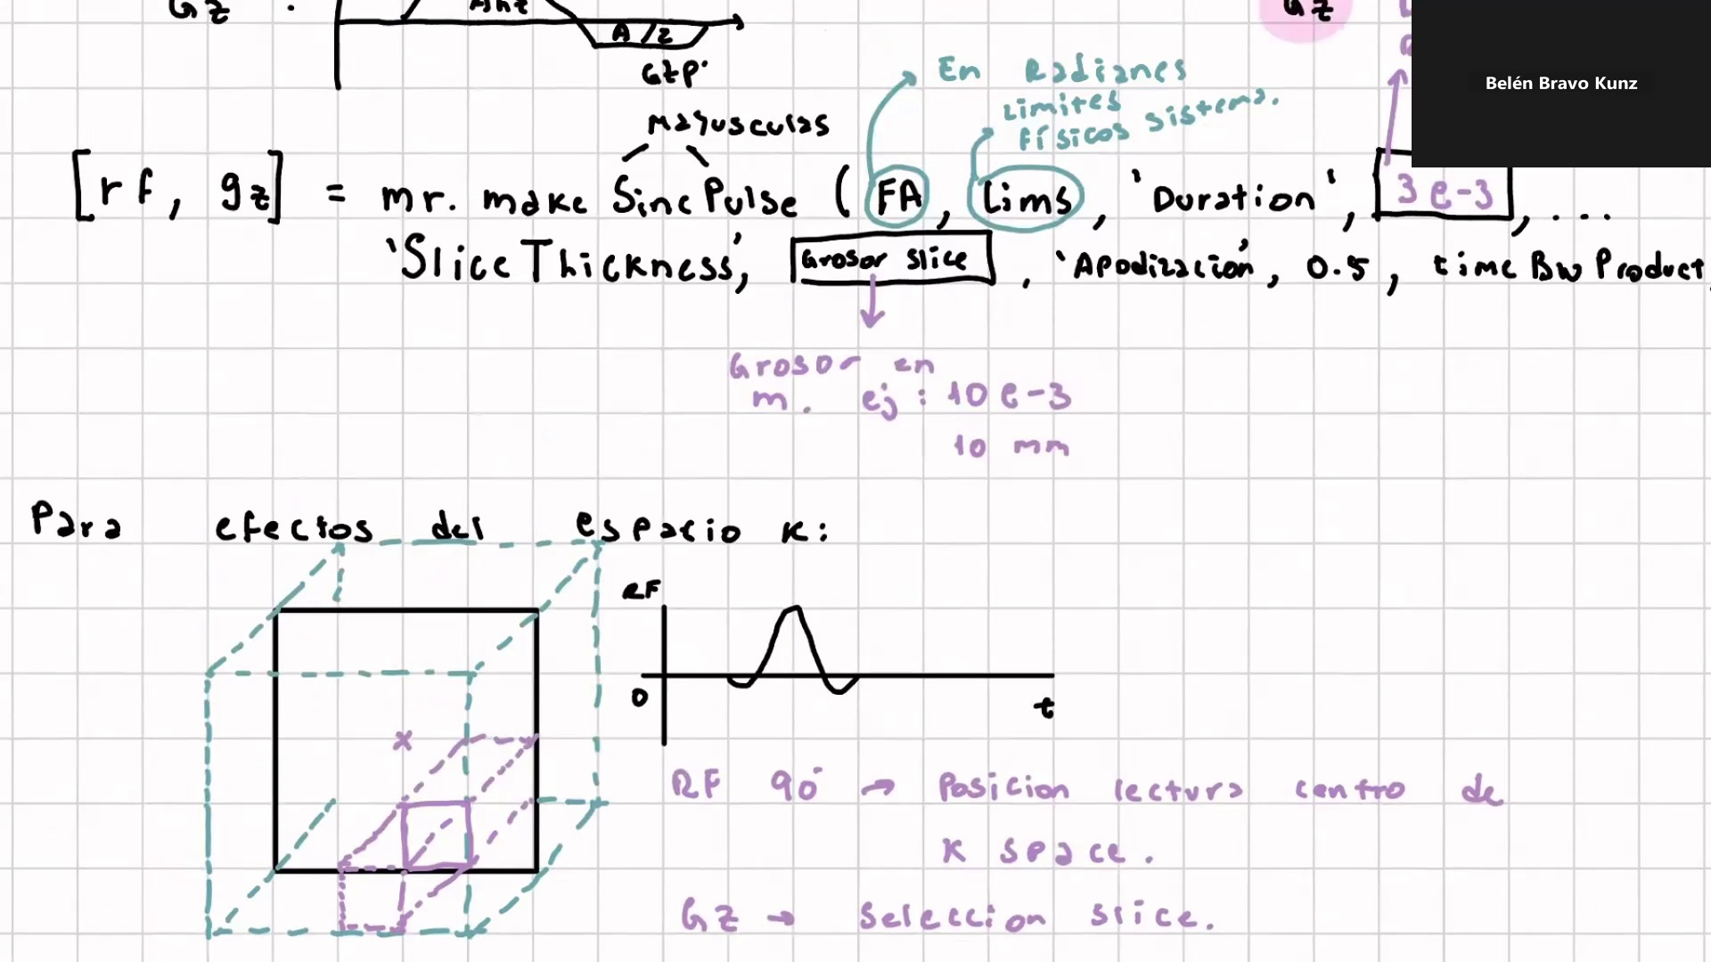
Frame 24 / 100

Slide 26
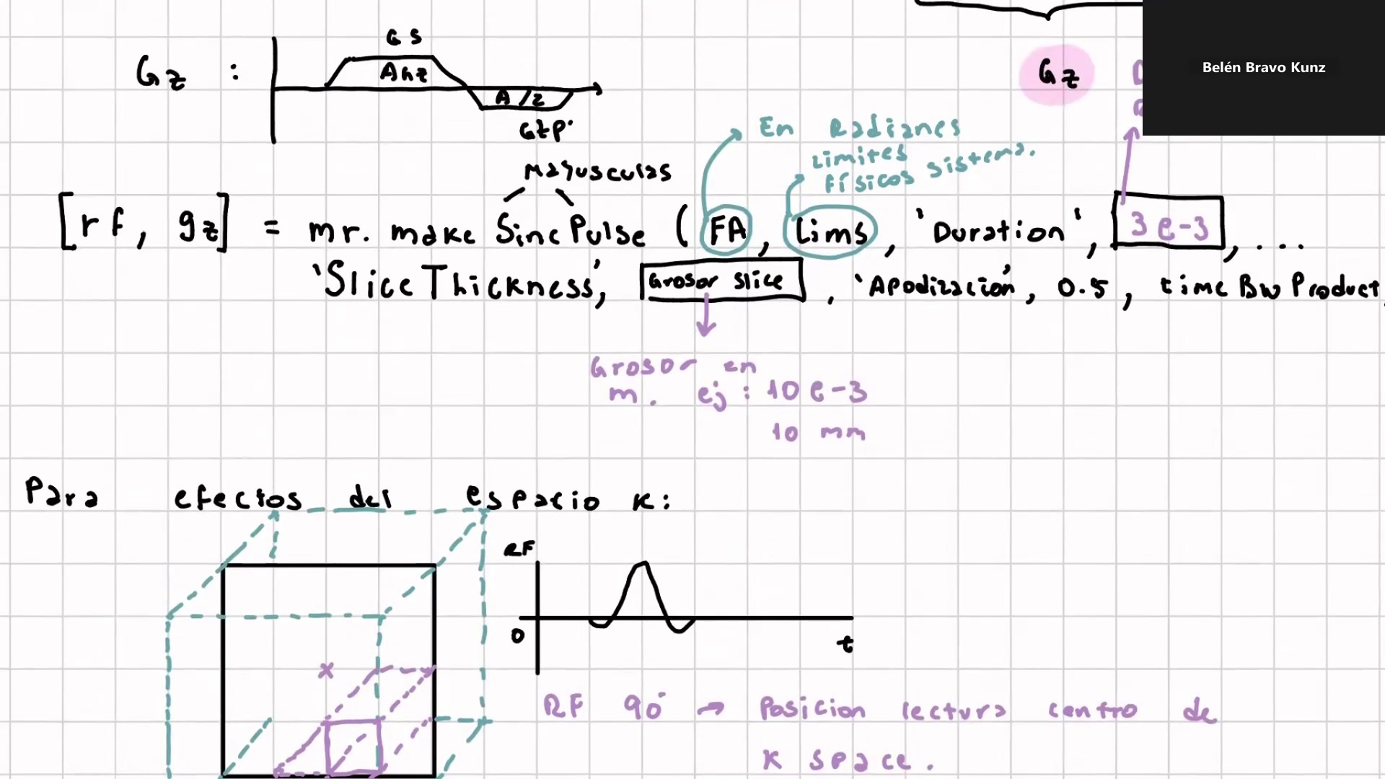
Frame 25 / 100

Slide 27
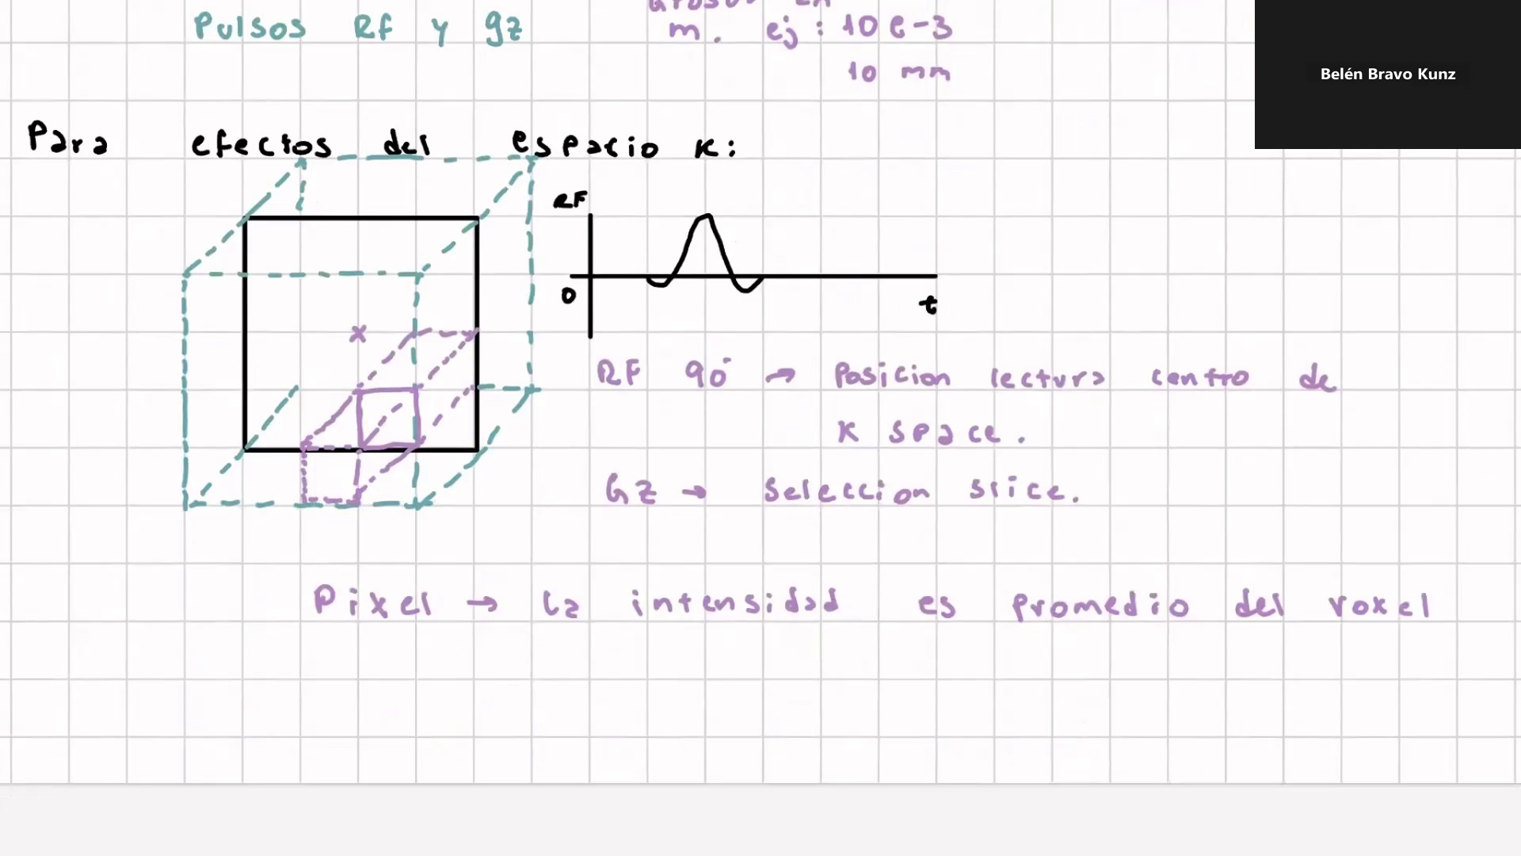
Frame 26 / 100

Slide 28
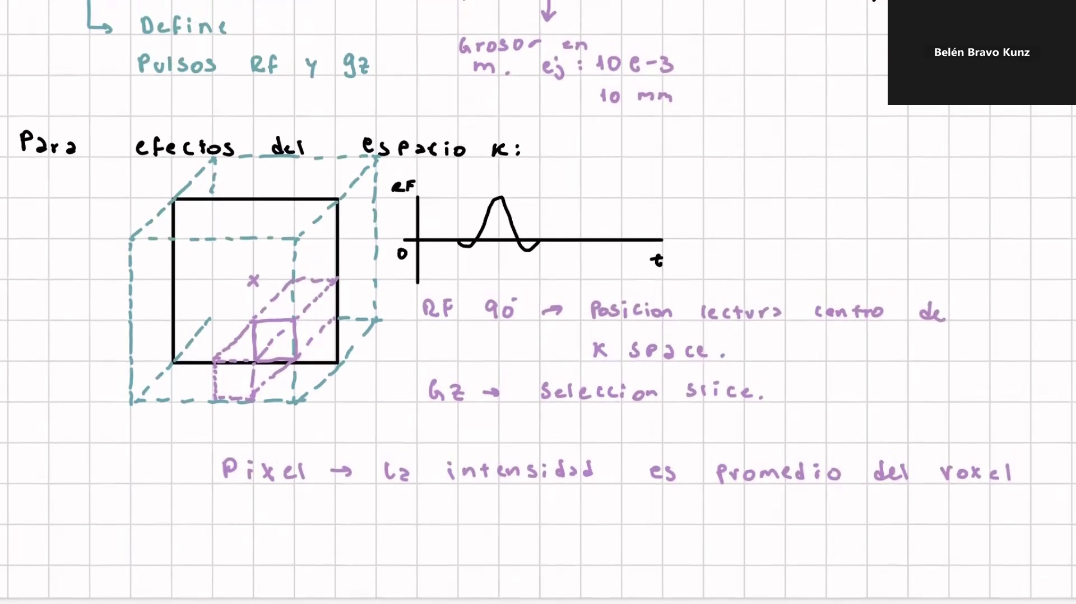
Frame 27 / 100

Slide 29

Frame 28 / 100

Slide 30

Frame 29 / 100

Slide 31
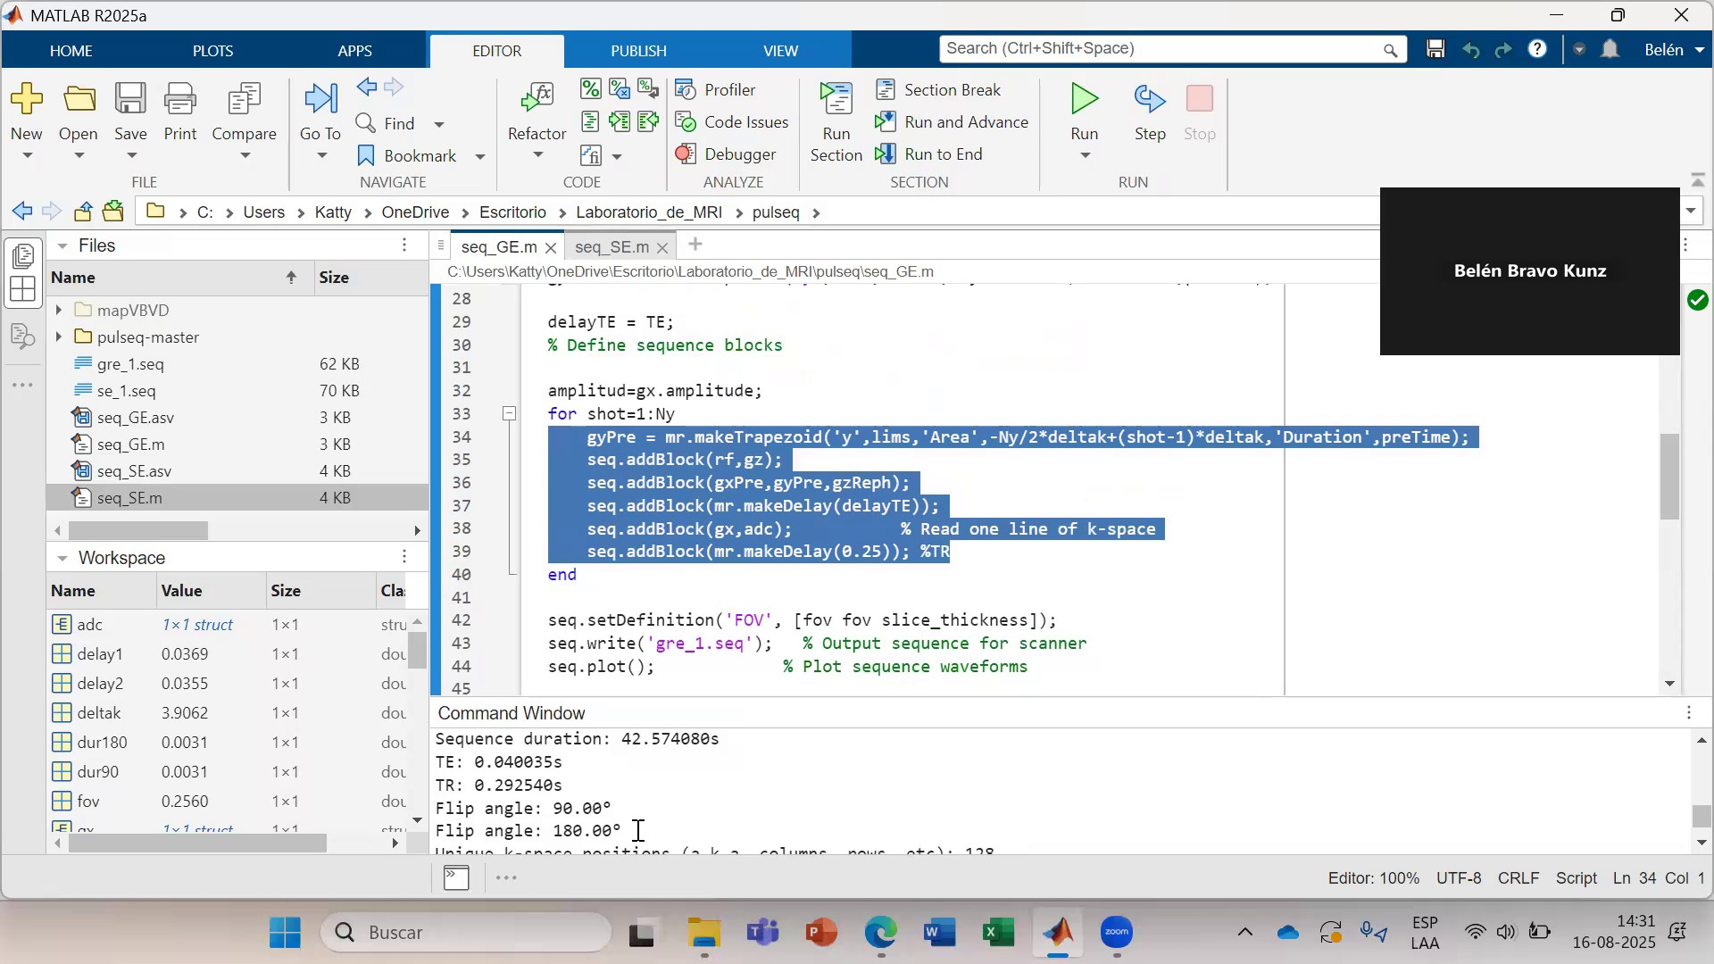
Frame 30 / 100

Slide 32
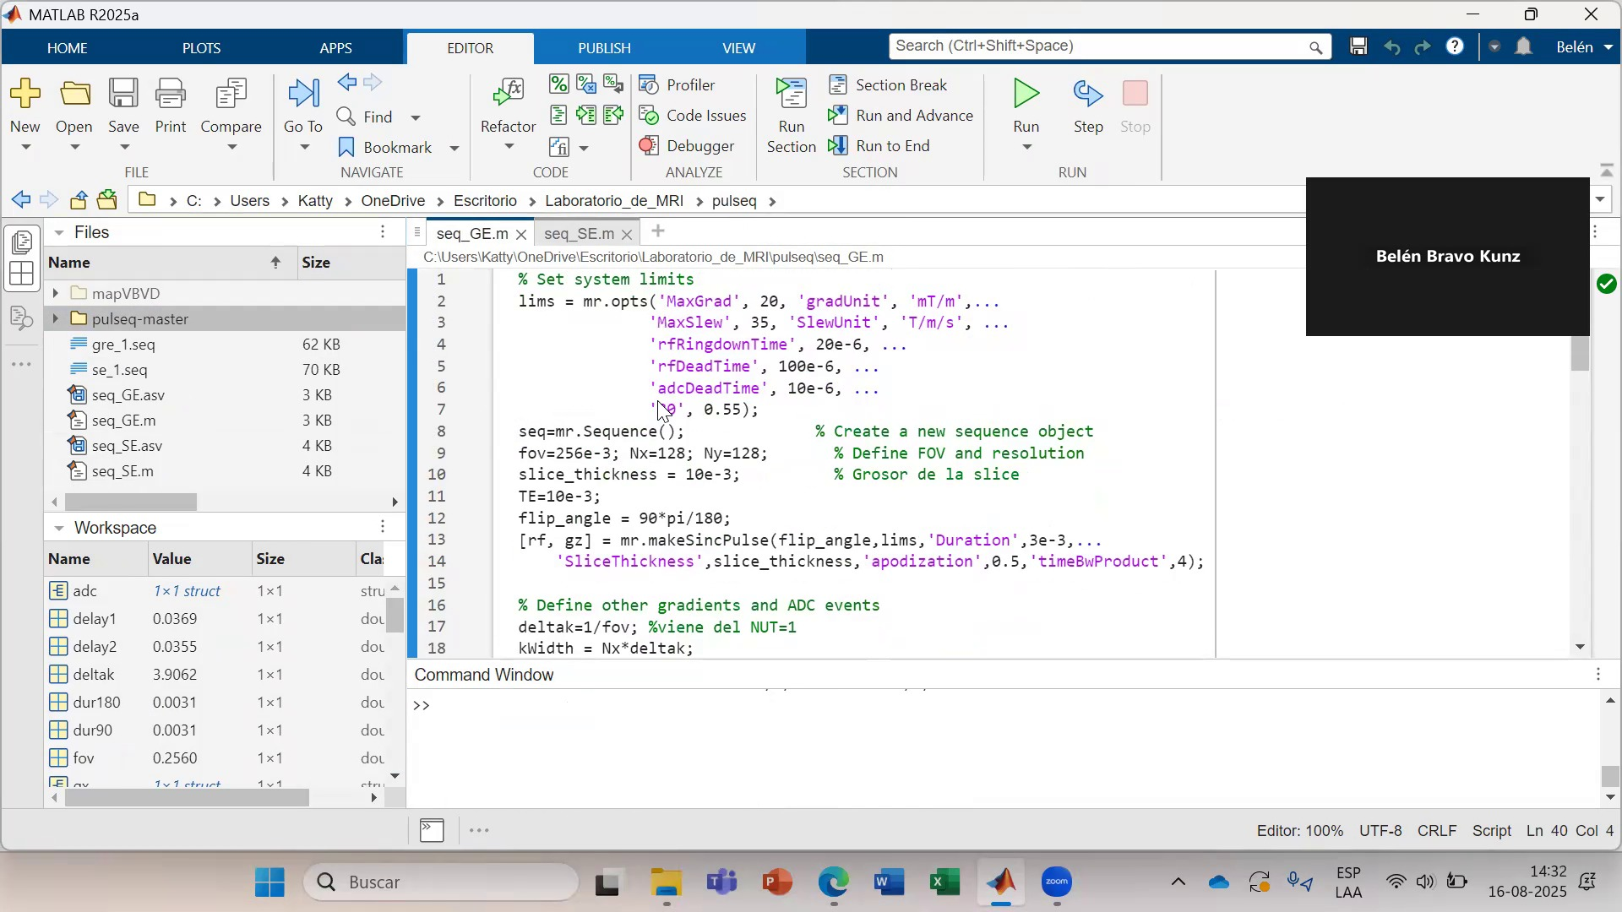
Frame 31 / 100

Slide 33
Frame 32 / 100

Slide 34
Frame 33 / 100

Slide 35
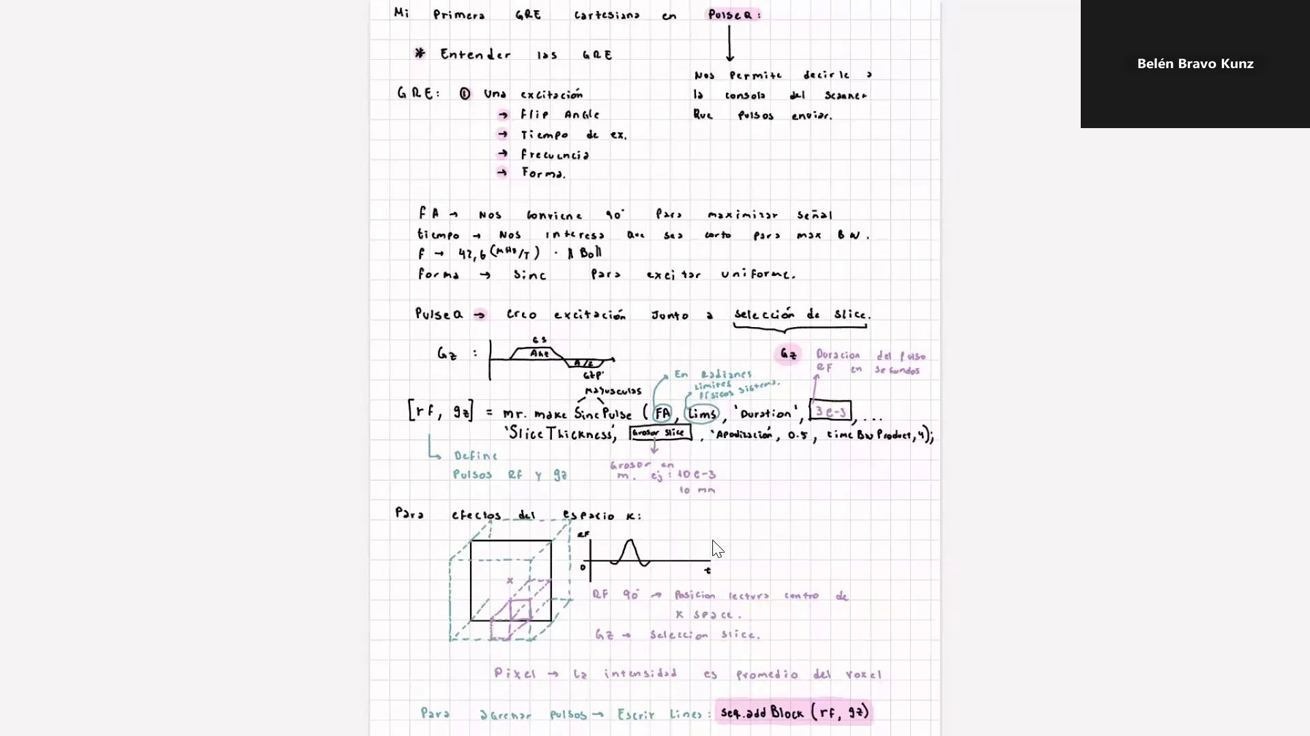
Frame 34 / 100

Slide 36
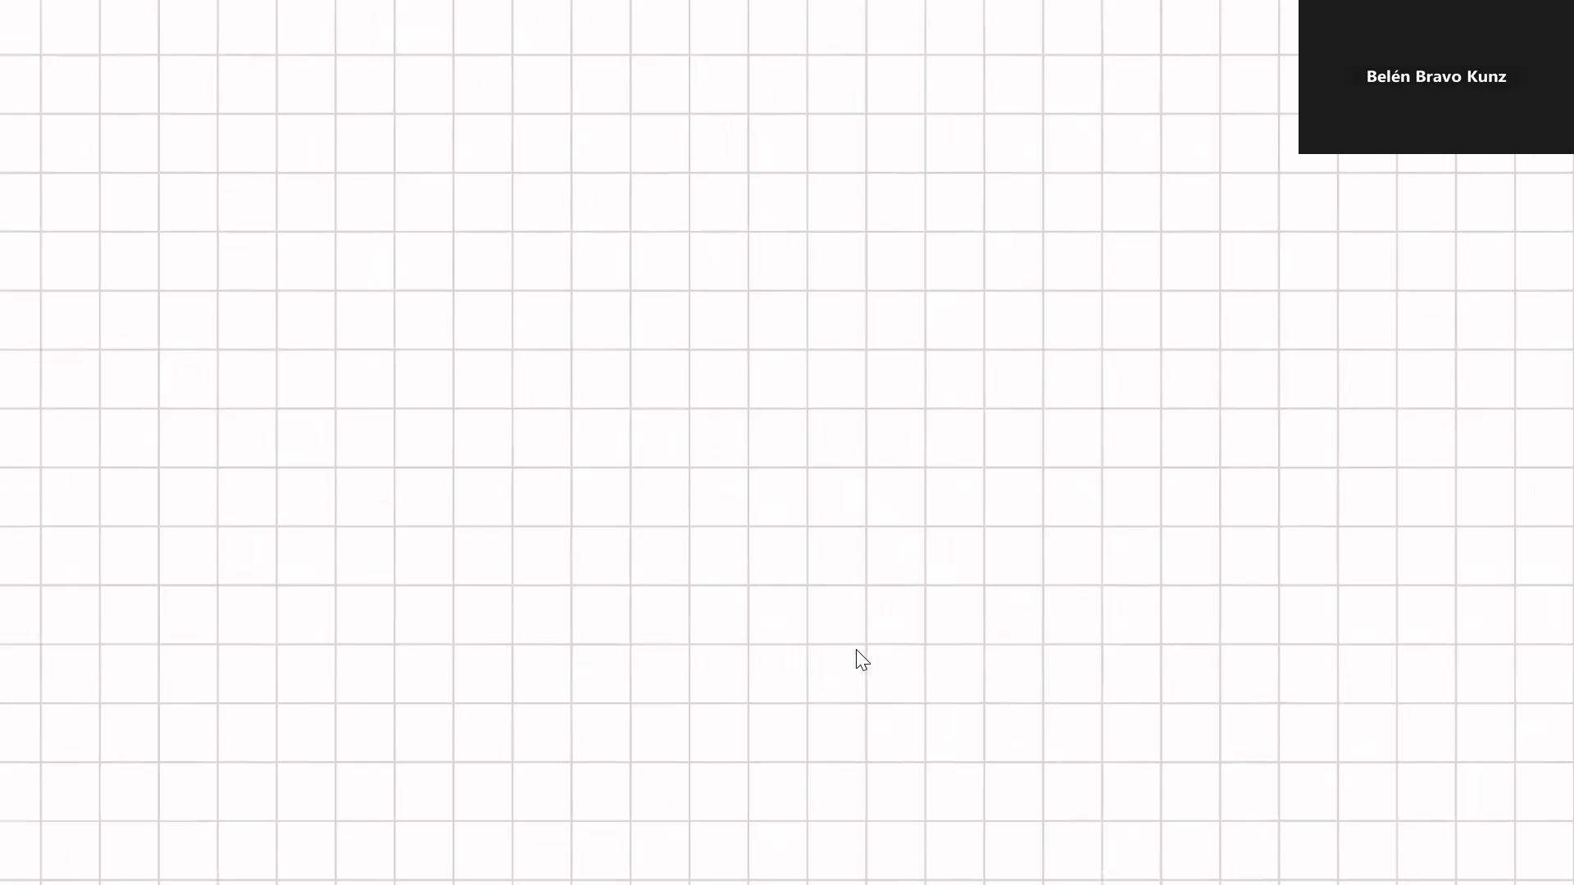
Frame 35 / 100

Slide 37
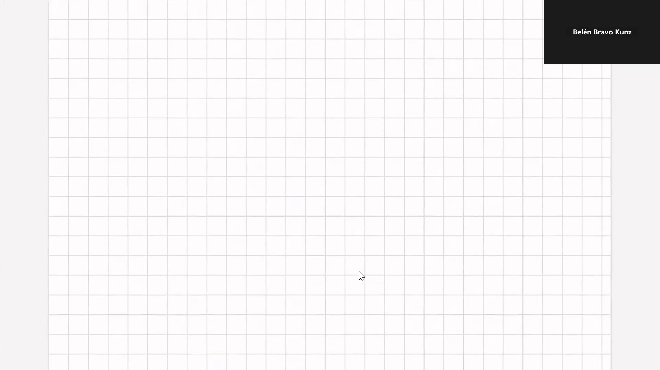
Frame 36 / 100

Slide 38
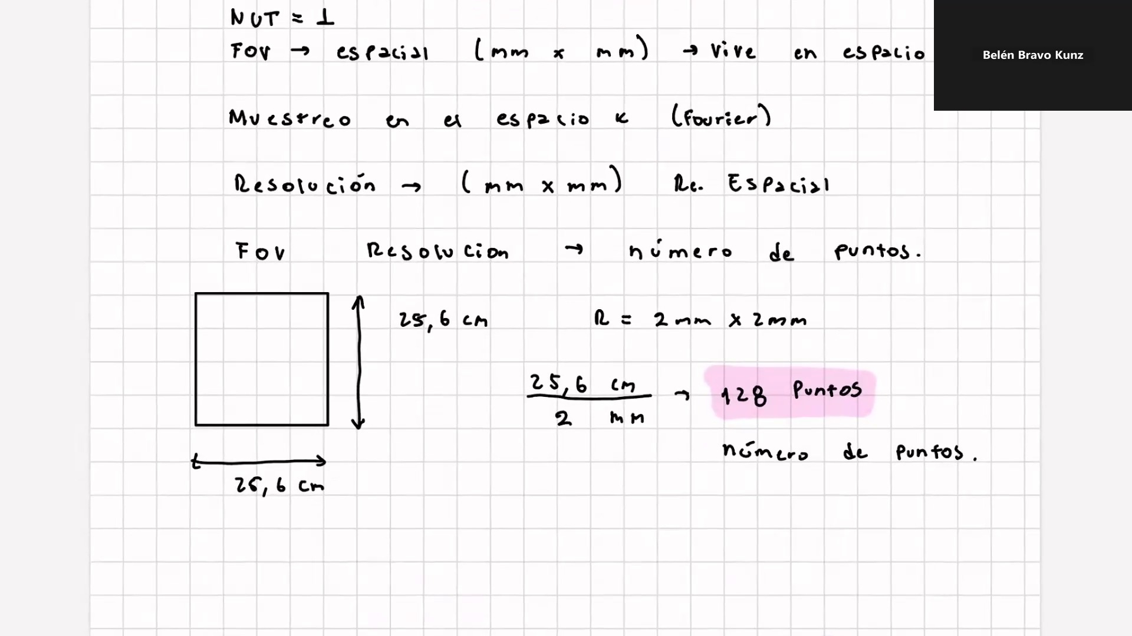
Frame 37 / 100

Slide 39
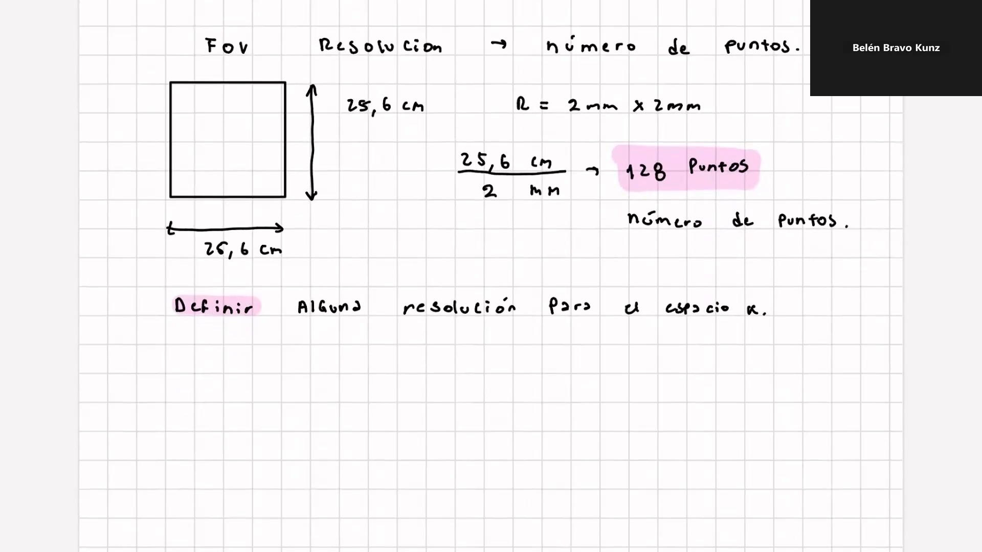
Frame 38 / 100

Slide 40
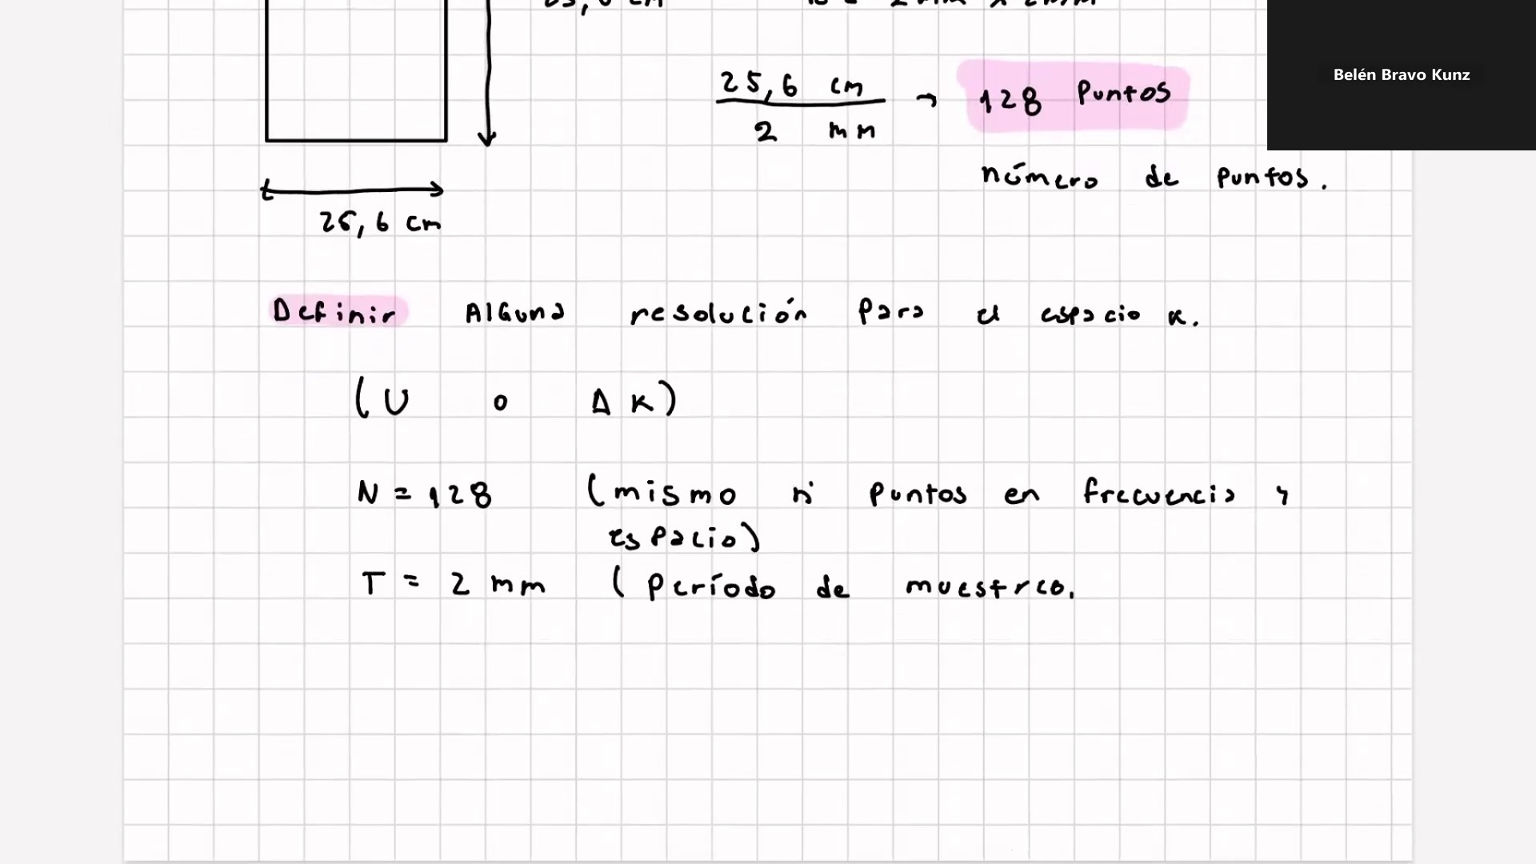
Frame 39 / 100

Slide 41
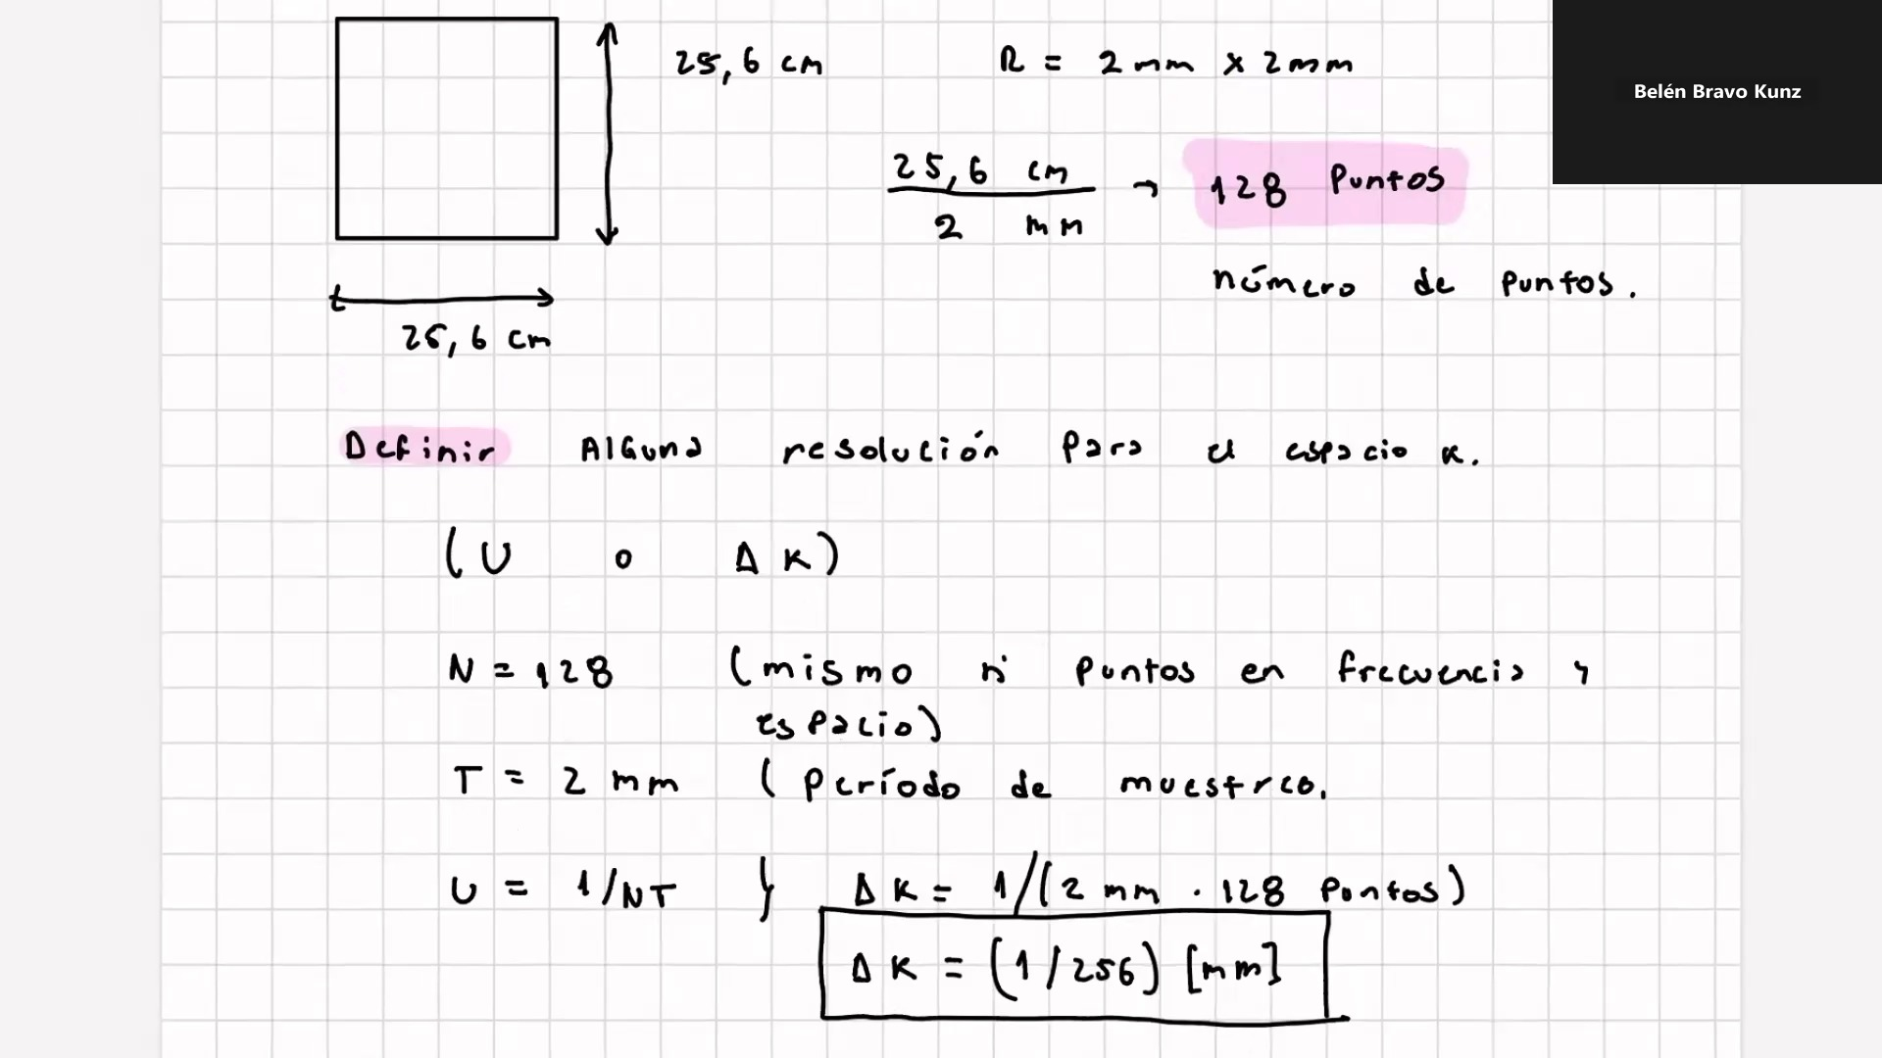
Frame 40 / 100

Slide 42
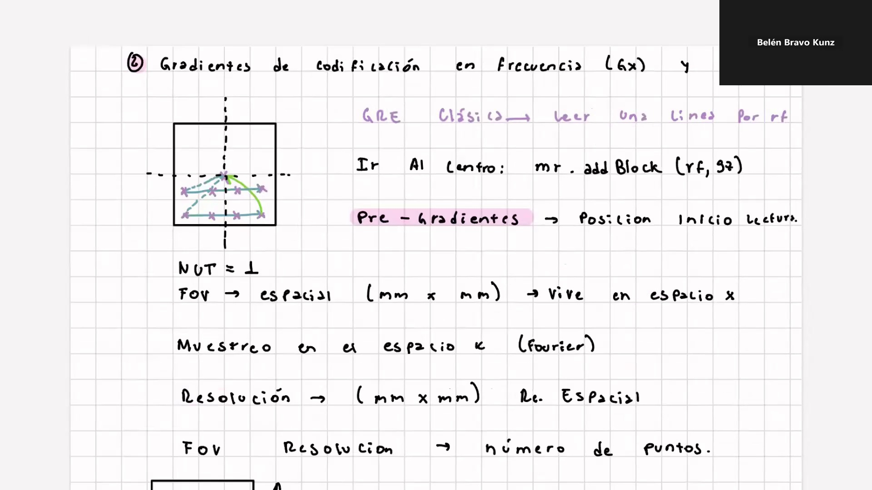
Frame 41 / 100

Slide 43
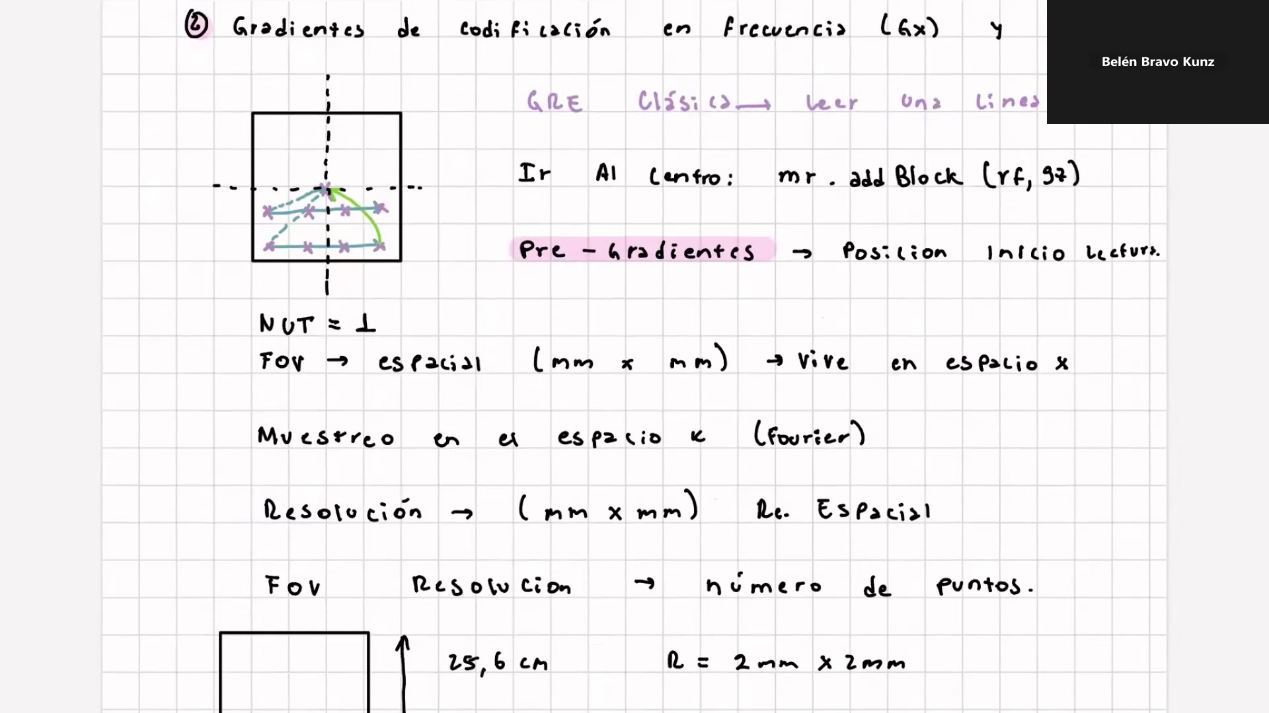
Frame 42 / 100

Slide 44
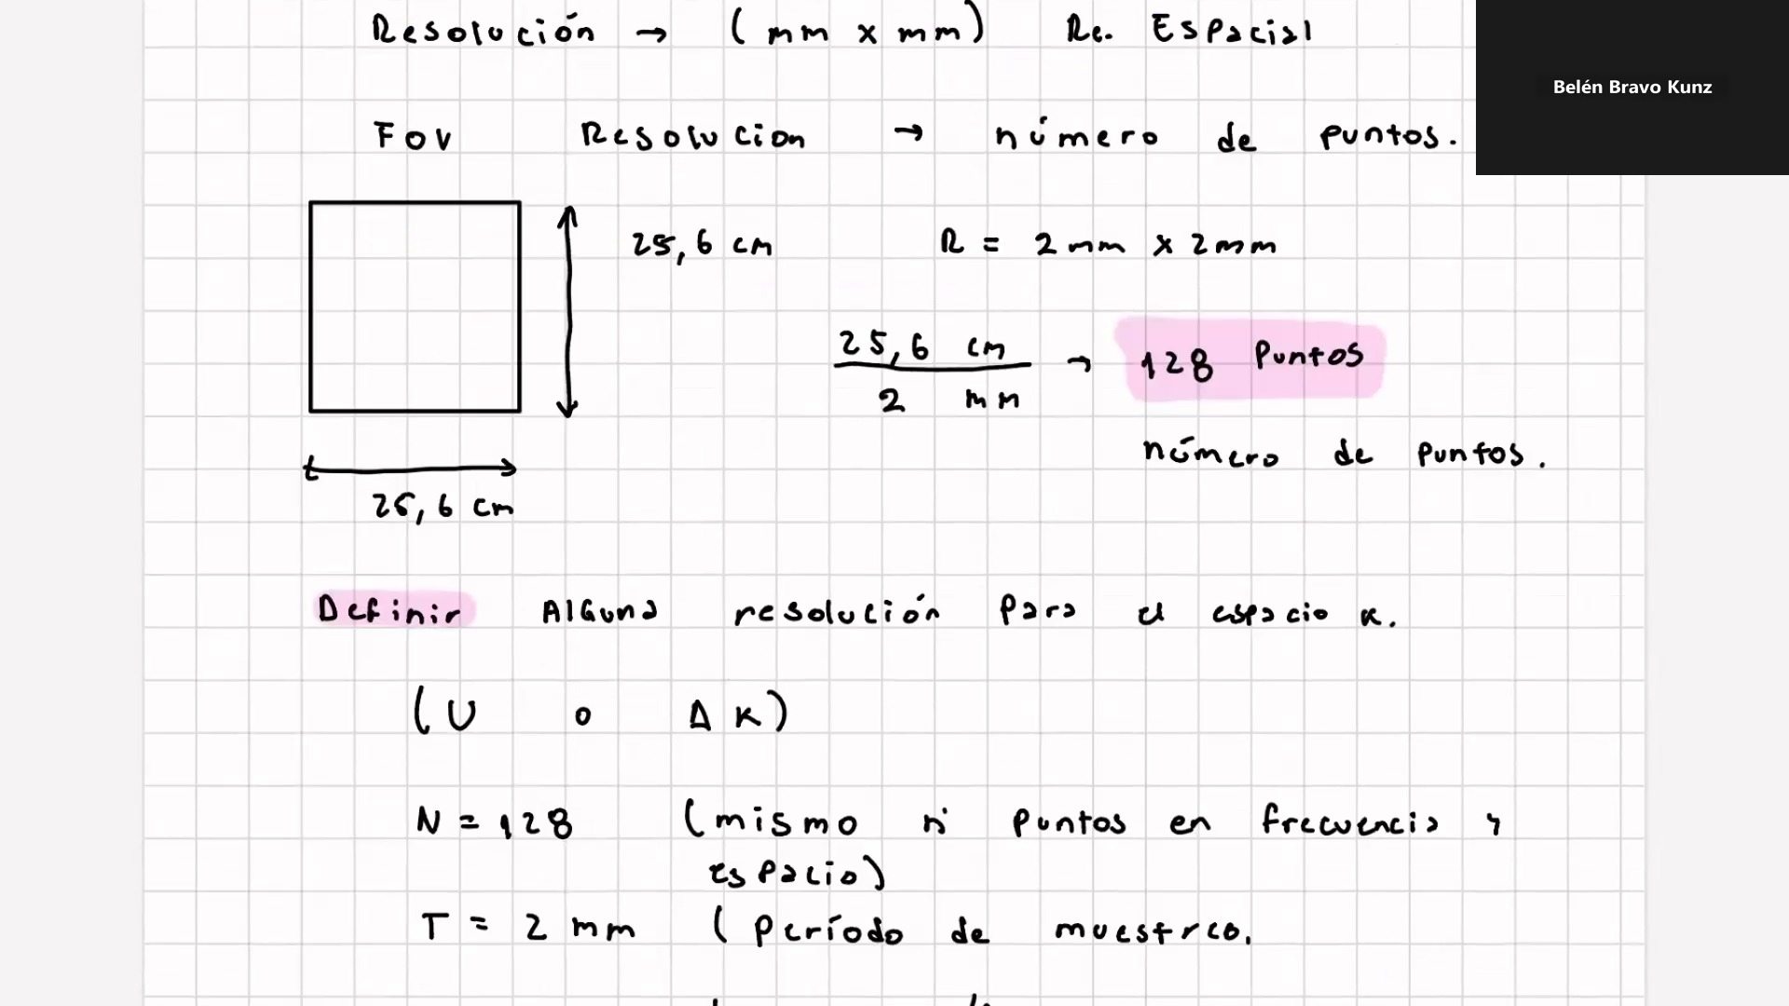
Frame 43 / 100

Slide 45
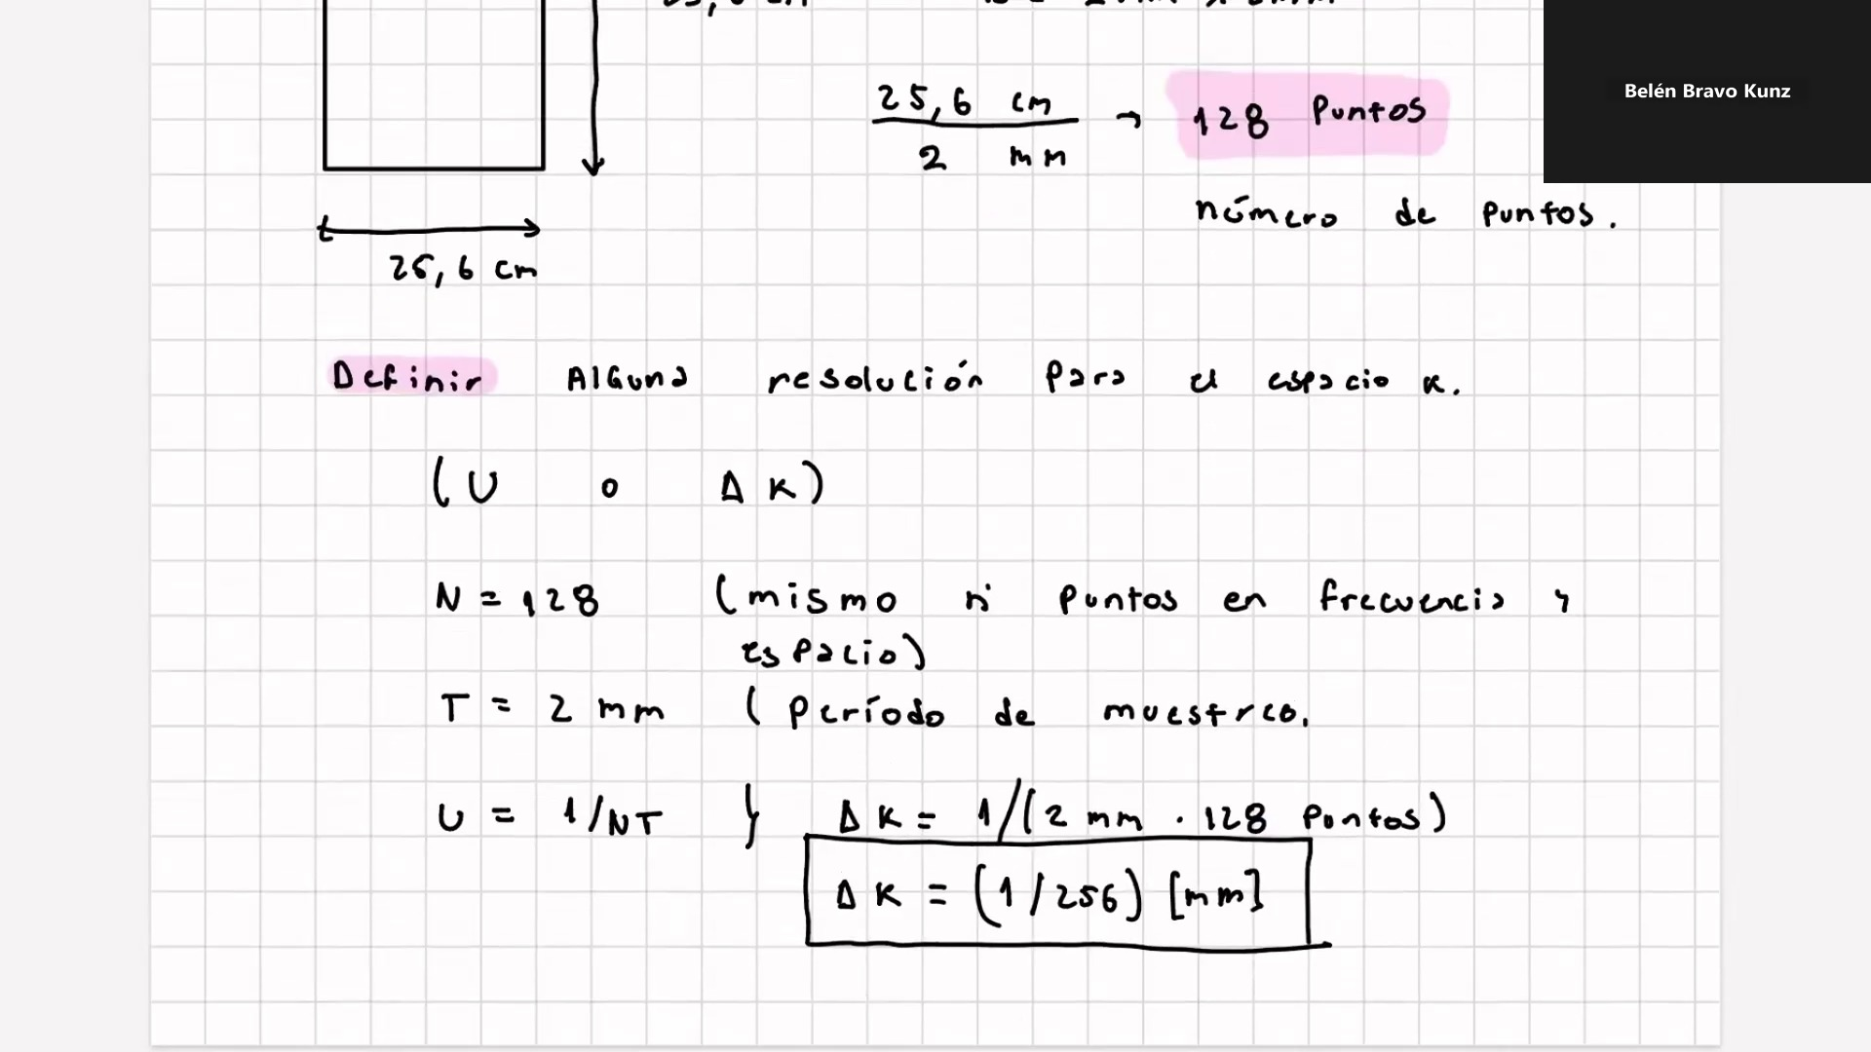
Frame 44 / 100

Slide 46
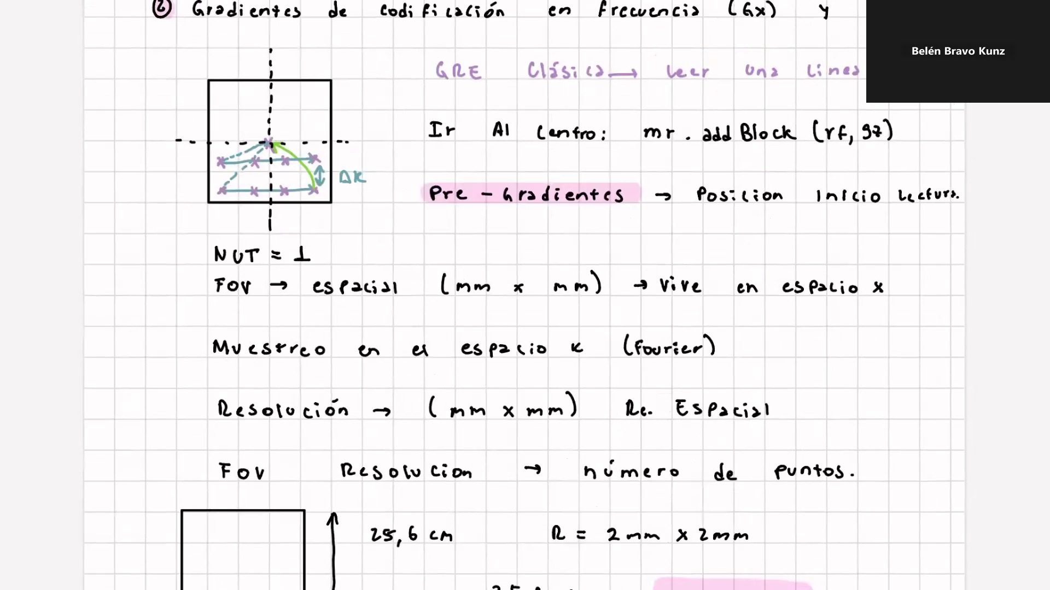
Frame 45 / 100

Slide 47
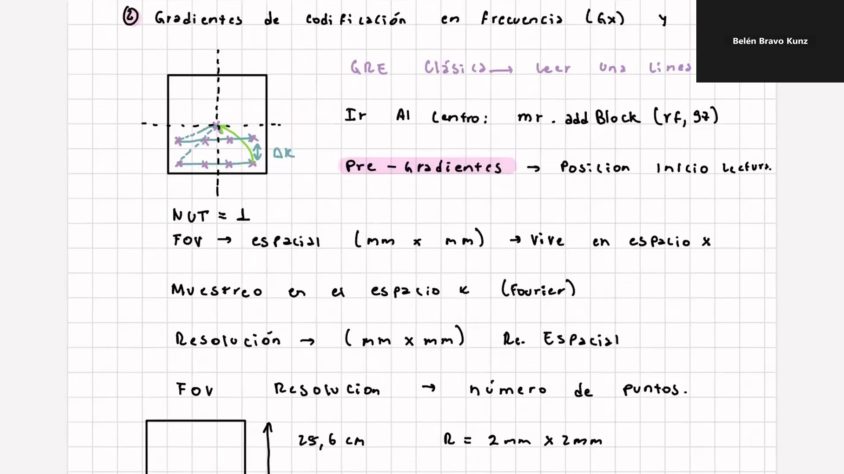
Frame 46 / 100

Slide 48
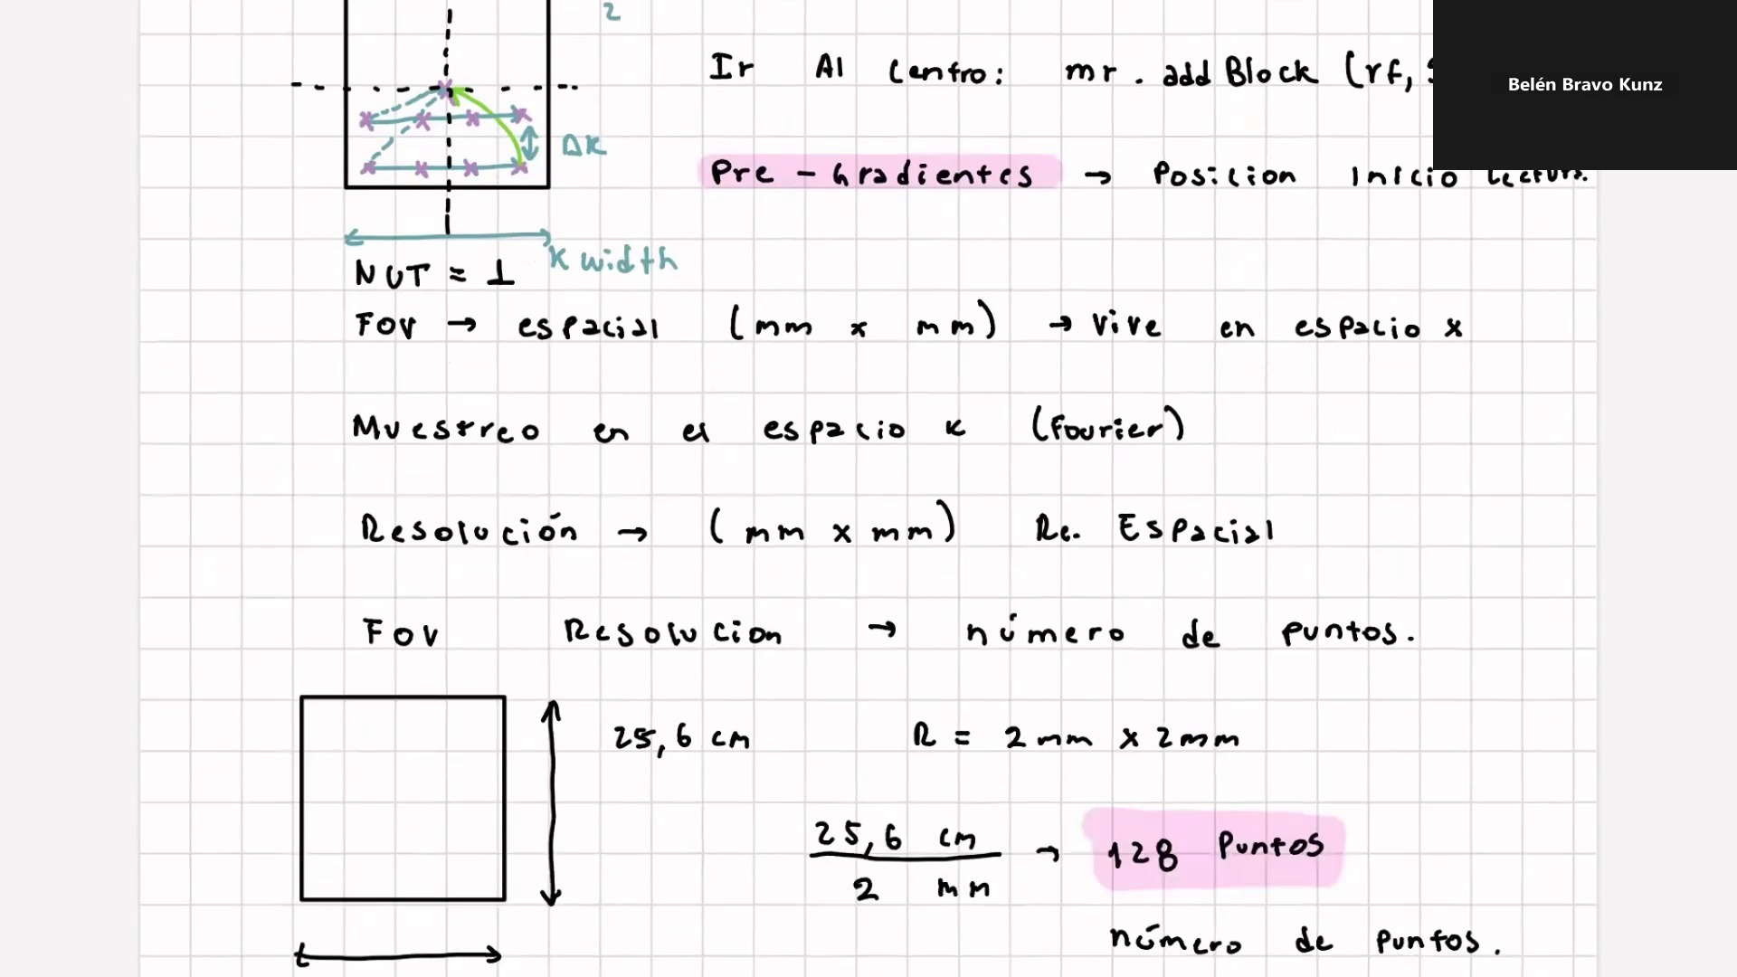
Frame 47 / 100

Slide 49
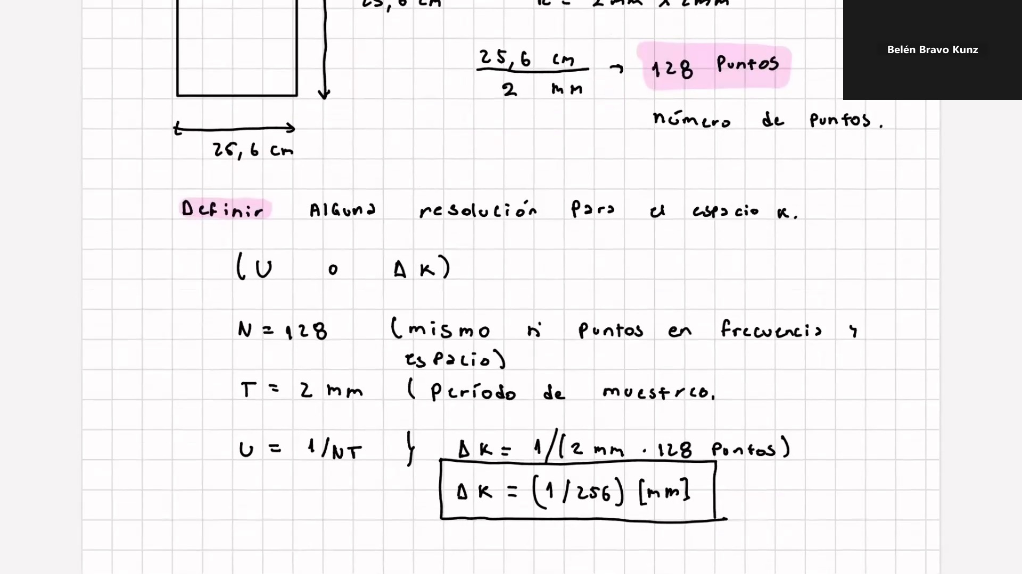
Frame 48 / 100

Slide 50
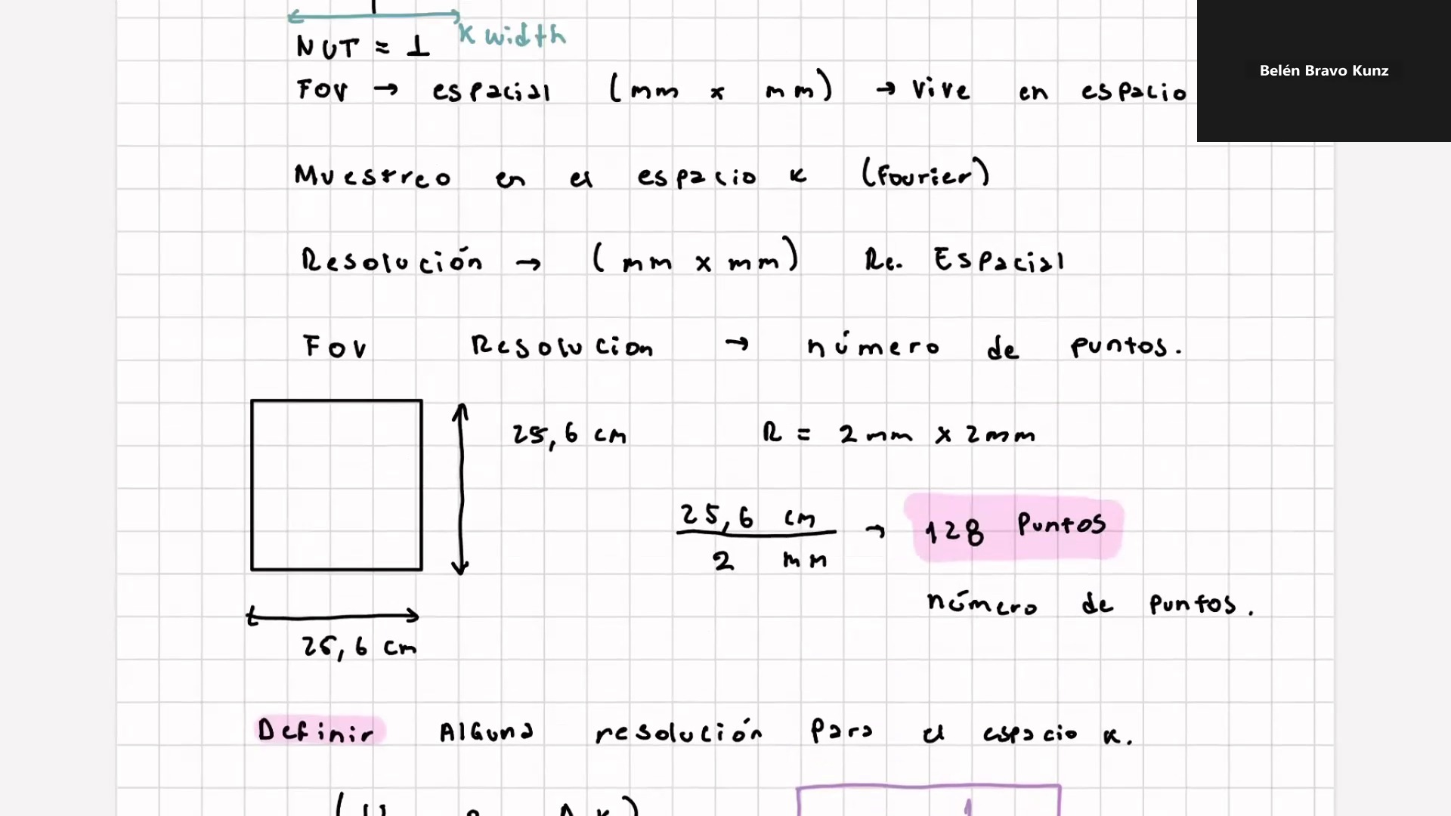
Frame 49 / 100

Slide 51
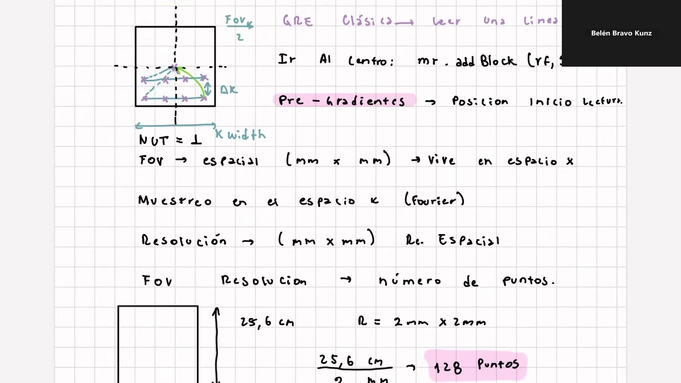
Frame 50 / 100

Slide 52
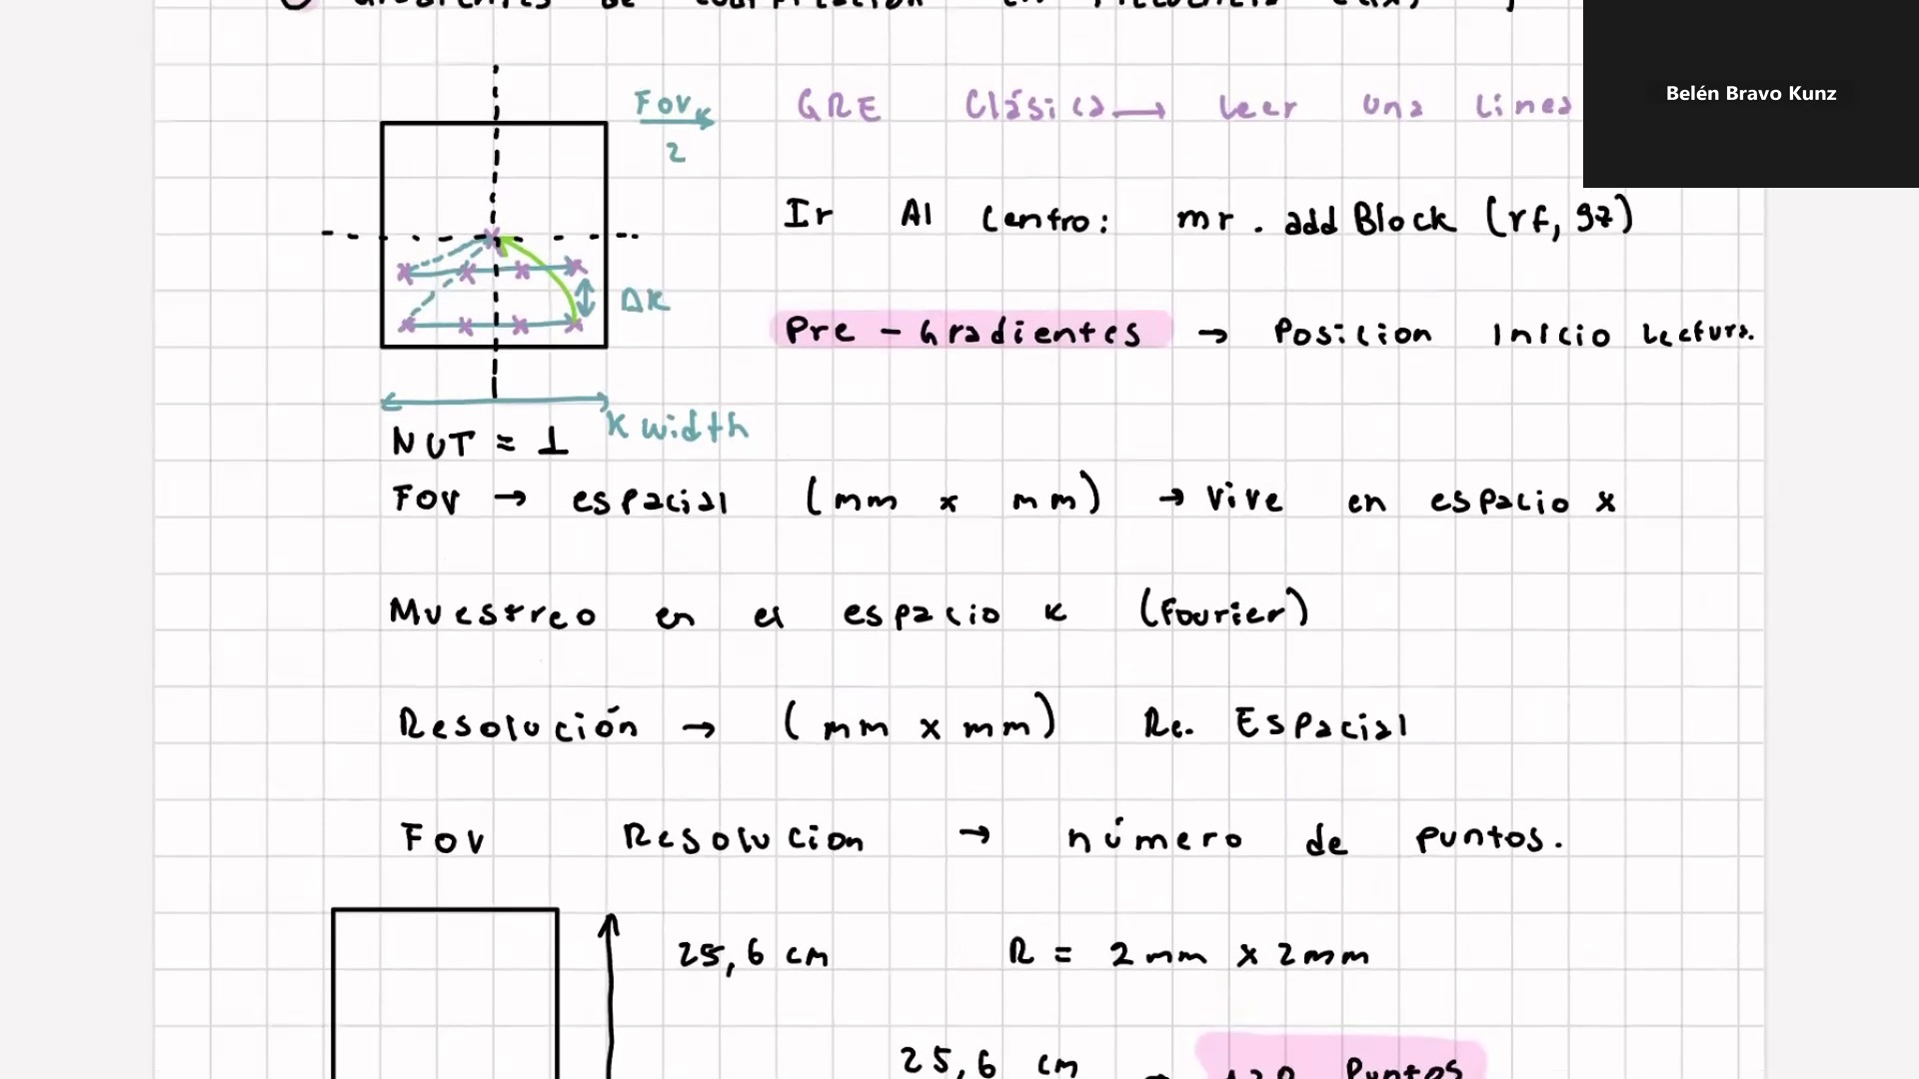
Frame 51 / 100

Slide 53
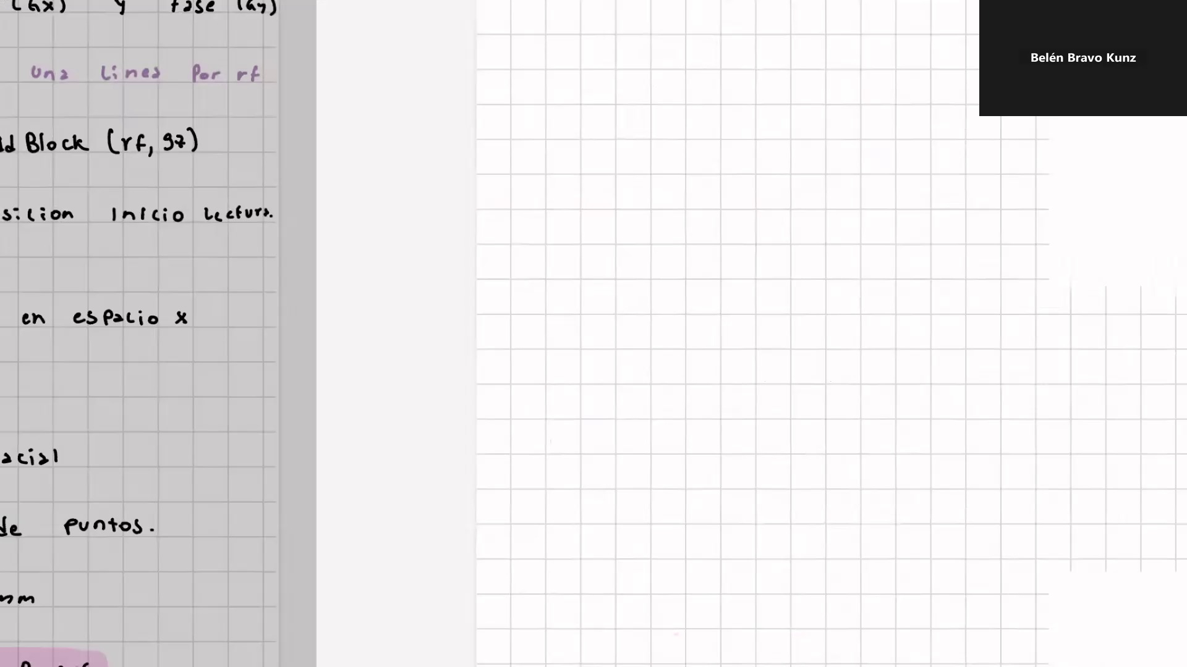
Frame 52 / 100

Slide 54

Frame 53 / 100

Slide 55
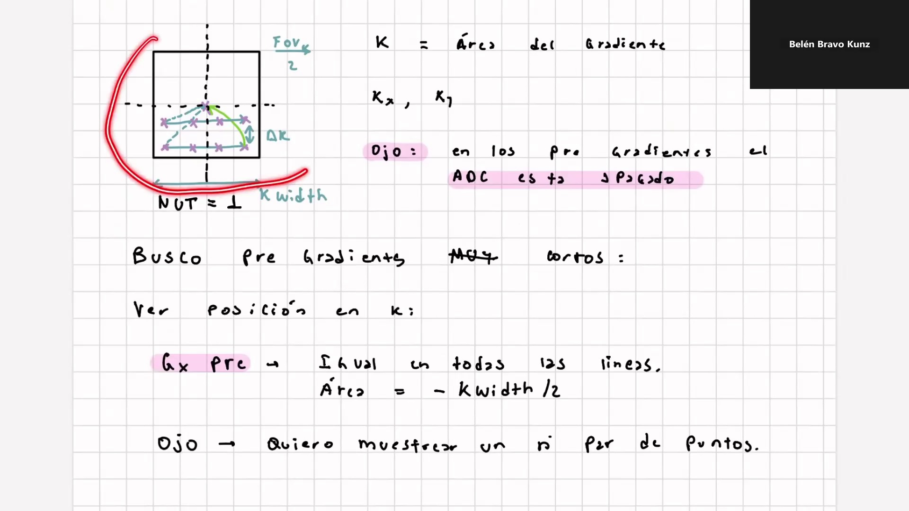
Frame 54 / 100

Slide 56
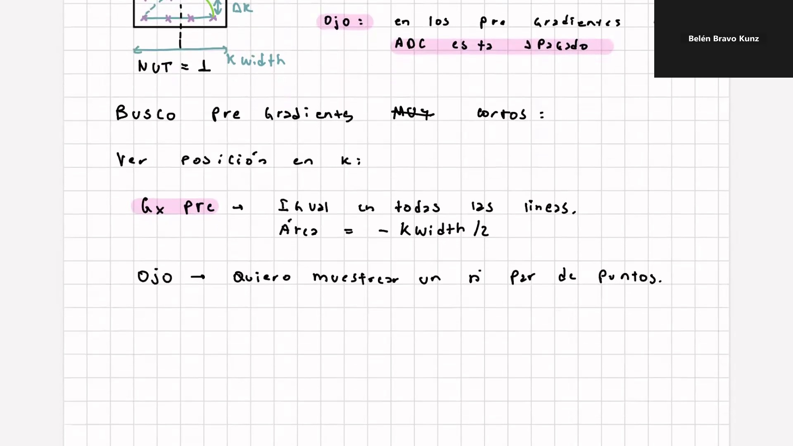
Frame 55 / 100

Slide 57
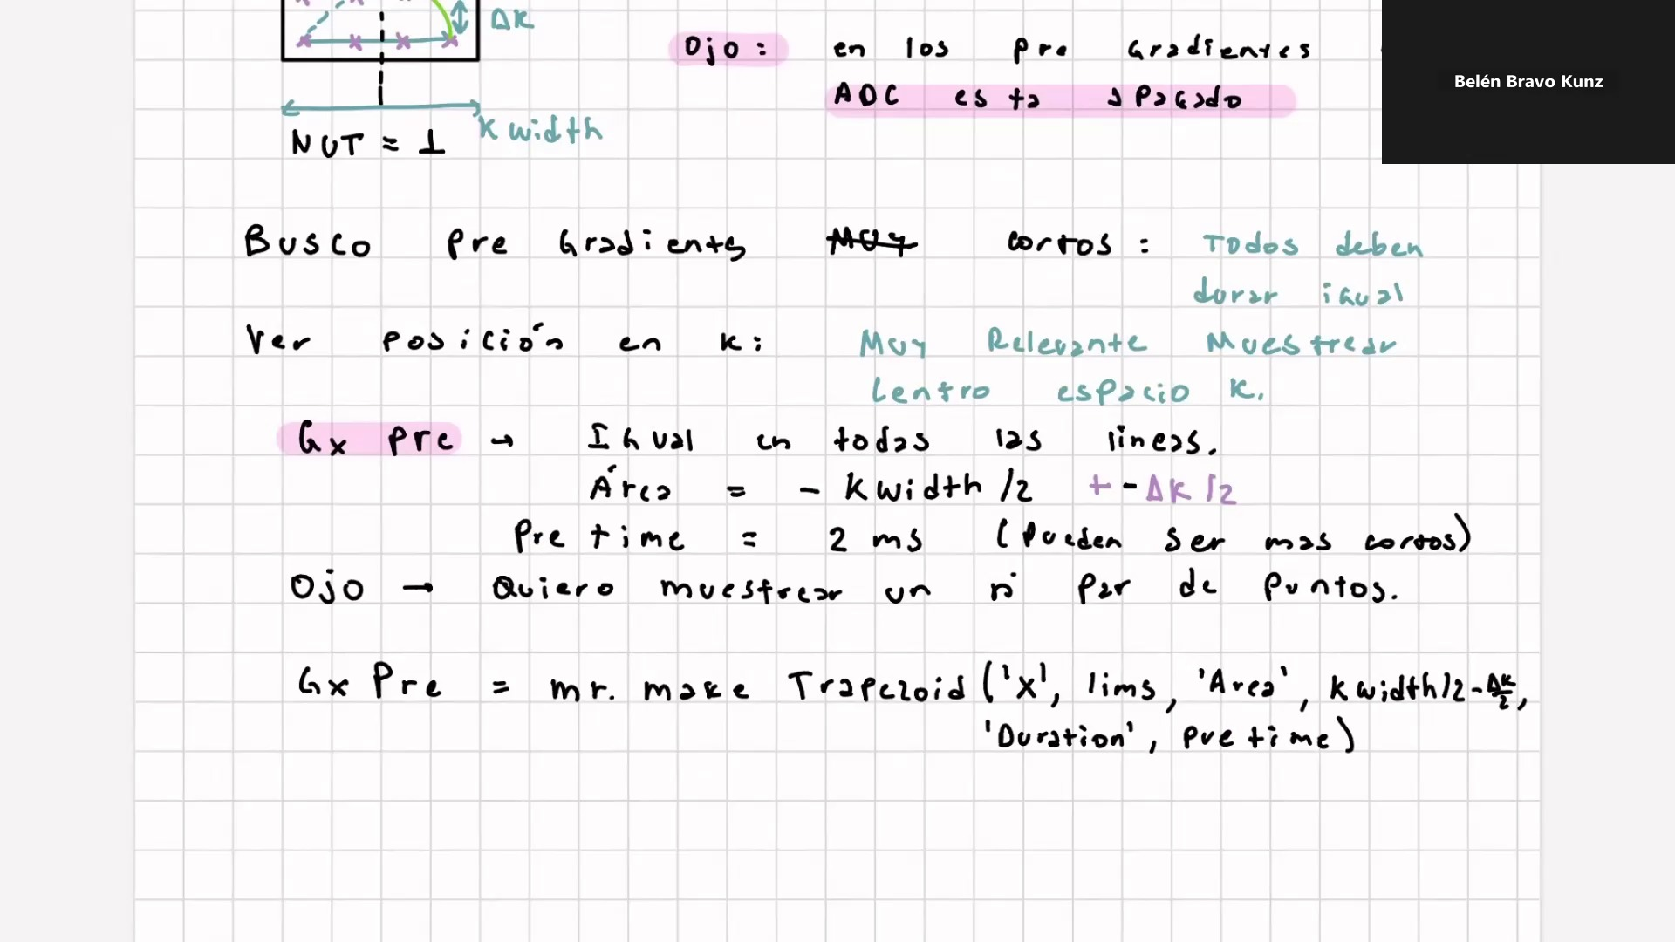
Frame 56 / 100

Slide 58
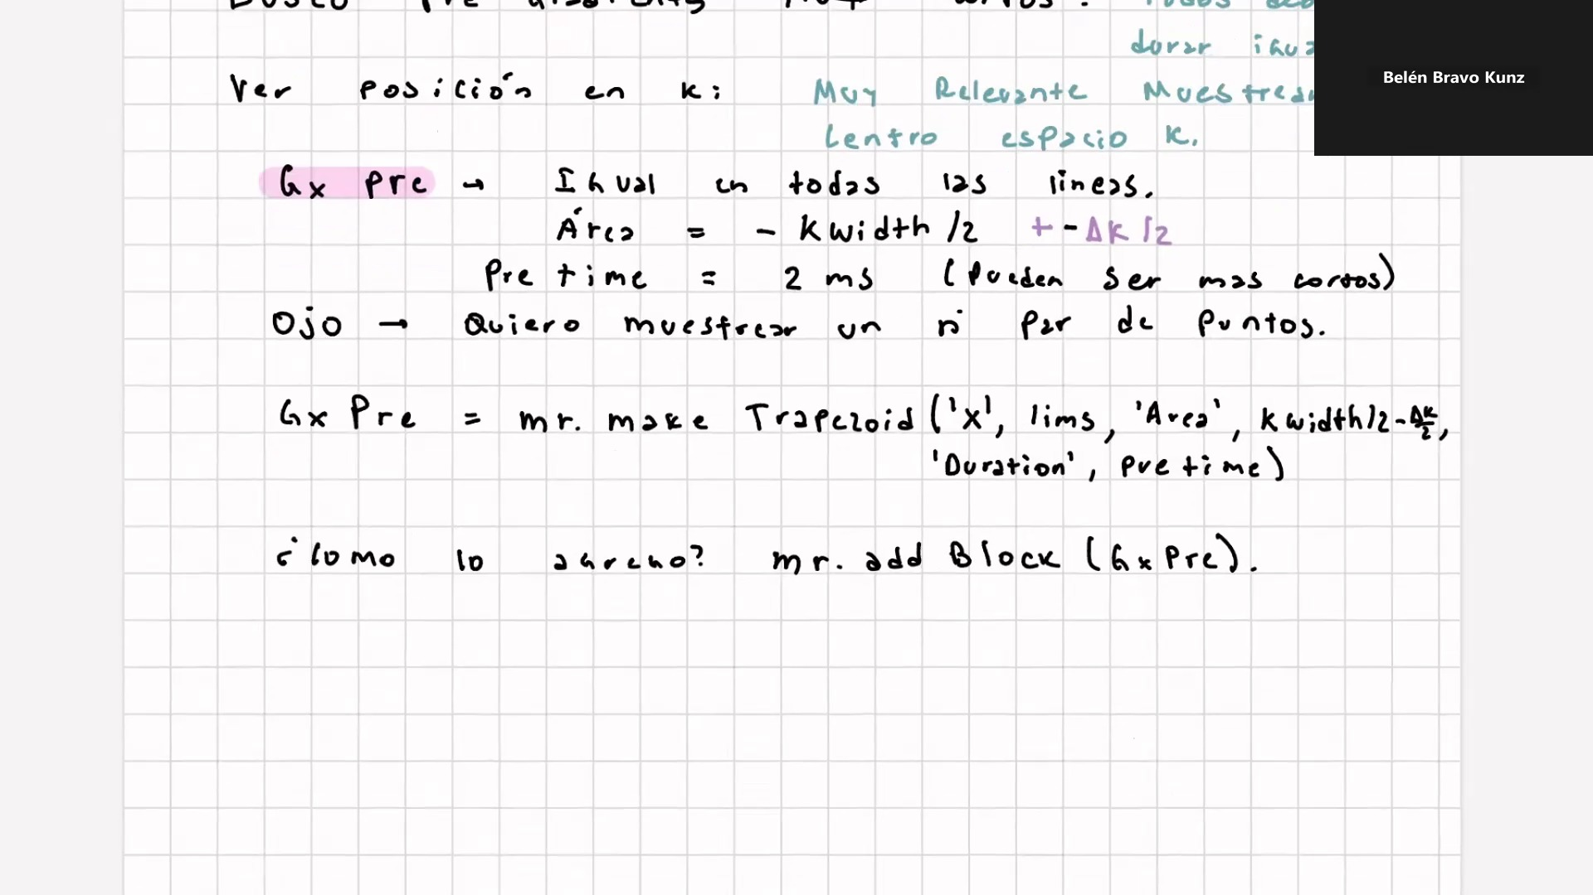
Frame 57 / 100

Slide 59

Frame 58 / 100

Slide 60

Frame 59 / 100

Slide 61

Frame 60 / 100

Slide 62

Frame 61 / 100

Slide 63

Frame 62 / 100

Slide 64

Frame 63 / 100

Slide 65

Frame 64 / 100

Slide 66

Frame 65 / 100

Slide 67

Frame 66 / 100

Slide 68

Frame 67 / 100

Slide 69

Frame 68 / 100

Slide 70

Frame 69 / 100

Slide 71

Frame 70 / 100

Slide 72

Frame 71 / 100

Slide 73

Frame 72 / 100

Slide 74

Frame 73 / 100

Slide 75

Frame 74 / 100

Slide 76

Frame 75 / 100

Slide 77
Frame 76 / 100

Slide 78
Frame 77 / 100

Slide 79

Frame 78 / 100

Slide 80

Frame 79 / 100

Slide 81
Frame 80 / 100

Slide 82
Frame 81 / 100

Slide 83

Frame 82 / 100

Slide 84

Frame 83 / 100

Slide 85

Frame 84 / 100

Slide 86

Frame 85 / 100

Slide 87

Frame 86 / 100

Slide 88

Frame 87 / 100

Slide 89

Frame 88 / 100

Slide 90

Frame 89 / 100

Slide 91

Frame 90 / 100

Slide 92

Frame 91 / 100

Slide 93

Frame 92 / 100

Slide 94

Frame 93 / 100

Slide 95

Frame 94 / 100

Slide 96

Frame 95 / 100

Slide 97

Frame 96 / 100

Slide 98

Frame 97 / 100

Slide 99
Frame 98 / 100

Slide 100

Frame 99 / 100

Slide 101

Frame 100 / 100

