Slide 1
MY FIRST
Cartesian GRE in MRI
Gradient Echo Sequence — Principles, k-Space & Implementation
Based on lecture by Belén Bravo Kunz · Enhanced English version
Flip Angle
Slice Selection
k-Space
Pre-Gradients

Slide 2
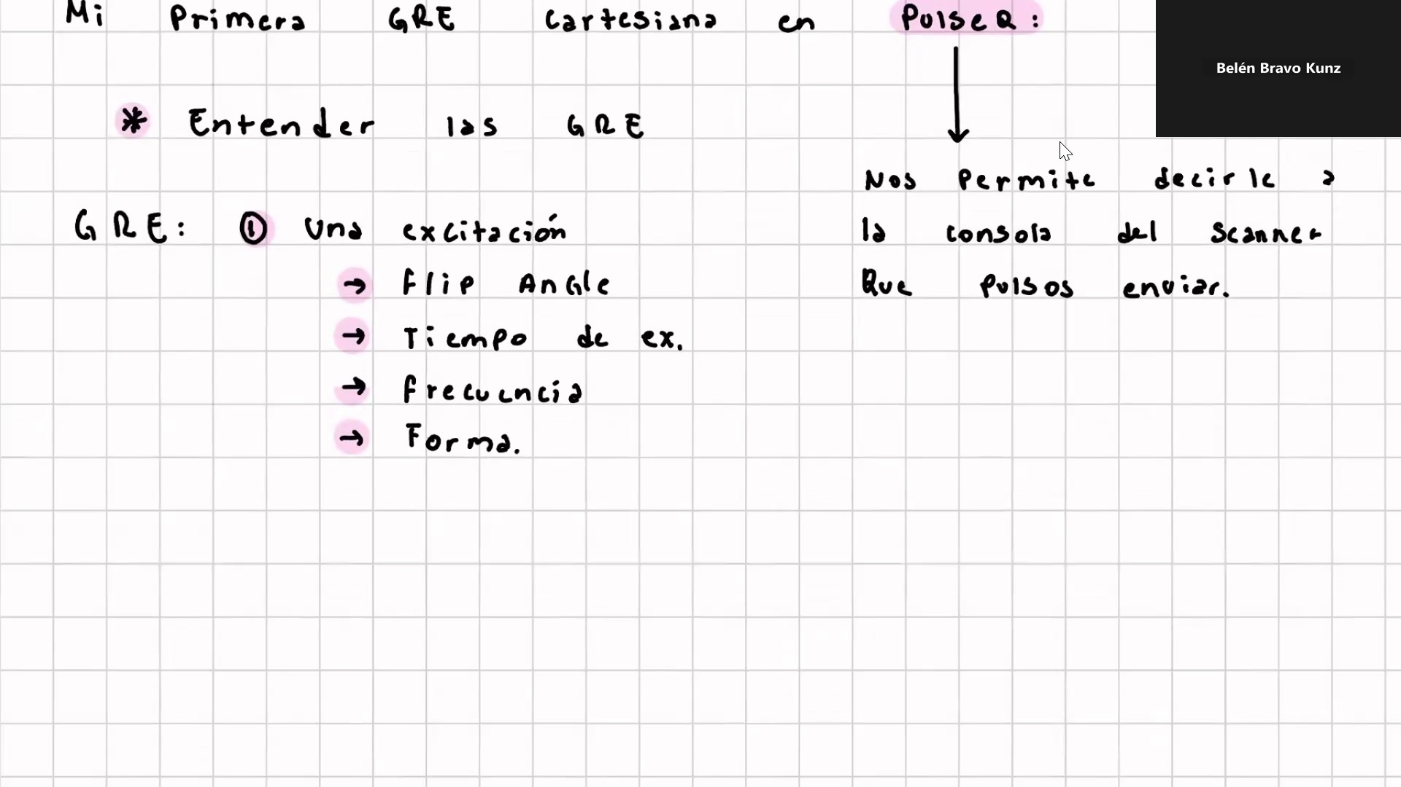
INTRODUCTION
What is a Gradient Echo (GRE)?
A fast MRI sequence using a single RF pulse and gradient reversal to form an echo
GRE vs. Spin Echo
No 180° refocusing pulse — uses gradient reversal instead
Shorter TR/TE → faster acquisitions
Sensitive to T2* (not T2) — susceptibility effects visible
Flip angle < 90° preserves longitudinal magnetization
Key Parameters to Define
Flip Angle (FA)
Tip angle of magnetization — trade-off between SNR & T1 contrast
Excitation Time
Duration of RF pulse — shorter → wider bandwidth
Frequency
42.6 MHz/T × B₀ (Larmor frequency)
Shape
Sinc pulse → uniform slice excitation

Slide 3
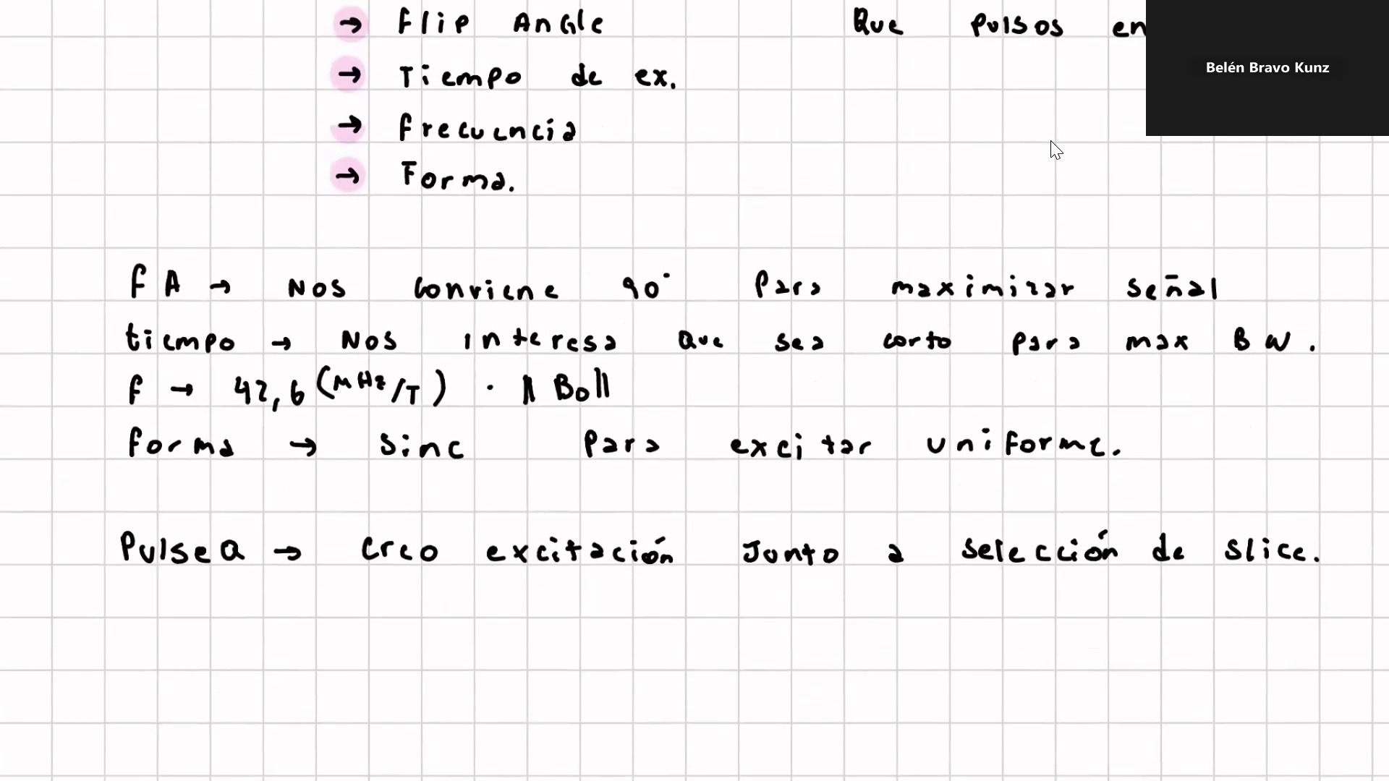
RF EXCITATION PULSE
Pulse A — RF Excitation Parameters
Defining the sinc pulse that creates slice-selective excitation
Optimal Choices
FA → 90°
Maximizes transverse magnetization → maximum signal
Duration → short
Short pulse = wide bandwidth = better slice definition
f = 42.6 MHz/T · B₀
Larmor frequency; scales with field strength
Shape = Sinc
Rectangular profile in frequency → uniform slice excitation
Pulse A = excitation AND slice selection in one step

Slide 4
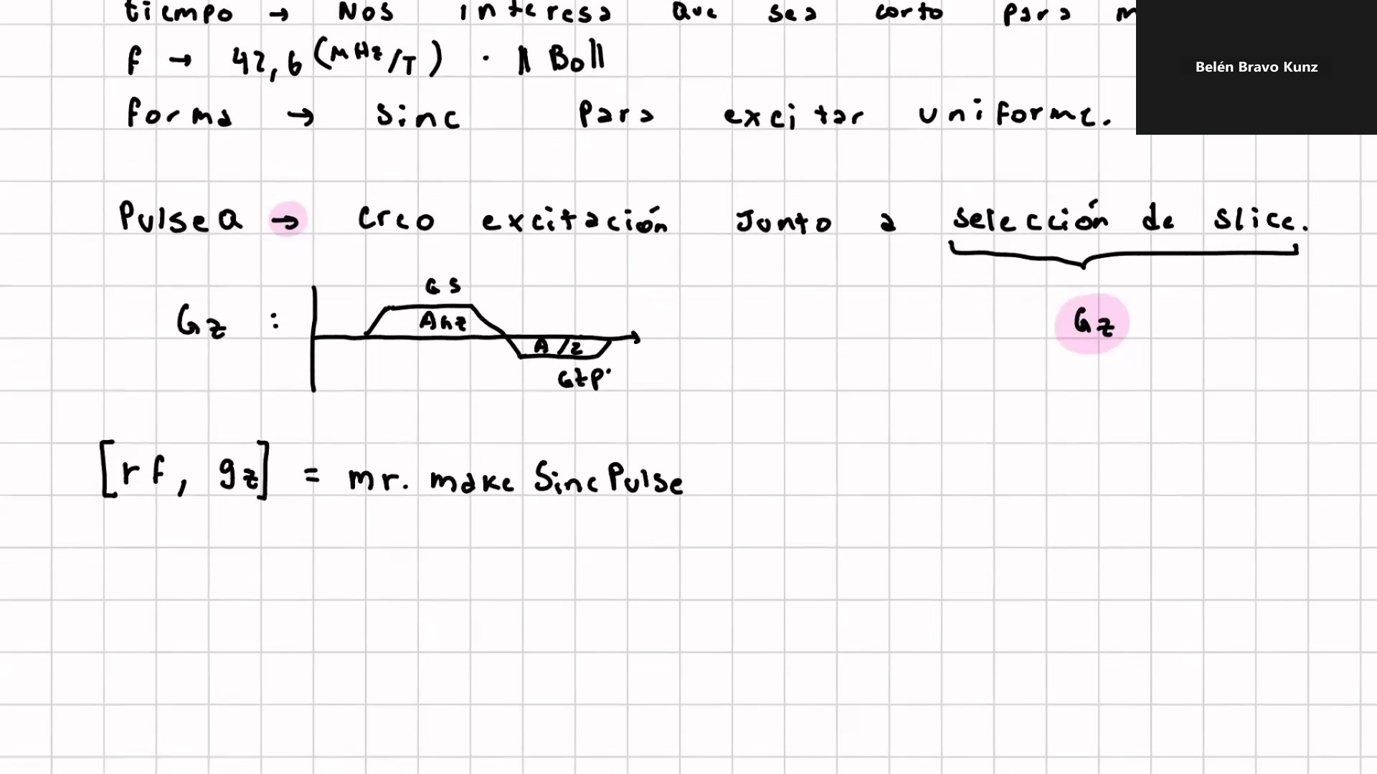
SLICE SELECTION GRADIENT
Gz — Slice-Selection Gradient
Applied simultaneously with the RF pulse to select a single slice
Gz Waveform Structure
GS (Anz)
Slice-selection lobe — active during RF pulse
A/2 (GTP)
Rephasing lobe — restores phase coherence after excitation
mr.makeSincPulse( )
FA — flip angle in radians
Lims — hardware limits (slew rate, max amplitude)
'Duration' — pulse duration in seconds (e.g. 3e-3 = 3 ms)
'SliceThickness' — slice thickness in metres (e.g. 10e-3 = 10 mm)
'Apodization' — 0.5 → Hanning window (reduces side-lobes)
'timeBwProduct' — time–bandwidth product controls slice profile

Slide 5
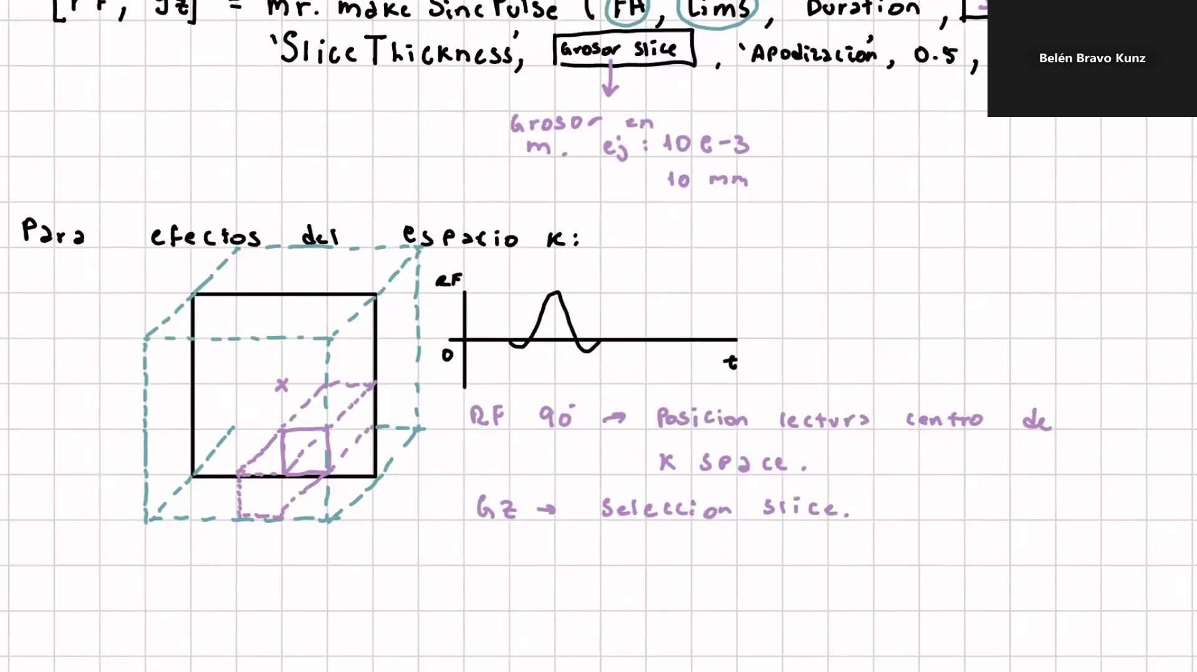
K-SPACE — FIRST LOOK
Where Are We in k-Space After the RF Pulse?
The 90° RF pulse positions the readout cursor at the center of k-space
Effect on k-Space Position
RF 90° pulse
Sets current k-space position to the CENTER (kx=0, ky=0)
Gz gradient
Provides SLICE SELECTION — confines excitation to one plane
Goal
Move from center to the CORNER of k-space before readout
Slice selection and k-space center happen at the same moment — efficient!

Slide 6
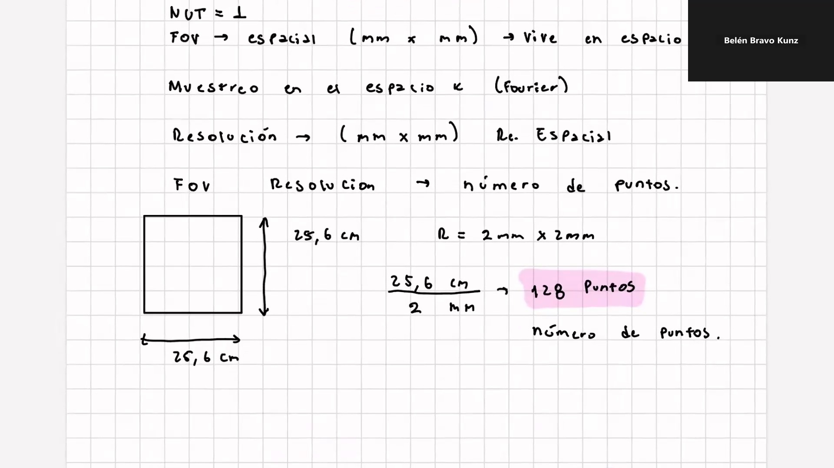
K-SPACE FUNDAMENTALS
Field of View & Spatial Resolution
The image lives in real space; we sample it via k-space (Fourier domain)
Key Relationships
FOV
Field of View — size of the imaged region (mm × mm)
Resolution
Pixel size (mm × mm) — spatial resolution of the image
# of points
FOV ÷ Resolution → number of k-space samples needed
Worked Example
FOV = 25.6 cm, Resolution = 2 mm × 2 mm
→ 256 mm ÷ 2 mm = 128 sample points per dimension
NUT = 1 (Number of Transients — single acquisition per line)
Sampling occurs in k-space (Fourier space), not image space directly.

Slide 7
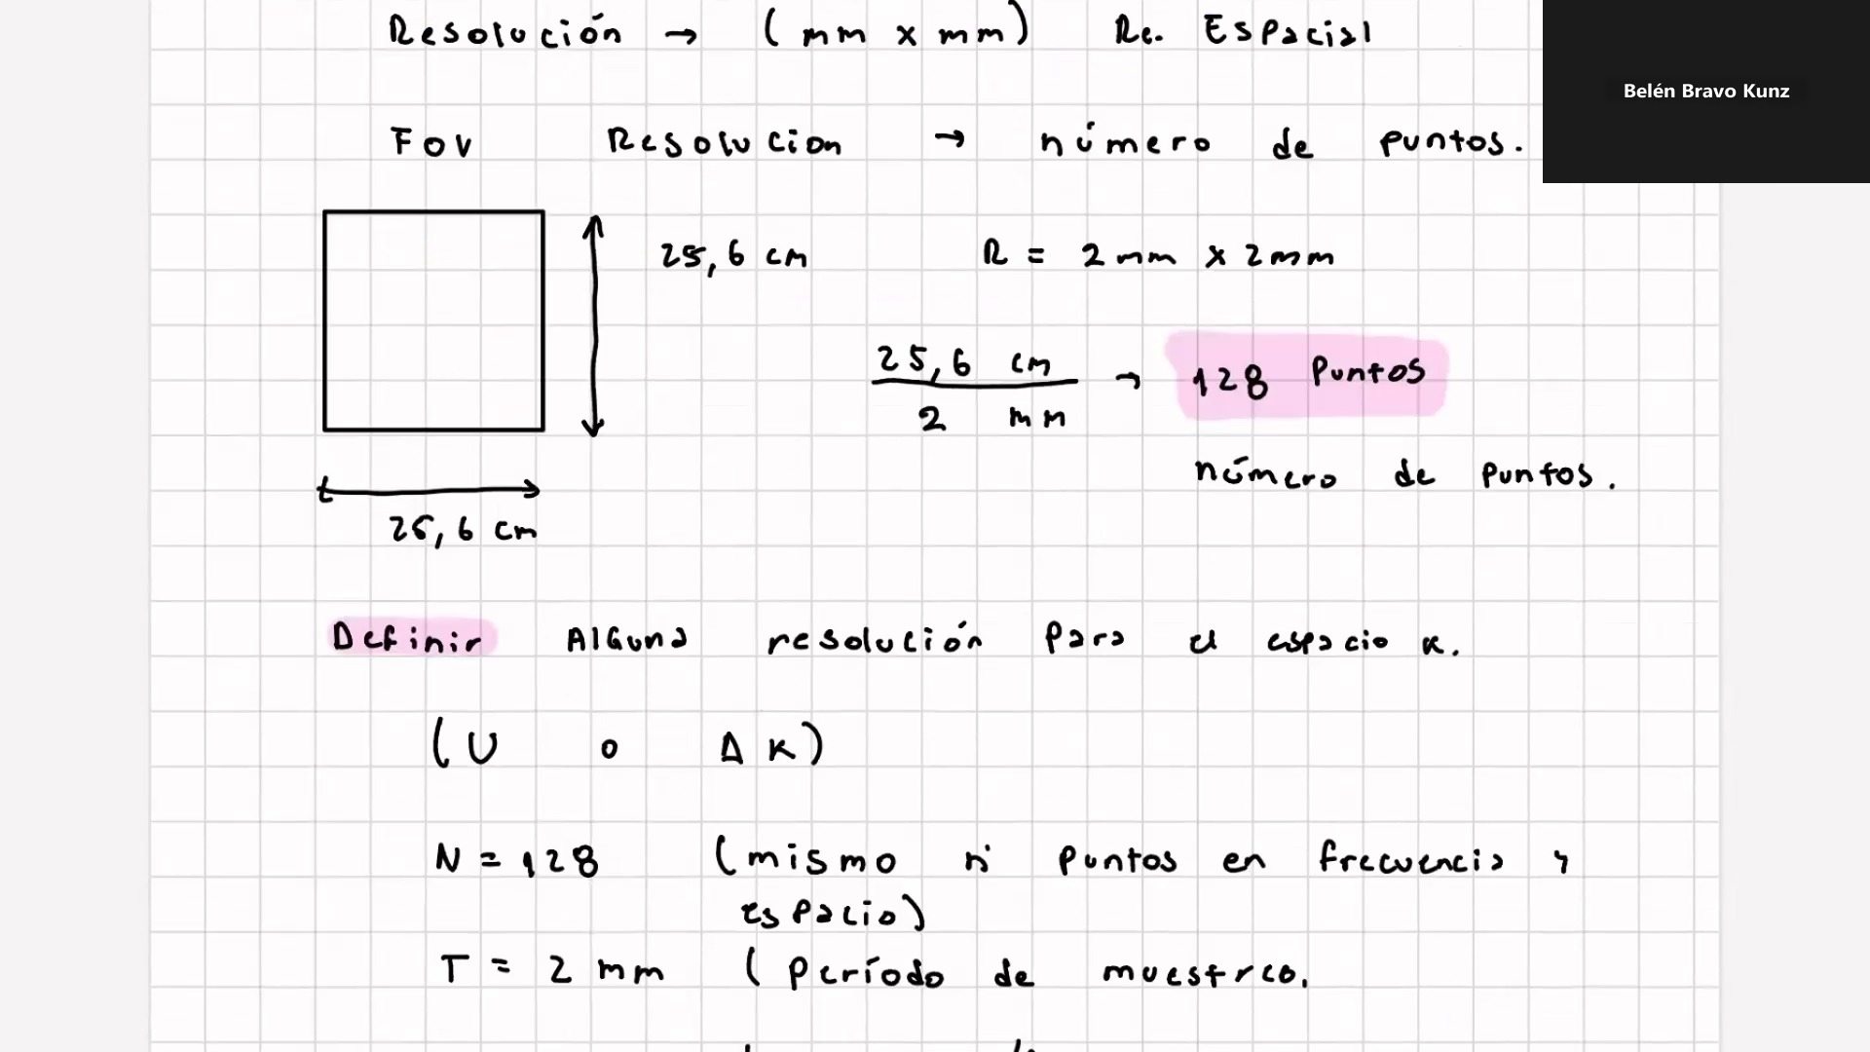
K-SPACE RESOLUTION
Defining k-Space Resolution (Δk)
The spacing between k-space samples determines the FOV in image space
k-Space Sampling Parameters
Δk (or u)
k-space resolution — spacing between adjacent samples
N = 128
Number of points (same in frequency & phase directions)
T = 2 mm
Sampling period in image space = Resolution
Δk = 1/FOV
Reciprocal relationship: smaller Δk → larger FOV
Duality Principle
• Total k-space extent (k_width) → controls RESOLUTION
• k-space step size (Δk) → controls FOV
• More k-space points → same FOV, better resolution

Slide 8
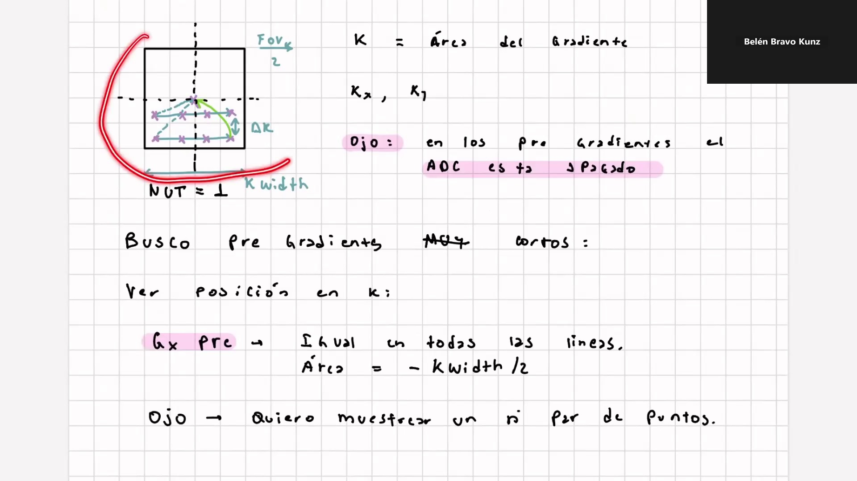
PRE-GRADIENTS
Pre-Gradients — Moving to the k-Space Corner
Before readout, we need to position the k-space cursor at (-kwidth/2, -kwidth/2)
Why Pre-Gradients?
After the RF pulse we are at k = (0, 0) — k-space center.
Readout must start at the edge: kx = −kwidth/2
Pre-gradients move the cursor to the starting corner before the ADC opens.
⚠ ADC is OFF during pre-gradients (hardware constraint).
k = Area Under the Gradient
K (m⁻¹) = γ / 2π · ∫G(t) dt = gradient AREA
Goal: very short pre-gradients → all pre-grads must have equal duration
→ Relevant: sample k-space CENTER (highest SNR) first → short TE

Slide 9
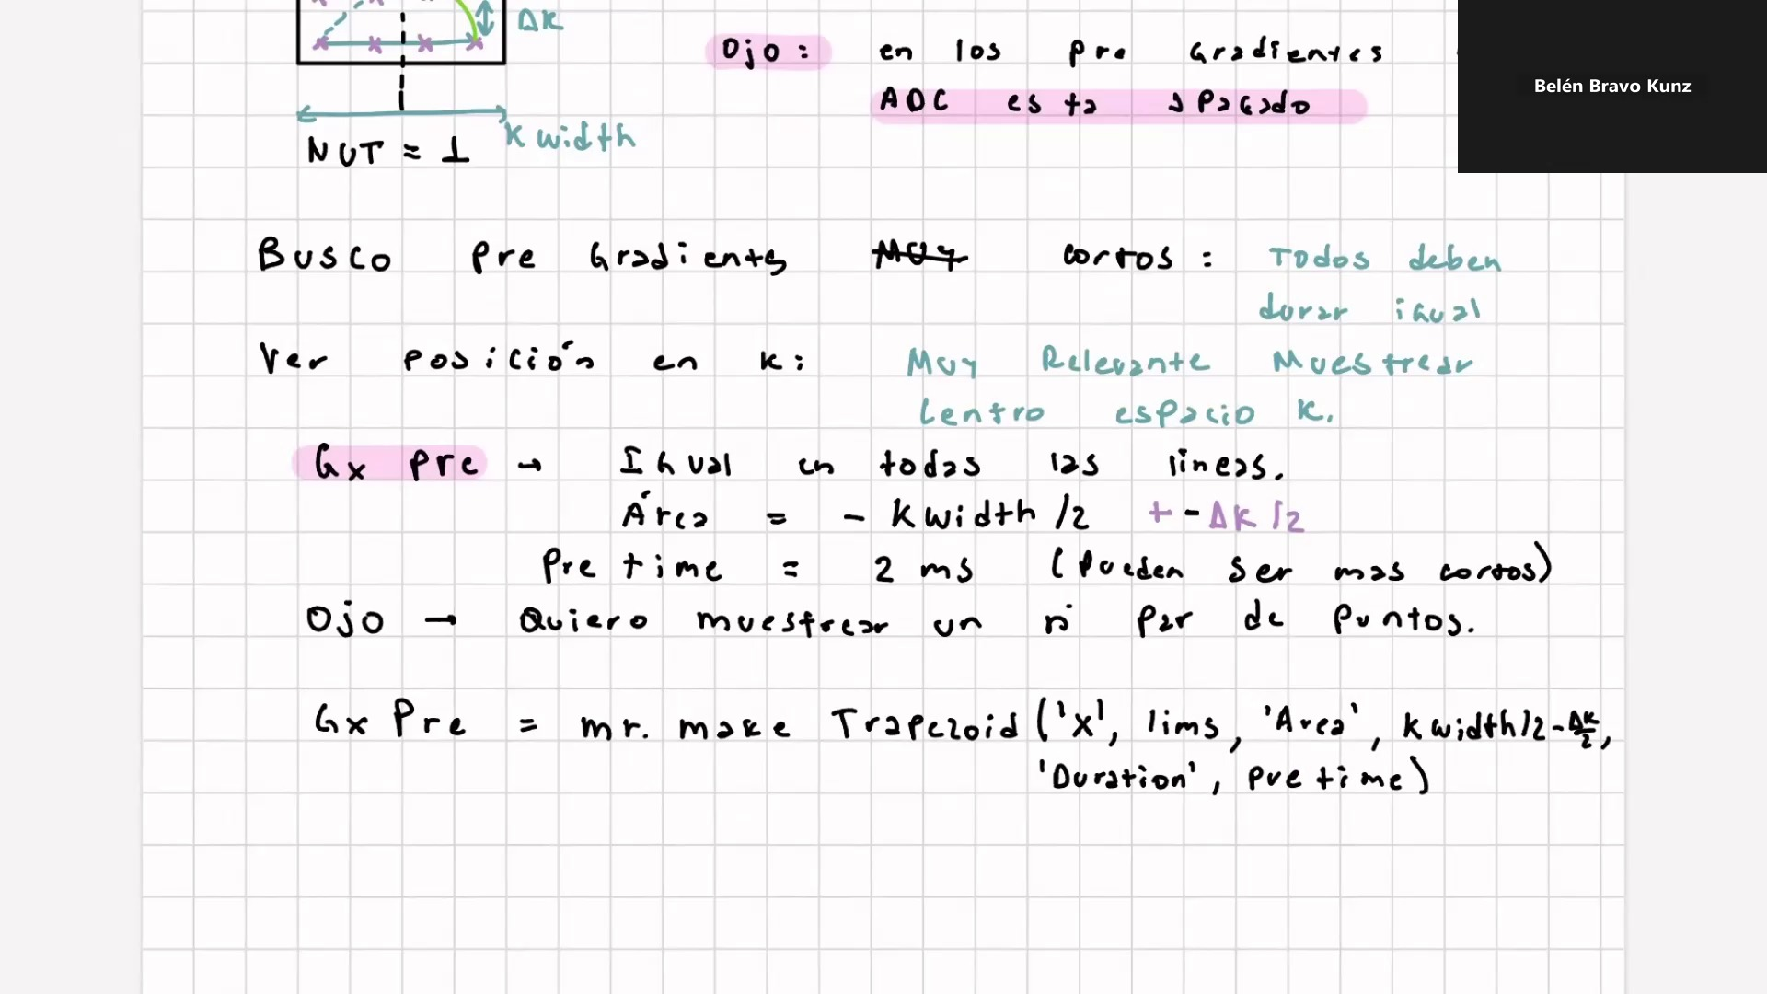
PRE-GRADIENTS — FREQUENCY DIRECTION
Gx Pre-Gradient (Frequency Encoding)
Identical for every k-space line — positions readout to kx = −kwidth/2
Gx Pre — Same for All Lines
Area
−kwidth/2 ± Δk/2
Duration
Pre time ≈ 2 ms (can be shorter with stronger gradients)
Polarity
Negative → moves kx to the LEFT edge of k-space
Varies?
NO — same waveform repeated for every phase-encode line
Gx_pre = mr.makeTrapezoid('x', lims,
'Area', kwidth/2 − Δk/2,
'Duration', pre_time)
Note: want even number of sample points → include ±Δk/2 correction

Slide 10
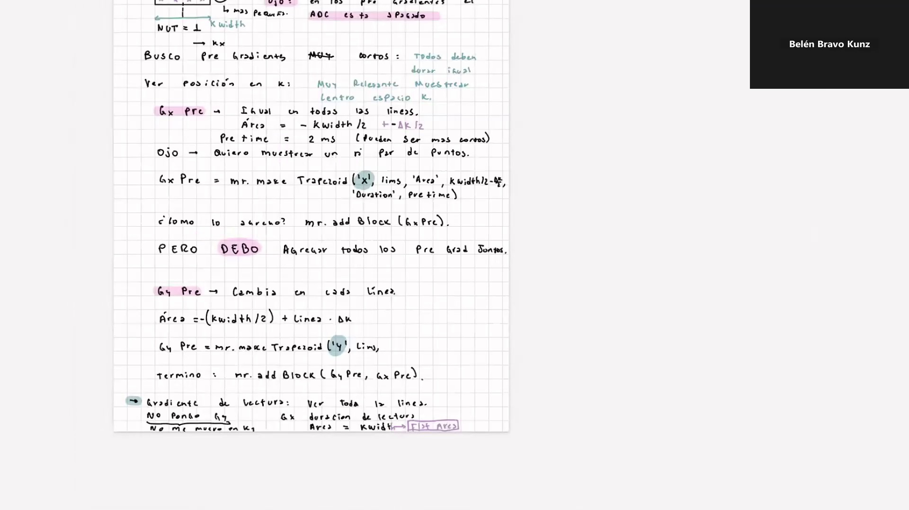
PRE-GRADIENTS — PHASE DIRECTION & READOUT
Gy Pre-Gradient & Readout Gradient
Gy changes each line (phase encoding); Gx readout collects all kx points
Gy Pre — Changes Every Line
Area
−(kwidth/2) + Line · Δk (Line = 0 … N−1)
Varies?
YES — different for each TR repetition
Purpose
Steps ky from bottom to top of k-space, one line per TR
Gy_pre = mr.makeTrapezoid('y', Lims, …)
termino = mr.addBlock(Gy_pre, Gx_pre)
Readout Gradient (Gx)
No Gy during readout
We do NOT move in ky during readout — fixed line
Gx duration
= ADC readout window duration
Gx flat area
= kwidth (covers the full kx extent)
ADC ON
Samples all N kx points during the flat top

Slide 11
SUMMARY
GRE Sequence — Full Timing Overview
Each TR block: RF + Gz → Pre-grads → Readout (Gx ADC) → repeat for all ky lines
RF + Gz
Gx Pre
Gy Pre
ADC ON
(Readout Gx)
Wait / Gy
Reset
Excitation
+ Slice
Select
Position
k-space
cursor
Collect
all kx
points
T1 recovery
Reset phase
t = 0
TE
TR
TR
Repetition Time — time between successive RF pulses
TE
Echo Time — from RF center to k-space center readout
Flip Angle
< 90° for short TR (Ernst angle optimizes SNR)
k-space
Filled line-by-line; N lines = N TR repetitions
Scan time
TR × N_lines × NUT (e.g. 100ms × 128 × 1 = 12.8 s)
T2* decay
Signal decays during readout → limits resolution

Slide 12
FROM PULSE TO IMAGE
You now have a complete
Cartesian GRE sequence
1
Define RF sinc pulse (FA, duration, frequency, shape)
2
Apply Gz for slice selection simultaneously
3
Compute k-space parameters (FOV, Δk, N)
4
Apply Gx_pre & Gy_pre to reach k-space corner
5
Readout with Gx — ADC collects N samples per line
6
Repeat N times (one per ky line) → full k-space
Belén Bravo Kunz · Enhanced English lecture

