Slide 1
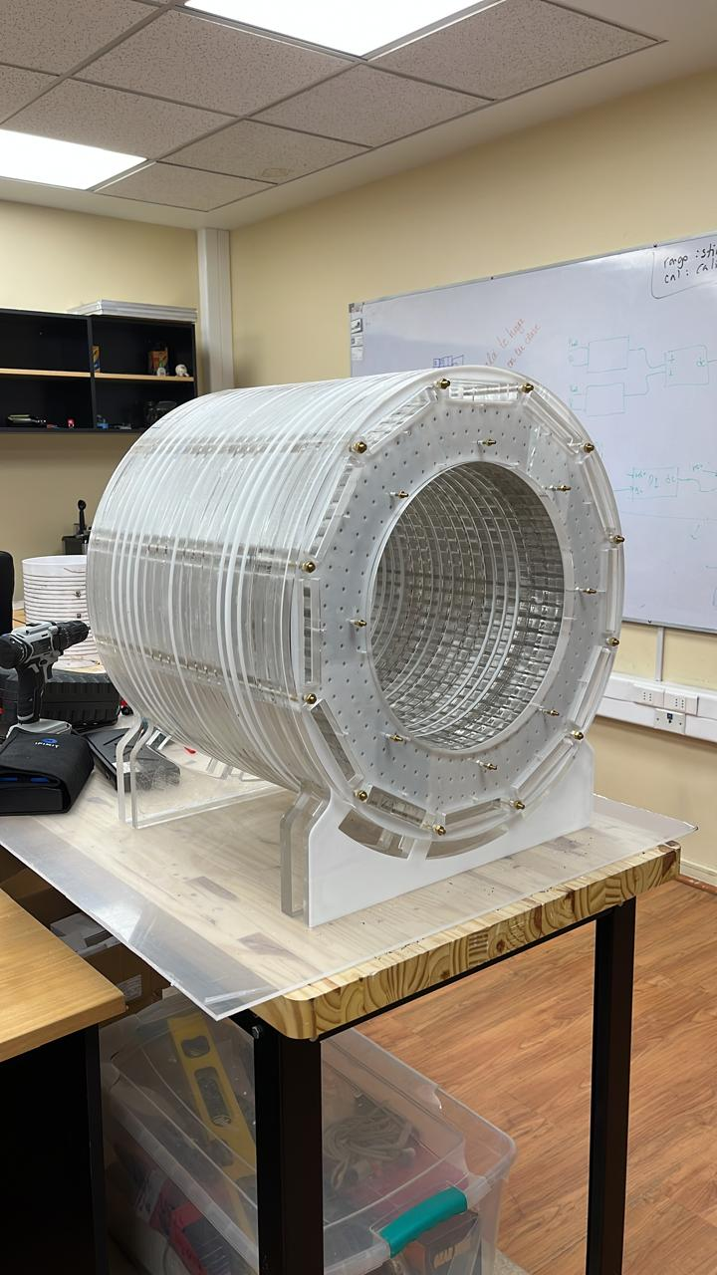




Belén Bravo Kunz - bkbravo@uc.cl
Cristian Montalba - cristian.montalba@uc.cl

Slide 2
Introduction - Democratizing MRI Sequence Design

Slide 3


Acknowledgements

