Slide 1
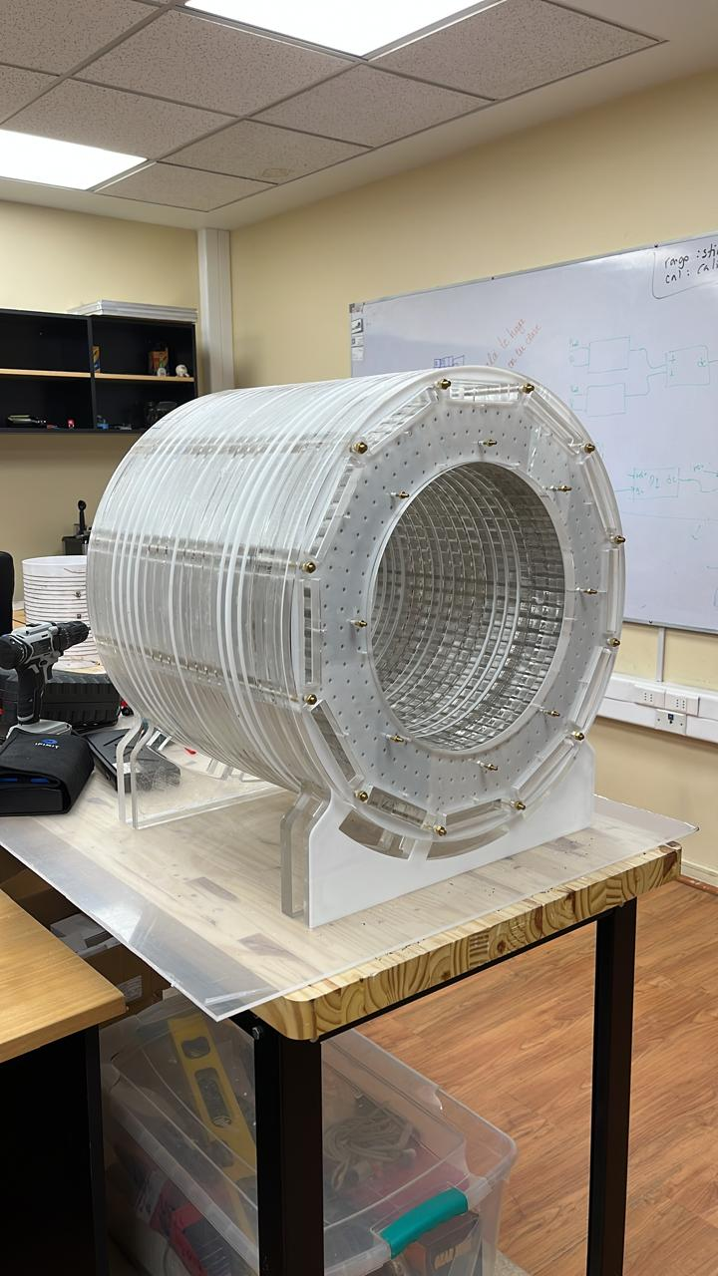
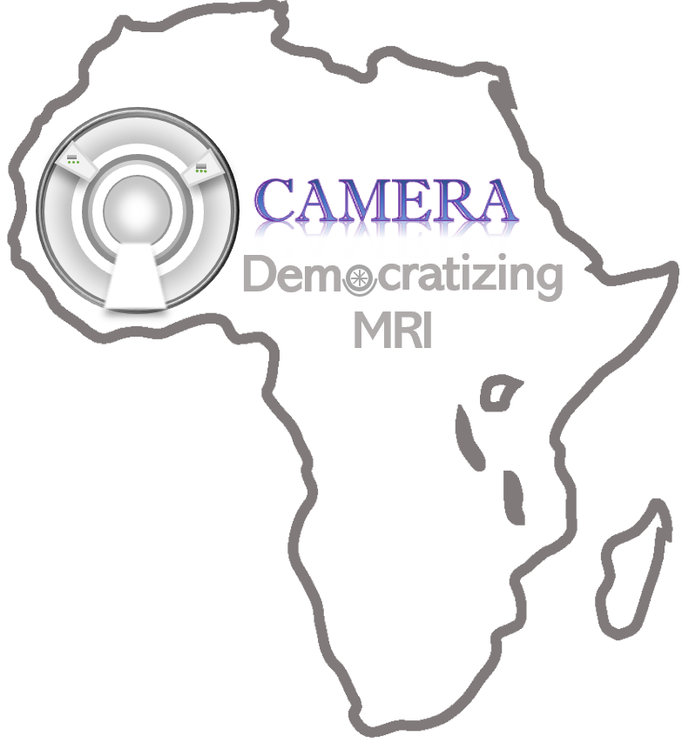



Belén Bravo Kunz - bkbravo@uc.cl
Cristian Montalba - cristian.montalba@uc.cl

Slide 2

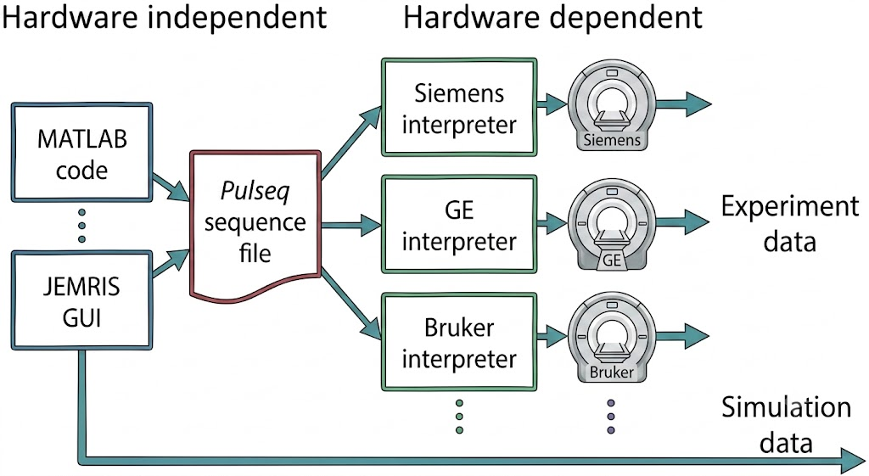
Introduction - Democratizing MRI Sequence Design
Sequence programming is traditionally confined to vendor frameworks requireing C/C++ and deep physics engineering skills.
Pulseq and pypulseq acts as an open-source, vendor-agnostic hardware interface.
Medical Technologists understand image artifacts, contrasts, and clinical constraints.
Empower clinical professionals to shift from passive sequence users to active sequence innovators without the coding barrier.

Slide 3
MINT Initiative
Consists in general MRI Courses:
Excitation: SE, GRE, IR
Trajectories: 2D-DFT Cartesian, EPI, Radial, Spiral
Sequence Builder: .seq file (based on 0.55T Siemens free max limitations)
Expectation projects:
Introduce proyects such as “My first GRE”
Program fMRI and DIXON sequences
TODO List:
General MRI classes and Videos with pulseq content

Slide 4
MINT Initiative
Browser execution:
No local MATLAB/Python installations, environment variables, or dependency conflicts.
Automated Simulation Pipeline:
Generates universal .seq files and pipes them directly into open-source virtual phantoms (KOMA / Bloch simulators).
Scalable Workshops & Hackathons:
GitHub / Google colab / Jupyter repositories equipped with "Open in Colab" buttons for instant deployment.
Enables clinical professionals to participate in collaborative sequence engineering, driving global reproducibility and Open Science.
MINT
.seq file
Block / KOMA / Scanner acquisiton
FFT
Image result

Slide 5
MINT’s Mission: Collaboration, Not Competition
We don’t seek to compete with established, high-level MR sequence design or simulation software like JEMRIS.
Instead, MINT acts as the educational gap.
It prepares clinical professionals by lowering the barrier to entry, enabling them to confidently step into the open-source ecosystem (such as Pulseq and JEMRIS) later on.
Captsone / HACKATON
MINT
Foundational and no-code
Videos + Simulator
Hands-on and coding
Google Colab Workspace

Slide 6
Conclusion
Main Focus: Let’s open MR sequence design to the world!
Impact Pillars:
  Empowering Technologists / other professionals to become collaborative researchers.
  Lowering costs for early-stage MR sequence design education globally.
  Driving true Democratization of Neuroimaging & Open Science.

Slide 7


MINT: fitting in CAMERA’S initiatives

Slide 8
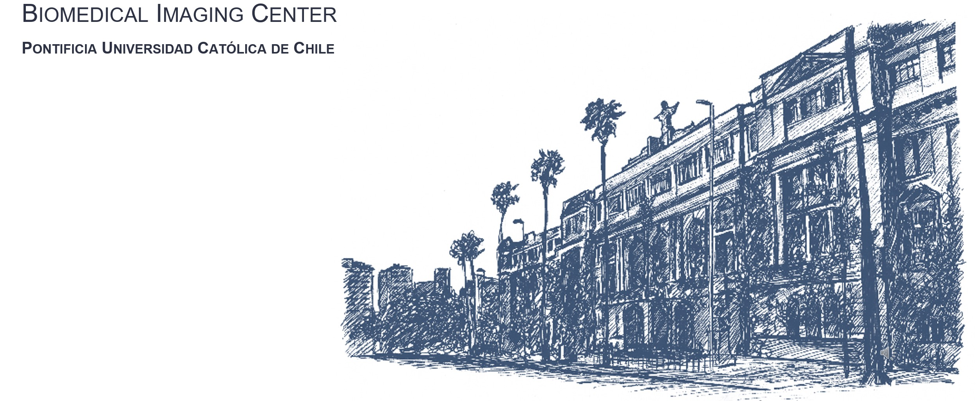

Acknowledgements

