Slide 1


K-Space
A rigorous treatment of spatial-frequency encoding, sampling and reconstruction in MRI
Advanced technical primer — trajectories, parallel imaging, and modern reconstruction

Slide 2
PART 1
Signal Equation & Sampling Theory
From the Larmor equation to a rigorous spatial-frequency formalism

Slide 3

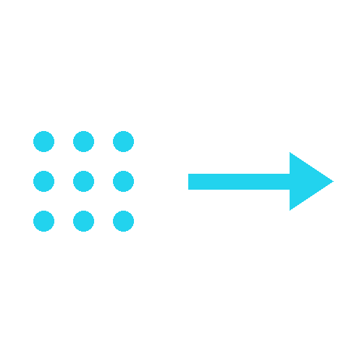
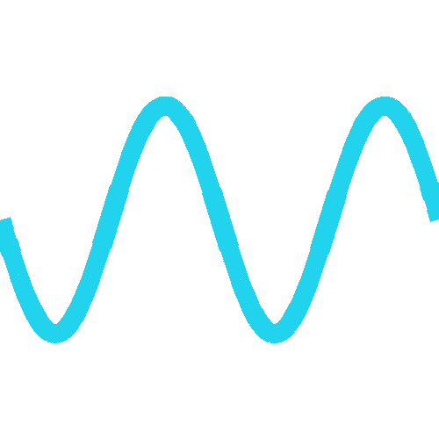
The General k-Space Signal Equation
k(t) = (γ/2π) ∫₀ᵗ G(t') dt' s(t) = ∫ ρ(r) e^(−i2π k(t)·r) dr
Two ways to move through k-space
A constant gradient moves the trajectory continuously along a straight line; a 180° refocusing pulse mirrors it discontinuously through the origin. Every pulse sequence is a specific combination of these two operators.
k-space and image space are Fourier pairs
Because the Fourier transform is information-preserving, the full content of the image is already present in k-space — reconstruction only changes its representation, never its content.
Magnitude and phase carry different information
The magnitude of a k-space point indicates how strongly that spatial frequency is represented in the object; its phase indicates how that frequency component is positioned within the image.

Slide 4
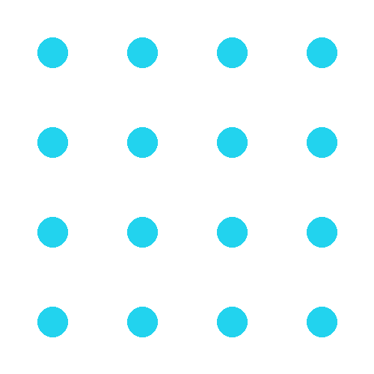

Nyquist Sampling, FOV and Resolution
Δk = 1 / FOV k_max = 1 / (2·Δx)
Sample spacing sets the field of view
The separation Δk between adjacent k-space samples is inversely proportional to the FOV; too coarse a Δk folds signal from outside the intended FOV back into the image as aliasing.
k-space extent sets spatial resolution
The maximum spatial frequency covered, k_max, is inversely proportional to the achievable pixel size; reaching farther into k-space sharpens the image without changing its contrast.
Faster sampling always costs SNR
Thermal noise scales with the square root of the acquisition bandwidth, so shortening dwell time to accelerate acquisition inevitably lowers SNR, regardless of the specific pulse sequence used.

Slide 5
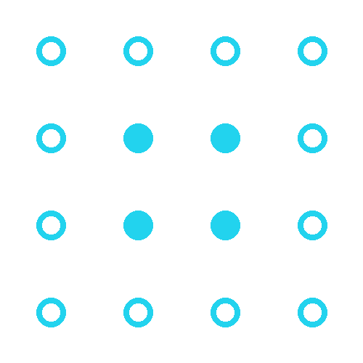

Hermitian Symmetry and Partial-Fourier Reconstruction
THREE WAYS TO FILL IN THE MISSING HALF OF K-SPACE
Zero-Filling
Conjugate-Symmetry Phase Correction
Homodyne Detection
Missing lines are simply set to zero before the FFT. Simple and artifact-free when the missing fraction is small, but blurs the image and is unusable for large gaps.
Missing data are estimated from their Hermitian conjugates, corrected for a slowly-varying phase term estimated from a small symmetric region. Requires the forward and inverse transform to be applied more than once.
A weighting function splits the k-space data into symmetric and antisymmetric components before a single forward/inverse transform pair — removing the repeated-transform overhead of conjugate-symmetry correction.

Slide 6
PART 2
Trajectory Physics & Pulse-Sequence Encoding
How gradient waveforms and refocusing pulses translate into distinct artifact and contrast signatures

Slide 7

Rectilinear (2DFT) Sampling: Gradient-Echo vs. Spin-Echo
One line, one repetition
In conventional rectilinear imaging, each excitation encodes and reads out a single k_y line; total scan time scales directly with the number of phase-encode steps times TR.
Gradient-echo: refocusing by gradient reversal
Dephasing from a negative readout lobe is reversed by a positive lobe; the echo forms exactly when the net gradient area is zero, at the k_x = 0 line.
Spin-echo: refocusing by a 180° pulse
The refocusing pulse mirrors the k-space trajectory through the origin, canceling static B0 inhomogeneity (but not true T2 decay) — and, because points fall on a grid, reconstruction is a single, direct FFT.

Slide 8


Echo-Planar Imaging: Speed at the Cost of Fidelity
Nearly all of k-space in one shot
A single excitation sweeps back and forth across k-space with oscillating gradients, filling most or all of the matrix before the signal has meaningfully decayed.
T2*-limited fidelity
Because total acquisition time is n times longer than a single line, EPI must finish before T2* decay significantly attenuates the signal — this caps achievable resolution and drives blurring or signal loss if pushed too far.
Off-resonance becomes geometric displacement
Chemical shift and field inhomogeneities accumulate over the long phase-encode dwell time and appear as pixel shifts along the phase-encode axis, not as blurring.
The N/2 ghost
Alternating readout polarity means odd and even lines are acquired in opposite directions; any timing asymmetry between them produces a ghost displaced by exactly half the field of view.

Slide 9
RARE / Turbo & Fast Spin Echo
A rewinder ties every echo back to the origin
Each phase-encode step must be undone after readout so the trajectory returns to the same k-space point before the next 180° pulse, otherwise unwanted coherence pathways appear.
T2 decay along the echo train sets the real resolution
Outer k-lines are acquired at longer effective echo times, so T2 relaxation across a long echo train blurs high-spatial-frequency detail even though the nominal resolution is unchanged.
Echo-train ordering controls contrast
Placing low-k_y lines early or late in the train determines whether the image is weighted toward the earliest or the latest effective TE.
J-coupling makes fat paradoxically bright
J-coupled lipid resonances are not refocused by repeated 180° pulses the way static field effects are, so fat signal in RARE/FSE is systematically brighter than in a conventional spin-echo at the same TE.

Slide 10


Non-Cartesian Trajectories: Radial and Spiral
Radial
Spiral
Each excitation acquires a spoke through the k-space origin. The center is intrinsically oversampled, giving strong motion robustness and extremely short TE, at the cost of streaking from an undersampled periphery.
Both gradients are driven simultaneously at full amplitude — the most gradient-efficient trajectory. Off-resonance manifests as blurring rather than displacement; periodic coverage gives inherent motion averaging.
Regridding is mandatory
FOV is set by trajectory spacing
Non-Cartesian samples do not fall on a rectangular grid, so an FFT cannot be applied directly. Data must first be resampled (regridding / NUFFT) onto a Cartesian grid with density compensation.
Unlike rectilinear scans, oversampling along a non-Cartesian readout does not enlarge the FOV for free — the FOV is fixed by how densely adjacent arms of the trajectory are spaced.

Slide 11
PART 3
Acceleration Beyond Nyquist
Parallel imaging, sparsity and learned priors let modern MRI undersample k-space and still reconstruct a faithful image

Slide 12

Parallel Imaging I — SENSE
R = FOV / FOV_reduced g ≥ 1 (geometry noise-amplification factor)
Coil sensitivity replaces missing gradient encoding
Multiple receiver coils, each with a distinct, known spatial sensitivity profile, provide additional spatial information that substitutes for some of the phase-encode steps that would otherwise need to be acquired.
Unfolding happens in image space
A reduced-FOV image from each coil is aliased; SENSE inverts the coil-sensitivity matrix at every pixel to separate the overlapping signals and recover the full FOV.
Acceleration has a noise penalty: the g-factor
Reconstructed SNR falls by more than the √R expected from reduced averaging alone; the extra, geometry-dependent penalty is the g-factor, which grows with acceleration and with unfavorable coil geometry.

Slide 13
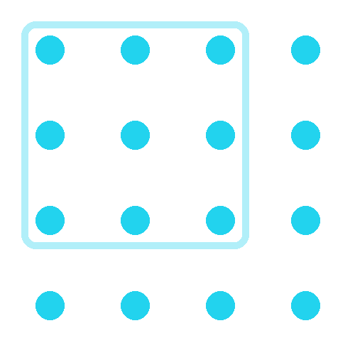

Parallel Imaging II — GRAPPA
Interpolation happens directly in k-space
Instead of unfolding aliased images, GRAPPA estimates each missing k-space line as a weighted combination of neighboring acquired lines across all coil channels.
Calibration lines teach the kernel
A small number of extra, fully-sampled autocalibration (ACS) lines near the center of k-space are used to fit the interpolation weights before they are applied to the undersampled data.
A gentler failure mode than SENSE
Because reconstruction stays in k-space and uses a local kernel, GRAPPA tends to degrade more gracefully than SENSE under unfavorable coil geometry, at the cost of greater computational complexity.

Slide 14
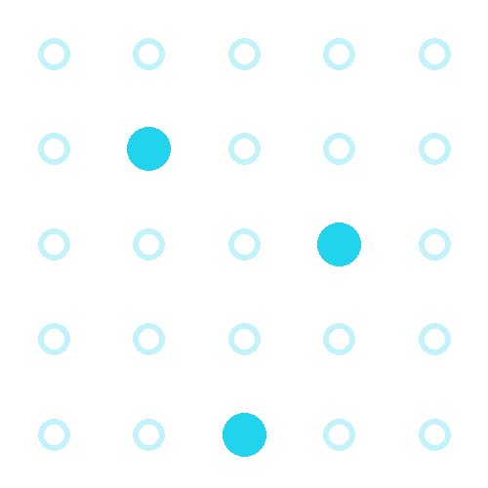

Compressed Sensing
Condition 1 — Sparsity
The image must have a compact representation in some transform domain (e.g. wavelets), meaning most of its transform coefficients are close to zero.
Condition 2 — Incoherent undersampling
Sampling k-space pseudo-randomly, rather than skipping regular blocks of lines, spreads the resulting aliasing into incoherent, noise-like artifact instead of a coherent, structured ghost.
Nonlinear, not Fourier, reconstruction
Because the acquisition is now underdetermined, the image is recovered by nonlinear optimization enforcing both data consistency and sparsity — typically an L1-regularized minimization — instead of a direct inverse transform.

Slide 15
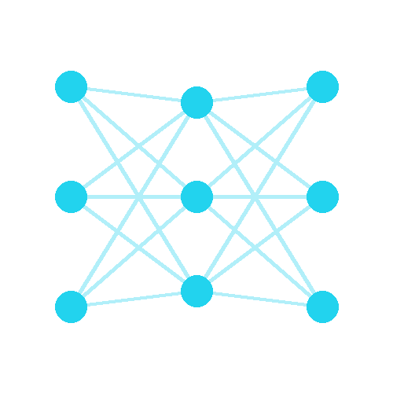
Deep Learning Reconstruction
Learned priors replace hand-crafted ones
Instead of assuming sparsity in a fixed transform like wavelets, a neural network learns — from large training datasets — what realistic anatomical images look like.
Unrolled optimization networks
Many modern architectures unroll an iterative reconstruction algorithm into a fixed number of network layers, alternating learned denoising steps with explicit data-consistency steps against the acquired k-space samples.
k-space-domain or image-domain learning
Networks can operate directly on raw k-space data, on the aliased image, or on both — depending on whether the priority is enforcing physical consistency or maximizing perceptual image quality.

Slide 16
k-Space Determinants of Contrast and Artifact
The point-spread function links coverage to sharpness
Truncating k-space is equivalent to convolving the true image with a sinc-like point-spread function — the mathematical origin of Gibbs ringing near sharp, high-contrast edges.
TE placement inside the trajectory sets contrast
Whichever moment the center of k-space (k=0) is sampled behaves as the effective echo time for contrast purposes, even when a single nominal TE cannot fully describe a complex trajectory.
Every acceleration strategy trades some fidelity for speed
Partial Fourier trades SNR, parallel imaging trades noise (the g-factor), non-Cartesian sampling trades reconstruction complexity, and compressed sensing / deep learning trade guaranteed exactness for a learned or assumed prior.

Slide 17
Every artifact, contrast and acceleration trade-off in MRI traces back to how — and how completely — k-space was sampled
Spatial-frequency thinking is the unifying language of MR image formation

