Slide 1

Berry Sings
Handmade music

Slide 2
Why Berry Sings?
1) Amusement
2) Dexterity
3) Develop ear for music

Slide 3
When Berry Sings?
1) Always
when you’re alone
2) Always
when you’re with your friends
3) Always
when you want to try something different

Slide 4
Phase 1
Phase 2
Phase 3
You start the game
You play the instrument by moving your hand up and down above the device
Your friend listens to the music track you’re creating in real time
Your friend tries to reproduce the music track you created
Your friend receives feedback regarding his musical creation
Activities

Slide 5
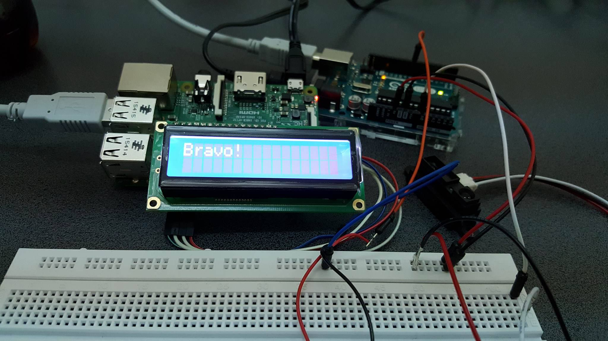
Congratulations!
You’ve composed great music!

