Slide 1
Analysis and Forecasting of Monthly Electricity
Consumption
in France
Time Series 2024/2025 - University of Aveiro
Cristiano Nicolau - 108536
Maria Rafaela Abrunhosa - 107658

Slide 2
Table of contents
01
02
03
04
05
06
Introduction
Data and Exploratory Analysis
Modal Proposals
Forecast Evaluation and Confidence Analysis
Results and Discussion
Conclusion

Slide 3
01
Introduction
Accurately forecasting electricity demand is crucial to guaranteeing system efficiency and security in a scenario of energy transition and combating climate change.
Study objective:
Analysing and forecasting monthly electricity consumption in France (2008–2025) using time series.
Highlights of France:
One of the largest economies in Europe.
Has a complex energy sector with a strong nuclear energy presence (84.7 %).
There is growing investment in renewable sources.

Slide 4
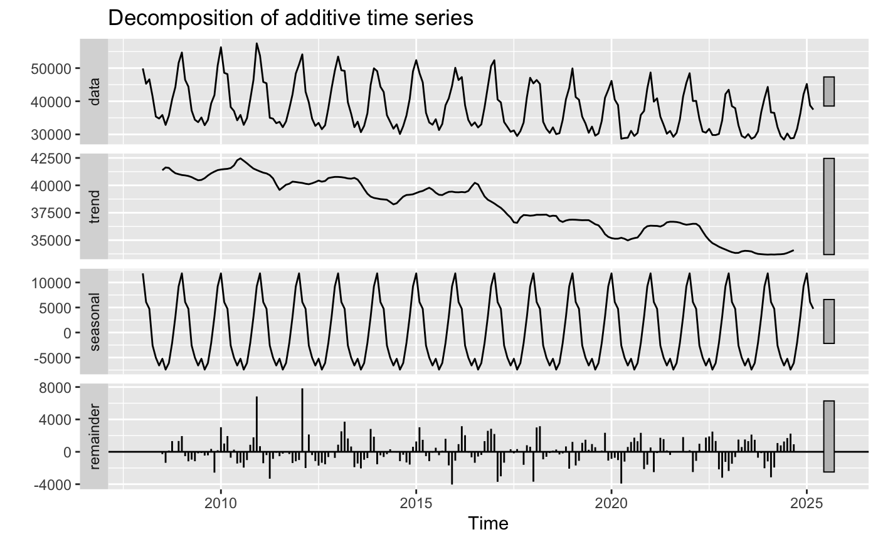
Data and Exploratory Analysis
Dataset Description
Exploratory Analysis
Eurostat portal dataset
Monthly amount of electricity available on the domestic market in France (in gigawatt hours)
From January 2008 to March 2025: 207 months of observation.
Absence of outliers on the box-plot
Visualization of the time series
• Strong seasonality: regular peaks in the winter and lows in the summer
• Slightly decreasing trend: especially since 2010.
• Slight variation in variance: greater variability in the early years, seems to decrease slightly over time.
Time Series Decomposition
Separation into training and testing sets
- Training: 80% (January 2008 – October 2021), 165 observations.
- Test: the remaining 20% (November 2021 – March 2025), 42 observations.
Applied transformations and models to the training set to avoid data leakage.

Slide 5
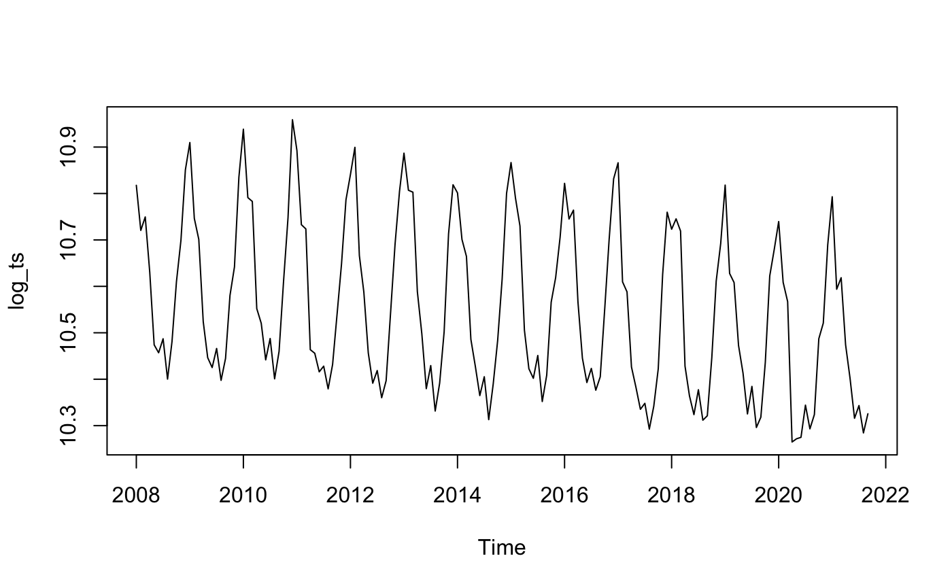
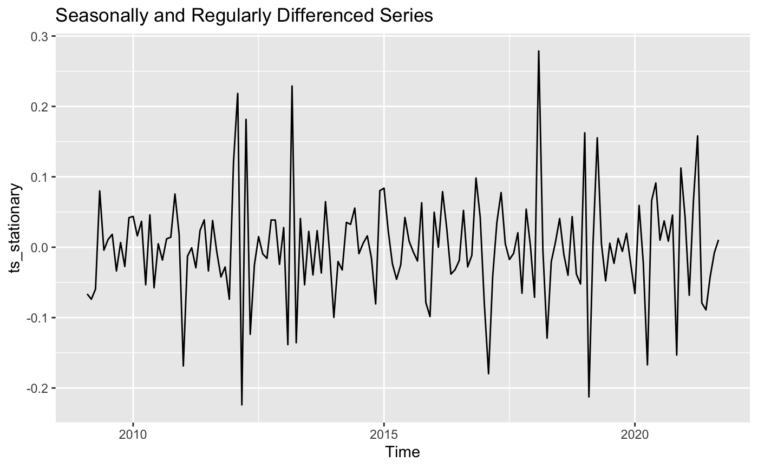
Data Transformations
Stabilise Variance
Stationarity Testing
Differencing
Logarithmic Transformation
Formal stationarity
tests with ADF and KPSS
• ADF test:
H0 : The series is non-stationary.
• KPSS test:
H0 : The series is stationary.
Ambiguous results - safer to differentiate the series, assuming it is not yet fully stationary.
Determine the order of differencing using ndiffs() and nsdiffs(): 1 for each differencing.
Seasonal differencing (lag = 12) due to the strong 12-month seasonality
Regular first difference
Re-ran the stationarity tests (ADF and KPSS)

Slide 6
Modal Proposals
Box-Jenkins Methodology
1
2
3
4
Model identification
Parameter estimation
Diagnostic checking
Forecasting
Analysing the ACF and PACF plots, along with stationarity tests to determine model orders.
Fitting the model to the training data.
Analysing the residuals through autocorrelation checks, white noise behaviour.
Produce forecasts and assess their accuracy against a test set.
Notes:
To rigorously compare different modeling methodologies, we developed multiple candidate models based on the transformed and stationary series.
The primary objective of this project is to evaluate the effectiveness of each model type in both the training and forecasting phases. To that end, we compare the model fit criteria and diagnostics in this section (Section 3), and evaluate predictive performance metrics in Section 4. This allows us to strike a balance between in-sample accuracy and out-of-sample generalization, while avoiding overfitting.

Slide 7
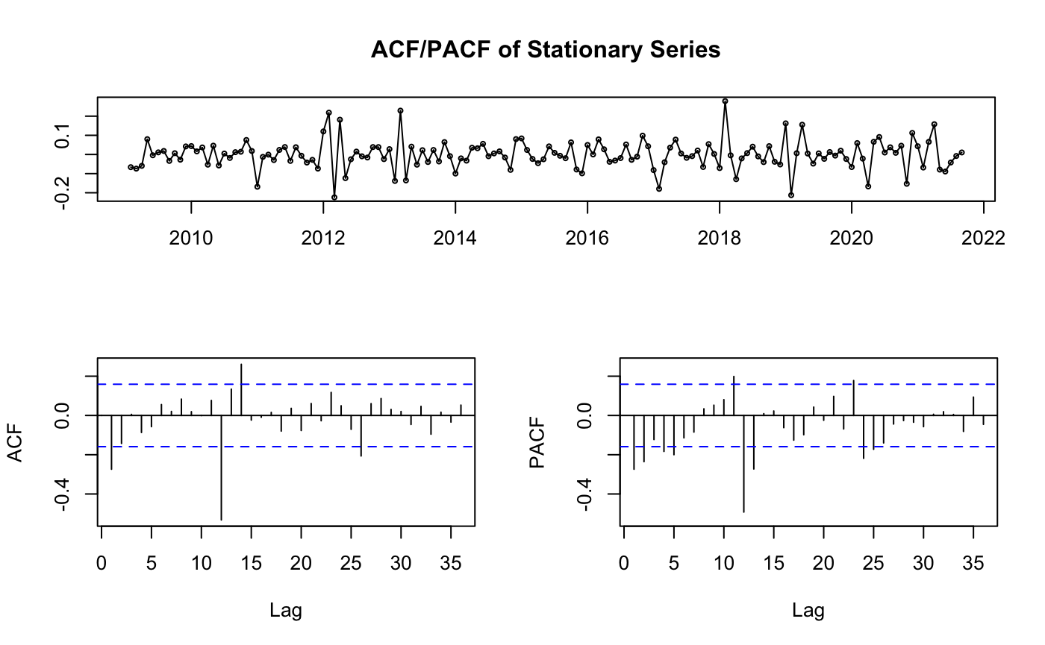
Analysis of ACF and PACF
Identify orders of an ARIMA model
ACF
Measures the correlation between the time series and its own lagged values.
Useful for identifying the order of the moving average component (q).
PACF
Measures the correlation between the time series and its lags while
controlling for other lags.
Used to determine the autoregressive order (p).
• Seasonal order (P, Q): Behaviour is characteristic
of a seasonal moving average component of order 1,
suggesting that Q = 1 and P = 0.
• Non-seasonal order (p, q): Not entirely conclusive, this ambiguity could indicate an autoregressive component of order 1 (p = 1), a moving average component
of order 1 (q = 1), or potentially both.
Notes:
Due to this ambiguity, we opted to use the auto.arima() function from the forecast package, which automates the model selection process by evaluating various combinations of (p, d, q)(P, D, Q) and selecting the model that minimises the AICc or BIC. As this function handles logarithmic transformations and differencing internally when needed, we applied it directly to the original time series object ts_data.

Slide 8
Modal Proposals
Automatic SARIMA Model
STL Decomposition Followed by ARIMA Modeling
Function selected a SARIMA(2,0,0)(0,1,2)[12] model
Seasonal differencing and a seasonal MA component were anticipated.
Selected non-seasonal AR order (p=2) was not fully evident in the initial visual analysis.
Applied STL decomposition - easier to model the residuals (trend and seasonality were removed).
Residuals were modelled using an ARIMA model - ARIMA(2, 1, 1)
ETS Model
Manual SARIMA Model
Automatically selects the best model by testing various combinations of error, trend, and seasonality components.
Selected model was ETS(M,Ad,M):
- Error: Multiplicative (M)
- Trend: Additive Damped (Ad)
- Seasonality: Multiplicative (M)
Chosen model SARIMA(1,1,1)(0,1,1)[12]
Reflects regular and seasonal differencing.
Uses p = 1 and q = 1, values that were selected based on the non-seasonal lags of the ACF and PACF.

Slide 9
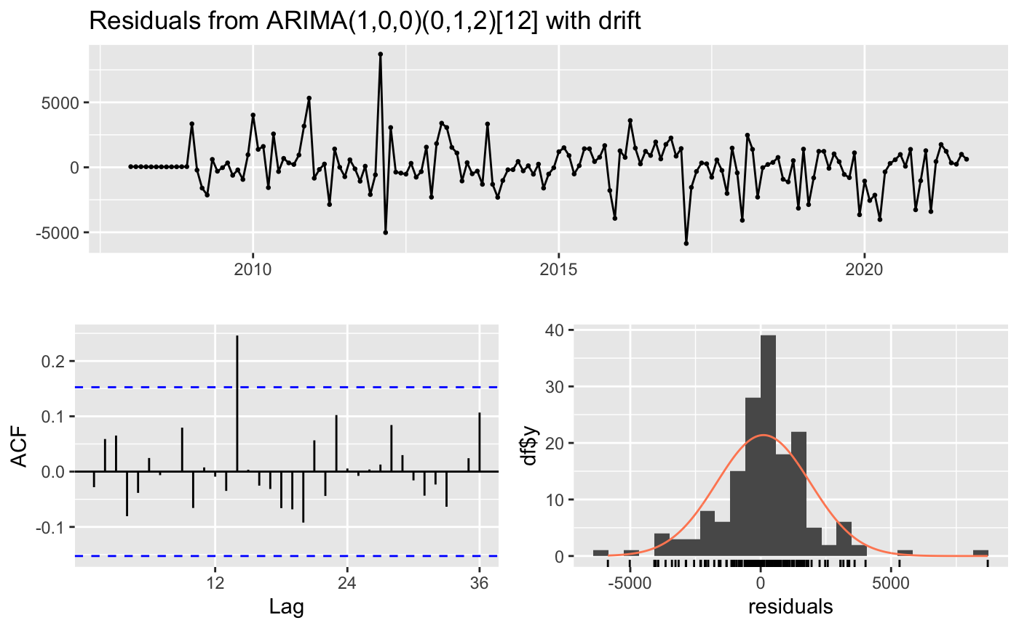
Automatic SARIMA Model Results
The residuals plot reveals no discernible patterns and oscillates around a zero mean.
The ACF of the residuals presents only one significant spike, suggesting minimal autocorrelation.
The Ljung-Box test returns a high p-value (0.35), indicating no significant autocorrelation structure in the residuals.
These results confirm that the residuals behave like white noise.

Slide 10
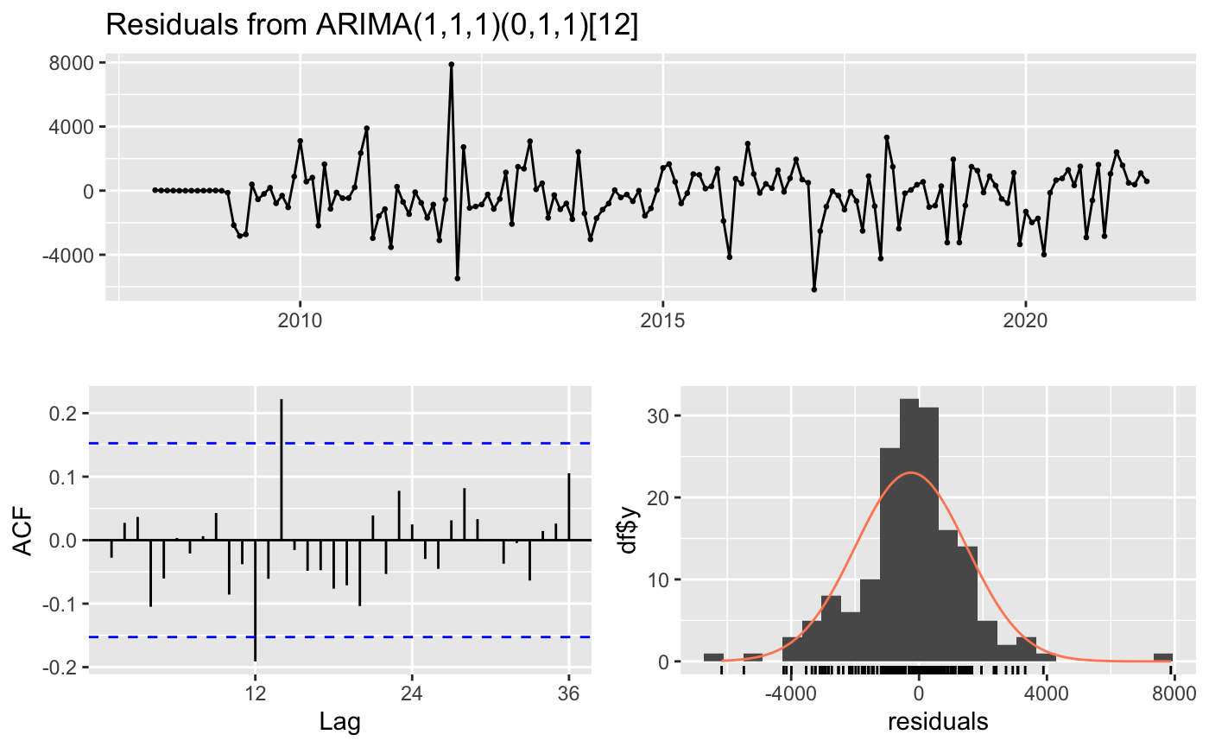
Manual SARIMA Model Results
• AR(1): ar1=0.3651, significant (low standard error).
• MA(1): ma1=-0.9689.
• Seasonal MA(1): sma1=-1.0000, indicating strong seasonal dependence.
• Standard error = 0.1472, likely significant.
• MAPE: 3.07% – excellent accuracy.
• ACF1: -0.028 – close to zero, indicating no residual autocorrelation.
Residuals fluctuate randomly around zero with no visible structure.
ACF of residuals show overall no meaningful autocorrelation.
Ljung-Box test returns a p-value of 0.13, meaning we cannot reject the null hypothesis of independently residuals.
The residuals behave like white noise.
Notes:
The estimated parameters are interpretable and appear to be statistically significant. When comparing information criteria to the previous automatic model SARIMA(2,0,0)(0,1,2)[12], we observe that AIC, AICc, and BIC are lower, suggesting that the manual model achieves a better fit.

Slide 11
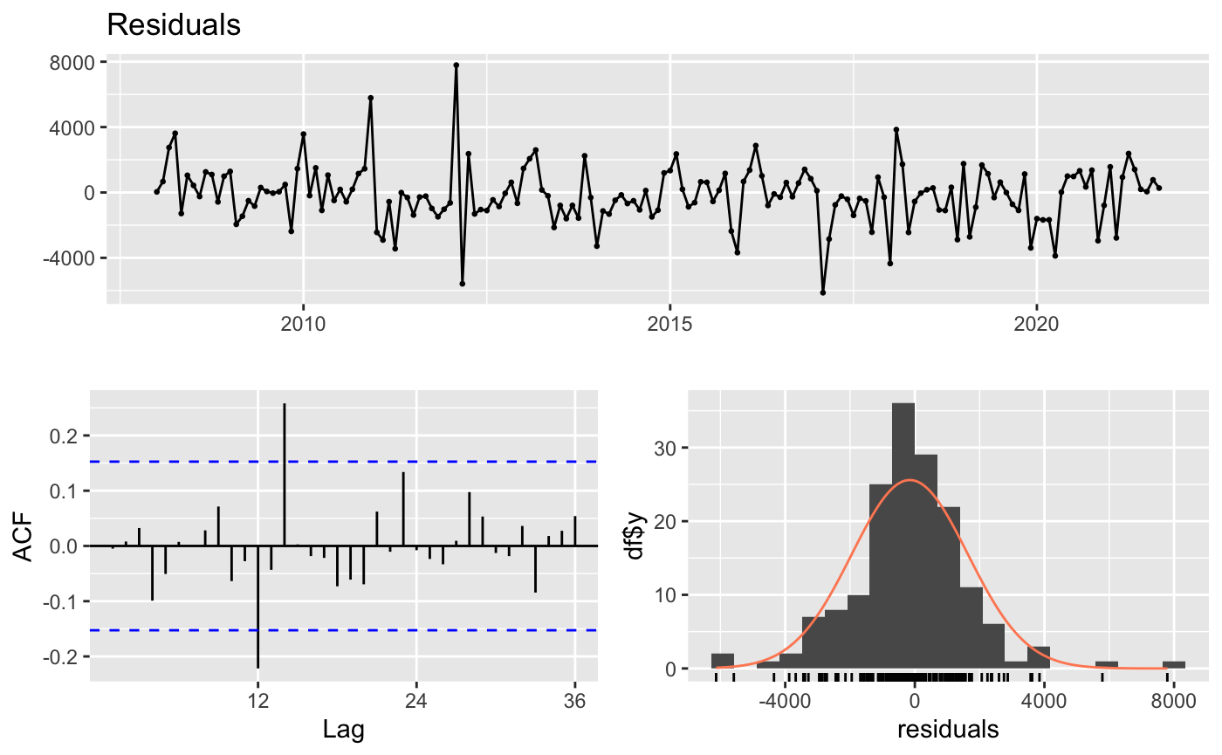
STL Decomposition Followed by ARIMA Modeling Results
The residuals show no obvious patterns, oscillating randomly around zero.
The ACF function of the residuals indicates no significant correlation between the residuals.
The Ljung–Box test showed a high p-value (0.11), implying that there is no evidence to reject the null hypothesis that the residuals are independent.
These results suggest that the model has successfully passed the diagnostic checks and that the residuals behave like white noise.

Slide 12
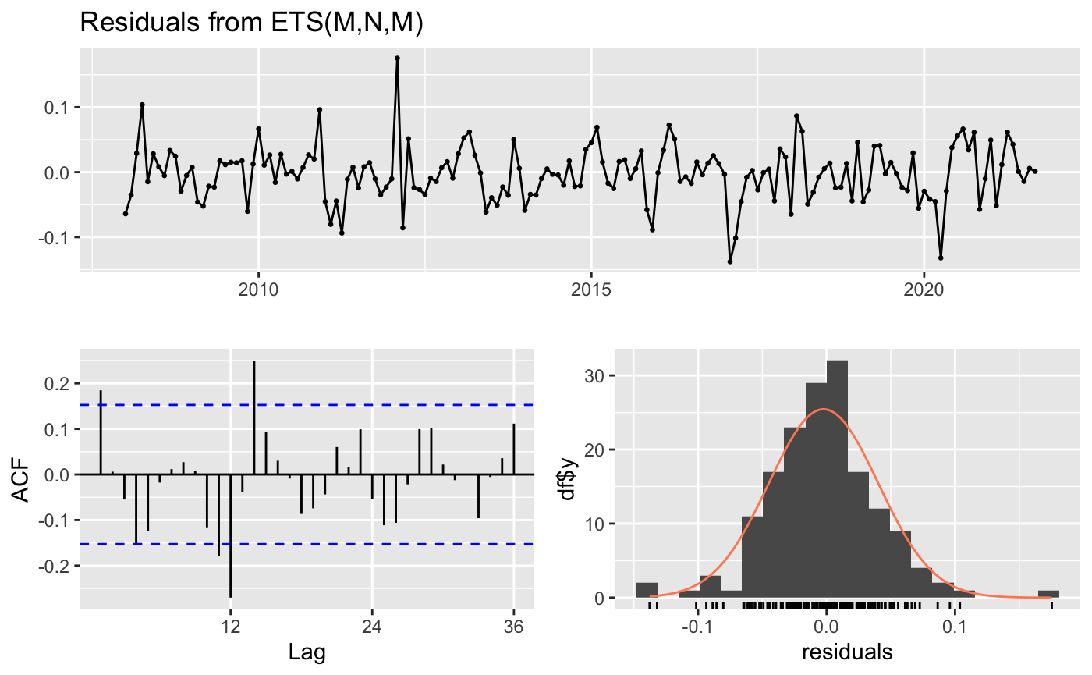
ETS Model Results
- Alpha (0.2592): indicates balance between the weight given to recent and past observations.
- Gamma (1e-04) is practically zero, suggesting fixed seasonality over the period.
The sigma value (0.0445) indicates low residual variability, suggesting that the model reasonably well controls the residuals.
Information criteria (AIC and BIC) are considerably higher than those of previous models, suggesting that this model does not fit the series as well.
The residual autocorrelation (ACF1 approximatly 0.16) suggests that the
residuals are slightly dependent.
Random behaviour around zero, with no clear patterns.
The autocorrelation function indicates residual correlation.
Ljung–Box test rejects the null
hypothesis of residual independence, indicating that the residuals do not behave like white noise.
Notes:
In addition, the model tends to underestimate the values, as indicated by the negative mean errors (ME and MPE). This poorer fit can be explained by the non-stationarity of the data, which requires differentiation to stabilise the series, a transformation that the ETS model does not perform, thus compromising its fit.

Slide 13
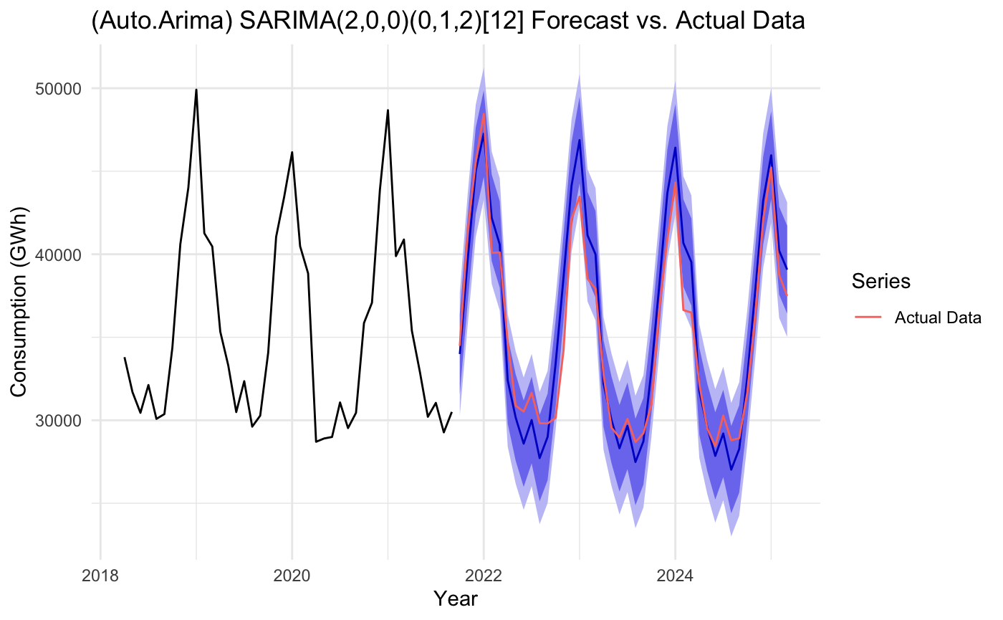
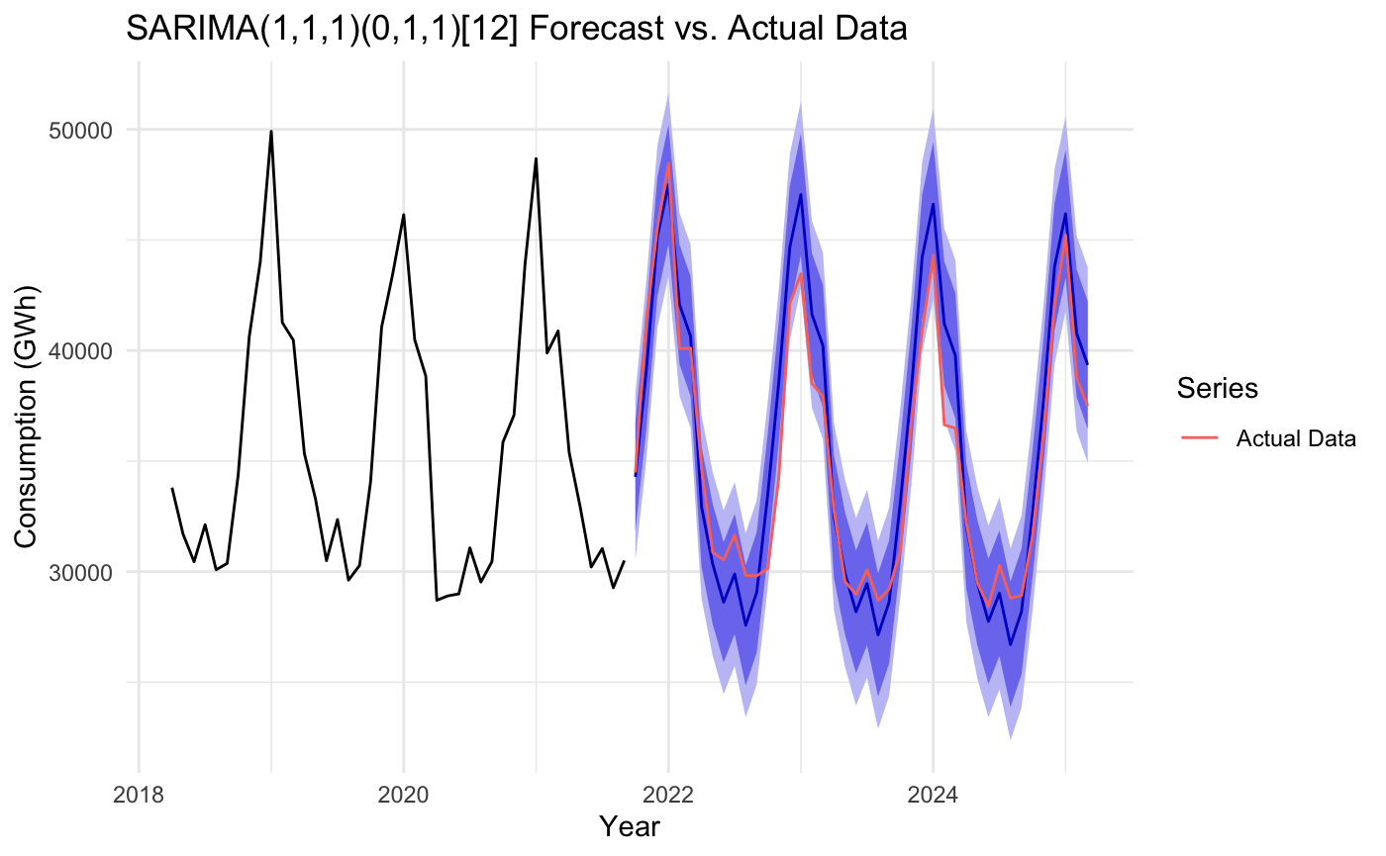
Forecast Evaluation and Confidence Analysis
1. SARIMA Automatic (2, 0, 0) (0, 1, 2) [12]
Best overall forecasting performance (MAPE = 4.37%,
Theil's U = 0.518).
Captures trends and seasonality well.
High reliability: most actual values are within the 95% confidence interval.
There is still room for improvement due to small residual autocorrelation (ACF1 = 0.619).
2. SARIMA manual (1, 1, 1) (0, 1, 1) [12]
Good predictive capacity (MAPE = 4.67%, Theil's U = 0.558).
Seasonality is well represented, but the higher ACF1 value (0.657) suggests that the residual patterns are not fully captured.

Slide 14
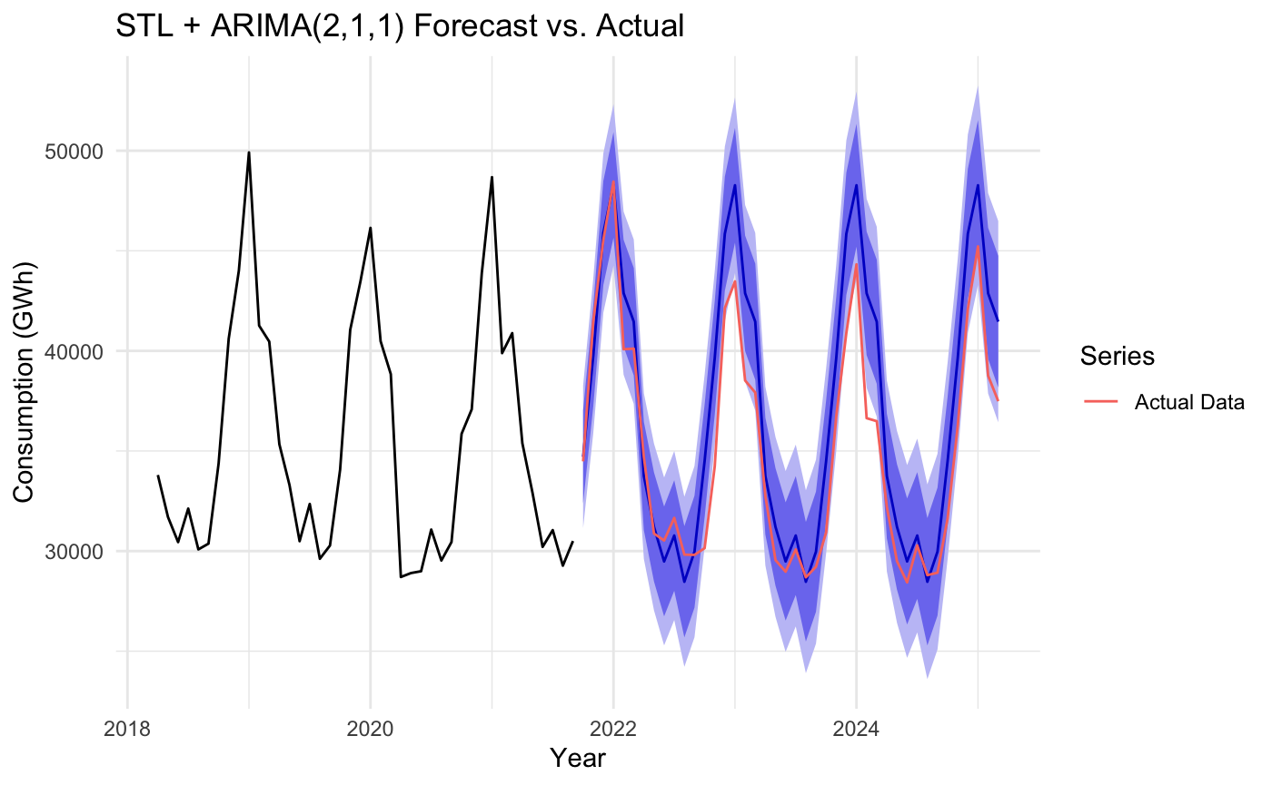
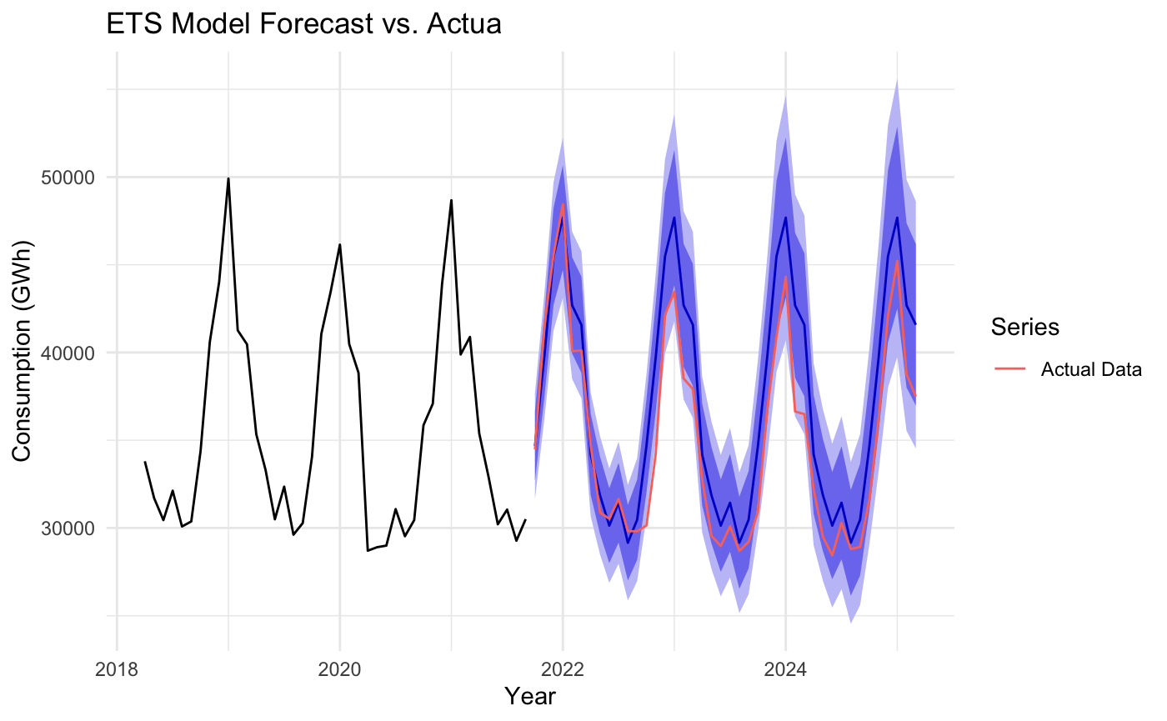
Forecast Evaluation and Confidence Analysis
3. STL + ARIMA (2, 1, 1):
Performs well in training (MAPE ≈ 3%), but underperforms in testing (MAPE > 6%).
Captures trends and seasonality well, but underfits out of sample.
High ACF1 (0.69) and Theil's U = 0.779 (better than naive, but inferior to SARIMA).
4. ETS (Exponential Smoothing):
Good fit in training (MAPE ≈ 3.2%), but performs poorly in testing (MAPE > 6%).
Seasonality is modelled well, but there is underfitting and ACF1 is approximately 0.65.
Theil's U = 0.787, which is worse than the SARIMA model but better than the naive model.

Slide 15
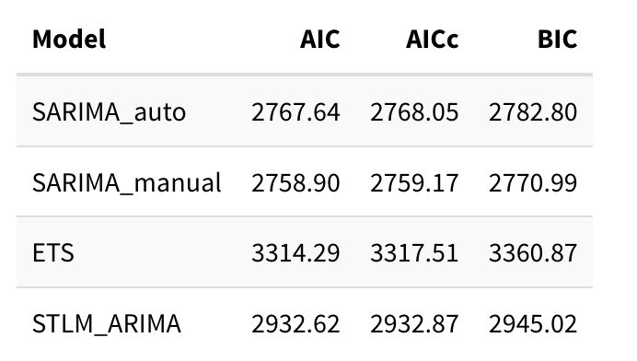
Results and Discussion
Model Comparison Based on Information Criteria
Best performance:
The SARIMA model in manual mode showed the lowest AIC, AICc and BIC values.
Similar performance:
The automatic SARIMA model produced close but slightly lower results.
Least efficient models:
The STLM ARIMA and ETS models showed significantly higher values, indicating lower adjustment capacity.

Slide 16
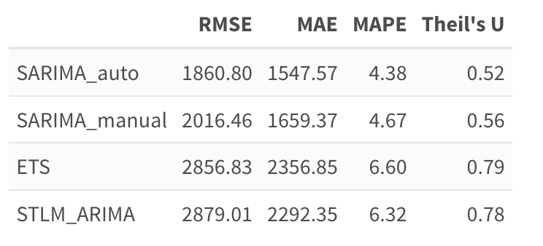
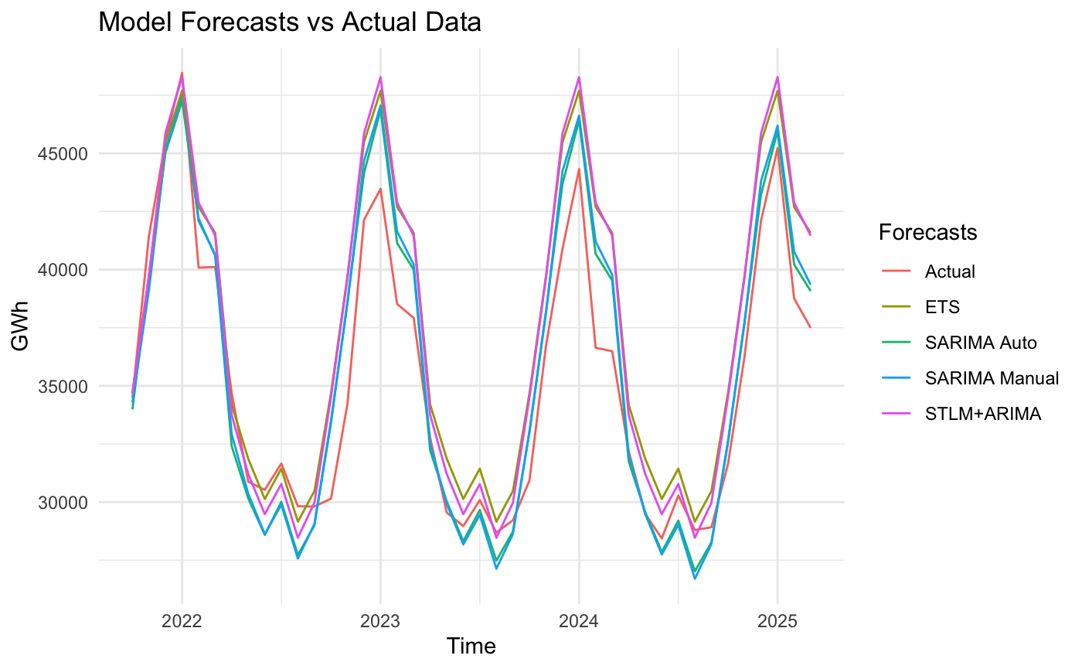
Results and Discussion
Model Comparison Based on Forecast Accuracy
Better predictive performance:
The automatic SARIMA model achieved the lowest RMSE, MAE,
MAPE and Theil's U values.
Good performance:
Manual SARIMA was also effective, albeit with slightly lower performance.
Less accurate models:
ETS and STLM ARIMA produced significantly higher error rates.

Slide 17
Conclusion
Most suitable models
Less suitable models
The SARIMA automatic and manual models stood out among those evaluated.
Manual SARIMA:
Best historical fit (the lowest AIC, AICc and BIC values).
Automatic SARIMA:
Higher predictive accuracy (lower RMSE, MAE, MAPE and Theil's U).
ETS and STLM ARIMA performed worse in terms of both criteria.
Final Conclusion
Manual SARIMA is ideal for historical analysis.
Auto SARIMA is better suited to future forecasting.
The SARIMA family of models is the most suitable for this time series.

Slide 18
Thanks!
Do you have any questions?

