Slide 1
Movie Reviews Database
Bryce Bond
Bipin Chhetr
Christopher Bednarz
Cristiano Caon
Michael Contreras
Notes:
Bryce
-Bepen chatri
Caon - Kaon

Slide 2
Motivation
Notes:
Bryce

Slide 3
Aggregating Movie Info and Reviews!
Create a database for movies and their respective info and reviews
Motivated by websites like IMDB and Rotten Tomatoes
Our goal is to inform people about the movies they want to watch
Notes:
Bryce

Slide 4
Approach

Slide 5
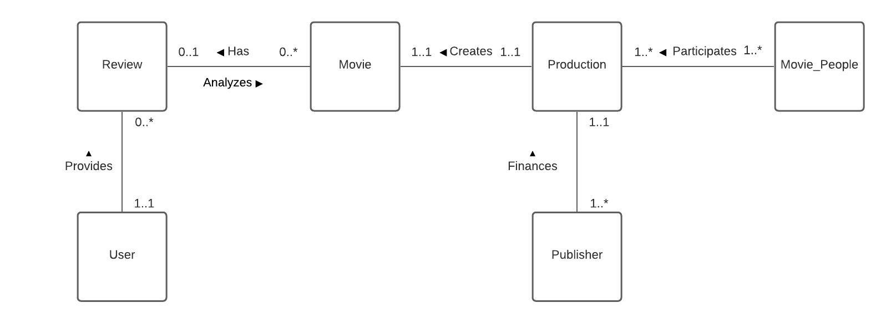
Conceptual Design
Notes:
Intro table and discus relations, movie people = writers, directors etc.

Slide 6
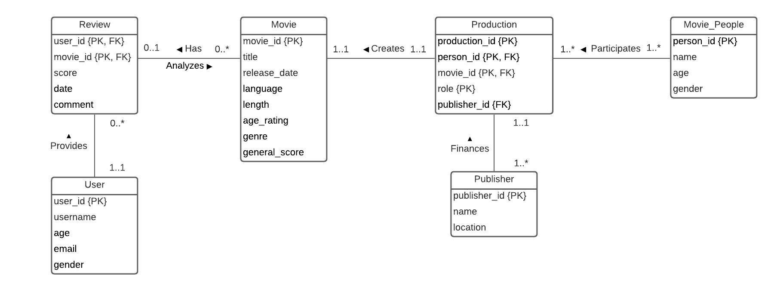
Logical Design
Notes:
Discuss primary and foreign keys, and how they uniquely identify the rows for those tables. Does not need to go in-depth about the other attributes

Slide 7
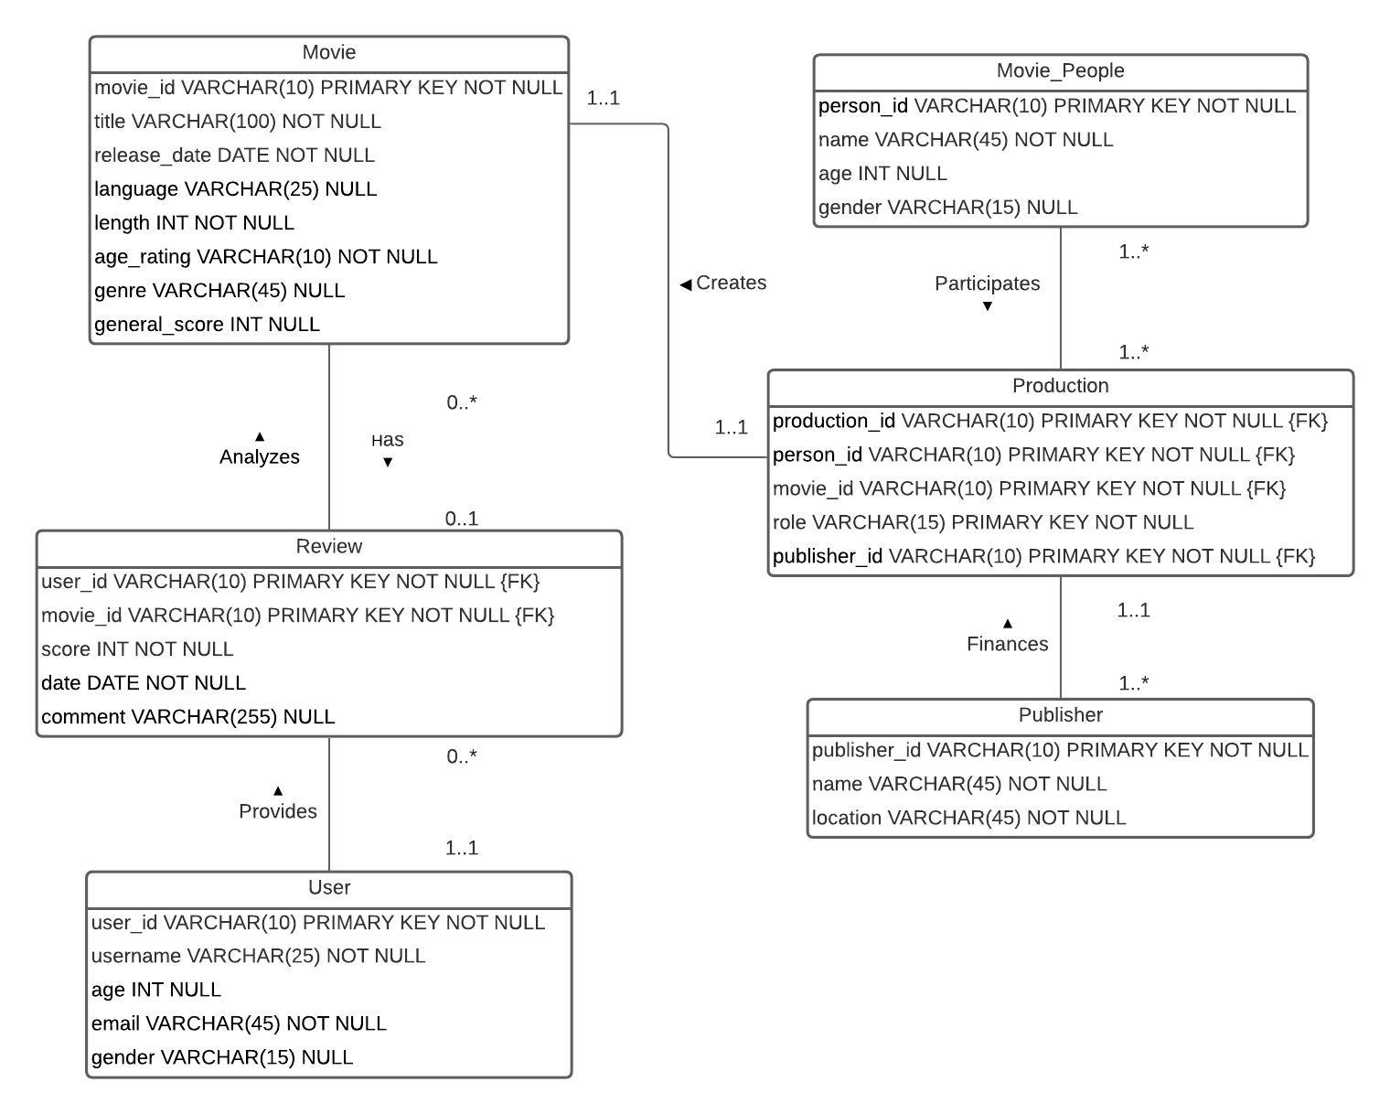
Physical Design
Notes:
Here is implementation of the actual database, NULLS and data type

Slide 8
Data

Slide 9
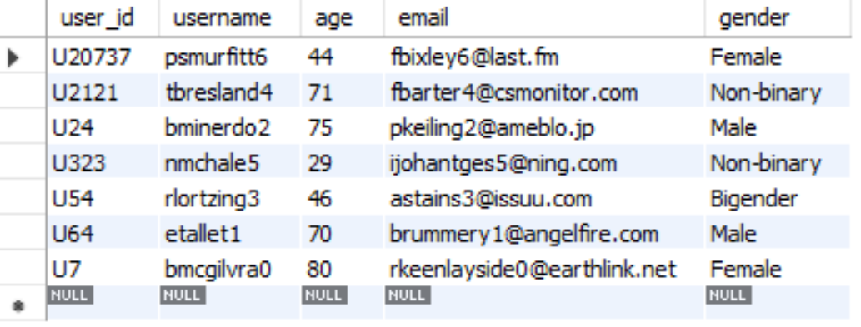
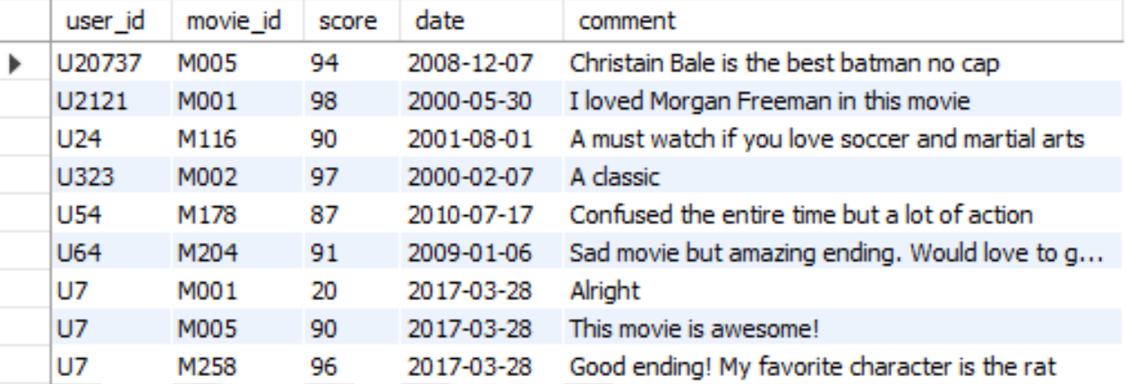
User
Review
Notes:
Cover id ideas

Slide 10
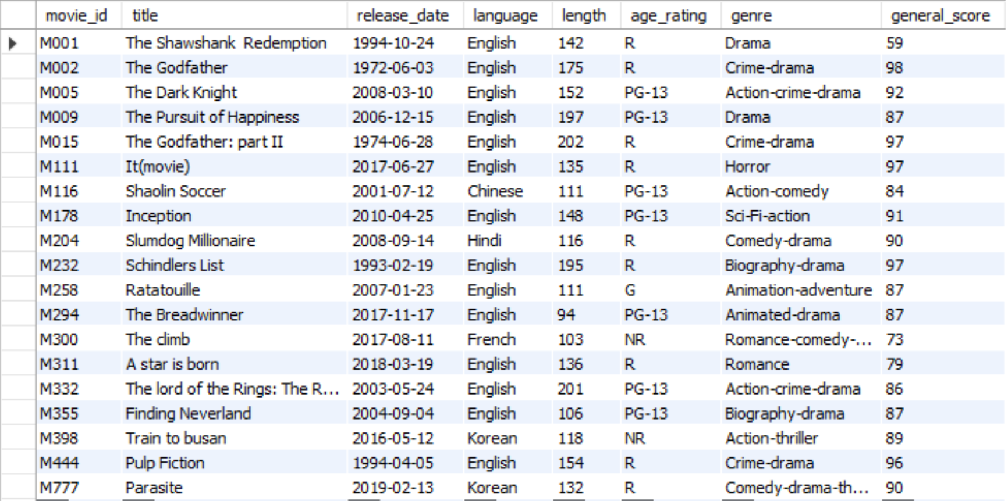
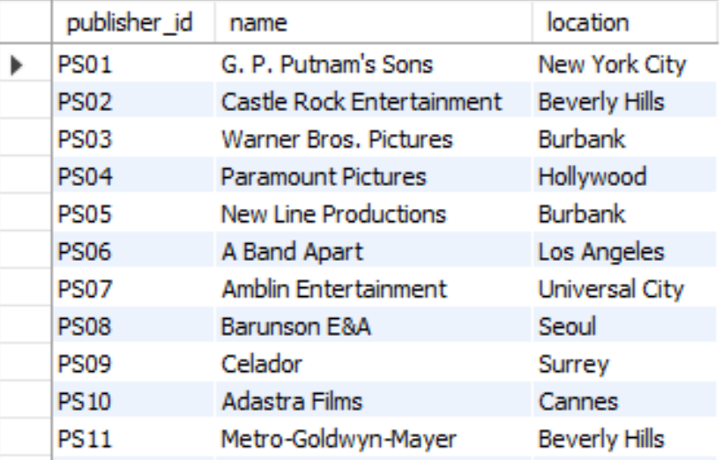
Movie
Publisher
Notes:
Movie uses most of the useful information needed

Slide 11
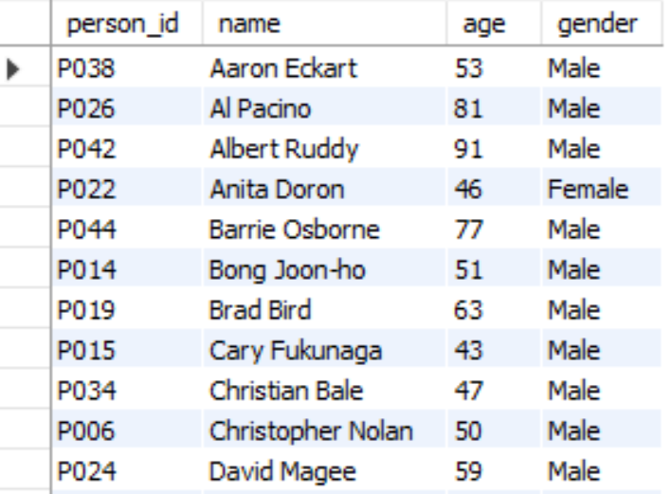
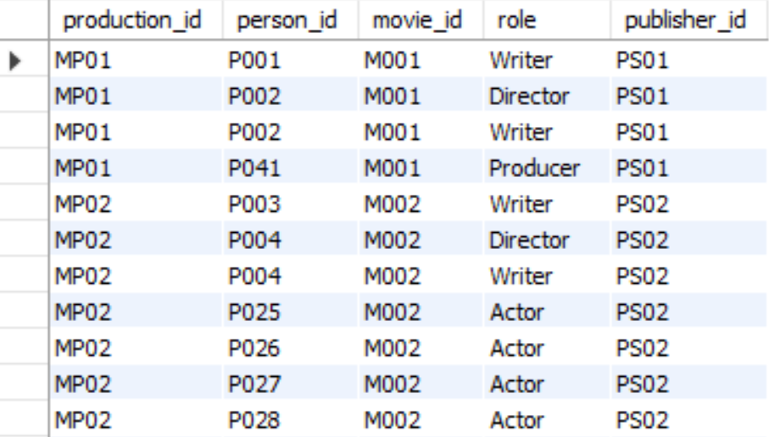
Movie People
Production

Slide 12
Discussion

Slide 13
Strengths
Weaknesses
No redundant data
Triggers for movie score update
Indexes for movies and reviews
Views for movie production and reviews
Database is not fully normalized
Needs more data
Notes:
Indexes on movie title, movie score, review comments and review, score

Slide 14
Potential Extensions and Omissions
Insertion of more movie data
Implementation of different views, stored procedures and triggers
Such as showing which movies an actor has starred in.
Further normalization
Production would have an accessory table that links to movie_people.

Slide 15
Demo
Notes:
Christiano

