Slide 1
Secure boot and firmware update
Architecture options for OEMiRoT on STM32C5
based on example_oemirot_dualslot_hwcrypto

Slide 2
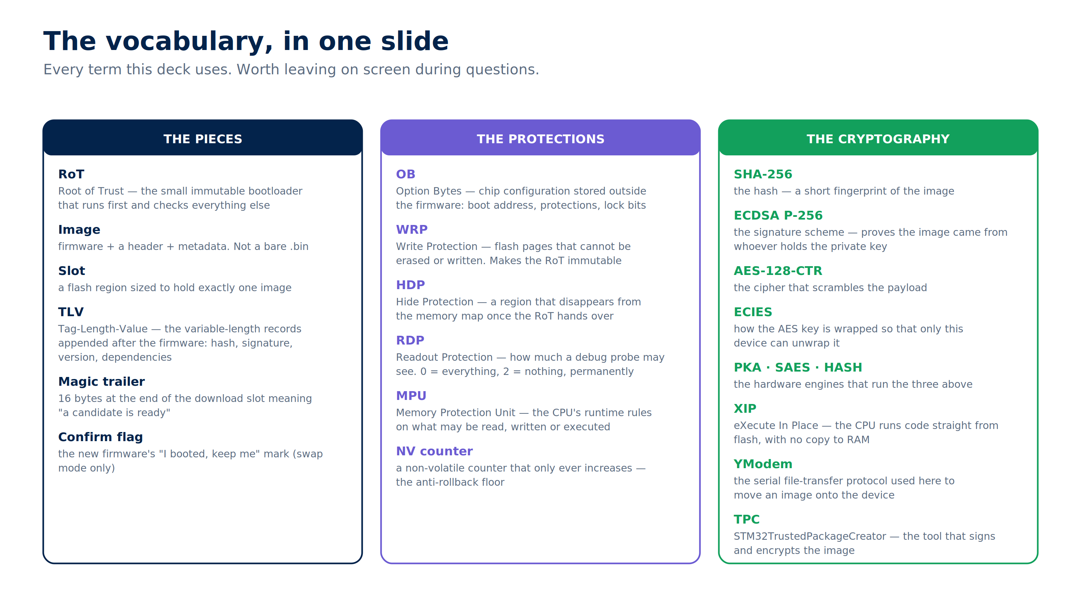
Notes:
Vocabulary slide. Do not read it out - put it up, say it stays available, and come back to it whenever someone asks what a term means.

Slide 3
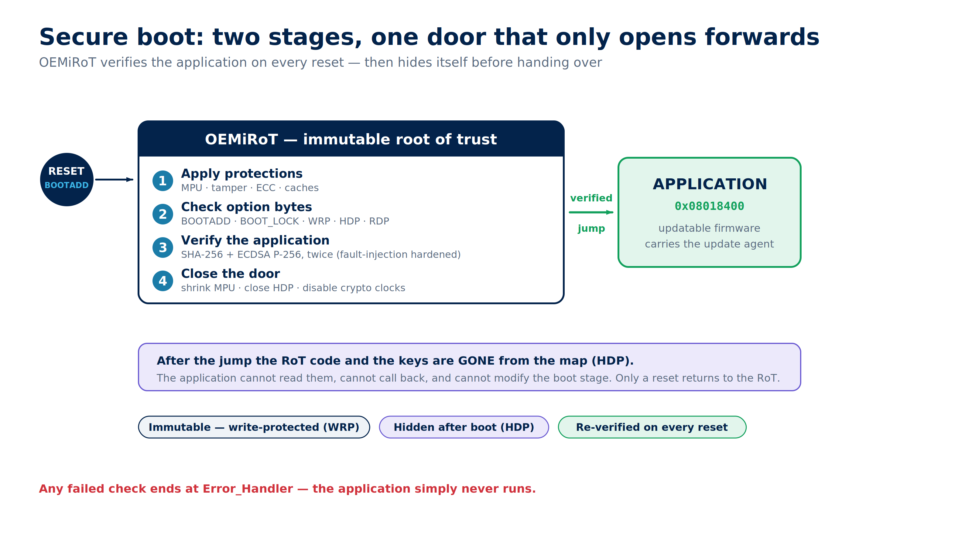
Notes:
The frame for everything else: an immutable first stage that checks the second one, then hides itself. Nothing the application does can reach back into it.

Slide 4
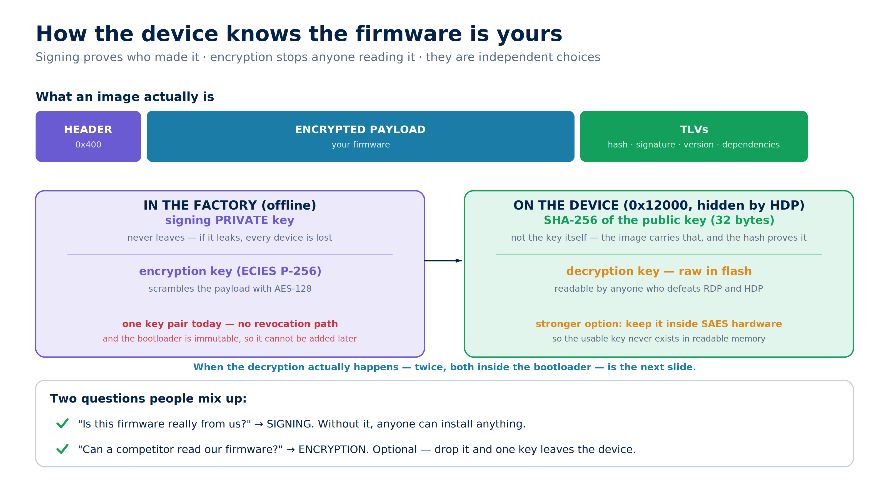
Notes:
Signing and encryption answer different questions. Note the two weak points we own: a single key pair with no revocation path, and a decryption key sitting raw in flash.

Slide 5
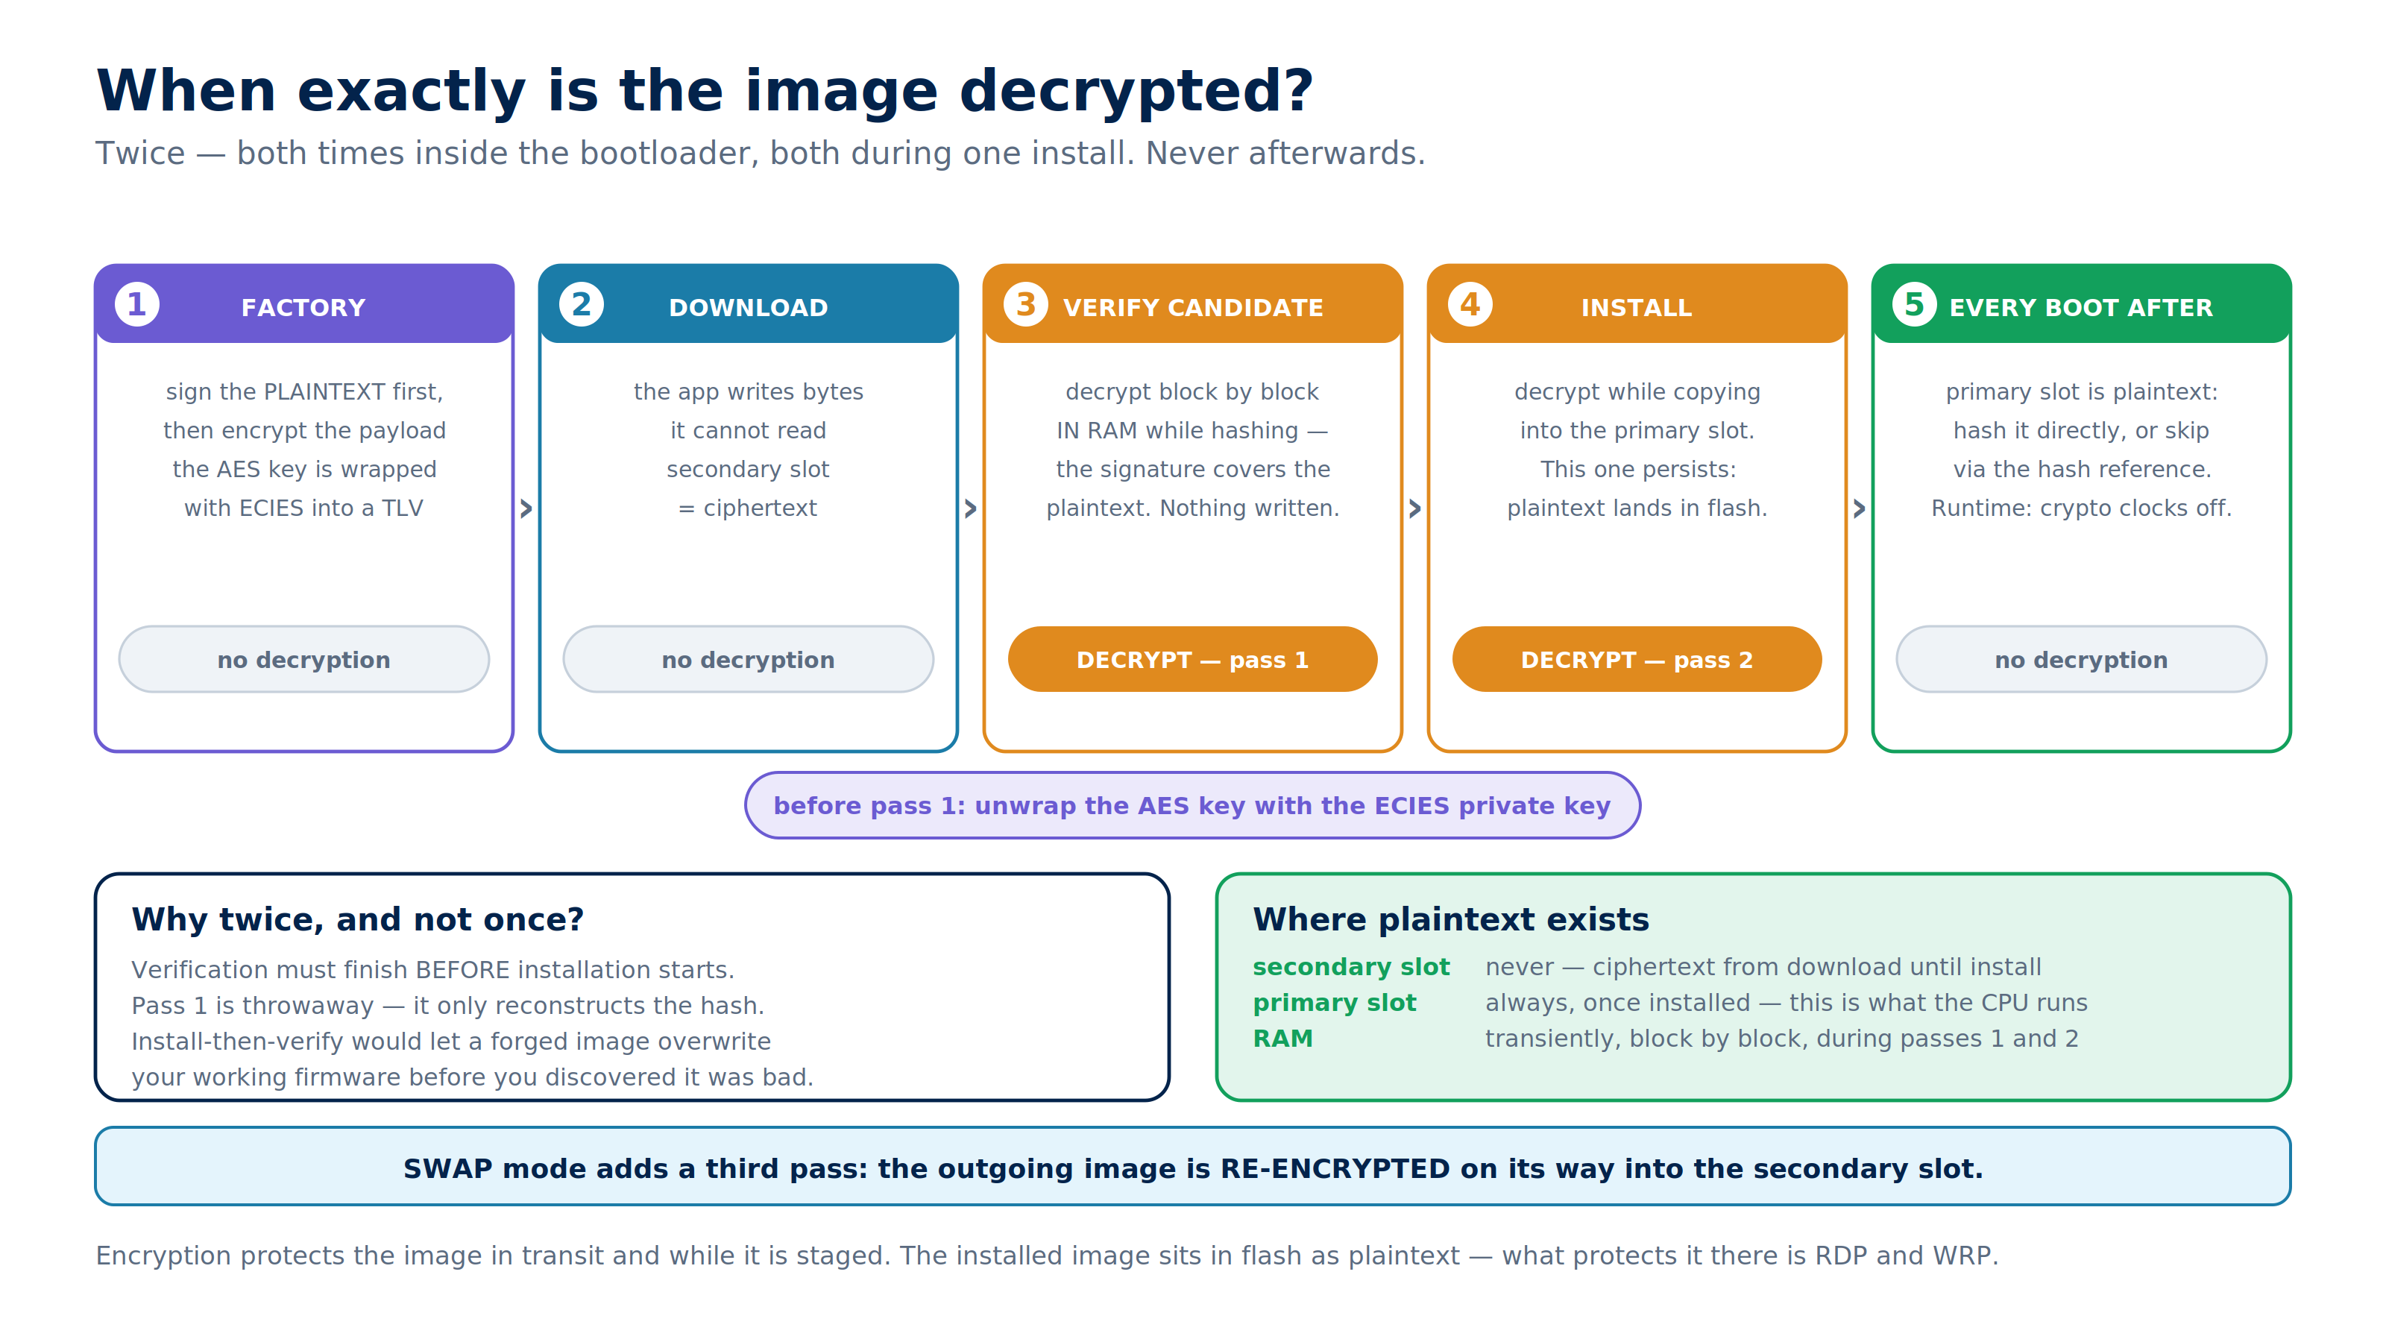
Notes:
Answers 'when is it decrypted'. The headline: twice, both inside the bootloader, both during one install, never afterwards. The 'why twice' box is the part people ask about - verification must finish before installation starts.

Slide 6
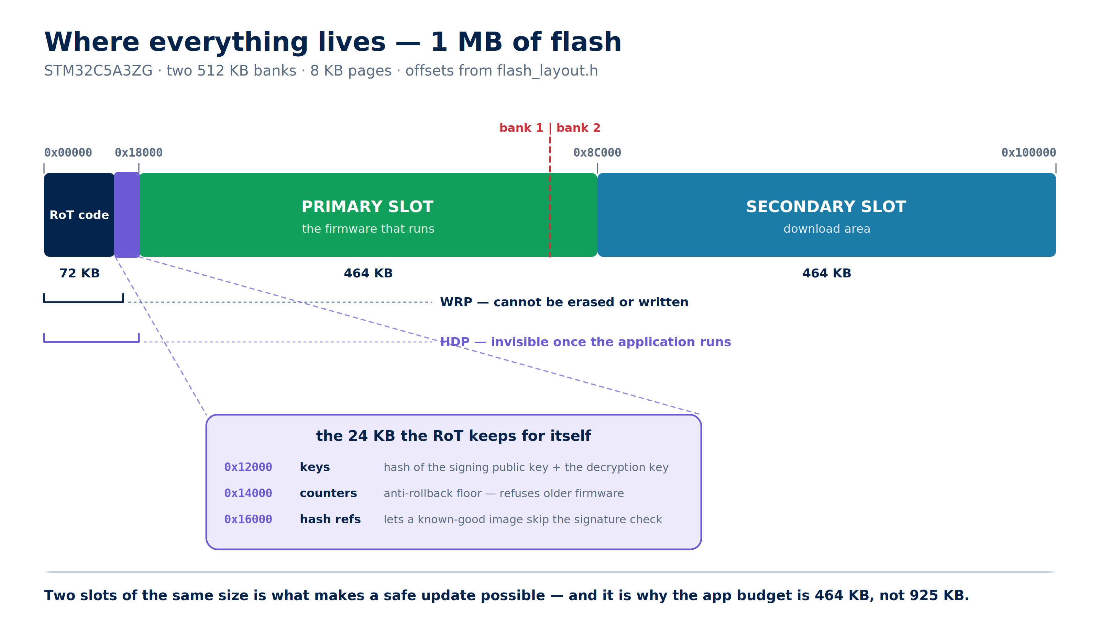
Notes:
Real offsets from flash_layout.h. The headline number is 464 KB usable out of 1 MB - that is the price of the second slot, and it drives most of the later decisions.

Slide 7
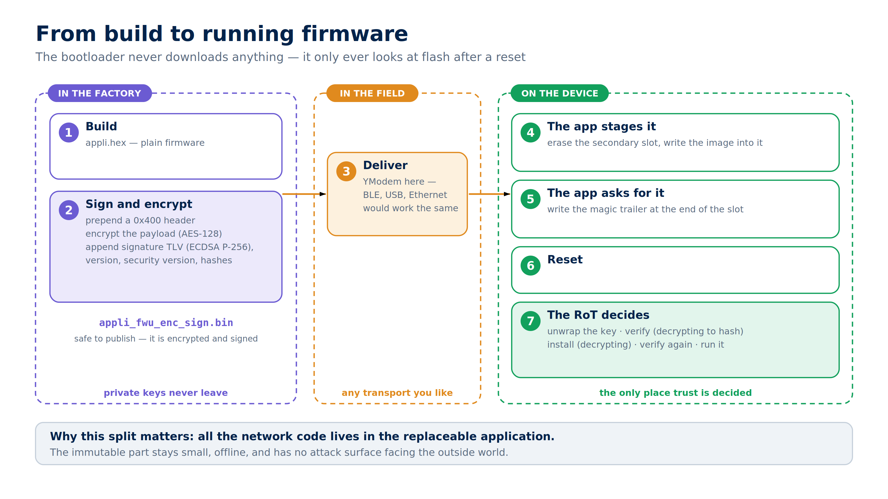
Notes:
Key point: the bootloader never downloads anything. All transport code lives in the replaceable application, so the immutable part stays small and offline.

Slide 8
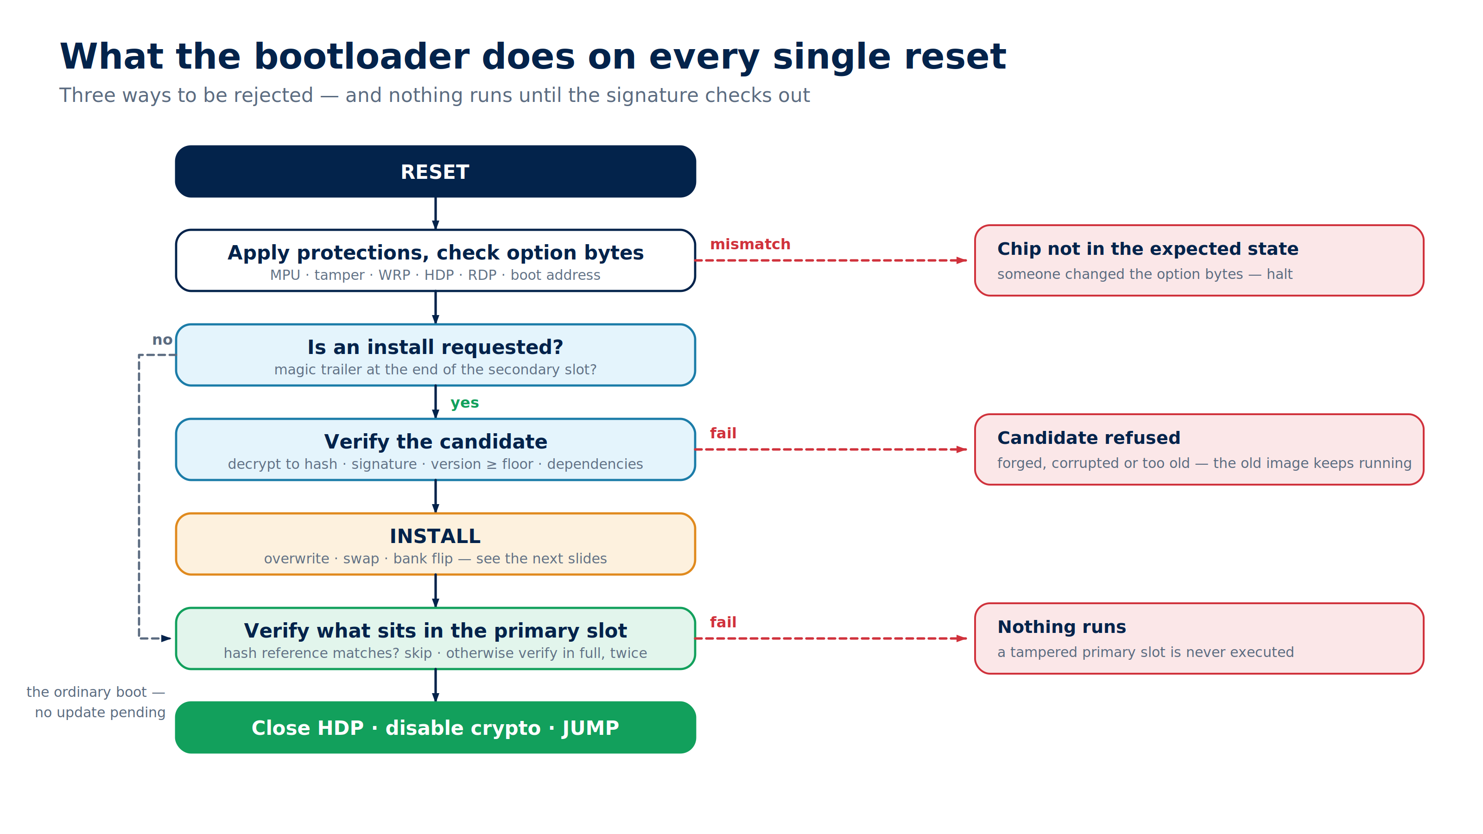
Notes:
This runs on every reset, not just on update. Three independent rejection paths, and the primary slot is re-verified even when no update is pending.

Slide 9
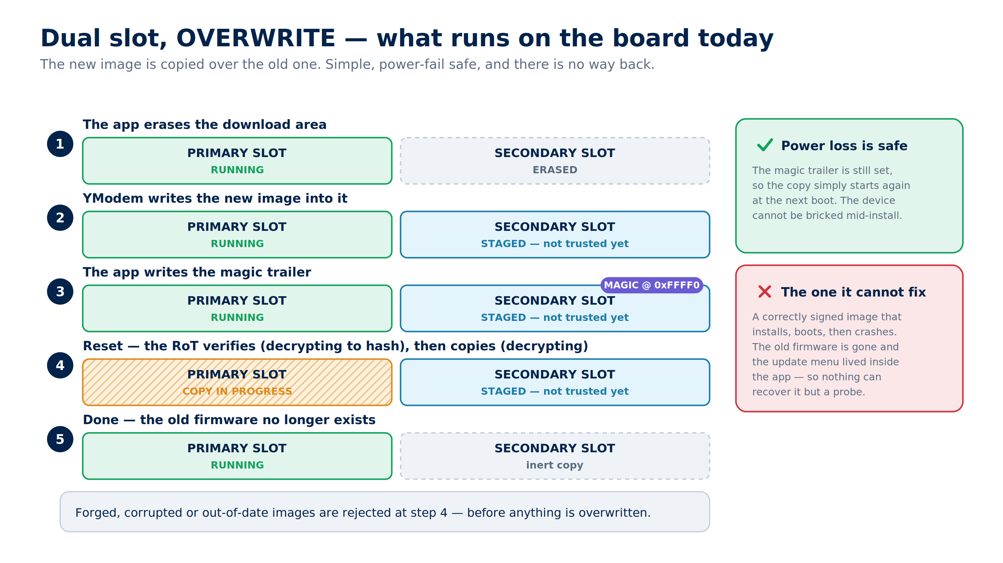
Notes:
What the board does today. Walk the five states, then land on the red box: a signed image that crashes takes the update path down with it.

Slide 10
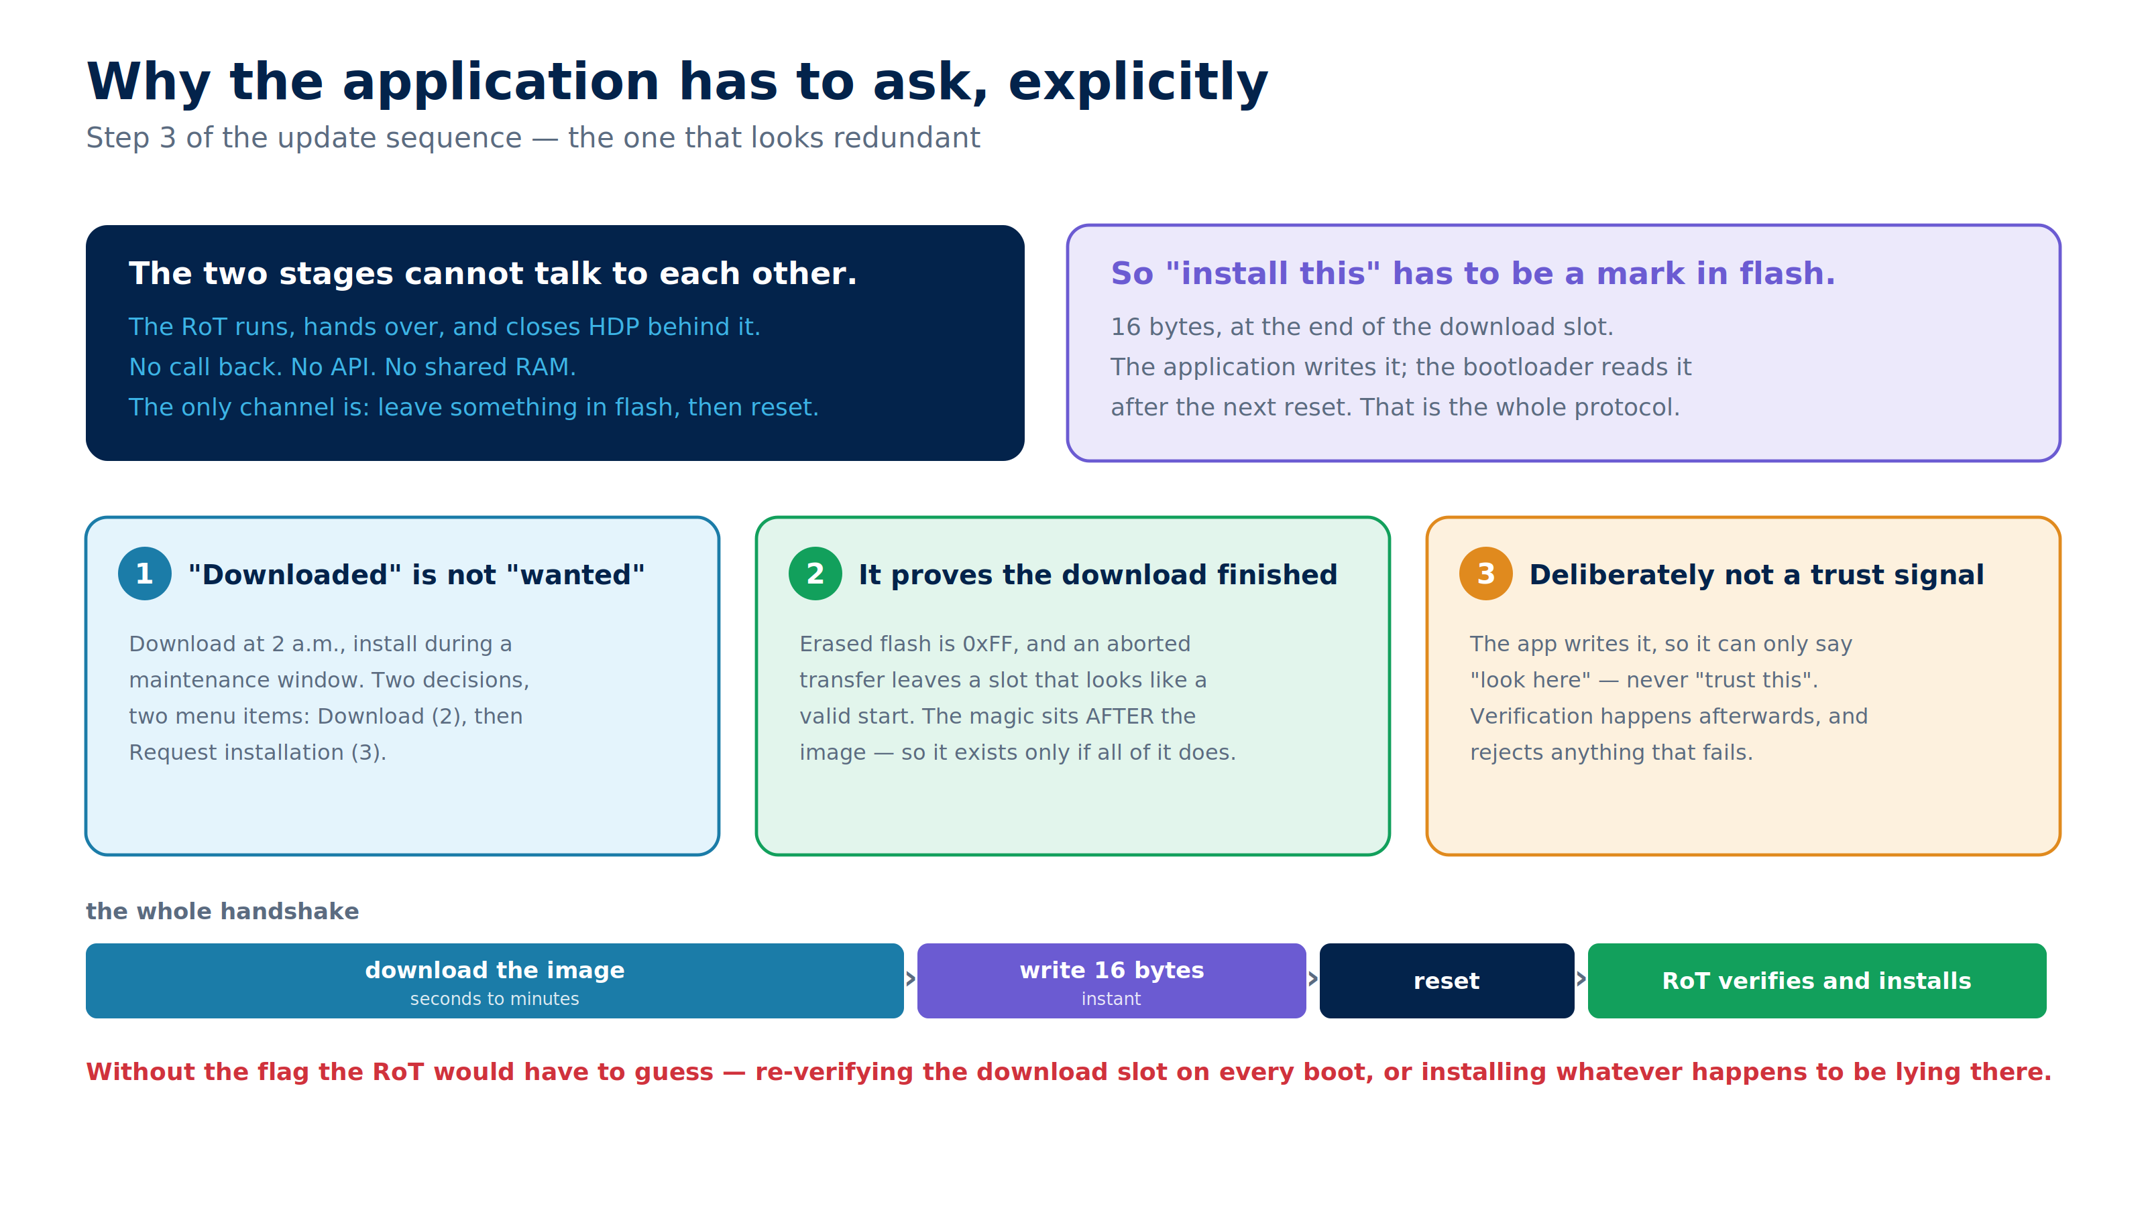
Notes:
Answers the question the previous slide always provokes: why a separate 'request install' step at all. The short version: the two stages cannot talk, so the only channel is a mark in flash - and that mark also proves the download completed.

Slide 11
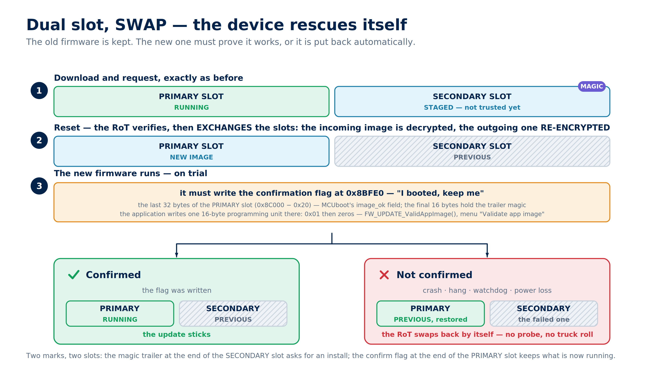
Notes:
The same flow plus one confirmation flag. Worth stressing: the confirm code already exists in our application, compiled out by OVERWRITE_ONLY.

Slide 12
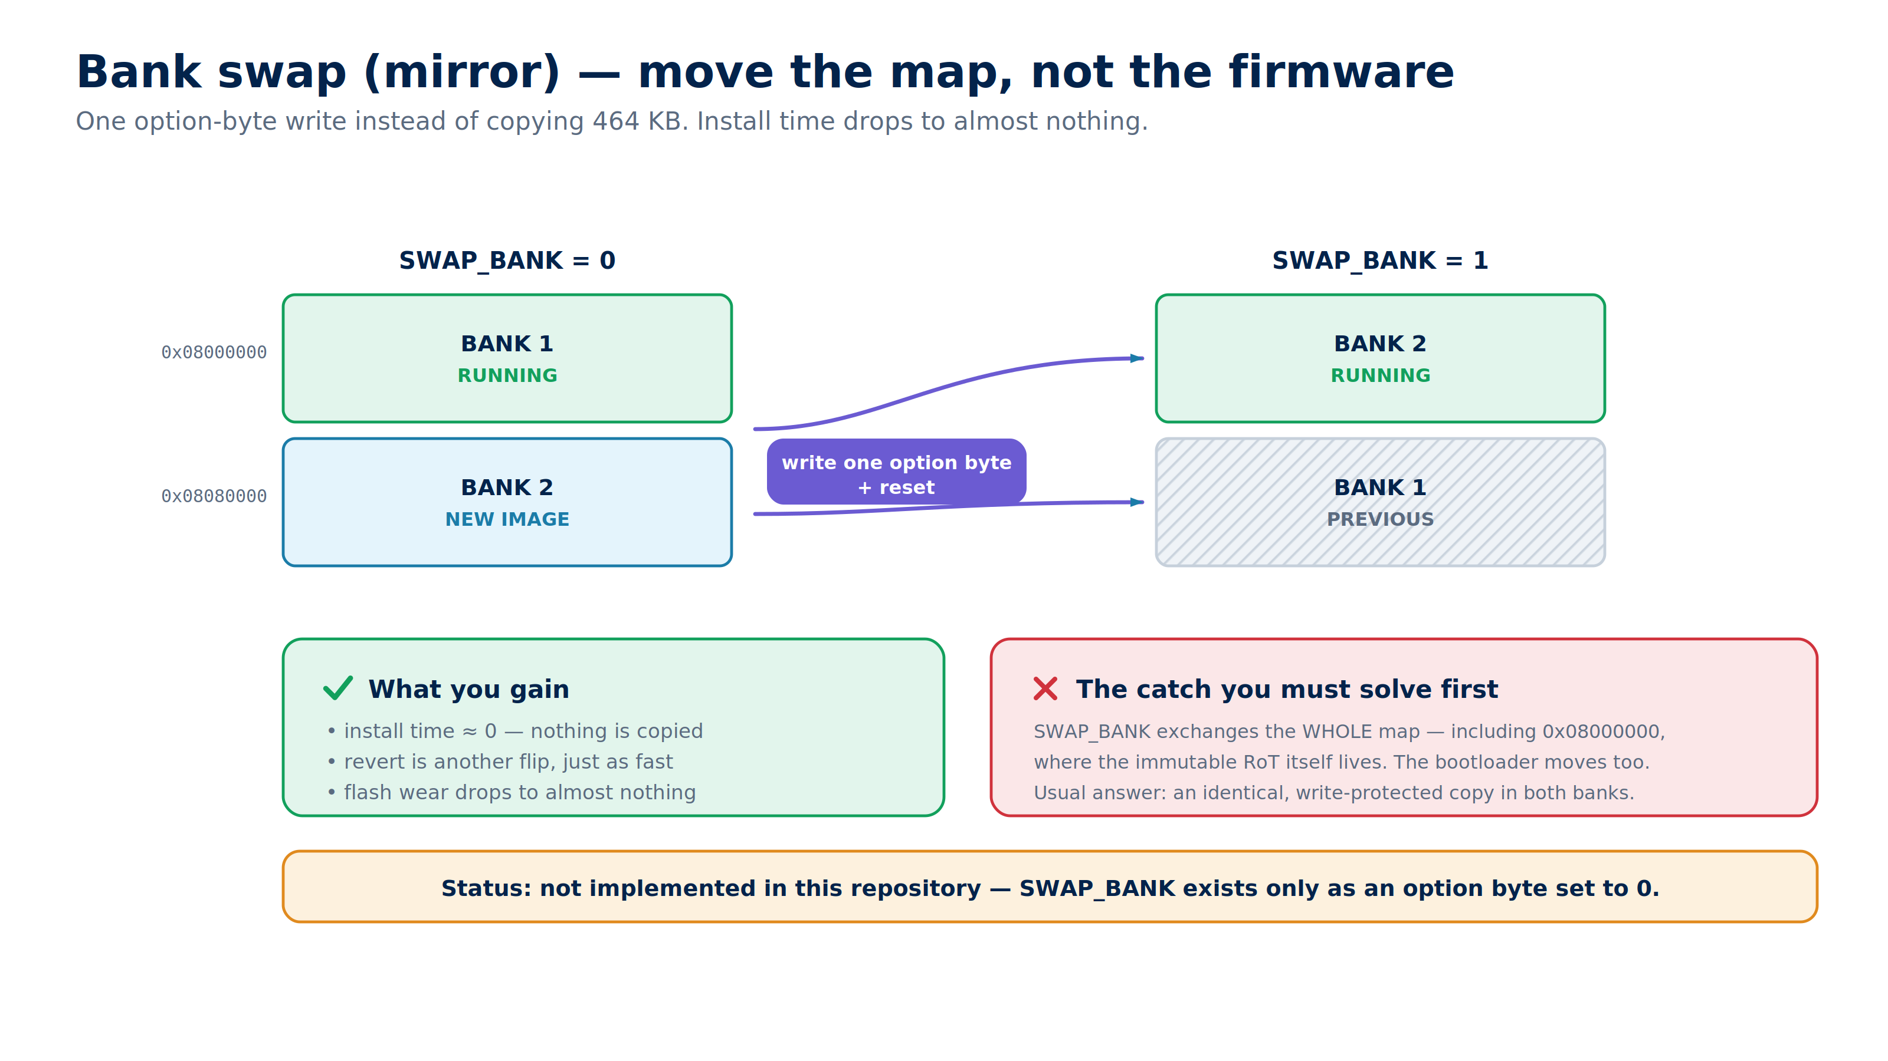
Notes:
Attractive on paper - instant install. Be honest about the open question: SWAP_BANK moves the bootloader too, and nothing in our repo implements this yet.

Slide 13
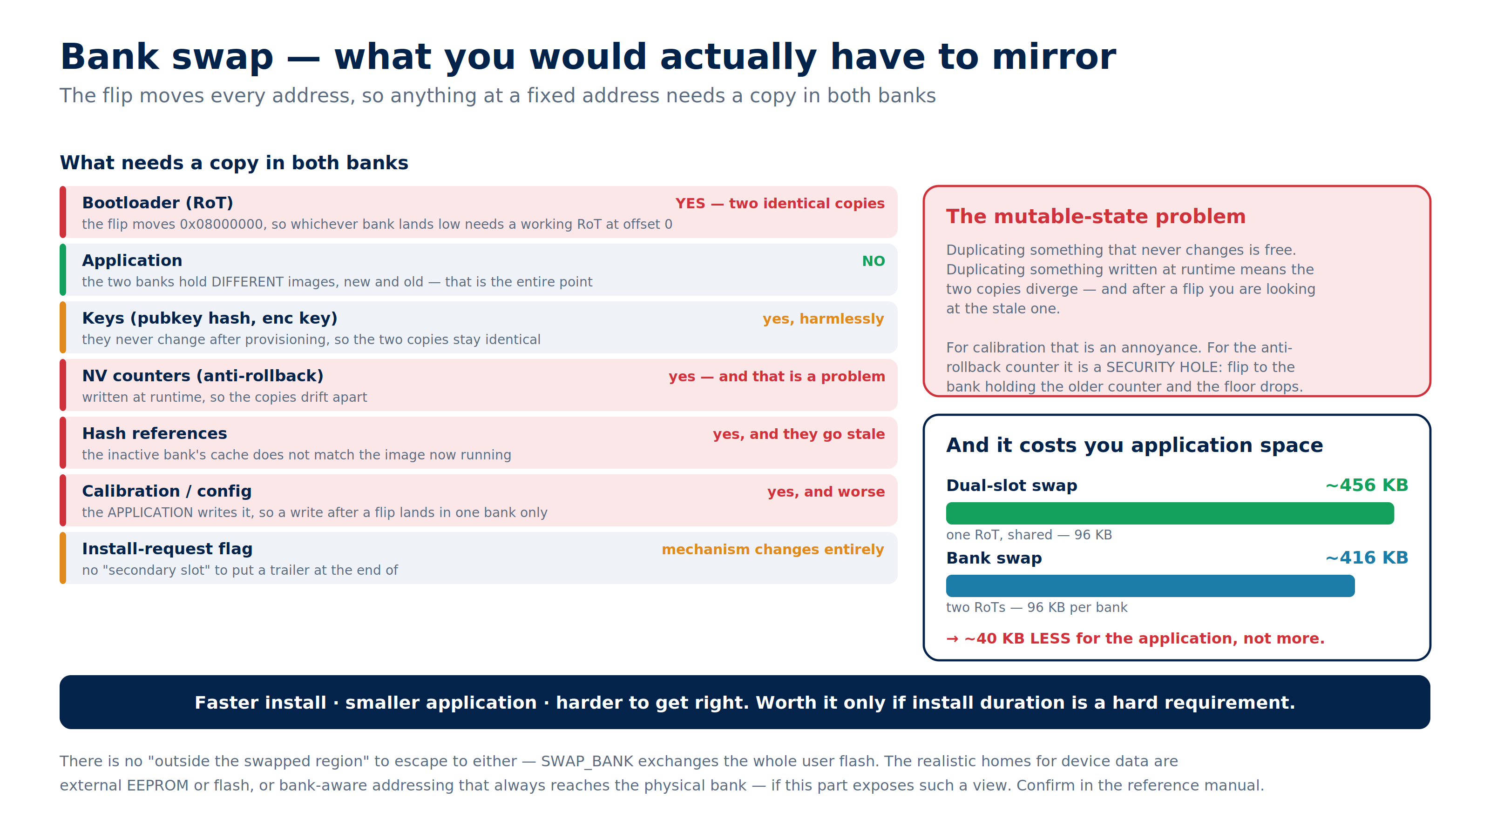
Notes:
The cost side of bank swap. Immutable things mirror harmlessly; runtime-written state (counters, calibration) does not - for the anti-rollback counter that is a security hole. And the doubled RoT leaves ~40 KB LESS for the application than dual-slot swap.

Slide 14
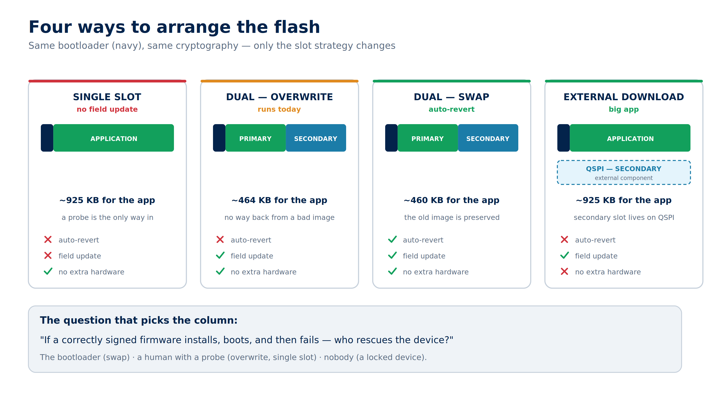
Notes:
The four arrangements side by side. The closing question is the one that actually picks a column; everything else follows from it.

Slide 15
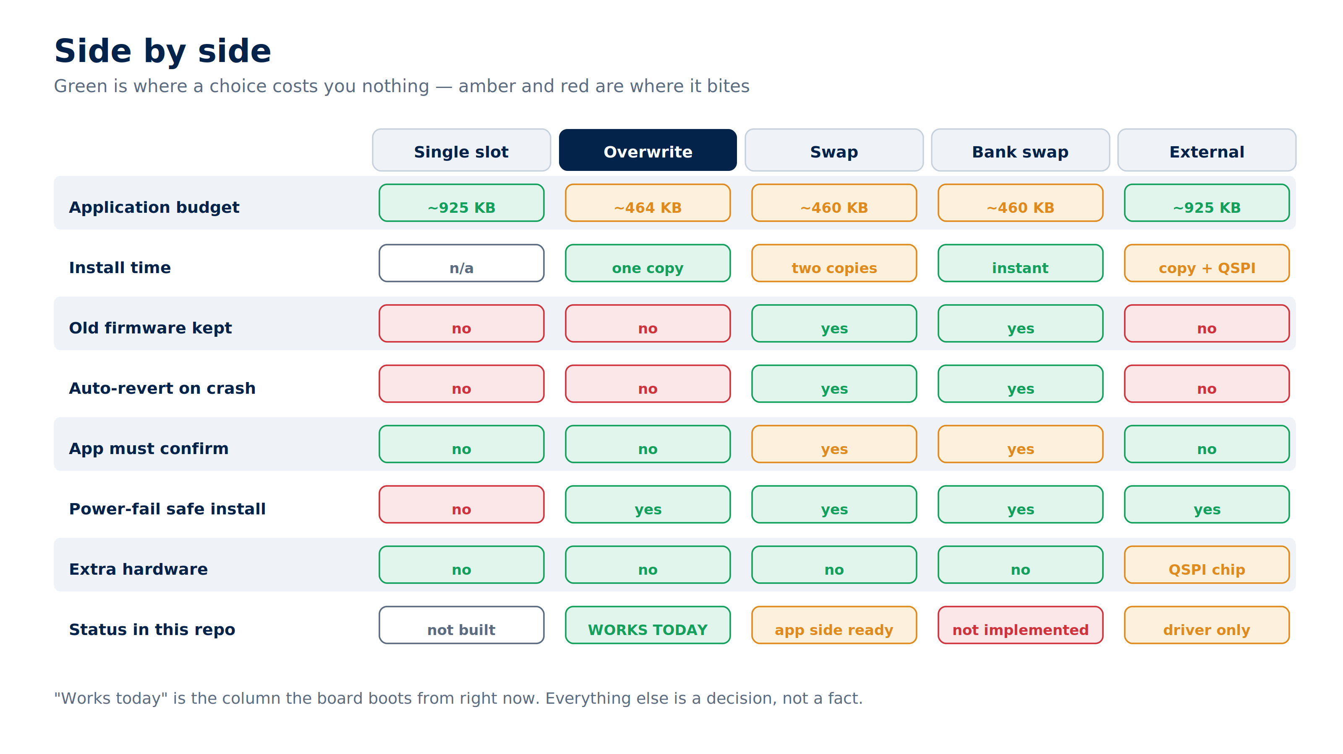
Notes:
Detail view of the same trade-offs. The status row separates what we have from what we would have to build.

Slide 16
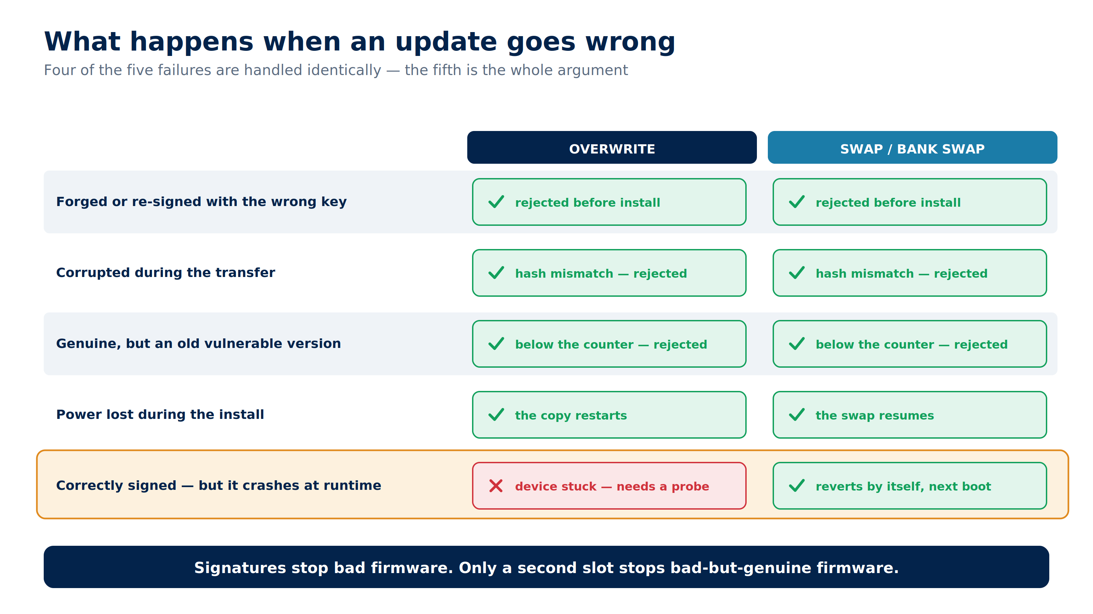
Notes:
The argument in one table. Four failures are handled identically - only the last row separates overwrite from swap.

Slide 17
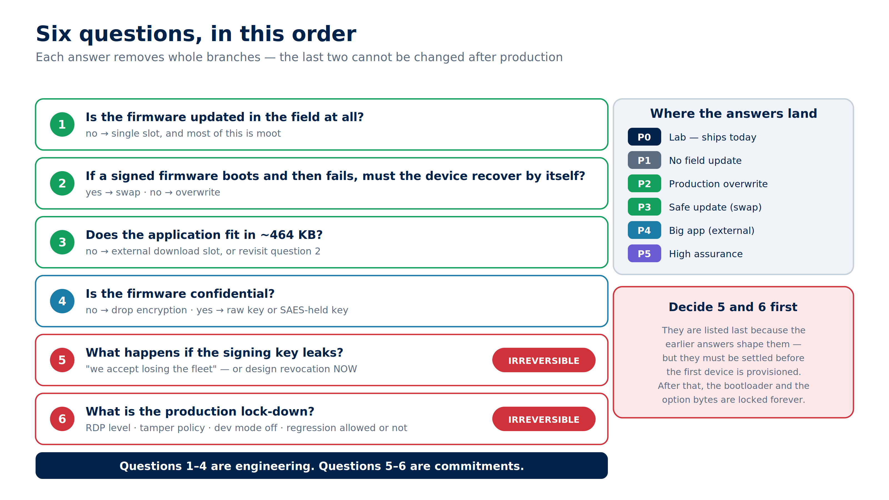
Notes:
Proposed order for the decision. Questions 5 and 6 are irreversible once devices are provisioned, so they need an answer before anything ships.

Slide 18
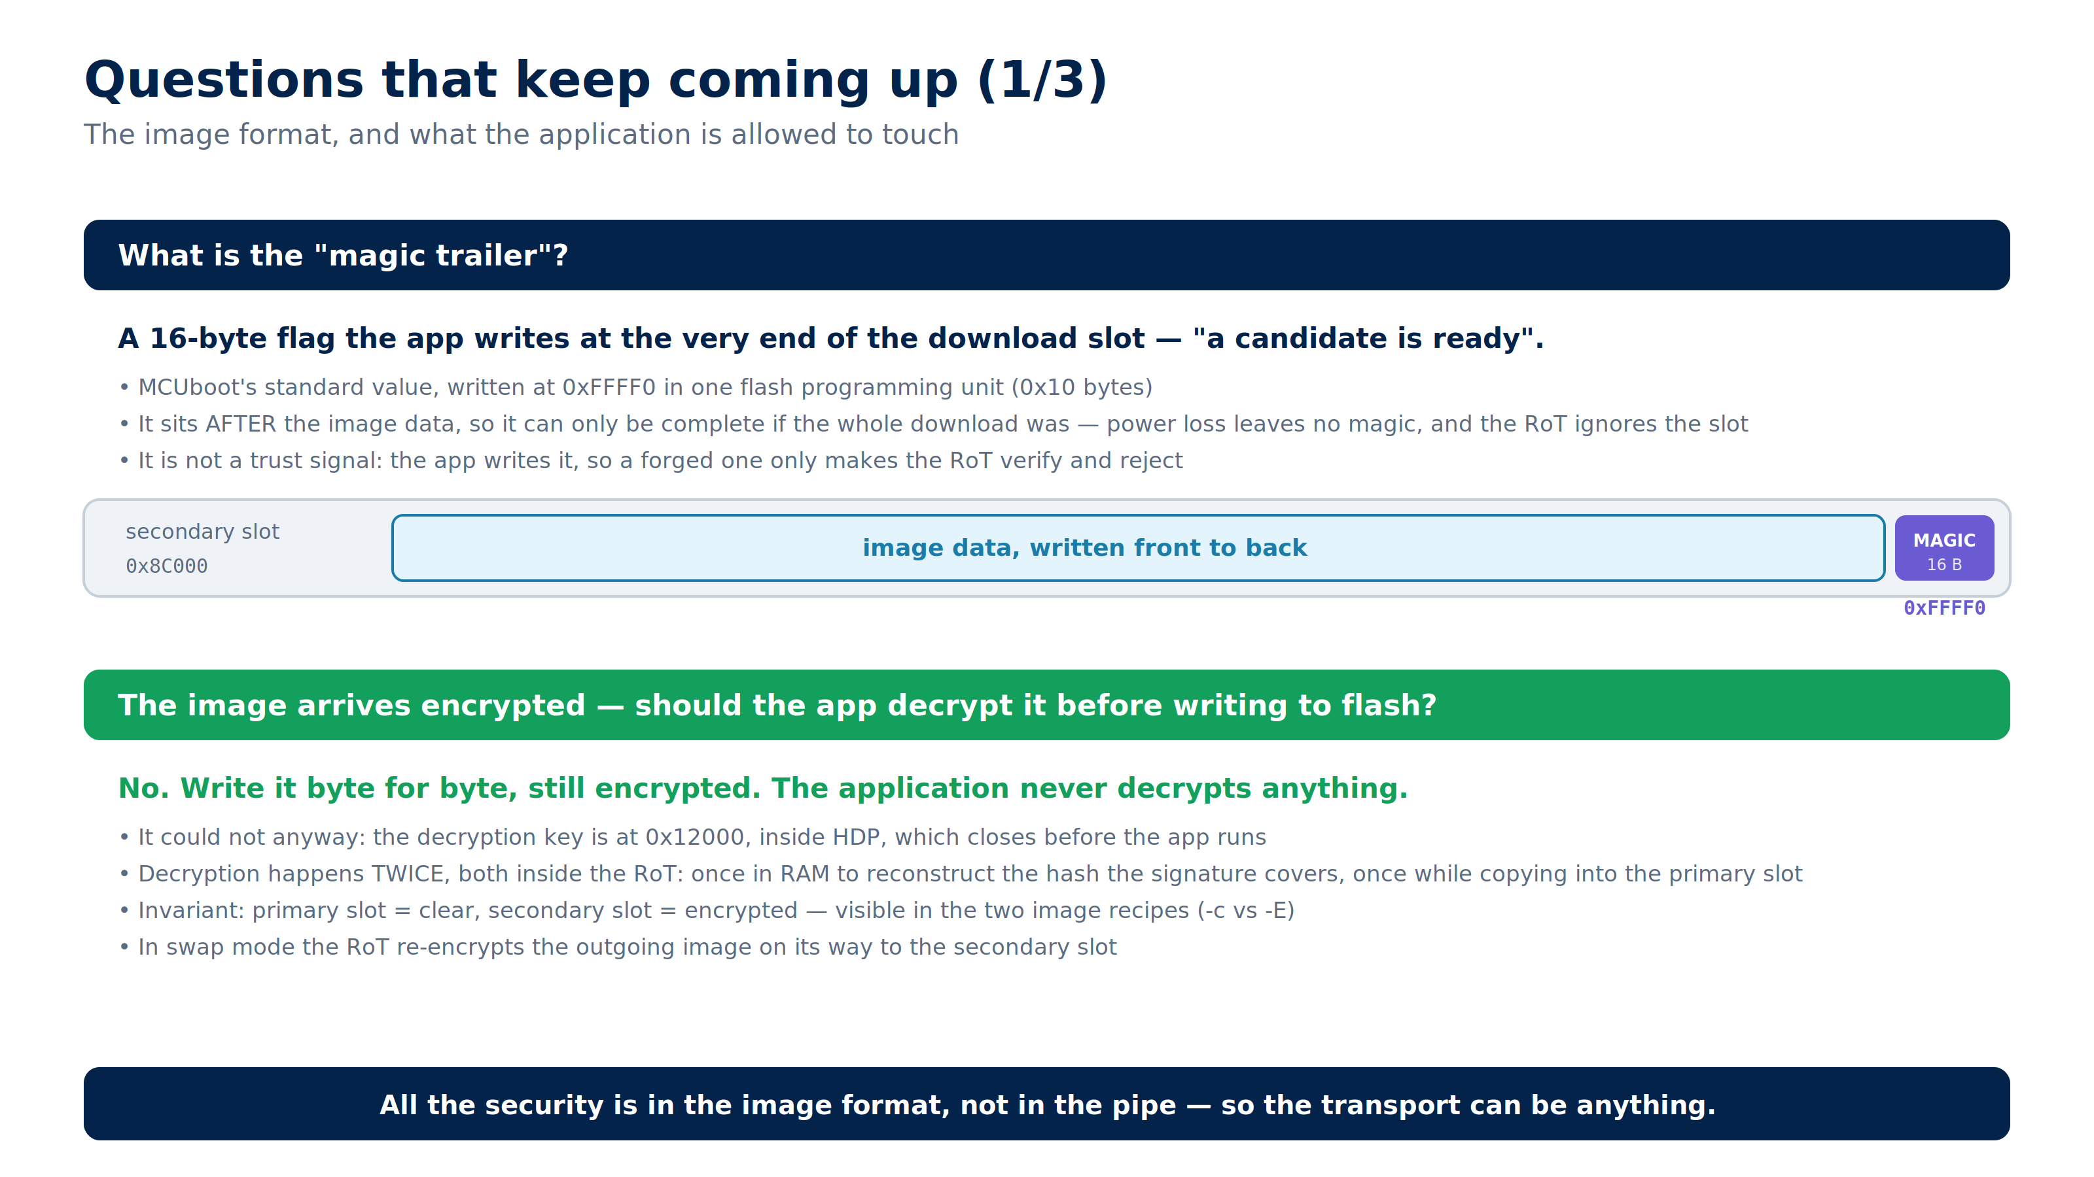
Notes:
FAQ. The magic trailer is a completion flag, not a trust signal - and the app writes the image encrypted because it has no access to the key. Keep for questions.

Slide 19
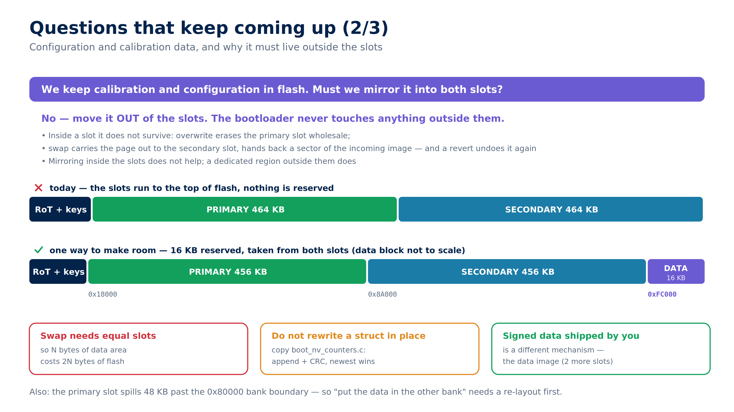
Notes:
FAQ. Calibration data must sit outside the slots; mirroring inside them does not work. Note the cost: reserving N bytes removes N from each slot.

Slide 20
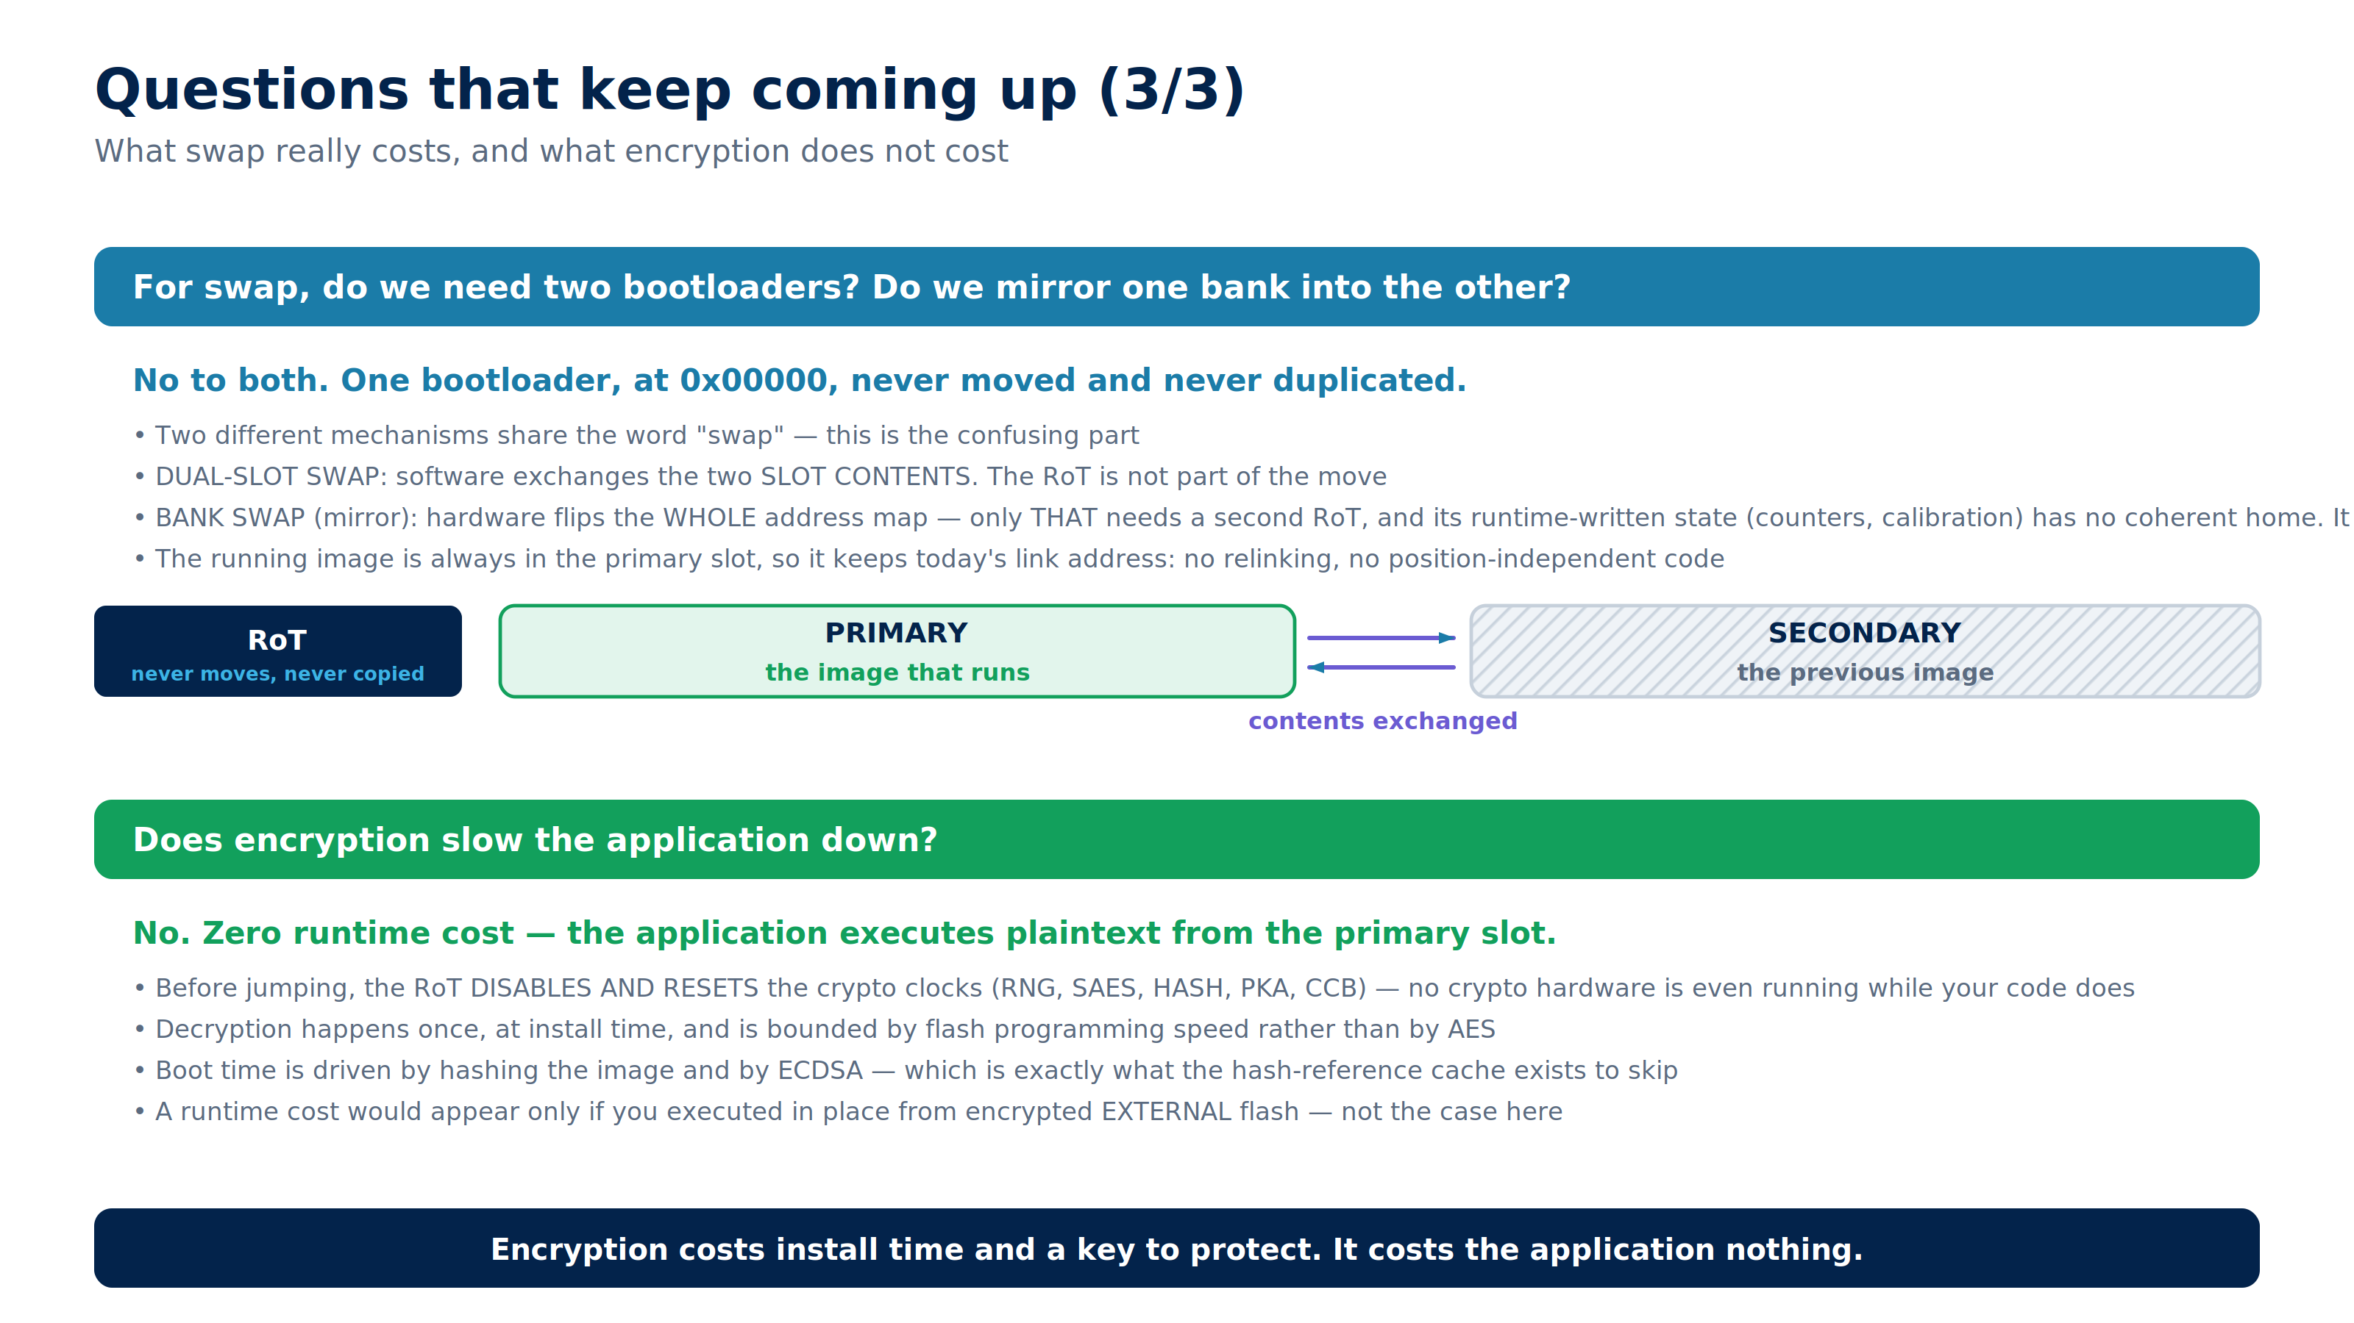
Notes:
FAQ. Two corrections worth stressing: swap needs ONE bootloader and no mirroring, and encryption costs the running application nothing.

Slide 21
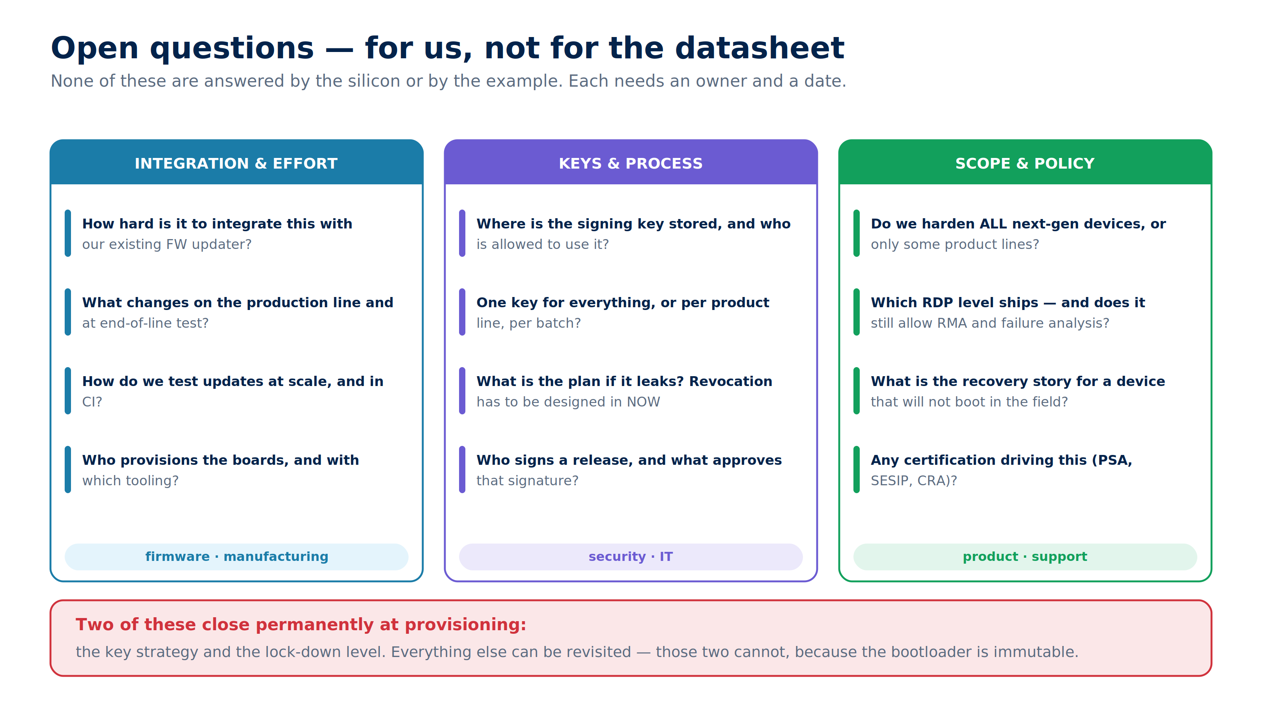
Notes:
Closing slide. Do not try to answer these here - the goal is to leave with an owner and a date against each. The key strategy and the lock-down level are the two that cannot be revisited after provisioning.

