Slide 1
The PicoMEML framework

Slide 2

Download this presentation

Slide 3
What is it?
A framework to run real-time audio and machine learning on the Raspberry Pi Pico 2
Built on top of the Pico C++ SDK and the Arduino framework
Accessible through the Arduino IDE
(and possibly Arduino CLI)

Slide 4
Prerequisites
Arduino IDE: https://www.arduino.cc/
Arduino-pico framework: https://github.com/earlephilhower/arduino-pico
Follow the tutorial on the README to configure the board
PicoMEML: https://github.com/MusicallyEmbodiedML/PicoMEML

Slide 5
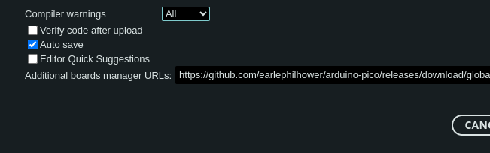
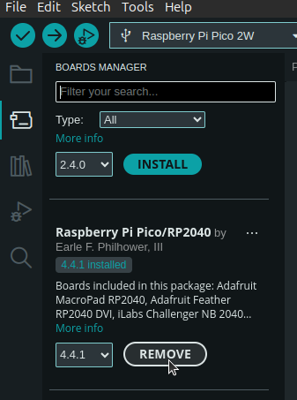
Get the Pi Pico 2 up and running
Follow https://github.com/earlephilhower/arduino-pico#installing-via-arduino-boards-manager
...and give Examples->Blink a spin?
INSTALL

Slide 6
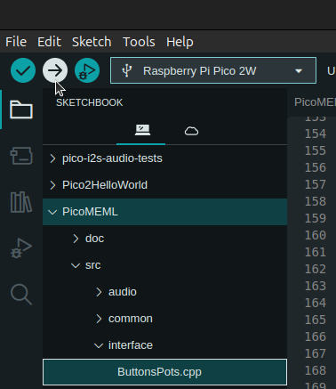
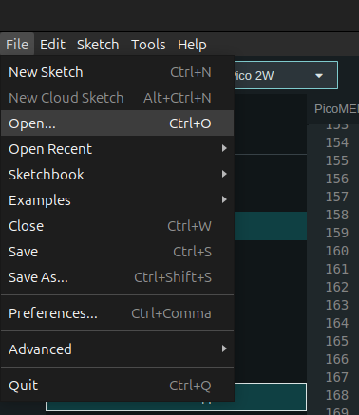
Try it out!
Check out the PicoMEML repository
Check out submodules
git submodule update --init
Open the PicoMEML folder with the Arduino IDE
Flash the board
Hear some FM synth buzz :)

Slide 7
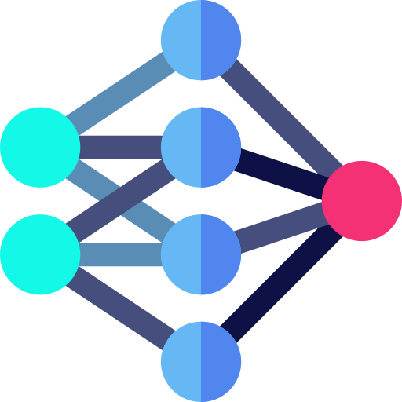
What is happening?
Pi pico has two cores
Core 0
Core 1
Audio routine: FM synth
Joystick
pots (3 params)
Training
control
Dataset (3 to 14 params)
FM parameter update (14 params)
Model

Slide 8
The model
MLP (multi-layer perceptron)
3-dimensional input: joystick coordinates
Layers: 3+1 (ReLU), 10 (ReLU), 10 (ReLU), 14 (sigmoid)
Trained for regression. Loss function: MSE
MLP_XMOS library
https://github.com/MusicallyEmbodiedML/MLP_XMOS/
Supports: MLP, Stochastic gradient descent, ReLU/sigmoid/tanh, MSE, classification or regression. (Replay memory WIP...)

Slide 9
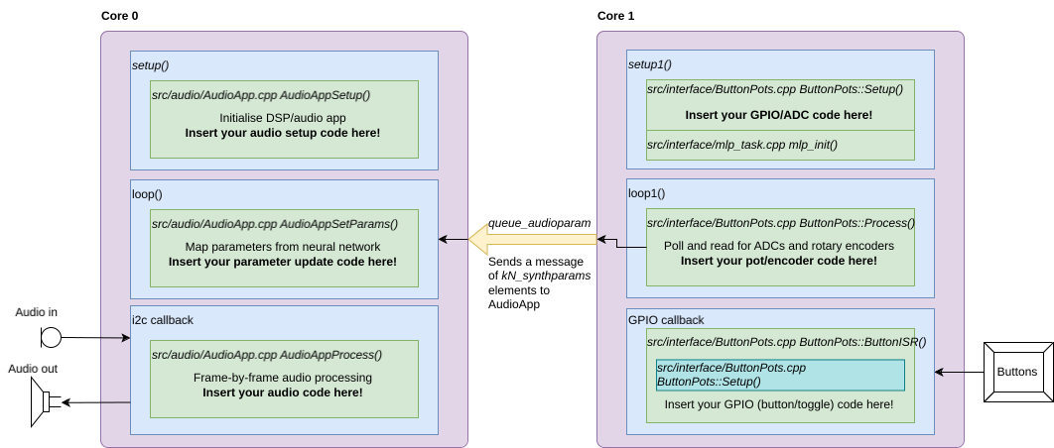
Where is everything?

Slide 10
Important files/libraries/objects
src/PicoDefs.hpp
Definition of the pin layout
Declaration of gAppState
Declaration of interface with MLP (meml_interface).
src/common/common_defs.h
Definition of structures for data exchange (pots, board state, training behaviours...)
ts_app_state gAppState
Current state of the app:
  Type of zoom (current_expl_mode)
  4 datasets, 4 models
  Changeable at runtime
kN_synthparams
Number of parameters in the output layer of the NN
Sent via the queue to the audio core

Slide 11
Task 1
Add buttons and joystick to the FMSynth app so that you can train it
  Add joystick (3 potentiometers) to the 3 ADCs of the pico: explore the parameter space by moving the joystick.
  Add training buttons (3 buttons): create a dataset and train the network.
  Add one extra button (exploration button): choose how you make the training dataset.

Slide 12
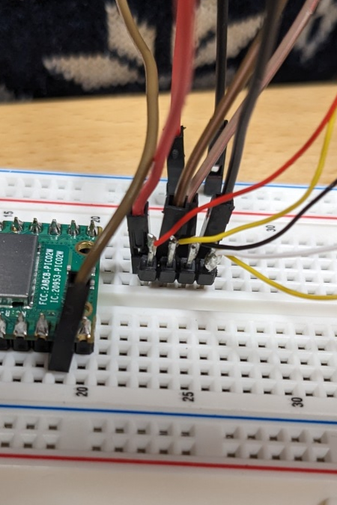
Task 1.1
Add joystick (3 potentiometers) to the 3 ADCs of the pico
3V3
(power)
Button
Pot wiper
(ADC)
Ground
3V3
rail
GPIO
14
ADC2
(GPIO
28)
Ground
rail

Slide 13
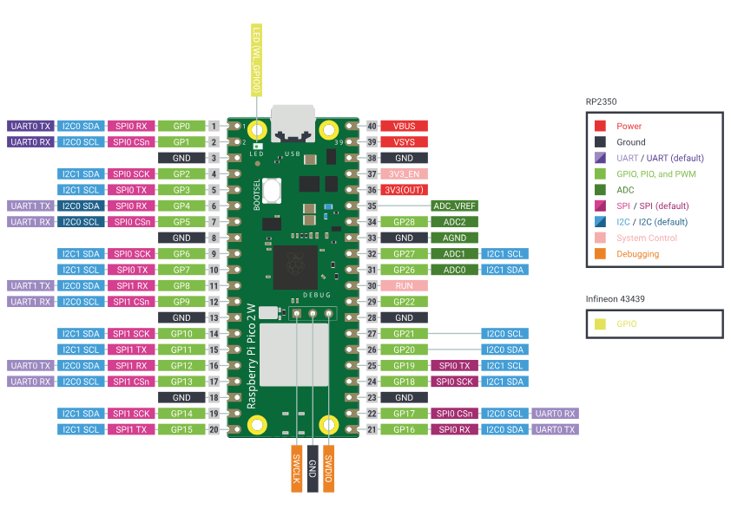
Task 1.1

Slide 14
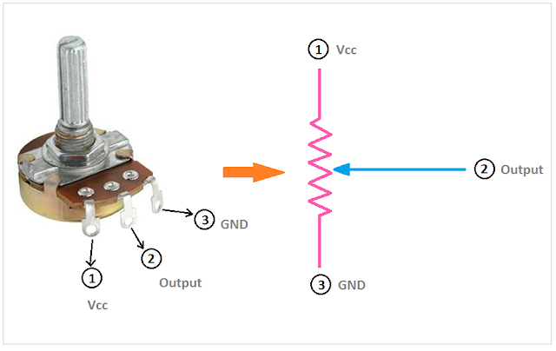
Task 1.1
Add the other pots!
ADC0(GPIO
26)
Ground
rail
3V3
rail

Slide 15
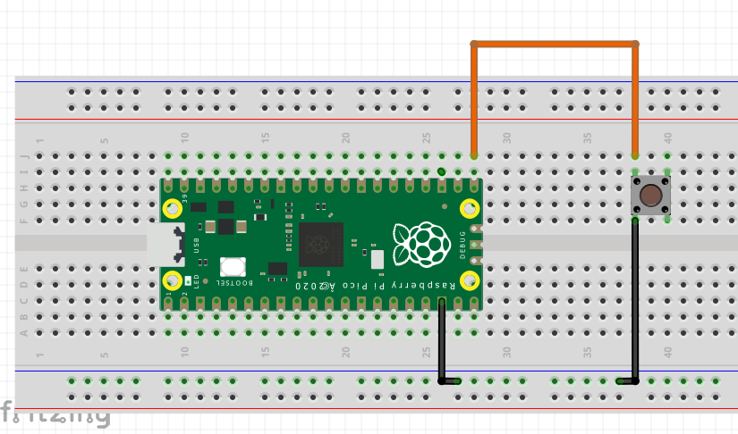
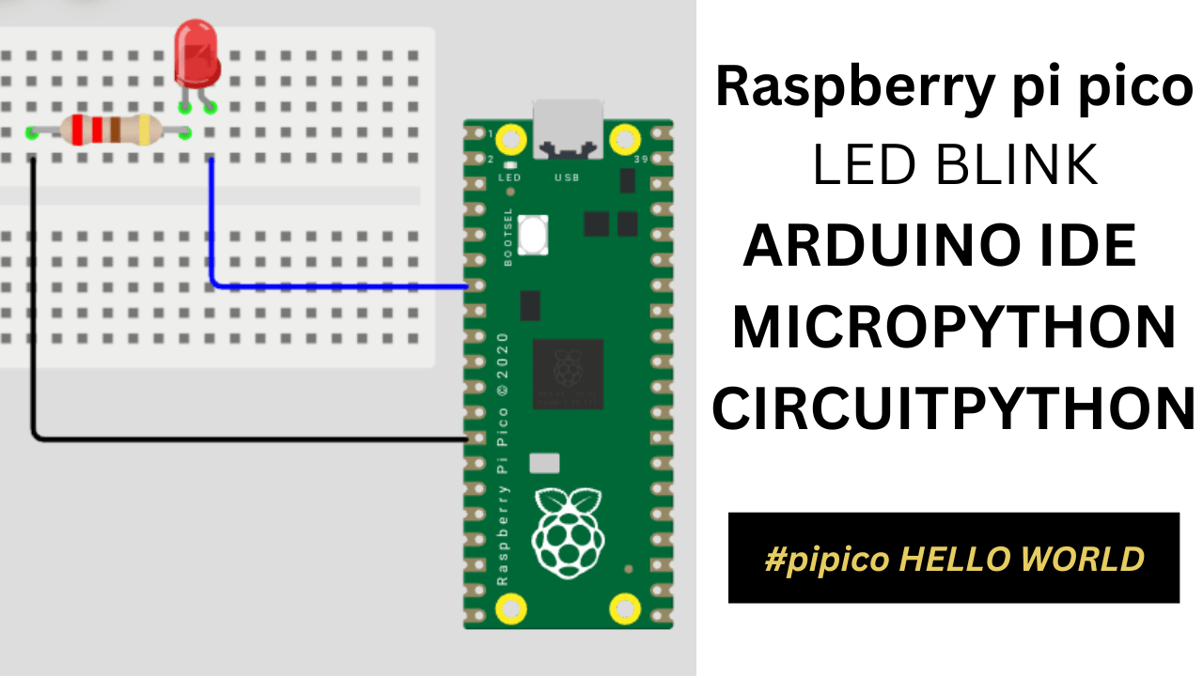
Task 1.2
Toggle: training mode VS inference mode – GPIO pin 15
LED: lights up in training mode – GPIO pin 2
GPIO15
1kOhm
GPIO2
Ground
Ground

Slide 16
Task 1.2
Clear dataset: button to GPIO pin 16
Have fun training your nets! :)
Random
button
Random
weights
RELEASE
SaveData
Dataset
Empty
Position
parameters
Data point
saved
Random
button
HOLD
SaveData
“Zoom into”
weights
Training
ON
Training
OFF
Random
button
Network
trains!

Slide 17
Task 1.3
Add a toggle that changes the “Zoom mode” (exploration mode)
interface/ButtonsPots.cpp – look at how other buttons/toggles are processed...
interface/MEMLInterface.cpp – look at MEMLInterface::SetToggleButton for toggle_expl_mode
Make sure SetToggleButton gets called by the right button...

Slide 18
The training workflow...
Think about the “choreography” of training
What would you change? How would you make it suit YOUR music?
What interface would you use?

Slide 19
Task 2
Add a flanger effect after the FM Synth, and make one or more parameters controlled by the neural network just like the FM synth parameters.
FM Synth
Flanger
Audio out
FM synth parameters (14)
Flanger parameters (1+)

