Slide 1

A.Y. 2024/2025
Master's Degree
Informatica
Medical Search Engine
Information Retrieval Project – January 2025
Group Partecipants:
Gargiulo Elio - 869184
Piacente Cristian - 866020

Slide 2

Introduction
The project focus is to develop a Search Engine for Medical Information Retrieval.
Given the dataset and the initial code found on the course page, the project structure follows these parts:
Analysis of the Dataset
Retrieval Pipelines and Experiments
Improvements to the baseline using Query Expansion
Final Considerations and Future Works

Slide 3
Analysis of the Dataset

Slide 4

Analysis of the Dataset - Preprocessing
Before starting to analize the dataset we need to preprocess the data:
Tokenization
Normalization and Removal of Stopwords
Stemming
Lemmatization
Then the analysis focuses on:
Documents Text (Abstract) and Title
Query Text
Relevance Judgements
Notes:
Normalization = lower case.

Slide 5

Analysis of the Dataset - Summary
For both Documents and Queries we have analyzed:
Token Count and Structure
Vocabulary Size
Distribution of number of terms using Histograms
Distribution of most frequent terms using Word Clouds
Upper and Lower tail analysis (with Outliers)
For the Relevance Judgments:
Scores Distribution
Distribution of number of relevant documents per Query
Min/Max number of documents retrieved

Slide 6
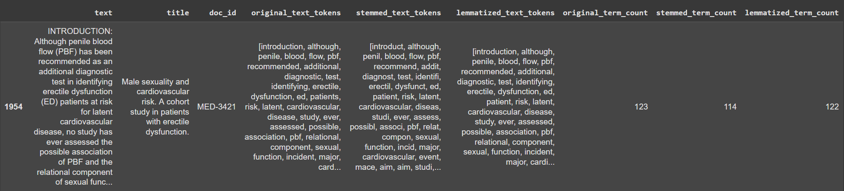
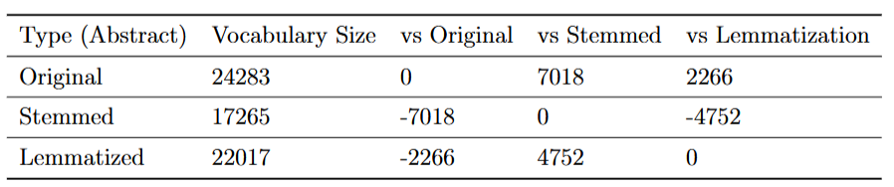
Analysis of the Dataset - Tokens
For Document Text as Example: we can see the effect of the preprocessing
Token Information and Vocabulary Sizes for Original, Stemmed and Lemmatized Tokens

Slide 7
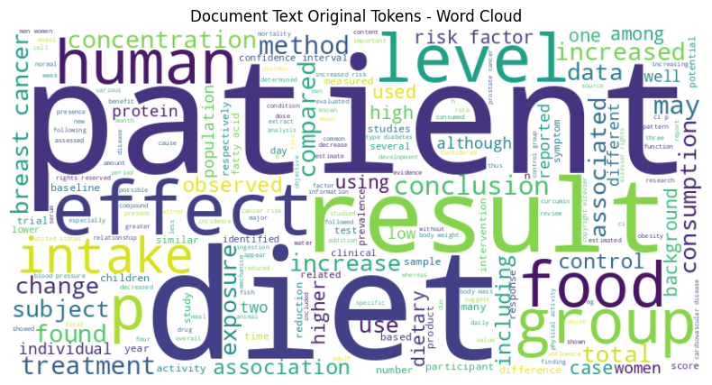
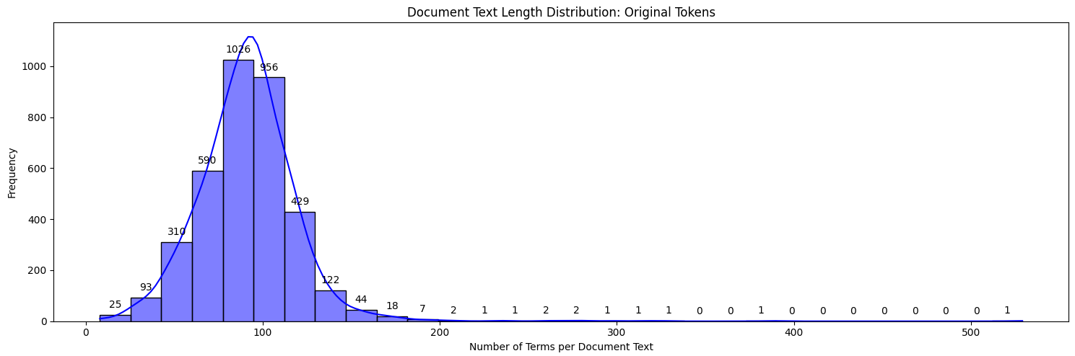
Analysis of the Dataset - Distributions
For Document Text as Example:
We can see the most frequent terms in the word cloud.
The distributions (which are very similar between Documents and Queries) show a normal distribution.

Slide 8
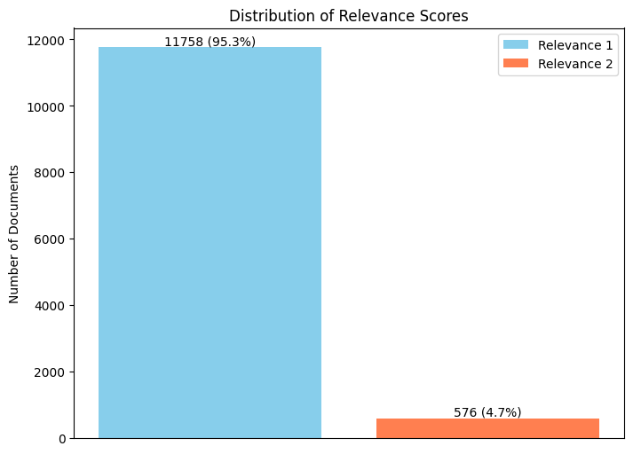
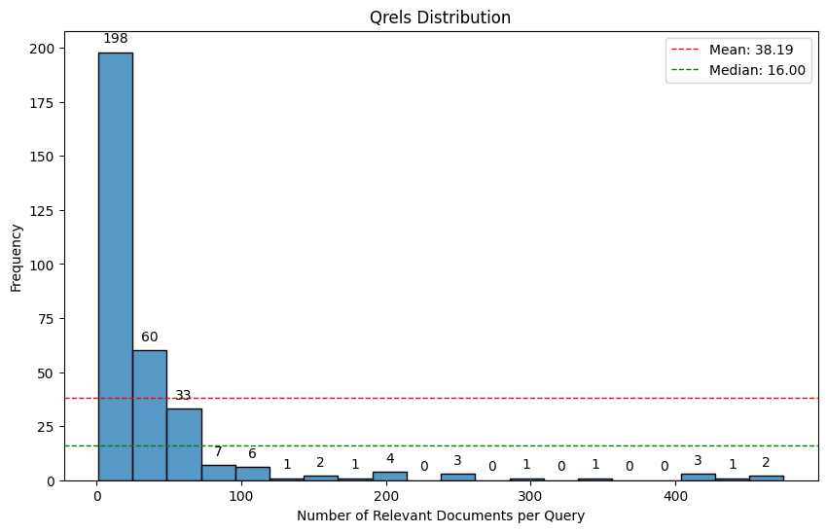
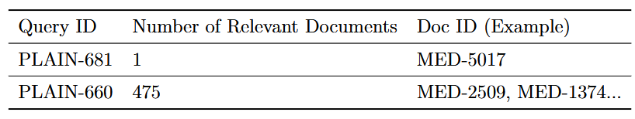
Analysis of the Dataset - QRels
For QRels Example:
We can see the two levels of relevance (scores).
The distribution shows the number of relevant documents per query.
The table is an example of Min/Max relevant documents per Query.

Slide 9
Pipelines and Experiments

Slide 10

Pipelines and Experiments - Summary
The process of Retrieval Pipelines and Experiments follows these steps :
Indexing
Building the Pipeline
Evaluation
In-Depth Analysis of Queries
Top 10 Queries in Precision@10
Inconsistencies in QRels and Relevant Pairs (Not shown here because of length)

Slide 11
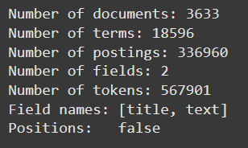
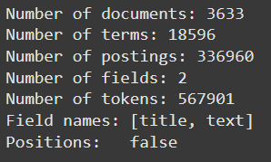
Pipelines and Experiments - Indexing
The indexing has been done using two distinct Stemmers:
PorterStemmer
SnowballStemmer, which is an improved version of PorterStemmer with multiple language supported.
And specifically on:
Only Document Text
Only Document Titles
Both Document Titles and Text
PorterStemmer
SnowballStemmer
The two Stemmers behave the same, probably because the dataset contains specifical terms for medical purposes.

Slide 12
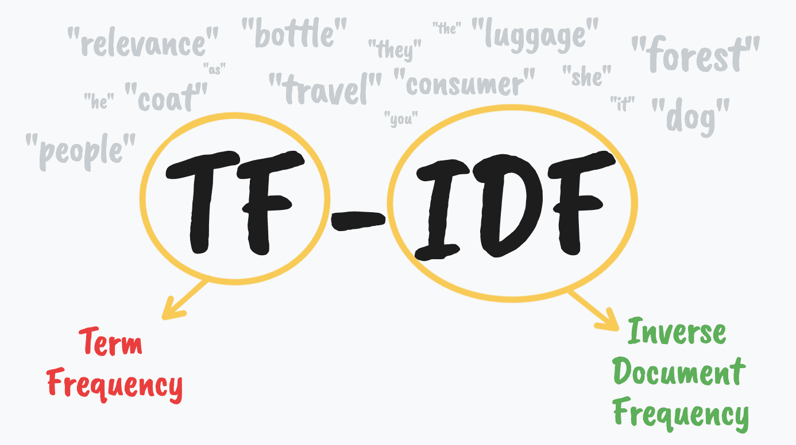

Pipelines and Experiments - Models
Two different Models have been used for the Retrieval Pipelines and Evaluation:
BM25
TF-IDF
The metrics considered for evaluation purposes are:
Precision@10
Recall@10
Mean Average Precision
Normalized Discounted Cumulative Gain
Notes:
BM25 → doc length normalization

Slide 13
Pipelines and Experiments - Results
Indexing Type | Model | P@10 | R@10 | MAP | NDCG
Only Documents Titles | BM25 | 0.169 | 0.109 | 0.099 | 0.203
 | TF-IDF | 0.168 | 0.109 | 0.098 | 0.203
Only Documents Text | BM25 | 0.226 | 0.145 | 0.146 | 0.295
 | TF-IDF | 0.227 | 0.146 | 0.146 | 0.295
Both Documents Titles and Text | BM25 | 0.232 | 0.150 | 0.149 | 0.298
 | TF-IDF | 0.231 | 0.148 | 0.148 | 0.298
The results shown consider only the SnowballStemmer as the performances are the same as PorterStemmer
The performances are not particularly high, but we can try to improve them using Query Expansion.

Slide 14
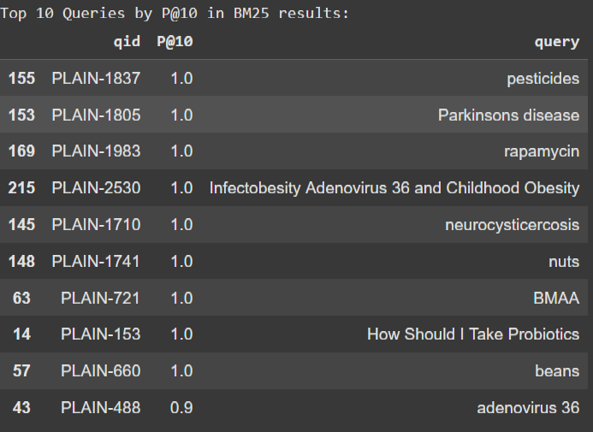
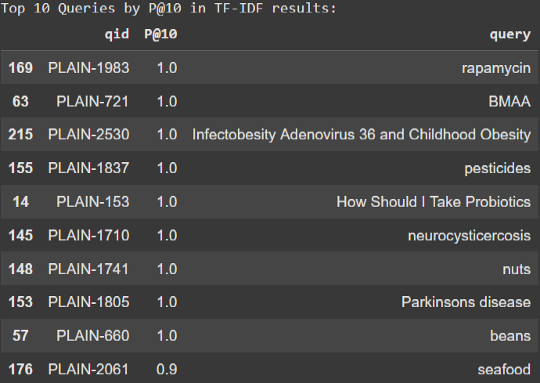
Pipelines and Experiments – Top 10 Queries
For every indexer and stemmer we have shown the top 10 queries for Precision@10, for example considering SnowballStemmer and Indexing on both Text and Titles:
BM25 Model TF-IDF Model

Slide 15
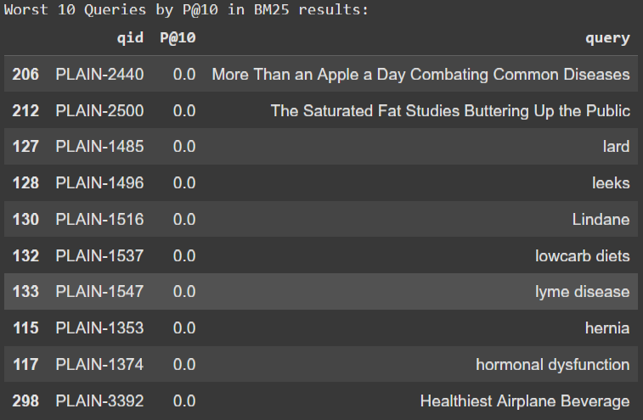
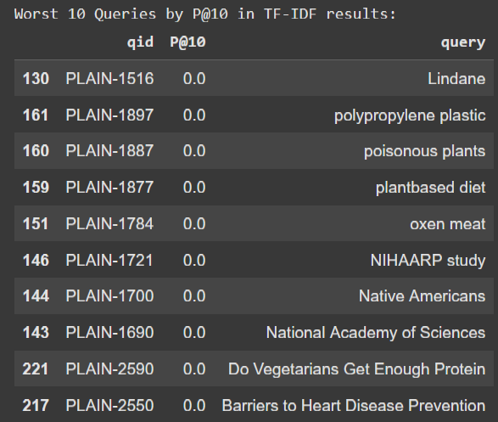
Pipelines and Experiments – Worst 10 Queries
For every indexer and stemmer we have also shown the worst 10 queries for Precision@10, for example considering SnowballStemmer and Indexing on both Text and Titles:
BM25 Model TF-IDF Model

Slide 16
Query Expansion

Slide 17
Query Expansion - Techniques
Provided by PyTerrier, we have used the following techniques:
RM3 Relevance Model
Bo1 Divergence
Kullback Leibler Divergence
As an extra experiment we have also tried the spaCy Library.
SpaCy uses Word Embeddings for Query Expansion.
The baseline used for comparation is the best one found in the previous part.
Notes:
RM3 → expands queries by selecting terms from top-ranked documents using a probabilistic relevance model
Bo1 → selects expansion terms based on their statistical deviation from the overall collection
KL → measures how different one probability distribution is from another.

Slide 18
Query Expansion - Results
Query Expansion Technique | Model | P@10 | R@10 | MAP | NDCG
Original Queries | BM25 | 0.232 | 0.150 | 0.148 | 0.298
 | TF-IDF | 0.231 | 0.148 | 0.148 | 0.298
RM3 Expansion | BM25 | 0.253 | 0.169 | 0.173 | 0.375
 | TF-IDF | 0.251 | 0.168 | 0.173 | 0.376
Bo1 Divergence Expansion | BM25 | 0.251 | 0.165 | 0.174 | 0.373
 | TF-IDF | 0.251 | 0.165 | 0.173 | 0.373
KL Divergence Expansion | BM25 | 0.250 | 0.164 | 0.174 | 0.373
 | TF-IDF | 0.250 | 0.165 | 0.173 | 0.374
spaCy Query Expansion | BM25 | 0.201 | 0.134 | 0.130 | 0.294
 | TF-IDF | 0.200 | 0.140 | 0.129 | 0.294
Besides spaCy, we can see some improvements in the overall performance, with the three techniques provided by PyTerrier producing similar results.

Slide 19
Query Expansion - SpaCy
Query Id | Query
PLAIN-2 | Do Cholesterol Statin Drugs Cause Breast Cancer co nothin somethin and that cause space sha havin nuff where
PLAIN-12 | Exploiting Autophagy to Live Longer co and that cause vs havin there pm not
PLAIN-23 | How to Reduce Exposure to Alkylphenols Through Your Diet dare and that cause havin these nt s
PLAIN-3432 | Healthy Chocolate Milkshakes cinnamon diet raspberries sweeteners health dietary
PLAIN-44 | Who Should be Careful About Curcumin should somethin that cause need you
We can see that spaCy doesn't put very coherent words, probably because of the highly technical language.
-> A possible solution: SciSpaCy

Slide 20
Final Considerations

Slide 21

Final Considerations and Future Works
In conclusion, the results obtained show little difference but constant improvements. The average metrics are not really high but there is room for improvements in possible future works:
Neural Re-ranking using BERT or using Pseudo Relevance Feedback.
Query expansion using other techniques such as LLMs or using SciSpaCy.
Using different Models for the retrieval pipelines.
Notes:
Query expansion → use it on terms after cut-off.

Slide 22
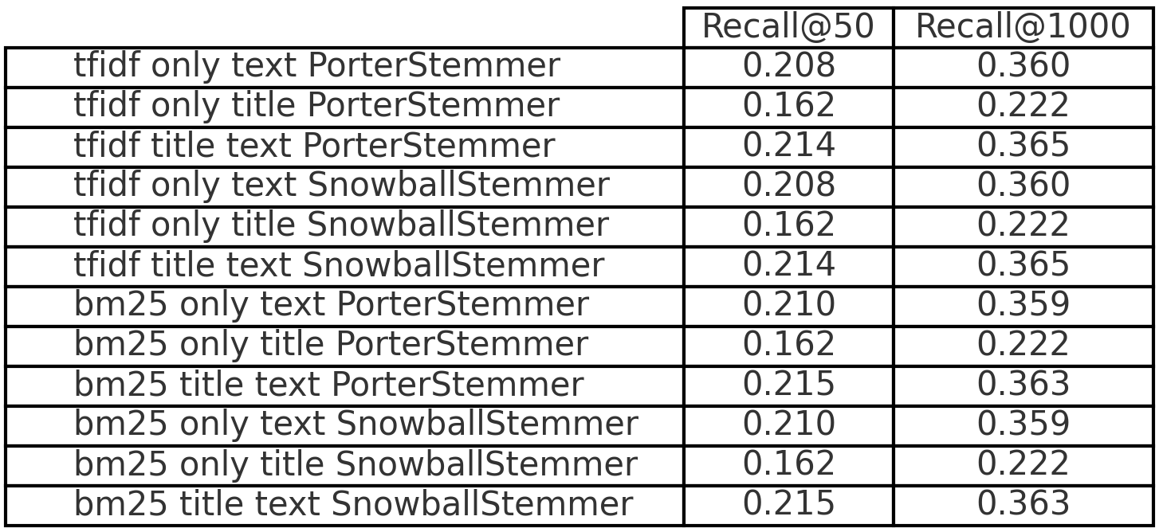
Extra: ASPIRE Recall Results
Higher @K -> Higher Recall

Slide 23
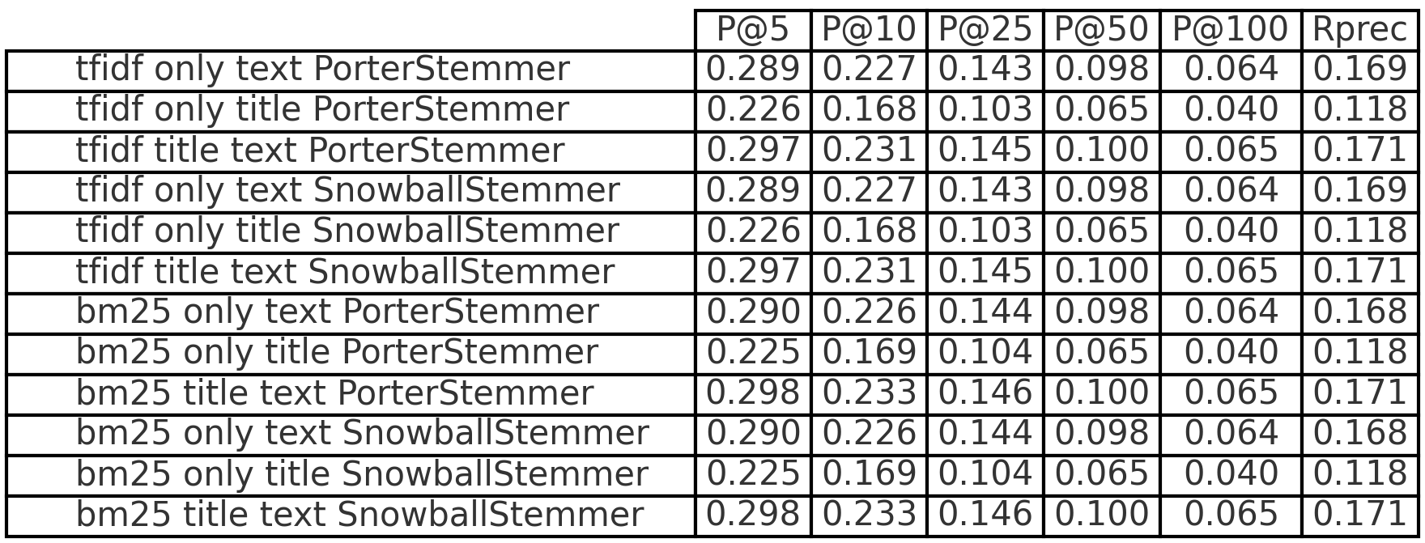
Extra: ASPIRE Precision Results
Higher @K -> Lower Precision
Notes:
Rprec evaluates precision at R, where R is the total number of relevant documents for that query (which varies per query).
In this slide we present the mean among all the queries.

