Slide 1
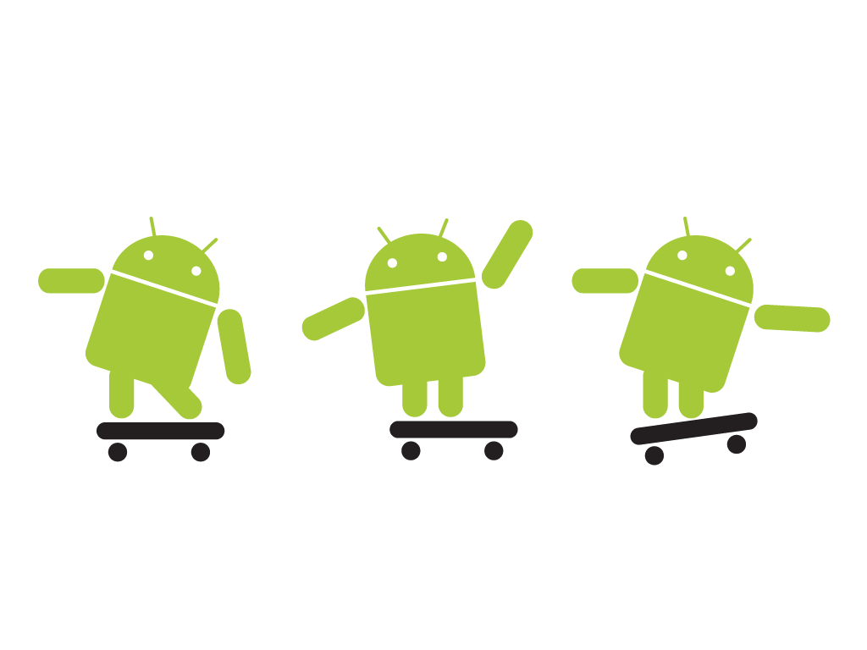
Android application development course
Welcome!
Diplomatura de postgrado en Ingeníeria de Desarrollo de Aplicaciones de Dispositivos Móviles
Notes:
Introducció a Android

Slide 2

Before we dive in...
Notes:
Conèixer una mica més els alumnes (backgroud).

Slide 3
Before we dive in...
How can you reach me?
Cristian Tanas
Office: QC-1082
E-mail: c.tanas@gmail.com
Twitter: @ctanas
Notes:
Conèixer una mica més els alumnes (backgroud).

Slide 4

Before we dive in...
Notes:
Conèixer una mica més els alumnes (backgroud).

Slide 5
General information
Contents
  Introduction to the Android SDK (~2 sessions)
  Design (nice) User Interfaces (~3 sessions)
  Manage persistent data and SQLite (~2 sessions)
  Working in background and notifications (~3 sessions)
  Enabling inter-app communication and offering content
  (~2 sessions)
  Location Based Services and maps (~2 sessions)
  Hardware access and sensor management (~2 session)
  Publishing and monetizing your apps (~1 session)

Slide 6
General information
+ 16 sessions of 3h:
- October 17-20, 2016
- October 24-27, 2016
- November 2-3, 2016
- November 7-9, 2016
- November 15-17, 2016
- Assessment:
- on-going work in class
- completion of 3 activities proposed throughout
the course
Notes:
2h 15 min + 30 minuts de pausa + 2h 15 min
Del projecte es parlarà més endavant

Slide 7
Android app development course
Today: Session 1-
+ Introduction. History, versions, ...
+ Our first project

Slide 8
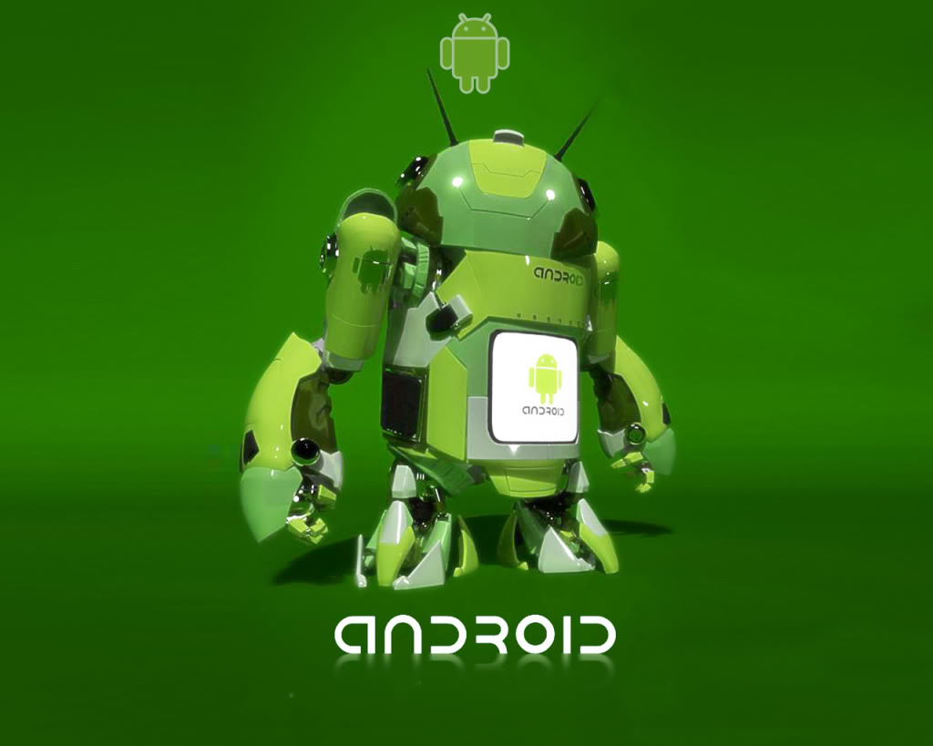
What is Android?
A robot that came from
the future intending to
dominate the world?!

Slide 9
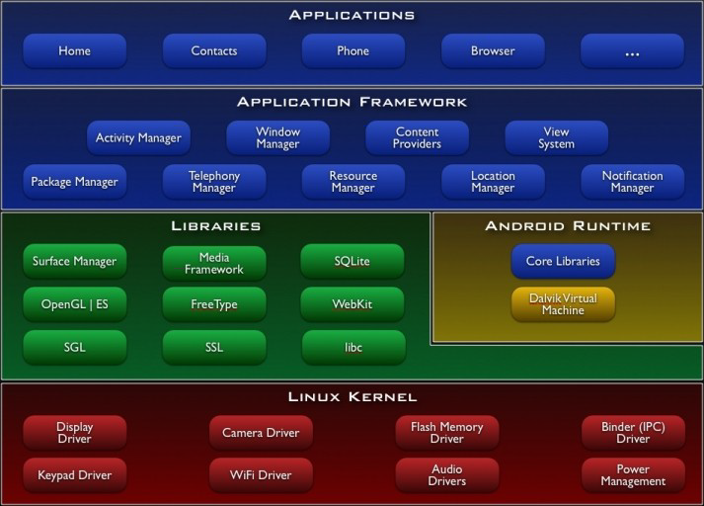
What is Android?
...not likely!
Notes:
Multi-user Linux system application = user
Process → own VM

Slide 10
What is Android?
- Much more limited resources compared to traditional PCs
- Battery life
- Data plans (€€€)
- Multiple network access capabilities
+ Specific Hardware (GPS, accelerometer, NFC, etc.)
+ Communication oriented
+ Compatible with multiple devices (from smartphones to
infernal machines to dominate the world!)
Notes:
Explicar una mica la problemàtica de programar amb dispositiu mòbils, però també les noves oportunitats!

Slide 11
A little bit of history
2003 – Andy Rubin, Rich Miner, Nick Sears and Chris White
create Android, Inc.
2005 – Google acquires Android, Inc.
2007 – The Open Handset Alliance is born
2008 – First mobile device and SDK 1.0
2010 – Birth of the Nexus mobile devices line
2011 – Android tablets
2012 – More than 60% of the smartphones sold worldwide
run the Android OS
2014 – Android 5.0 Lollipop – Material Design
2014/15 – Android Wear/Auto. Android Marshmallow
Notes:
Primer telèfon amb Android T-Mobile G1 (HTC Dream)
Nexus One: primer mòbil de la gama Nexus. Android 2.1 (Eclair)

Slide 12




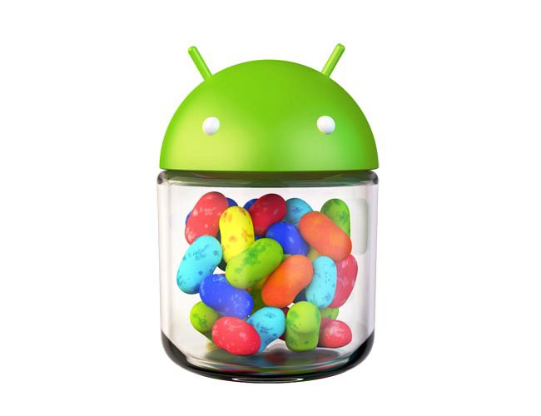



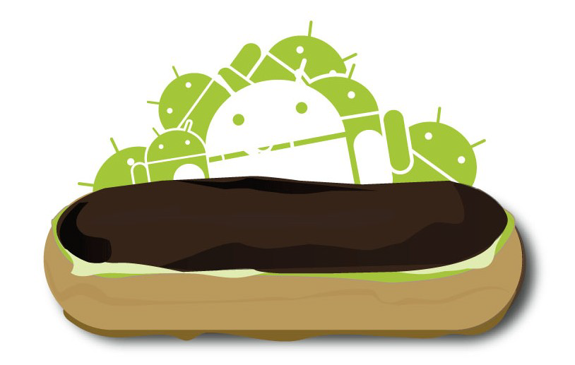


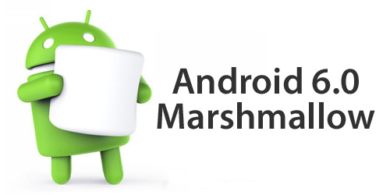
Android versions
    API 1
    API 3
    API 4
    API 5
    API 8
    API 9
    API 11
    API 14
    API 16
    API 19
    API 21
    Oct 2008
    Oct 2009
    Jun 2010
    Feb 2011
    Oct 2011
    Jun 2012
    Oct 2014
    May 2009
    Nov 2009
    Nov 2010
    Nov 2013
API 23
Oct 2015
Warning! Mind outdated references, tutorials, blogs, etc.

Slide 13
Activity 1.1
1.1.1 Get familiar with the Android developers main
web page
http://developer.android.com/
1.1.2 Find out the minimum Android version for which
it makes sense to develop a new app

Slide 14
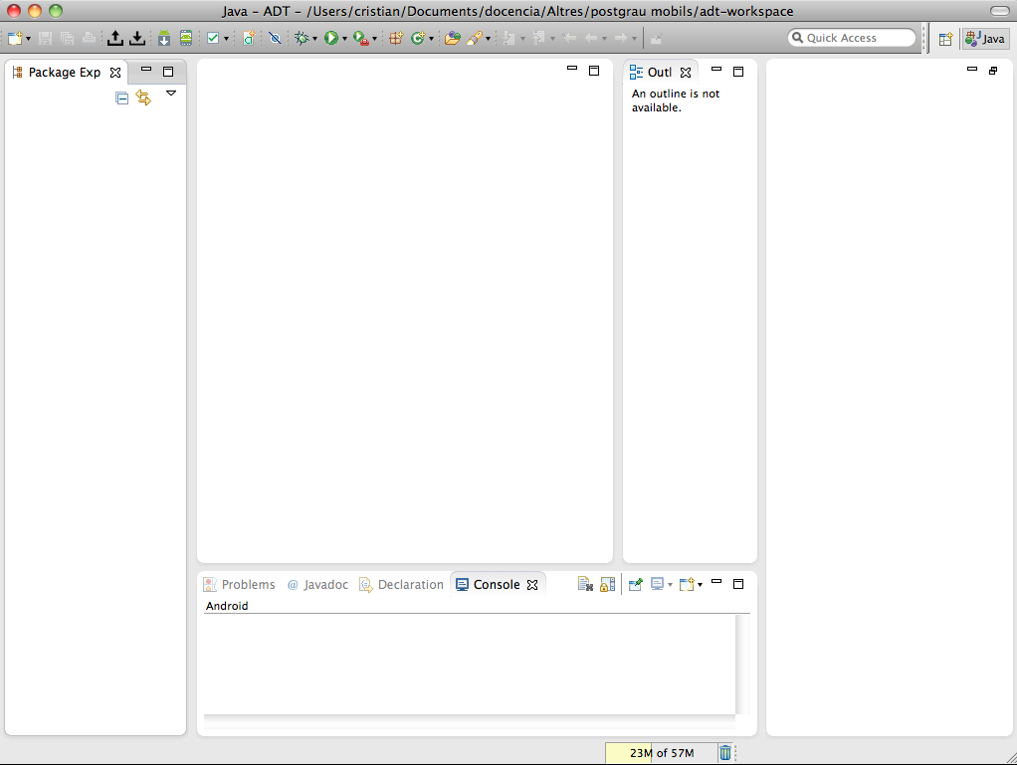
Development tools
ADT Bundle: Eclipse IDE + Android Developer Tools
DEPRECATED

Slide 15
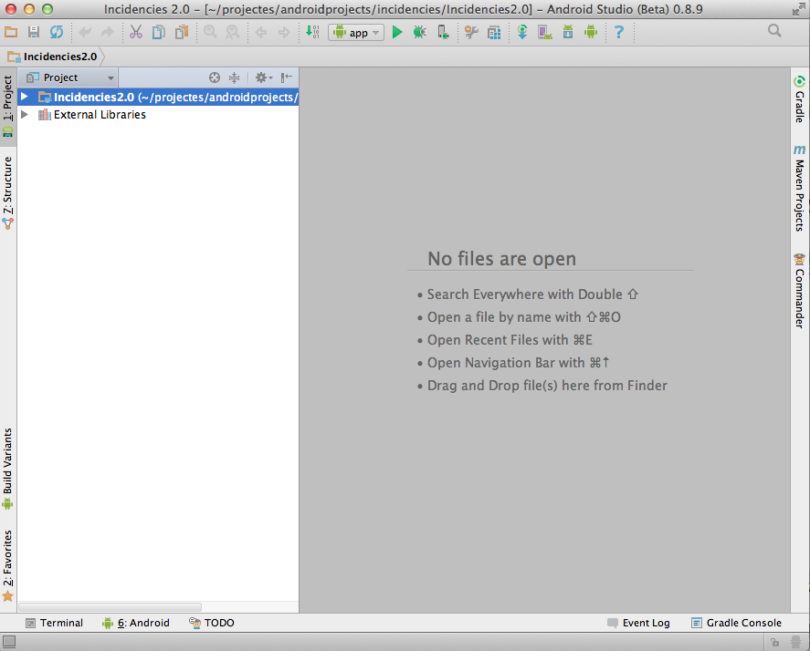
Development tools
Android Studio – new official development tool

Slide 16
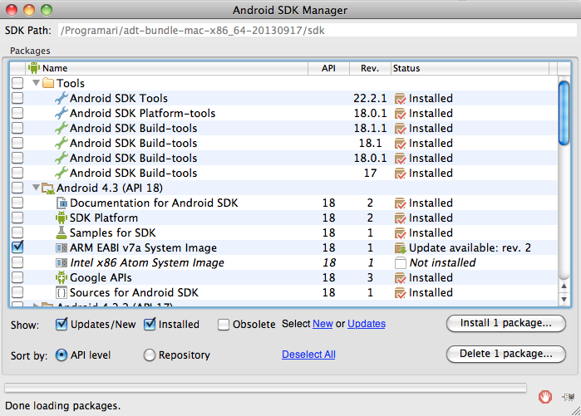
Development tools
Software Development Kit (SDK) - Manager

Slide 17
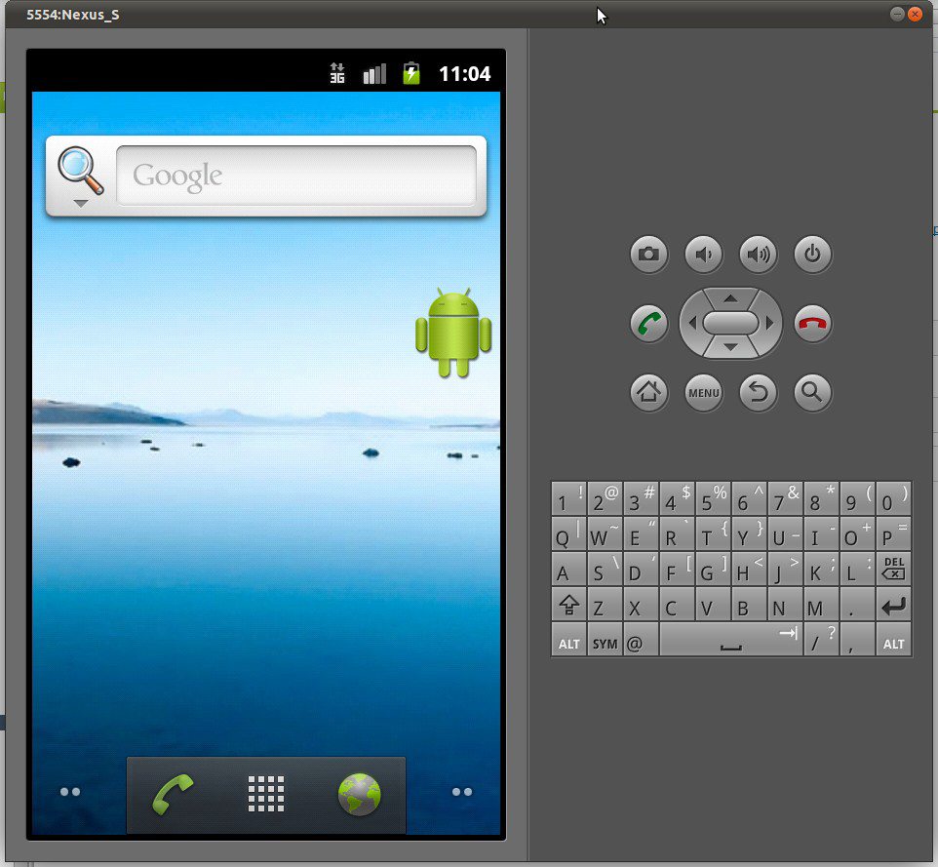
Development tools
Emulator

Slide 18
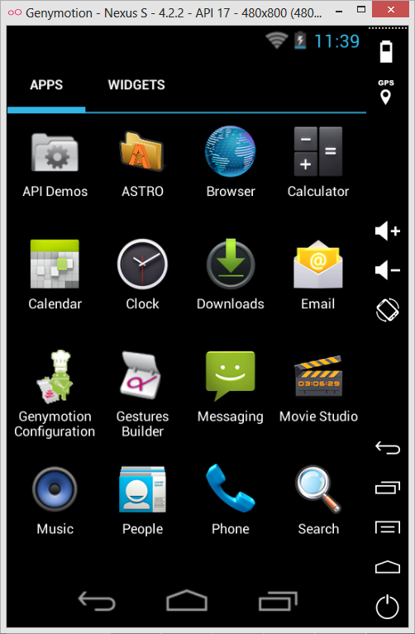
Development tools
Emulator – alternatives
Genymotion
Headless emulator
Intel HAXM

Slide 19
Development tools
Other available tools:
  ADB – Android Debug Bridge
  NDK – Native Developement Kit
  layoutopt – Layout optimizer
  Android Asset Studio
  ...and much more

Slide 20
Test your apps on real devices
  Configure the device
  (Settings → Applications → Development → USB Debugging)
  Mac Os X/Windows devices detected automatically (if you are lucky!)
  Unix-based environments may require manual configuration
    Find device ID using lsusb
    Create the file /etc/udev/rules.d/51-android.rules
    Add execution permission to the previous file (chmod +x)
    Add the new device in the file:
    SUBSYSTEMS==”usb”, ATTRS{idVendor}==”xxxx”,
    ATTRS{idProduct}=”yyyy”, MODE=”0666”,
    OWNER=”user”
    Restart the udev service
    $ sudo service udev reload

Slide 21
Activity 1.2
1.2.1 Create two virtual devices
- Gingerbread (Google API 10)
- Jelly Bean (Google API 18)
1.2.2 Mark the “Snapshot” option
1.2.3 Power on the virtual devices to create the OS images

Slide 22
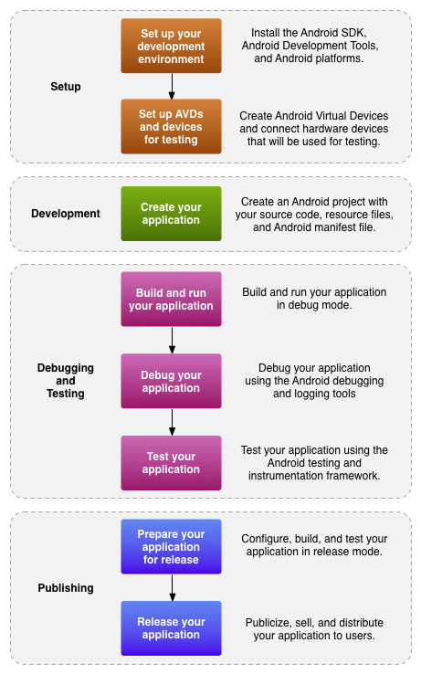
Development process overview
Setup
Development
Debugging and Testing
Publishing

Slide 23
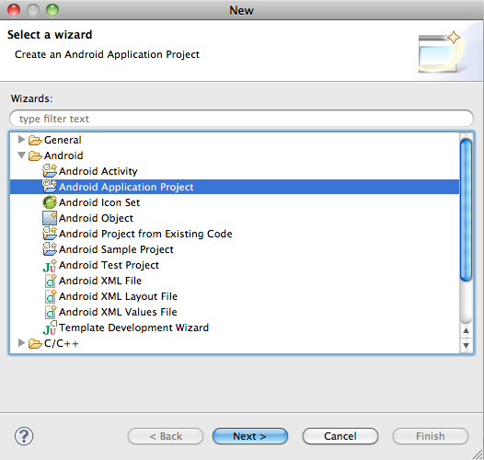
Our first Android project
Activity! Create a new project – Hello Android!

Slide 24
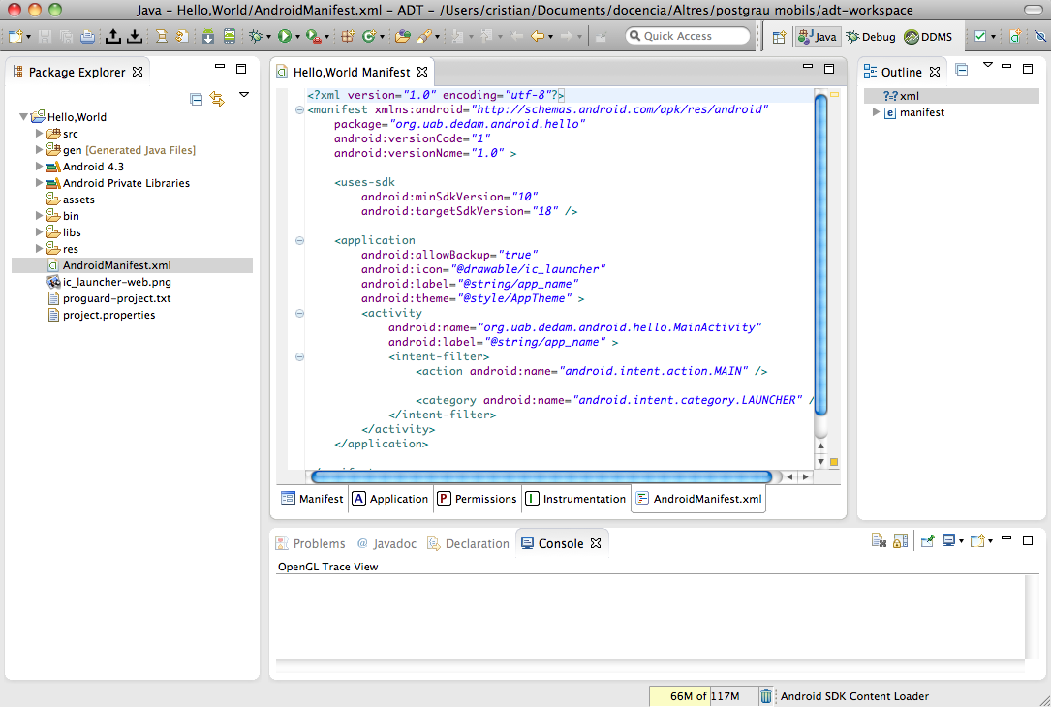
Android project. The basics
AndroidManifest.xml
Notes:
Java package → identificador únic de l'aplicació
Descriu les components d'una aplicació
Permissos
Llibreries
Etc.

Slide 25
Android project. The basics
  src/ - application source code directory
  res/ - directory where different resources associated with
  the application are stored (images, layouts, etc.)
      drawable/ : images
      anim/ : animations
      layout/ : User Interfaces
      values/ : strings, arrays, colors, dimensions, styles, etc.

Slide 26
Android project. Resources
  res/ directory – good practices
  resource modifiers
    MCC i MNC
    Language and region (-ca, -es, -ca-rES, -es-rUS)
    Screen sizes (-small, -medium, -large, -xlarge)
    Orientation (-port, -land)
    Pixels density (-ldpi, -mdpi, -hdpi, -xhdpi)
Notes:
MCC : Mobile Country Code
MNC : Mobile Network Code

Slide 27
Android application fundamentals
4 basic components of an application:
  Activity
  Service
  BroadcastReceiver
  ContentProvider
Notes:
Activity → una pantalla de l'aplicació! UI
Service → component que sempre s'executa en background i no disposa d'una UI. Pot ser llançat per una activity
Content provider → compartir informació
Broadcast receiver → tracta notificacions del sistema operatiu. Poden crear notificacions a la barra de notificacions

Slide 28
Android application fundamentals
but there are lot more:
  Intents
  Fragments
  Layouts
  Menus and dialogs
  Databases
  Alarms and notifications
  Widgets
  Hardware resources (positioning, accelerometer, ...)
  etc.

Slide 29
Android application fundamentals
Processes
  By default, all the components of an application run
  in the same process
  5 levels of hierarchy depending on priority:
    Foreground processes
    Visible processes
    Service processes
    Background processes
    Empty processes
Critical priority
High priority
Low priority
Notes:
Els components d'una mateixa aplicació sempre s'executen dintre del mateix process amb un sol thread d'execució

Slide 30
Android application fundamentals
Processes (cont.)
  A foreground process may be:
    A foreground Activity
    BroadcastReceivers executing its onReceive() method
    Services executing one of its lifecycle callbacks:
    onStart(), onCreate() or onDestroy()
    Services bound to currently running Activities

Slide 31
Android application fundamentals
Threads
  All the components of an application run in the
  “main thread” , also known as “UI thread”
  Any UI element can only be manipulated from the
  UI thread”!
public void onClick(View v) {
new Thread(new Runnable() {
public void run() {
final Bitmap bitmap = loadImageFromNetwork("http://example.com/image.png");
mImageView.post(new Runnable() {
public void run() {
mImageView.setImageBitmap(bitmap);
}
});
}
}).start();
}

Slide 32
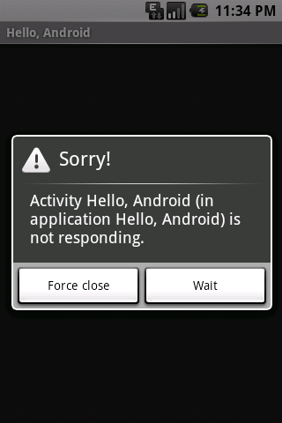
Android application fundamentals
Threads (cont.)
  Important! Avoid performing “intensive work” tasks in
  response to user interaction inside the “main thread”!
  (e.g. network access or database queries)

Slide 33
If you want to know more...
  Professional Android 4 Application Development .
  Chapters 1, 2 i 3
  Pro Android 4. Chapters 1, 2 i 3
  Android Developers: What is Android?
  Android Developers: Getting Started
  Android Developers: Application Fundamentals
  Android Developers: Android API Levels
  Android Developers: Using Hardware Devices
  El androide libre: ¿Cómo acelerar el emulador de Android?

Slide 34
Homework!
  Create a new project containing two Activities:
    MainActivity
    SubActivity
  In the MainActivity class add the following events:
    onStart()
    onResume()
    onRestart()
    onPause()
    onStop()
    onDestroy()
  Add a Button in the layout of MainActivity

