Slide 1
Android app development course
Session 2-
+ User Interfaces (UI)
. Views, Fragments, Menus and dialogs
. Action Bar
<número>

Slide 2
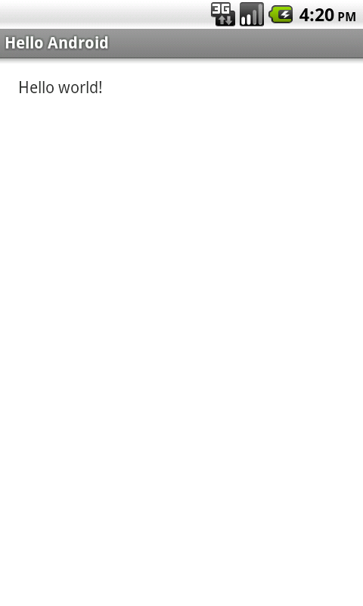
Activities
Activity == Single screen with a UI + lifecycle management
code
Screen design or layout
<?xml version="1.0" encoding="utf-8"?>
<LinearLayout xmlns:android="http://schemas.android.com/apk/res/android"
android:layout_width="match_parent"
android:layout_height="match_parent"
android:orientation="vertical" >
<TextView
android:layout_width="match_parent"
android:layout_height="wrap_content"
android:text="@string/hello_world"
/>
</LinearLayout>
<número>

Slide 3
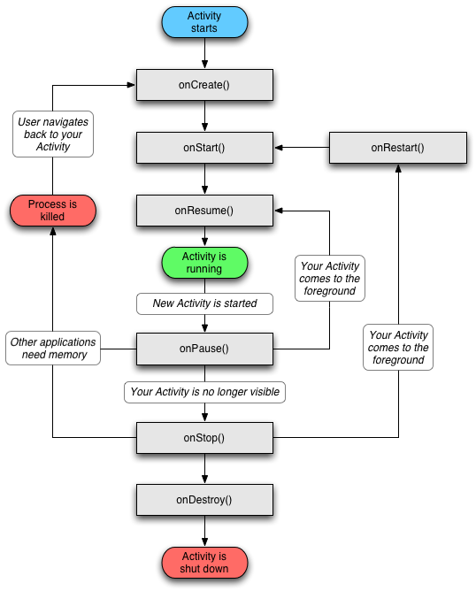
Activities
Activity Lifecycle
<número>

Slide 4
Activity 2.1
2.1.1 Open our last project (homework!)
2.1.2 Add a breakpoint for each of the following events:
  onCreate()
  onStart()
  onPause()
  onResume()
  onRestart()
  onStop()
  onDestroy()
2.1.3 Debug the application under the following scenarios
  Open and close the application using the Back button
  Open the application, press the Home button and open the app again
<número>

Slide 5
Activities
Start new Activities from existing ones:
  New activity
  // Start activity as a new activity
startActivity(new Intent(this, SubActivity.class));
  New activity to get back a result
  // Start activity as a subactivity
startActivityForResult(new Intent(this, SubActivity.class), 0);
Parameter identifying the performed operation
REQUEST_CODE
<número>

Slide 6
Activities
Getting back the result from a sub-activity:
  Sending back the result (sub-activity)
  setResult(Activity.RESULT_OK);
finish();
  Acting in consequence (main activity)
  @Override
protected void onActivityResult(int requestCode, int resultCode,
Intent data) {
super.onActivityResult(requestCode, resultCode, data);
// Manage the incoming data
}
<número>

Slide 7
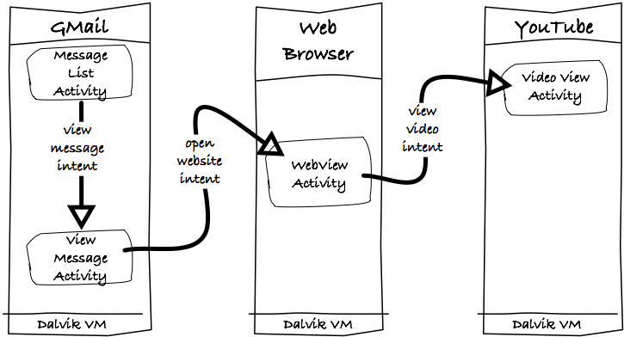
Activities
Intents: description of an operation to be performed
(e.g. start a new Activity).
<número>

Slide 8
Activities
Managing Intents:
  Explicit Intents
  Intent intent = new Intent(this, SubActivity.class);
  startActivity(intent);
  Implicit Intents
  Intent intent = new Intent(Intent.ACTION_VIEW,
  Uri.parse("http://d.android.com"));
  startActivity(intent);
<número>

Slide 9
Activity 2.2
2.2.1 Open our last project
2.2.2 Add an EditText to the MainActivity's layout
2.2.3 Add a TextView to the SubActivity's layout using the
string.xml resource
2.2.4 Add a listener to the Button in MainActivity so that it
can start the sub-activity when clicked.
2.2.5 Send the text from the EditText using the Activity's
Intent and visualize the text in the SubActivity's
TextView.
<número>

Slide 10
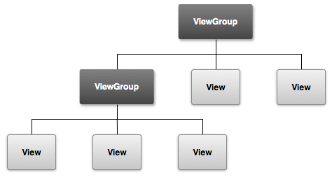
View and ViewGroup
  The View class represents objects that draw something
  on the screen and allow the user to interact with
  A ViewGroup is a “container” which is composed by
  View or ViewGroup objects
<número>

Slide 11
View and ViewGroup
Some examples of simple Views include:
  TextView
  EditText
  AutoCompleteTextView
  Button
  ImageView
  SurfaceView
<TextView
android:layout_width="match_parent"
android:layout_height="wrap_content"
android:text="@string/hello"
/>
<EditText
android:inputType="textAutoComplete"
android:hint="@string/send_hint"
android:layout_width="wrap_content"
android:layout_height="wrap_content"
/>
<número>

Slide 12
View and ViewGroup
AutoCompleteTextView
<AutoCompleteTextView android:id="@+id/operating_systems"
android:layout_width="wrap_content"
android:layout_height="wrap_content"
/>
private static final String[] OP_SYSTEMS =
{ "Android", "iOS", "Windows Phone", "BlackBerry OS", "bada", "webOs" };
@Override
protected void onCreate(Bundle savedInstanceState) {
super.onCreate(savedInstanceState);
setContentView(R.layout.activity_main);
// Get references to the UI components of the layout
textToSend = (AutoCompleteTextView) findViewById(R.id.textToSend);
ArrayAdapter<String> adapter = new ArrayAdapter<String>(this,
android.R.layout.simple_list_item_1, OP_SYSTEMS);
textToSend.setAdapter(adapter);
}
<número>

Slide 13
View and ViewGroup
Button
<Button
android:id="@+id/sendButton"
android:layout_width="wrap_content"
android:layout_height="wrap_content"
android:text="@string/send"
/>
Listener → interface that specifies recognized events
Button sendButton = (Button) findViewById(R.id.sendButton);
sendButton.setOnClickListener(new OnClickListener() {
@Override
public void onClick(View v) {
// Create a new explicit Intent object to start a new Activity
Intent subActivityIntent = new Intent(getBaseContext(),
SubActivity.class);
// Start the new Activity
startActivity(subActivityIntent);
}
});
<número>

Slide 14
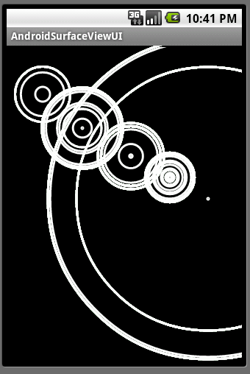
View and ViewGroup
ImageView
<ImageView
android:layout_width="wrap_content"
android:layout_height="wrap_content"
android:src="@drawable/myimage"
/>
SurfaceView
<SurfaceView
android:layout_width="match_parent"
android:layout_height="match_parent"
/>
<número>

Slide 15
View and ViewGroup
ViewGroups combine different elements of type View
to create a single new element.
The most common ones are:
  ListView
  Spinner
  GridView
  ScrollView
  WebView
<número>

Slide 16
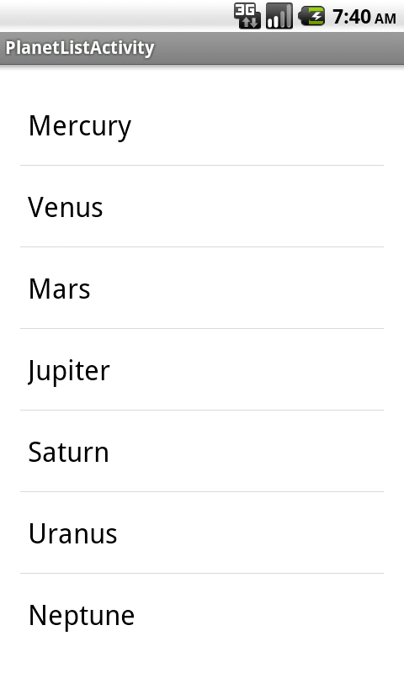
View and ViewGroup
ListView ( ListActivity ➛ homework! )
List<Map<String, String>> planetsList =
new ArrayList<Map<String, String>>();
@Override
protected void onCreate(Bundle savedInstanceState) {
super.onCreate(savedInstanceState);
setContentView(R.layout.activity_sub);
initList();
// Get the ListView component from the layout
ListView customList =
(ListView) findViewById(R.id.customListView);
SimpleAdapter adapter = new SimpleAdapter(
this,
planetsList,
android.R.layout.simple_list_item_1,
new String[] { "planet" },
new int[] { android.R.id.text1 } );
customList.setAdapter(adapter);
}
<número>

Slide 17
View and ViewGroup
ScrollView
  Allows the user to scroll the content on the screen
  Useful if the sum of the space occupied by the Views
  exceeds the total screen size
  Many Views, ViewGroups or Layouts have the scrolling
  gesture enabled by default, not having to use this
  ViewGroup (e.g. ListView)
<número>

Slide 18
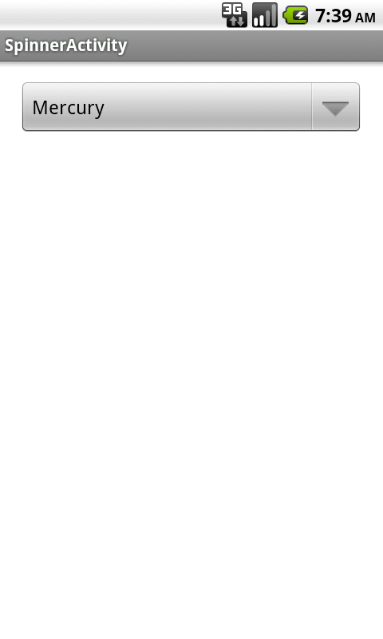
View and ViewGroup
Spinner
<Spinner
android:id="@+id/chooseAPlanet"
android:layout_width="match_parent"
android:layout_height="wrap_content"
android:layout_alignParentLeft="true"
android:layout_alignParentTop="true"
android:prompt="@string/prompt"
android:entries="@array/planets_array" />
<string-array name="planets_array">
<item>Mercury</item>
<item>Venus</item>
<item>Earth</item>
<item>Mars</item>
<item>Jupiter</item>
<item>Saturn</item>
<item>Uranus</item>
<item>Neptune</item>
</string-array>
<número>

Slide 19
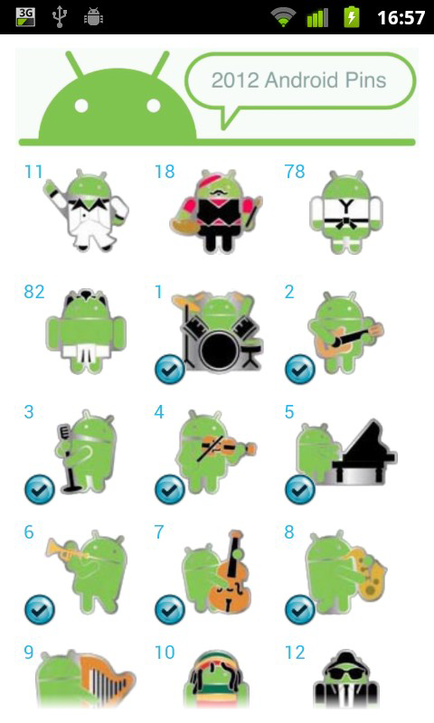
View and ViewGroup
GridView
<GridView
android:id="@+id/gridview"
android:layout_width="match_parent"
android:layout_height="match_parent"
android:columnWidth="90dp"
android:numColumns="auto_fit"
android:verticalSpacing="10dp"
android:horizontalSpacing="10dp"
android:stretchMode="columnWidth"
android:gravity="center"
/>
GridView gridview = (GridView) findViewById(R.id.gridview);
gridview.setAdapter(new ImageAdapter(this));
<número>

Slide 20
View and ViewGroup
WebView
  Optimal for creating WebApps
  By default it can only manage HTML data
  Implements the WebKit engine
Warning! Requires the INTERNET permission!
<número>

Slide 21
View and ViewGroup
WebView
<WebView android:id="@+id/webview"
android:layout_width="fill_parent"
android:layout_height="fill_parent"
/>
@Override
protected void onCreate(Bundle savedInstanceState) {
super.onCreate(savedInstanceState);
setContentView(R.layout.activity_web_view);
webView = (WebView) findViewById(R.id.webView);
webView.getSettings().setJavaScriptEnabled(true);
webView.loadUrl("http://www.google.com");
}
<número>

Slide 22
View and ViewGroup
Layouts
  Are ViewGroup objects and define the structure and
  organization of View elements on the screen
    LinearLayout
    RelativeLayout
    TableLayout
    FrameLayout
    AbsoluteLayout
    GridLayout
<número>

Slide 23
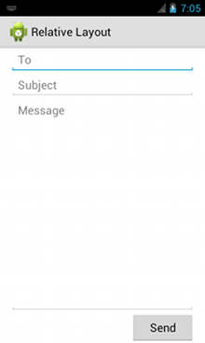
View and ViewGroup
LinearLayout
<LinearLayout
android:layout_width="fill_parent"
android:layout_height="fill_parent"
android:orientation="vertical" >
<EditText
android:layout_width="fill_parent"
android:layout_height="wrap_content"
android:hint="@string/to" />
<EditText
android:layout_width="fill_parent"
android:layout_height="wrap_content"
android:hint="@string/subject" />
<EditText
android:layout_width="fill_parent"
android:layout_height="0dp"
android:layout_weight="1"
android:gravity="top"
android:hint="@string/message" />
<Button
android:layout_width="100dp"
android:layout_height="wrap_content"
android:layout_gravity="right"
android:text="@string/send" />
</LinearLayout>
<número>

Slide 24
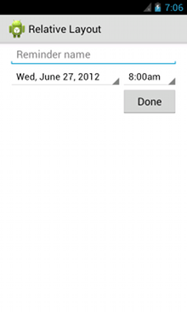
View and ViewGroup
RelativeLayout
<RelativeLayout
android:layout_width="fill_parent"
android:layout_height="fill_parent" >
<EditText
android:id="@+id/name"
android:layout_width="fill_parent"
android:layout_height="wrap_content"
android:hint="@string/reminder" />
<Spinner
android:id="@+id/dates"
android:layout_width="0dp"
android:layout_height="wrap_content"
android:layout_below="@id/name"
android:layout_alignParentLeft="true"
android:layout_toLeftOf="@+id/times" />
<Spinner
android:id="@id/times"
android:layout_width="96dp"
android:layout_height="wrap_content"
android:layout_below="@id/name"
android:layout_alignParentRight="true" />
<Button
android:layout_width="96dp"
android:layout_height="wrap_content"
android:layout_below="@id/times"
android:layout_alignParentRight="true"
android:text="@string/done" />
</RelativeLayout>
<número>

Slide 25
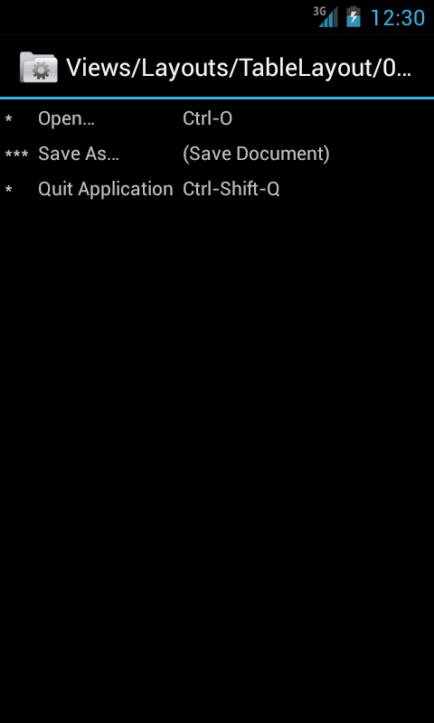
View and ViewGroup
TableLayout
<TableLayout
android:layout_width="match_parent"
android:layout_height="match_parent">
<TableRow>
<TextView
android:text="@string/table_layout_1_star"
android:padding="3dip" />
<TextView
android:text="@string/table_layout_1_open"
android:padding="3dip" />
<TextView
android:text="@string/table_layout_1_open_shortcut"
android:padding="3dip" />
</TableRow>
<TableRow>
<TextView
android:text="@string/table_layout_1_triple_star"
android:padding="3dip" />
<TextView
android:text="@string/table_layout_1_save"
android:padding="3dip" />
<TextView
android:text="@string/table_layout_1_save_shortcut"
android:padding="3dip" />
</TableRow>
...
</TableLayout>
<número>

Slide 26
View and ViewGroup
FrameLayout
  Blocks out an area on the screen to display a single item
  Optimal for images or overlapping views
AbsoluteLayout
  Allows absolute positioning of the Views elements based on screen's pixels
  Not recommended due to the obvious problems it introduces having different screen densities and sizes
<número>

Slide 27
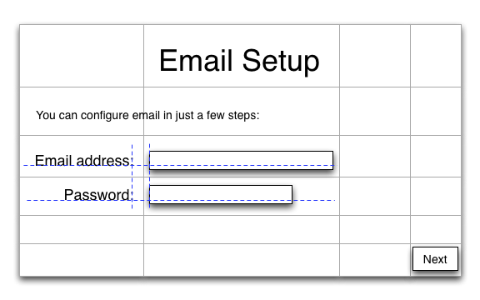
View and ViewGroup
GridLayout
  Available from Android 4.0 onwards (ICS)
  Not to be confused with GridView!
<número>

Slide 28
Activity 2.3
2.3.1 Create an application that shows a form to the
user to save classes or courses he or she is
enrolled in.
2.3.2 The form should contain at least the following fields:
  Name of the course
  Course's number of credits
  Days of the week for the course's lectures
  Start time for the course's lectures
Use any combination of Layouts and Views! (be creative)
<número>

Slide 29
Fragments
  Fragments are portions of a User Interface in an Activity
  Their lifecycle is directly affected by the lifecycle of the Activity containing them
  Fragments declare their own view layout, which is included inside the Activity's view hierarchy (ViewGroup)
  We can create them either statically, within a layout file (XML), or dynamically from the application code
<número>

Slide 30
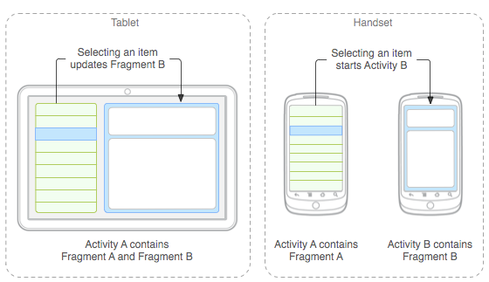
Fragments
  Fragments design: develop a single app running across multiple devices
<número>

Slide 31
Fragments
  Fragments require API version 11 (Honeycomb)
  We can use them for previous versions including the support library provided by Android and the FragmentActivity class
  Ice Cream Sandwich (API 14) is the first version to support Fragments natively in smartphones
<número>

Slide 32
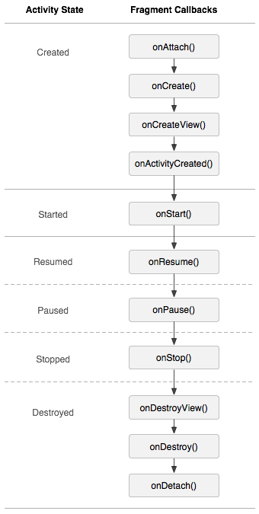
Fragments
Fragments lifecycle
  onAttach/onDetach: associate /
  disassociate a Fragment from an l'Activity
  onCreate: specific of Fragment
  onCreateView/onDestroyView:
  create/destroy the view hierarchy
  of the Fragment
  onActivityCreated: called when the
  Activity's onCreate() finishes
<número>

Slide 33
Fragments
Fragment implementation example:
public class GeneralInfoFragment extends Fragment
{
@Override
public View onCreateView(LayoutInflater inflater, ViewGroup container, Bundle savedInstanceState)
{
View v = inflater.inflate(R.layout.fragment_info, container, false);
return v;
}
@Override
public void onActivityCreated(Bundle savedInstanceState)
{
super.onActivityCreated(savedInstanceState);
Activity parentActivity = getActivity();
TextView textviewGeneralInfo = (TextView)
parentActivity.findViewById(R.id.generalinfo_text);
textviewGeneralInfo.setText(R.string.info);
}
}
<número>

Slide 34
Fragments
Add a new Fragment to an Activity (XML):
<FrameLayout xmlns:android="http://schemas.android.com/apk/res/android"
android:layout_width="fill_parent"
android:layout_height="fill_parent"
android:id="@+id/framelayout_example">
<fragment android:name="org.uab.deic.uabdroid.ExampleFragment"
android:id="@+id/fragment_example"
android:layout_width="fill_parent"
android:layout_height="fill_parent"/>
</FrameLayout>
Fragment manager
  findFragmentById()
  findFragmentByTag()
Class managing the Fragment's
layout
<número>

Slide 35
Fragments
Add a new Fragment to an Activity (dynamically):
→ FragmentTransaction
FragmentManager fragmentManager = getFragmentManager();
FragmentTransaction fragmentTransaction = fragmentManager.beginTransaction();
ExampleFragment fragment = new ExampleFragment();
fragmentTransaction.add(R.id.fragment_container, fragment);
fragmentTransaction.commit();
We need an instance of
FragmentManager!
The “transaction” is performed only after commit() is called!
<número>

Slide 36
Activity 2.4
2.4.1 Modify the application from Activity 2.3 as follows
2.4.1.1 Encapsulate the layout and functionality of the original Activity class in a Fragment class
2.4.1.2 Create and load the Fragment from an XML layout (reuse the original Activity's layout)
Remark! The original Activity class contains some setup code (click listener, AutoCompleteTextView, …). This code should remain in the Activity or placed in the new Fragment class?
<número>

Slide 37
Activity 2.4 bis (optional)
2.4.1 bis Modify the Activity class in order to load the Fragment dynamically.
2.4.2 bis Consider using the Android Support Library v4 and test the application against an emulator running Android 2.3.3 (API 10).
<número>

Slide 38
Menus and dialogs
Menus and dialogs are tools for:
  offering additional information or options
  avoiding to sacrifice screen space
They reinvent themselves from Honeycomb (API 11)
  Some menu buttons go from hardware to software
  Dialogs transform into Fragments
<número>

Slide 39
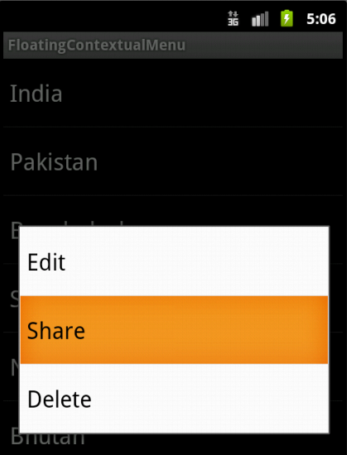
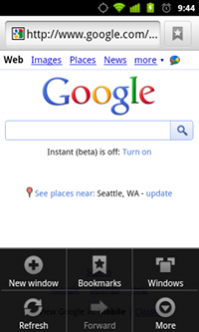
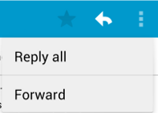
Menus and dialogs
We can offer three types of menus:
  Options menu
  Context menu
  Popup menu
  (API 11+)
<número>

Slide 40
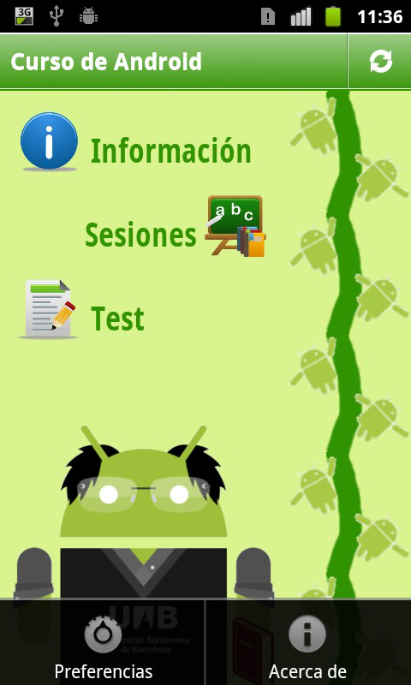
Menus and dialogs
Option menus
<menu>
<item android:id="@+id/PREFERENCES_ID"
android:title="@string/menu_preferences"
android:icon="@drawable/menu_preferences"
/>
<item android:id="@+id/ABOUT_ID"
android:title="@string/menu_about"
android:icon="@drawable/menu_about"
/>
</menu>
@Override
public boolean onCreateOptionsMenu(Menu menu)
{
MenuInflater inflater = getMenuInflater();
inflater.inflate(R.menu.menu, menu);
return true;
}
<número>

Slide 41
Menus and dialogs
Handling click events:
@Override
public boolean onOptionsItemSelected(MenuItem item)
{
switch ( item.getItemId() )
{
case R.id.PREFERENCES_ID:
{
userPreferences(this);
return true;
}
case R.id.ABOUT_ID:
{
showDialog();
return true;
}
}
return super.onOptionsItemSelected(item);
}
<número>

Slide 42
Menus and dialogs
Contextual menu
  Register the View to which the context should be associated by calling registerForContextMenu()
  Implement
  onCreateContextMenu() in your Activity or Fragment
  Implement
  onContextItemSelected()
<número>

Slide 43
Menus and dialogs
Popup menu
<ImageButton
android:layout_width="wrap_content"
android:layout_height="wrap_content"
android:src="@drawable/ic_overflow_holo_dark"
android:contentDescription="@string/descr_overflow_button"
android:onClick="showPopup" />
public void showPopup( View v ) {
PopupMenu popup = new PopupMenu(this, v);
MenuInflater inflater = popup.getMenuInflater();
inflater.inflate(R.menu.actions, popup.getMenu());
popup.show();
}
<número>

Slide 44
Activity 2.5
2.5.1 Modify the MainActivity of the project in Activity 2.2 to add an options menu containing two items
2.5.2 The first item should allow us to start the Subactivity in the same way as a Button
2.5.3 The second item should show a list of other “dummy” options
<número>

Slide 45
Menus and dialogs
Dialogs (before Honeycomb (API 11))
  Invoke showDialog(int)
@Override
protected Dialog onCreateDialog(int id)
{
Dialog dialog = new Dialog(this);
switch(id)
{
case DIALOG_ABOUT_ID:
dialog.setContentView(R.layout.about_dialog);
dialog.setCancelable(true);
dialog.setTitle(getResources().getString(R.string.about_dialog));
ImageView image = (ImageView) dialog.findViewById(R.id.image_layout);
image.setImageResource(R.drawable.logo);
image.setAdjustViewBounds(true);
break;
default:
dialog = null;
}
return dialog;
}
<número>

Slide 46
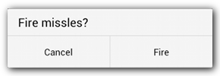
Menus and dialogs
DialogFragments
public class FireMissilesDialogFragment extends DialogFragment {
@Override
public Dialog onCreateDialog(Bundle savedInstanceState) {
// Use the Builder class for convenient dialog construction
AlertDialog.Builder builder = new AlertDialog.Builder(getActivity());
builder.setMessage(R.string.dialog_fire_missiles)
.setPositiveButton(R.string.fire, new DialogInterface.OnClickListener() {
public void onClick(DialogInterface dialog, int id) {
// FIRE ZE MISSILES!
}
})
.setNegativeButton(R.string.cancel, new DialogInterface.OnClickListener() {
public void onClick(DialogInterface dialog, int id) {
// User cancelled the dialog
}
});
// Create the AlertDialog object and return it
return builder.create();
}
}
<número>

Slide 47
Action Bar
  Is a very popular UI design pattern used both on smartphones and tablets
  Introduced in Honeycomb (API 11), becomes the default behavior of Activities.
  For previous versions of the API we can use the Android Support Library v7 (appcompat v7).
  From Android 4.0 we can use the same mechanism both for tablets and for smartphones
<número>

Slide 48
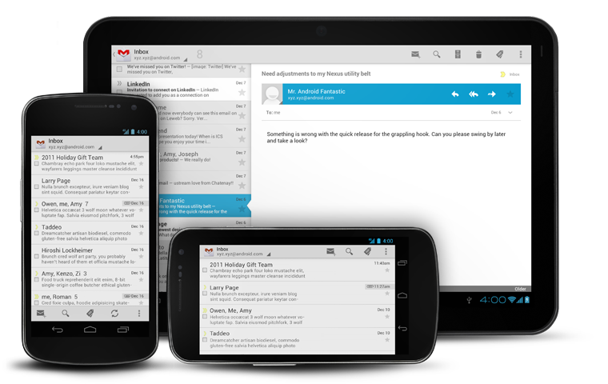
Action Bar
<número>

Slide 49
Action Bar
Implementing the Action Bar
  Each ActionBar is related only to the activity that created it
  We can get an instance of the ActionBar using the getActionBar() method
  We can also eliminate the ActionBar from an Activity:
<activity android:theme="@android:style/Theme.Holo.NoActionBar">
<número>

Slide 50
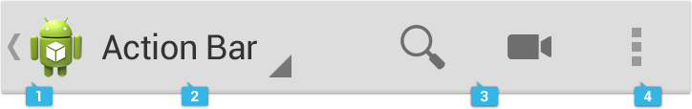
Action Bar
Element organization in the ActionBar
Options menu in the ActionBar
  the menu items are placed in
  the Action Bar itself
Application icon
  works like any other
  button
Least frequent actions
Navigation or View filtering
(e.g. tabs o drop-down menus)
<número>

Slide 51

Action Bar
Adding menu items and Action Views
<menu xmlns:android="http://schemas.android.com/apk/res/android">
<item android:id="@+id/menu_search"
android:title="@string/menu_search"
android:icon="@drawable/ic_menu_search"
android:showAsAction="ifRoom|collapseActionView"
android:actionViewClass="android.widget.SearchView"
/>
</menu>
@Override
public boolean onCreateOptionsMenu(Menu menu) {
getMenuInflater().inflate(R.menu.main, menu);
SearchView searchView = (SearchView) menu.findItem(R.id.menu_search).getActionView();
// Configure the search info and add any event listeners
// ...
return true;
}
<número>

Slide 52
Action Bar
Starting with Android 3.0, three new navigation modes are included within the SDK, which are incorporated into the Action Bar:
  Home button
  Tabs
  Drop-down menu
<número>

Slide 53

Action Bar
Home button navigation
@Override
protected void onStart() {
super.onStart();
ActionBar actionBar = this.getActionBar();
actionBar.setDisplayHomeAsUpEnabled(true);
}
<activity
android:name="com.example.myfirstapp.MainActivity" ...>
</activity>
<activity
android:name="com.example.myfirstapp.DisplayMessageActivity"
android:label="@string/title_activity_display_message"
android:parentActivityName="com.example.myfirstapp.MainActivity" >
<!-- Parent activity meta-data to support API level 7+ -->
<meta-data
android:name="android.support.PARENT_ACTIVITY"
android:value="com.example.myfirstapp.MainActivity" />
</activity>
<número>

Slide 54

Action Bar
Tab navigation
  Replaces previous tab navigation (TabWidget i TabHost)
<número>

Slide 55
Action Bar
Tab navigation. Creating the tabs
@Override
protected void onCreate(Bundle savedInstanceState)
{
super.onCreate(savedInstanceState);
setContentView(R.layout.main);
final ActionBar actionBar = getActionBar();
actionBar.setNavigationMode(ActionBar.NAVIGATION_MODE_TABS);
actionBar.setDisplayShowTitleEnabled(false);
Fragment artistsFragment = new ArtistsFragment();
actionBar.addTab(actionBar.newTab().setText(R.string.tab_artists)
.setTabListener(new MyTabListener(artistsFragment)));
Fragment albumsFragment = new AlbumsFragment();
actionBar.addTab(actionBar.newTab().setText(R.string.tab_albums)
.setTabListener(new MyTabListener(albumsFragment)));
}
<número>

Slide 56
Action Bar
Tab navigation. Switching between tabs
private class MyTabListener implements ActionBar.TabListener
{
private TabContentFragment mFragment;
public MyTabListener(TabContentFragment fragment){
mFragment = fragment;
}
public void onTabSelected(Tab tab, FragmentTransaction ft) {
ft.add(R.id.fragment_content, mFragment, null);
}
public void onTabUnselected(Tab tab, FragmentTransaction ft) {
ft.remove(mFragment);
}
public void onTabReselected(Tab tab, FragmentTransaction ft) {
}
}
<número>

Slide 57
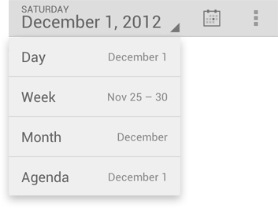
Action Bar
Drop-down navigation
  It uses a Spinner
<número>

Slide 58
Action Bar
Drop-down navigation. Creating the drop-down list
@Override
protected void onCreate(Bundle savedInstanceState) {
super.onCreate(savedInstanceState);
setContentView(R.layout.main);
Spinner spinner = new Spinner(this);
// Fill the spinner with some data
SpinnerAdapter spinnerAdapter = spinner.getAdapter();
final ActionBar actionBar = getActionBar();
actionBar.setNavigationMode(ActionBar.NAVIGATION_MODE_LIST);
actionBar.setListNavigationCallbacks(spinnerAdapter, new OnNavigationListener()
{
@Override
public onNavigationItemSelected(int itemPosition, long itemId)
{
// Do something like change some fragments in the activity
}
});
}
<número>

Slide 59
Activity 2.6
2.6.1 Modify the UIListView example project as follows
2.6.1.1 Create two menu options that will go into the Action Bar
2.6.1.2 Create three menu options that will go in the overflow area. The third menu option should show a sub-menu when clicked with some dummy option.
2.6.1.3 Create a Context Menu for the list items showing two options: remove and share.
<número>

Slide 60
If you want to know more...
  Professional Android 4 Application Development. Chapters 3, 4, 10 i 11
  Pro Android 4. Chapters 6, 7, 8, 16, 29 i 30
  Android Developers: User Interface
  Android Developers: Activities
  Android Developers: GridLayout
  Android Developers: Fragments
  Android Developers: ActionBar
<número>

