Slide 1
Android app development course
Session 3-
+ Manage persistent data
. SharedPreferences, Files, SQLite
+ Android Backup Service
<número>

Slide 2
SharedPreferences
An object of type SharedPreferences references a file that:
  stores pairs of data (key, value)
  the key is of type String
  the value may be of any basic data type
  boolean, string, float, long or integer
The data is stored on a non volatile memory space.
<número>

Slide 3
SharedPreferences
The most common use cases of SharedPreferences are:
  Save execution state of an application across user
  sessions
  Save the execution state of an Activity
  Save “user preferences” for your application
  (☛ PreferenceActivity)
<número>

Slide 4
SharedPreferences
To get a SharedPreferences object for your application
  getSharedPreferences ()
  SharedPreferences sharedPreferences =
getSharedPreferences("INIT_PREFS", Activity.MODE_PRIVATE);
if ( sharedPreferences.getBoolean("firstTime", true) )
{
// ...
}
  getPreferences ()
  SharedPreferences sharedPreferences = getPreferences(Activity.MODE_PRIVATE);
if ( sharedPreferences.getBoolean("firstTime", true) )
{
// ...
}
Multiple files identified by name.
Default value.
One preference file per Activity.
<número>

Slide 5
SharedPreferences
Creating or writing data in a SharedPreferences file
SharedPreferences sharedPref =
getActivity().getPreferences(Activity.MODE_PRIVATE);
SharedPreferences.Editor editor = sharedPref.edit();
editor.putInt(getString(R.string.saved_high_score), newHighScore);
editor.commit();
Calling commit() saves the values into the file!
<número>

Slide 6
PreferencesActivity
  Activity framework to easily create user preferences
  This might perfectly be all its code:
  public class AppPreferences extends PreferenceActivity
{
@Override
public void onCreate(Bundle savedInstanceState)
{
super.onCreate(savedInstanceState);
addPreferencesFromResource(R.xml.userpreferences);
}
}
  Preferences are stored automatically using
  SharedPreferences
  SharedPreferences sharedPref =
PreferenceManager.getDefaultSharedPreferences(context);
<número>

Slide 7
PreferencesActivity
<PreferenceScreen xmlns:android="http://schemas.android.com/apk/res/android">
<PreferenceCategory
android:title="@string/user_preferences_category_alarms">
<CheckBoxPreference android:key="PREF_NEXT_SESSION_ALERTS_CHECK"
android:title="@string/user_preferences_next_session_alerts_title"
android:summary="@string/user_preferences_next_session_alerts_text"
android:defaultValue="false" />
<ListPreference android:key="PREF_NEXT_SESSION_ALERT_FREQ"
android:title="@string/user_preferences_next_session_alert_frequency_title"
android:summary="@string/user_preferences_next_session_alert_frequency_text"
android:dialogTitle="@string/user_preferences_next_session_alert_frequency_dialog_title"
android:entries="@array/user_preferences_alert_frequency_options"
android:entryValues="@array/user_preferences_alert_frequency_values"
android:defaultValue="24"
android:enabled="false" />
<ListPreference android:key="PREF_NEXT_SESSION_ALERT_INTERVAL"
android:title="@string/user_preferences_next_session_window_interval_title"
android:summary="@string/user_preferences_next_session_window_interval_text"
android:dialogTitle="@string/user_preferences_next_session_window_interval_dialog_title"
android:entries="@array/user_preferences_next_session_interval_options"
android:entryValues="@array/user_preferences_next_session_interval_values"
android:defaultValue="4"
android:enabled="false" />
</PreferenceCategory>
</PreferenceScreen>
(key, value)
XML design
<número>

Slide 8
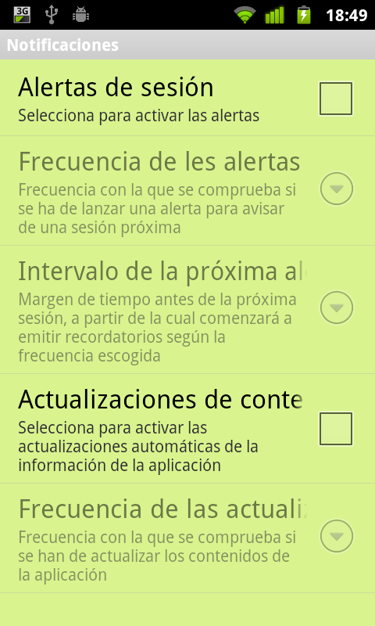
PreferencesActivity
Sample prefs
<número>

Slide 9
Activity 3.1
3.1.1 Clone the PersistentDataSharedPreferences project
in your own working directory.
3.1.2 Modify the project so that the high score is persisted
across subsequent executions using
SharedPreferences.
<número>

Slide 10
Files
We can read and write files using the standard Java library (Streams).
Classification depending on their access type:
  Raw files
  Assets
  Application specific
    internal storage
    external storage (SD card)
    cache
<número>

Slide 11
Files
Raw files
  May be of any type (e.g. video, audio, etc.)
  Their are not compiled by the application
  Read-only. We cannot modify them
  Access through:
  getResources().openRawResource(R.raw.<filename>)
<número>

Slide 12
Files
Assets
  Files that are not compiled by the application
  Are not included in the app's resources directory
  → they don't have an associated ID
  Read-only files
  Access available through an AssetManager:
  Context context = getBaseContext();
  AssetManager assetManager = context.getAssets();
  InputStream is = assetManager.open(filename);
<número>

Slide 13
Files
Application specific
  Read and write access
  We need an input or an output stream object to read or write to a file
  FileOutputStream openFileOutput(string name, int mode)
FileInputStream openFileInput(string name, int mode)
FileInputStream fis = openFileInput(”origen.txt”, Context.MODE_PRIVATE);
FileOutputStream fos = openFileOutput(”destino.txt”, Context.MODE_PRIVATE);
byte[] b = new byte[512];
While ( is.read(b) != -1 )
{
fos.write(b);
}
fos.close();
fis.close();
<número>

Slide 14
Files
Different file creation modes:
  Context.MODE_PRIVATE
  Context.MODE_APPEND
  Context.MODE_WORLD_READABLE
  Context.MODE_WORLD_WRITEABLE
Deprecated
from API 17
<número>

Slide 15
Files
Useful functions for internal storage management
  getFilesDir() - path of the directory where files are stored using the openFileOutput() function
  getDir(name, mode) – Opens a directory or creates it if it does not exist
  deleteFile(name) – eliminates a file created by openFileOutput()
  fileList() - returns a list of all created files by the application
<número>

Slide 16
Files
We can create cache files
  getCacheDir() - open the directory where the application can store temporary cache files
  Use carefully!!
    Android may delete these file when low on internal storage space
    We may not know when these file are eliminated
    Limited to 1MB
<número>

Slide 17
Files
External storage
  SD cards or non-removable storage (e.g. Nexus S)
  First we must check for availability!
boolean mExternalStorageAvailable = false;
boolean mExternalStorageWriteable = false;
void updateExternalStorageState()
{
String state = Environment.getExternalStorageState();
if (Environment.MEDIA_MOUNTED.equals(state))
{
mExternalStorageAvailable = mExternalStorageWriteable = true;
}
else if (Environment.MEDIA_MOUNTED_READ_ONLY.equals(state))
{
mExternalStorageAvailable = true;
mExternalStorageWriteable = false;
}
else
{
mExternalStorageAvailable = mExternalStorageWriteable = false;
}
}
<número>

Slide 18
Files
External storage
  We need the WRITE_EXTERNAL_STORAGE permission
  Useful functions
    getExternalStorageDirectory() - path of the directory where the files are stored (API 7-)
    getExternalFilesDir(type) – idem (API 8+)
    getExternalStoragePublicDirectory(type) – allows access to top-level public directories (audio, video, ringtones, etc.) (API 8+)
    getExternalCacheDir() - cache directory (API 8+)
<número>

Slide 19
Databases
SQLite
  We can access the DB from any class if and only if resides in the same application
  We can explore its content either through a command line tool or through the DDMS view
$ adb -s emulator-5554 shell
# sqlite3
/data/data/com.example.google.rss.rssexample/databases/rssitems.db
SQLite version 3.3.12
Enter ".help" for instructions
.... enter commands, then quit...
sqlite> .exit
<número>

Slide 20
Databases
Working with SQLite
  To create a new SQLite database we need to create a subclass of SQLiteOpenHelper
    onCreate() → override it to create the tables
  It a good practice to create a helper class to ease the interaction with the database
<número>

Slide 21
Databases
public class YourDatabase extends SQLiteOpenHelper
{
YourDatabase(Context context)
{
super(context, DB_NAME, null, DB_VERSION);
}
@Override
public void onCreate(SQLiteDatabase database)
{
database.execSQL(DATABASE_CREATE_SESSIONS);
database.execSQL(DATABASE_CREATE_MATERIALS);
database.execSQL(DATABASE_CREATE_SOURCES);
database.execSQL(DATABASE_CREATE_MATERIALSBYSESSION);
database.execSQL(DATABASE_CREATE_SOURCESBYSESSION);
database.execSQL(DATABASE_CREATE_MATERIALTYPE);
database.execSQL(DATABASE_CREATE_SOURCETYPE);
database.execSQL(DATABASE_CREATE_TEST);
}
@Override
public void onUpgrade(SQLiteDatabase database, int oldVersion, int newVersion)
{
}
}
<número>

Slide 22
Databases
To write to and read from the database use the following functions of SQLiteOpenHelper:
  getWritableDatabase() - read and write
  getReadableDatabase() - read-only
There is an alternative method to access a DB
  Use the SQLiteDatabase class to get an instance of the DB
  openDatabase(path, factory, CREATE_IF_NECESSARY, errorHandler)
<número>

Slide 23
Databases
Create tables in the DB
public static final String DB_TABLE_SESSIONS = "tblSessions";
public static final String KEY_ROWID = "_id";
public static final String KEY_SESSIONS_TITLE_CA = "title_ca";
public static final String KEY_SESSIONS_TITLE_ES = "title_es";
public static final String KEY_SESSIONS_CLASSROOM = "classroom";
public static final String KEY_SESSIONS_DATE = "date";
public static final String KEY_SESSIONS_HOUR = "hour";
public static final String KEY_SESSIONS_CONTENT_CA = "content_ca";
public static final String KEY_SESSIONS_CONTENT_ES = "content_es";
private static final String DATABASE_CREATE_SESSIONS =
"create table " + DB_TABLE_SESSIONS + "("
+ KEY_ROWID +" integer primary key, "
+ KEY_SESSIONS_TITLE_CA + " text not null, "
+ KEY_SESSIONS_TITLE_ES + " text not null, "
+ KEY_SESSIONS_CLASSROOM + " text not null, "
+ KEY_SESSIONS_DATE + " text not null, "
+ KEY_SESSIONS_HOUR + " text not null, "
+ KEY_SESSIONS_CONTENT_CA + " text not null, "
+ KEY_SESSIONS_CONTENT_ES + " text not null);";
Table name
Columns
<número>

Slide 24
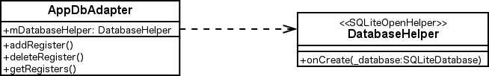
Databases
Using an auxiliary class
  Holds a reference to an SQLiteOpenHelper object
  Contains methods to deal with common DB operation
<número>

Slide 25
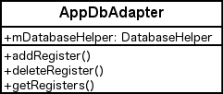
Databases
Examples. Insert registers
  Use ContentValues
private SQLiteDatabase mDatabase;
public long addSession(long rowId, String title_ca,
String title_es, String classroom, String date, String hour,
String content_ca, String content_es)
{
ContentValues initialValues = new ContentValues();
initialValues.put(KEY_ROWID, rowId);
initialValues.put(KEY_SESSIONS_TITLE_CA, title_ca);
initialValues.put(KEY_SESSIONS_TITLE_ES, title_es);
initialValues.put(KEY_SESSIONS_CLASSROOM, classroom);
initialValues.put(KEY_SESSIONS_DATE, date);
initialValues.put(KEY_SESSIONS_HOUR, hour);
initialValues.put(KEY_SESSIONS_CONTENT_CA, content_ca);
initialValues.put(KEY_SESSIONS_CONTENT_ES, content_es);
return mDatabase.insert(DB_TABLE_SESSIONS, null, initialValues);
}
<número>

Slide 26
Databases
Examples. Delete registers
public boolean deleteSession(long rowId)
{
String where = KEY_ROWID + "=" + rowId;
return mDatabase.delete(DB_TABLE_SESSIONS, where, null) > 0;
}
<número>

Slide 27
Databases
Examples. Most common queries
  query(table, columns, selection, selectionArgs, groupBy, having, orderBy)
public Cursor fetchAllSessions()
{
String from = DB_TABLE_SESSIONS;
String select = new String[] {
KEY_ROWID, KEY_SESSIONS_TITLE_CA,KEY_SESSIONS_TITLE_ES,
KEY_SESSIONS_CLASSROOM,KEY_SESSIONS_DATE,
KEY_SESSIONS_HOUR,KEY_SESSIONS_CONTENT_CA,
KEY_SESSIONS_CONTENT_ES
};
Cursor cursor = mDatabase.query(from, select, null, null,
null, null, null);
if (cursor != null)
{
cursor.moveToFirst();
}
return cursor;
}
<número>

Slide 28
Databases
Fetch registers. Cursors
  Stores a query result
  Needs to reference a specific register before using it (moveToXxxx() function)
  We can access register values through the index of the column we want the value from
  We must close it when done working with it ( Cursor.close() )
  Activities can manage the Cursors for us through the startManagingCursor(cursor) method
<número>

Slide 29
Databases
Fetch registers. Cursors
private void fillData(long numOfSession)
{
int columnaContentIndex;
final String locale = Locale.getDefault().toString();
Cursor cSession = mDatabaseHelper.fetchSession(numOfSession);
mParentActivity.startManagingCursor(cSession);
if(locale.compareTo("ca_ES")==0) {
columnaContentIndex = cSession.getColumnIndexOrThrow(
AppDbAdapter.KEY_SESSIONS_CONTENT_CA);
}
else {
columnaContentIndex = cSession.getColumnIndexOrThrow(
AppDbAdapter.KEY_SESSIONS_CONTENT_ES);
}
String strContent = cSession.getString(columnaContentIndex);
TextView textviewContent = (TextView) findViewById(R.id.generalinfo_text);
textviewContent.setText(strContent);
}
<número>

Slide 30
Activity 3.2
3.2.1 Open the UIFormExample project in your working directory. Add the necessary code to:
3.2.1.1Include a database.
3.2.1.2 Create a table to store all the information gathered from the user.
3.2.1.3 Save the data from the form into the database.
<número>

Slide 31
Adapters and data binding
Adapters
  Used to create AdapterViews from a data set
Data binding
  Is the process of binding or linking a data source with a UI View
<número>

Slide 32
Adapters and data binding
Different Adapters...
  ArrayAdapter
  SimpleCursorAdapter
  ListAdapter
  etc.
for different AdapterViews
  ListView
  GridView
  Spinner
  etc.
<número>

Slide 33
Adapters and data binding
ArrayAdapter<type>
  Typically stores information from an ArrayList<type>
  Invokes the toString() method of each element to get a String description displayable in an AdapterView
ListView listView = getListView(); // Or findViewById() if not a ListActivity or ListFragment
ArrayList<Integer> integerArray = new ArrayList<Integer>();
// ... (Populate the ArrayList with some integers)
ArrayAdapter<Integer> integerAdapter = new ArrayAdapter<Integer>(
this,
android.R.layout.simple_list_item_1,
integerArray
);
listView.setAdapter(integerAdapter); // Or setListAdapter(integerAdapter)
// Update list content
integerArray.add(new Integer(0));
integerAdapter.notifyDataSetChanged();
<número>

Slide 34
Adapters and data binding
SimpleCursorAdapter
  Populates an AdapterView with values obtained from a Cursor's columns
  Allows us to select the source columns of the Cursor and the target Views of the UI layout by establishing a unique relation between each column/View
<número>

Slide 35
Adapters and data binding
SimpleCursorAdapter
mCursor = getContentResolver().query(People.CONTENT_URI,
null, null, null, null);
startManagingCursor(mCursor);
ListAdapter adapter = new SimpleCursorAdapter(
this,
android.R.layout.two_line_list_item,
mCursor,
new String[] {People.NAME,People.COMPANY},
new int[] {android.R.id.text1, android.R.id.text2}
);
setListAdapter(adapter);
<número>

Slide 36
Adapters and data binding
We can create our own Adapters
  Extend the BaseAdapter class
  Store the data model in the class's constructor
  Override the following method
  public View getView(int position, View convertView, ViewGroup parent)
    If convertView != null, represents the View to fill in
    If convertView == null, we must create the View
    Fill the elements of the View with data from our data model and return it
<número>

Slide 37
Share data across different Activities
Three ways of sharing information among Activities:
  Non volatile memory (files, DB, SharedPreferences)
  Using a Singleton pattern
      extending the Application class
  Bundles
<número>

Slide 38
Share data across different Activities
Three ways of sharing information among Activities:
  Non volatile memory
  (fitxers, BBDD, SharedPreferences)
  Using a Singleton pattern
    extending the Application class
  Bundles
Ineficient
Use it wisely
Adequate for basic data types
<número>

Slide 39
Application Singleton
public class MyApplication extends Application
{
private static MyApplication mSingleton;
private AnOrdinaryObject mObject;
@Override
public void onCreate()
{
super.onCreate();
mSingleton = this;
mObject = null;
}
public static MyApplication getInstance()
{
return mSingleton;
}
public void setTheOrdinaryObject(AnOrdinaryObject object)
{
mObject = object;
}
public AnOrdinaryObject getTheOrdinaryObject()
{
return mObject;
}
}
<número>

Slide 40
Bundle
Use the Bundle class:
  Stores basic data types.
  Uses the same principle of (key, value) pairs similar to
  SharedPreferences.
  We can get and add values using the get_type_() and
  put_type_() methods
      getString(key)
      getInt(key, defaultValue)
      putBoolean(key, value)
  When getting a certain value, we can assign it a
  default value if the key does not exist.
<número>

Slide 41
Bundle
Intents implement Bundles by default
Intent intent = new Intent(context, MapActivity.class);
intent.putExtra("Nombre", "Un lugar de ensueño");
intent.putExtra("Direccion", "Calle Los Manolos, nº 2");
intent.putExtra("Longitud", 1.56772234);
intent.putExtra("Latitud", 1.567235236);
intent.putExtra("Zoom", 18);
startActivity(intent);
And we can recover the data later on
@Override
protected void onCreate(Bundle icicle)
{
super.onCreate(icicle);
setContentView(R.layout.map);
Intent intent = getIntent();
latitud = intent.getFloatExtra("Latitud", 0));
longitud = intent.getFloatExtra("Longitud", 0));
}
<número>

Slide 42
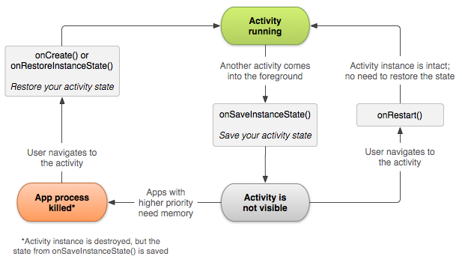
Bundle
Offer an alternative mechanism to save the state of an
Activity to deal with unexpected events.
<número>

Slide 43
Bundle
  onSaveInstanceState(Bundle)
    Called when the Activity goes into the background
    It is not called if the Activity is destroyed by the actual
    app behavior (back button navigation)!
    Allows us to save the Activity's state in case of an
    hara-kiri situation for the greater good
  onRestoreInstanceState(Bundle)
    Called immediately after onCreate()
    Allows us to restore the state of the Activity before it
    was destroyed
<número>

Slide 44
Activity 3.3
3.3.1 Add a ListActivity to the project in Activity 3.2 to show the list of enrolled courses.
3.3.2 Create a custom layout for the list items using 3 TextViews (course name, days of week and hour).
3.3.3 Populate the list from the database using a SimpleCursorAdapter and the layout you designed.
3.3.4 When an item is selected open the detailed view for that particular item.
<número>

Slide 45
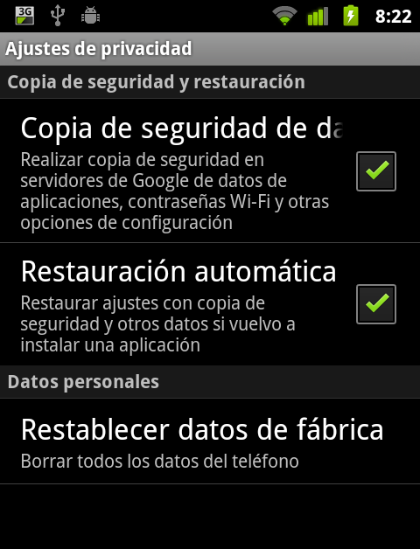
Android Backup Service
“If you don't implement the Backup Manager, I have a question for you: why do you hate your users?”
Reto Meier, Tech Lead at Google
<número>

Slide 46
Android Backup Service
Backup Manager
  Available from Android 2.2 onwards
  Not all devices implements this service
  The user must enable it in the system's configuration
  Not designed for reading or writing data on demand (it's not a Dropbox-like service!)
<número>

Slide 47
Android Backup Service
To implement it you need to
  Declare a backup agent in your manifest file
  Register your application with a backup service
  Define a backup agent by either
    Extending BackupAgent
    Extending BackupAgentHelper
  Implement the following operations
    Backup
    Restore
<número>

Slide 48
Android Backup Service
Declare a backup agent in your manifest file
<manifest ... >
...
<application android:label="MyApplication"
android:backupAgent="MyBackupAgent">
<activity ... >
...
</activity>
</application>
</manifest>
<número>

Slide 49
Android Backup Service
Register your application with a backup service
  Google provides it free of charge to register your applications with
  The service generates a Backup Service Key you must add in your manifest file
<application android:label="MyApplication"
android:backupAgent="MyBackupAgent">
...
<meta-data android:name="com.google.android.backup.api_key"
android:value="AEdPqrEAAAAIDaYEVgU6DJnyJdBmU7KLH3kszDXLv_4DIsEIyQ" />
</application>
<número>

Slide 50
Android Backup Service
BackupAgent vs BackupAgentHelper
  BackupAgentHelper → easier to implement
  BackupAgent → more adaptable/flexible
  Use it under the following assumptions
    We want to backup data stored in a DB
    We want to backup partial files rather than whole files
    Version the data format and perform compatibility work
<número>

Slide 51
Android Backup Service
BackupAgentHelper
  Eases backup of files and SharedPreferences
  Uses two different helpers
    SharedPreferencesBackupHelper
    FileBackupHelper (is not “threadsafe”!)
public class MyPrefsBackupAgent extends BackupAgentHelper
{
static final String PREFS = "user_preferences";
static final String PREFS_BACKUP_KEY = "prefs";
@Override
public void onCreate() {
SharedPreferencesBackupHelper helper =
new SharedPreferencesBackupHelper(this, PREFS);
addHelper(PREFS_BACKUP_KEY, helper);
}
}
<número>

Slide 52
Android Backup Service
BackupAgent
  Implemented by extending BackupAgent
  No helpers! :(
  We must override the following methods
    onBackup()
    onRestore()
<número>

Slide 53
Android Backup Service
onBackup() - parameters
  oldState: local representation of the data that was backed up the last time onBackup() was called
  data: BackupDataOutput object used to deliver the date to the Backup Manager
  newState: reference to a file in which you must write a representation of the backed up data (e.g. last-modified timestamp for your file)
<número>

Slide 54
Android Backup Service
onBackup() - skeleton
// Open a stream for the old state
FileInputStream instream = new FileInputStream(oldState.getFileDescriptor());
DataInputStream in = new DataInputStream(instream);
try {
// Get the last modified timestamp from the state file and data file
long stateModified = in.readLong();
long fileModified = mDataFile.lastModified();
if (stateModified != fileModified) {
// The file has been modified, so do a backup
// Or the time on the device changed, so be safe and do a backup
} else {
// Don't backup because the file hasn't changed
return;
}
} catch (IOException e) {
// Unable to read state file... do a backup “just in case”
}
<número>

Slide 55
Android Backup Service
onRestore() - parameters
  data: BackupDataInput object to read the backup data from the Backup Manager
  appVersionCode: application version number as it was when the backup was performed
  newState: reference to a file in which you must write a representation of the backed up data
<número>

Slide 56
Android Backup Service
onRestore() - skeleton
while (data.readNextHeader()) {
String key = data.getKey();
int dataSize = data.getDataSize();
// If we recognize the key and we are able to manage the data.
// We write the key when performing the backup
if (TOPSCORE_BACKUP_KEY.equals(key)) {
// Create an input stream for the BackupDataInput
// Read the backup data and store on the device...
// typically to a file
} else {
// We don't know this entity key. Skip it.
// Shoudn't happen!
data.skipEntityData();
}
}
<número>

Slide 57
Android Backup Service
Writing and reading data
  We can request a backup at any time using the following method
    requestBackup() de BackupManager
  We can also request a restore action at any time ...but we shouldn't do that!!
    requestRestore() de BackupManager
  A restore action is performed automatically when the application is installed
<número>

Slide 58
If you want to know more
  Professional Android Application Development. Chapters 3, 5, 6 i 7
  Pro Android 3. Chapters 3, 6 i 9
  Android Developers: Data Storage
  Android Developers: Data backup
  Antonio's $HOME: Singletonitis
<número>

