Slide 1
Android app development course
Session 4-
+ Performing actions in the background
. Services, AsyncTasks, Loaders
. Notificacions, Alarms

Slide 2
Services
A Service
  Is an app component that can perform long-running
  operations in the background, invisible to the user.
  Does not provide an user interface!
  Allows other components to interact with it to send
  and receive messages (Interprocess communication)
  By default runs in the Main Thread of the application
  that hosts it! (Watch out for an ANR)

Slide 3
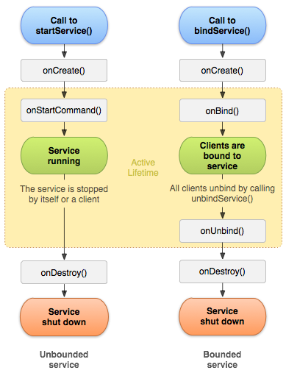
Services
Service Lifecycle
Android 2.0 or higher
Two main states:
  STARTED: runs
  indefinitely ☢
  BOUND: runs as long as
  another component is
  associated with it

Slide 4
Services
Create a new Service. Common steps (STARTED)
Activity
Service
Intent
startService( )
Intent
onStartCommand()
DO_SOMETHING
stopSelf()
stopService()
Different ways to stop the Service!

Slide 5
Services
Create a new Service. Common steps (BOUND)
Activity
Service
bindService()
onBind()
return IBinder
Interface that defines
the communication
with the Service.
unbindService()
When there is no component
bound to the service, the OS
stops it.

Slide 6
Services
☢ A Service may be stopped by the system if the Memory
Manager requires it! The system can then continue
according to the following constants:
  START_STICKY: restart the Service
  START_NOT_STICKY: do not recreate the Service
  START_REDELIVER_INTENT: recreate the Service
  with the last Intent that was delivered to it

Slide 7
Services
START_STICKY
  Typically used by services that manage the lifecycle by
  themselves through the startService and stopService
  methods
  These services usually interact with an Activity or a
  home-screen widget
  Examples:
    Music player
    Downloads in the background

Slide 8
Services
START_NOT_STICKY
  Commonly used for services specific task that are finite
  in time, but are executed periodically
  These services usually stop themselves by calling
  stopSelf when they finish their activity
  Only recreated if there are pending Intents to deliver to
  the service
  Examples:
    Content update (email, social networks, etc.)
    Event notifications (new email, new tweet, etc.)

Slide 9
Services
START_REDELIVER_INTENT
  Commonly used for tasks that are executed periodically,
  but we don't know exactly when these finish
  These services may have more than one pending Intent
  to deal with
  We need to ensure that all pending Intents are delivered
  and managed; therefore the service is always recreated
  by the system

Slide 10
Services
Examples (STARTED)
public class UpdateService extends Service
{
@Override
public int onStartCommand(Intent intent, int flags, int startId)
{
super.onStartCommand(intent, flags, startId);
XMLParser.update(getBaseContext());
return Service.START_NOT_STICKY;
}
}

Slide 11
Services
Examples (BOUND)
private final IBinder mBinder = new MyBinder();
@Override
public IBinder onBind(Intent intent)
{
return mBinder;
}
public class MyBinder extends Binder
{
MyService getService()
{
return MyService.this;
}
}
Service-side

Slide 12
Services
Examples (BOUND) (cont.)
@Override
public void onCreate(Bundle savedInstanceState) {
super.onCreate(savedInstanceState);
setContentView(R.layout.main);
Intent bindIntent = new Intent(this, MyService.class);
bindService(bindIntent, mConnection, Context.BIND_AUTO_CREATE);
}
private MyService mServiceBinder;
private ServiceConnection mConnection = new ServiceConnection() {
@Override
public void onServiceConnected(ComponentName name, IBinder service)
{
mServiceBinder = ((MyService.MyBinder) service).getService();
}
@Override
public void onServiceDisconnected(ComponentName name)
{
mServiceBinder = null;
}
};
Activity-side

Slide 13
Activity 4.1
4.1.1 Create a new Service to download a file
Use the following code for the download:
try {
URL url =
new URL("http://www.gencat.cat/opendata/recursos/equipaments/equipaments.rdf");
InputStream inputStream = url.openConnection().getInputStream();
FileOutputStream fileOutputStream =
openFileOutput("resultat.xml", Context.MODE_PRIVATE);
byte[] buffer = new byte[1024];
while ( (inputStream.read(buffer) > -1) )
{
fileOutputStream.write(buffer);
}
fileOutputStream.close();
inputStream.close();
Toast.makeText(getBaseContext(), "Download complete!", Toast.LENGTH_LONG).show();
}
catch (Exception e) { e.printStackTrace(); }

Slide 14
AsyncTask
AsyncTasks
  allow us to perform operations asynchronously
  on the user interface
  use a “worker thread” to perform long-running or
  blocking operations
  publish the results on the UI Thread.
If we need to perform a long-running operation and ensure
that is executed, is most common to use
  Service + AsyncTask

Slide 15
AsyncTask
The three types used by an AsyncTask are the
following:
  Params: parameters sent to the task upon execution
  Progress: progress units published during the
  background computation
  Result: result of the background computation
Not all types are always used, we can marked them as
Void.
private class MyTask extends AsyncTask<Void, Void, Void> { ... }

Slide 16
AsyncTask
An AsyncTask typically follows these 4 steps:
  onPreExecute(): executed before any background
  computation is started (e.g. show a progress bar)
  doInBackground(Params...): implementation of the
  actual computation task
  onProgressUpdate(Progress...): executed after calling
  publishProgress(...) allowing to show the progress of
  the task on the UI Thread
  onPostExecute(Result): executed at the end of the
  background computation

Slide 17
AsyncTask
private class DownloadFilesTask extends AsyncTask<URL, Integer, Long> {
protected Long doInBackground(URL... urls) {
int count = urls.length;
long totalSize = 0;
for ( int i = 0; i < count; i++ ) {
totalSize += Downloader.downloadFile( urls[i] );
publishProgress( (int) ( (i / (float) count) * 100 ) );
// Escape early if cancel() is called
if ( isCancelled() ) break;
}
return totalSize;
}
protected void onProgressUpdate(Integer... progress) {
setProgressPercent( progress[0] );
}
protected void onPostExecute(Long result) {
showDialog("Downloaded " + result + " bytes");
}
}

Slide 18
IntentService
Combines a Service and an AsyncTask in the same class!
  Is a Service that when started, executes the method
  onHandleIntent(Intent intent)
  The task is executed in a worker parallel thread
  When the previous method finishes, it calls stopSelf()
  of the Service
  We only have to override onHandleIntent if we
  decide to implement a new IntentService

Slide 19
IntentService
Pros
  Fast implementation
  It can be started with an Intent which specifies the task
  to be performed
  Optimal for database or file content update
Cons
  Very little adaptable or flexible
  Can not interact with the UI Thread
  We can not change its behavior

Slide 20
Activity 4.2
4.2.1 Create an AsyncTask inside the Service.
4.2.2 Move the download code for the file in the
doInBackground() method.
4.2.3 Start the AsyncTask from the onStartCommand()
method of the Service.
4.2.4 Call stopSelf() from the onPostExecute() method
in the AsyncTask in order to stop the Service once the
download is complete.

Slide 21
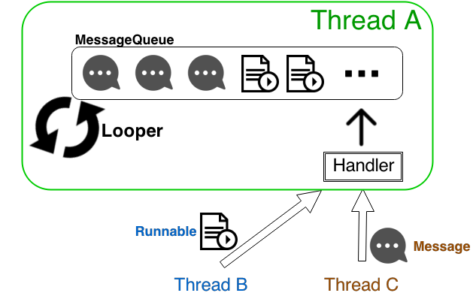
Handler Architecture

Slide 22
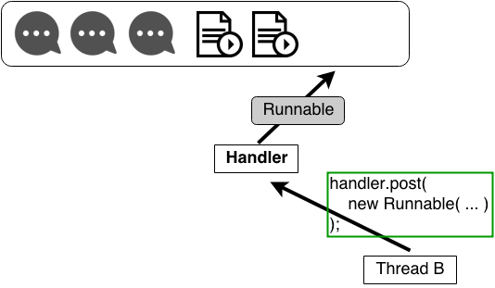
Handler Architecture
Runnable
  Contains an instance of the Runnable interface.
  Sender implements response.
Runnable.run( … )

Slide 23
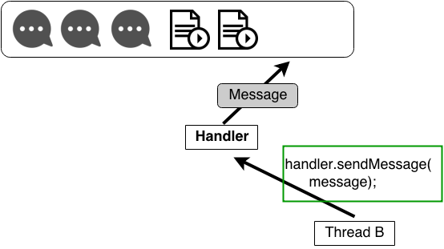
Handler Architecture
Message
  Can contain a message code, an object and a bundle.
  Handler implements response.
Handler
.handleMessage( … )

Slide 24
Handler Architecture
Update the UI in the UI Thread
  View hierarchy can only be modified from the UI Thread → Exception
  Android provides methods that are guaranteed to run in the UI Thread
boolean View.post (Runnable action)
void Activity.
runOnUiThread (Runnable action)

Slide 25
Activity 4.3
4.3.1 Clone the ThreadingRunOnUIThread project in your
working directory.
4.3.2 Load the image from the project's drawable
resources.
4.3.3 Use the runOnUiThread( … ) method to set the
ImageView's bitmap resource from the loading
Thread.

Slide 26
Loaders
The adapters that we have seen in Unit 3 have a common
issue: the data must come from “somewhere”.
This “somewhere” uses to be the Main Thread! → Problem!
ANR if we surpass the 5 seconds threshold.
There are several techniques to deal with this issue...

Slide 27
Loaders
Poor solution: get the data in an AsyncTask and wait until
all the data is ready to update the View.
Acceptable solution: get the data using several AsyncTasks,
first loading the less heavy data (commonly text) and
update the Views as slower data is loaded (lazy loading).
Better solution: use Loaders introduced from Android 3.0
(Honeycomb).

Slide 28
Loaders
Loaders offer
  Asynchronous data loading
  Available to any Activities or Fragments
  Continuously monitor the data source and update the
  Views when changes are detected
  Save their state in order to avoid unnecessary reload
  of the data

Slide 29
Loaders
An application using Loaders usually combines the
following elements:
  An Activity or a Fragment
  An instance of LoaderManager
  A CursorLoader to load data from a ContentProvider or a class extending AsyncTaskLoader to load data from any other source
  An implementation of LoaderManager.LoaderCallbacks where new loaders are created or existing ones are managed

Slide 30
LoaderManager
public class AppListActivity extends FragmentActivity
{
@Override
public void onCreate(Bundle savedInstanceState)
{
super.onCreate(_savedInstanceState);
setContentView(R.layout.listactivity);
mCursorAdapter = new SimpleCursorAdapter(getBaseContext(),
android.R.layout.two_line_list_item,
null,
COLUMNS_FROM, VIEWS_TO);
ListView listView = (ListView)findViewById(R.id.list_view);
listView.setAdapter(mCursorAdapter);
getSupportLoaderManager().
initLoader(0, null, new CursorLoaderCallback());
}
}
Implementation of
LoaderManager.LoaderCallbacks
ID
Additional parameters

Slide 31
LoaderManager.LoaderCallbacks
private SimpleCursorAdapter mCursorAdapter;
private class CursorLoaderCallback implements
LoaderManager.LoaderCallbacks<Cursor>
{
@Override
public Loader<Cursor> onCreateLoader(int id, Bundle bundle)
{
return new DatabaseCursorLoader(getBaseContext());
}
@Override
public void onLoadFinished(Loader<Cursor> loader, Cursor cursor)
{
mCursorAdapter.swapCursor(cursor);
}
@Override
public void onLoaderReset(Loader<Cursor> loader)
{
}
}

Slide 32
AsyncTaskLoader
public class DatabaseCursorLoader extends AsyncTaskLoader<Cursor> {
private Cursor mCursor;
private SQLiteDataRepository mDatabaseAdapter;
public DatabaseCursorLoader(Context context) {
super(context);
mDatabaseAdapter = new SQLiteDataRepository(getContext());
mDatabaseAdapter.openDatabaseForReadOnly();
}
@Override
protected void onStartLoading() {
forceLoad();
super.onStartLoading();
}
@Override
public Cursor loadInBackground() {
if ( (mCursor!=null) && (!mCursor.isClosed()) ) {
mCursor.close();
}
mCursor = mDatabaseAdapter.fetchAllCourses();
return mCursor;
}
}

Slide 33
Loaders
Updating the data when the source modifies its content: we need to add two elements
  The data source should generate a new event (an Intent) when it modifies its content
  A BroadcastReceiver to capture this event (Intent) and act in consequence

Slide 34
Activity 4.4
4.4.1 Clone the ContentProviderSQLite project in your working directory.
4.4.2 Implement the LoaderManager.LoaderCallbacks interface.
4.4.3 Use a CursorLoader to load the data from the ContentProvider and populate the ListView.

Slide 35
Notifications
Notifications are the mechanism to communicate the user any major event of the system when working in background.
Two formats of communicating information to the user:
  Toasts
  Notifications

Slide 36
Notifications
Toasts
  Very simple! It only displays a floating text box on the screen during a limited amount of time.
Toast toast = Toast.makeText(getBaseContext(),
"Downloading file!",
Toast.LENGTH_SHORT);
toast.show();

Slide 37
Notifications
Notifications
  Typically used from components that are purely background: Services, Receivers, Alarms, …
  The main objective is to inform of any event detected or produced by any of these.
  Three different ways of offering a notification:
    An icon on the notification bar
    A View on the extended notification bar
    Audio-visual effects, such as vibrations, sounds or led

Slide 38
Notifications
NotificationManager
  Manages notifications
  We can obtain a reference through getSystemService()
  getSystemService(Context.NOTIFICATION_SERVICE);
  It generates new notifications using the following
  notify(id, notification);
  Assigns each notification an unique ID. Then
    we can modify notifications later on
    eliminate existing notifications

Slide 39

Notifications
Notification. Basic information
  The information related to a notification usually combines the following elements
    Icon
    Notification text
    Date and time of occurrence of the notification

Slide 40
Notifications
Notification. Extended information
  Reuses the icon
  May incorporate a title and simple description
  May contain an Intent which will be delivered when the user clicks over the notification
  We can define a custom layout for the notification and update it remotely (e.g. progress bar)
    we must modify the contentView attribute of the created notification
    we must use RemoteViews

Slide 41
Notifications
Notification. Example
int icon = R.drawable.ic_launcher;
String text = "Notification";
long when = System.currentTimeMillis();
Notification notification = new Notification(icon, text, when);
Context context = getApplicationContext();
String expandedTitle = "Extended notification";
String expandedText = "This is a notification!";
Intent intent = new Intent(this, FormAppActivity.class);
PendingIntent pendingIntent = PendingIntent.getActivity(context, 0,
intent, Intent.FLAG_ACTIVITY_NEW_TASK);
notification.setLatestEventInfo(context, expandedTitle,
expandedText, pendingIntent);
NotificationManager notificationManager =
(NotificationManager) getSystemService(Context.NOTIFICATION_SERVICE);
notificationManager.notify(1,notification);

Slide 42
Notifications
Notification. Adding sounds, led and vibrations
  To add a sound we must modify the sound attribute of the notification, specifying an URI of the audio file
  Three attribute led configuration
    ledARGB: color
    ledOffMS: off time in miliseconds
    ledOnMS: flashing time in miliseconds
    and activate Notification.FLAG_SHOW_LIGHTS
  To add vibrations (they require the VIBRATE permission)
    use the vibrate attribute
    specify the vibration intervals

Slide 43
Notifications
Notifications redefine themselves from Android 3.0 (Honeycomb)
  More visually than in code
  Create through a new factory Notification.Builder
  Expanded notifications are introduced
    Display images into the notification's layout
    May include buttons to perform actions
    3 predefined styles: BigPictureStyle, BigTextStyle, InboxStyle

Slide 44
Notifications
Notifications using NotificationCompat.Builder
NotificationCompat.Builder builder =
new NotificationCompat.Builder(getApplicationContext());
builder.setAutoCancel(true);
.setTicker(tickerText);
.setSmallIcon(R.drawable.ic_launcher);
.setWhen(System.currentTimeMillis());
.setContentTitle(expandedTitle);
.setContentText(expandedText);
.setContentIntent(launchIntent);
Notification newSessionNotification = builder.build();
notificationManager.notify(NOTIFICATION_ID, newSessionNotification);

Slide 45
Activity 4.5
4.5.1 Clone the NotificationBroadcastReceiverSkeleton project into your working directory.
4.5.2 Set up a BroadcastReceiver in the MainActivity that lets the sender know the Intent was received.
4.5.3 Send an ordered broadcast from the LoadImageRunnable to inform that the loading process has finished.
4.5.2 Send a notification, if the MainActivity is not in foreground to let the user know that the image is available.

Slide 46

Alarms
In Android alarms are not wake up calls... or are they?!
→ Their objective is to perform an action on a precise
moment of time. → sending messages into the future!

Slide 47
Alarms
AlarmManager
  Similar to notifications we can get an instance through getSystemService()
  getSystemService(Context.ALARM_SERVICE)
  We must define three parameters...
    alarm type
    when it is going to go off
    the action to perform when it goes off
  ...by calling the method set(type, time, intent)

Slide 48
Alarms
Alarm types
  RTC: tries to perform the action at the specified time only if the device is active
  RTC_WAKEUP: the same as the previous one, but if the device is not active the alarm will wake it up
  ELAPSED_REALTIME: the same as RTC, but it takes into account the time the device was on
  ELAPSED_REALTIME_WAKEUP: the same as the previous one, but it wakes up the device when the time comes

Slide 49
Alarms
Time-repeating alarms
  Alarms that go off periodically
  Two ways of using them
    setRepeating() - they repeat each X time period
    setInexactRepeating() - we must specify an interval and all the alarms of the same type within this interval will go off at the exact same moment
  Possible intervals for the second type
    INTERVAL_FIFTEEN_MINUTES, INTERVAL_HALF_HOUR, INTERVAL_HOUR, INTERVAL_HALF_DAY, INTERVAL_DAY

Slide 50
Alarms
Time-repeating alarms. Example
intentToFire = new Intent(UABDroidReceiver.UPDATE_INTENT);
updatesAlarmIntent = PendingIntent.getBroadcast(context, 0, intentToFire, 0);
prefsCheck = AppPreferences.PREF_AUTOMATIC_UPDATES_CHECK;
prefsFreq = AppPreferences.PREF_AUTOMATIC_UPDATES_FREQ;
alarmIntent = updatesAlarmIntent;
DefaultTime = "48";
int alertFreq =
Integer.valueOf(sharedPreferences.getString(prefsFreq, defaultTime))*60;
int alarmType = AlarmManager.ELAPSED_REALTIME;
long timeToRefresh = SystemClock.elapsedRealtime() + alertFreq*60*1000;
alarms.setInexactRepeating(alarmType, timeToRefresh,
AlarmManager.INTERVAL_DAY, alarmIntent);

Slide 51
If you want to know more...
  Professional Android Application Development.
  Chapter 9
  Pro Android 3. Chapters 8, 13, 14 i 15
  Android Developers: Services
  Android Developers: Processes and Threads
  Android Developers: Loaders
  Android Developers: Notifications
  androiddesignpatterns.com: Life before Loaders

