Slide 1
Android app development course
Session 8-
+ Beyond the SDK
. Google Play Store
. Monetization

Slide 2
Google Play
Google offers Play Store as a distribution platform for our
applications.
  Present on all Android-powered devices
  You must pay 25$ for life to publish app on the Play Store
  (we can publish an unlimited number of apps)
  For all apps and in-app products you decide to sell on
  Google Play, the transaction fee is of 30% of the value
  Managed through the Google Play Developer Console
  https://play.google.com/apps/publish

Slide 3
Google Play
The Play Store is not the only option!
  You can distribute your app from your website
  Send the app's executable (APK) directly to your clients
Regardless of the distribution model you choose, the
app must follow a compression and signature
process before being able to install it onto any device.

Slide 4
Google Play
Signing an application
  Android Studio makes our life easier (at least for signing!)
  → highly recommended!
    Go to Build → Generate Signed APK...
    Select the application module you want to generate an APK for
  Disable or eliminate any Log references and remove the
  android:debuggable from the Manifest
  You need a private key (auto-generated) to sign your
  applications and a keystore to save the associated
  certificates

Slide 5
Google Play
Generating the private key and the keystore
  You can create a keystore from Android Studio and
  generate a new private key if you don't have one
  (recommended)
  Or you can use the command line tool: keytool
  keytool -genkey ...
  The validity period of the private key MUST be greater
  that the app's expected lifetime (recommended: 25 years!)
    To publish on Google Play the key must be valid at
    least until October 22, 2033.

Slide 6
Google Play
Notice that in order to update your app on the Play Store,
it is imperative to have signed the updated APK with
the same private key as the original application!
  That's why you must ensure the validity period of the
  private key is greater than the app's lifetime
  And it is also very important to preserve your keystore
  and not to loose or forget your password!

Slide 7
Monetization
How to monetize your work? (or how to become rich
without dying in the process)
  Selling your applications at a fixed price
  Selling virtual assets inside the application (in-app billing)
  Advertising
  Or any combination of the previous models
    Freemium, donations for an ads-free version,
    subscriptions, etc.
  Google's Guide to the App Galaxy

Slide 8
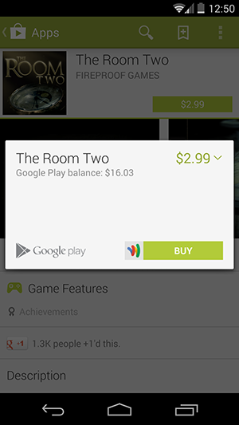
Monetization
Premium Apps
  You must first set up a Merchant Account
  Set a fixed price for your app
  Target a narrow group of users in the market

Slide 9
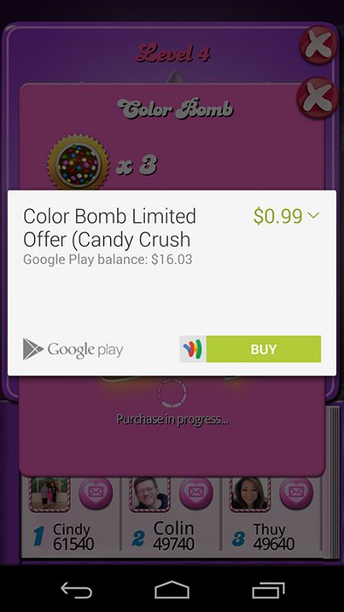
Monetization
Freemium Apps
  Free download with limited features or full features for a limited time
  Use In-app Billing
  You can sell:
    Durable goods
    Consumable items

Slide 10
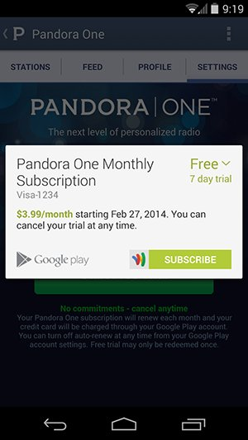
Monetization
Subscriptions
  Digital goods available on a monthly or annual basis
  Google Play handles all the boiler plate from financial transactions!
  Free trial subscriptions
  Can be combined with Freemium apps

Slide 11
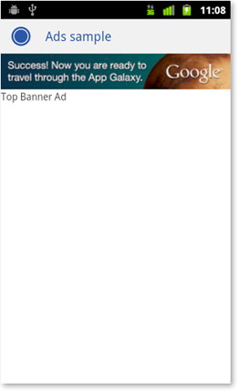
Monetization
Ads
  Compatible with all previous models
  You need to register a publishing account with a mobile advertising network
  Get the specific Android SDK if applies

Slide 12
Monetization
Advertising: AdMob
  Google's advertising service www.admob.com
  SDK available through the Android SDK Manager (extra)
  Requires a Publisher ID, which we obtain when
  registering at www.admob.com
  It also require an Internet connection to retrieve the
  actual advertisements
  More info at
  Google Mobile Ads SDK

Slide 13
Monetization
3 basic steps to add advertisements using AdMob
  Set up the Google Play services SDK
  Configure your AndroidManifest.xml
    Add the INTERNET and ACCESS_NETWORK_STATE permissions
  Add an AdView to the layout of the Activity that we
  want to show the advertisements in

Slide 14
Monetization
Layout
<LinearLayout
xmlns:android="http://schemas.android.com/apk/res/android"
xmlns:ads="http://schemas.android.com/apk/res-auto"
android:orientation="vertical"
android:layout_width="fill_parent"
android:layout_height="fill_parent">
<TextView
android:layout_width="fill_parent"
android:layout_height="wrap_content"
android:text="@string/hello"/>
<com.google.android.gms.ads.AdView
android:id="@+id/ad"
android:layout_width="wrap_content"
android:layout_height="wrap_content"
ads:adSize="BANNER"
ads:adUnitId="MY_ADD_UNIT_ID" />
</LinearLayout>

Slide 15
Monetization
Activity
protected void onCreate(Bundle savedInstanceState) {
super.onCreate(savedInstanceState);
setContentView(R.layout.activity_main);
MobileAds.initialize(
getApplicationContext(),
“ca-app-pub-3940256099942544~3347511713"
);
AdView mAdView = (AdView) findViewById(R.id.ad);
AdRequest adRequest = new AdRequest.Builder().build();
mAdView.loadAd(adRequest);
}

Slide 16
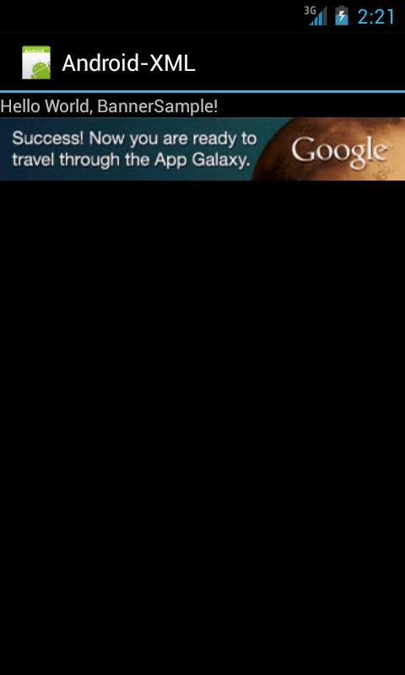
Monetization
Result

Slide 17
If you want to know more...
  Android Developers: Google Play Distribution
  Android Developers: Google Play In-app Billing
  Google Developers: Google Mobile Ads SDK
  AdMob by Google
  Advertising without Compromising User Experience

