Slide 1
Endesa Challenge:
Joint optimization of a
Battery System and a Wind Farm
Queen of fog
Cristian Tabares, Sergio Paniego, Jan Schneider,
Joan Agustí, Yanis Le Fur
14/12/2025

Slide 2
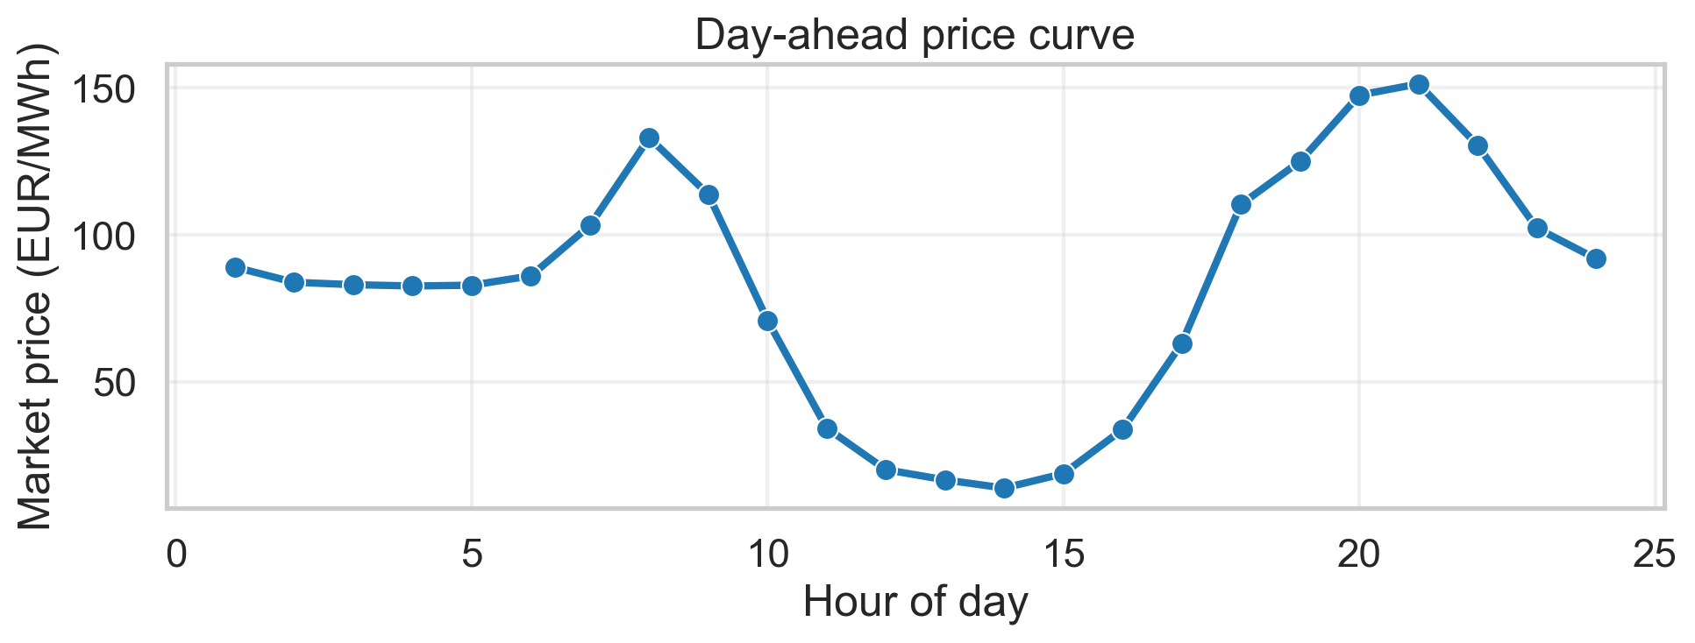
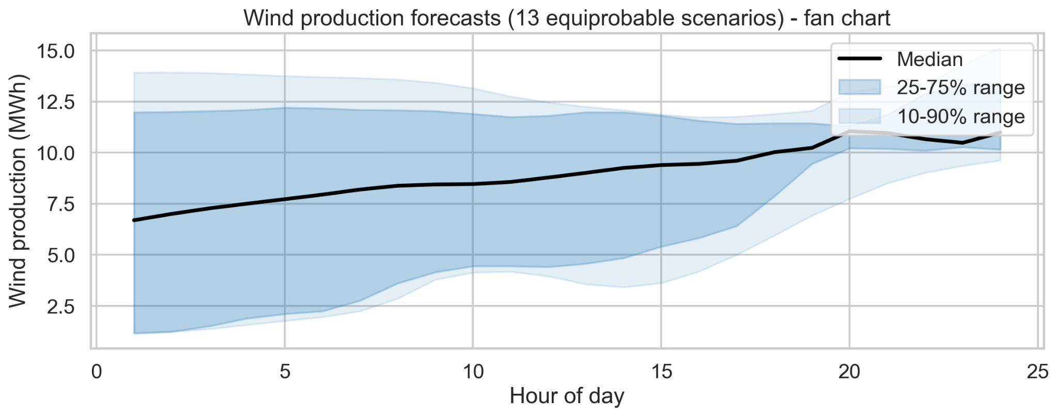
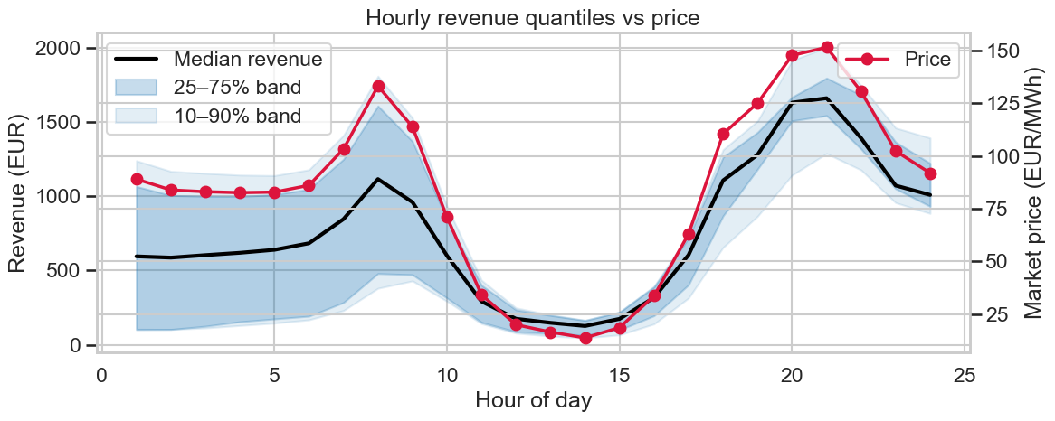
The problem
Our objective: to maximize the joint revenue of a wind farm and a battery over a one-day horizon, modeling a battery energy storage system (BESS).
Our data:
Expected revenue
from wind farm: 17.645 €

Slide 3
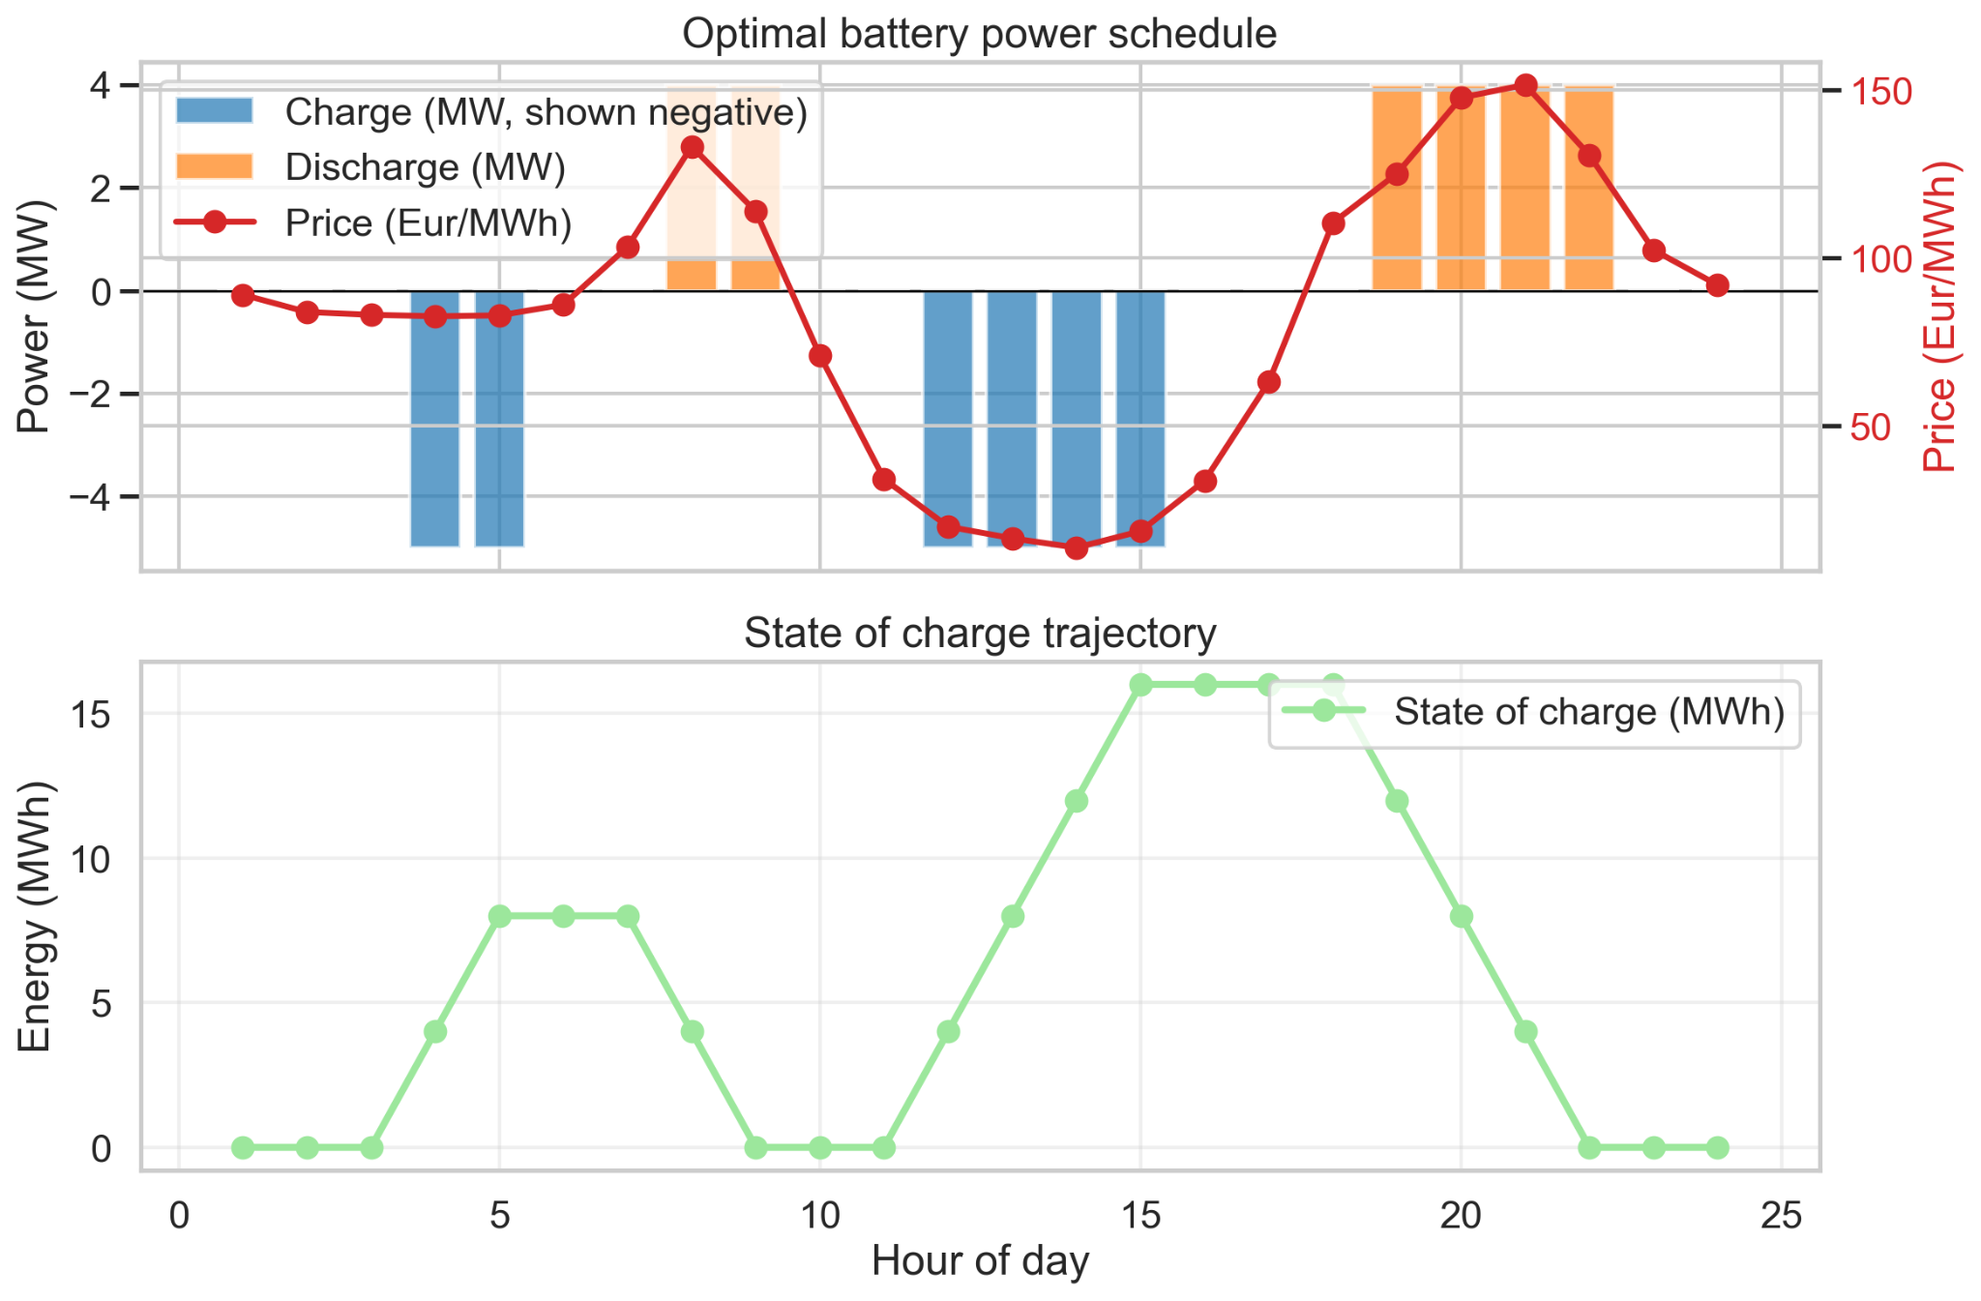
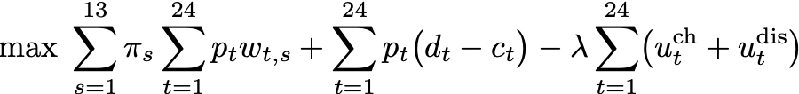
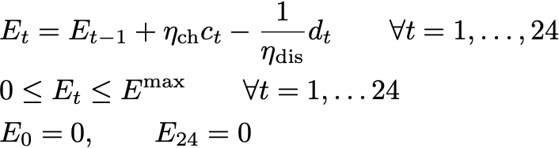
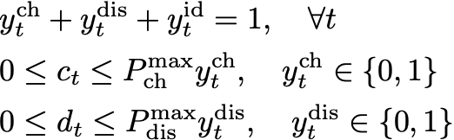
Mixed-integer linear programs (MILP)
Our approach: the problem can be formulated as a MILP because maximizing revenue required optimizing continuous power flows while following strict discrete, binary decisions.
Expected revenue to maximize:
Continuous variable constraint:
Discrete variable constraint:
Pozo, David. ‘Linear battery models for power systems analysis’. Electric Power Systems Research, 212 (2022)

Slide 4
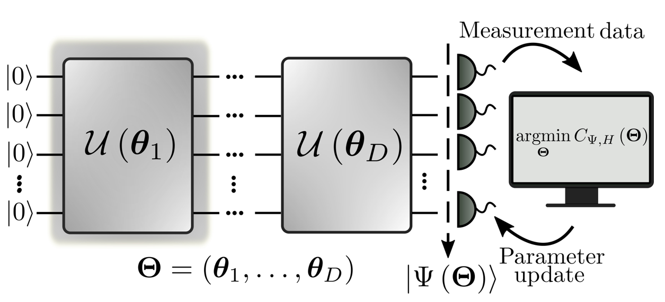

Hybrid quantum+classical MILP algorithm
Motivation: For large systems (many time steps, many batteries, complex constraints, etc.), the total solution space for a MILP is massive and usual approaches are inefficient.
Solution: Quantum Warm-Starting. To provide the classical solver with an initial, high-quality guess for the Discrete Variables using a quantum algorithm
Conclusion: By using the quantum-obtained guess, we transform a problem of inefficient exploration to one of focused, rapid exploitation, unlocking faster and higher-quality solution for large-scale energy systems.
Quantum Simulation
Quantum Warm-Starting
Efficient solution
Classical Simulation

Slide 5
Hybrid quantum+classical MILP algorithm
Motivation: For large systems (many time steps, many batteries, complex constraints, etc.), the total solution space for a MILP is massive and usual approaches are inefficient.
Solution: Quantum Warm-Starting. To provide the classical solver with an initial, high-quality guess for the Discrete Variables using a quantum algorithm
Conclusion: By using the quantum-obtained guess, we transform a problem of inefficient exploration to one of focused, rapid exploitation, unlocking faster and higher-quality solution for large-scale energy systems.
Quantum Simulation
Quantum Warm-Starting
Classical Simulation

Slide 6

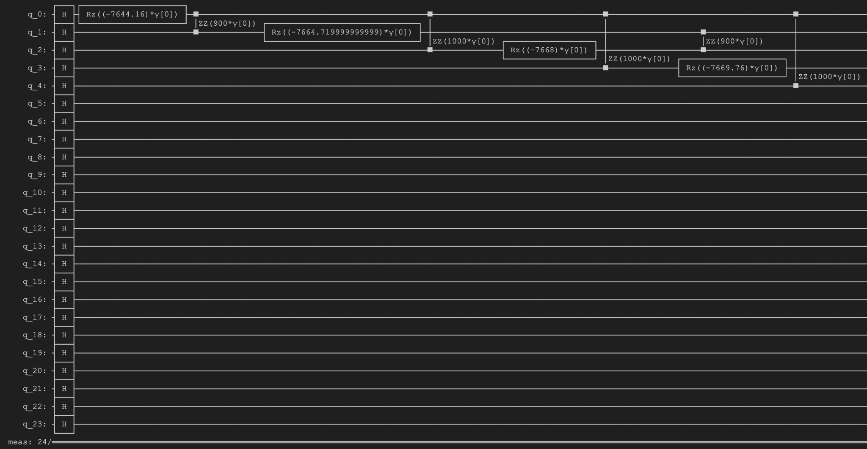
Hybrid quantum+classical MILP algorithm: QAOA
Our proposal: QAOA is a algorithm to find near-optimal solutions for discrete optimization tasks. It uses quantum effects to explore complex spaces.
We seek to optimize two angles:
In practice:
We rewrite a simplified version of the problem in QUBO form including the constraints as const function penalties. This can be solved with standard quantum optimization routines to recover a quantum guess of the optimal schedule.

Slide 7
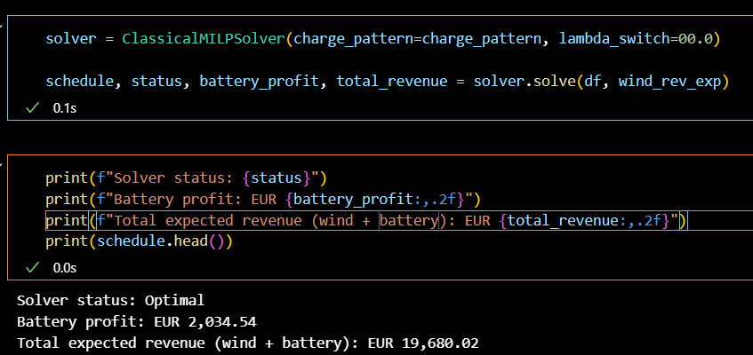
Hybrid quantum+classical MILP algorithm: COIN-OR CBC
Our proposal: QAOA is a algorithm to find near-optimal solutions for discrete optimization tasks. It uses quantum effects to explore complex spaces.
In practice:
We seek to optimize two angles:
After this, we solve the full MILP (constraints+objective) problem using standard classical solvers:
PuLP package in Python.
Problem is dispatched to a COIN-OR CBC algorithm, which solves it using a branch-and-cut approach (LP relaxations + branching + cuts) and returns the optimal schedule.

Slide 8
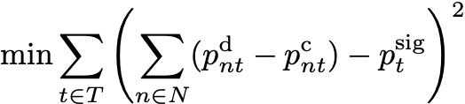
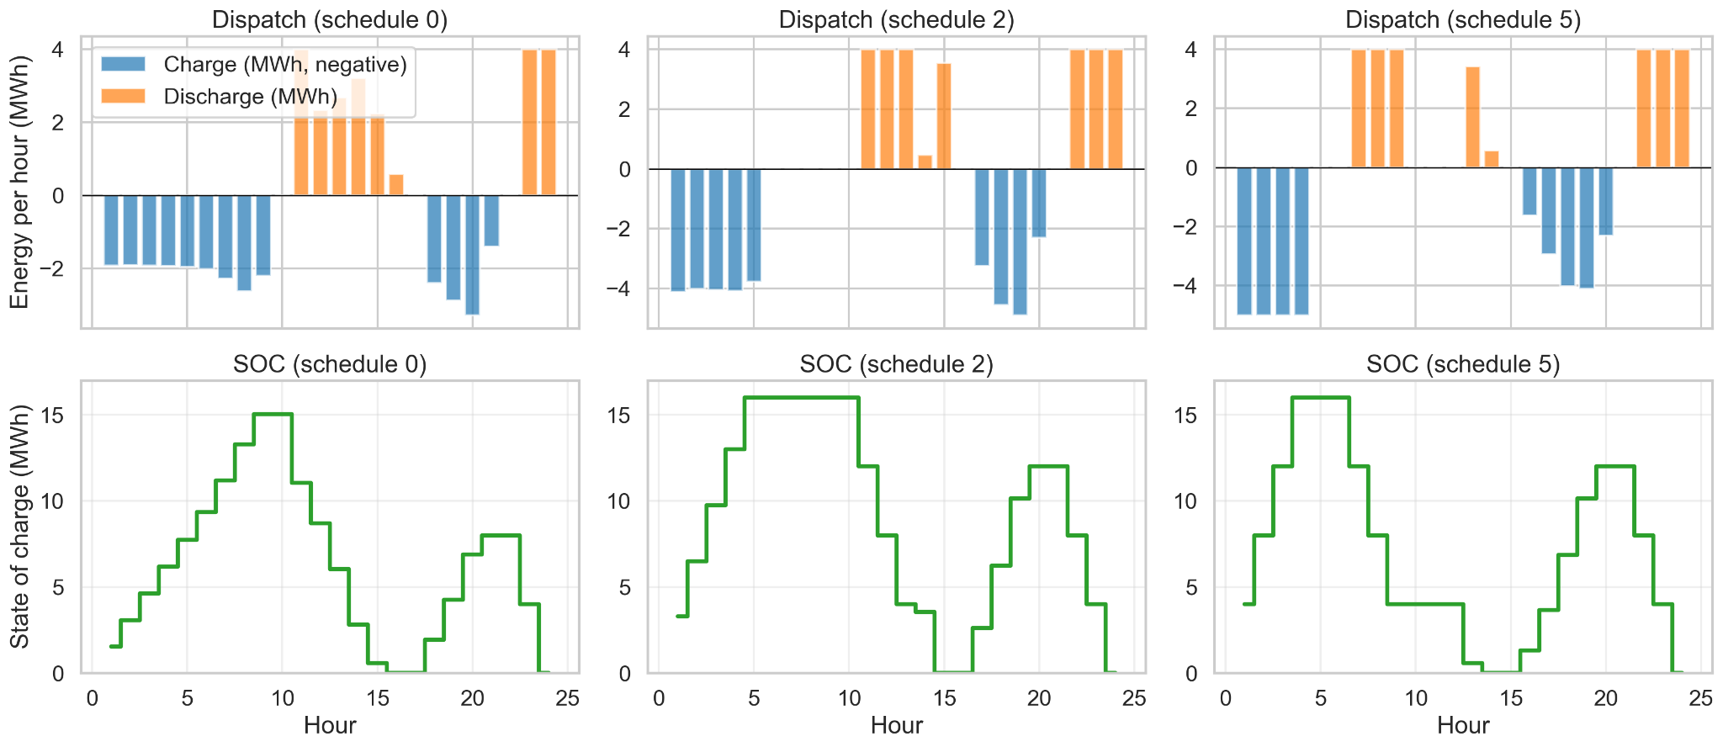
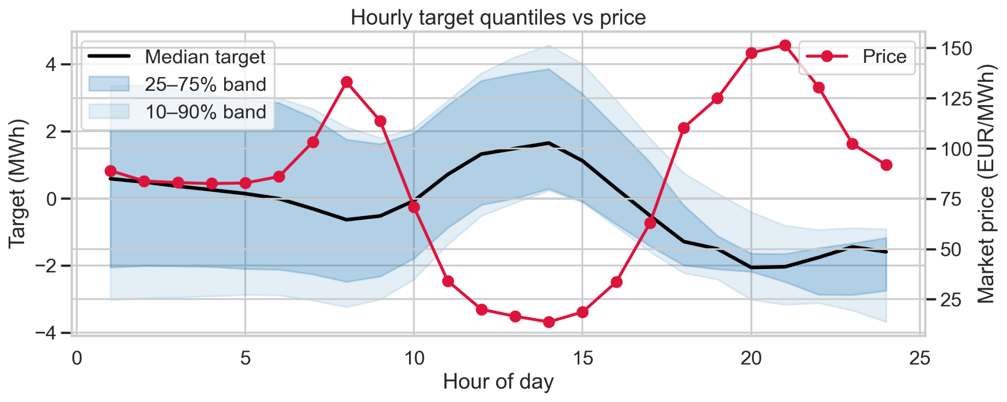
Mixed-integer linear programs (MILP)
More realistic models: to take into account effects from the wind farm such as the variance of all 13 predictions, which did NOT affect the previous state of the battery
Set-point tracking problem (SPT)
Pozo, David. ‘Linear battery models for power systems analysis’. Electric Power Systems Research, 212 (2022)

