Slide 1

Analytics

Slide 2
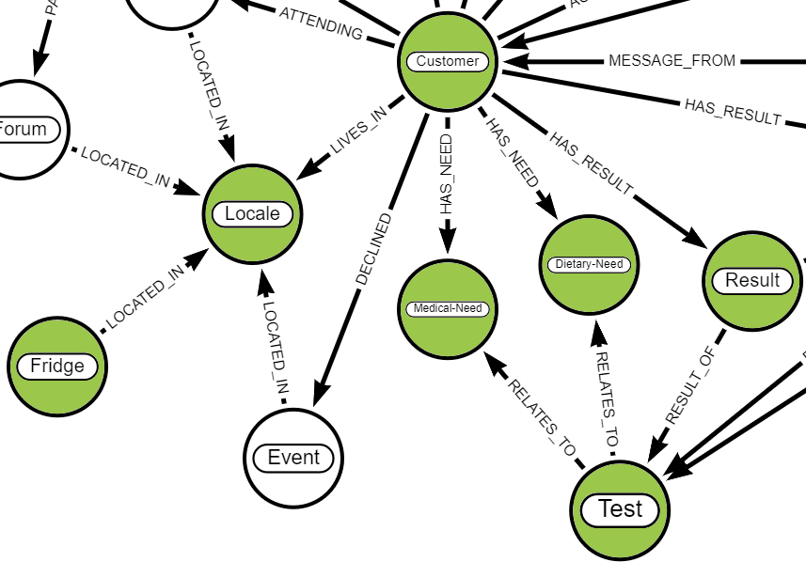

Optimising food placement requires an effective analytical capability that can use geographic trend data to ensure the right products are sent to where they are needed.
Notes:
Analytics uses data such as greographical trends, ingredients, dietrary & medical needs for analysis.
The results for a Locale drive the food distributed to the fridge in that Locale by Farmacy Foods.

