Slide 1


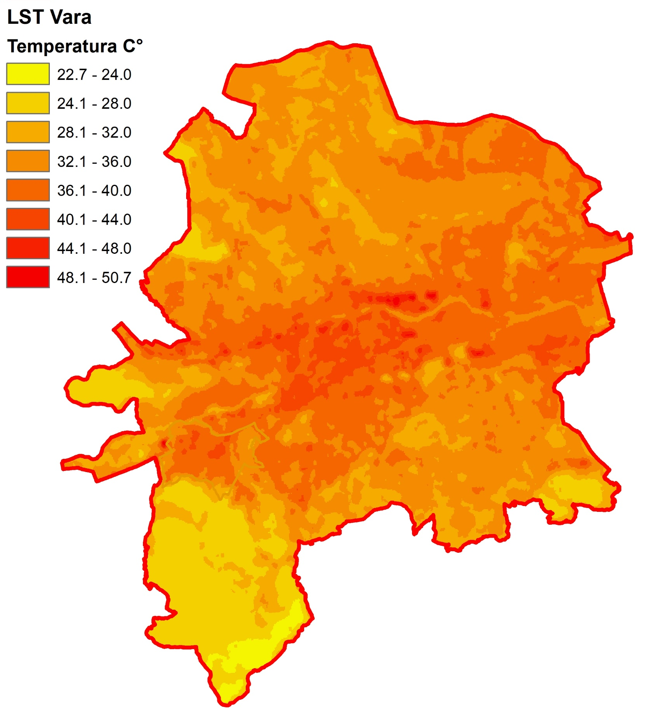
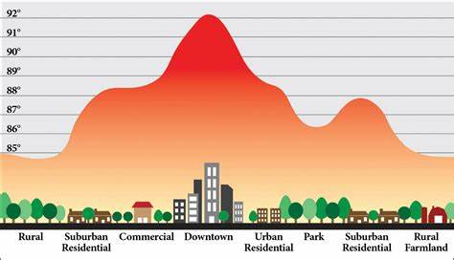
Challenge 1: Improving thermal map spatial (and temporal) resolution by exploring the possibilities of correlating Sentinel-2 images and LST from Landsat
Csaba HORVATH, Adina Eliza CROITORU

Slide 2
Context
Keywords:
land surface temperature (LST)
Sentinel-2
Landsat 7/8
Spatial resolution
Surface Urban Heat Island (UHI – SUHI)
Thermal infrared (TIR) satellite imagery is essential for mapping global land surface temperature (LST).
In complex urban environments, a finer LST spatial pattern is often needed.
The spatial resolution of TIR bands is typically coarser than shorter wavelength multispectral bands, limiting the LST resolution to around 100 meters and downscaled to 30m. (available from www.usgs.gov)
NASA's TIRS sensor onboard Landsat 8, Landsat 9, and ASTER onboard Terra, provide higher thermal spatial resolution,
ESA's Sentinel-2(available from Sentinel-2 | Copernicus Data Space Ecosystem) offers finer spatial resolution in multispectral imagery (10 meters) but lacks TIR scanning (no surface temperature provided).

Slide 3
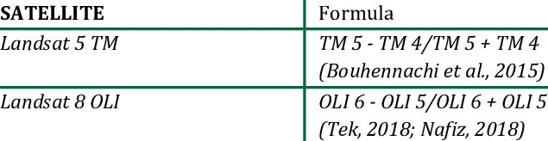
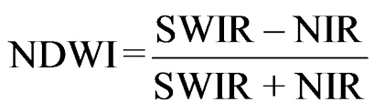
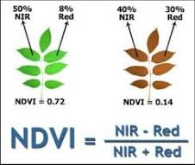
What do we need?
(1) Cloud gap filling
(2) An approach to offer a realistic improved spatial pattern of LST, aligning with urban land cover features, based on the relationship between LST and land cover or other metrics (e.g., NDVI, NDBI, and NDWI) available from Sentinel-2
NDBI = (SWIR - NIR) / (SWIR + NIR)
Why ?
Urban area planners can benefit since such an application would contribute to enhancing urban planning decision-making process to mitigate urban overheating and enhance the quality of life for residents.

Slide 4
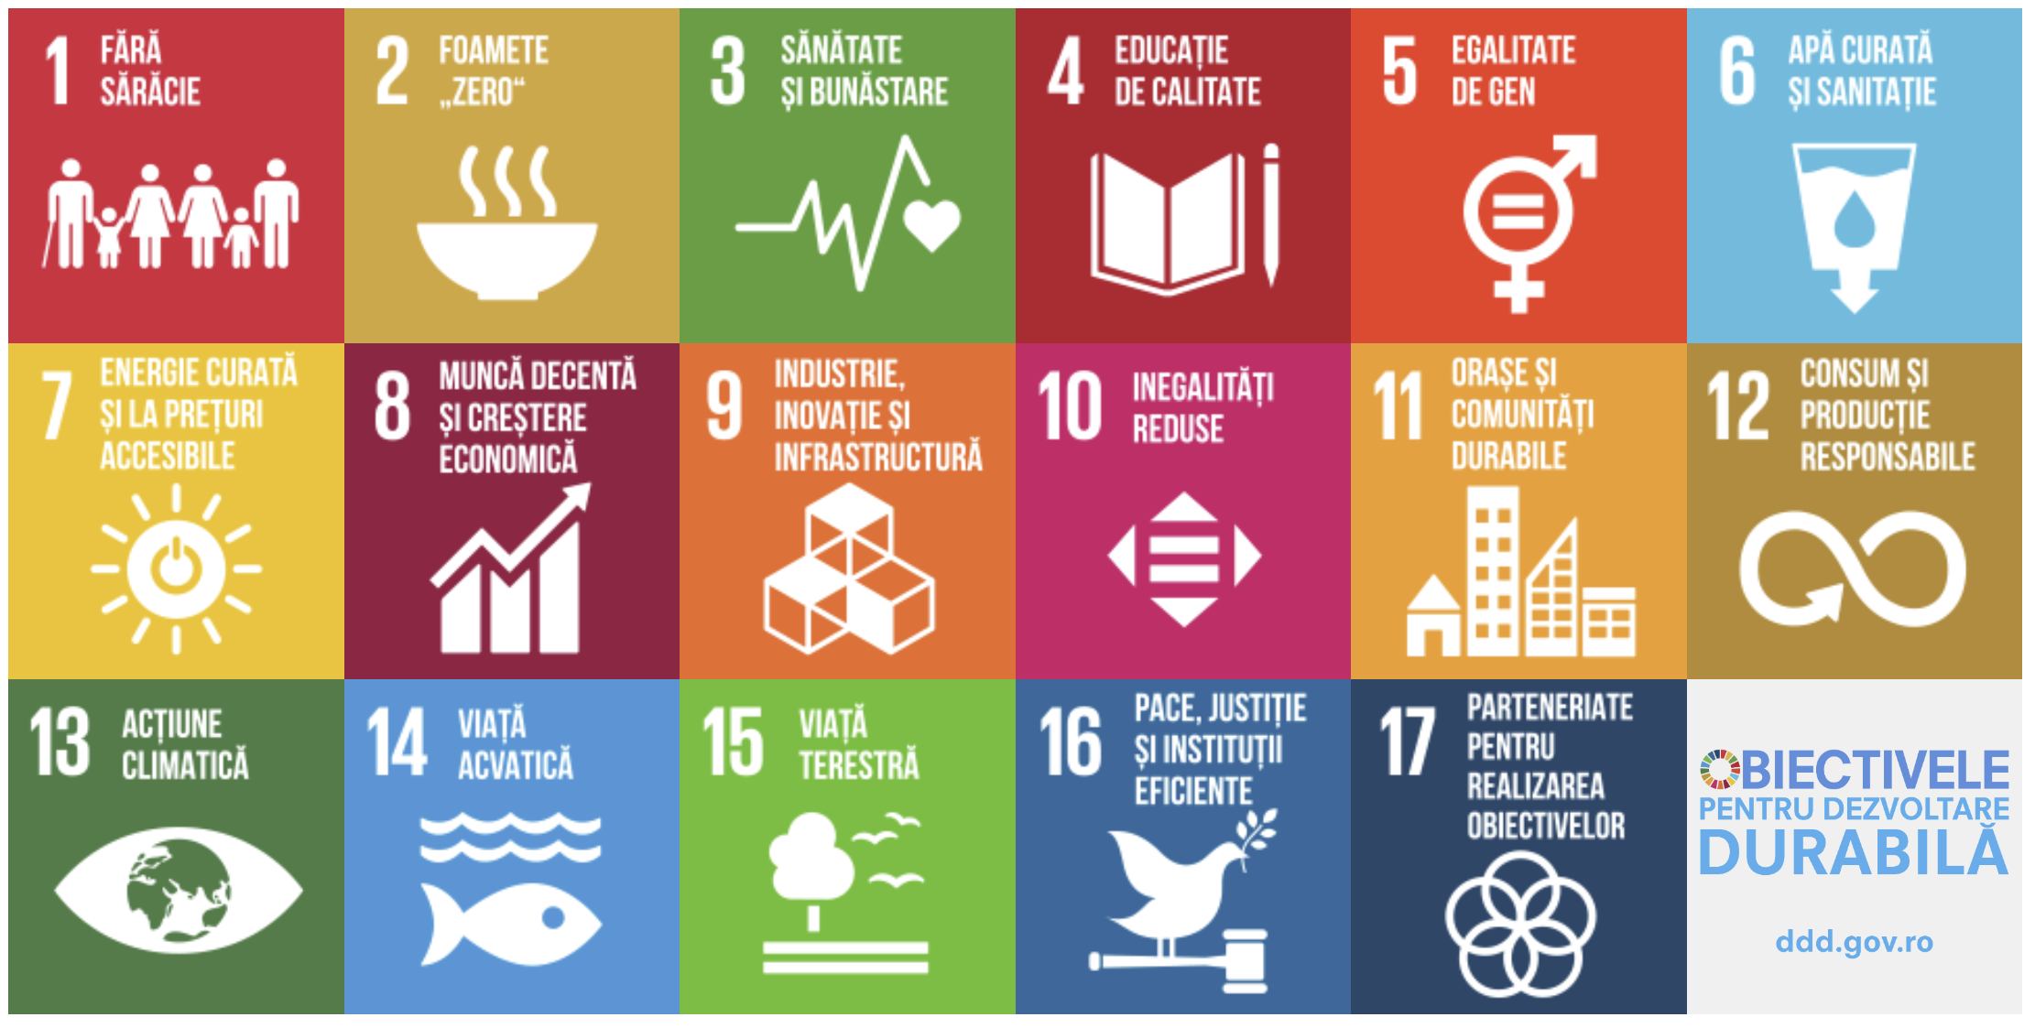
Challenge 2: Identify the interactions between SDG targets/indices for maximizing the investment impact
Adina Eliza CROITORU, Kinga IVAN-TEMERDEK, Csaba HORVATH

Slide 5
Context
Keywords:
Sustainable development goals/target/indices
SDGs Interaction
Investment prioritization
Sustainable development is an approach that attempts to balance the social and economic needs of present and future human generations with the imperative of preserving or preventing undue damage to the natural environment → long-term planning.
The 2030 Agenda for Sustainable Development is a global framework adopted by UN, a core guiding document and a global framework adopted by all United Nations members in 2015.
Agenda 2030 (Romania)
Structure of goals, targets and indicators:
17 SDGs - UN resolution.
Each goal typically has 8-12 targets;
Each target has 1-4 indicators used to measure progress toward reaching the targets, They are:
outcome targets (circumstances to be attained) or
means of implementation targets.

Slide 6
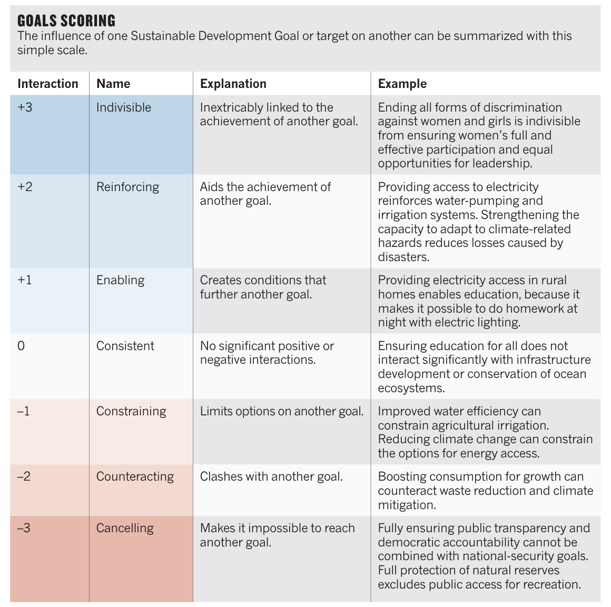

What do we need?
To develop a model aiming to prioritize intervention (investments) in a territorial unit to maximize the impact.
For each target/indicator → a map of interactions (a tree).
Ex: educational efforts for girls (goal 4) would enhance maternal health outcomes (part of goal 3), and contribute to poverty eradication (goal 1), gender equality (goal 5) and economic growth (goal 8).

Slide 7
Resources
Why ?
All types of organizations must report financially and non-financially based on SDGs !!!
This type of analysis could improve the efficacity of the investments!
Nilsson M, Griggs D, Visbeck M (2016) Map the interactions between Sustainable Development Goals. NATURE | VOL 534 |
Database - Eurostat (europa.eu) - https://ec.europa.eu/eurostat/web/sdi/database
Rezultate | România Durabilă (gov.ro)
Romania Durabila 2030 (gov.ro)
https://unstats.un.org/sdgs/indicators/indicators-list
https://ec.europa.eu/eurostat/web/sdi/indicators
http://romania-durabila.gov.ro/wp-content/uploads/2022/02/INDD_tin te2030_14febr2022.pdf

Slide 8
Contact: adina.croitoru@ubbcluj.ro csaba.horvath@ubbcluj.ro kinga.ivan@ubbcluj.ro

