Slide 1
climarisk
Hoszu Bernadett
Zirbo George Samuel
Babeș Bolyai University, Cluj Napoca, Romania

Slide 2


Agenda
Why
What
Data
Demo
Results

Slide 3

WHY?
Short answer
BEING PREPARED
Who should be prepared?
Both medical staff and the average person.
What to be prepared for?
Handling the medical implications of current weather conditions.

Slide 4
WHY?
climarisk
How can medical staff prepare?
How can the average person prepare?
Managing physical resources (such as gear, space, rooms) in order to tackle incoming emergencies efficiently.
Allocating staff according to number of expected patients, such that each patient receives a prompt medical care.
By taking measures to combat weather related symptoms, to protect themselves in the days which pose increased medical risks due to weather conditions.
4

Slide 5

WHAT?
Two ML models to make predictions of number of patients coming to the ER in a day and the probability of a person developing severe symptoms related to selected diseases in a day, all based on the weather conditions from that day.
climarisk

Slide 6
WHAT?
climarisk
HOSPITAL MODEL
PATIENT MODEL
INPUT: date
Action: retrieve weather data in the background, make prediction
OUTPUT: estimated number of patients for each day in the next 7 days
INPUT: sex, age, comorbidities
Action: retrieve weather data in the background, make prediction
OUTPUT: a probability of developing each of the medical emergencies analyzed.
6

Slide 7
DATA
MEDICAL DATA
The training dataset is built of records from the County Emergency Hospital Cluj-Napoca.
WEATHER DATA
Meteomanz.com

Slide 8

What data?
WEATHER
MEDICAL
Hypertension
Atrial fribrillation
Chronic ischemic heart disease
Min temp.
Atm. pressure
Valvular insufficiency
Chronic obstructive pulmonary disease
INPUT
Max temp.
OUTPUT
Insolation
Respiratory failure
Precipitations
Cerebral infarction
Wind speed
Heart failure

Slide 9
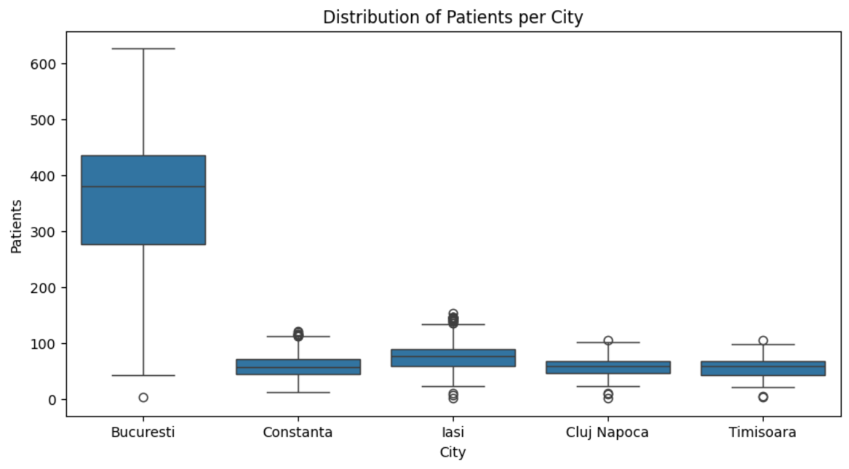
What does our data look like?
Initially…
Hospital
Dataset
Number of overall admissions to the emergency room in the cities from the ‘City’ column in one day.

Slide 10
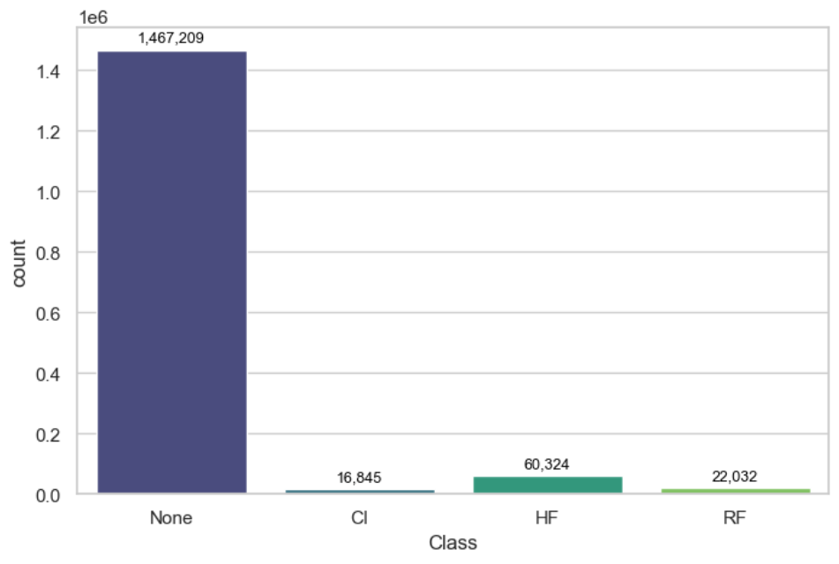
What does our data look like?
Initially…
Patient
Dataset
Number of registered emergency cases from the three analysed emergencies (CI, HF, RF), throughout the years…

Slide 11
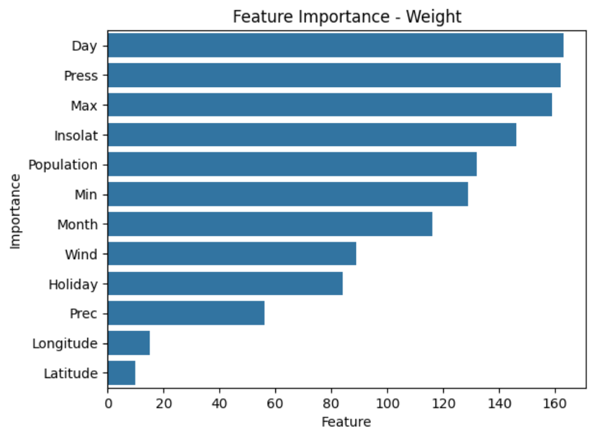
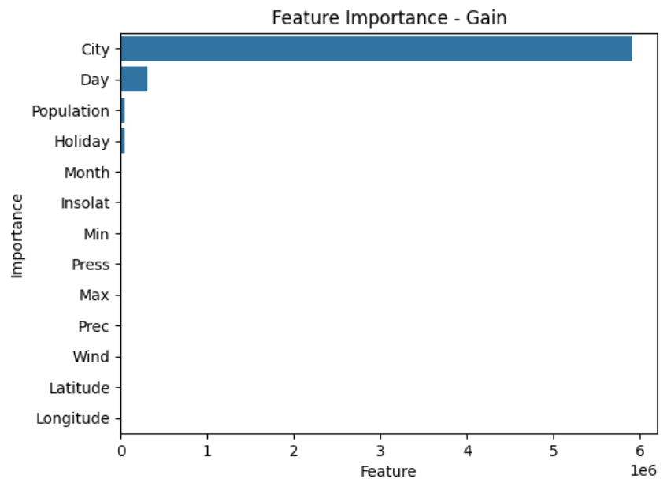
What our data tells us…
Hospital model
– what feature(s) hold the greatest influence over the prediction?

Slide 12
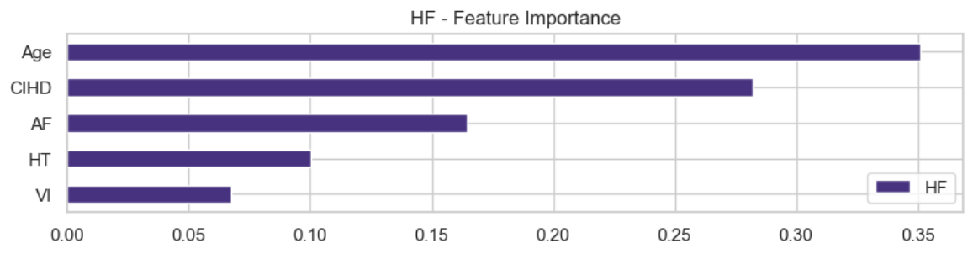
What our data tells us…
Patient model
– what feature(s) hold the greatest influence over the prediction?
Heart failure

Slide 13
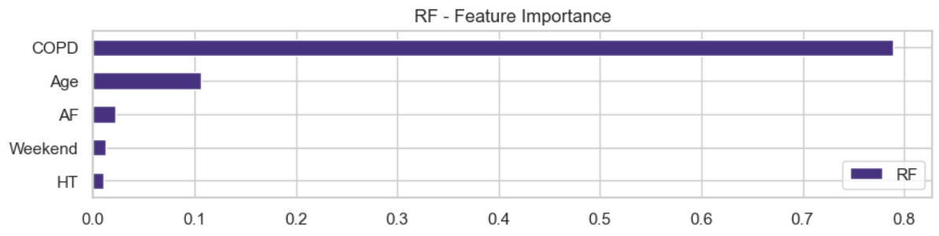
What our data tells us…
Patient model
– what feature(s) hold the greatest influence over the prediction?
Respiratory failure

Slide 14
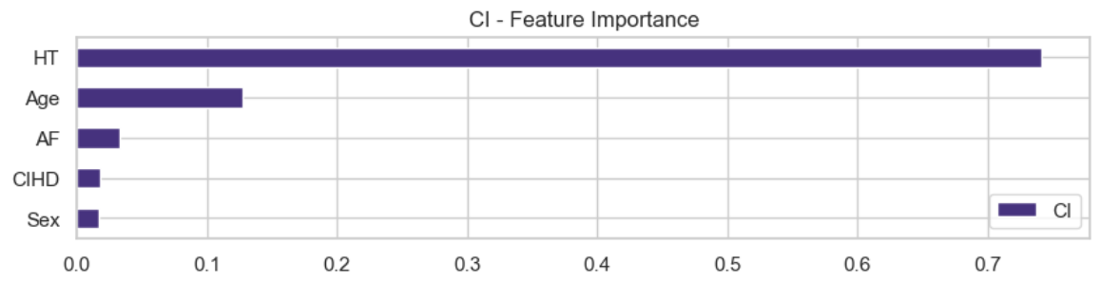
What our data tells us…
Patient model
– what feature(s) hold the greatest influence over the prediction?
Cerebral infarction

Slide 15
DEMO

Slide 16

RESULTS
Or, in other words… How well our AI models understand what our data tells us and how well they are expected to read the future from the it.

Slide 17
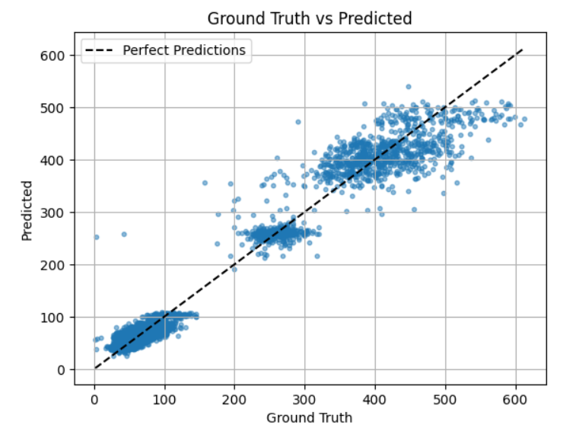
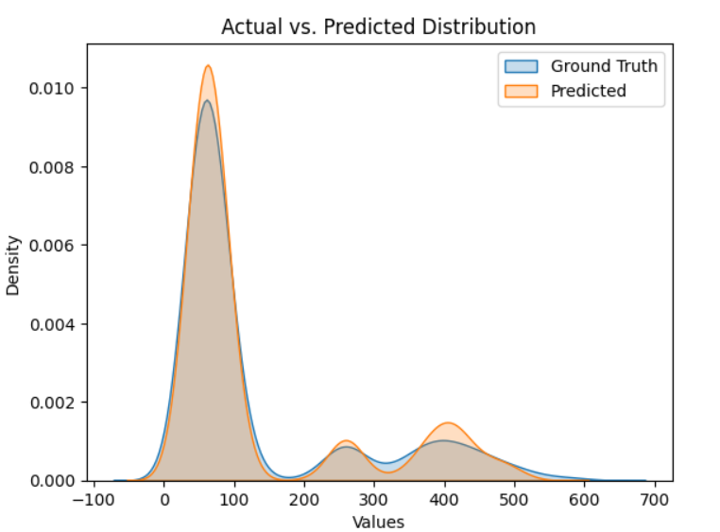
RESULTS Hospital
Mean Absolute Error wrt. average incoming patients number: 11.19%

Slide 18
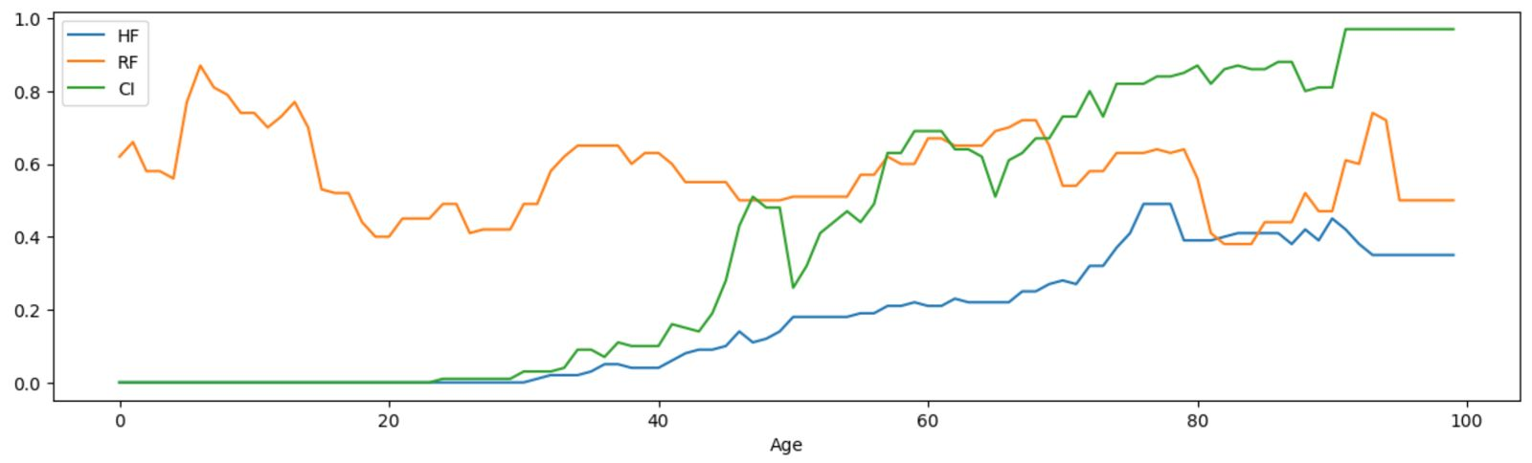
RESULTS Patient
 | precision
Develops the emergency | 0.83
Is not affected by the emergency | 0.75
Chances of disease by age

Slide 19
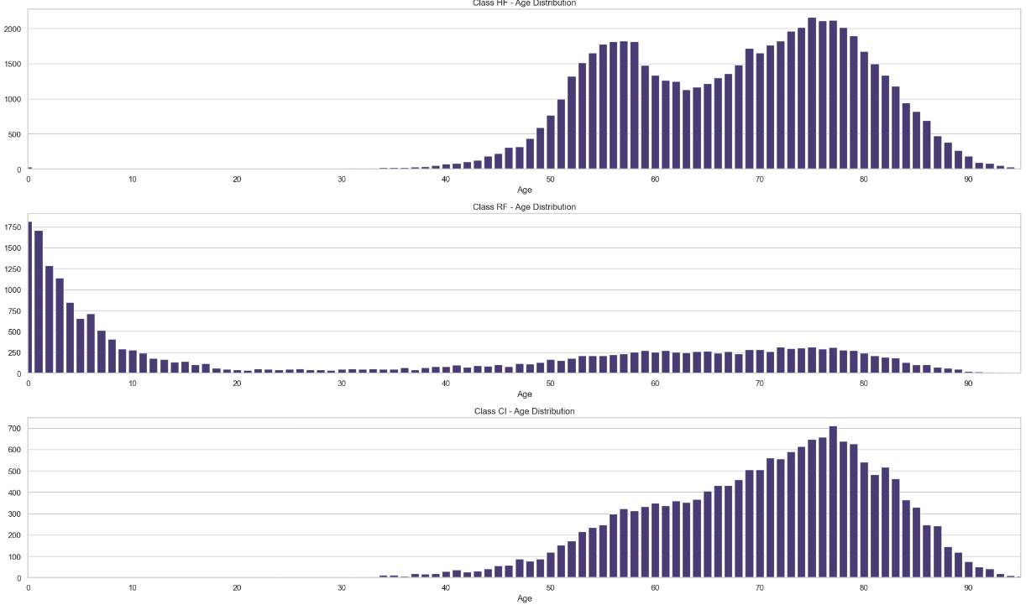
RESULTS Patient - Dataset

Slide 20
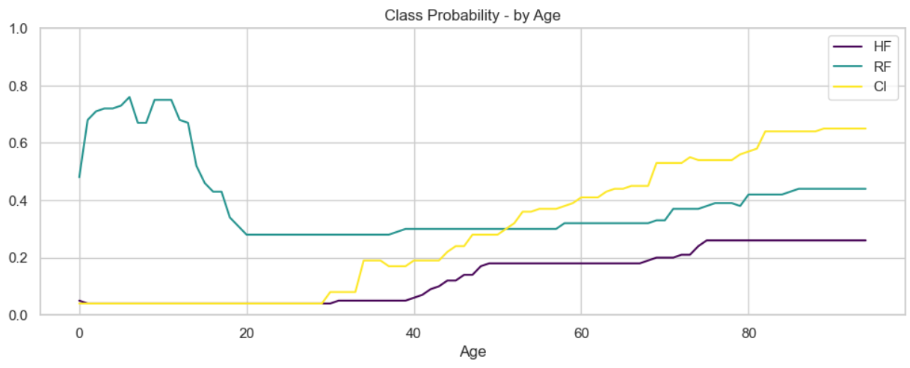
RESULTS Patient - Model

Slide 21
conclusion
& future work

Slide 22
Conclusion
We managed to:
Predict the number of patients expected to be admitted to the ER in a given day, in one of the counties: Timișoara, Iași, Cluj, Bucharest, Constanța.
Estimate a probability of developing one of: Cerebral Infarction, Heart Failure, Respiratory Failure, given certain comorbidities that a person might present.

Slide 23
Conclusion
Hospital Model Conclusion
Number of admissions to the ER is highly dependent of the atmospheric pressure, how hot/cold it is in the given day. Further, with a bit smaller influence, but still considerable come the wind and whether it’s holidays or not.
Patient model
Age and organ related diseases have the highest influence on the probability of developing a certain organ-related symptomatology/emergency.

Slide 24
Future Work
The aim is improving:
- the precision of the patient model
- the MAE of the hospital model (reducing it)
What could be done in this matter…
- using cleaner, more accurate and fresh data (on the clinical side)
- exploring additional ML techniques to take most out of the data

Slide 25

Thank you
Hoszu Bernadett
Zirbo George Samuel

