Slide 1
Kickstarter
How to create a successful campaign
Cristina Iacob
2021-07-02

Slide 2
Goal
Kickstarter is one of the most popular crowdfunding platform on the internet.
The aim of this project is to analyze the Kickstarter data collected between 2009 and 2012 to find the best tips for launching a successful campaign.

Slide 3
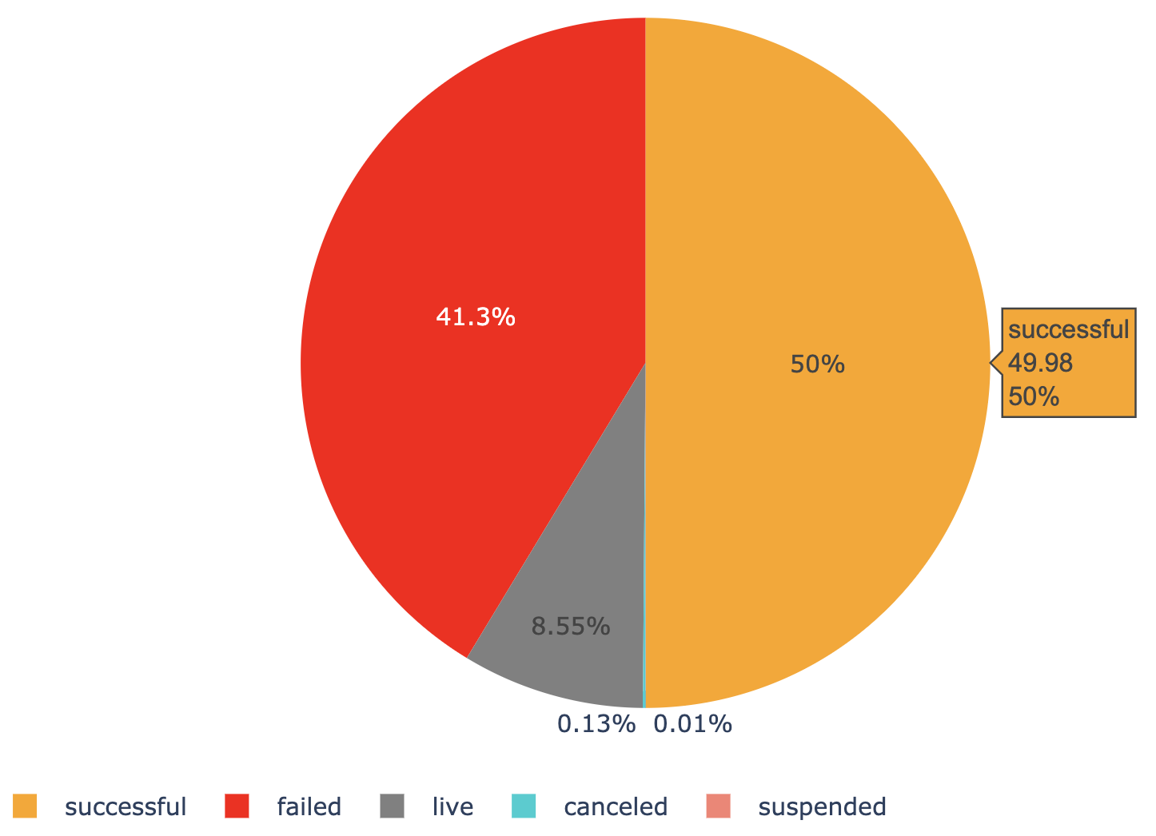
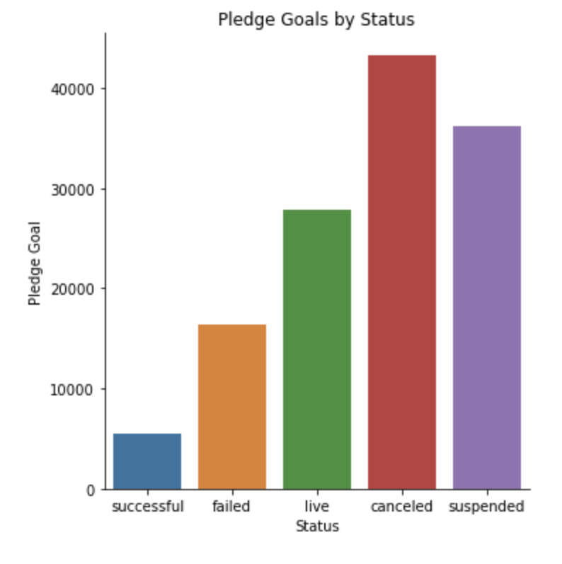
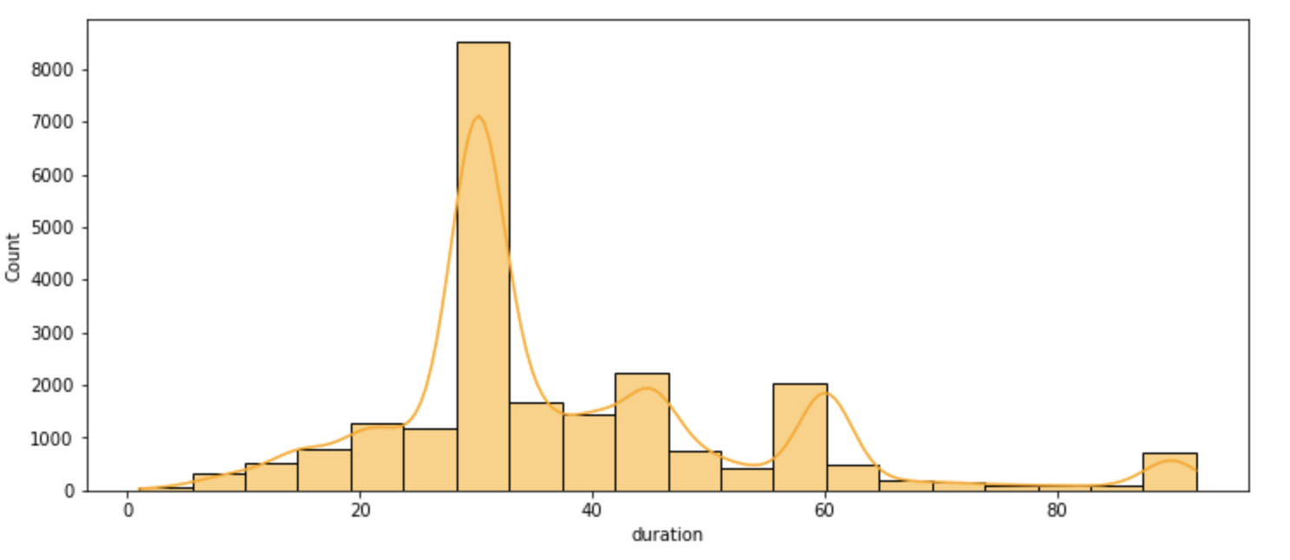

Slide 4
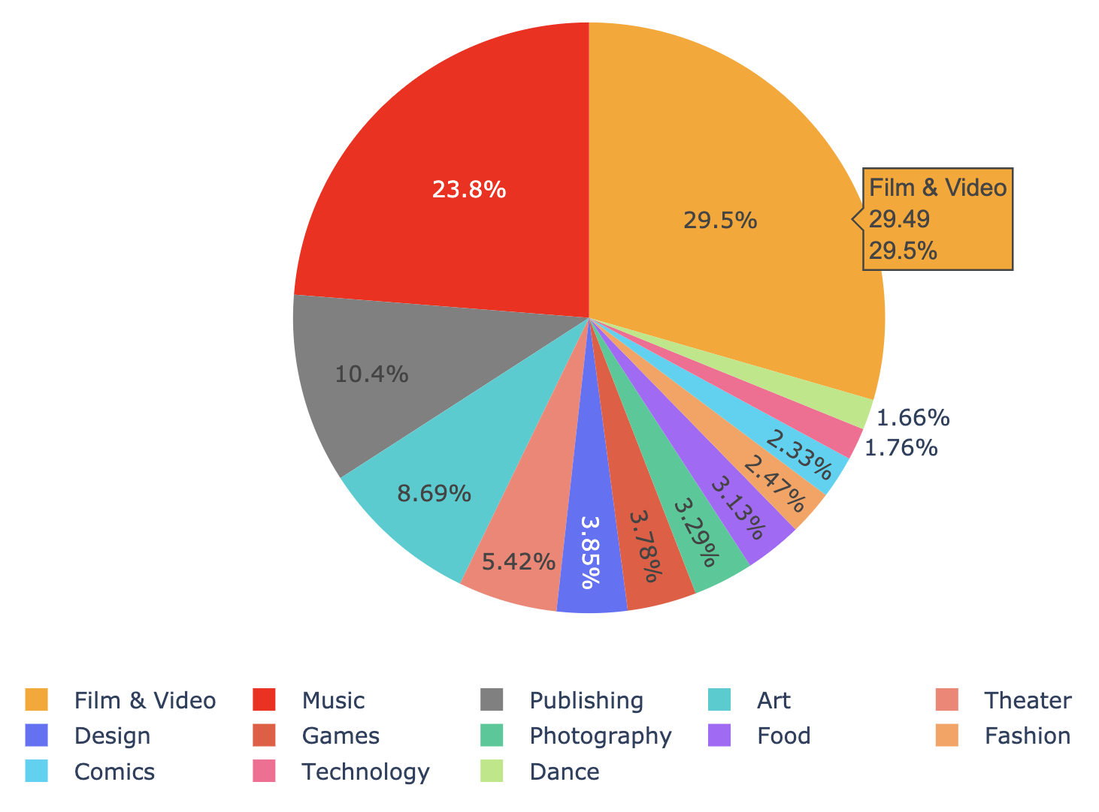
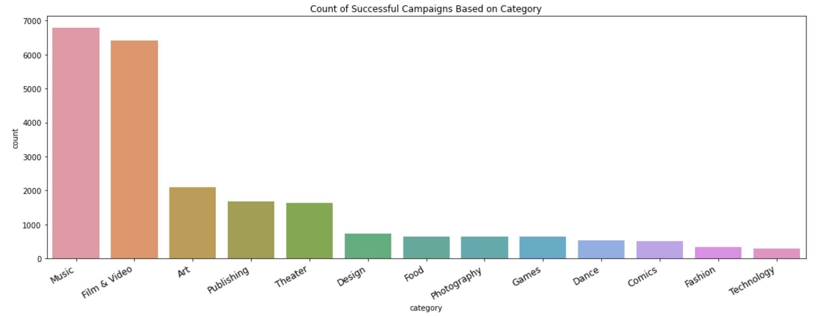

Slide 5
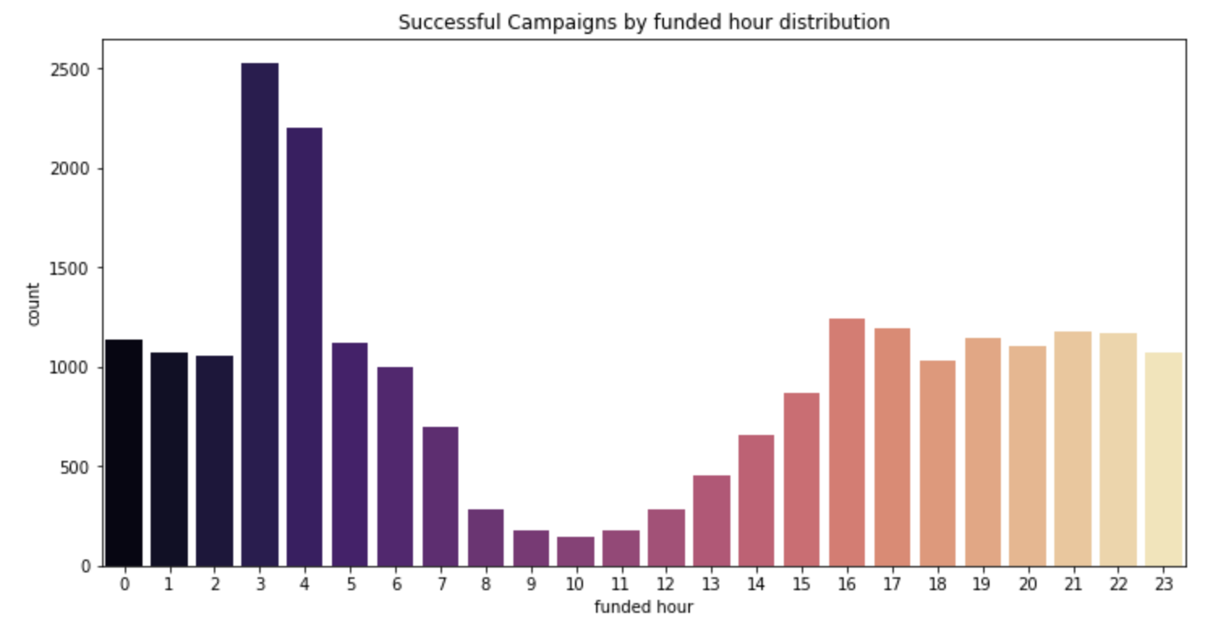
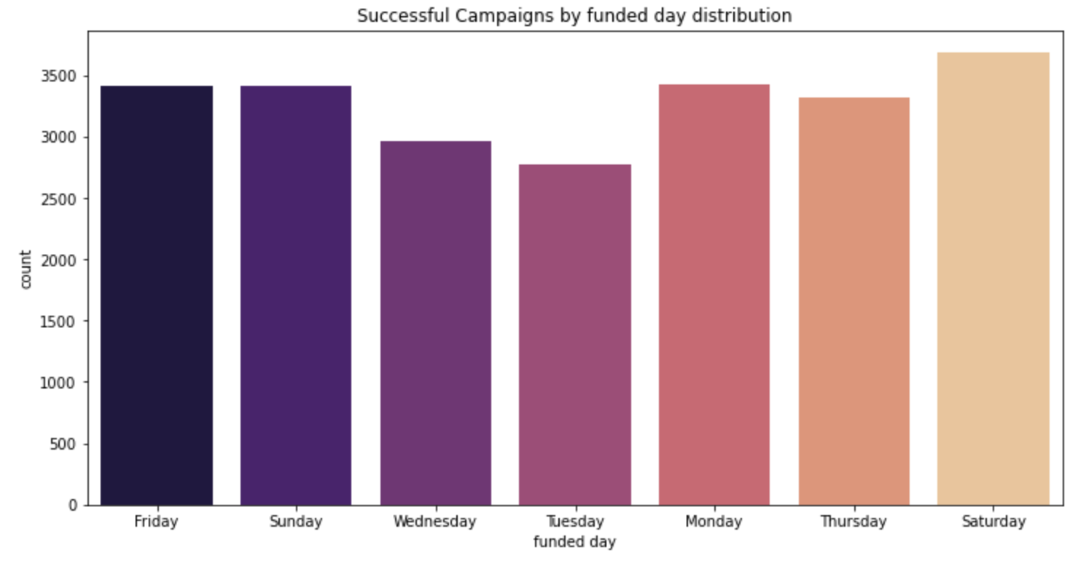
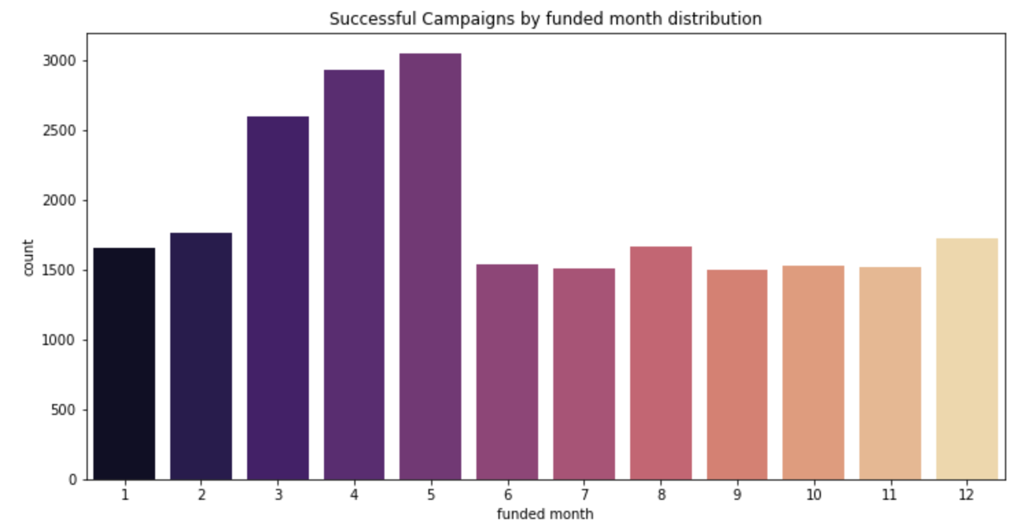

Slide 6
Thanks!
Any questions?

