Slide 1
Kickstarter
How to create a successful campaign
Cristina Iacob
2021-07-02

Slide 2
Goal
Kickstarter is one of the most popular crowdfunding platform on the internet.
The aim of this project is to analyze the Kickstarter dataset to find the best tips for launching a successful campaign.

Slide 3
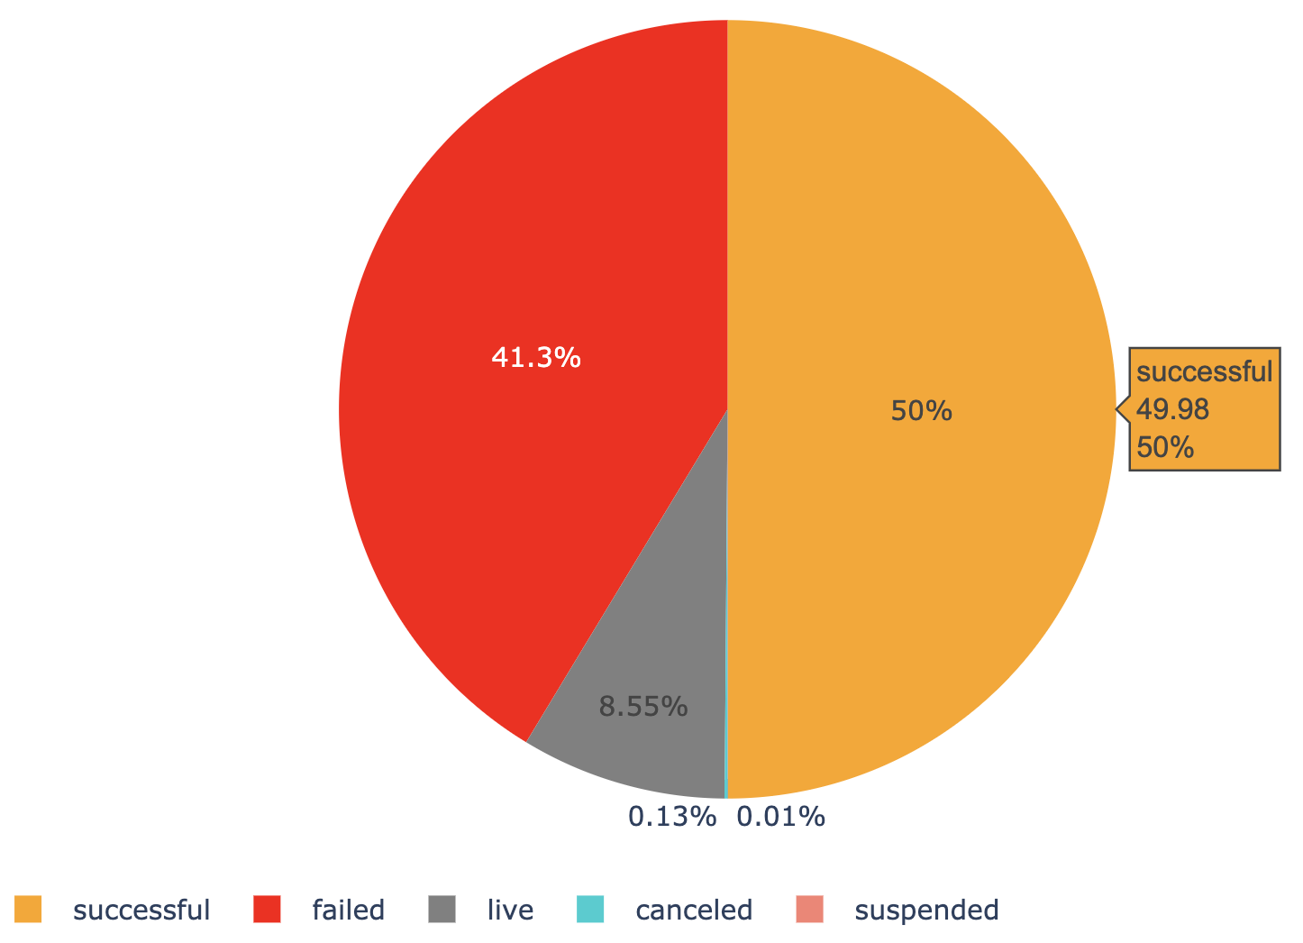
Qualitative Analysis
The Kickstarter dataset contains about 45,957 records and 17 features which were collected from opening year in 2009 to 2012.
The total pledged amount is just over $211 million while the minimum goal of launched projects was from 1 cent to $21.5 million. About 50% of the campaigns were successful while the rest failed to meet their minimum goal, were canceled, suspended or were still live.
What's the best length of time to run a campaign?
What's the ideal pledge goal?
Year No. of campaigns
2011: 20,182
2012: 17,822
2010: 7,253
2009: 700

Slide 4
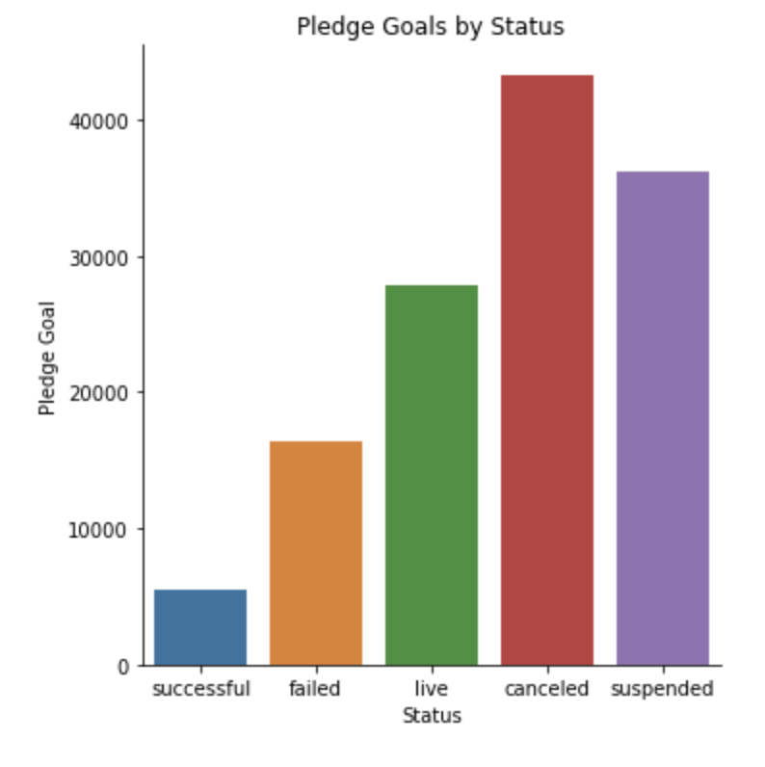
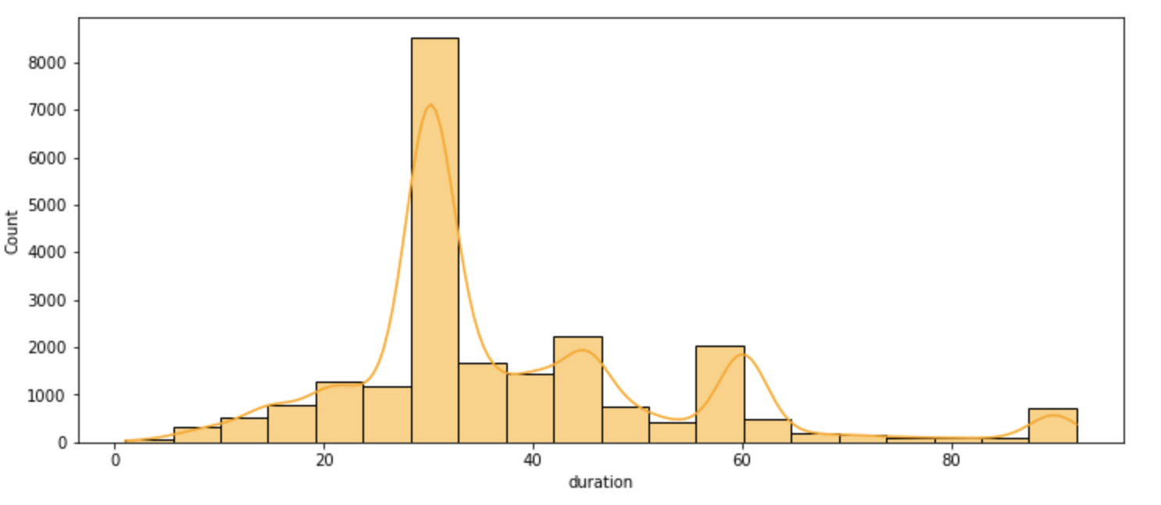
Qualitative Analysis
Kickstarter is an “all-or-nothing” platform, meaning that you keep the money if your goal is successfully met or you lose them. Therefore setting realistic time frames and campaign goals are very important.
What's the best length of time to run a campaign?
Successful campaigns have:
Average duration: 38 days
Ideal duration : 30 days
Goal: less that $5,500
What's the ideal pledge goal?
30 days
< $5,500

Slide 5
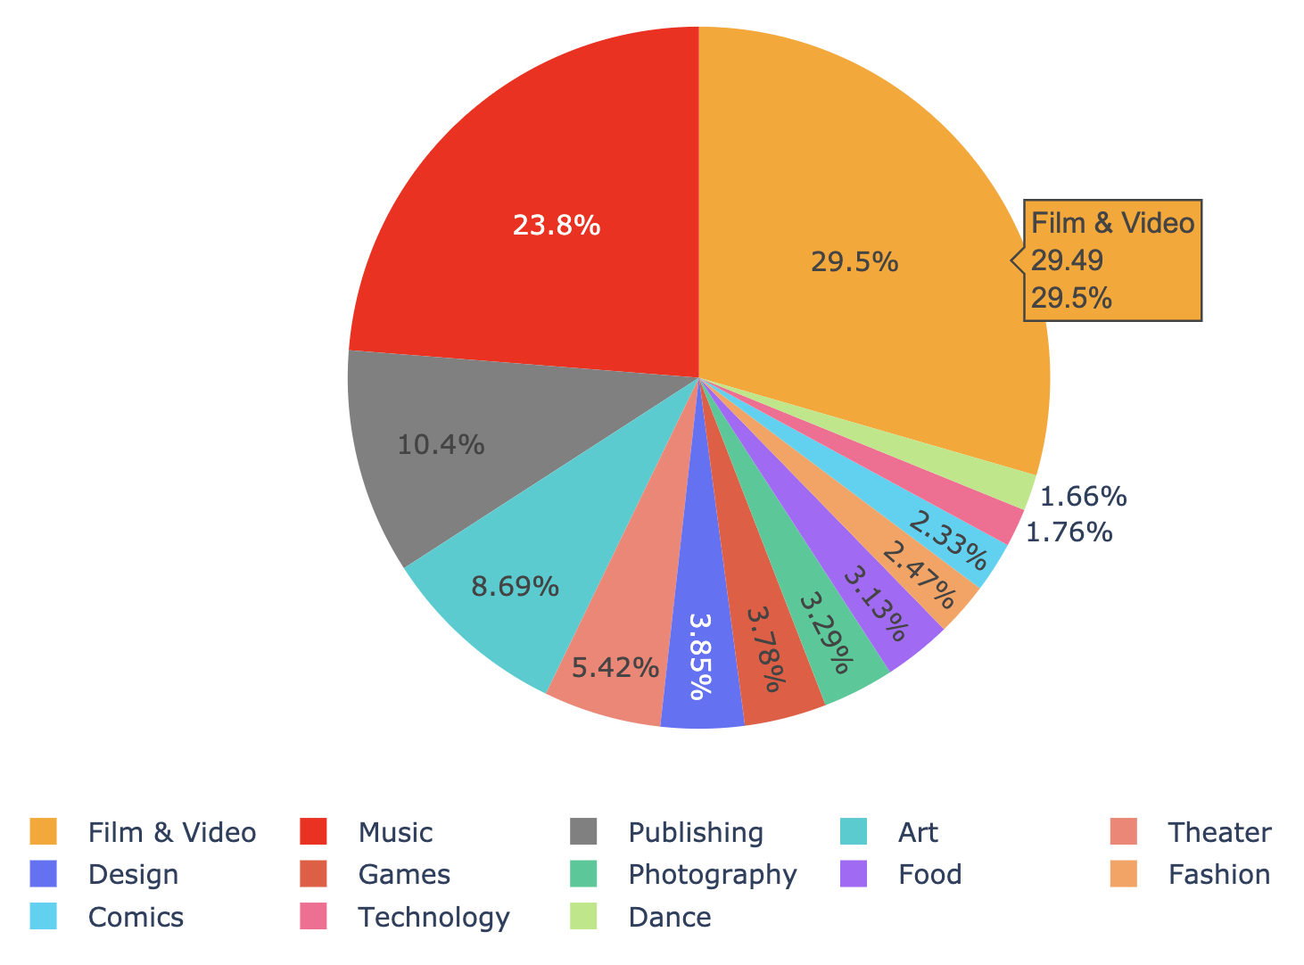
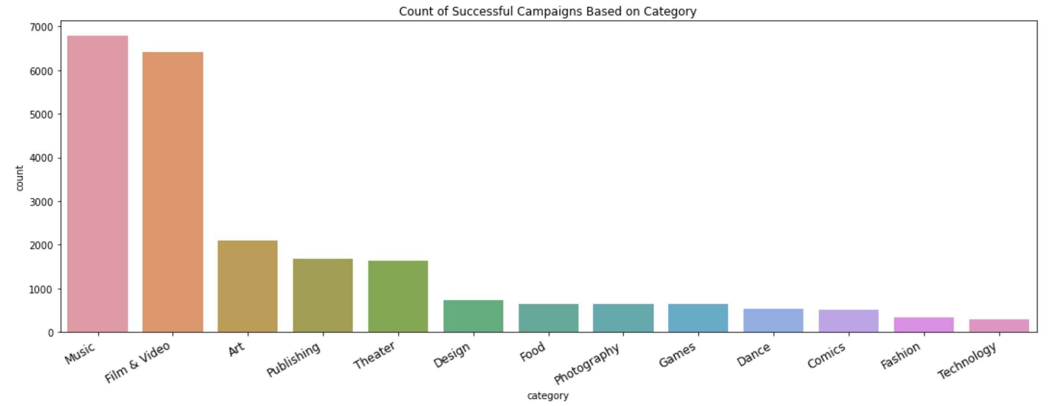
Qualitative Analysis
Film & Video is the most represented category at Kickstarter
What type of projects would be most
successful at getting funded?
However, the most successful campaigns are from Music and then from Film & Video.

Slide 6
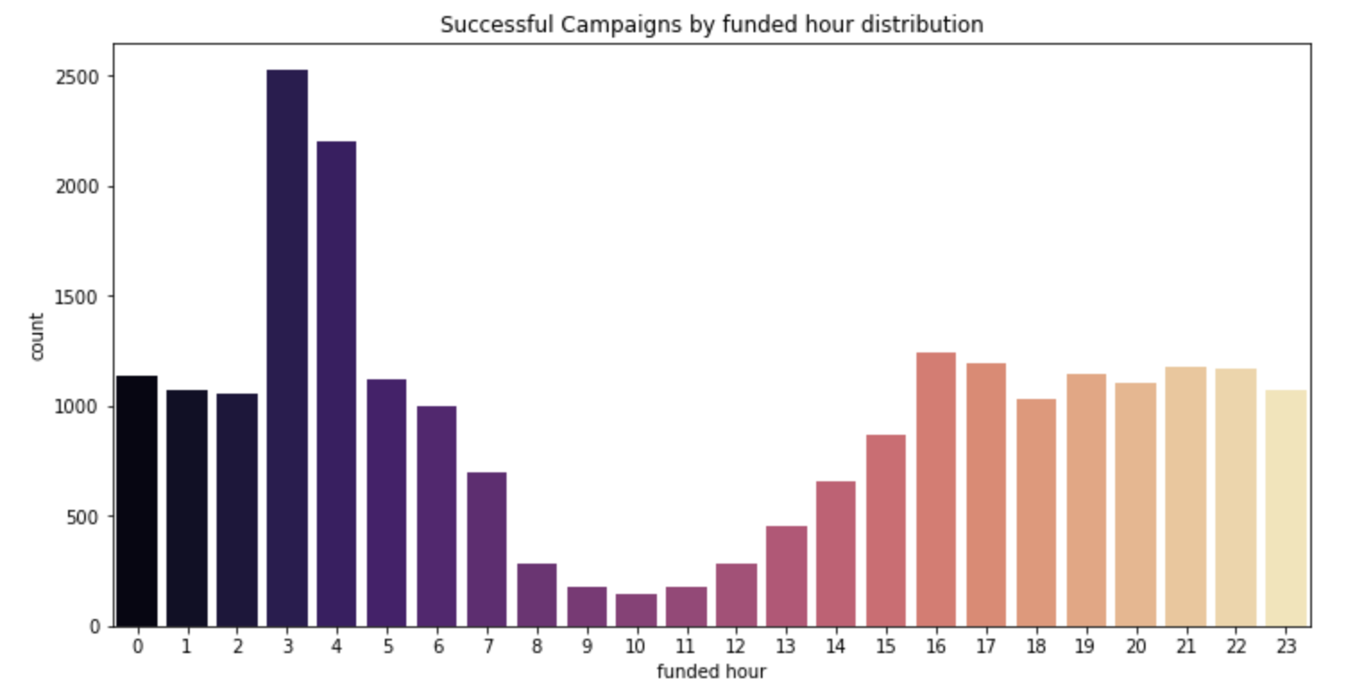
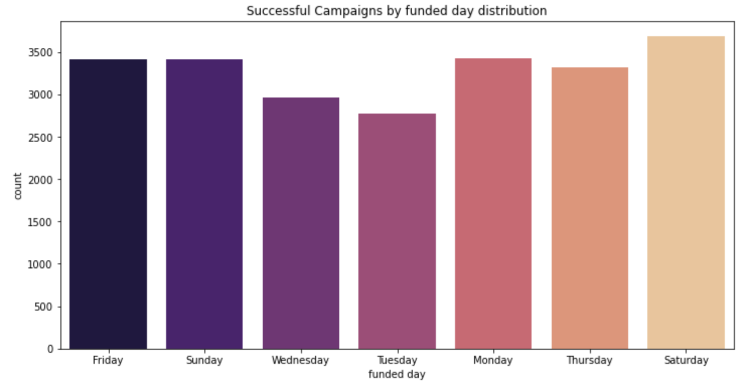
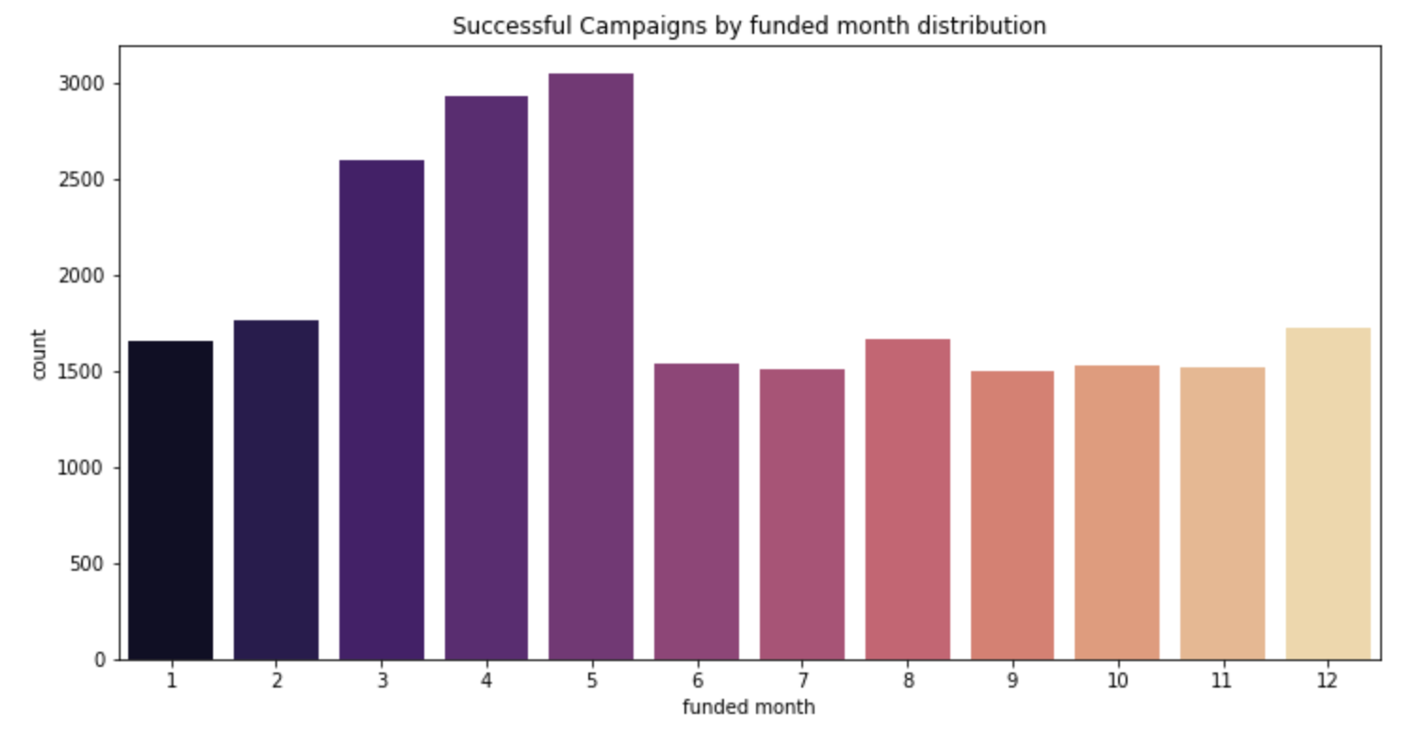
Qualitative Analysis
Is there an ideal month/day/time to launch a campaign?
The most successful campaigns were funded in spring, on a Saturday at 3-4am.

Slide 7
Thanks!
Any questions?

