Slide 1
Today’s session
Review basic OOP and smells
SOLID principles
Other agile/OOP principles

Slide 2
Basic OOP
Polymorphism
Encapsulation
Inheritance
Cohesion
Coupling

Slide 3
Refactoring code smells
Duplicate code
Long method
Large class
Switch statements
Etc.

Slide 4
Design smells
Rigidity
Software is difficult to change
Fragility
Program breaks in many places when a change made in a single place
Immobility
Parts could be useful in other systems, but effort and risk to separate from original system is too great

Slide 5
Design smells
Viscosity
Design-preserving methods are more difficult to use than the hacks
Development environment is slow and inefficient
Needless complexity
Contains elements that aren’t currently useful
Needless repetition
System has lots of repeated code elements
Opacity
A module is difficult to understand

Slide 6
Why does software rot?
Waterfall methodology
Requirements change
Code wants to be chaotic
We don’t take time to refactor
We suck at OO design
Designs and practices are at fault

Slide 7
Technical Debt
The cost to fix rotting code
Interest charges build over time
The longer we take to remove the smells, the more it will cost

Slide 8
SOLID
Single Responsibility Principle (SRP)
Open-Closed Principle (OCP)
Liskov Substitution Principle (LSP)
Interface Segregation Principle (ISP)
Dependency Inversion Principle (DIP)

Slide 9
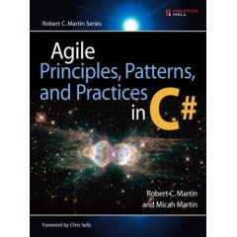
Where does SOLID come from?

Slide 10
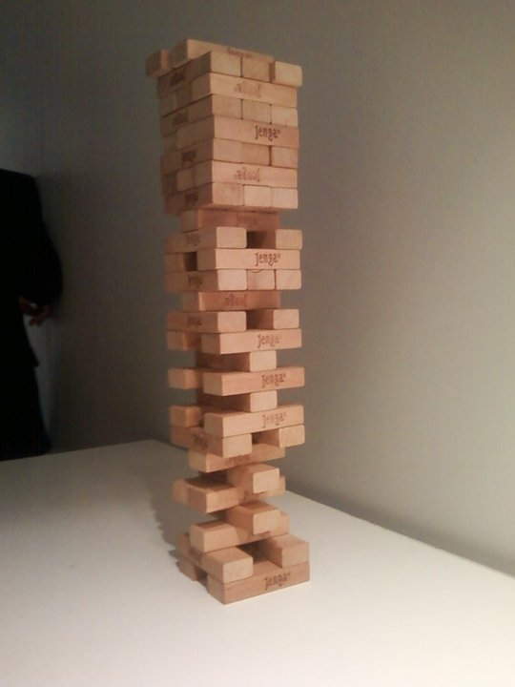
Jenga

Slide 11
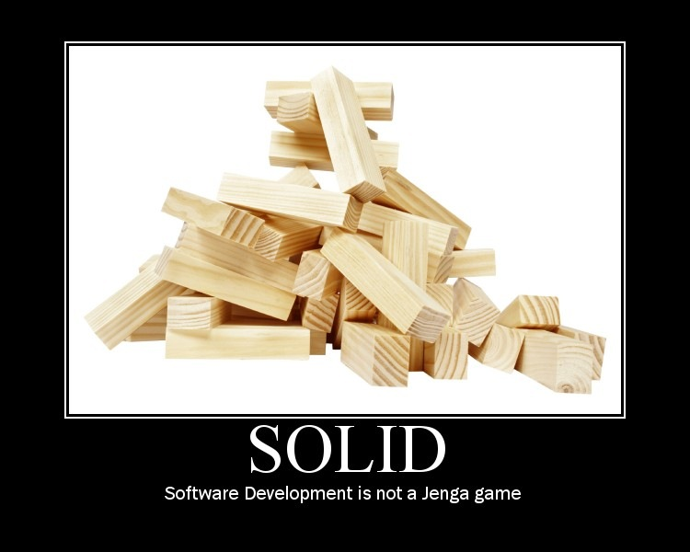

Slide 12
Single Responsibility Principle (SRP)
Every class should have responsibility over a single part of the functionality provided by the software

Slide 13
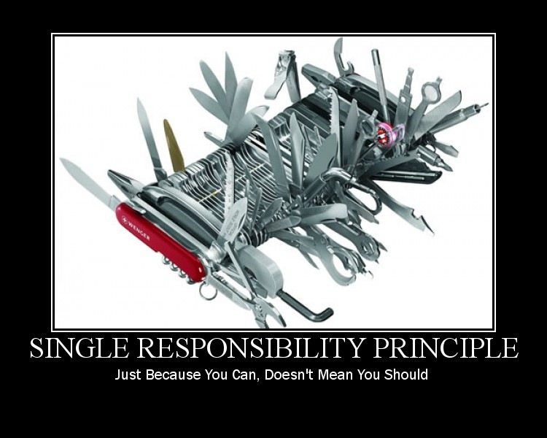

Slide 14
Responsibility
What a class does
The more a class does, the more likely it will change
The more a class changes, the more likely we will introduce bugs

Slide 15
Cohesion and Coupling
Cohesion – How closely related are the different responsibilities of a module
Coupling – How much one module relies on another
Goal is low coupling and high cohesion

Slide 16
EXAMPLE CODE Single Responsibility Principle

Slide 17
Open Closed principle (OCP)
Software entities (classes, modules, functions, etc.) should be open for extension but closed for modification

Slide 18
Conforming to OCP
Open for extension
Behavior of the module can be extended
We are able to change what the module does
Closed for modification
Extending behavior does not result in changes to source, binary, or code of the module

Slide 19
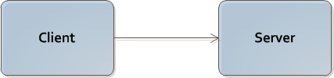
Does not conform to OCP
Client is not open and closed

Slide 20
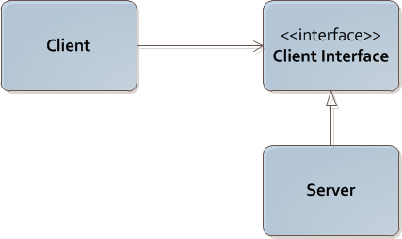
Strategy pattern
Client is both open and closed

Slide 21
Conforming to OCP
Rely on abstractions
Interfaces
Abstract classes

Slide 22
EXAMPLE CODE Open Closed Principle

Slide 23
Liskov Substitution Principle (LSP)
Subtypes must be substitutable for their base types

Slide 24
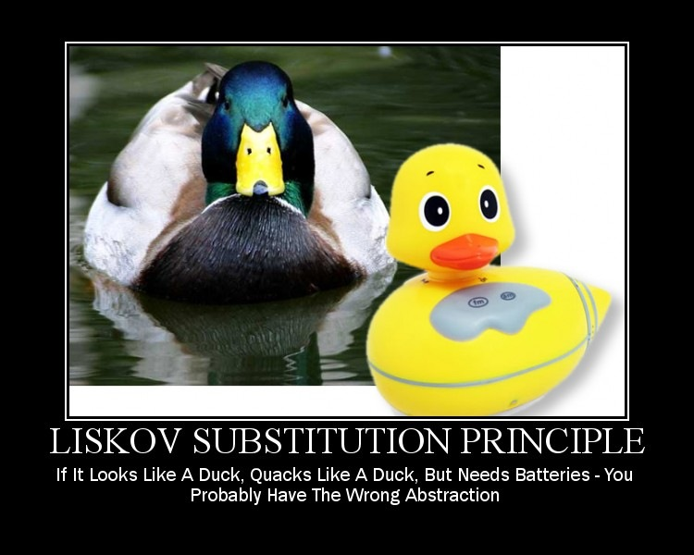

Slide 25
IS-A
Basic OOP discusses inheritance with “IS-A”
LSP says that “IS-A” refers to behavior
Behavior is what software is really all about

Slide 26
Substitution
Calling code should not know that one module is different from its substitute

Slide 27
EXAMPLE CODE Liskov Substitution Principle

Slide 28
Interface Segregation Principle (ISP)
Clients should not be forced to depend on methods they do not use

Slide 29
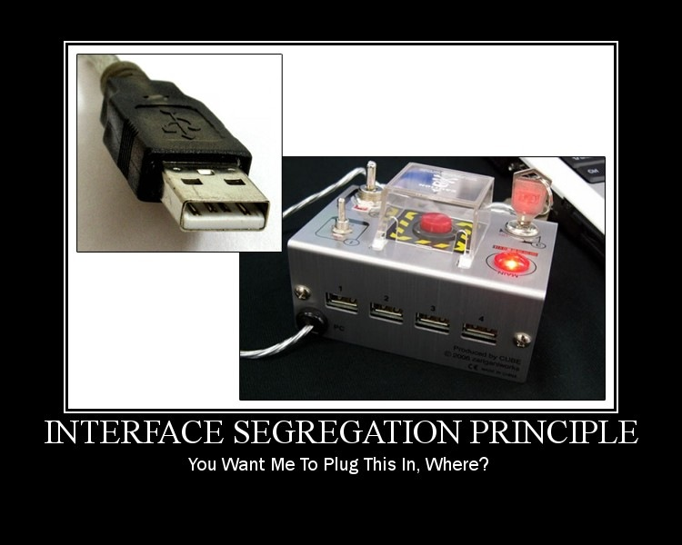

Slide 30
EXAMPLE CODE Interface Segregation Principle

Slide 31
Dependency Inversion Principle (DIP)
High-level modules should not depend on low-level modules. Both should depend on abstractions
Abstractions should not depend on details. Details should depend upon abstractions

Slide 32
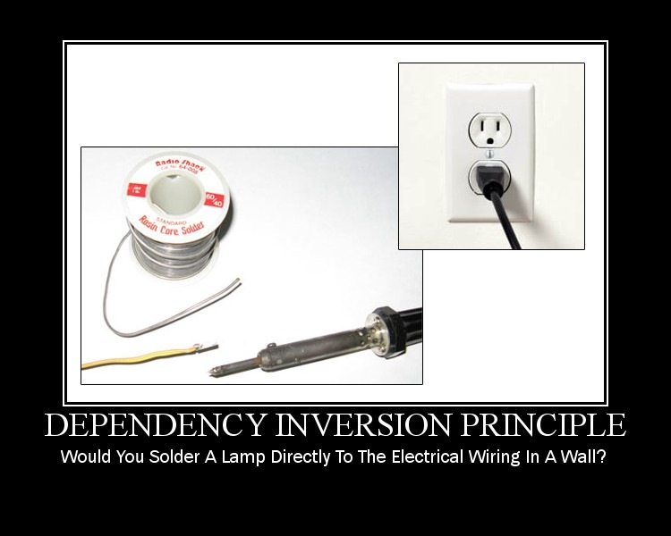

Slide 33
EXAMPLE CODE Dependency Inversion Principle

Slide 34
Other principles
Keep It Simple Stupid (KISS)
You Ain’t Gonna Need It (YAGNI)
Don’t Repeat Yourself (DRY)

Slide 35
Today’s session
Review basic OOP and smells
Single Responsibility Principle (SRP)
Open-Closed Principle (OCP)
Liskov Substutution Principle (LSP)
Interface Segregation Principle (ISP)
Dependency Inversion Principle (DIP)
Other agile/OOP principles

