Slide 1

Duck Game
Group members:
Stoyan Rizov
Cristina Nita
Kamila Michel

Slide 2
Outline
Project Objectives
Gameplay
Menus
Technologies
Hardware
Tracking Mode
Gestures
Conclusion

Slide 3

Project Objectives
Look
Look into ideas for the project using Kinect V2
Integrate
Integrate Kinect V2 to Unity Environment
Body
Body Movement Recognition
Implement
Implement Speech Recognition for Menu
Complete
Complete a Duck Game
Complete
Report documentation with the architecture, implementation & conclusion

Slide 4
Schedule
Study
Design
Implement
Testing
Report
Motion detecting device
Library
Technologies
Graphic interface
User scenario
Game
Real Environment
Report Document
Video

Slide 5
Gameplay The player must capture the flying ducks while defeating the enemies
Controls
The player collects the ducks with the hands
Defeat the enemies when colliding with the legs
Access the Menu using Speech
Difficulty
Enemies Spawning
Score – Collect Ducks and bonuses

Slide 6
Menus
PAUSE MENU
MAIN MENU PLAY AGAIN RESUME QUIT
MAIN MENU
PLAY CONTROLS SCORE QUIT

Slide 7


Technologies
Framework Unity
Language
C#
Hardware Kinect V1

Slide 8
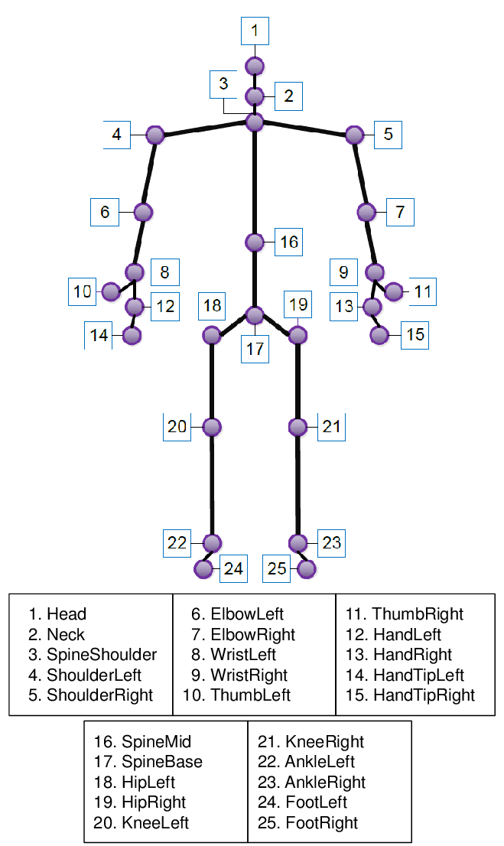
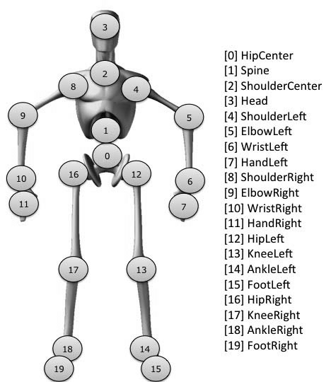
Kinect V1 vs V2
Kinect V2
Kinect V1
tracks 25 joints of the skeleton
The “Kinect for Windows SDK 2.0”
Higher resolution camera
More fps (frames/second)
Tracks 20 joints of the skeleton
The “Kinect for Windows SDK v1.8”
Lower resolution camera
Less fps (frames/second)

Slide 9
Kinect v1 SDK’s available
Windows SDK:
Kinect for Windows SDK v1.8
Kinect for Windows Developer Toolkit v1.8
speech recognition
Microsoft Speech Platform - Software Development Kit (SDK) (Version 11)
Microsoft Speech Platform - Runtime (Version 11)
Kinect for Windows Runtime Language Pack

Slide 10
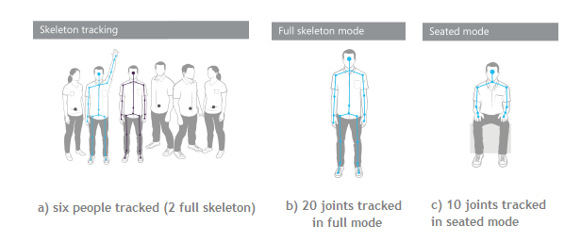
Tracking Mode
Default Mode
20 skeleton joints for v1 and 25 skeleton joints for v2.
Optimized to recognize and track people who are standing and fully visible to sensor.
Measures distance from the sensor
One tracking mode can be used at the time.

Slide 11



User Posture
User posture may effect design of a gesture

Slide 12

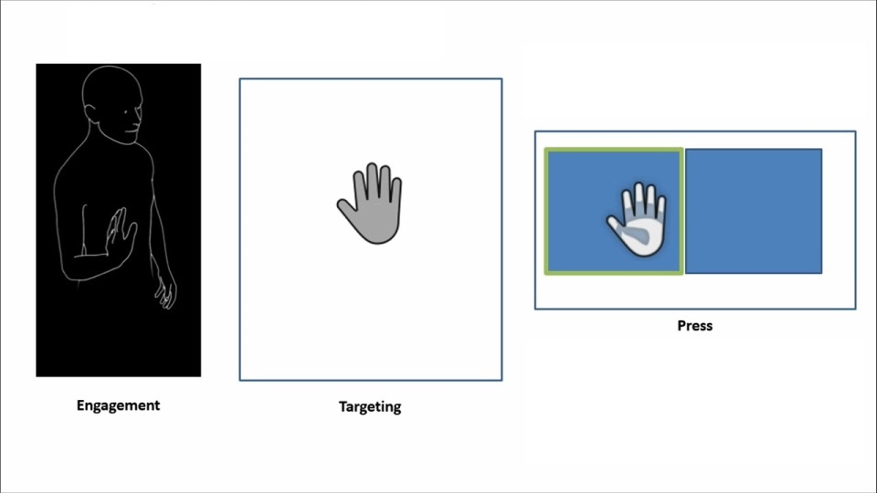
Gesture
Body parts Movement using the Kinect hardware
Unity Speech recognition

Slide 13
Difficulties
Documentation about Kinect v2 and v1
Connecting the user to the character in Kinect v2
Speech recognition in Kinect v1
Linking the game started on Kinect v2 to the Kinect v1 hardware

Slide 14
Conclusion
Interesting and challenging newly introduced hardware
Kinect can provide significant functionality in a joint-tracking application
Phases of movements are easily identifiable from graphs of joint positions
Experienced connecting Unity with Kinect V2 & V1

