Slide 1
Traffic Sign Detection & Recognition Week one
Idoia Ruiz
Lidia Talavera
Onofre Martorell
Roque Rodríguez

Slide 2
Content
Project M1- Traffic Sign Detection & Recognition Week one
Introduction to the problem
Proposed strategy
Results
Discussion and conclusion

Slide 3
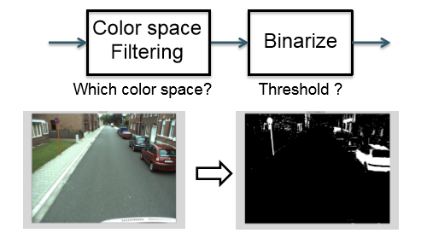
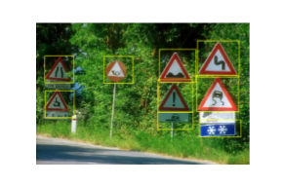
Introduction to the problem
Project M1- Traffic Sign Detection & Recognition Week one
Build a traffic sign detector/recognizer.
First week: From image to pixels candidates
Left: Example of the traffic sign detector. Right: workflow of the first week. Source: Lectures’ slices.
Introduction to the problem
Proposed strategy
Results
Discussion and conclusions

Slide 4
Proposed strategy
Project M1- Traffic Sign Detection & Recognition Week one
Introduction to the problem
Proposed strategy
Results
Discussion and conclusion

Slide 5
Results
Project M1- Traffic Sign Detection & Recognition Week one
 | Precision | Accuracy | Recall | F measure | TP | FP | TN | FN | Time
RGB
Otsu RGB
HSV
HSV&RGB
Lab
Introduction to the problem
Proposed strategy
Results
Discussion and conclusion

Slide 6
Discussion and conclusion
Project M1- Traffic Sign Detection & Recognition Week one
We can see how color segmentation is a good first approximation to the problem.
Results are not very satisfactory. Better techniques must be implement.
The hardest thing to achieve was finding the appropriate thresholds.
Introduction to the problem
Proposed strategy
Results
Discussion and conclusion

Slide 7
¡Thank you!

