Slide 1

Europarl: How to Build a Multilingual Parallel Corpus
Matthew Kuhn - Saarland University Machine Translation SS 2018

Slide 2
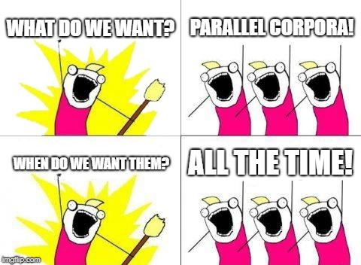
The Problem of Parallelism
Why so much?
SMT and NMT systems must be trained on data
What properties must that data have?
For each language pair: text in the source, with its corresponding translation
Must be sentence-aligned, pre-processed
How much data do we need?

Slide 3
Solving the Problem
Where can we get the data we need?
Crawling the internet (e.g. Twitter, Wikipedia)
Pros: Plenty of data
Cons: No inherent parallelism
Manually constructed
Pros: Guaranteed parallelism
Cons: Expensive
Books
Pros: more or less parallel
Cons: not enough data
Big problem: each language pair needs a corresponding corpus

Slide 4

Solving the Problem
Multilingual countries require official documents to be translated into multiple languages
EU Parliament (ca. 2004): 11 official languages, 18-30 million words per language
Danish, German, Greek, English, Spanish, French, Finnish, Italian, Dutch, Portuguese, Swedish
Extraction
1) Crawl data
2) Align documents
3) Split into sentences
4) Preprocessing
5) Align sentences

Slide 5
Extraction 1: Crawling Data
Automatically extracted from HTML
Issues:
Noisy data: HTML contains extraneous code
Extraction takes time, several days per language in 2004
Changes in formatting over time
Advantages:
Faster than direct file transfer
Copyright: EU Parliament allows reproduction with citation

Slide 6
Extraction 2: Document Alignment
Corpus is divided by day, and by topic
Core task: identify topic, match languages
Stored as one file per day per language
No text preprocessing at this stage

Slide 7
Extraction 3: Sentence Splitting
MT systems require aligned sentences
Challenge: No universal cross-linguistic standard
Ex: Ambiguity of period “ . ”
Language specific rules: period followed by lowercase = abbreviation
Possibility: Empirical sentence breaking
Decision trees (Riley 1989)
Maximum entropy (Reynar and Ratnaparkhi 1997)

Slide 8
Extraction 4: Preprocessing
Tokenization
Many systems
Goal is to use Penn Treebank standard
Lowercasing/Truecasing
Motivation: The, the, and THE are the same word
Truecasing allows for distinguishing Mr. Black and black

Slide 9
Extraction 5: Sentence Alignment
Advantage: Texts are already paragraph-aligned
Discarded texts where number of paragraphs differ between languages
Challenge: Sentence fertility
One long sentence in source may be 2 small sentences in target, or vice versa
Algorithm: Gale and Church 1993
Match sentences of similar length
Merge shorter sentences if necessary
Small number of sentences per paragraph = high alignment quality
Why?
One file per day per language
Same line number means same sentence
At time of publication, English had ~30x10⁶ words, ~1x10⁶ sentences

Slide 10
Versions
Version 1: April 1996 - December 2001, ~ 20x10⁶ words/language
Version 2: January 2002 - September 2003, up to 28x10⁶ words/language
Version 3: October 2003 - October 2006 (update to UTF-8), up to 44x10⁶ words/language
Version 5: November 2007 - October 2009, up to 55x10⁶ words/language
Version 6: November 2009 - December 2010, adds 10 new languages with data from 01/2007
Bulgarian, Czech, Estonian, Hungarian, Latvian, Lithuanian, Polish, Romanian, Slovak, Slovene
Version 7: January 2011 - November 2011, up to 60x10⁶ words/language

Slide 11
Limitations
Only X <-> English available as parallel corpora
Corpora must still be tokenized, lowercased, and have empty lines/XML tags removed
Standard test set does not include data for newer languages
Newer languages have much less data (up to 13x10⁶ words/language)
No updates since 2012
Limited Domain

Slide 12
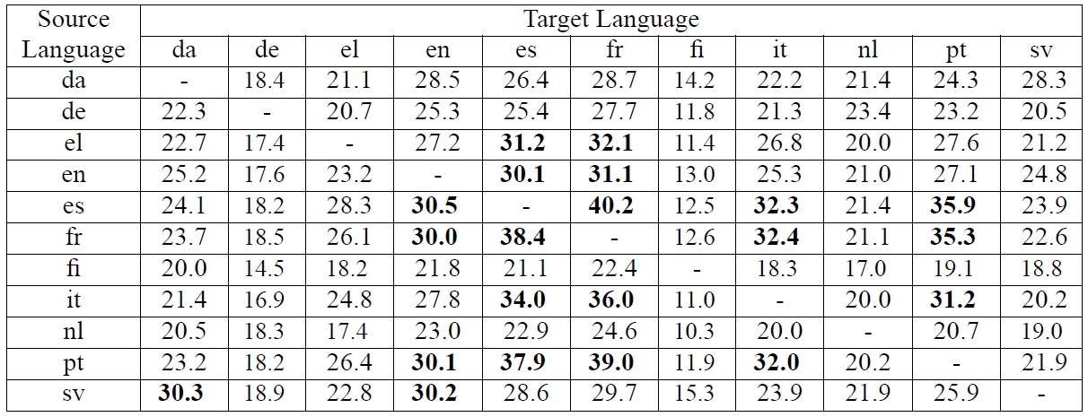
PBSMT Performance
110 SMT: Koehn et al. 2003
110 language pairs
Map source phrases to target phrases with probabilistic phrase translation table
Phrase table: start with word alignments, collect phrases consistent with word alignments
Decoder: Pharaoh, Koehn 2004
Beam search over all segmentations of input into phrases, translations, and reordering
Performance (BLEU)
Best: Spanish -> French, 40.2
Worst: Dutch -> Finnish, 10.3

Slide 13
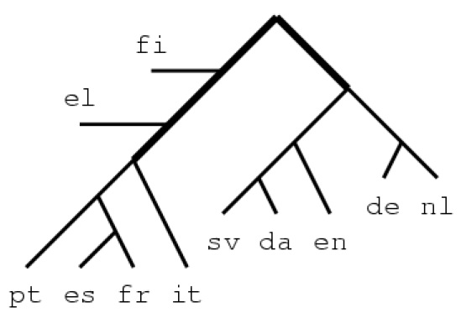
Language Clustering
Given the translation scores, can we induce relationships between languages?
Assumption: easier to translate between closely related languages
Group languages that have highest translation scores
Bias towards smaller clusters
Results:

Slide 14
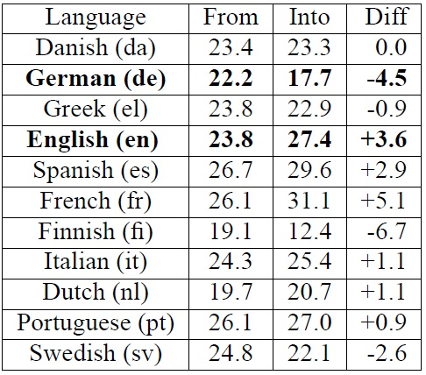
Translation Direction
Translations are not symmetric
Why?
One reason: Information richness/poorness (e.g. due to morphology)
Performance:

Slide 15
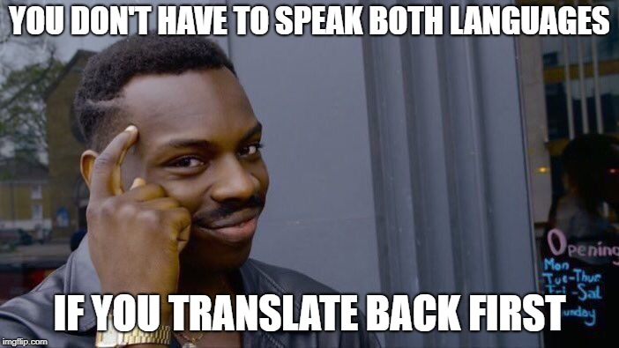
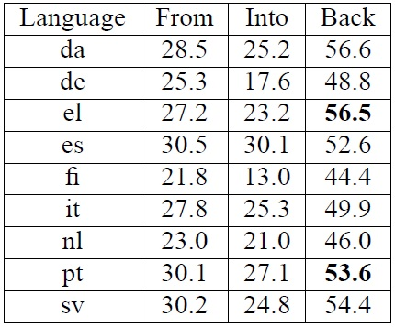
Back Translations
Evaluating MT is tricky
Possible trick: evaluate with a back translation
Back translation = translate source to target, then reverse order and translate back, and evaluate
Does it work?
Why the high back translation scores?
Question: What would score be if the translation did nothing?
Artifact of BLEU
Monodirectional is evaluated against human translation; penalized for not exactly matching
Back translation compares to original input; easier to match

Slide 16
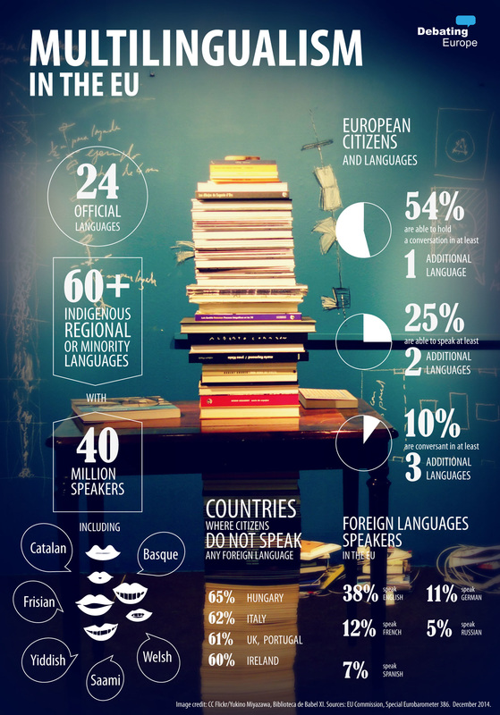
Questions?

