Slide 1
Removing the Gender Bias from Word Embeddings
Kathryn Chapman, Vanessa Hahn, Guadalupe Romero

Slide 2
Content
Introduction
Debiasing Pre-Trained Word Embeddings
Training Unbiased Word Embeddings
Conclusion

Slide 3
Introduction
Useful information such as context and subword information is used to improve embeddings
How can we improve them in other ways?

Slide 4

Introduction
Word embeddings inherit the gender biases of their training corpora
This can lead to amplification of gender biases in real-life applications
Notes:
This amplification is indeed real as can be proven by some word analogy tasks.

Slide 5
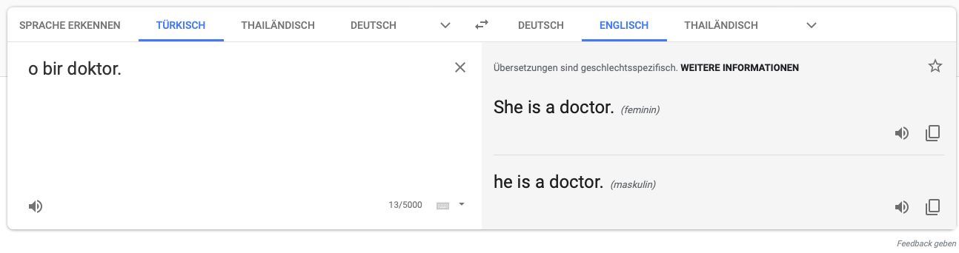
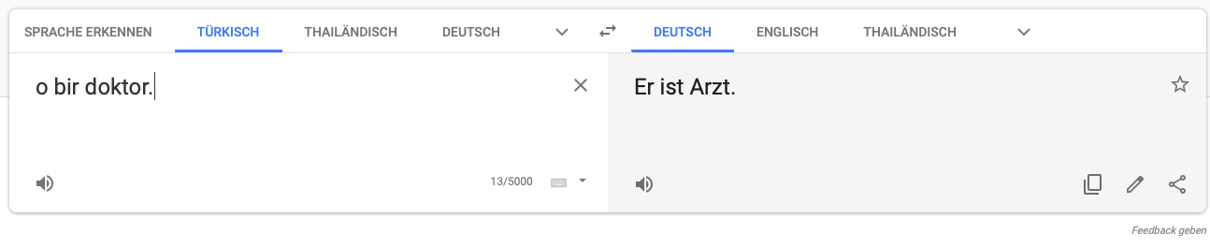
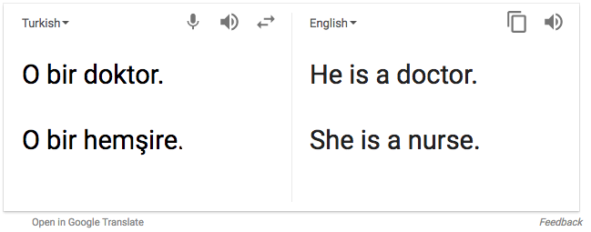
Introduction
Word Embeddings rely on the data they are trained on
But there can be a downside to it!

Slide 6
Introduction
How can we debias word embeddings? Can we give them a moral compass? Can we make them learn world knowledge about what is appropriate and what is not?
We can use linear algebra to find the directions in vectors that cause the bias!
Notes:
If we are given an option of 100 nearly identical web pages that differ only in name, thanks to the biased embeddings, we will be returned only male names as top search results -> Because they rank male names closer to computer science than female names -> makes it harder for women to be recognized in a male-dominated field
There is indeed a good reason to debiase the embeddings!

Slide 7
Man is to Computer Programmer as Woman is to Homemaker? Debiasing Word Embeddings
Tolga Bolukbasi, Kai-Wei Chang, James Zou, Venkatesh Saligrama, Adam Kalai

Slide 8
Gender-Neutral vs. Gender-Specific Words
Nurse
Doctor
Football
Shoes
N ⊂ W
Her/Him
She/He
Father/Mother
Brother/Sister
P ⊂ W x W
Notes:
What to debiase? It is important to keep definitional gender directions in some words!

Slide 9
Direct vs. Indirect Bias
Association between gender-neutral word and a clear gender pair
e.g. nurse is closer to woman than to man
Association between gender-neutral words due to gender bias
e.g. receptionist is closer to softball than to football
Notes:
Receptionist closer to softball than to football because receptionist and softball have female connotations which they should not have

Slide 10
Goals
Reduce Gender Bias
Ensure same distance between gender neutral words and gender pairs
Reduce gender associations
Maintain Utility
Maintain meaningful gender-related associations between gender neutral words
Maintain definitional gender associations
Notes:
Bias 1: Direct bias
Bias 2 : Indirect bias
Util 1: Fashion words such as blouse vs shirt
Util 2: association between man - father

Slide 11
Crowd Experiments
U.S. based evaluators (the crowd) were recruited to rate bias/stereotypes in embedding similarities
Goal: Measure the extent of present bias in word embeddings
Are stereotypes visible for occupation words?
Do analogies reflect stereotypes?
Notes:
Note that the evaluators were from US. Other cultures would have different notions of (degrees of) bias

Slide 12
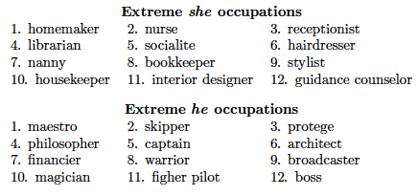
Crowd Exp 1: Stereotypes in Occupation Words
* word2vec pre-trained on Google News Corpus
Notes:
From the occupations closest in similarity to he/she, the crowd workers rated their stereotypicality (0-10).
When projecting these words onto the she/he axis based on embedding similarity, the crowd’s ratings align with word embeddings geometry

Slide 13
Crowd Exp 2: Stereotypes in Analogy Task
Analogies are good indicators of word embedding’s general performance
They can also be used to determine whether a word embedding is biased!

Slide 14

Crowd Exp 2: Stereotypes in Analogy Task
Generate word pairs (x,y) s.t. x is to he as y as to she
(he,she) = seed pair
Rank word pairs (x,y) by
Crowd workers rated whether pair is reasonable analogy
Crowd workers rated stereotypicality of analogy
29/150 analogies were rated as biased by at least 5 persons
Notes:
Delta is a similarity threshold value to ensure that the words x and y are not too far apart, usually delta = 1. Because we want two pairs like doctor - nurse and not doctor - pregnancy
Then ranking is done by taking cosine similarity of (he,she) and (x,y) -> words pairs most similar to he,she will be ranked first

Slide 15
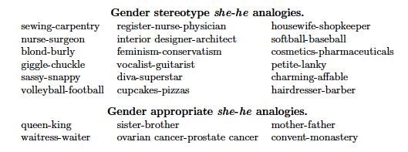
Crowd Exp 2: Stereotypes in Analogy Task
Notes:
These are some of the analogies that were rated as biased by at least 5 out of 10 crowd workers

Slide 16
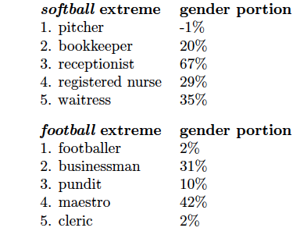
Indirect Gender Bias
How can we find out what part of the embeddings is responsible?
Notes:
Project the occupation words to softball vs football -> These are the most extreme occupation words on the football and softball axis. (replace he she on axis by football and softball)

Slide 17
Identifying the Gender Subspace
Gender must be captured in a direction g in the word embedding’s vector space!

Slide 18
Identifying the Gender Subspace
Crowd workers generate list of definitional gendered words (waitress, menswear) and list of gender-biased words (football, receptionist)
Use the 50 most frequent male/female words of each list for classification of definitional and gender-biased words
Apply PCA to top gender words.
The top component from PCA must be the gender direction.
Notes:
Classification: If receptionist is classified closer to she, then the classifier is correct.
Use SVM for this task.

Slide 19
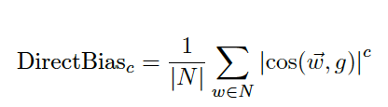
Calculating the Direct Bias of the Embedding Space
N = Set of gender-neutral words g = gender-bias direction c = strictness parameter
Notes:
C = 0 would be very strict, C = 1 would be more gradual
Example: if N is a set of 327 occupation words, then DirectBias_1 = 0.08 -> occupation words are big on the gender-bias component -> occupation words are biased in w2vNews

Slide 20
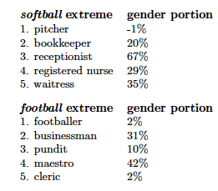

Calculating the Indirect Bias between Word Pairs
We can measure the contribution of gender subspace g to similarities between a pair gender-neutral words (w,v):
Notes:
We can decompose a word embedding: w = w_t + w_g
W_t is the word embedding without the contribution from gender w_g -> w_t = w - w_g

Slide 21
Debiasing Algorithms
Steps
Identify Gender Subspace
Debias
Neutralize and Equalize, or
Soften
Hard debiasing
Soft debiasing

Slide 22
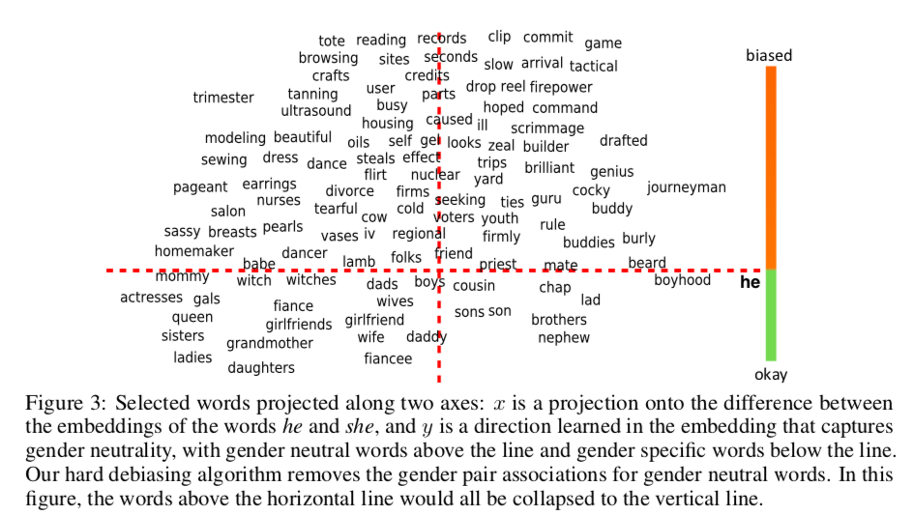
Separating Gender Specific from Gender Neutral Words
she

Slide 23
Separating Gender Specific from Gender Neutral Words
she

Slide 24
Separating Gender Specific from Gender Neutral Words
GOAL: make words
here equidistant
to each word in a
gender specific pair
METHOD:
collapse them to vertical line
she

Slide 25
Identifying Gender Subspace
Identify direction of the embedding that captures bias

Slide 26
Identifying Gender Subspace
Identify direction of the embedding that captures bias
collect directional words
he-she, father-mother, boyfriend-girlfriend…
apply dimensionality reduction

Slide 27
Identifying Gender Subspace
Inputs
word sets W
defining sets D₁, D₂, ... , D_{n} ⊂ W
embedding {w ∈ R^{d}}_{w∈W}
integer parameter k ≥ 1
Let
𝜇_{i} := Σ_{w∈Di} w / |D_{i}|
means of the defining sets
C := Σ_{i=1}Σ_{w∈Di}(w - 𝜇_{i})^{T}(w - 𝜇_{i}) / |D_{i}|
bias subspace B is first k rows of SVD(C)
n
gender specific word pairs used to define bias direction
Notes:
1. we took the ten gender pair difference vectors and computed its principal components (PCs)
2. there is a single direction that explains the majority of variance in these vectors.

Slide 28
Identifying Gender Subspace
n
C := Σ_{i=1}Σ_{w∈Di}(w - 𝜇_{i})^{T}(w - 𝜇_{i}) / |D_{i}|
for all defining sets (e.g.
{she, he})
and their means
for all words in defining sets
e.g. ‘she’
word embedding minus mean of defining pair, transposed
word embedding minus mean of defining pair
cardinality of defining set
Notes:
First row of SVD(C) gives us bias direction

Slide 29
Identifying Gender Subspace
gender direction
babysitter
Gender neutral
feminine
masculine
grandmother
Gender specific
grandfather

Slide 30
Hard Debiasing: Neutralize and Equalize
Additional inputs
words to neutralize N ⊆ W
equality sets Ε = {E₁, … ,E_{m}} where E_{i} ⊆ W
Let
each w in N be re-embedded to w := (w - w_{B})/ ||w - w_{B}||
𝜇_{i} := Σ_{w∈E} w / |E|
means of the equality sets
v := 𝜇 - 𝜇_{B}
For each w ∈ E:
w := v + √1 - ||v||²
Finally, output new embedding
e.g.
‘babysitter’,
‘nurse’
neutralize
w_{B} - 𝜇_{B}
gender specific words to equalize
e.g. {guy, gal}
{grandmother, grandfather}
||w_{B} - 𝜇_{B}||
equalize

Slide 31
Neutralize
Ensure that gender neutral words are 0 in the subspace
Gender neutral
babysitter
feminine
masculine
grandmother
Gender specific
grandfather

Slide 32
Neutralize
Ensure that gender neutral words are 0 in the subspace
Gender neutral
babysitter
babysitter
feminine
masculine
grandmother
Gender specific
grandfather

Slide 33
Neutralize
Ensure that gender neutral words are 0 in the subspace
Gender neutral
babysitter
feminine
masculine
grandmother
Gender specific
grandfather

Slide 34
Equalize
equalize sets of words outside the subspace; enforces the property that any neutral word is equidistant to all words in each equality set
Gender neutral
babysitter
feminine
masculine
grandmother
Gender specific
gal
grandfather
guy

Slide 35
Equalize
equalize sets of words outside the subspace; enforces the property that any neutral word is equidistant to all words in each equality set
Gender neutral
babysitter
feminine
masculine
grandmother
grandmother
grandfather
Gender specific
gal
grandfather
gal
guy
guy

Slide 36
Equalize
equalize sets of words outside the subspace; enforces the property that any neutral word is equidistant to all words in each equality set
Gender neutral
babysitter
feminine
masculine
grandmother
grandfather
Gender specific
gal
guy

Slide 37
Equalize
equalize sets of words outside the subspace; enforces the property that any neutral word is equidistant to all words in each equality set
Gender neutral
babysitter
Do this for every equalizing pair
{woman, man}
{girl, boy}
...
feminine
masculine
grandmother
grandfather
Gender specific
gal
guy

Slide 38
Equalize
Disadvantage of the equalizing:
removes certain distinctions that are valuable in certain applications
‘grandfather a regulation’ more probable than than ‘grandmother a regulation’
grandfather here has a meaning that grandmother does not
equalizing the two removes this distinction
Solution: Soften algorithm as an alternative

Slide 39
Soften Algorithm
reduces differences between these sets while maintaining as much similarity to the original embedding as possible
Inputs
W ∈ R^{d x |vocab|}
matrix of all embedding vectors
N - matrix of embedding vectors of gender neutral words
Desired
debiasing transformation T ∈ R^{d x d}
a linear transformation to preserve pairwise inner products between all word vectors while minimizing projection of gender neutral words onto the gender subspace
T is debiasing transformation of word embedding
Formalized as optimization problem:
min_{T}‖(TW)^{T}(TW) - W^{T}W‖_{F} + λ‖(TN)^{T}(TB)‖_{F}
B is subspace learned in step 1
λ is tuning parameter
2
2

Slide 40

Soften Algorithm
ensures that pairwise inner products are preserved
induces the biases of gender neutral words into gender subspace to be small

Slide 41
Soften Algorithm
reduces differences between these sets while maintaining as much similarity to the original embedding as possible
When λ is large, T would completely remove projection onto B from all vectors in N
this is exactly what Neutralize/Equalize does
For the experiment, λ = 0.02 is used

Slide 42
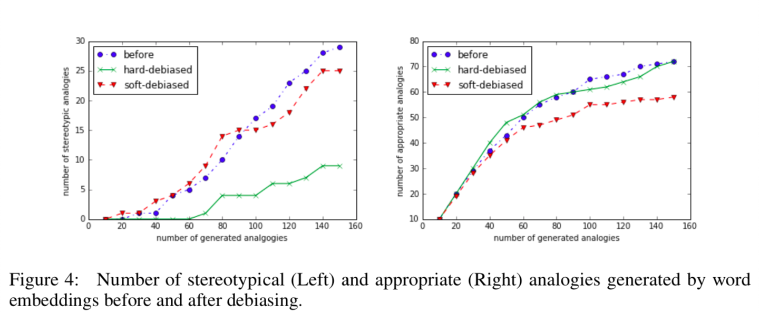
Results
Notes:
-automatically generated pairs of words that are analogous to she-he and asked crowd-workers to evaluate whether these pairs reflect gender stereotypes.
-before: 19% of 150 generated analogies were deemed stereotpyical
-after: 6% of 150 generated analogies were seemed stereotypical
-no loss of appropriate analogies between ‘before’ and ‘after hard debiasing’ for 150 generated analogies

Slide 43
Results
19% stereotype analogies reduces to
6% stereotype analogies
Notes:
-automatically generated pairs of words that are analogous to she-he and asked crowd-workers to evaluate whether these pairs reflect gender stereotypes.
-before: 19% of 150 generated analogies were deemed stereotpyical
-after: 6% of 150 generated analogies were seemed stereotypical
-no loss of appropriate analogies between ‘before’ and ‘after hard debiasing’ for 150 generated analogies

Slide 44
Results
little difference in # appropriate analogies from before/after hard debiasing
Notes:
-automatically generated pairs of words that are analogous to she-he and asked crowd-workers to evaluate whether these pairs reflect gender stereotypes.
-before: 19% of 150 generated analogies were deemed stereotpyical
-after: 6% of 150 generated analogies were seemed stereotypical
-no loss of appropriate analogies between ‘before’ and ‘after hard debiasing’ for 150 generated analogies

Slide 45
Results
soft debiasing not as effective at removing gender bias
soft debiasing not as effective at preserving # appropriate analogies
Notes:
-automatically generated pairs of words that are analogous to she-he and asked crowd-workers to evaluate whether these pairs reflect gender stereotypes.
-before: 19% of 150 generated analogies were deemed stereotpyical
-after: 6% of 150 generated analogies were seemed stereotypical
-no loss of appropriate analogies between ‘before’ and ‘after hard debiasing’ for 150 generated analogies

Slide 46
Results - Examples
Removing bias:
before:
he : doctor :: she : x
x is returned as ‘nurse’
after hard debiasing:
x is returned as ‘physician’
Preserving appropriate analogies:
after hard debiasing:
she : ovarian cancer :: he : prostate cancer
Notes:
-automatically generated pairs of words that are analogous to she-he and asked crowd-workers to evaluate whether these pairs reflect gender stereotypes.
-before: 19% of 150 generated analogies were deemed stereotpyical
-after: 6% of 150 generated analogies were seemed stereotypical
-no loss of appropriate analogies between ‘before’ and ‘after hard debiasing’ for 150 generated analogies

Slide 47
Limitations
Pipeline approach that requires gender neutral words to be identified in advance by a classifier
if classifier makes mistake, error will be propagated
Better performing model completely removes gendered information from embeddings

Slide 48
Limitations
Pipeline approach that requires gender neutral words to be identified in advance by a classifier
if classifier makes mistake, error will be propagated
Better performing model completely removes gendered information from embeddings
Solution?

Slide 49
Learning Gender-Neutral Word Embeddings
Jieyu Zhao, Yichao Zhou, Zeyu Li, Wei Wang, Kai-Wei Chang

Slide 50
Overview
Goals:
Learn gender neutral word embeddings during training
Preserve gender information in certain dimensions of word vectors
but also, compel other dimensions to be free of gender information
Method:
Gender Neutral Global Vectors (GN GloVe)

Slide 51
Gender Neutral GloVe
Represents protected attributes in certain dimensions ; neutralizing others during training
because of restriction, information can easily be removed
Does not require separate classifier to identify gender neutral words
eliminates error propagation issue present in other method

Slide 52

Decomposition of word vectors

Slide 53
Decomposition of word vectors
word vector

Slide 54
Decomposition of word vectors
gendered components (dimension k)

Slide 55
Decomposition of word vectors
definitional (e.g., waiter - waitress)
gendered components (dimension k)

Slide 56
Decomposition of word vectors
definitional (e.g., waiter - waitress)
gendered components (dimension k)
stereotypical (e.g., doctor - nurse)

Slide 57
Decomposition of word vectors
neutralized componentes (dimension d-k)

Slide 58
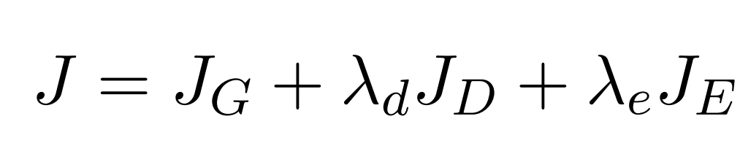
Cost function

Slide 59
Cost function
GloVe cost function captures word proximity

Slide 60
Cost function
hyperparameters

Slide 61
Cost function
restrict gender information in w^{(g)} so that w^{(a)} becomes neutral

Slide 62
Cost function
learned by using vocabulary words categorized as male, female and neutral in WordNet
restrict gender information in w^{(g)} so that w^{(a)} becomes neutral

Slide 63
Experiments: Separate protected attribute
(1) GN-GloVe preserves the gender association in w^{(g)}

Slide 64
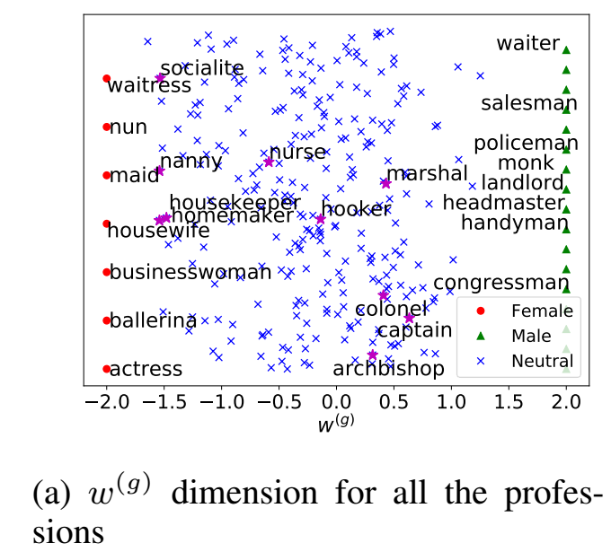
Experiments: Separate protected attribute
w^{(g)}
negative values = bias towards female positive values = bias towards male

Slide 65
Experiments: Separate protected attribute
male by definition
female by definition
w^{(g)}
negative values = bias towards female positive values = bias towards male

Slide 66
Experiments: Separate protected attribute
female by stereotype
w^{(g)}
negative values = bias towards female positive values = bias towards male

Slide 67
Experiments: Separate protected attribute
(2) Gender information is substantially diminished from w^{(a)} in the GN-GloVe embedding

Slide 68
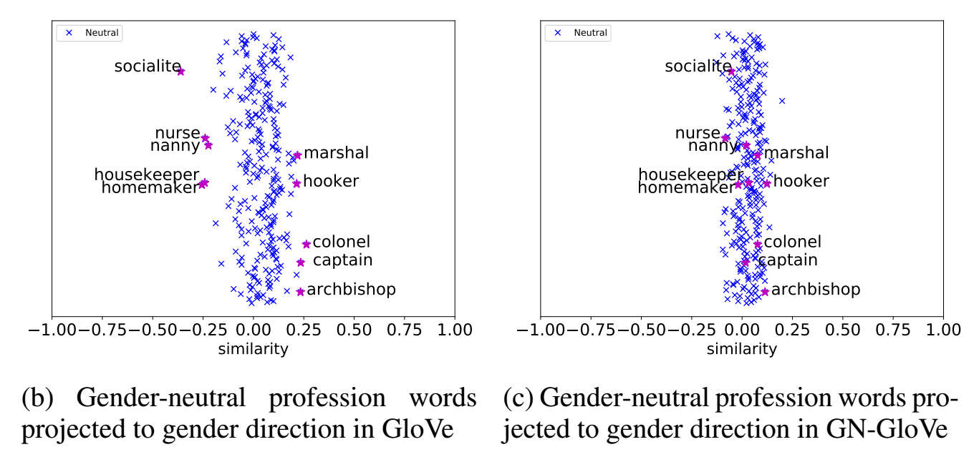
Experiments: Separate protected attribute
w^{(a)}
negative values = bias towards female positive values = bias towards male

Slide 69
Experiments: Separate protected attribute
(3) Project word vectors of occupational words into the gender sub-space defined by “he-she” and compute their average size.
Larger projection = more biased.

Slide 70
Experiments: Separate protected attribute
model | average projection
GloVe | 0.080
GN-Glove | 0.052
Hard-GloVe | 0.019

Slide 71
Experiments: Separate protected attribute
model | average projection
GloVe | 0.080
GN-Glove | 0.052
Hard-GloVe | 0.019
reduces bias by 35% with respect to GloVe

Slide 72
Experiments: Separate protected attribute
model | average projection
GloVe | 0.080
GN-Glove | 0.052
Hard-GloVe | 0.019
reduces bias by 35% with respect to GloVe
less gender bias, but worse at differentiating definitional / stereotypical bias

Slide 73
Experiments: Gender Relational Analogy
Identify if word pairs are “he - she” analogies:
Gender definition → “waiter - waitress”
Gender stereotype → “doctor - nurse”
No gender → “cat - dog”

Slide 74
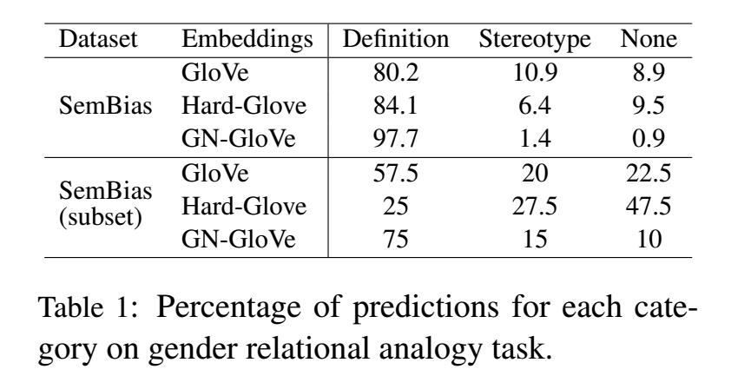
Experiments: Gender Relational Analogy

Slide 75
Experiments: Gender Relational Analogy
should be high

Slide 76
Experiments: Gender Relational Analogy
should be high
should be low

Slide 77
Experiments: Gender Relational Analogy
should be high
should be low
should be low

Slide 78
Experiments: Gender Relational Analogy
should be high
should be low
should be low
Why? Do they use w(g) for Definition and w(a) for Stereotype/None? How do we know when to use one and when to use the other? With a classifier?

Slide 79
Experiments: Word Similarity and Analogy
Evaluate the word embeddings on the benchmark tasks to ensure their quality
Similarity task (comparing to different human-annotated datasets)
Analogy task: “A is to B as C is to ___?” (comparing to Google and MSR datasets)

Slide 80
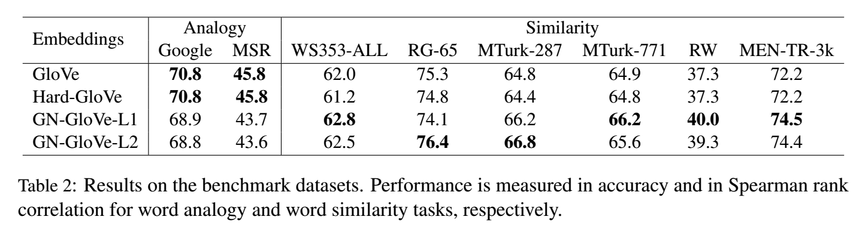
Experiments: Word Similarity and Analogy

Slide 81
Experiments: Word Similarity and Analogy
different ways of estimating J_{D}

Slide 82
Experiments: Word Similarity and Analogy
slightly lower scores

Slide 83
Experiments: Word Similarity and Analogy
highest scores

Slide 84
Experiments: Coreference Resolution
OntoNote

Slide 85
Experiments: Coreference Resolution
OntoNote
WinoBias dataset:
PRO stereotype: “The CEO raised the salary of the receptionist because he is generous.”
ANTI stereotype: “The CEO raised the salary of the receptionist because she is generous.”

Slide 86
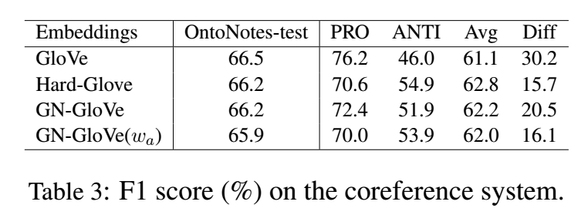
Experiments: Coreference Resolution

Slide 87
Experiments: Coreference Resolution
smaller diff = less biased

Slide 88
Experiments: Coreference Resolution
smaller diff = less biased
A lot better than GloVe, a bit worse than Hard-GloVe

Slide 89
Future work
Other languages
Other embedding models
Non-binary gender
Other attributes (sentiment, religion, race, etc.)

