Slide 1
Lattice-Based Recurrent Neural Network Encoders for Neural Machine Translation
Jinsong Su,1 Zhixing Tan,1 Deyi Xiong,2 Rongrong Ji,1 Xiaodong Shi,1 Yang Liu
Presented by Yanzhe Guo

Slide 2
What is Lattice
Combine lattice into GRU
Experiment, Result & Evaluation

Slide 3
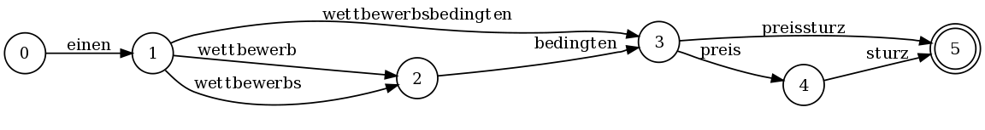
Lattice
A word lattice is a directed acyclic graph with a single start point and edges labeled with a word and weight. Here is an example lattice showing possible ways of decompounding some compound words in German:
http://www.statmt.org/moses/?n=Moses.WordLattices

Slide 4
Segmentation for Translation of Chinese
结婚／的／和／尚未／结婚／的
Married/Auxiliary/And/Have not/Married/Auxiliary
结婚／的／和尚／未／结婚／的
Married/Auxiliary/Monk/Have not/Married/Auxiliary

Slide 5
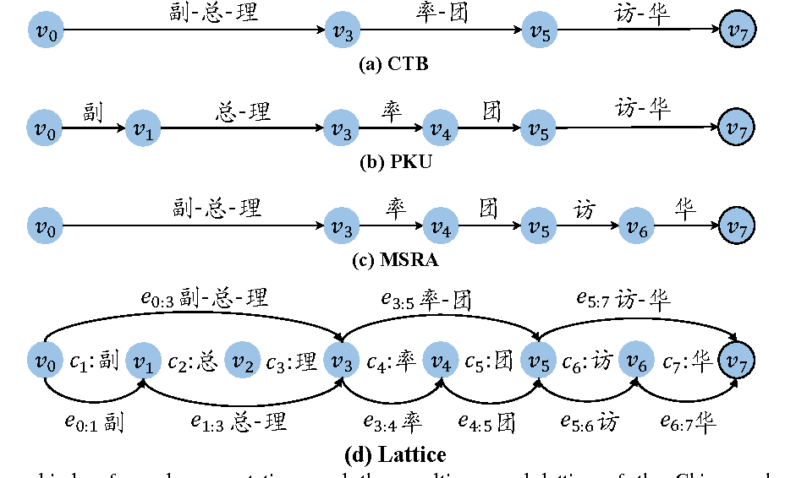
How to create lattice

Slide 6
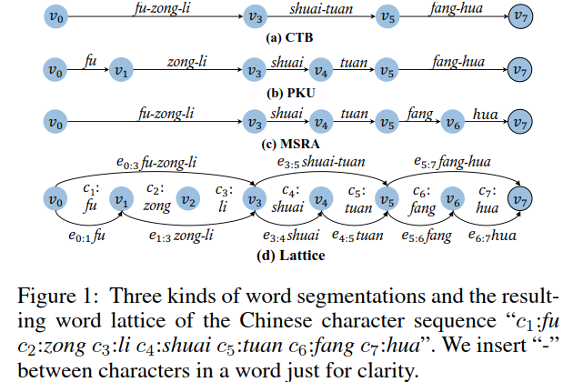
How to create lattice

Slide 7
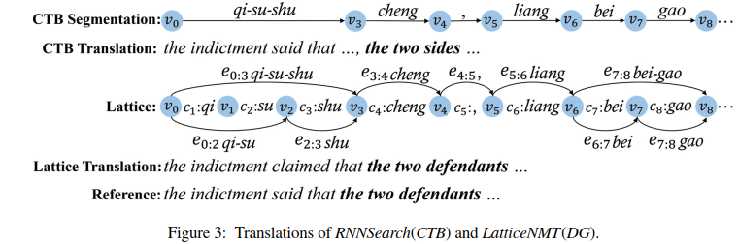
Example

Slide 8
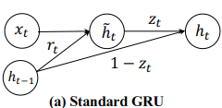
Traditional Gated Recurrent Unit
Only one path is possible…

Slide 9
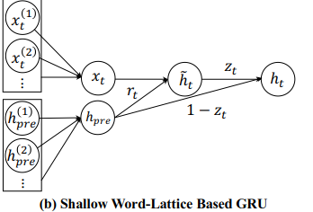
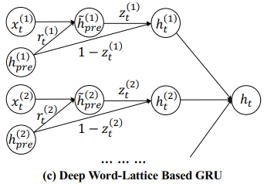
Two solutions proposed for lattice based GRU

Slide 10
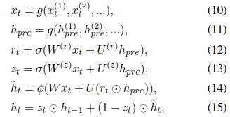
Shallow Word-Lattice based GRU (SWL-GRU)

Slide 11
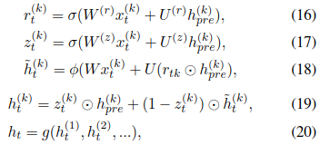
Deep Word-Lattice based GRU (DWL-GRU)

Slide 12
What is composition funciton g?

Slide 13
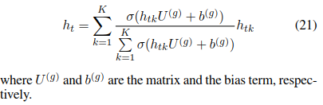
What is composition funciton g?
Pooling Operation Function
Average Pooling?
Gating Operation Function
Reminiscent of Softmax and Attention?

Slide 14



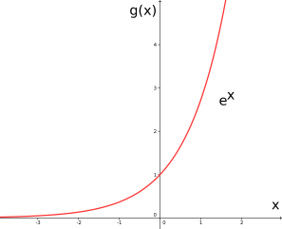
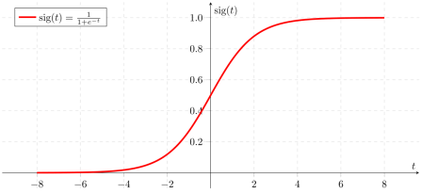
What is composition funciton g?
Gating Operation Function
softmax
sigmoid
(0, ∞)
(0, 1)

Slide 15
Experiment Setup
Training data: 1.25M sentence pairs extracted from LDC2002E18, LDC2003E07, LDC2003E14, Hansards portion of LDC2004T07, LDC2004T08 and LDC2005T06, with 27.9M Chinese words and 34.5M English words
Validation set: NIST 2005
Test sets: NIST 2002, 2003, 2004, 2006, and 2008
Evaluation metric: case-insensitive BLEU (Papineni et al. 2002) by the multi-bleu.perlscript
Trained NMT systems ﬁve times and reported the average BLEU scores
Signiﬁcance test: paired bootstrap sampling (Koehn 2004)
Word segmenters: toolkit2 released by Stanford to train on CTB, PKU, and MSR corpora

Slide 16
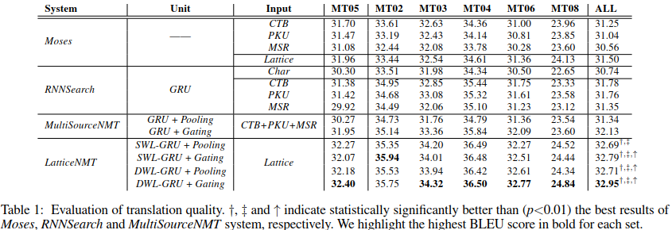
Result & Evaluation
an attention-based NMT system
Traditional best-first RNN without lattice
validation set
Peking University Corpus (PKU),
Microsoft Research Corpus (MSR)
Penn Chinese Treebank 6.0 (CTB)

Slide 17
Systems compared
Moses3: an open source phrase-based translation system with default configurations and a 4-gram language model trained on the target portion of training data.
RNNSearch (Bahdanau, Cho, and Bengio 2015): an inhouse attention-based NMT system, which has slightly better performance and faster speed than GroundHog. In addition to the RNNSearch with word-based segmentations, we also compared to that with character-based segmentations to study whether word boundary information is helpful for NMT.
MultiSourceNMT: an attention-based NMT system which also uses many tokenizations of each source sentence as input. However, it performs combination at the final time step, significantly different from the proposed word-lattice based GRUs. Similarly, it has two variants with different composition functions.

Slide 18
Where could lattice be useful?
What other composition functions is available?

Slide 19
Reference
J. Su, Z. Tan, D. Xiong, and Y. Liu, "Lattice-based recurrent neural network encoders for neural machine translation," 2017, pp. 3302-3308.

