Slide 1
Day 4 – NXP MBDT Bootcamp

Slide 2
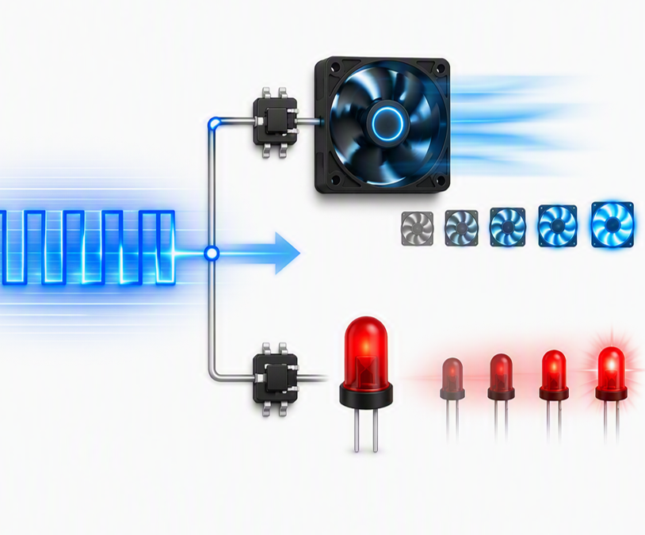
What you will learn
Part 1
PWM Basics
How to use PWM in Simulink
Control fan speed

Slide 3
Pulse Width Modulation
Precision Control through Pulse Timing

Slide 4
Pulse Width Modulation – in a “nutshell”
Why do we need PWM?
DIO can output only 2 states, but real loads need variable power
THE LIMIT
THE PWM SOLUTION
Digital output
Switch rapidly and control the ON-time ratio
LOW or HIGH
The load responds to the delivered average energy, enabling smooth control of brightness, speed, torque, or heat.
No direct “half power” state exists on the pin.

Slide 5
Key parameters for PWM
One waveform, three essential parameters
ON time
Period (T)
PERIOD
Time for one complete cycle
FREQUENCY
Cycles generated each second
DUTY CYCLE
Percentage of the period spent HIGH
f = 1 / T [Hz]
d = tON/T * 100 [%]
T = tON + tOFF [s]

Slide 6
Duty Cycle – the control knob for delivered power
10%
25%
50%
75%
90%

Slide 7
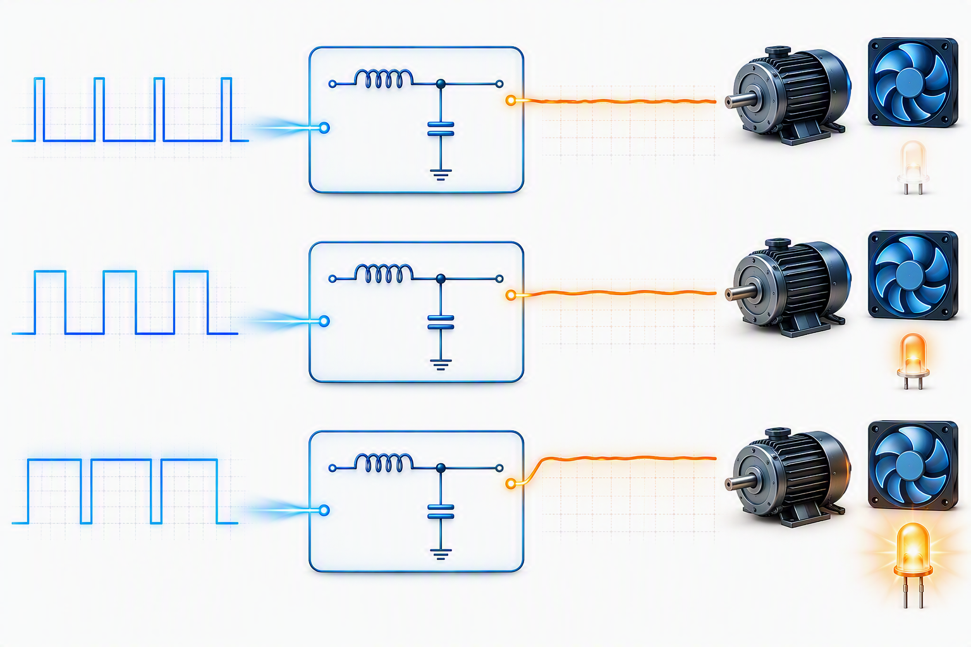
Average Voltage – what the load “sees”
Higher duty cycle means more average energy delivered to the load
IDEAL AVERAGE
Vavg = D × Vsupply
25%
.25 × 3.3 V
0.825 V
50%
.50 × 3.3 V
1.65 V
75%
.75 × 3.3 V
2.475 V
D is duty cycle expressed from 0 to 1.

Slide 8
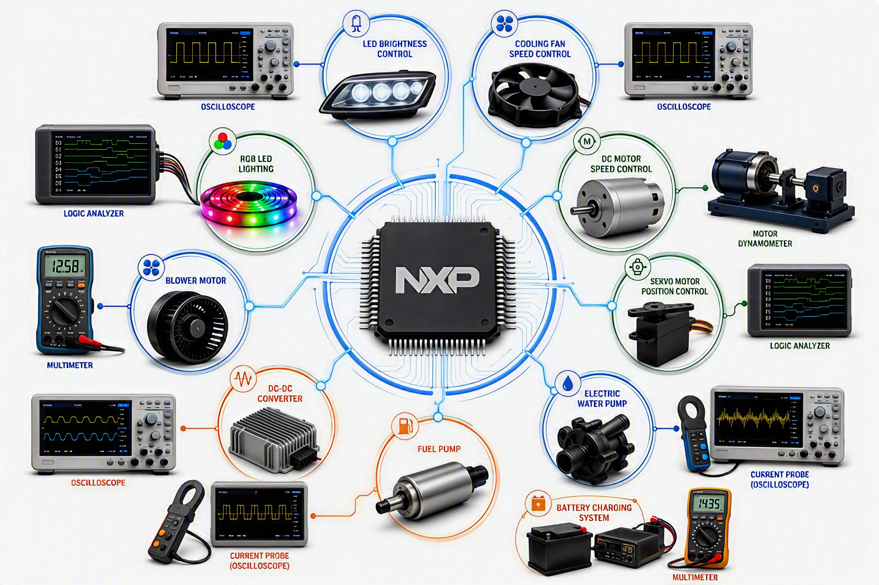
PWM Applications

Slide 9
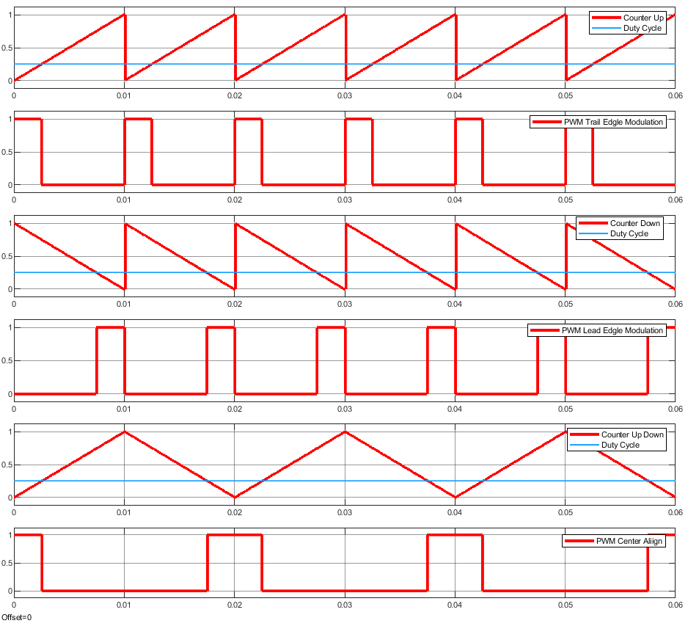
How PWM works?
Edge-Aligned PWM
  A timer is used as carrier to count from 0 to MOD value
  The MOD (ex. max 16 bit size) gives the timer period
  When the counter matches a compare value, the PWM output state is changed
  Types:
Center-Aligned PWM
  Edge-Aligned PWM
  Timer counts up from 0 to MOD (or down from MOD to 0) and the PWM is aligned at 0
  Center-Aligned PWM
  Timer counts up and down (from 0 to MOD and then from MOD to 0)

Slide 10
When to use Center-Aligned vs Edge-Aligned PWM?
Edge Aligned
Basic dimming
Single-phase control
Simpler configuration
Creates larger current spikes
High Electromagnetic Interference
Center Aligned
Multi-phase control (BLDC, PMSM, ACIM)
Power Inverters
Buck/Boost Converters
Lower audible noise
Lower EMI
More complex configuration

Slide 11
PWM in Simulink

Slide 12
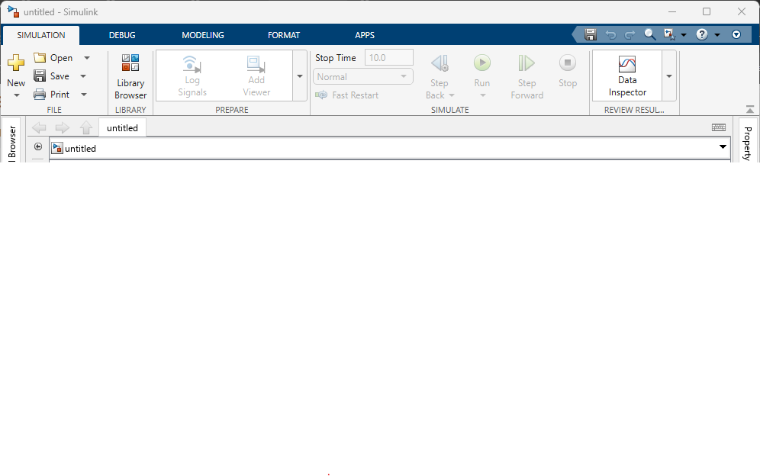
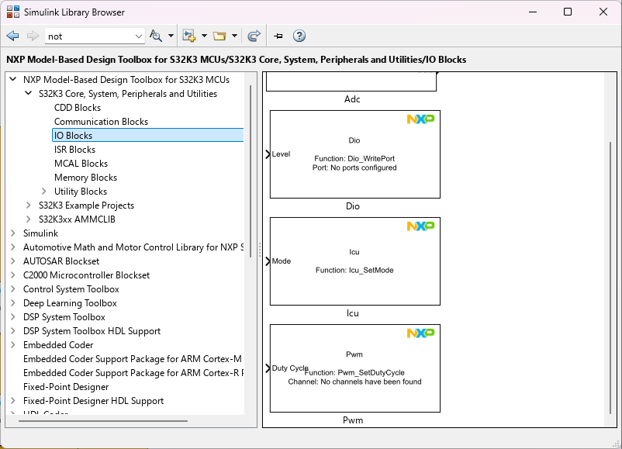
Explore the Simulink Library Browser
In any Simulink model, go to SIMULATION tab and open the Library Browser.
Expand the NXP Model-Based Design Toolbox for S32K3 and open the S32K3 Core, System, Peripherals and Utilities library
Expand the IO Blocks that includes Dio, Adc, Icu and Pwm NXP blocks

Slide 13
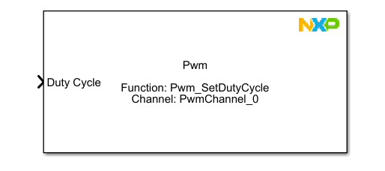
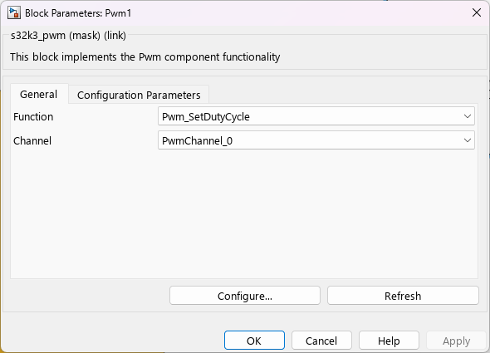
PWM Simulink Block
The most important and used PWM API Function use is Pwm_SetDutyCycle
Input port expects an uint16 value between 0 and 32768, where 0 represents 0% duty cycle and 32768 is 100% duty cycle

Slide 14
Control the speed of a fan using PWM
Practice

Slide 15
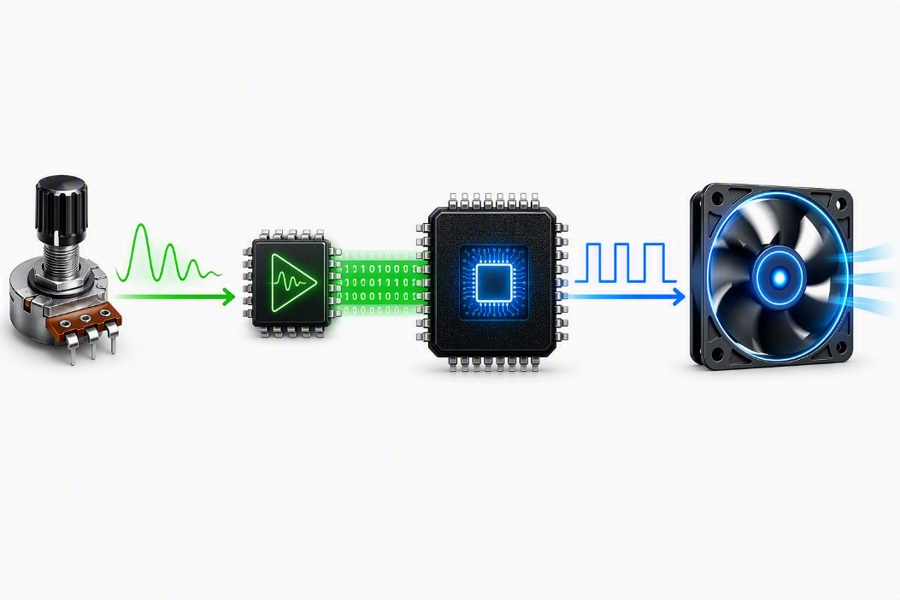
What we want to achieve?

Slide 16
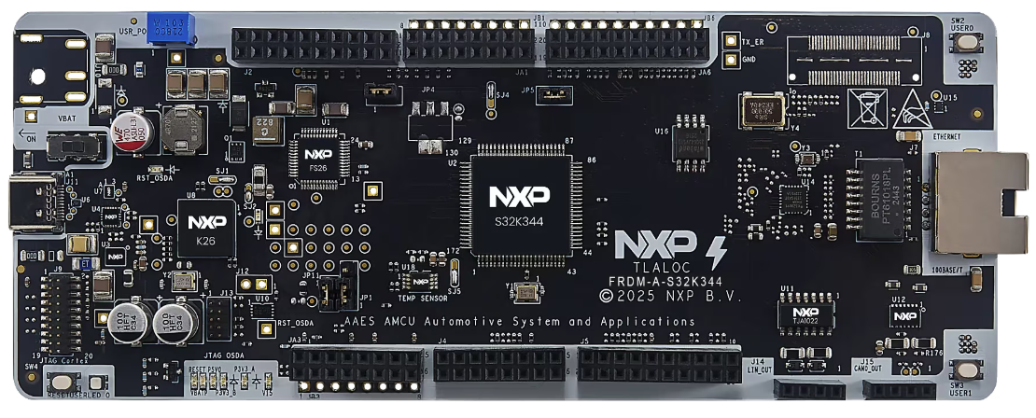
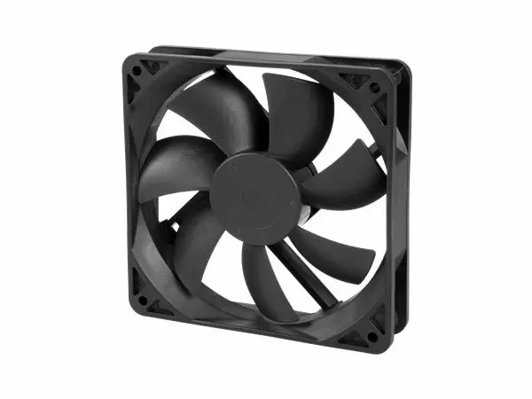
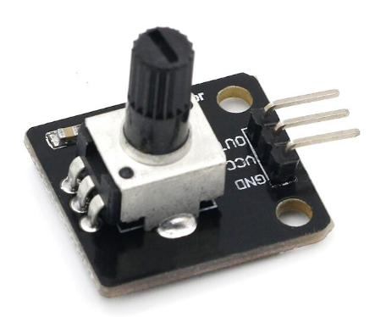
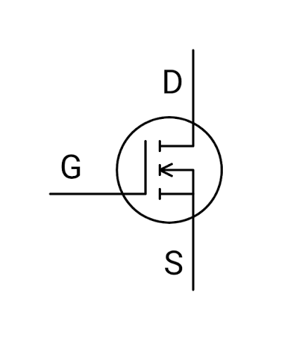
What we want to achieve?
Rotate the KNOB_1 to change the speed of the fan
12V
VCC
PTA7
PTA12
GND
FRDM-A-S32K344
Cooling Fan
GND

Slide 17
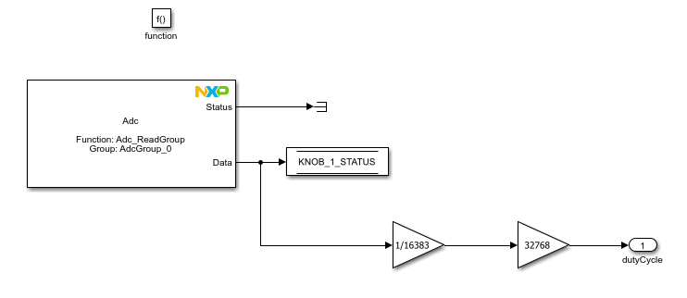
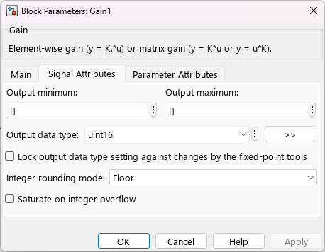
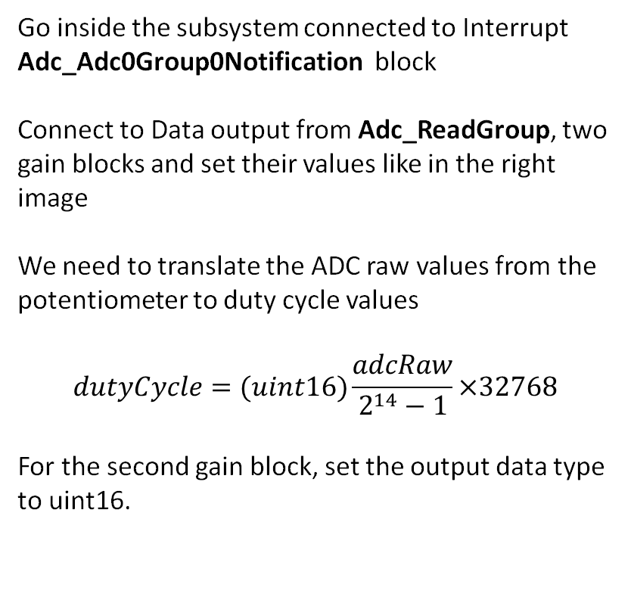
PWM Practice
Go inside the subsystem connected to Interrupt Adc_Adc0Group0Notification block
Connect to Data output from Adc_ReadGroup, two gain blocks and set their values like in the right image
We need to translate the ADC raw values from the potentiometer to duty cycle values
$$dutyCycle=(uint16)\frac{adcRaw}{2^{14}−1}×32768$$
For the second gain block, set the output data type to uint16.

Slide 18
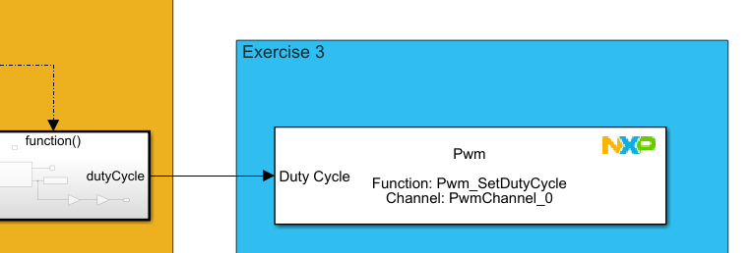
PWM Practice
From the Library Browser, drag & drop a PWM block and set the Function parameter to Pwm_SetDutyCycle
Leave Channel parameter as it is
Connect the DutyCycle input to the function-call subsystem output
Build & Deploy the model and check
the functionality of your application

Slide 19
Schematics
JA1[4] – PTA7 -> KNOB_1
JA1[6] – PTE10 -> KNOB_2
JA1[8] – PTE11 -> SWITCH_1
JA1[10] – PTA17 -> SWITCH_2
JA1[12] – PTC23 -> FAN (DIO)
J2[4] – PTA12 -> FAN (PWM)
JA3[11] – VCC (5V)
JA3[13] - GND
PTA12
PTC23
PTA17
PTE11
PTE10
PTA7
J2
JA1
JA3
VCC
GND

