Slide 1
Day 3 – NXP MBDT Bootcamp
Digital IO & Analog-Digital Converter
Bridging the Digital and Analog Worlds

Slide 2

What you will learn
Part 1
DIO Basics
How to use DIO in Simulink
Actuate a Fan using a switch
Part 2
ADC Basics
How to use ADC in Simulink
Read a Potentiometer

Slide 3
Digital Input/Output
From a button press to a physical response

Slide 4
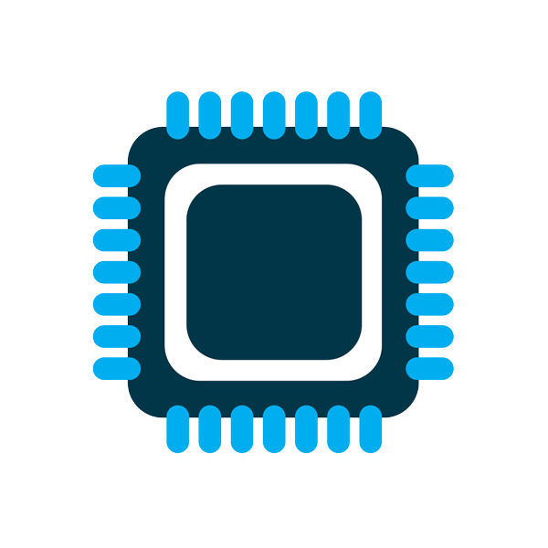


Digital Input/Ouput – The basics
A programmable pin on a MCU that acts as a bridge between the processor and external world
Send/Receive digital signals
Connect software to the physical world
Also known as GPIO
Each MCU external pin can be configured as
Output send a HIGH or LOW signal
Input read whether the pin is HIGH or LOW
A Digital Signal is a voltage interpreted as logic
Logical LOW
  Software - 0 or False
  Electrical - 0V
Logical HIGH
  Software - 1 or True
  Electrical - 3.3V or 5V
3.3V
0V
0
1
0
1
0
1

Slide 5
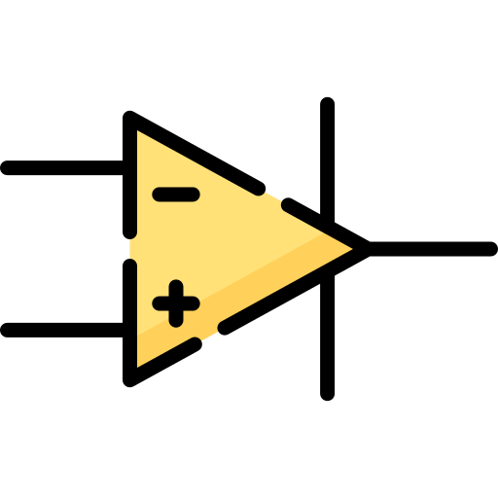


Digital Input/Ouput – The basics
Digital Output – software drives the pin
Software Value
Output Register
Output Driver
MCU Pin
Control
Basic Configuration
Direction & Output type
Safe startup value
Active-high or active-low behavior

Slide 6
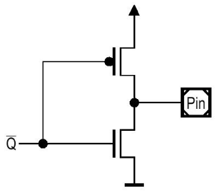
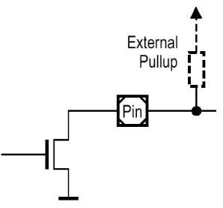
Digital Input/Ouput – The basics
Output Electrical Behavior – Push-Pull vs Open-Drain
Push-Pull
Actively drive signals HIGH/LOW
Uses 2 internal transistors
Can both source and sink current
High speed switch
Open-Drain
One transistor to GND
Leaves the pin floating
Can only sink current
High-impedance state when off
When to use? Unidirectional data lines like SPI, UART
When to use? Bidirectional and shared communication buses, like I2C

Slide 7
Digital Input/Ouput – The basics
Digital Input – a pin becomes information
Signal
MCU Pin
Input Buffer
Input Register
Software Value
Basic Configuration
Direction
Pull device
Polarity

Slide 8
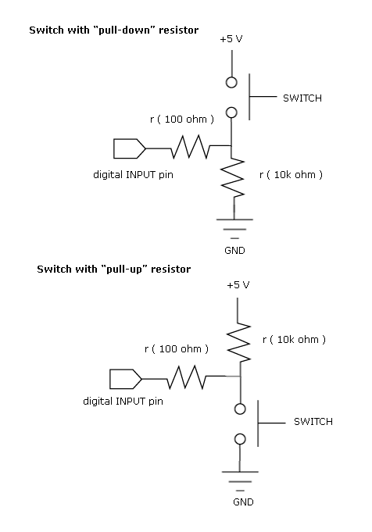
Digital Input/Ouput – The basics
Pull-Up vs Pull-Down
Pull-Up
Default state – logic 1 when input is inactive or open
Active state – connects the pin to GND to read logic 0
Pull-Down
Default state – logic 0 when input is inactive or open
Active state – connects the pin to VCC to read logic 1
When to use? A button connects the pin to GND
When to use? A button connects the pin to VCC

Slide 9
DIO in Simulink
Make your model interact with the Hardware

Slide 10
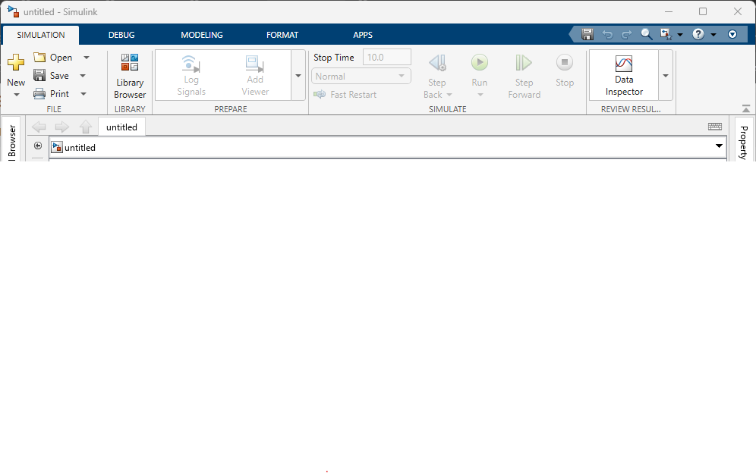
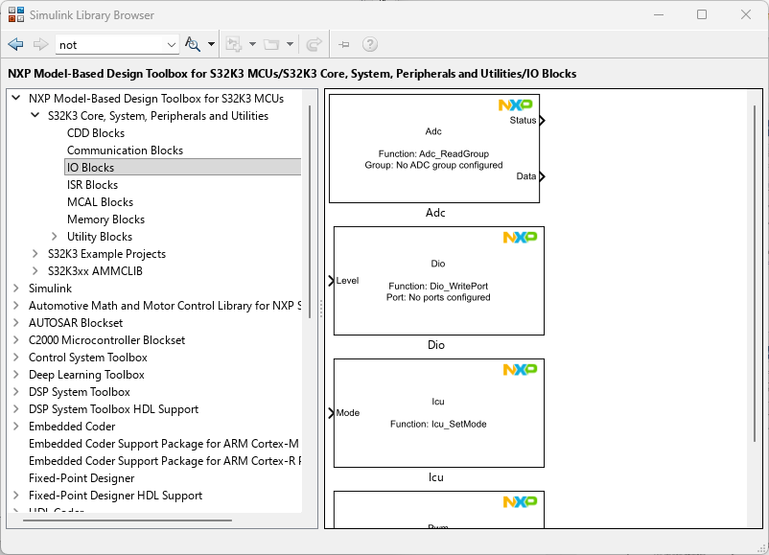
Explore the Simulink Library Browser
In any Simulink model, go to SIMULATION tab and open the Library Browser.
Expand the NXP Model-Based Design Toolbox for S32K3 and open the S32K3 Core, System, Peripherals and Utilities library
Expand the IO Blocks that includes Dio, Adc, Icu and Pwm NXP blocks

Slide 11
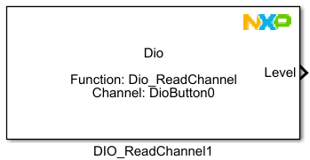
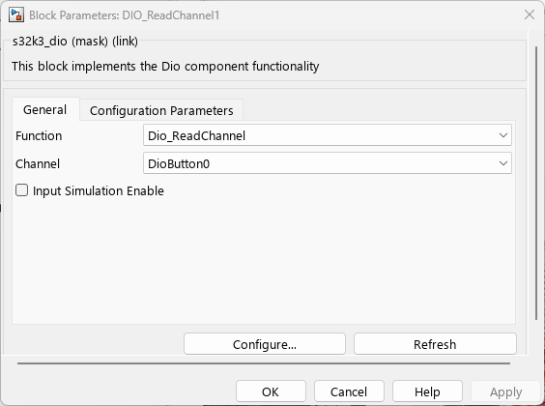
DIO Block – Basic Configuration
When double-clicking on a block, a window will pop-up with blocks configuration
Function parameter let the user to choose the equivalent RTD-based API function that will be called at code generation phase
Based on the chosen function, other block’s parameter will be available
For example, when we choose the Dio_ReadChannel Function, the Channel parameter is available.
You can choose which channel to use when reading the state. The available channels are configured externally via S32CT

Slide 12
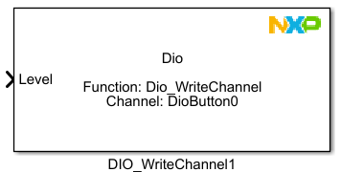
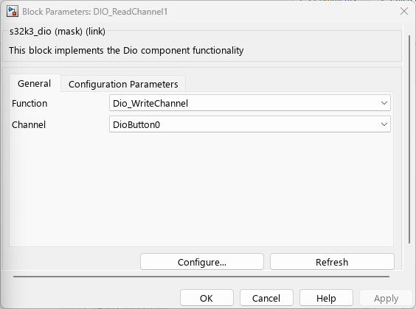
DIO Block – Basic Configuration
Now, you can observe that we changed the Function to Dio_WriteChannel
The block has changed its output port to a input port
This means that we need to provide a value to the block and it will update the state of the selected channel

Slide 13
Actuate a fan with a switch using DIO in Simulink
Practice

Slide 14
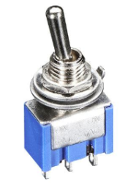
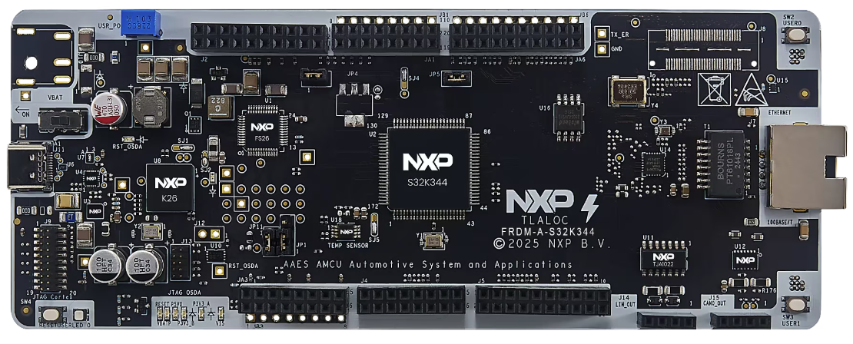
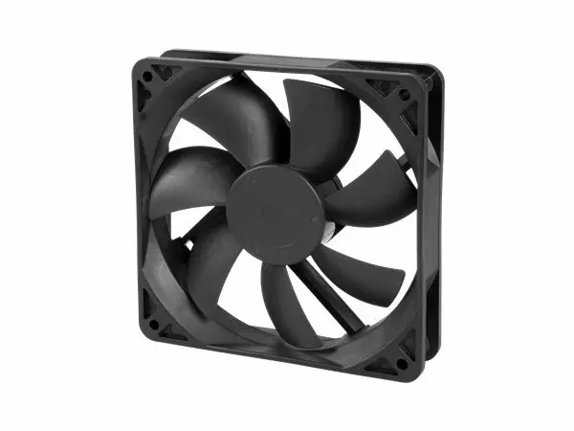
What we want to achieve?
Turn on the cooling fan when the switch is in ON position
Turn off the cooling fan when the switch is in OFF position
PTE11
PTC23
Button Switch
FRDM-A-S32K344
Cooling Fan

Slide 15
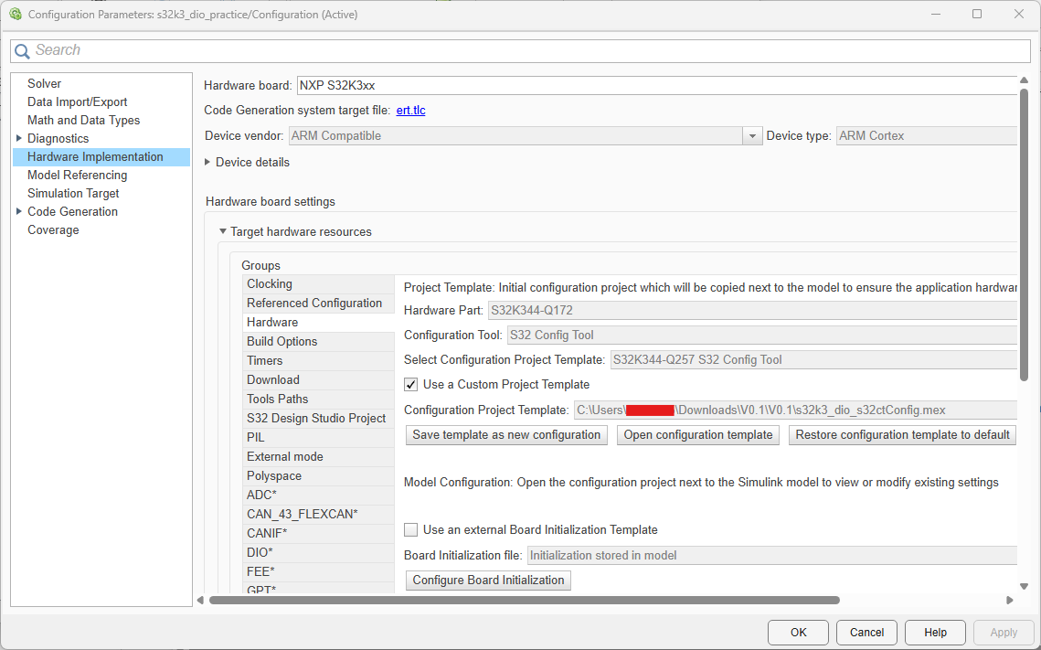
DIO Practice
What we need?
A DIO block for continuously reading the state of the PTE11 pin to know in which position is the switch
A DIO block to output the corresponding state of the PTC23 pin to actuate the fan
Create a new Simulink model
Set the Hardware Board to NXP S32K3xx
By default, the selected Hardware Part is S32K344-Q257 with S32 Configuration Tool as external configurator
Enable Use a Custom Project Template and Browse for the .mex file provided

Slide 16
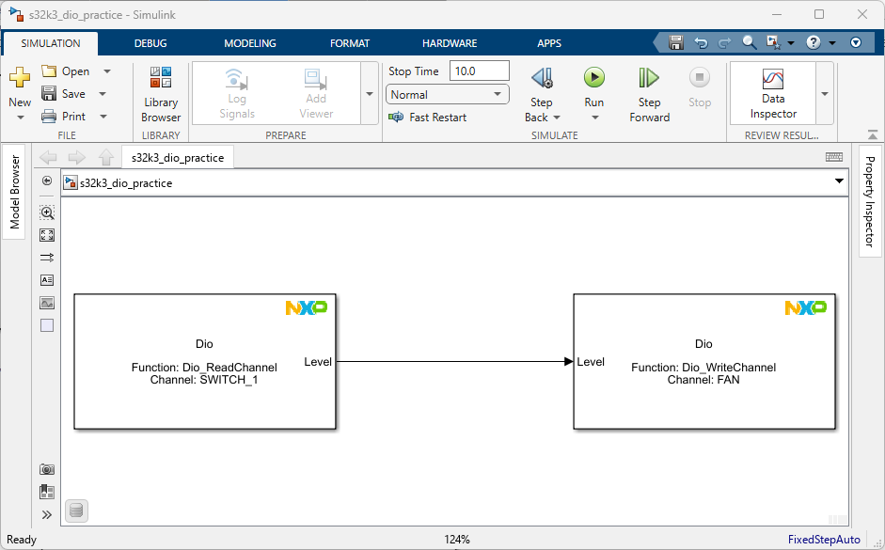
DIO Practice
Drag & Drop two DIO Blocks from NXP MBDT library
For the first block, double-click on it and select the Dio_ReadChannel function
Select as the Channel parameter the SWITCH_1 which corresponds to PTE11 pin
For the second block, double-click on it and select the Dio_WriteChannel function
Select as the Channel parameter the FAN which corresponds to PTC23 pin
Connect the 2 blocks

Slide 17
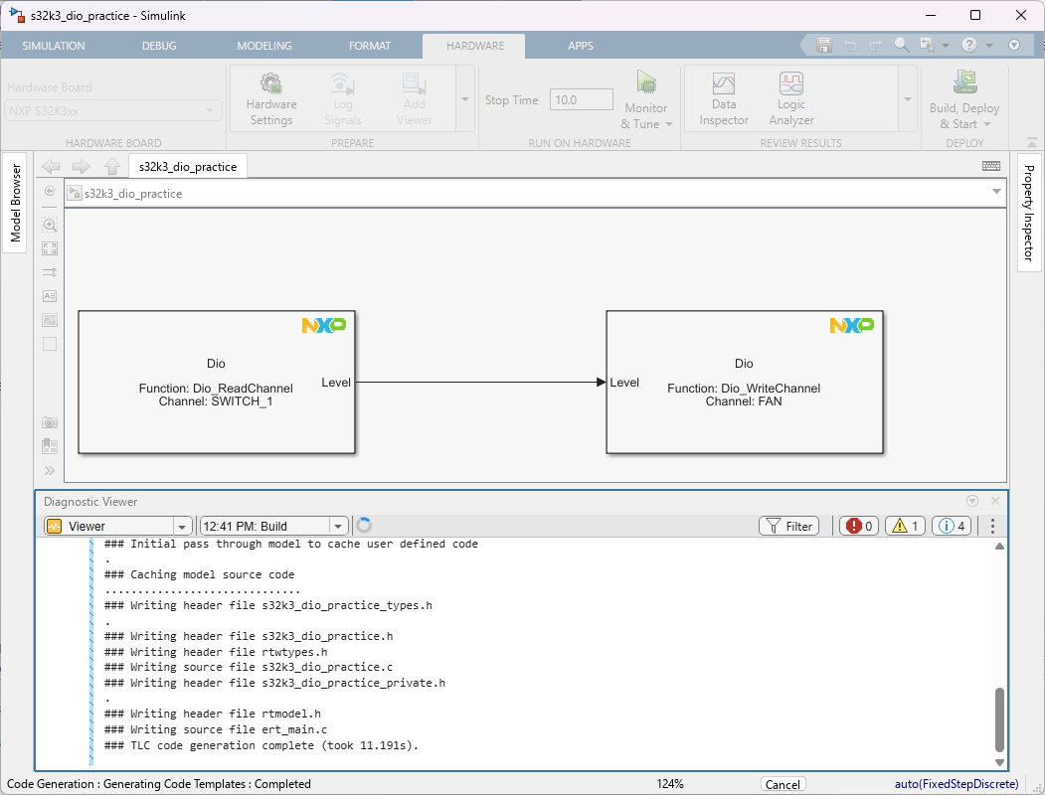
DIO Practice
Press the Build, Deploy & Start button.
After the code generation and build process is done, the application should be deployed on the target
You can test the logic of your application by changing the switch position and to check if the fan will spin
Q: How can we control how fast the fan spins?

Slide 18
Analog to Digital Converter
Measuring the Analog World

Slide 19
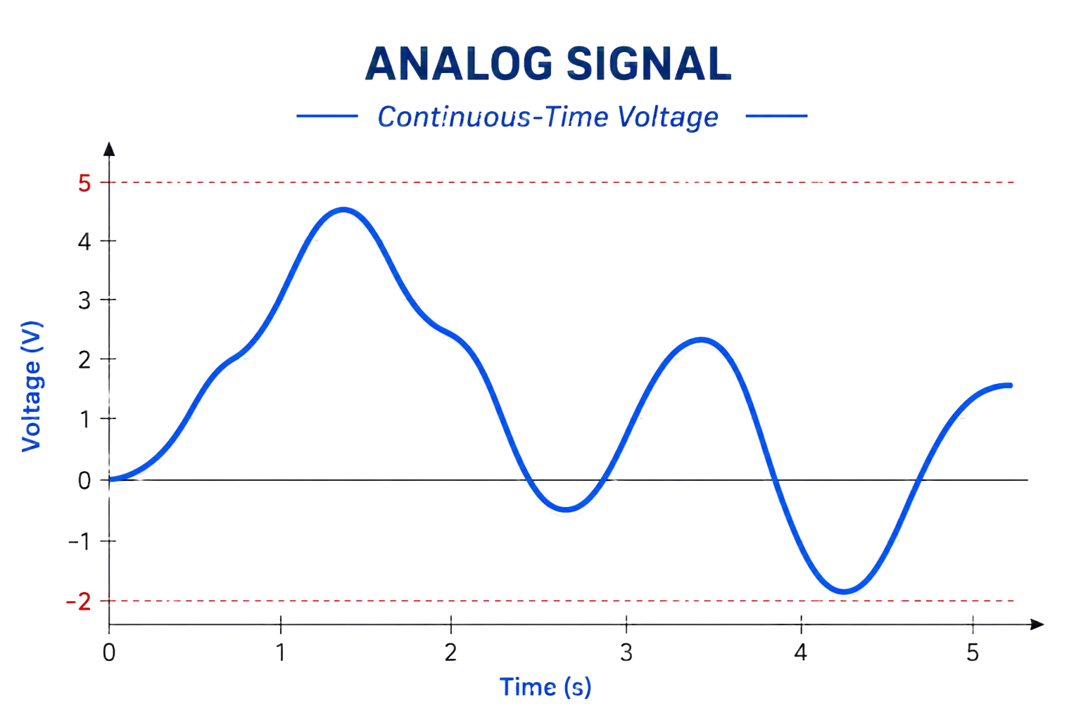
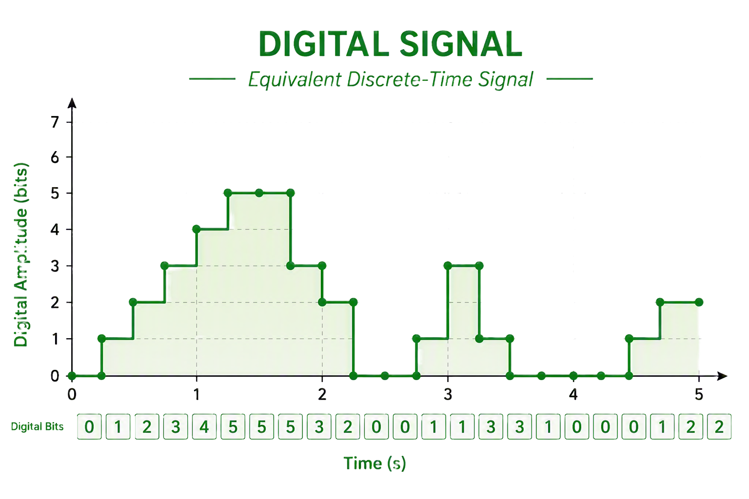
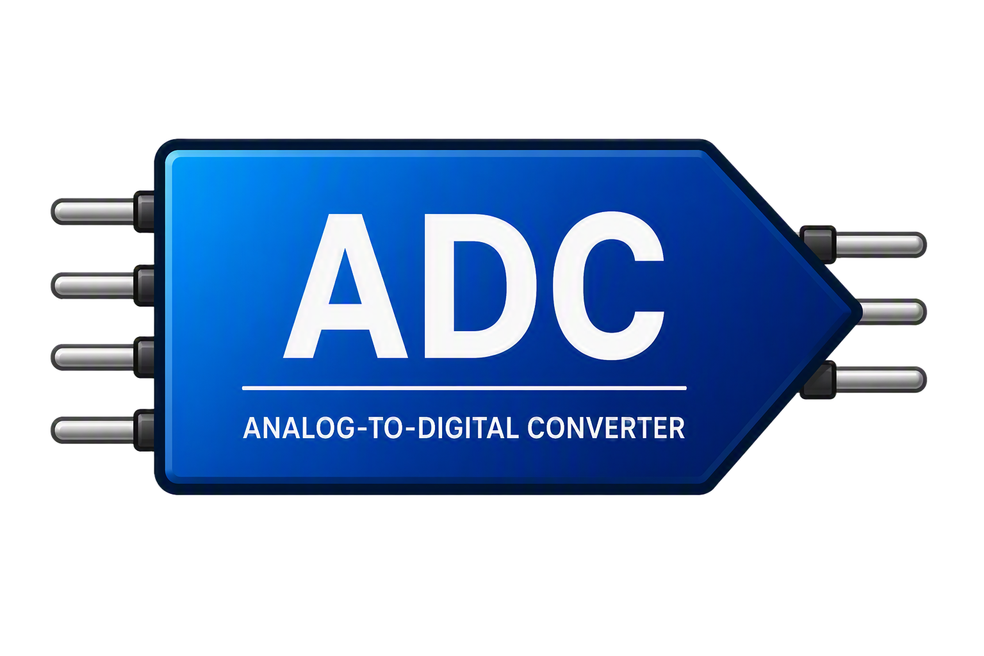
Analog to Digital Conversion - in a “nutshell”
An MCU works in digital domain, but physical world works in analog domain
What is an ADC?
MCU peripheral that translates an analog signal to a digital signal
An ADC periodically measures an analog voltage input and maps it to one of a finite number of digital output code

Slide 20
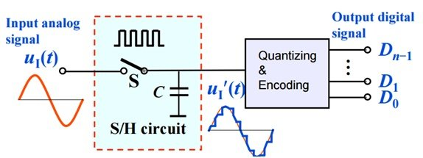
Analog to Digital Conversion - in a “nutshell”
Conversion Process
Sampling – captures the analog signal at discrete time intervals
Quantization – each sampled value is rounded to the nearest available ADC level
Encoding – the quantized value is converted into a binary number
Key Parameters
Resolution – number of bits for representation(2^{n})
  8-bit (256 levels)
  10-bit (1024 levels)
  12-bit (4096 levels)
Reference Voltage (Vref) – full measurement range
Sampling Rate – how fast the ADC takes measurement

Slide 21
Analog to Digital Conversion - in a “nutshell”
Common ADC Types
SAR-ADC
Sigma-Delta ADC
Flash ADC
Successive Approximation Register
Good accuracy
Moderate Speed
Low power
Current Sensing
Resolver interfaces
High precision
Very high resolution
Extremely fast
Higher cost
High power consumption

Slide 22
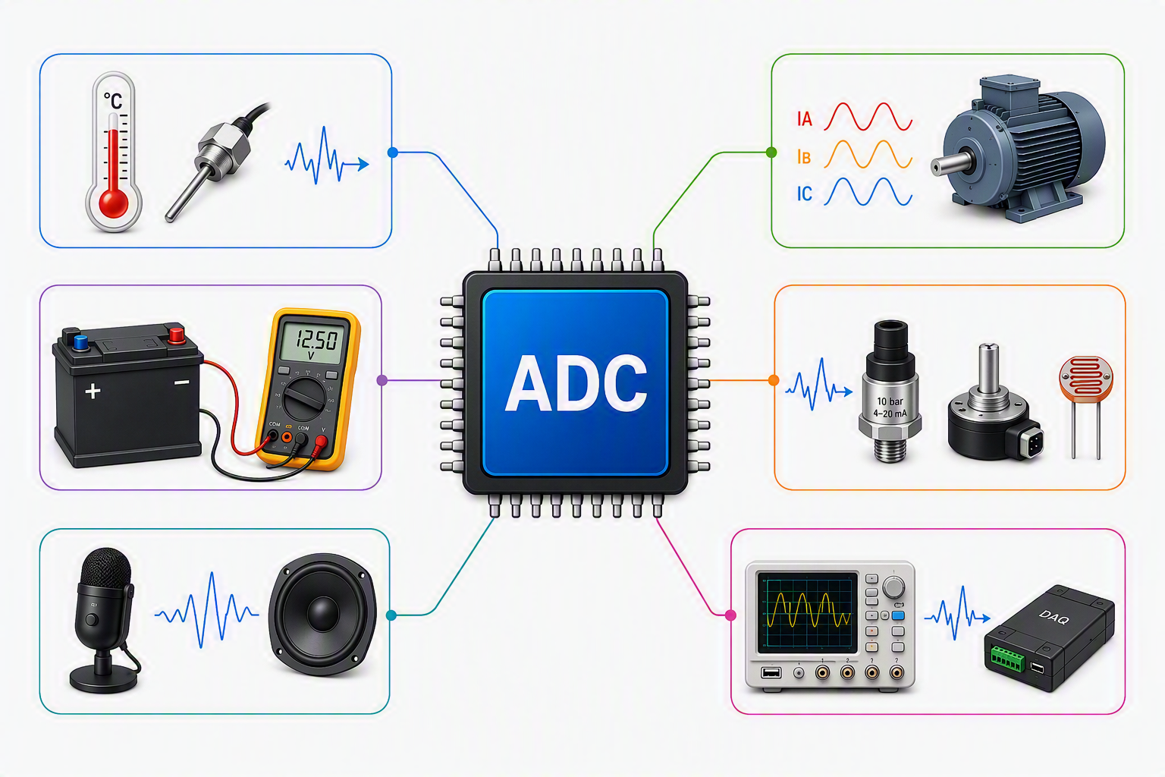
Analog to Digital Conversion - in a “nutshell”
Examples of ADC Applications
Temperature Measurement
NTC, thermocouple
Motor Control
Measures phase currents and voltages for precise control of motors
Battery Monitoring
Measure battery voltage and current (BMS)
Sensor Interfacing
Interfaces with analog sensors like pressure, position, light, etc.
Audio Signal Processing
Converts analog audio signal to digital for processing
Data Acquisition
Used in measurement systems to capture real data for analysis and logging

Slide 23
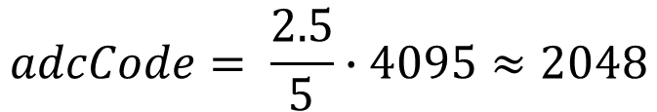
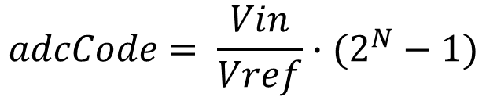
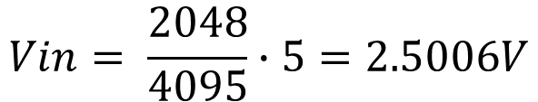
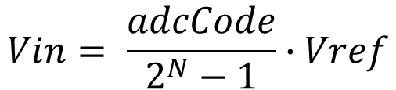
Analog to Digital Conversion - in a “nutshell”
Analog Voltage -> Digital Code
Digital Code -> Analog Voltage
$$adcCode= \frac{Vin}{Vref}∙(2^{N}−1)$$
$$Vin= \frac{adcCode}{2^{N}−1}∙Vref$$
Example (12-bit ADC)
Vref = 5V
Vin = 2.5V
N = 12
Example (12-bit ADC)
adcCode = 2048
Vref = 5V
N = 12
$$adcCode= \frac{2.5}{5}∙4095≈2048$$
$$Vin= \frac{2048}{4095}∙5=2.5006V$$
Vin – measured analog voltage
Vref – ADC reference voltage
N – ADC resolution
adcCode – digital output value

Slide 24
ADC in Simulink
Bringing real-world signals into your model

Slide 25
Explore the Simulink Library Browser
In any Simulink model, go to SIMULATION tab and open the Library Browser.
Expand the NXP Model-Based Design Toolbox for S32K3 and open the S32K3 Core, System, Peripherals and Utilities library
Expand the IO Blocks that includes Dio, Adc, Icu and Pwm NXP blocks

Slide 26
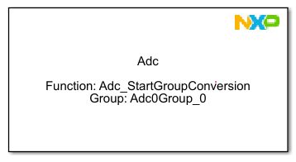
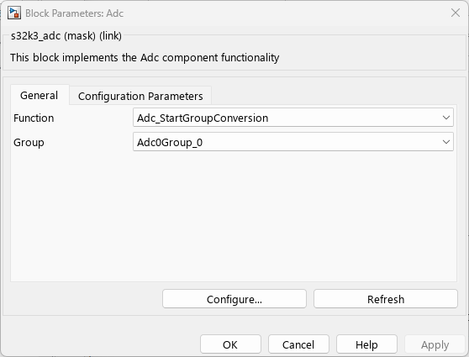
ADC Block – Triggering a measurement
Imagine taking a photo with a camera. Adc_StartGroupConversion is pressing the shutter button
This function tells the ADC peripheral to start converting one ore more configured channels
Starts an ADC conversion on a configured Group
Does not return a measurement value
Triggers the ADC hardware
Can convert one or multiple channels in a group
Usually called periodically, on demand, before reading ADC results

Slide 27
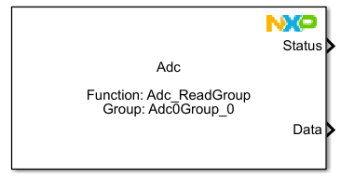
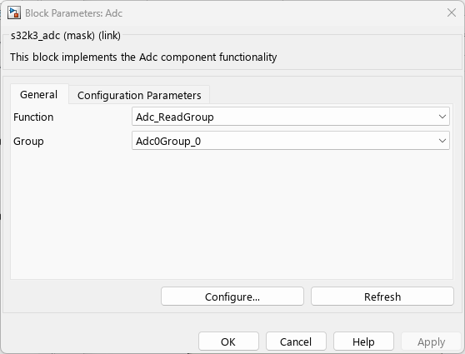
ADC Block – Retrieving the Conversion Results
Adc_ReadGroup is opening the gallery and viewing the photo after captured it
This function reads the digital values generated by ADC conversion
Reads converted ADC samples
Returns digital values
Reads all channels belonging to a group
Output can be voltage measurement, potentiometer position, temperature sensor value, current sensor value
Data returned ready for further processing

Slide 28
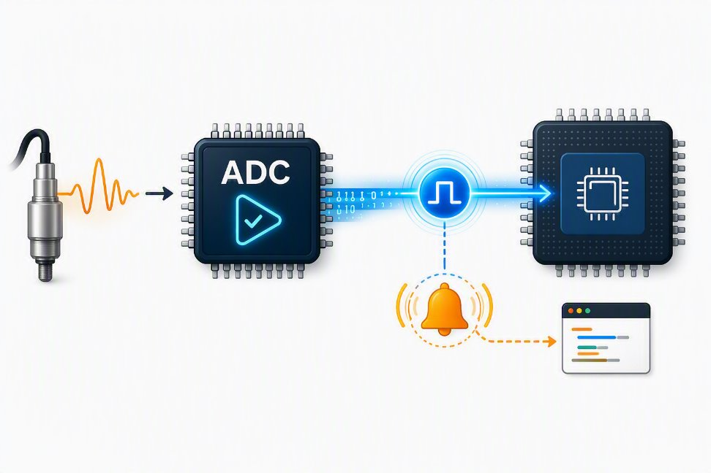




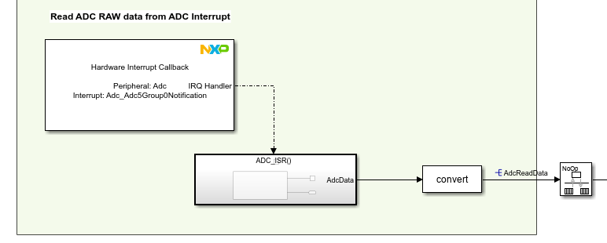
ADC Interrupts – Get notified when an ADC Group conversion is complete
Enable Notification
Start Conversion
ADC Converts
Callback Runs
Per-group control
The notification mechanism is enabled only for selected ADC group
Completion callback
The configured group callback is called when conversion completes
CPU efficiency
The application can continue other work instead of repeatedly polling ADC status
POLLING
NOTIFICATION
WHEN TO USE
CPU keep asking
VS
Interrupt-driven acquisition
ADC tells the CPU when conversion complete

Slide 29
Read a Potentiometer value in Simulink
Practice

Slide 30
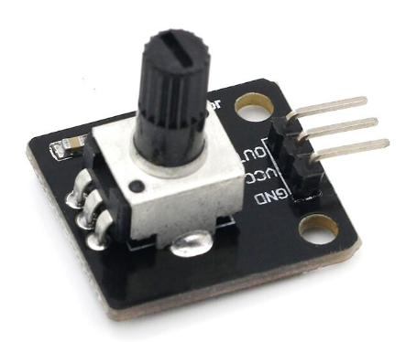

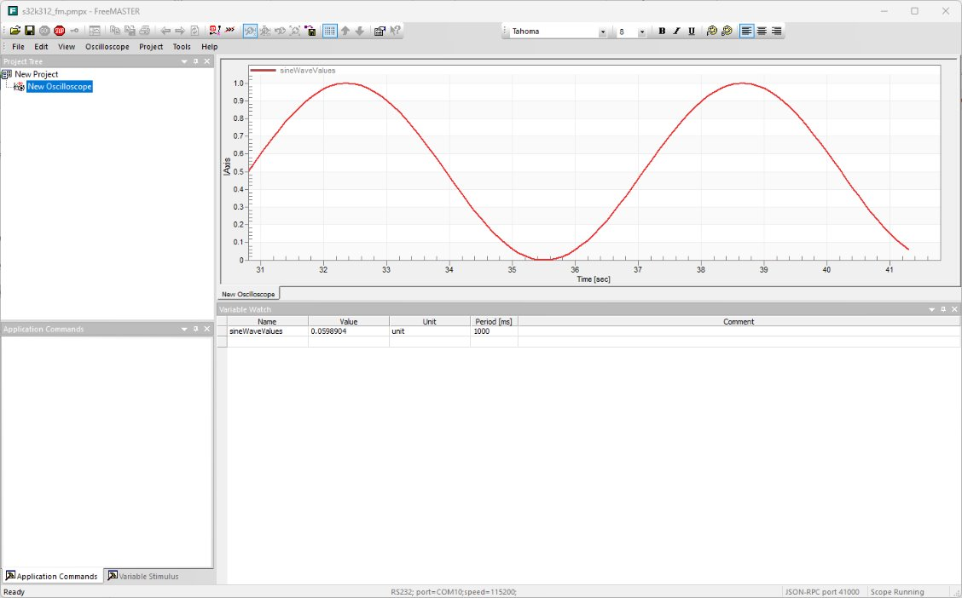
What we want to achieve?
VCC
PTA7
GND
FRDM-A-S32K344
FreeMASTER
UART

Slide 31
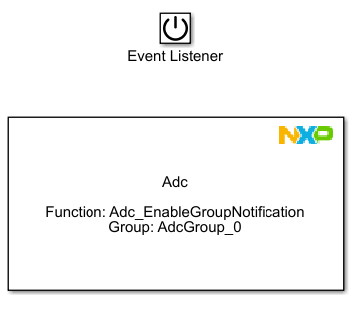
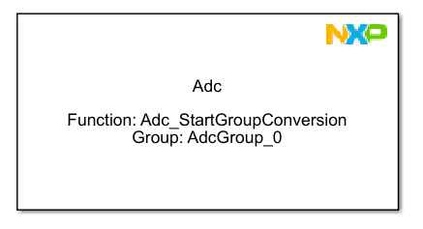
ADC Practice – Enable Group Notification & Start Group Conversion
In a Simulink model already configured for S32K3 hardware, add an ADC block from NXP MBDT library.
Select Adc_StartGroupConversion function and select as Group parameter the AdcGroup_0 which is already pre-configured with PTA7 as ADC channel input.
In an Initialize subsystem add another ADC block and select Adc_EnableGroupNotification function. Choose the same AdcGroup_0 group.

Slide 32
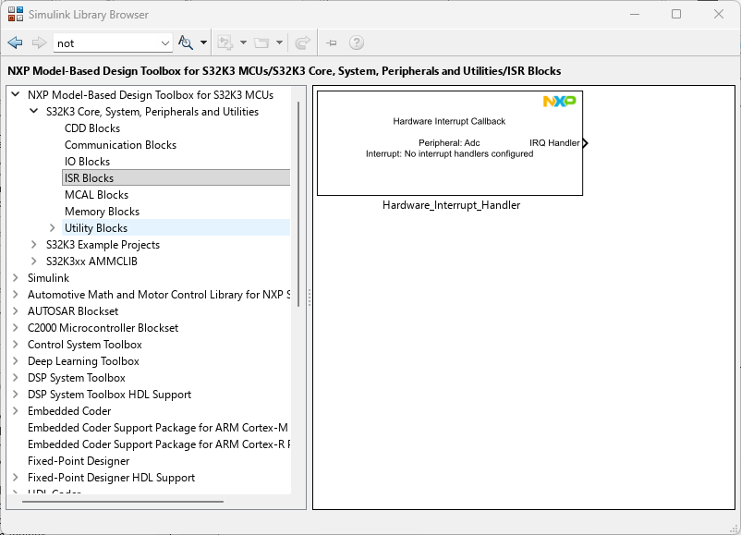
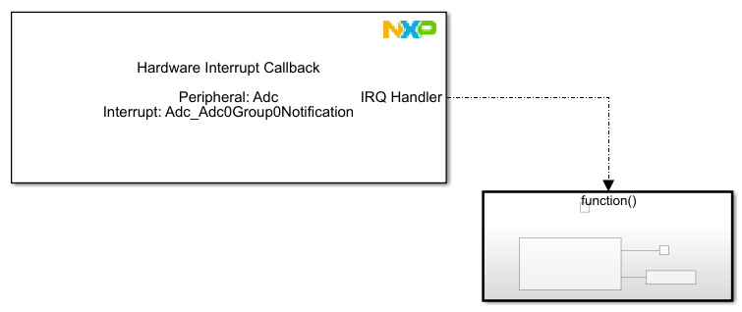
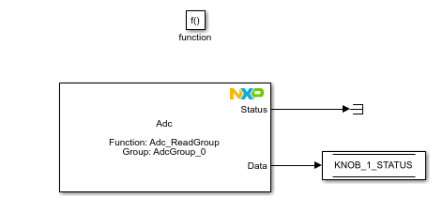
ADC Practice – Data Acquisition
From Library Browser, drag & drop the NXP ISR Block.
Select the Adc as Peripheral and Adc_Adc0Group0Notification as Interrupt.
Connect this block to a function call subsystem.
Add an ADC block within the newly created function call subsystem and select the Adc_ReadGroup function and the AdcGroup_0 group used for gathering the data from potentiometer.
Route the output from this block to a data store memory.

Slide 33
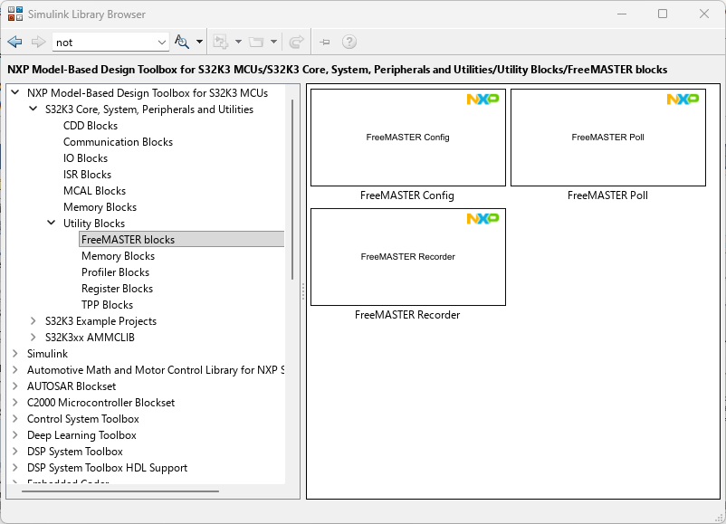
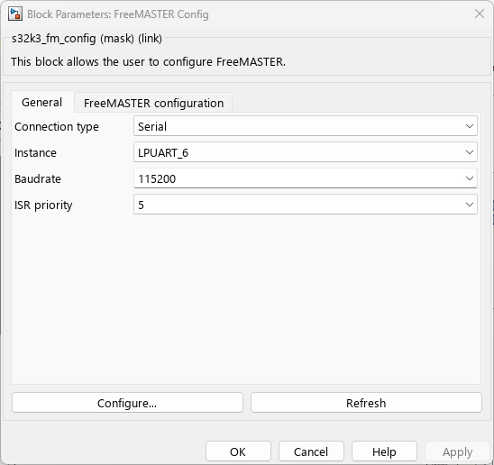
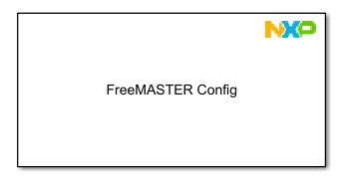
ADC Practice – FreeMASTER Configuration
From Library Browser, drag & drop the NXP FreeMASTER Config block from Utility Library.
You can let the default configuration parameters as they are

Slide 34
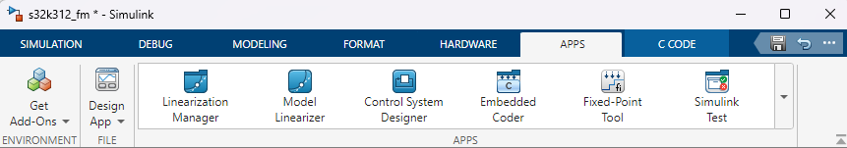
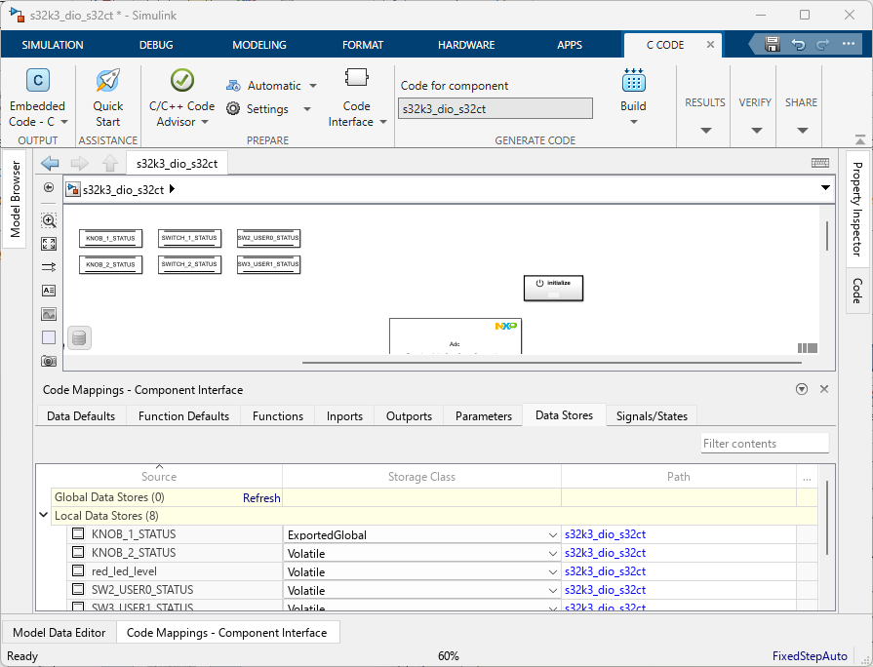
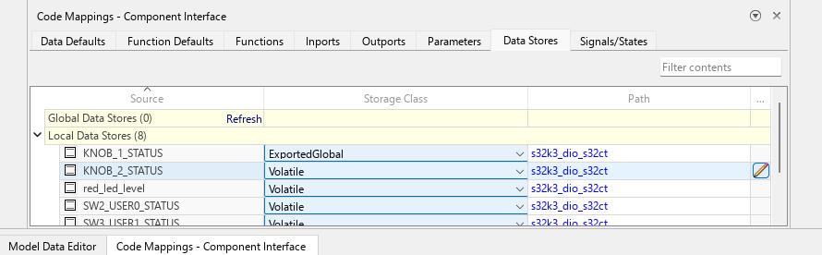
ADC Practice – FreeMASTER Configuration
From the APPS tab open the Embedded Coder in the “C CODE” tab open the “Code Mappings – Component Interface”.
Select the “Data Stores” tab in the Code Mappings interface.
Change the storage class of your data store to ExportedGlobal.

Slide 35
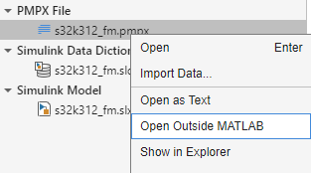
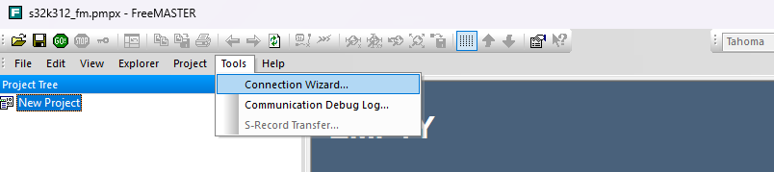
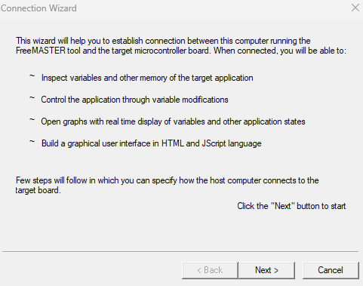
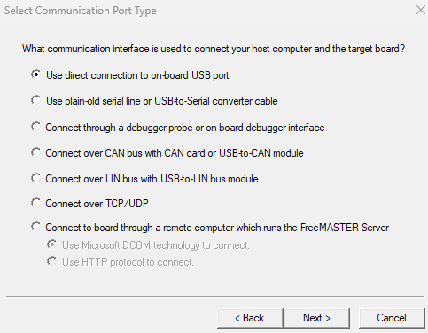
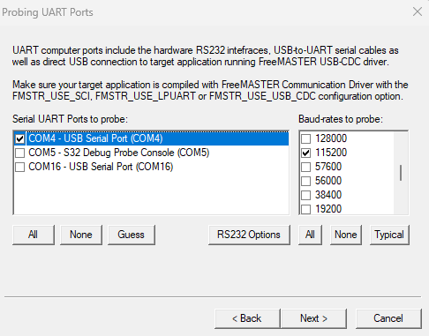

ADC Practice – FreeMASTER Configuration
After a successful build of the model and the elf being downloaded to the EVB, we can monitor the execution on FreeMASTER
Open The FreeMASTER application
In Tools select connection wizard
Follow the step to set the COM port of the board and baudrate at 115200

Slide 36



ADC Practice – FreeMASTER Configuration
After successfully connecting the board, the elf file needs to be added to the FreeMASTER configuration
Click on YES on the pop up window
Provide path to elf file
Check that the board is properly connected
PATH to elf file

Slide 37





ADC Practice – FreeMASTER
2.
1.
4.
Right Click on New Project then Create Oscilloscope
Select Variables view then click on Add Variable
Click on the 3 dots button to create a new variable to Variables List
Click on New and type the name of the data store memory and in Address select the name of your created variable then click OK
3.
5.
6.
7.
8.
10.
9.

Slide 38
Schematics
JA1[4] – PTA7 -> KNOB_1
JA1[6] – PTE10 -> KNOB_2
JA1[8] – PTE11 -> SWITCH_1
JA1[10] – PTA17 -> SWITCH_2
JA1[12] – PTC23 -> FAN (DIO)
J2[4] – PTA12 -> FAN (PWM)
JA3[11] – VCC (5V)
JA3[13] - GND
PTA12
PTC23
PTA17
PTE11
PTE10
PTA7
J2
JA1
JA3
VCC
GND

