Slide 1
Analysis of CARTool Data
Notes:
COVER SLIDE – USE THIS COVER SLIDE IF YOU HAVE NO PICTURE OR IF YOU HAVE MULTIPLE PICTURES
SLIDE DE CAPA - USE ESTE SLIDE SE NÃO TEM NENHUMA IMAGEM PARA COLOCAR OU SE TEM MAIS DO QUE UMA

Slide 2
Data (for analysis)
Input:
Date
Run
Donor
Notes
Agitation_Strategy (more complete than agitation column), but needs to be merged
System
Agitation
Activation_Reagent
Activation_Time
Cells_per_Microbeads (only valid if activation_reagent is microBeads)
DO_Activation
DO_Expansion
Cytokine_Supplementation
Inocolum
Volume
Feeding_Strategy
pH_Strategy
Type
Output:
VCD
Viability
Lac
Glc
CD25
CD69
PD-1
TIM-3
LAG-3
Naive_Memory
Central_Memory
Effector_Memory
Effector
IFN-y
TNF-a
IFN-y+ TNF-a+
CD4/CD8​
To add cell subpopulation

Slide 3
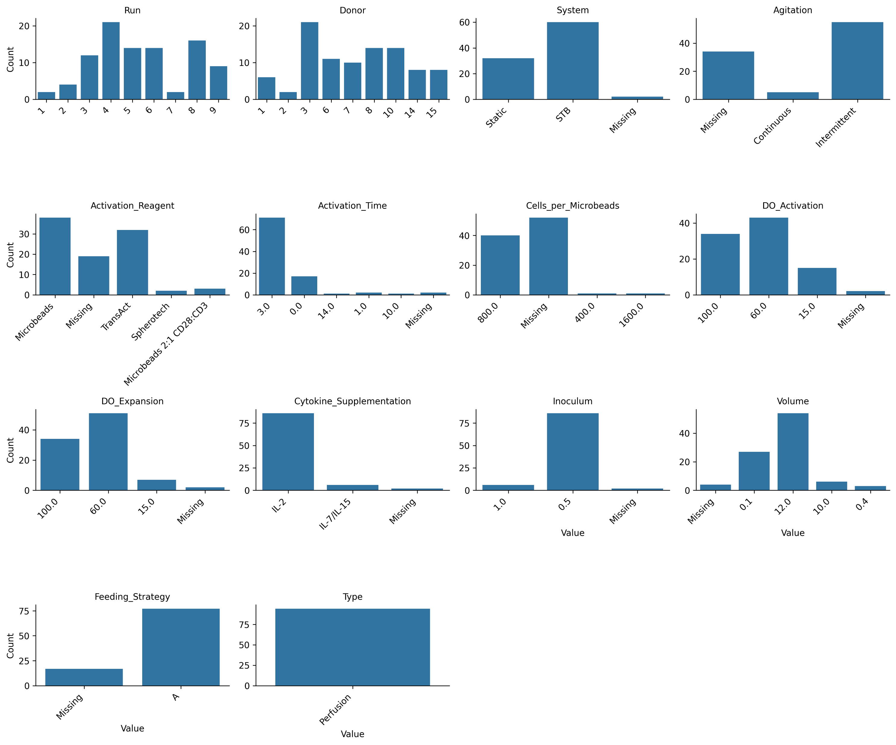
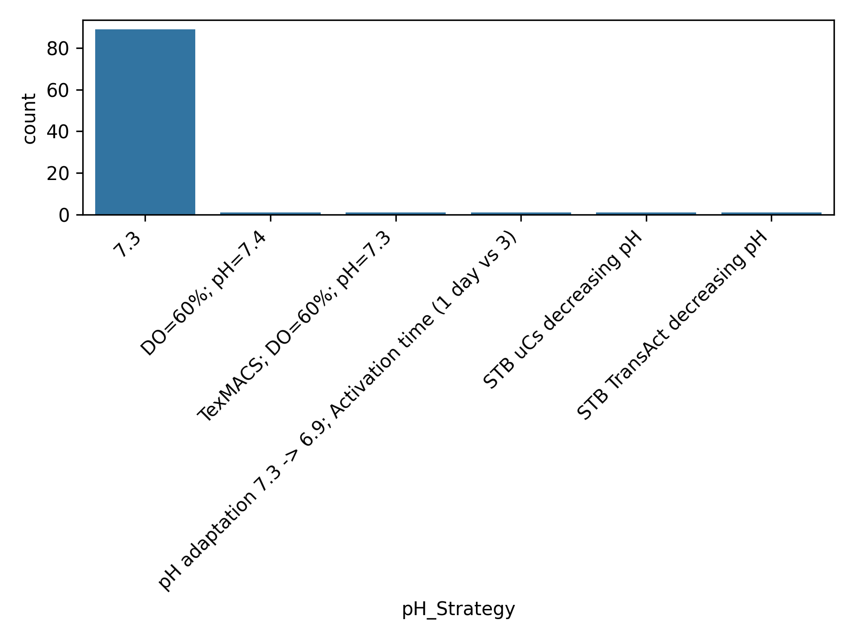
EDA – Univariate Analysis
Count plots of categorical input variables
There is a considerable amount of Agitation and Activation rows that are missing. Moreover, they will focus on continuous agitation, and we don’t have much data about it

Slide 4
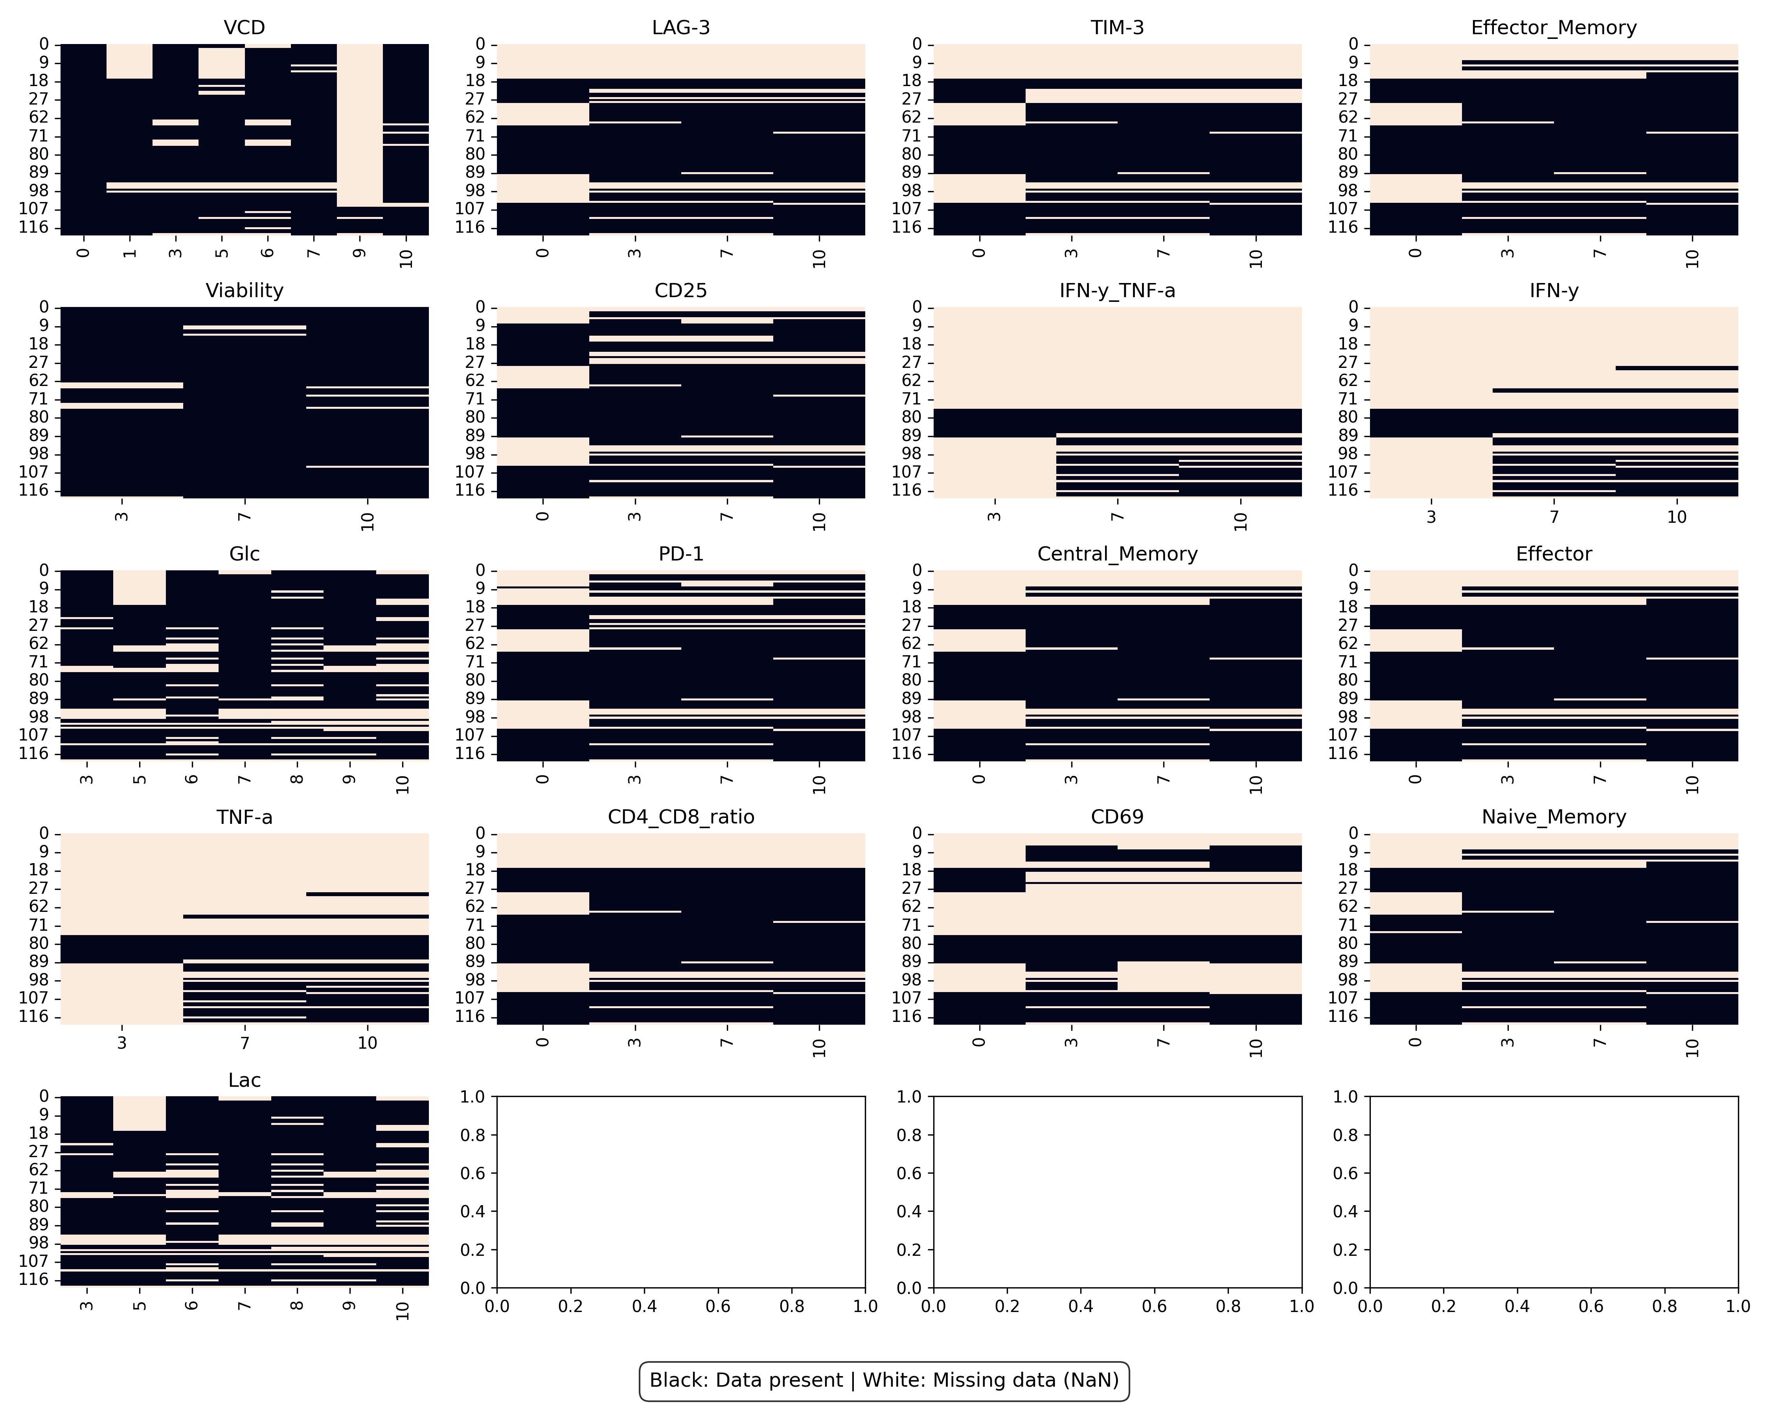
EDA – Univariate Analysis
Missing data of output variables (all numerical)
There is a considerable amount of data missing for the first rows, which are the first runs, might not be too impactful, since we want to focus the modelling on the most recent runs.

Slide 5
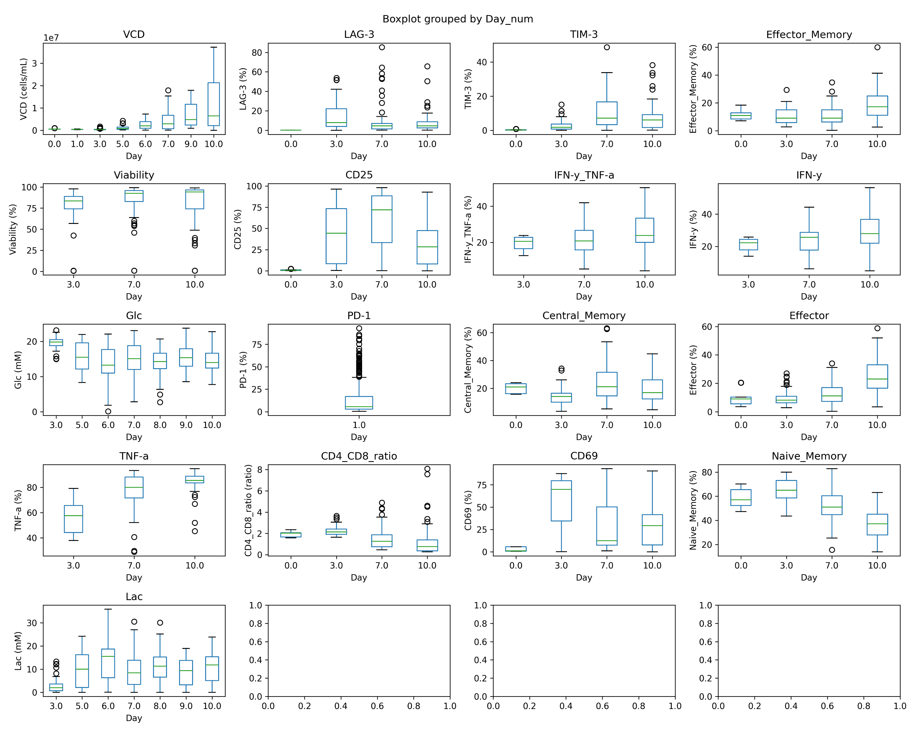
EDA – Univariate Analysis
Boxplot of output variables
There is a considerable dispersion of the data, which should make sense, we are looking into very different experimental conditions.
For the exception of VCD, variables are more or less in the same order of magnitude.

Slide 7
Modelling Brainstorm
Notes:
SEPARADOR 2

Slide 8
Modelling
How CPPs influence product quality and yield
Phenotopyc distribution
VCC
CD4/CD8 ratio
Exhaustion markers
Optimize
Can we determine the inputs that lead to a desired output?
Can be a dynamic or a “static” solution
Can use a dynamic model or a “static model”
Actuate
Can we monitor, predict and ajust inputs in real time to maintain control?
Based on inputs at time t, can we predict output t+1 and change input value to lead the process to the desired output
Requires a dynamic model

