Slide 1
Vehicle detection from color images
Militaru Cristian
Gr. 30431

Slide 2
1. Possible solutions

Slide 3
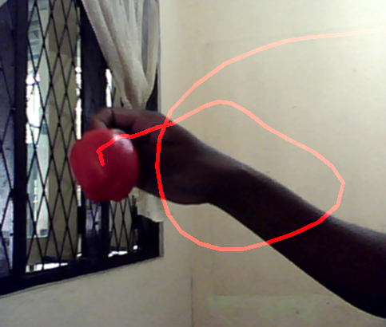

Color-based detection
Simple
Requires to know the color range of the object
Implementation in OpenCV
Fig: Tracking (up) and
segmentation of the apple (bottom).

Slide 4
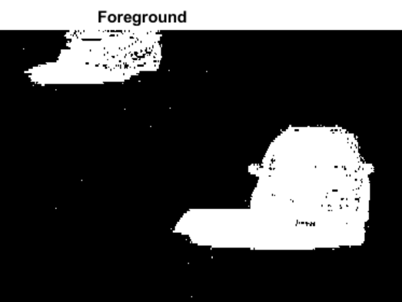
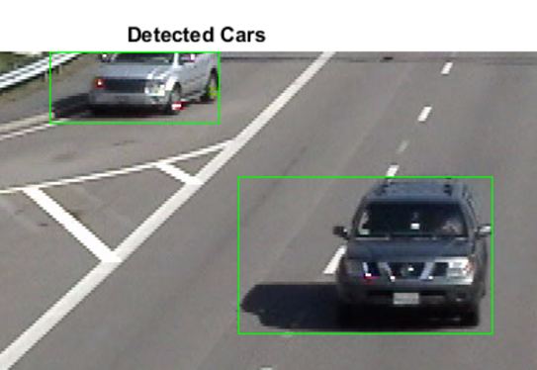
Detecting Cars Using Gaussian Mixture Models
Requires a video from a stationary camera
Extracts the foreground from the background
The foreground detector is trained from the first frames of the video.
Implementation in MatLab

Slide 5
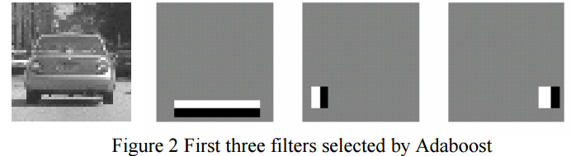
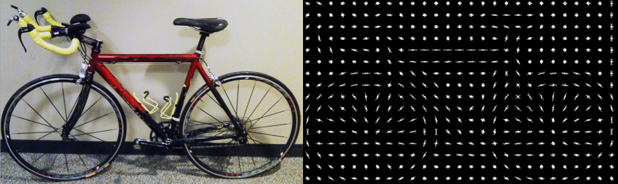
Cascade Object Detector
It requires only images (positive – containing the object - and negative).
It works best if the object is viewed from the same side.
Does it work only with grayscale images?
Is it scale invariant?
Implementation in MatLab
Haar features
Histogram of oriented gradient features

Slide 6
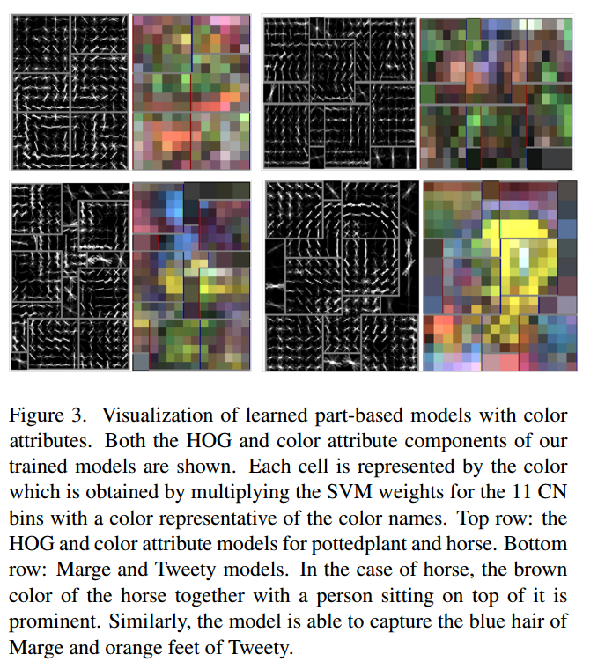
Using Color for Object Recognition
Works with images.
Requires color constancy: the effect of different natural lightings should be eliminated. [see this - requires multiple polarized images - or this - complicated - or this - simple]
„In this project we focus on fine-grained visual object categories in which the categories are somewhat similar to each other and focus is on the little differences between the categories.” It is not color invariant. (the classes of birds can be determined using color, but for vehicles the color is irrelevant).
Another approach is presented here

Slide 7
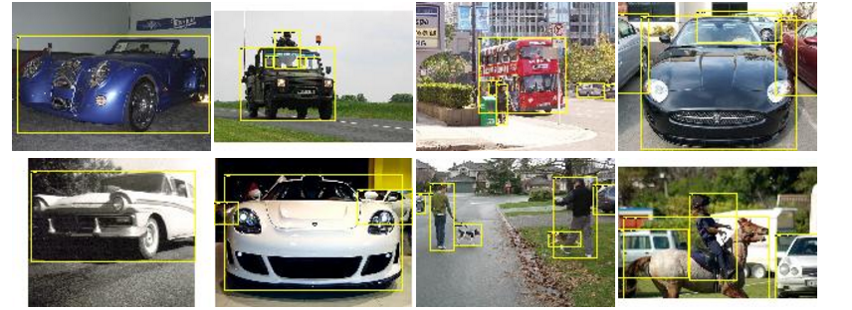
2. Datasets
PASCAL VOC challenges: annotated images with different classes of objects (including cars)

