Slide 1

Apache Flink APIs DataSet / DataStream
Timo Walther Flink Committer, PMC Member
twalthr@apache.org

Slide 2
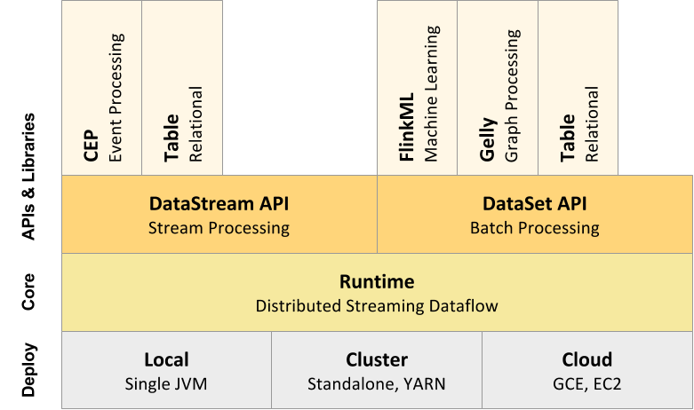
Overview / Flink Stack

Slide 3
DataSet API

Slide 4
Example: WordCount
public static void main(String[] args) throws Exception {
// set up the execution environment
final ExecutionEnvironment env = ExecutionEnvironment.getExecutionEnvironment();
// get input data either from file or use example data
DataSet<String> inputText = env.readTextFile(args[0]);
DataSet<Tuple2<String, Integer>> counts =
// split up the lines in tuples containing: (word,1)
inputText.flatMap(new Tokenizer())
// group by the tuple field "0"
.groupBy(0)
//sum up tuple field "1"
.reduceGroup(new SumWords());
// emit result
counts.writeAsCsv(args[1], "\n", " ");
// execute program
env.execute("WordCount Example");
}

Slide 5
Execution Environment
public static void main(String[] args) throws Exception {
// set up the execution environment
final ExecutionEnvironment env = ExecutionEnvironment.getExecutionEnvironment();
// get input data either from file or use example data
DataSet<String> inputText = env.readTextFile(args[0]);
DataSet<Tuple2<String, Integer>> counts =
// split up the lines in tuples containing: (word,1)
inputText.flatMap(new Tokenizer())
// group by the tuple field "0"
.groupBy(0)
//sum up tuple field "1"
.reduceGroup(new SumWords());
// emit result
counts.writeAsCsv(args[1], "\n", " ");
// execute program
env.execute("WordCount Example");
}

Slide 6
Data Sources
public static void main(String[] args) throws Exception {
// set up the execution environment
final ExecutionEnvironment env = ExecutionEnvironment.getExecutionEnvironment();
// get input data either from file or use example data
DataSet<String> inputText = env.readTextFile(args[0]);
DataSet<Tuple2<String, Integer>> counts =
// split up the lines in tuples containing: (word,1)
inputText.flatMap(new Tokenizer())
// group by the tuple field "0"
.groupBy(0)
//sum up tuple field "1"
.reduceGroup(new SumWords());
// emit result
counts.writeAsCsv(args[1], "\n", " ");
// execute program
env.execute("WordCount Example");
}
Notes:
Text
readTextFile(“/path/to/file”)
CSV
readCsvFile(“/path/to/file”)
Collection
fromCollection(collection)
fromElements(1,2,3,4,5)

Slide 7
Data types
public static void main(String[] args) throws Exception {
// set up the execution environment
final ExecutionEnvironment env = ExecutionEnvironment.getExecutionEnvironment();
// get input data either from file or use example data
DataSet<String> inputText = env.readTextFile(args[0]);
DataSet<Tuple2<String, Integer>> counts =
// split up the lines in tuples containing: (word,1)
inputText.flatMap(new Tokenizer())
// group by the tuple field "0"
.groupBy(0)
//sum up tuple field "1"
.reduceGroup(new SumWords());
// emit result
counts.writeAsCsv(args[1], "\n", " ");
// execute program
env.execute("WordCount Example");
}

Slide 8
Transformations
public static void main(String[] args) throws Exception {
// set up the execution environment
final ExecutionEnvironment env = ExecutionEnvironment.getExecutionEnvironment();
// get input data either from file or use example data
DataSet<String> inputText = env.readTextFile(args[0]);
DataSet<Tuple2<String, Integer>> counts =
// split up the lines in tuples containing: (word,1)
inputText.flatMap(new Tokenizer())
// group by the tuple field "0"
.groupBy(0)
//sum up tuple field "1"
.reduceGroup(new SumWords());
// emit result
counts.writeAsCsv(args[1], "\n", " ");
// execute program
env.execute("WordCount Example");
}

Slide 9
User functions
public static void main(String[] args) throws Exception {
// set up the execution environment
final ExecutionEnvironment env = ExecutionEnvironment.getExecutionEnvironment();
// get input data either from file or use example data
DataSet<String> inputText = env.readTextFile(args[0]);
DataSet<Tuple2<String, Integer>> counts =
// split up the lines in tuples containing: (word,1)
inputText.flatMap(new Tokenizer())
// group by the tuple field "0"
.groupBy(0)
//sum up tuple field "1"
.reduceGroup(new SumWords());
// emit result
counts.writeAsCsv(args[1], "\n", " ");
// execute program
env.execute("WordCount Example");
}

Slide 10
DataSinks
public static void main(String[] args) throws Exception {
// set up the execution environment
final ExecutionEnvironment env = ExecutionEnvironment.getExecutionEnvironment();
// get input data either from file or use example data
DataSet<String> inputText = env.readTextFile(args[0]);
DataSet<Tuple2<String, Integer>> counts =
// split up the lines in tuples containing: (word,1)
inputText.flatMap(new Tokenizer())
// group by the tuple field "0"
.groupBy(0)
//sum up tuple field "1"
.reduceGroup(new SumWords());
// emit result
counts.writeAsCsv(args[1], "\n", " ");
// execute program
env.execute("WordCount Example");
}
Notes:
Text
writeAsText(“/path/to/file”)
writeAsFormattedText(“/path/to/file”,
formatFunction)
CSV
writeAsCsv(“/path/to/file”)
Return data to the Client
Print()
Collect()
Count()

Slide 11
Execute!
public static void main(String[] args) throws Exception {
// set up the execution environment
final ExecutionEnvironment env = ExecutionEnvironment.getExecutionEnvironment();
// get input data either from file or use example data
DataSet<String> inputText = env.readTextFile(args[0]);
DataSet<Tuple2<String, Integer>> counts =
// split up the lines in tuples containing: (word,1)
inputText.flatMap(new Tokenizer())
// group by the tuple field "0"
.groupBy(0)
//sum up tuple field "1"
.reduceGroup(new SumWords());
// emit result
counts.writeAsCsv(args[1], "\n", " ");
// execute program
env.execute("WordCount Example");
}
Notes:
Print()
Collect()
Count()

Slide 12
User function example: Map
public static class Tokenizer implements FlatMapFunction<String, Tuple2<String, Integer>> {
@Override
public void flatMap(String value, Collector<Tuple2<String, Integer>> out) {
// normalize and split the line
String[] tokens = value.toLowerCase().split("\\W+");
// emit the pairs
for (String token : tokens) {
if (token.length() > 0) {
out.collect(new Tuple2<String, Integer>(token, 1));
}
}
}
}

Slide 13
User function example: Map
public static class Tokenizer implements FlatMapFunction<String, Tuple2<String, Integer>> {
@Override
public void flatMap(String value, Collector<Tuple2<String, Integer>> out) {
// normalize and split the line
String[] tokens = value.toLowerCase().split("\\W+");
// emit the pairs
for (String token : tokens) {
if (token.length() > 0) {
out.collect(new Tuple2<String, Integer>(token, 1));
}
}
}
}

Slide 14
User function example: Reduce
public static class SumWords
implements GroupReduceFunction<Tuple2<String, Integer>, Tuple2<String, Integer>> {
@Override
public void reduce(Iterable<Tuple2<String, Integer>> values,
Collector<Tuple2<String, Integer>> out) {
int count = 0;
String word = null;
for (Tuple2<String, Integer> tuple : values) {
word = tuple.f0;
count++;
}
out.collect(new Tuple2<String, Integer>(word, count));
}
}

Slide 15
Important Operators: .map()
// Takes one element and produces one element.
DataSet<Integer> tokenized = text.map(new MapFunction<String, Integer>() {
@Override
public Integer map(String value) {
return Integer.parseInt(value);
}
}); DataSet<ExperimentResult> converted = text.map( new MapFunction<String, ExperimentResult>() { ... });
static class ExperimentResult {
public String name;
public Tuple2<String, Long>[] parameters;
public int result;
}

Slide 16
.flatMap(), .filter(),
// Takes one element and produces zero, one, or more elements.
data.flatMap(new FlatMapFunction<String, String>() {
public void flatMap(String value, Collector<String> out) {
for (String s : value.split(" ")) {
out.collect(s);
}
}
});
// Retains those elements for which the function returns true.
data.filter(new FilterFunction<Integer>() {
public boolean filter(Integer value) { return value > 1000; }
});

Slide 17
.join()
DataSet<ExperimentResult> input1= ...
DataSet<ExperimentResult> input2= ...
// Joins two data sets by creating all pairs of elements that are equal on
// their keys.
DataSet<Tuple2<ExperimentResult, ExperimentResult>> =
input1.join(input2)
.where("name") // key of the first input
.equalTo("name"); // key of the second input
DataSet<ExperimentResult> =
input1.join(input2)
.where("name") // key of the first input
.equalTo("name") // key of the second input
.with(...);

Slide 18
.reduce(), .reduceGroup()
// Combines a group of elements into a single element.
number.reduce(new ReduceFunction<Integer> {
public Integer reduce(Integer a, Integer b) { return a + b; }
});
// Combines a group of elements into one or more elements.
data
.groupBy("name")
.reduceGroup(new GroupReduceFunction<Integer, Integer> {
public void reduce(Iterable<Integer> values, Collector<Integer> out) {
int sum = 0;
for (Integer i : values) sum++;
out.collect(sum);
}
});

Slide 19
DataStream API

Slide 20
Example: Window WordCount
public static void main(String[] args) throws Exception {
// set up the execution environment
final StreamExecutionEnvironment env = StreamExecutionEnvironment.getExecutionEnvironment();
// configure event time
env.setStreamTimeCharacteristic(TimeCharacteristic.EventTime);
DataStream<Tuple2<String, Integer>> counts = env
// read stream of words from socket
.socketTextStream("localhost", 9999)
// split up the lines in tuples containing: (word,1)
.flatMap(new Splitter())
// key stream by the tuple field "0”
.keyBy(0)
// compute counts every 5 minutes
.timeWindow(Time.minutes(5))
//sum up tuple field "1"
.sum(1);
// print result in command line and execute program
counts.print(); env.execute("Socket WordCount Example");
}

Slide 21
DataSources
// read text socket from port
DataStream<String> socketLines = env.socketTextStream("localhost", 9999);
// read a text file ingesting new elements every 100 milliseconds
DataStream<String> localLines =
env.readFileStream("/path/to/file", 100, WatchType.PROCESS_ONLY_APPENDED);
// read data stream from custom source function
DataStream<<Tuple2<Long, String> stream = env.addSource(new MySourceFunction());
// read data from many stream serving systems such as Apache Kafka
Properties properties = new Properties();
properties.setProperty("bootstrap.servers", "localhost:9092"); properties.setProperty("zookeeper.connect", "localhost:2181");
properties.setProperty("group.id", "test");
DataStream<String> stream = env
.addSource(new FlinkKafkaConsumer08<>("topic", new SimpleStringSchema(), properties))

Slide 22
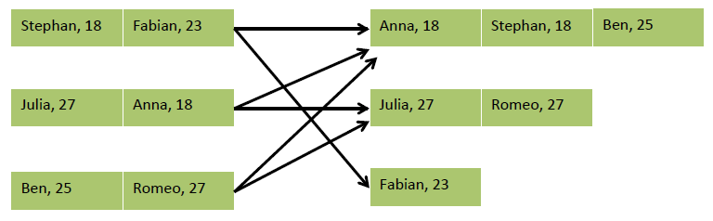
.keyBy()
// Organizes a DataStream by a key / partitions the data.
// All elements with the same key are processed by the same operator
// (name, age) of employees
DataStream<Tuple2<String, Integer>> passengers = …
// group by second field (age)
DataStream<Integer, Integer> grouped = passengers.keyBy(1)

Slide 23
Windows
Aggregations on DataStreams are different from aggregations on DataSets e.g., it is not possible to count all elements of an unbounded DataStream
DataStream aggregations make sense on windowed streams → Discretize streams
Only windows on keyed stream can be processed in parallel

Slide 24
Windows
Tumbling time window .timeWindow(Time.minutes(1))
Sliding time window .timeWindow(Time.minutes(1), Time.seconds(30))
Tumbling count window .countWindow(100)
Sliding count window .countWindow(100, 10)

Slide 25
Windows
// (name, age) of passengers
DataStream<Tuple2<String, Integer>> passengers = …
passengers
// group by first field (age)
.keyBy(0)
// window of 1 minute length triggered every 10 seconds
.timeWindow(Time.minutes(1), Time.seconds(10))
// apply a custom window function on window data
// or reduce(), fold(), sum(), min(), max(), etc.
.apply(new CountByAge());

Slide 26
Windows
public static class CountByAge implements WindowFunction<
Tuple2<String, Integer>, // input type
Tuple3<Integer, Long, Integer>, // output type
Tuple, // key type
TimeWindow> // window type {
@Override
public void apply(
Tuple key,
TimeWindow window,
Iterable<Tuple2<String, Integer>> persons,
Collector<Tuple3<Integer, Long, Integer>> out) {
int age = ((Tuple1<Integer>)key).f0;
int cnt = 0;
for (Tuple2<String, Integer> p : persons) { cnt++; }
// return (age, window-end-time, count)
out.collect(new Tuple3<>(age, window.getEnd(), cnt));
}
}

Slide 27
Stateful Functions
All DataStream functions can be stateful. (State can be checkpointed and recovered in case of a failure.)
Types of states:
Local State Functions can register local variables to be checkpointed.
Key-Partitioned State Functions on a keyed stream can access and update state scoped to the current key.

Slide 28
Key-Partitioned State
KeyedStream<Tuple2<String, String>, Tuple> keyedStream = aStream.keyBy(0);
DataStream<Long> lengths = keyedStream.map(new MapWithCounter());
public static class MapWithCounter extends RichMapFunction<Tuple2<String, String>, Long> {
private ValueState<Long> totalLengthByKey;
@Override
public void open(Configuration conf) {
totalLengthByKey = getRuntimeContext().getState("totalLengthByKey", Long.class, 0L);
}
@Override
public Long map(Tuple2<String,String> value) throws Exception {
long newTotalLength = totalLengthByKey.value() + value.f1.length();
totalLengthByKey.update(newTotalLength);
return totalLengthByKey.value();
}
}

Slide 29

flink.apache.org @ApacheFlink Or follow me on Twitter: @twalthr

