Slide 1
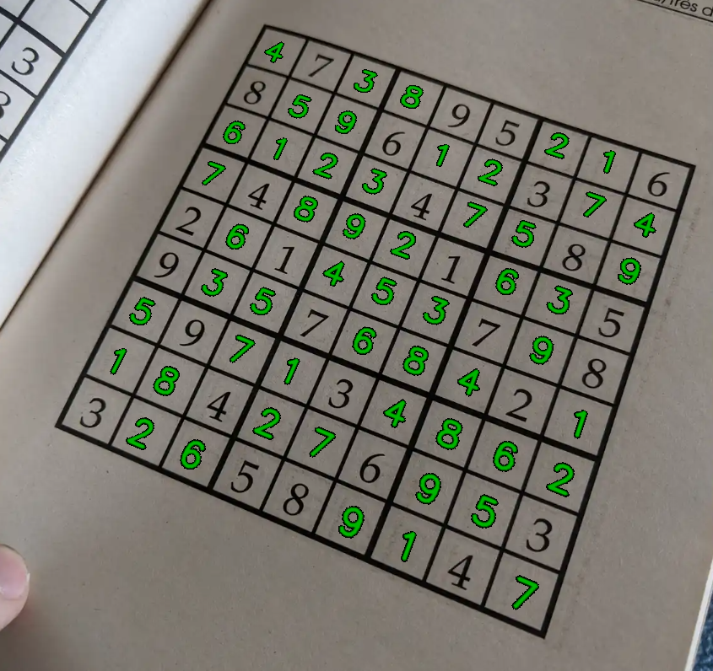
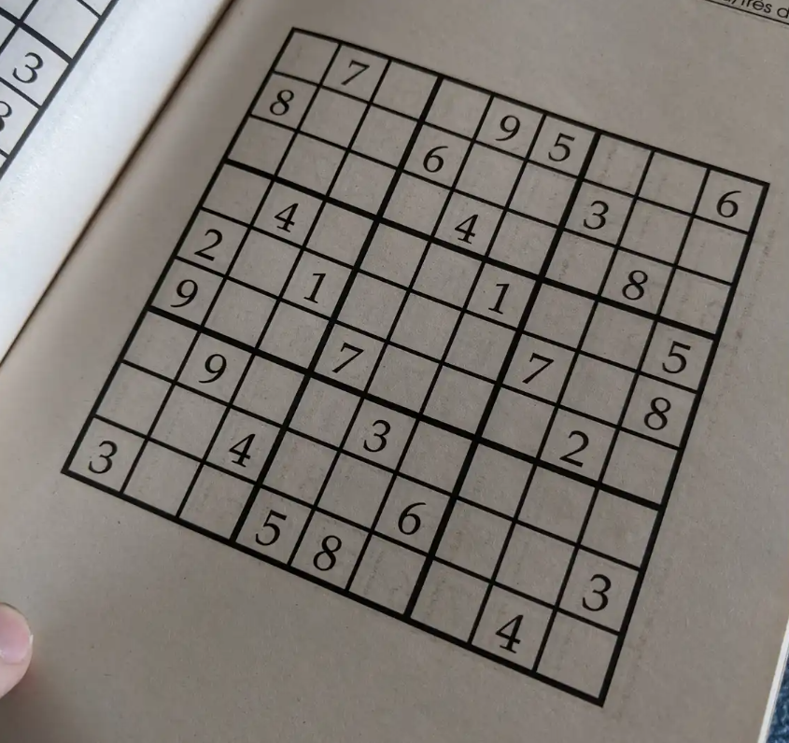
Sudoku Solver
Computer-vision pipeline in C++ / OpenCV — Natea Cristian-Ioan, 30434
solved output
input (perspective-2)
Reads a photo of a puzzle → finds & rectifies the grid → recognizes the digits → solves → draws the answer back

Slide 2
OVERVIEW
What the project does
• Input: a single photo of a Sudoku grid (possibly skewed / perspective).
• Output: the same image with the missing digits filled in, in green.
• Constraint: not allowed to use built-in recognition / contour / ML functions — every step is hand-written.
• Robustness comes from a real, harvested digit library + nearest-neighbour matching.
input
result

Slide 3
THE PIPELINE
Six stages, one straight line
1 Pre-process
Gaussian blur → adaptive threshold → morphological close
2 Locate grid
Largest connected blob → its 4 extreme corners
3 Rectify
Perspective transform → 450×450 fronto-parallel grid
4 Extract
Flood-fill blobs → filter by size/aspect → assign to 9×9
5 Recognize
Normalize → zoning + projections → weighted k-NN vote
6 Solve + draw
Backtracking solver → render answer → inverse-warp back

Slide 4
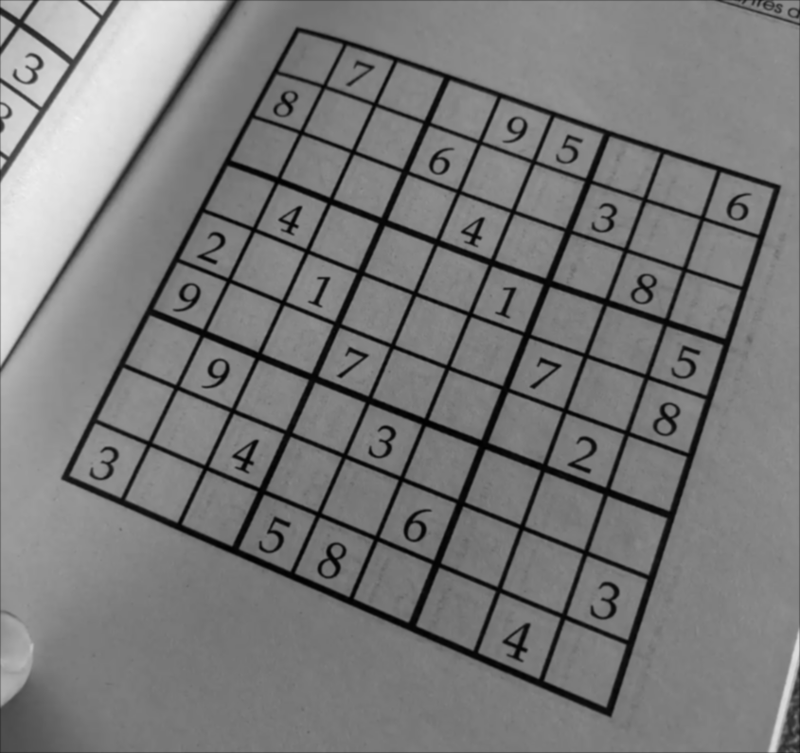
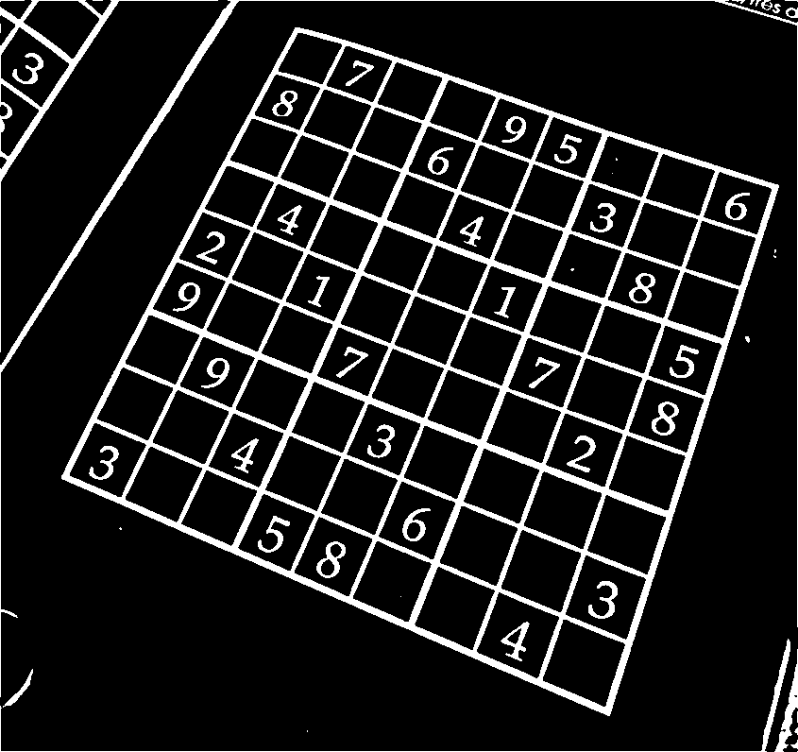
STAGE 1 — PRE-PROCESSING
Clean the image, isolate the ink
blurred = gaussianBlur(gray, 5);
thresholded = adaptiveThreshold(blurred, 21, 15);
morphed = morphClose(thresholded, 5);
• Gaussian blur: separable convolution — kills sensor noise so thresholding is stable.
• Adaptive threshold (local mean via an integral image): copes with uneven lighting; gives white ink on black.
• Morphological close: seals tiny gaps in the grid lines before we trace it.
after blur
after threshold
Why local (adaptive) thresholding?
A single global cut-off fails when one corner of the photo is darker. Comparing each pixel to its neighborhood mean keeps the strokes everywhere.

Slide 5
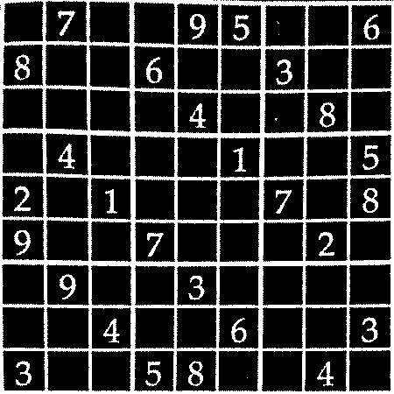
STAGE 2-3 — LOCATE & RECTIFY
Find the grid, flatten the perspective
blob = findLargestBlob(morphed); // BFS flood fill
corners = getGridCorners(blob); // extreme x+y / x-y
M = getPerspectiveTransform(src, dst);
warpPerspective(thresholded, warped,
M, {450,450}, INTER_NEAREST);
• The grid frame is the biggest white connected component in the image.
• Its 4 corners = pixels with min/max of (x+y) and (x−y).
• A homography maps those corners to a clean 450×450 square; the inverse is kept to warp the answer back later.
rectified 450×450 grid

Slide 6
STAGE 4 — EXTRACT DIGIT CELLS
Separate digits from grid lines & noise
for (blob : findBlobs(warped)) {
a = blob.area; ar = w / h;
if (a < 0.02*cell || a > 0.80*cell) reject; (either noise or grid)
if (ar < 0.2 || ar > 1.5) reject; (some wrong blob/ noise)
row = blob.center.y / cellSize;
col = blob.center.x / cellSize; // place in 9x9 matrix
}
• Each white component is tested by area and aspect ratio: specks are too small, the grid frame is one huge blob, both are dropped.
• Surviving blobs are real digits — placed into the 9×9 grid by their centroid.
• Bug fixed here: the original flood fill grew into the background (inverted test) and the area threshold rejected every digit.

Slide 7
STAGE 5 — RECOGNISE DIGITS
The reliable part: normalise + k-NN
normalise(cell): // crop -> aspect-resize
-> centre by mass on 28x28
features = pixels(784) + zoning(7x7)
+ h_proj(28) + v_proj(28)
// weighted vote over K=5 nearest
votes[d] += 1 / (dist + eps);
Why k-NN on real samples?
One template per digit is brittle across fonts & warps. Many real examples + a nearest-neighbour vote generalise far better — and labels are trustworthy because a grid only 'solves' if every given was read correctly.
• Aspect-preserving + centroid centring stop a thin '1' being stretched to look like others.
• 7×7 zoning (density per region) is what separates the look-alikes: 1/7, 3/8.
• Reference set = 302 REAL digits harvested from solved grids (templates_knn/), not one synthetic template each.

Slide 8
STAGE 6a — SOLVE
Backtracking with a safety guard
bool backtrack(grid) {
if (++steps > 2'000'000) return false; // guard
pick first empty cell;
for (n = 1..9)
if (isValid(grid,r,c,n)) {
grid[r][c]=n;
if (backtrack(grid)) return true;
grid[r][c]=0; // undo
}
}
• Classic depth-first search: try a digit, recurse, undo on failure.
• isValid checks the row, column and 3×3 box.
• The step cap means a mis-read (inconsistent) grid can never hang — it just reports 'could not solve'.

Slide 9
STAGE 6b — DRAW THE ANSWER BACK
From solved grid to annotated photo
for empty cells:
putText(overlay, solved[r][c], centre);
warpPerspective(overlay, back,
Minv, img.size());
composite where back != 0;
• Only the cells that were empty are drawn — the printed givens stay untouched.
• The overlay is built in the flat 450×450 frame, then warped BACK with the inverse homography so the digits sit in the original perspective.
final result (perspective-2)

