Slide 1

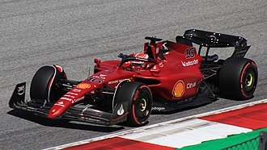
Formula One World Championship Analysis (2014-2021)
Cristian Zagar
Taken from https://en.wikipedia.org/wiki/Ferrari_F1-75

Slide 2
Introduction
Overview:
Analyse Formula One (F1) public data to gather insights into team and driver performances (2014-2021)
Data source:
Kaggle Dataset
Key aims:
Investigate recent top performing teams and how their performance varies over time
Investigate recent best performing drivers and their effect on the corresponding team’s performance

Slide 3
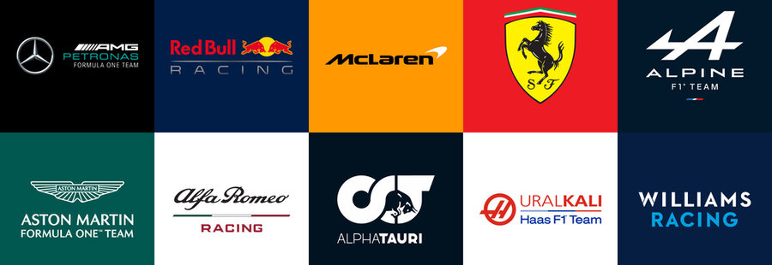
Team Analysis
Taken from https://stock.adobe.com/uk/images/formula-1-team-logo-badges-f1-teams-ferrari-mercedes-amg-red-bull-alpine-etc-every-racing-team-or-constructor-currently-competing-in-f1-racing-world-championship/471722307

Slide 4
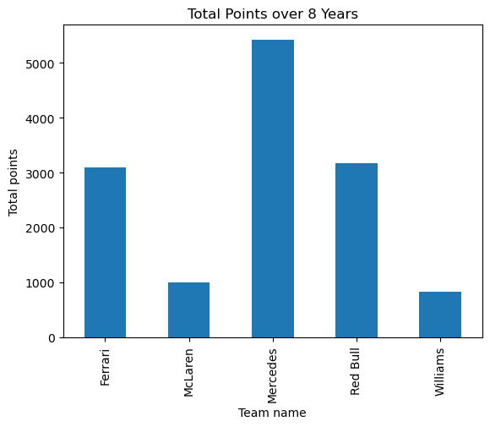
2014-2021 Participant Teams
Only 5 out of 211 teams participated every year
Analysis focused on top 3 (Mercedes, Red Bull, Ferrari)

Slide 5
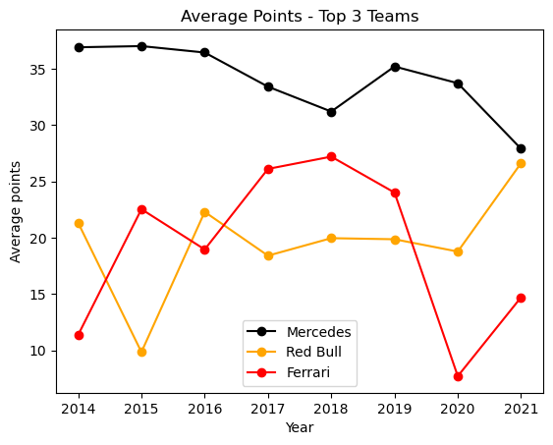
Top 3 Participant Teams
Mercedes dominated the entire time period, relatively steady performance
Red Bull increases consistently in the second half (2017-2021), catching up with Mercedes
Ferrari performed somewhat similarly to Red Bull until 2019, showing a massive decline afterwards

Slide 6
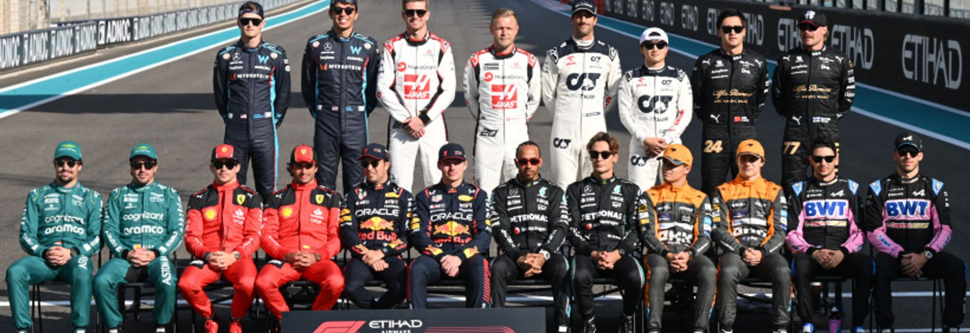
Driver analysis
https://www.skysports.com/f1/news/12433/13042702/f1-driver-contracts-how-long-are-lewis-hamilton-lando-norris-max-verstappen-and-others-signed-for

Slide 7
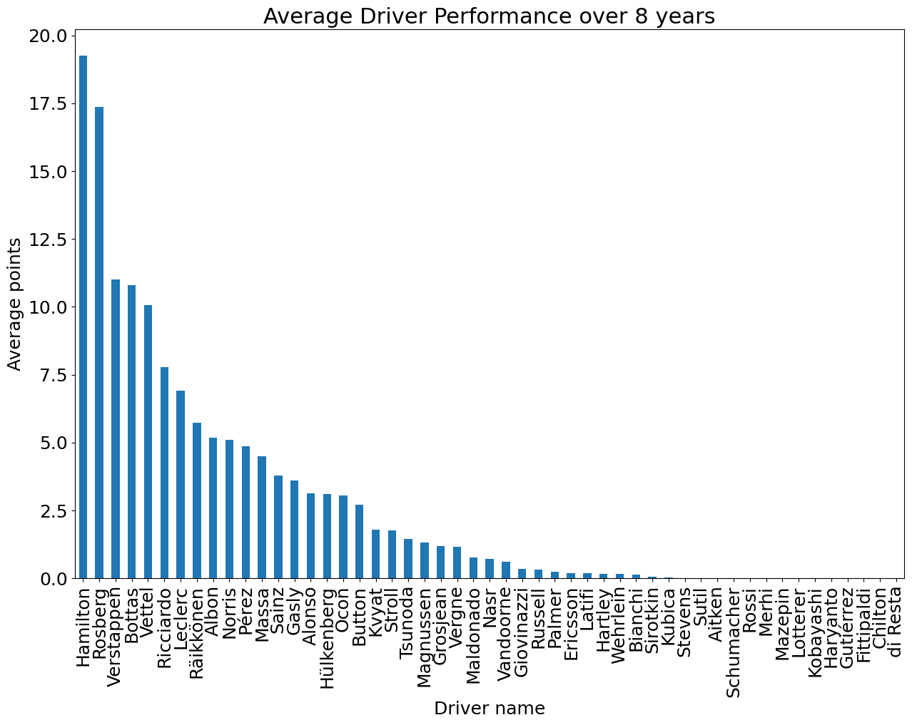
2014-2021 Participant Drivers
Analysis focused on the top 5 drivers (Hamilton-Vettel)
Top 5 drivers were mostly driving for top 3 teams
Their performance correlates with that of top 3 teams

Slide 8
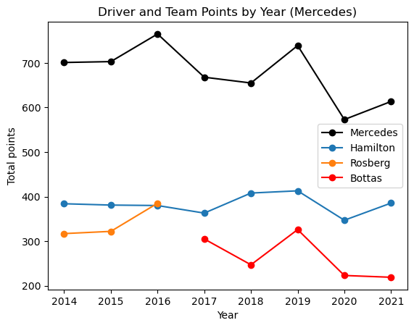
Mercedes and their drivers
The consistency in performance appears to be mostly due to Hamilton
Hamilton has consistently been the better driver of Mercedes between 2014 and 2021

Slide 9
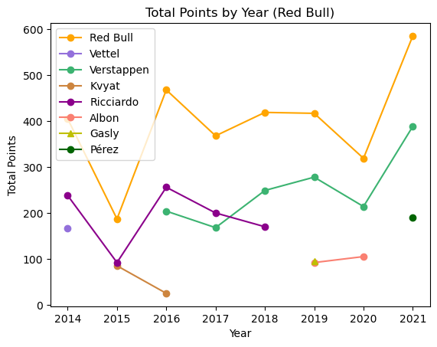
Red Bull and their drivers
Ricciardo and Verstappen spent the longest time with Red Bull between 2014 and 2021
Noticeable increase in team performance starting 2017
Increase appears to be highly correlated with Verstappen’s performance increase

Slide 10
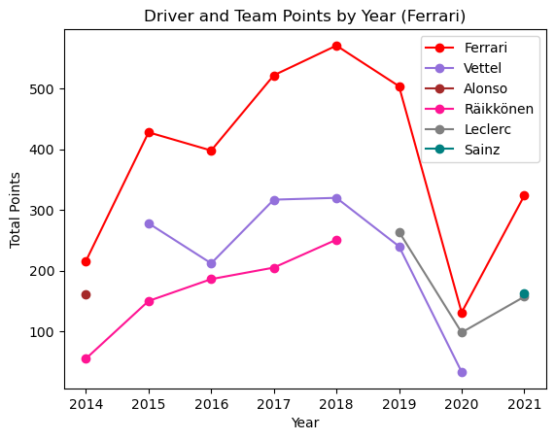
Ferrari and their drivers
Räikkönen and Vettel have spent the longest time with Ferrari
Team’s and both drivers’ performances declined massively from 2019 to 2020, most likely due to car design or technical failure
Cheating allegation in 2019 was followed by a rule change for car design in 2020, correlating with the drop

