Slide 1
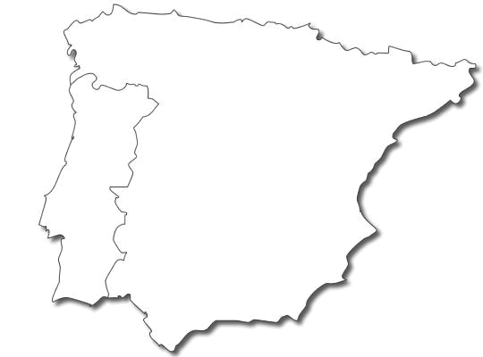





Installed capacities
Solar-
Wind 20 GW
Hydro 15 GW
Gas 20 GW
Coal 10 GW
Nuclear 8 GW

Slide 2
Round steps
Day D-1
Public information is provided: expected demand, hydro reserves, ...
Participants privately define their bids.
The Market Operator gathers bids.
Market results are computed → market incomes and generation commitments
Day D
Real dispatch is observed → variable costs
Imbalances are computed → penalties
TOTAL INCOMES = market incomes - variable costs - penalties

Slide 3
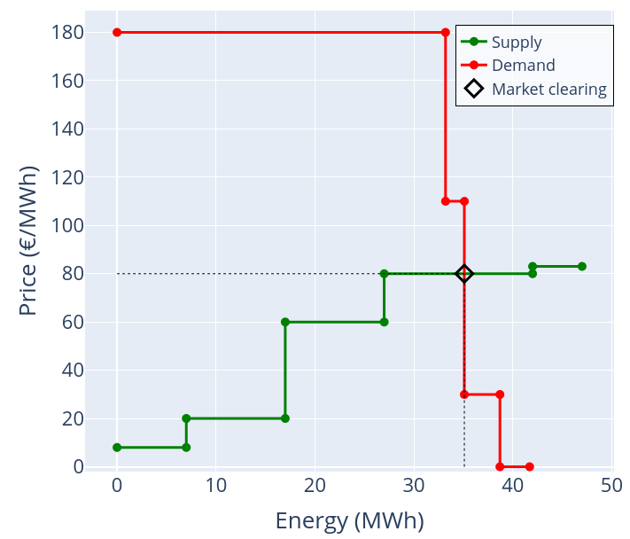
Supply and demand curves

Slide 4
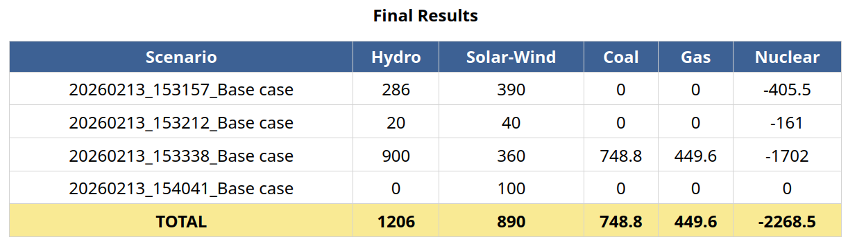
Game results
Four rounds

