Slide 1
Solar power forecasts
# Round 1
You hired a new forecasting company with little experience in the field, but cheap prices.
They work with point-forecasting models
They provided the following power forecast for your solar farm portfolio:
11 GWh

Slide 2
Solar power forecasts
# Round 2
To improve your bids, you hired four forecasting companies.
All four generate point-forecasts.
They provided the following power forecasts for your solar farm portfolio:
15 GWh
17 GWh
18 GWh
18 GWh

Slide 3
Solar power forecasts
# Round 3
You are still working with these four companies.
They provided the following power forecasts for your solar farm portfolio:
6 GWh
7 GWh
18 GWh
20 GWh
When asked about these discrepancies, they inform you that a weather front is approaching the Iberian peninsula, and is expected to arrive by 2 p.m. tomorrow. Two companies predict it will arrive slightly earlier, resulting in a low solar PV generation due to clouds. The other two companies predict a delay in the arrival of the weather front, which would result in high solar generation.

Slide 4
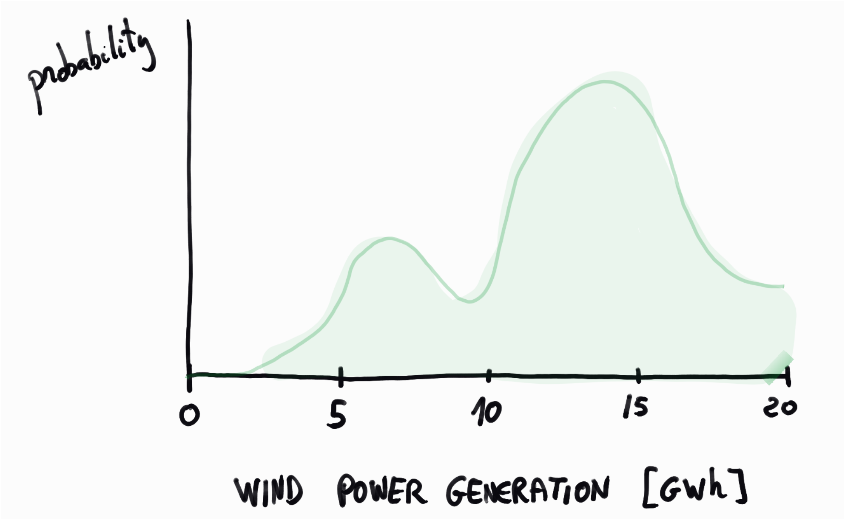
Solar power forecasts
# Round 4
You hired a top-tier company that works with probabilistic forecasting models.
The situation is similar to that of the previous round: A weather front is approaching the Iberian Peninsula, so solar power generation is highly volatile.
The following forecast of the solar power probability density function has been reported for your solar farm portfolio:

