Slide 1
Wind power forecasts
# Round 1
You hired a new forecasting company with little experience in the field, but cheap prices.
They work with point-forecasting models.
They provided the following wind power forecast for your wind farm portfolio:
11 GWh

Slide 2
Wind power forecasts
# Round 2
To improve your bids, you hired four forecasting companies.
All four generate point-forecasts.
They provided the following wind power forecasts for your wind farm portfolio:
15 GWh
17 GWh
18 GWh
18 GWh

Slide 3
Wind power forecasts
# Round 3
You are still working with these four companies.
They provided the following wind power forecasts for your wind farm portfolio:
6 GWh
7 GWh
18 GWh
20 GWh
When asked about these discrepancies, they inform you that a weather front is approaching the Iberian Peninsula and is expected to arrive by 2 p.m. tomorrow. Two companies predict it will arrive slightly earlier, resulting in high wind generation. The other two companies predict a delay in the arrival of the weather front, which would result in low wind generation.

Slide 4
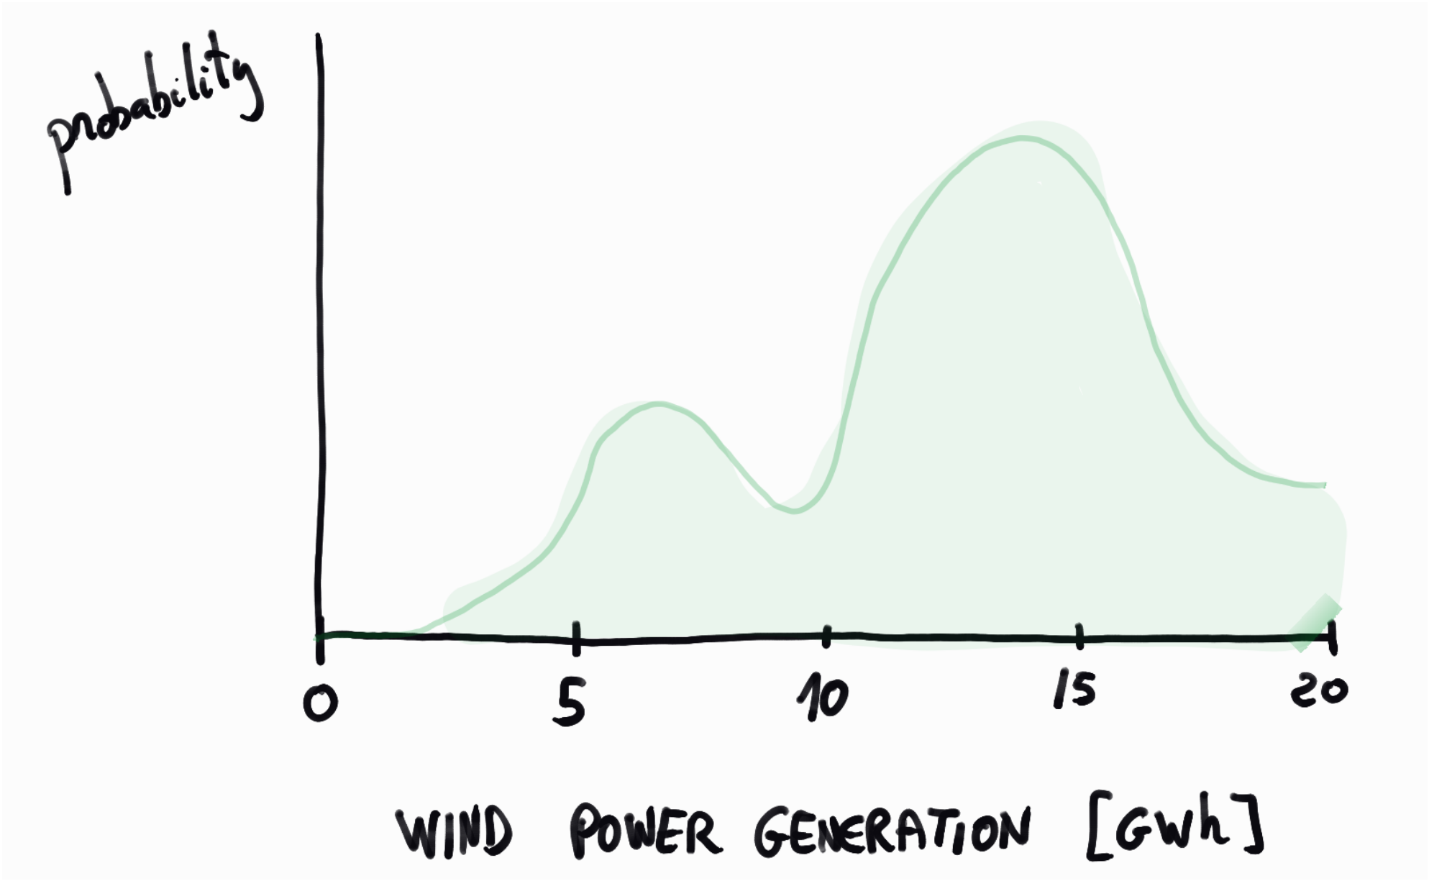
Wind power forecasts
# Round 4
You hired a top-tier company that works with probabilistic forecasting models.
The situation is similar to that of the previous round: A weather front is approaching the Iberian Peninsula, so wind power generation is highly volatile.
The following forecast of the wind power probability density function has been reported for your wind farm portfolio:

