Slide 1
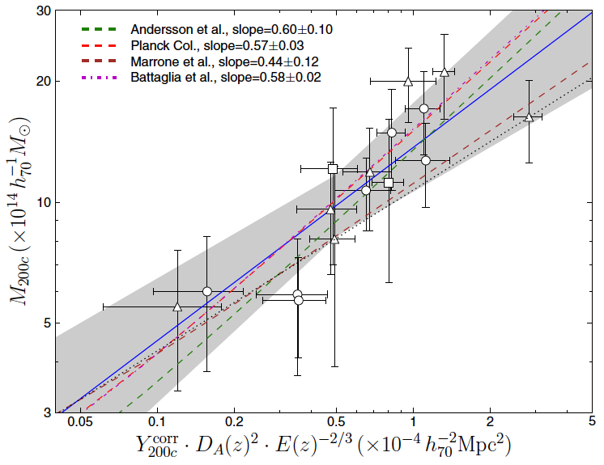
Method SGF: shifting gapper and a σ-M relation from simulations
Cristóbal Sifón
Leiden Observatory
As applied to observations of SZ-selected clusters detected by the Atacama Cosmology Telescope
Method and Simulations:
Fadda et al. (1996)
Evrard et al. (2008)
Implementation:
Sifón et al. (2013)
Cristóbal Sifón Andalaft – Halo Mass Calibration Project, U Nottingham, 2013 September 2

Slide 2
Outline
1) Method Summary
2) Member selection: the shifting gapper
3) Mass calibration from numerical simulations
4) Application to real data
Cristóbal Sifón Andalaft – Halo Mass Calibration Project, U Nottingham, 2013 September 2

Slide 3
Method SGF: shifting gapper and a σ-M relation from simulations
Method Summary:
  Select all galaxies with v_{rest}<4,000 km/s from z_{o}, where zo is the biweight estimator of location.
  Run the shifting gapper member selection.
  Measure z_{o} and σ_{gal}, the biweight estimator of scale.
  Use σ_{gal}-M₂₀₀ scaling relation and use M₂₀₀ to get r₂₀₀.
  Consider only galaxies within r₂₀₀.
  Repeat steps 3-5 until numbers are stable.
Cristóbal Sifón Andalaft – Halo Mass Calibration Project, U Nottingham, 2013 September 2

Slide 4
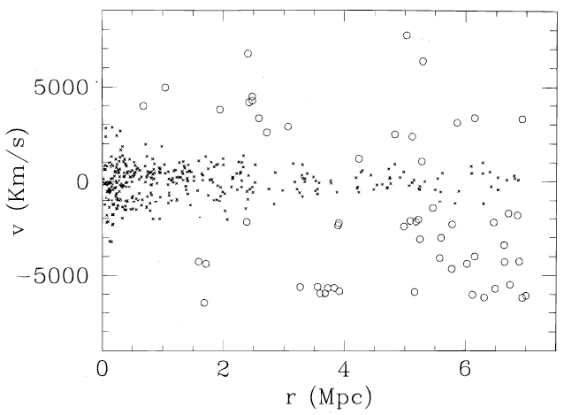
Method SGF: shifting gapper and a σ-M relation from simulations
The shifting gapper:
Fadda et al. (1996)
Define radial bins with Δr>250 kpc and N>15 galaxies
Sort galaxies with increasing abs(v)
Binding gap: 500 km/s
Maximum gap: 1,000 km/s
Cristóbal Sifón Andalaft – Halo Mass Calibration Project, U Nottingham, 2013 September 2

Slide 5
Method SGF: shifting gapper and a σ-M relation from simulations
The shifting gapper:
Fadda et al. (1996)
Define radial bins with Δr>250 kpc and N>15 galaxies
Sort galaxies with increasing abs(v)
Binding gap: 500 km/s
Maximum gap: 1,000 km/s
Cristóbal Sifón Andalaft – Halo Mass Calibration Project, U Nottingham, 2013 September 2

Slide 6
Method SGF: shifting gapper and a σ-M relation from simulations
The shifting gapper:
Fadda et al. (1996)
In a diagram like this, members and non-members are mostly quite distinct
Need a reasonable number of members (below which it becomes a simple sigma-clipping)
If well sampled, shows the “trumpet” shape we expect
However:
Gives a discrete v_{max} profile
Is susceptible to poor sampling, can give quite crazy results
Cristóbal Sifón Andalaft – Halo Mass Calibration Project, U Nottingham, 2013 September 2

Slide 7
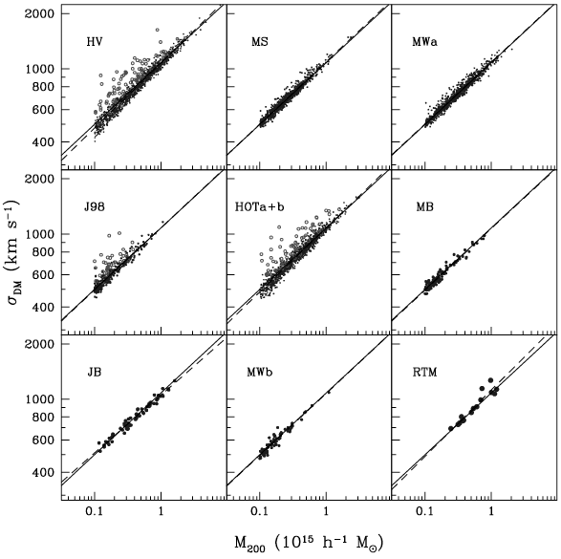


Method SGF: shifting gapper and a σ-M relation from simulations
The σ-M relation:
Evrard et al. (2008)
N-body simulations, averaged over a variety of cosmologies
Assume that galaxies are unbiased tracers of mass
Calibrated for isolated, massive (>10¹⁴M_{o}) clusters
Cristóbal Sifón Andalaft – Halo Mass Calibration Project, U Nottingham, 2013 September 2

Slide 8
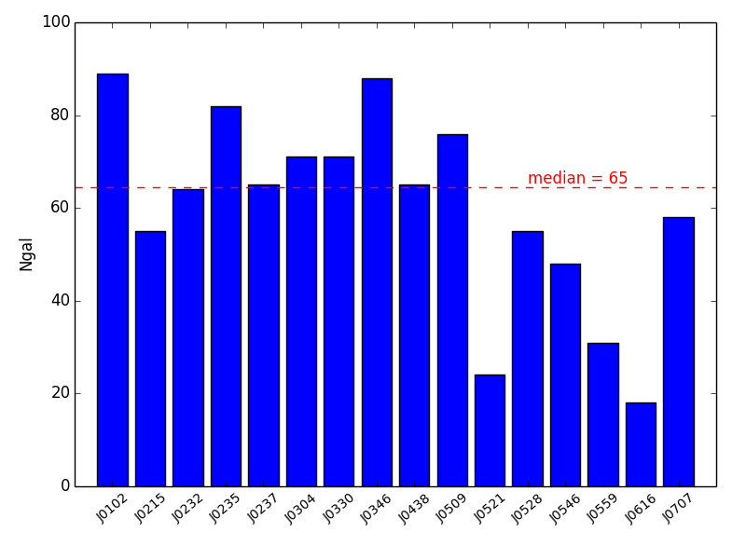
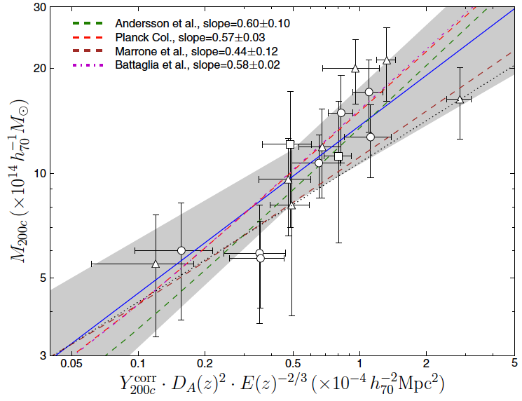
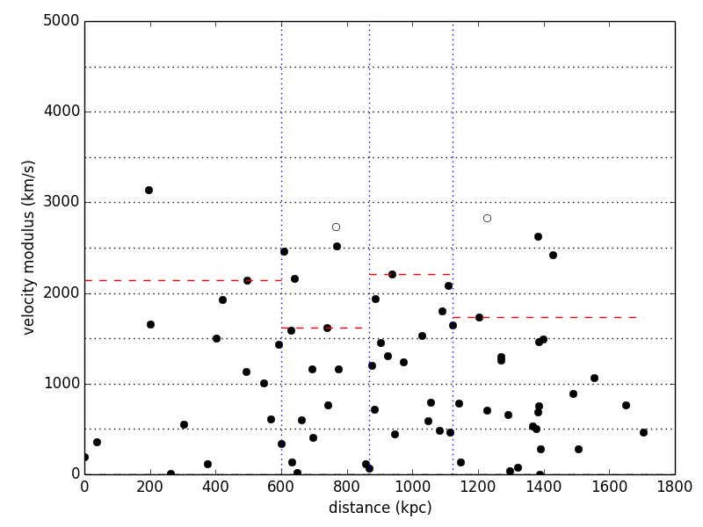
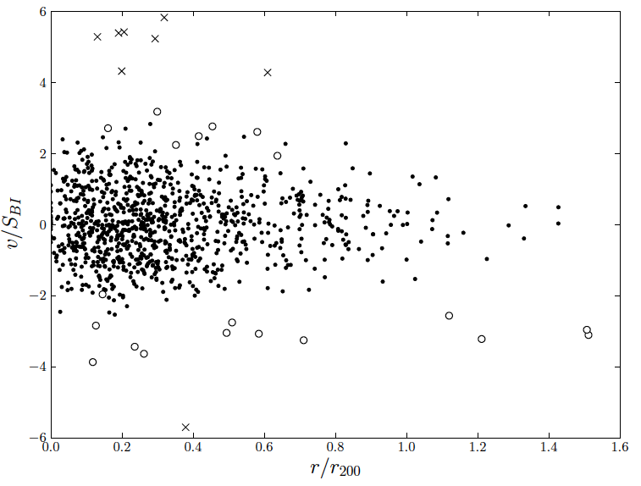
Method SGF: shifting gapper and a σ-M relation from simulations
Application to real data:
At least, the masses are consistent
with what we could expect
Fadda et al. (1996), Evrard et al. (2008), Sifón et al. (2013)
Cristóbal Sifón Andalaft – Halo Mass Calibration Project, U Nottingham, 2013 September 2
Notes:
-In a diagram like this, members and non-members are mostly quite distinct
-Need a reasonable number of members (below which it becomes a simple sigma-clipping)
-If well sampled, shows the “trumpet” shape we expect
However:
-Doesn't give a real profile but
-Is susceptible to poor sampling, can give quite crazy results

Slide 9
Method SGF: shifting gapper and a σ-M relation from simulations
Method Summary:
  Select all galaxies with v_{rest}<4,000 km/s from z_{o}, where zo is the biweight estimator of location.
  Run the shifting gapper member selection.
  Measure z_{o} and σ_{gal}, the biweight estimator of scale.
  Use σ_{gal}-M₂₀₀ scaling relation and use M₂₀₀ to get r₂₀₀.
  Consider only galaxies within r₂₀₀.
  Repeat steps 3-5 until numbers are stable.
Cristóbal Sifón Andalaft – Halo Mass Calibration Project, U Nottingham, 2013 September 2

