Slide 1
A Comprehensive Statistical Analysis of Traffic Accidents in
Slovakia

Slide 2
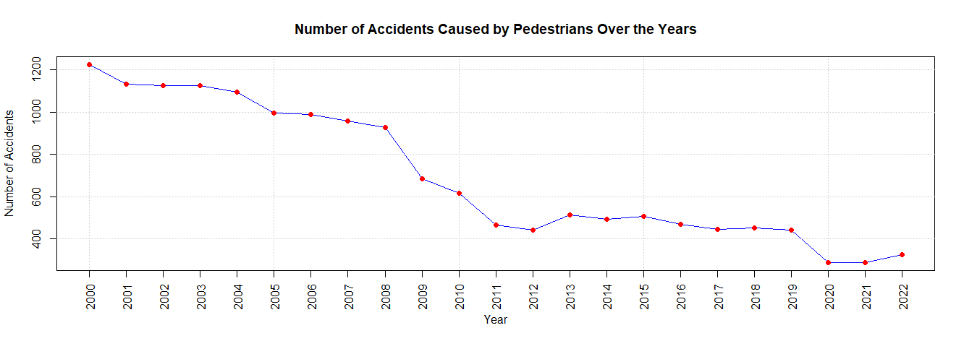
Introduction and Data
Our aim:
find and compile data concerning road accidents in Slovakia
analyze given data
identify trends and patterns
Data:
datasets from the Statistical Office of the Slovak Republic [1]
[1] DATAcube., http://datacube.statistics.sk/#!/view/en/vbd\_sk\_win2/do3806rr/v\_do3806rr\_00\_00\_00\_en

Slide 3
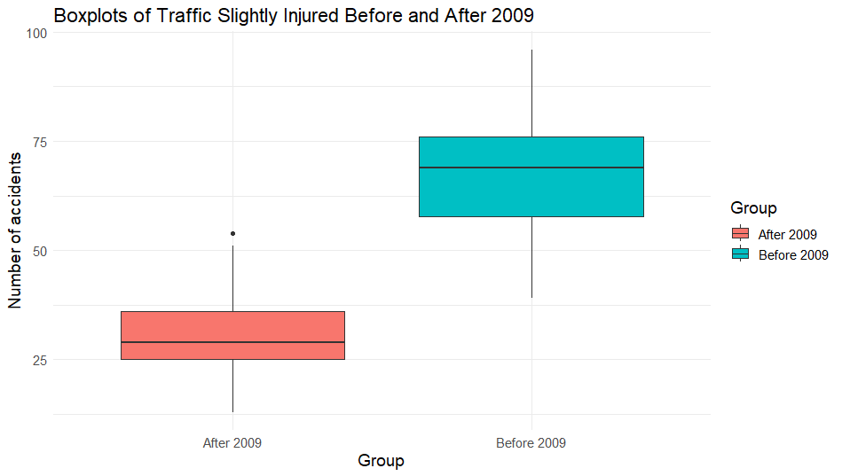
Impact of the 2009 legislative change
Objective:
Analyze its impact on traffic incidents before and after the legislative change
Methodology:
Mann-Whitney U Test
P-values < 0.05 across all datasets, rejecting the null hypothesis.
Concludes that the legislative change in 2009 had a profound impact on various aspects of traffic incidents.
Notes:
Why Mann-Whitney?
Violation of assumption of equal variances
Non-normality in data
Traditional parametric tests not suitable
Robust analysis with Mann-Whitney U test

Slide 4
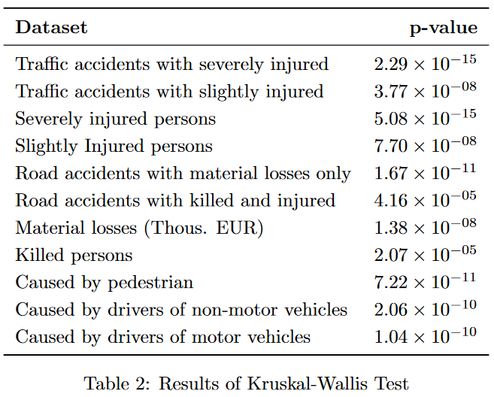
Regional differences - Kruskal-Wallis
Investigation of regional disparities in traffic incidents
Utilized Kruskal-Wallis test for a nonparametric approach

Slide 5
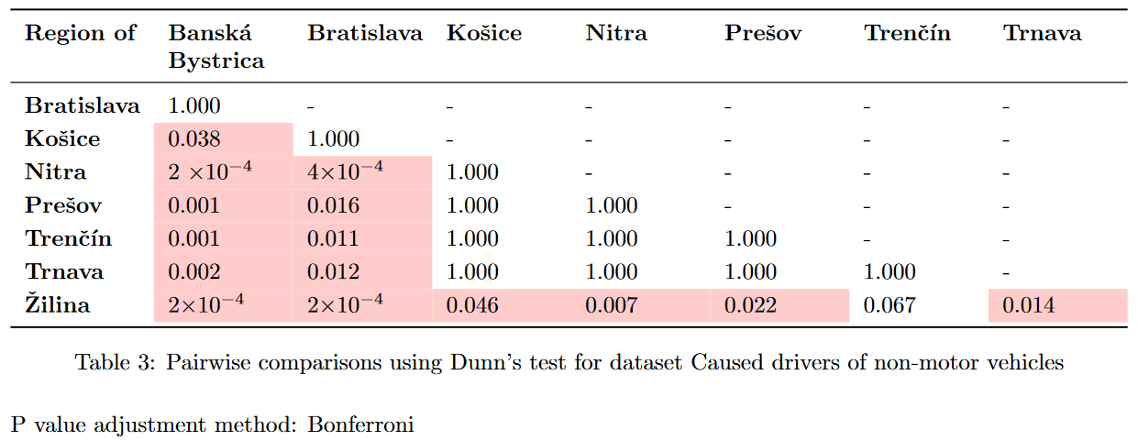
Detailed Pairwise Comparisons

Slide 6
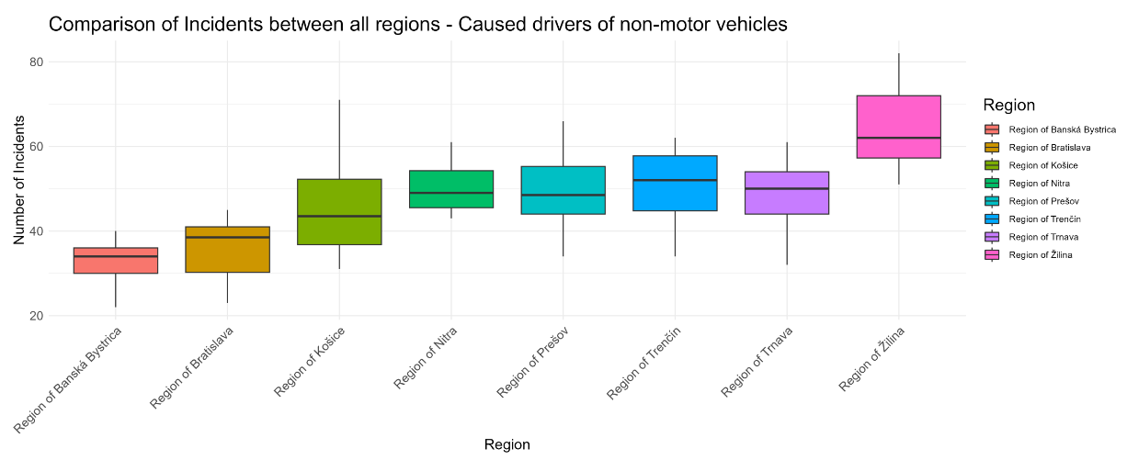

Slide 7
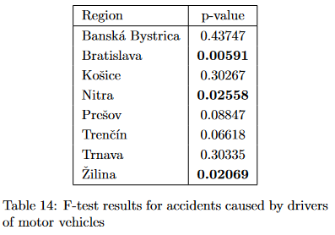
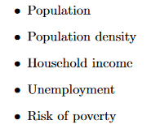
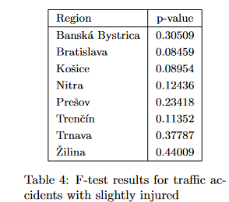
Accidents and demographic data

Slide 8
Influence of railways crossings
Secured vs. unsecured
Multiple linear regression models for each region
each model better compared to constant model
Correlation analysis
for secured crossings - positive correlation for all regions
for unsecured crossings - negative correlation for most regions

Slide 9
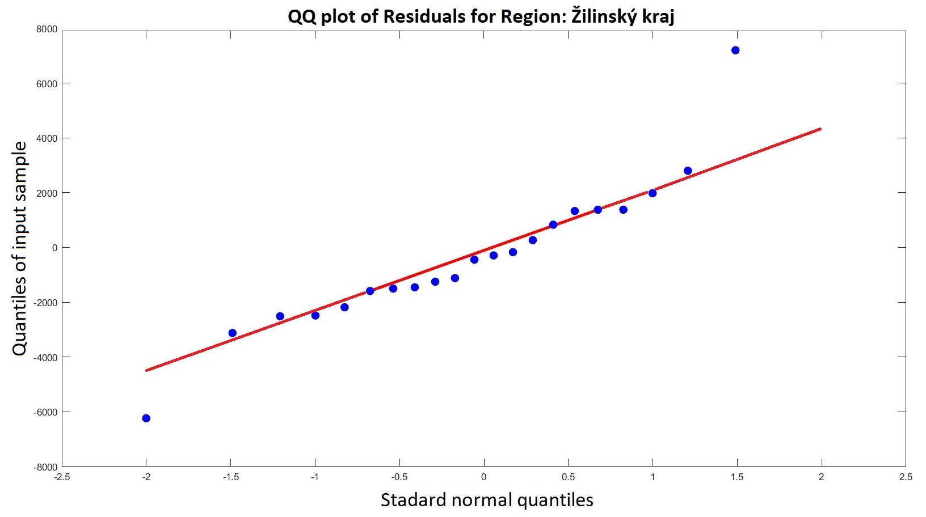
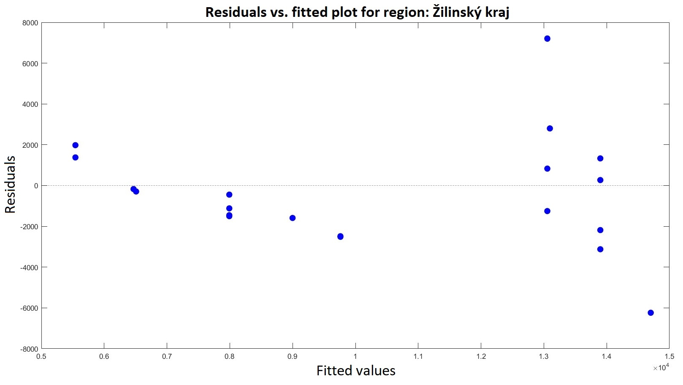
Influence of railways crossings
Examples of diagnostic plots

Slide 10
Conclusion
Legislative change - great impact
Demographic data - inconclusive
Rail crossings
for secured crossings - positive correlation for all regions
for unsecured crossings - negative correlation for most regions

