Slide 1
Alignment to reference
By Verónica Reyes Galindo

Slide 2

Data to RNAseq

Slide 3
What I can use?
GSNAP
Tophat
SHRiMP
Bowtie2
STAR
BWA (Burrows-Wheeler Aligner)
Notes:
BWA isn't splice aware, so is not appropriate if you are mapping RNAseq to the genome - unless you are dealing with bacteria, which have no introns.
If you are mapping to the transcriptome, you can use both.

Slide 4
History
BWA is largely influenced by BWT-SW (It performs the same function as BLASTn, but BWT-SW finds all local alignments).
While BWA-SW learns from BWT-SW, it introduces heuristics that can hardly be applied to the original algorithm. In all, BWA does not guarantee to find all local hits as what BWT-SW is designed to do, but it is much faster than BWT-SW on both short and long query sequences.
Heng Li

Slide 5

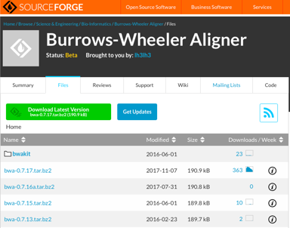
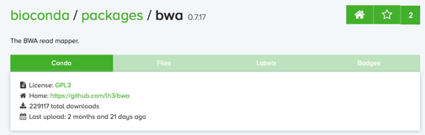
BWA is…
BWA is a software package for mapping low-divergent sequences against a large reference genome, such as the human genome o more large like a conifer.

Slide 6
It consists of three algorithms:
BWA-backtrack (designed for Illumina sequence reads up to 100bp)
BWA-SW
BWA-MEM
(for longer sequences ranged from 70bp to 1Mbp)BWA-MEM and BWA-SW share similar features such as long-read support and split alignment. But BWA-MEM, is generally recommended for high-quality queries as it is faster and more accurate. BWA-MEM also has better performance than BWA-backtrack for 70-100bp Illumina reads.

Slide 7
The BWA-SW algorithm is a new component of BWA. It was conceived in November 2008 and implemented ten months later.
The BWA-MEM algorithm is based on an algorithm finding super-maximal exact matches (SMEMs), which was first published with the fermi assembler paper in 2012. I first implemented the basic SMEM algorithm in the fastmap command for an experiment and then extended the basic algorithm and added the extension part in Feburary 2013 to make BWA-MEM a fully featured mapper.

Slide 8
which one should I choose?
For 70bp or longer Illumina, 454, Ion Torrent and Sanger reads, assembly contigs and BAC sequences, BWA-MEM is usually the preferred algorithm.
For short sequences, BWA-backtrack may be better. BWA-SW may have better sensitivity when alignment gaps are frequent.

Slide 9
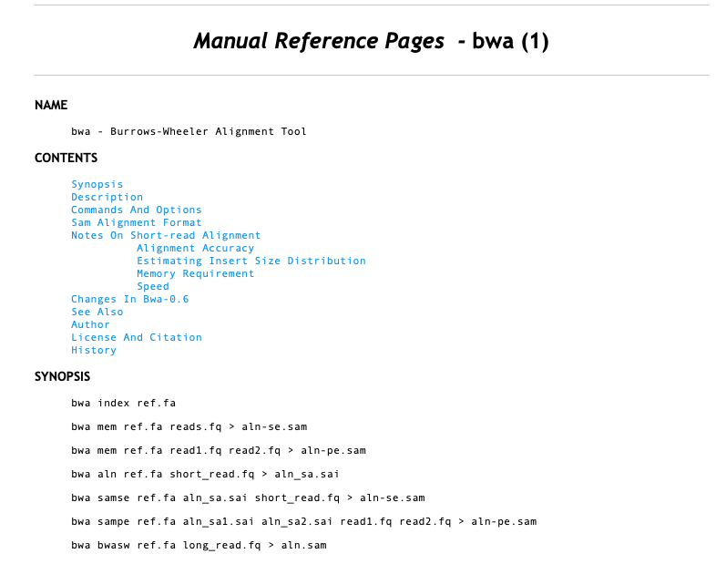

Slide 10
EXAMPLE
1.- create reference index
bwa index -p index_Areligiosa -a is ../../Reference_Transcriptome/GCAT_AB-RNA-1.0.16.fa
2.- align reads to index
bwa mem ../../Index/index_GCAT_AB-RNA-1.0.16/index_Areligiosa ../../../TRANSCRIPTOMICS_TRIMMING/Trimm18s_sw10-28_ml50/Trimmer_DPVR1_S179_L007_R1_001_paired.fq.gz ../../../TRANSCRIPTOMICS_TRIMMING/Trimm18s_sw10-28_ml50/Trimmer_DPVR1_S179_L007_R2_001_paired.fq.gz > SC01_15_sw10L50.sam

Slide 11
3.- generate bam files
for i in DC01_15_sw10L50 DC04_17_sw10L50 DS04_15_sw10L50 SC03_15_sw10L50 SS02_15_sw10L50 DC02_15_sw10L50 DC05_15_sw10L50 SC01_15_sw10L50 SC04_15_sw10L50 SS05_15_sw10L50 DC03_15_sw10L50 DS01_15_sw10L50 SC01_17_sw10L50 SC05_15_sw10L50 DC04_15_sw10L50 DS02_15_sw10L50 SC02_15_sw10L50 SS01_15_sw10L50; do docker run -v /LUSTRE/Genetica/vreyes/TRANSCRIPTOMICS_MAP/Alignment/alignment_AbP_paired_sw10_L50:/data biocontainers/samtools samtools view -Sb $i.sam > $i.bam; done
4.- count reads

Slide 12
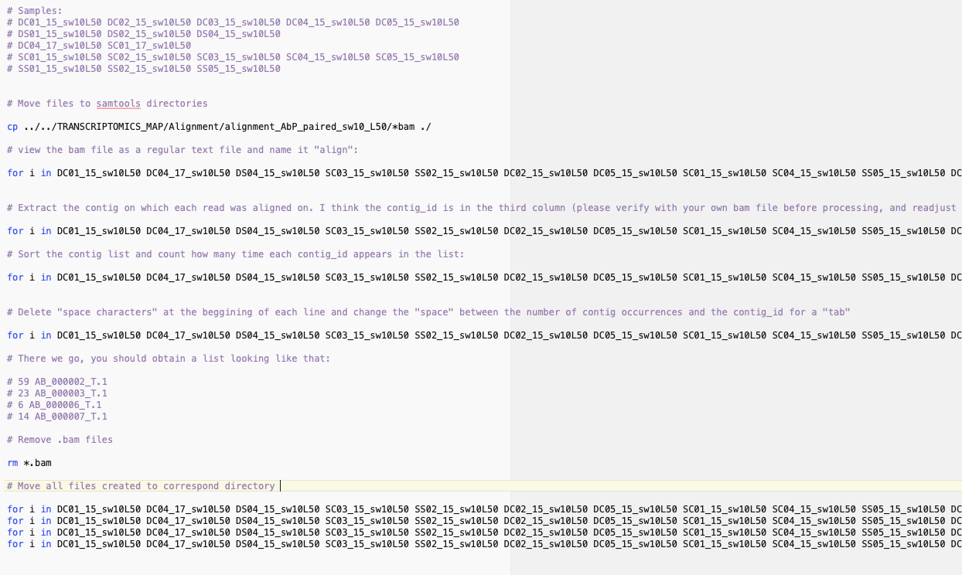

Slide 13
