Slide 1
Enchilada
Hanting Wong

Slide 2
What if Mattresses were trusses ?

Slide 3
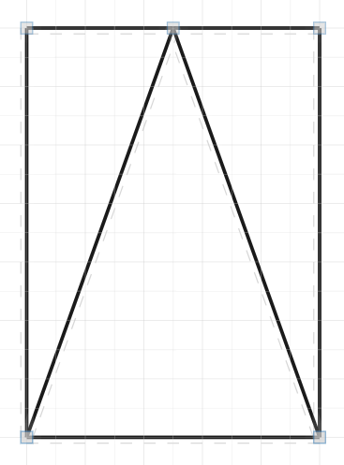
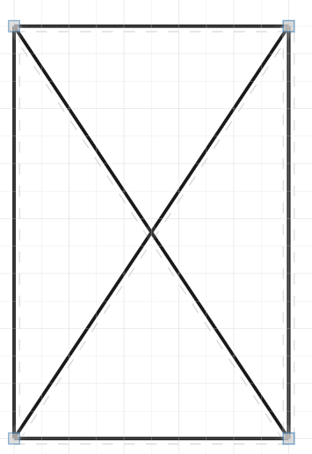

Slide 4
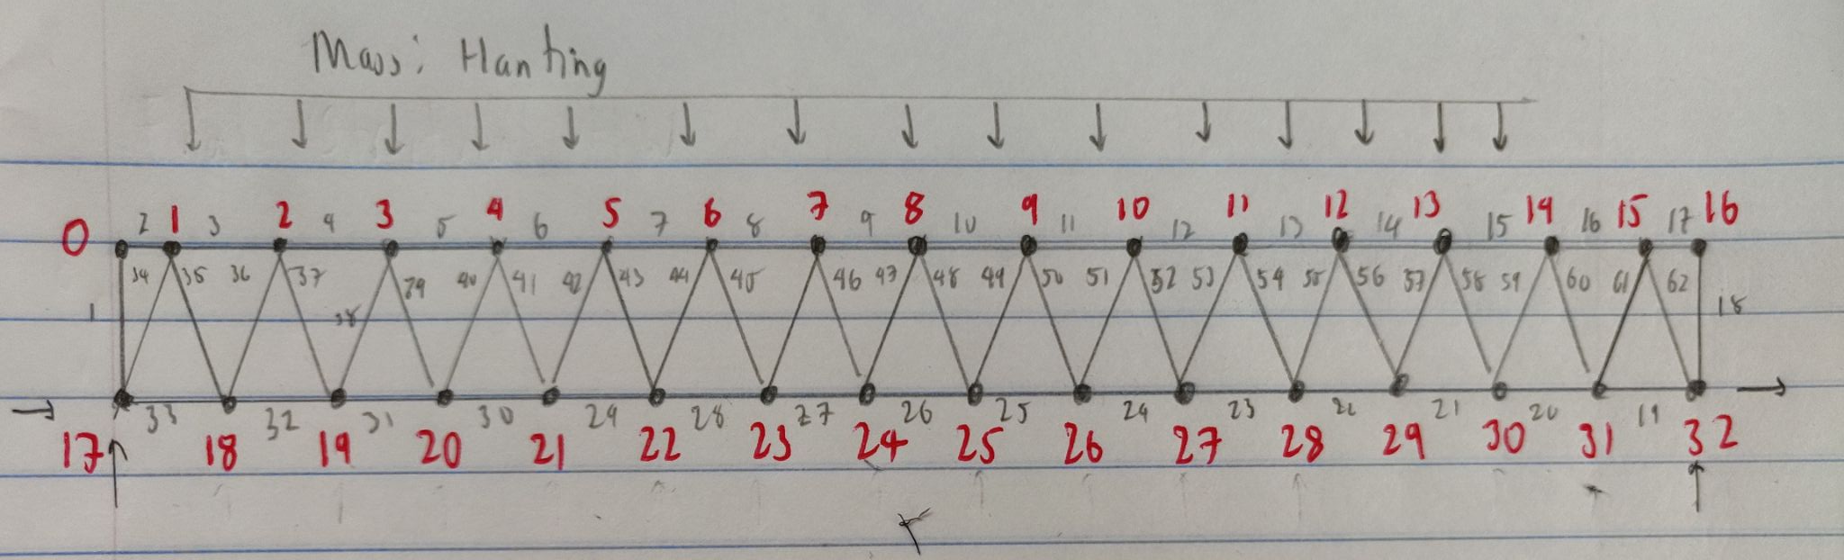
Truss

Slide 5
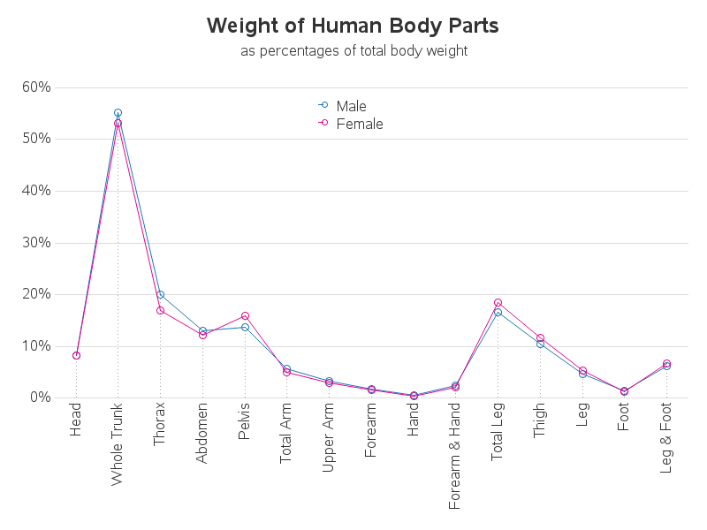

Slide 6
Forces
Assuming Hanting lays and spans from node 1 to node 15 equalling 70in length
With weight of 145 lbs assumes weight split into point nodes
Head- node 2- 9.87 lbs
Thorax - node 4- 24.145 lbs
Upper arm - node 5 - 16.53 lbs
Abdomen - node 6 - 21.94 lbs
Lower arm + hand - node 7 - 7.308 lbs
Pelvis- node 7 - 19.81 lbs
Thighs -node 9 -27.225 lbs
Legs - node 12- 13.775 lbs
Feet - node 14- 4.147 lbs
Total to 2.38 lbs per square inch along length

Slide 7
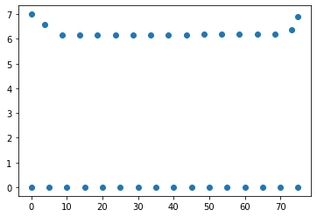
Results
Condition 1: Mattress on Bed frame
X axis (inch) Y-axis (inch)
Max displacement
Node 6 with change in y = -1.089 inch
Node 2 with change in x = 1.55 inch

Slide 8
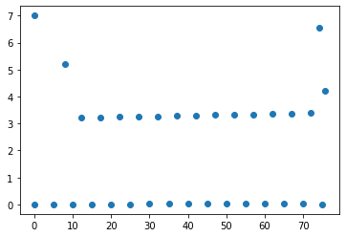
Result Part 2
Condition 2: No bed frame
X axis (inch) Y-axis (inch)
Max displacement
Node 3 with change in y = -3.773 inch
Node 3 with change in x = 2.27 inch

Slide 9
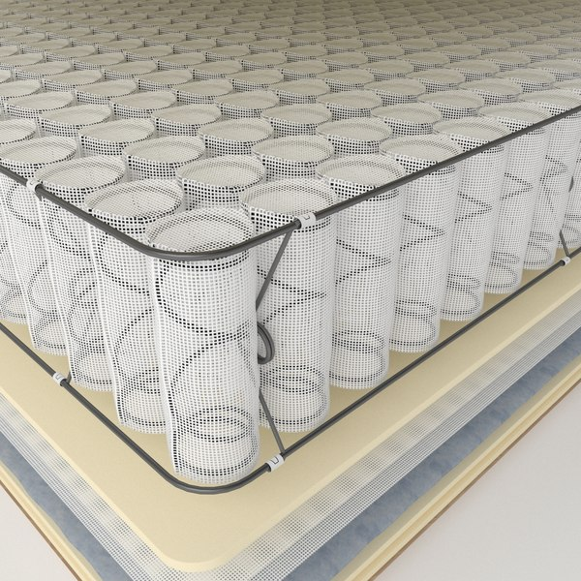
Errors
Expected max Y displacement = -1.57 in
Indicating diagonal members were stiffer
Could indicate diagonal springs could make stiffer mattresses
Force not properly transferred to bottom members, negligible displacement there
While it is understandable that the spring members move first but unreasonable no displacement of bottom nodes
Bending could not actually be simulated with stiffness method
Differently shaped truss can produce different results
More members in truss leads to less accurate spring results
Most spring like truss structure is not considered a truss

