Slide 1
Arch Katas
Buland Malik

Slide 2
R1: Add a new system to manage customer profiles, allowing community engagement, personalization around preferences and dietary needs
R2: Support geographical trend analysis to hone Farmacy Family’s ability to optimize the foods delivered to fridges (an additional integration point TO Farmacy Foods)
R3: Support both push and pull models for community engagement. In other words, Farmacy Family will manage forums, emails, and create connections between similar demographics. Farmacy Family needs transactional member information for outreach purposes. The engagement model includes subscriptions, forums, reference material, class information, and other media that supports Food-as-medicine
R4: eDietian has access customer profile to improve advice and monitoring of customers. Additionally, the customer and dietitian can interact via messages.
R5: Farmacy Family wants to improve the distribution and potential food waste from having the wrong mix of foods in a particular fridge.
R6: Farmacy Family will include medical profile information and the ability to share information with medical service providers.
R7: Farmacy Family customers can customize how much profile information they want to allow the community to see, at a fine- grained level.
R8: Farmacy Family has relationships with third party providers(clinics, doctors, etc) that have access to more analytical data to improve engagement (for example, regional dietary observations).
R9: Add Farmacy Family user interface to existing Foods interface, which is currently a Reactive monolith. Create a holistic UX for both food and Farmacy Family to support engagement model.
R10: The new system must seamlessly incorporate into Farmacy Foods.
R11: Improved use of analytics driven through the new integration of Farmacy Family will help gather new investors and prove better dietary outcomes in member communities.
Security
Availability
Elasticity
Scalability
Extensibility
Configurability
Reliability
Performability

Slide 3
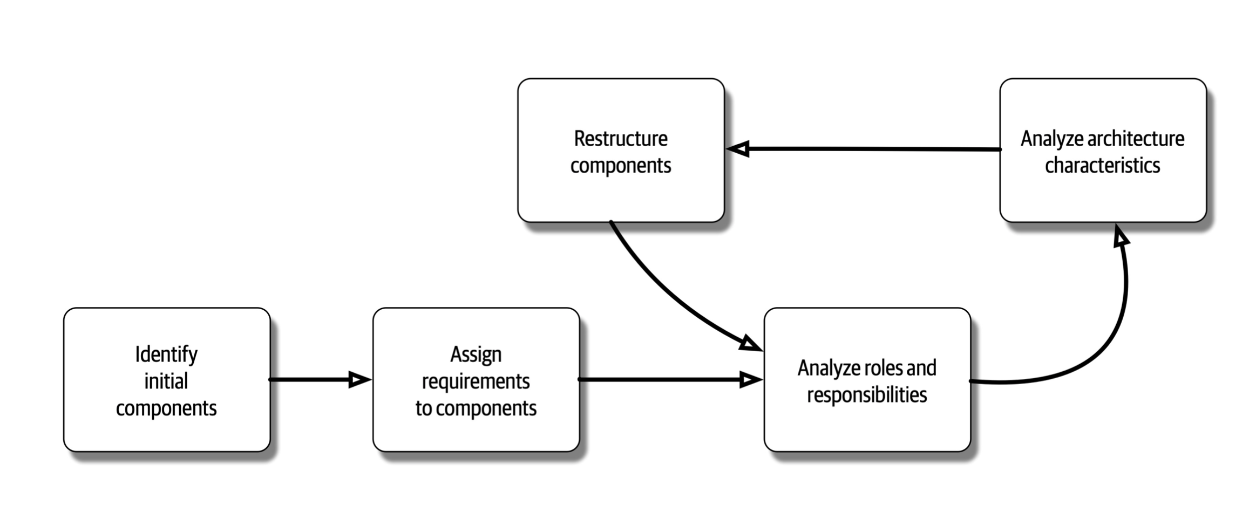
Component Decomposition

Slide 4
Step 1: Component Identification
Avoid “Entity Trap”
Too many entities like Manager X, Manager B
No need to define 1:1 relationship
Use Workflow Approach (Event Storming DDD Concept)
Crate Order -> Add Items -> Place Order -> Fulfill Order -> Ship Order
***** Actor/Action Approach
Customer
Signup to become Engage Customers (Provide Profile Info)
Configure Preferences
Customer Info Community can see
Can be shared with medical service providers
Create Forums
Engage in Social events (classes, forums, wellness education programs)
Engage with doctors & Dieticians
Dieticians
Access Customer Profile
Update Customer Profile
Engage with Customers
System
Integrate with Clinics
Integrate with eDieticians
Integrate with Farmacy Food
Integrate with Generic Components (Notifications, Reports etc.)
Gather Customer results and store it in Data Lake via Ingestion process
Payments/Procurements???
Analytics
Gather results from data lake and run ML Models
Store Customer/Geographical suggestions/trends suggested by ML

Slide 5
Step 2 & 3: Assign Requirements to Components
Customer
Customer Profile Capture
Preferences Capture
Wellness Engagement Models
Medical Engagement models
Medical Providers
Gather Results
Analyze Results
Give Suggestions/Advise
Dieticians
Access Customer Profile
Update Customer Profile
Engage with Customers
System
Advertisement (Generating Leads for Email Notification)
Integration with Clinics
Integration with eDieticians
Integration with Farmacy Food
Integration with Generic Components (Notifications etc.)
Payments/Procurements???
Store customer data in the Data Lake via Ingestion process
Payments/Procurements???
Analytics
Gather results from data lake and run run ML Models
Store Customer/Geographical suggestions/trends suggested by ML
R1
R2
R3
R4
R5
R6
R7
R8
R9
R10
R11

Slide 6
Step 4: Assign Illities to Components

Slide 7







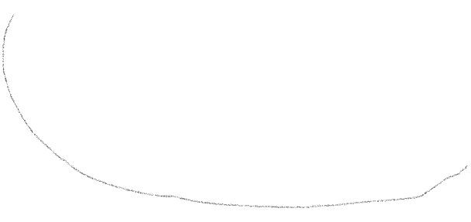
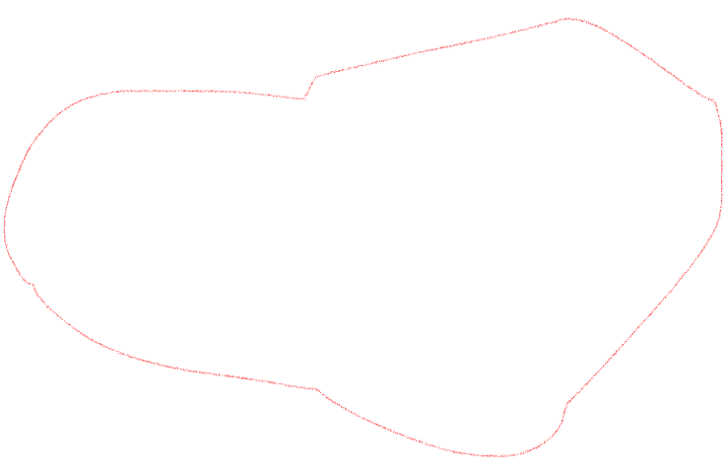

Strategic Design
Customer Engagement
Customer
System Engagement
Farmacy Food
conformist
D
Advertisement
Analytics
Via REST API
Via Event
U
via events
Clinics
Auth A/Z
Via REST API
Via Event
Notification
eDietician
Distillation is the process of identifying the domain, decoupling, isolating, clarifying and making it explicit.
As Eric Evans wrote “Distillation is the process of separating the components of a mixture to extract the essence in a form that makes it more valuable and useful.”
Distilling a domain is extremely important to a good strategical design, when doing that, we start to distinguish what is a Core Domain from what is just a Generic Domain for example and, reducing them to manageable sizes.
https://thedomaindrivendesign.io/distilling-domain/

Slide 8
Strategic Design
Supportive
Core
Uniqueness
Email/Text Messaging
Scheduling
Customer
Analytics
Advertisement
Customer Engagement
AuthN & AuthZ
System Engagement
Generic
Notification
Payments??
Complexity

Slide 9
Choose Architecture Style(s)

Slide 10
Architecture Decision Records (ADRs)

Slide 11
Analytics
Farmacy Data Platform
Sources
Farmacy Data Lake
Analytics Processor
Stream Ingestion
Farmacy Family
Analytics Processor
Clinics Results
Raw data
Domain Events
Farmacy Food
ML Model
Event Bus
ML Store
ML Training

Slide 12
Appendix

Slide 13
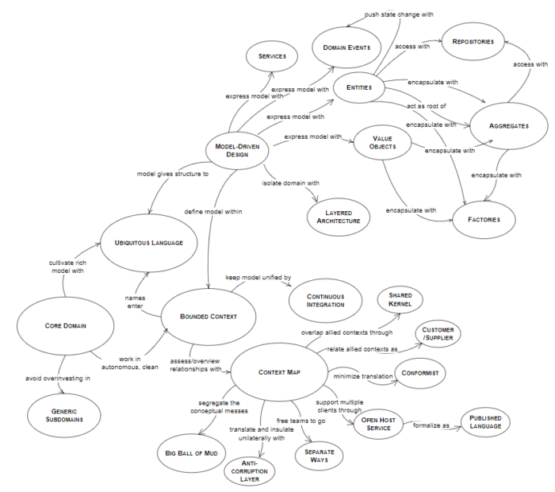
Domain-Driven Design Learning Map

